Slide 1


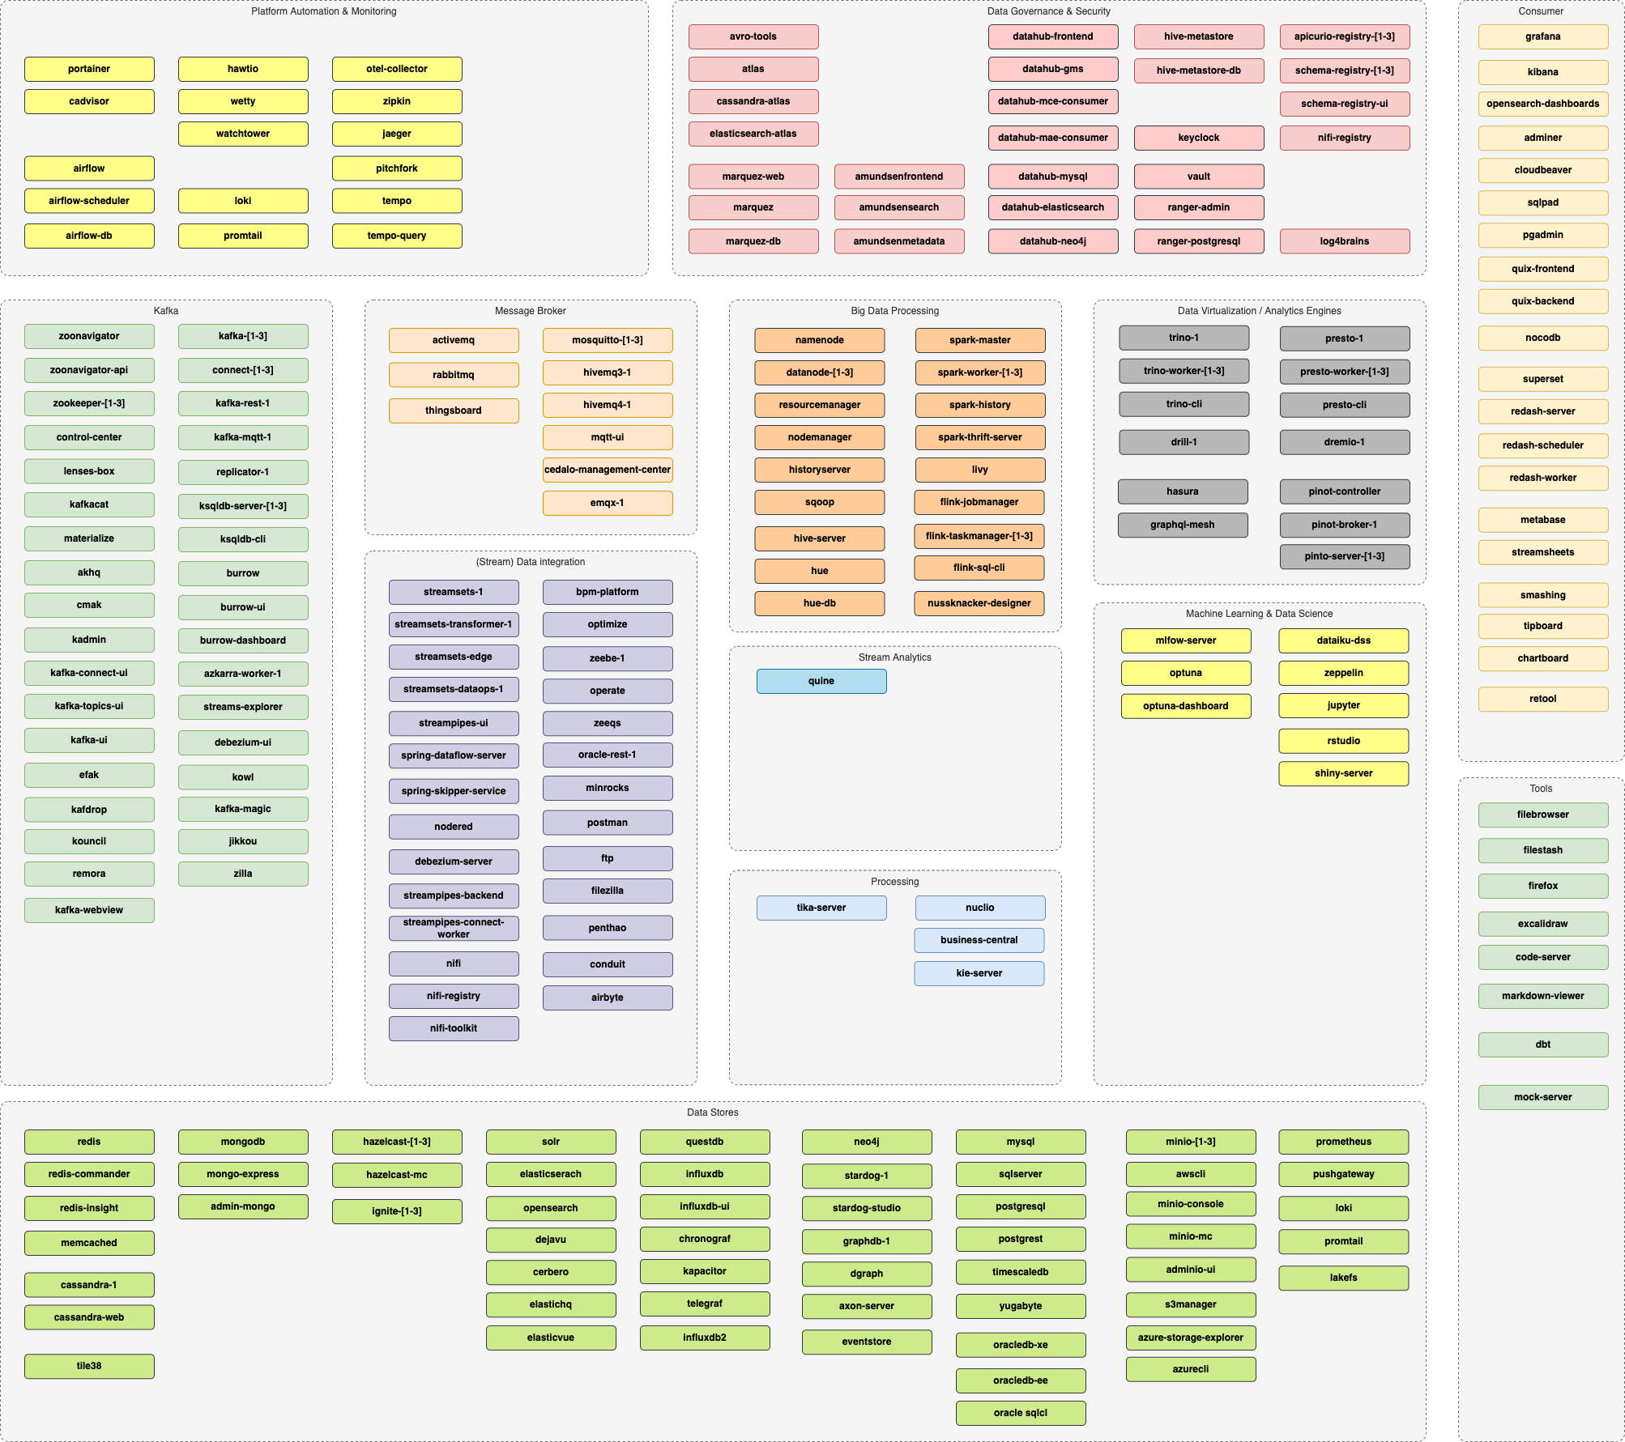
Platys Tool to generate Data Platforms
Conclusion Code Café – 30 mei 2023
Lucas Jellema, CTO & Architect AMIS | Conclusion

Slide 2

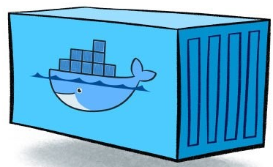

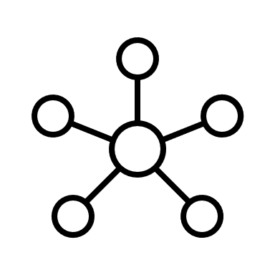
Platys – by Trivadis
Generate the definition of a Data Platform
in the form of a Docker Compose file
based on a simple configuration file
Run Docker Compose Up to have the custom assembled Data Platform environment running
platys
CLI
config.yml
docker-compose.yml

Slide 4
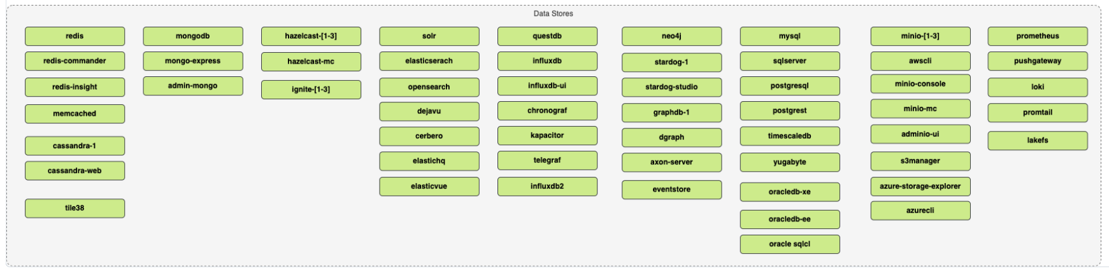

Slide 5
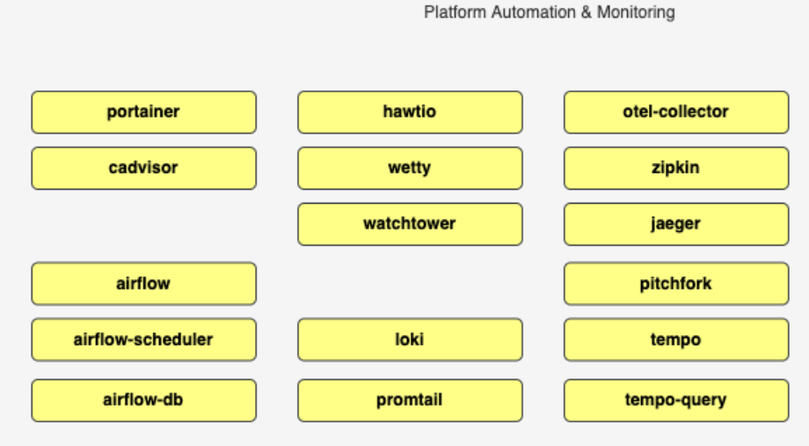
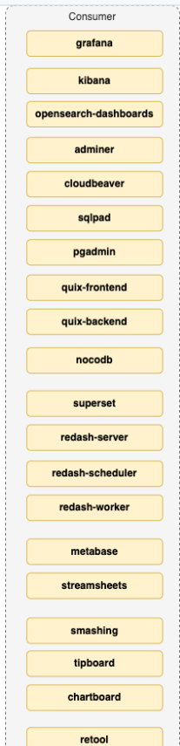

Slide 6
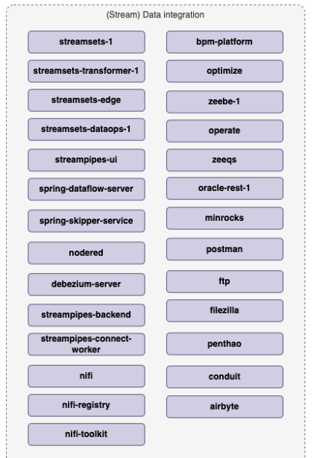
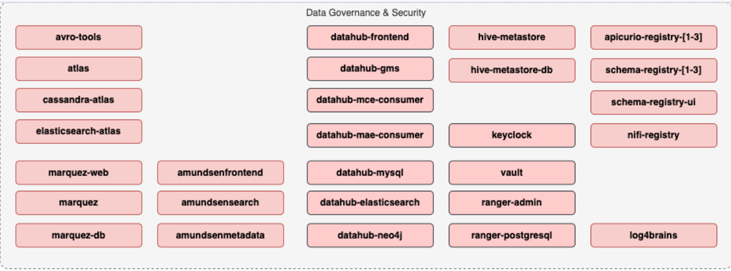
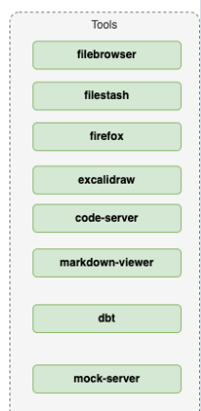

Slide 7
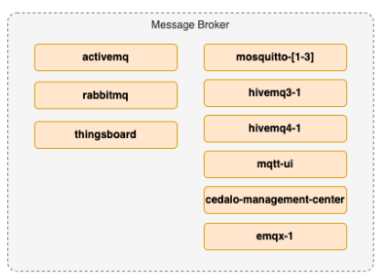
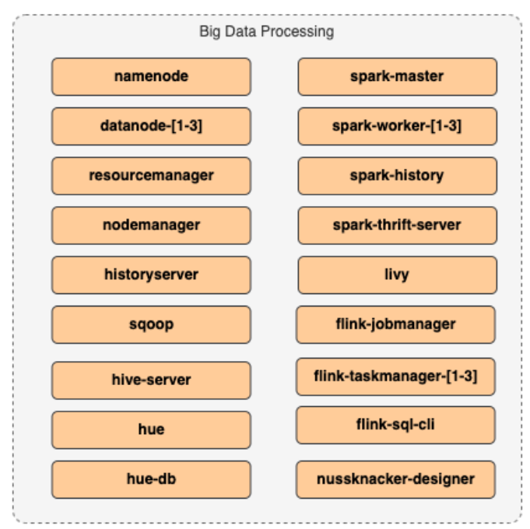
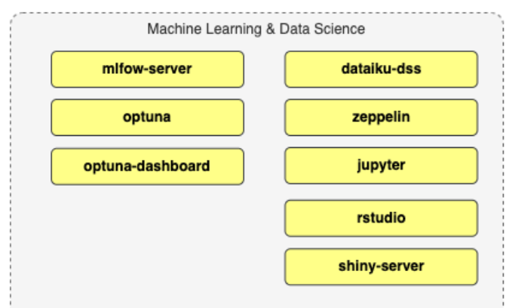
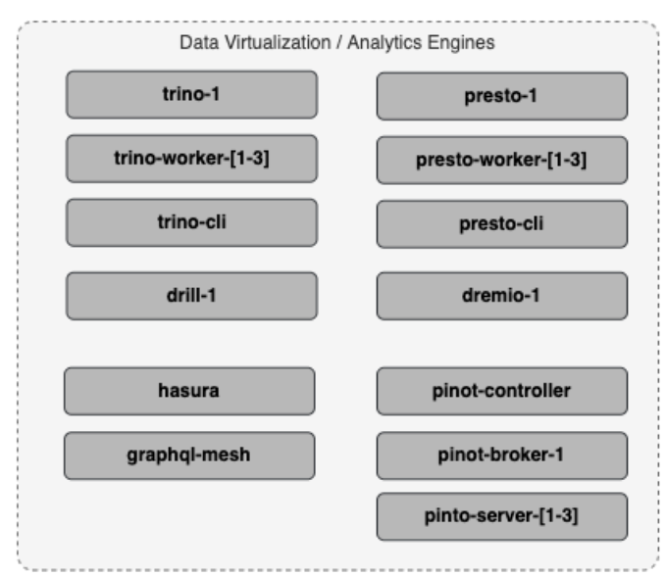
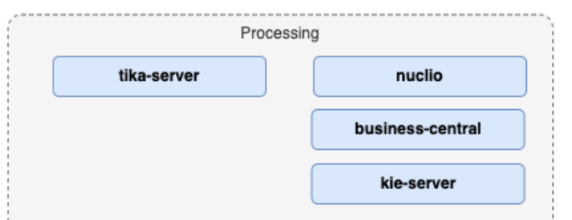

Slide 9




Menu

Slide 10

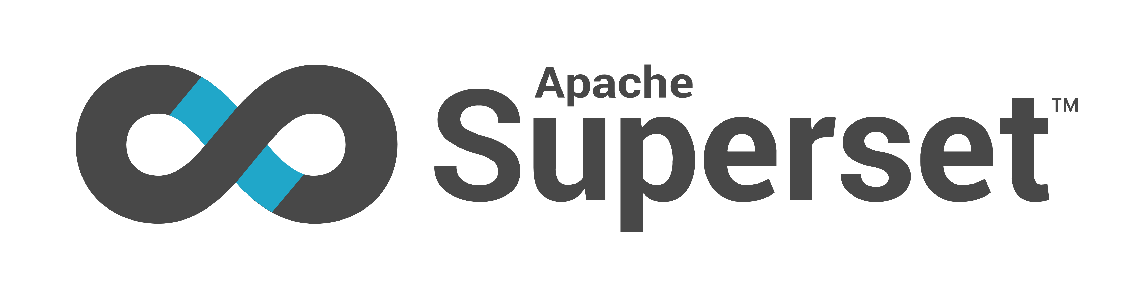
Menu

Slide 11
Details on Configuration
# ========================================================================
# Platys Services
# ========================================================================
PROVISIONING_DATA_enable: false
#
# ===== Apache Zookeeper ========
#
ZOOKEEPER_enable: false
ZOOKEEPER_volume_map_data: false
ZOOKEEPER_nodes: 1 # either 1 or 3
#
# ===== Apache Zookeeper Navigator ========
#
ZOOKEEPER_NAVIGATOR_enable: false
#
# ===== Apache Kafka ========
#
KAFKA_enable: false
# one of enterprise, community
KAFKA_edition: 'community'
KAFKA_volume_map_data: false
KAFKA_datacenters: 1
KAFKA_broker_nodes: 3
KAFKA_internal_replication_factor: 3
KAFKA_delete_topic_enable: false
KAFKA_auto_create_topics_enable: false
KAFKA_message_timestamp_type: CreateTime
# ===== Apache Kafka HQ ========
#
KAFKA_AKHQ_enable: false
# ===== PostgreSQL ========
#
POSTGRESQL_enable: false
POSTGRESQL_volume_map_data: false
# Default values for the generator
# this file can be used as a template for a custom configuration
# or to know about the different variables available for the generator
platys:
platform-name: 'demo-platform'
platform-stack: 'trivadis/platys-modern-data-platform'
platform-stack-version: '1.15.0'
structure: 'flat'
# ========================================================================
# Global configuration, valid for all or a group of services
# ========================================================================
# the UID to use when using the "user" property in a service to override user inside container
uid: '1000'
# ========================================================================
# External Services
# ========================================================================
external:
KAFKA_enable: false
KAFKA_bootstrap_servers:
KAFKA_username:
KAFKA_password:
SCHEMA_REGISTRY_enable: false
SCHEMA_REGISTRY_url:
S3_enable: false
S3_endpoint:
S3_path_style_access: false
S3_access_key:

Slide 12
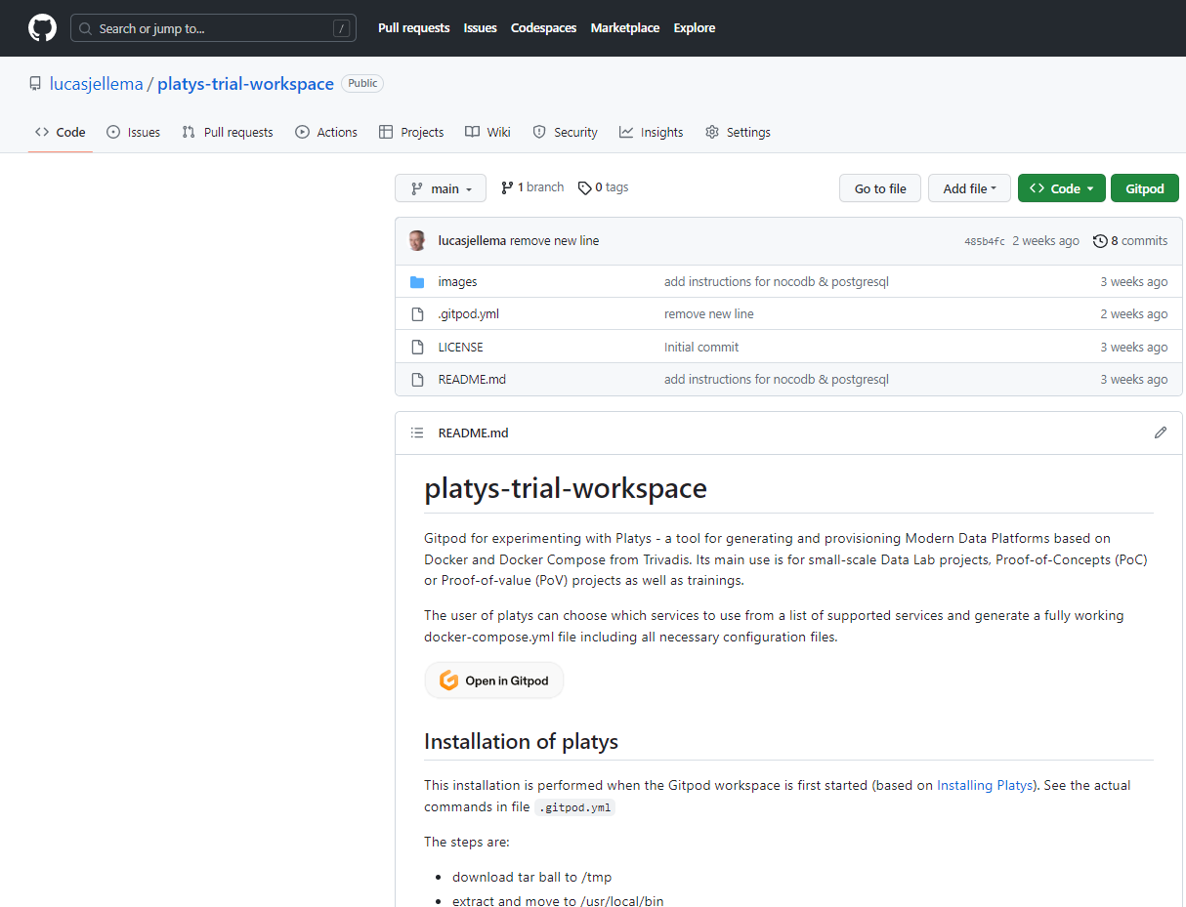




Gitpod Workspace for Trying Out Platys
platys
workspace
Notes:
https://github.com/TrivadisPF/platys-modern-data-platform/blob/master/cookbooks/recipes/querying-kafka-with-trino/README.md

Slide 13
Configure & Run Platys – then Docker Compose Up
platys
CLI
config.yml
docker-compose.yml
workspace

Slide 14
Configure & Run Platys – then Docker Compose Up
platys
CLI
config.yml
docker-compose.yml
workspace

Slide 15
Explore, Investigate, Try Out in your new Data Platform
docker-compose.yml
workspace

Slide 16








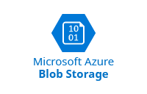





















Trino makes many data processing | storing technologies consolidated accessible through one SQL interface
Any tool or technology that speaks SQL

Slide 17
Steps
Environ-ment with Docker & Docker Compose
1
Install Platys
2
Initialize New Platform
3
Fine tune configura-tion config.yml
4
Generate Platform => docker-compose. yml + config files/folders
5
Run platform with docker compose up
6
<use platform>
7

Slide 18
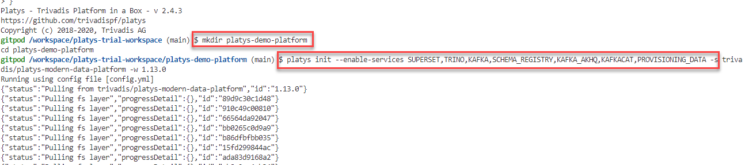
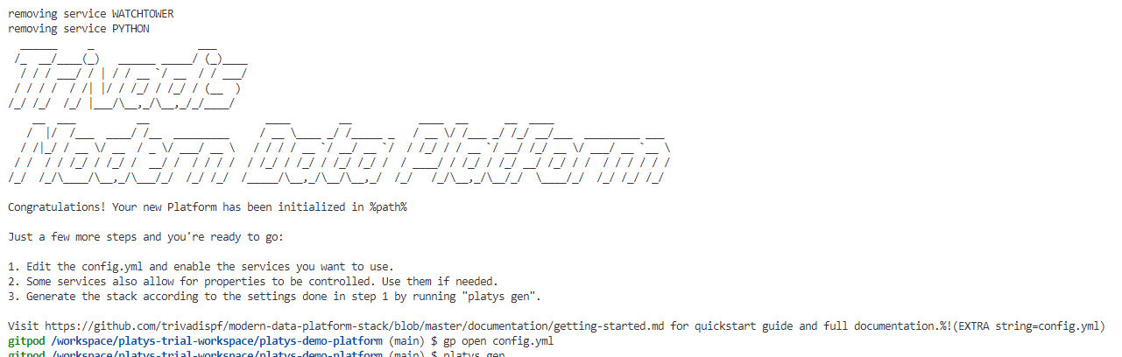
Initialize New Platys Platform

Slide 19
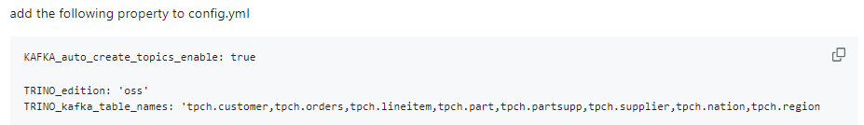
Fine Tune Configuration

Slide 20
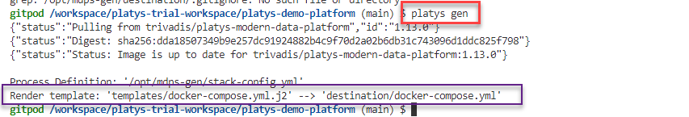
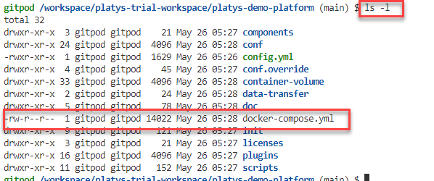
Generate Platform from Configuration using Platys

Slide 21
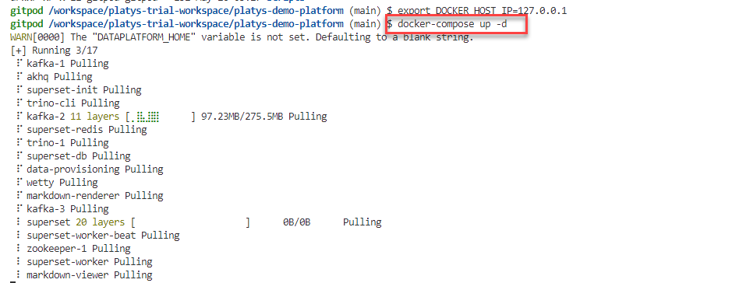
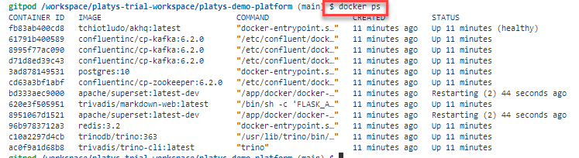
Run New Platform

Slide 22
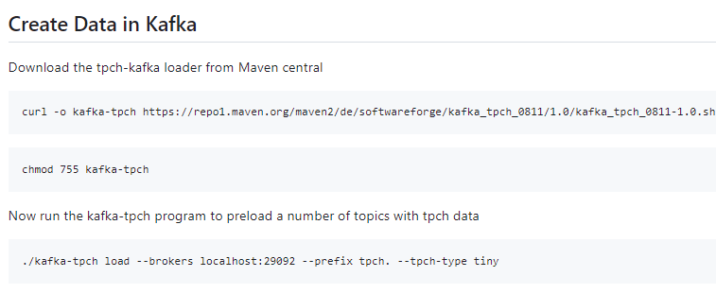
Generate Kafka Topics and Messages

Slide 23
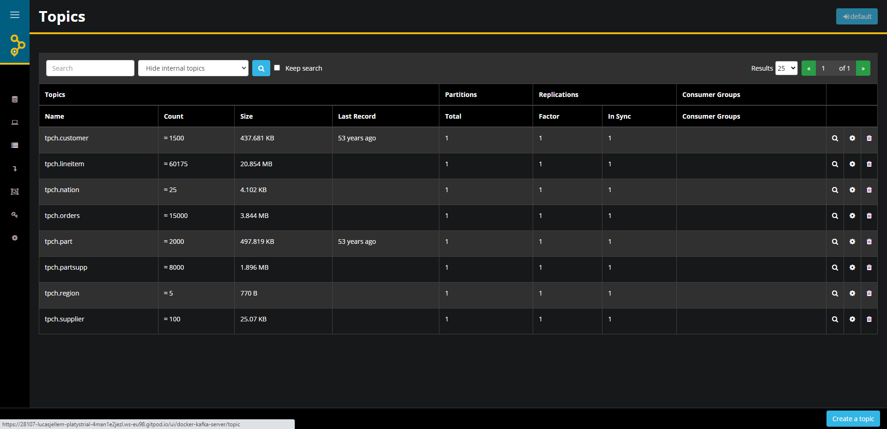
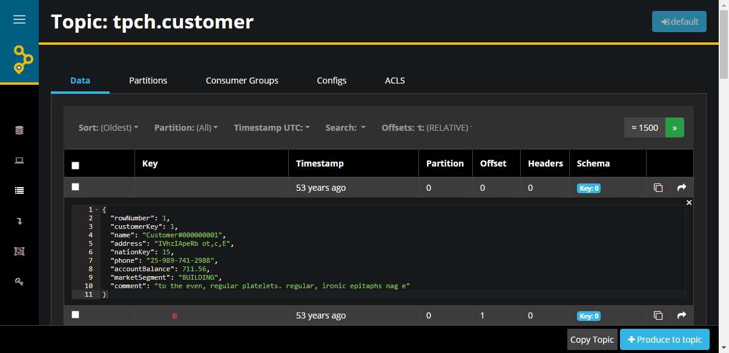

Slide 24
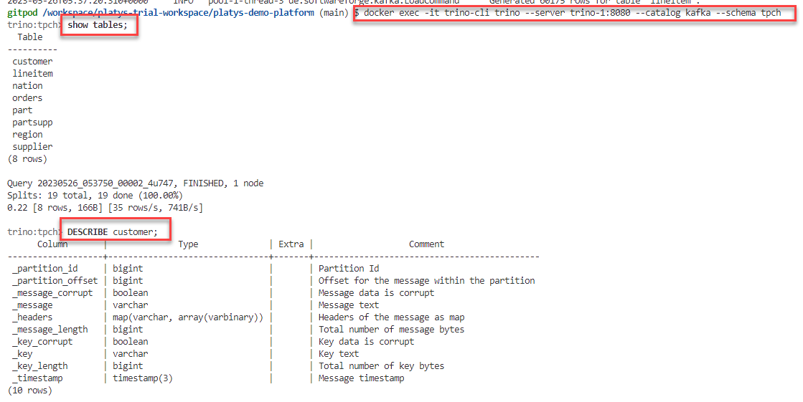
Query Kafka Topics as SQL Tables through Trino

Slide 25
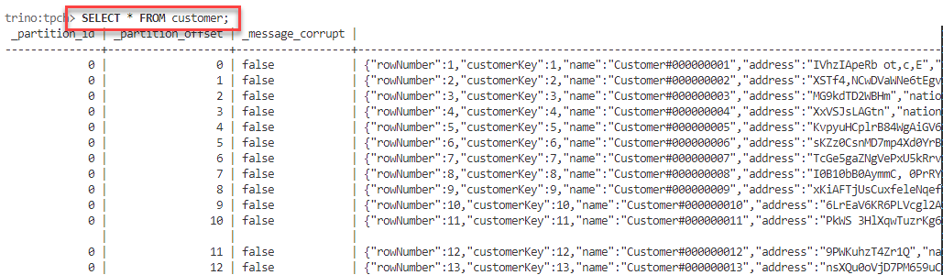

Slide 26
Summary
Use Platys to quickly assemble an R&D or workshop environment – for exploration & inspiration
Platys runs anywhere – CLI and Container
Generate Docker Compose configuration for selected Data Platform components & config
Run Data Platform with Docker Compose Up
Platys and Gitpod go together well

