Slide 1
Wrap Up
Oracle OpenWorld 2017 - Review

Slide 2
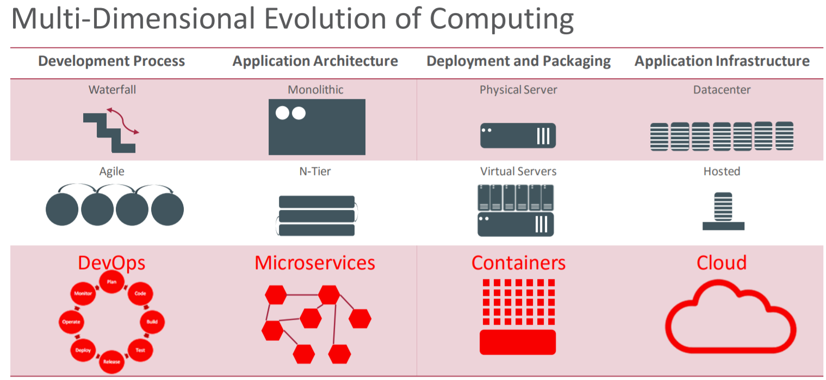
Our world is changing rapidly
Focus on business value and true costs
Realization that business value is only created at runtime
Flexibility & Agility require ownership across Dev & Ops
And across infrastructure, platform and application
Software delivery (and testing) requires full automation

Slide 3
Our world is changing rapidly
Few organizations require their own data centers
Owning hardware is not relevant either for most
In fact: it is a burden
It is smart to focus on owning & managing those resources that are critical to you or enable you to differentiate
Paying for what you use – only for as long as you use
Ideally in terms of business metrics
Rapid ramp up, rapid scale up, rapid discontinuation
Cloud services are surpassing corporate IT departments
Cost, quality, breadth of service, effort and hassle
λ

Slide 4
Our world is changing rapidly
Application cannot be seen apart from platform
The combination provides business value
Dedicated physical resources are expensive, sized based on peaks (rather than actual usage), hard to manage
Containers are the true cross on premises, clouds and vendor vehicle
Containers are the unit of delivery, deployment, scaling and any other form of management
λ

Slide 5
Our world is changing rapidly
Agility can only be achieved with independent components of limited complexity (we are just not that smart)
With a changing role for Oracle Database, WebLogic Server, Fusion Middleware
With CQRS and data proliferation
With REST APIs and Event Pub/Sub
Using many [open] development technologies and runtime application platforms

Slide 6
Our world is changing rapidly
λ
λ

Slide 7
The Only Way is Up
Cloud Native
Serverless
High PaaS and SaaS
That need to be integrated
For a long time: a hybrid world
Of on premises and clouds
Of legacy and cloud native
Of SaaS, High PaaS and custom components
Of multiple cloud vendors
SaaS
PaaS
IaaS
On Premises

Slide 8
Oracle’s Cloud Strategy
DaaS
CX
Sales
ERP
HCM
EPM
Supply Chain
Industry specific
SaaS
SaaS Analytics
Management Cloud
IoT Apps & Cloud
Big Data & AI
Developer Cloud
High PaaS
Analytics Cloud
Integration Cloud
Mobile & IB Cloud
Integration Platform Cloud
API Platform Cloud
CASB &
IDCS
Managed Serverless
Block Chain
Autonomous Database (DWH, OLTP, IoT,…)
Managed Kubernetes
Event Hub
Low PaaS
ACC
Data Hub
NoSQL
MySQL
Container Cloud
DNS
Messaging
IaaS
LB
CDN
Compute
Networking
Storage

Slide 9
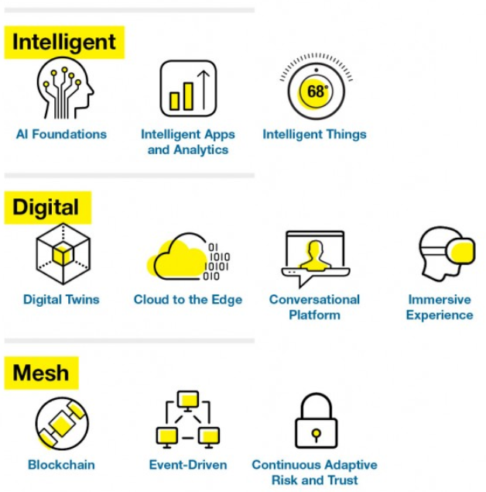
Trends and Technologies
Artificial Intelligence and Machine Learning
To make Business and IT smart and autonomous
Integrate Physical Domain into Enterprise IT: IoT
Richer & Smarter UI
channels, formats, personalized & smart
Embrace open technologies & communities
Kubernetes & Docker, Kafka, Hadoop & Spark, Hyperledger, Node/ES6, Python, Java, …
DevOps and BusOps– full lifecycle ownership and focus on business value and true costs
You create it, you run it, you fix and evolve it
Security (DevSecOps) across components, environments channels, actors – prevent, monitor, respond

Slide 10

What to do next/first?
Microservices & Serverless
Docker
Kubernetes
Istio
Java
Node/ES6
Python
REST/JSON
Kafka
Hadoop/Spark
Fn & FnFlow
Integration Cloud
IoT
Management Cloud
Oracle Cloud Infrastructure
API Platform & Apiary
Wercker CI/CD, Container Engine & Managed Serverless
Intelligent Bots
Oracle JET
Database 18c
SQL
Networking

Slide 11
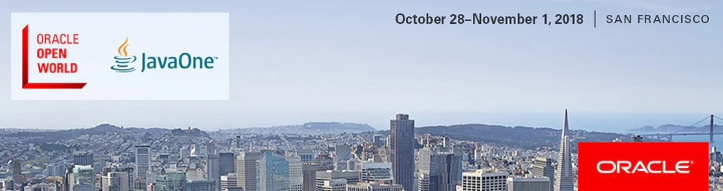
See you next year…!

