Slide 1
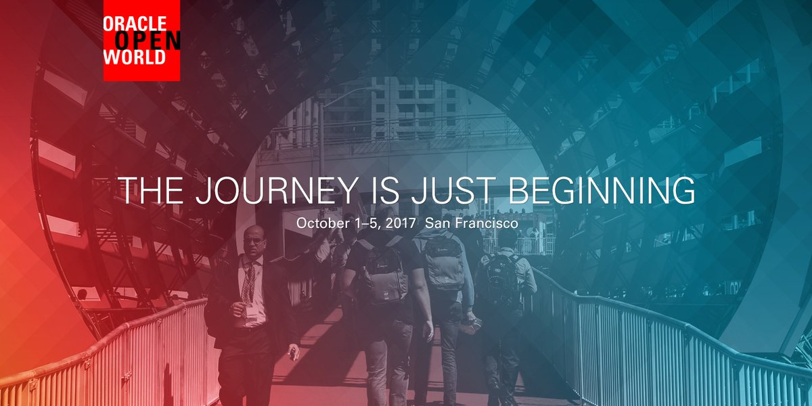
9 days and 2000 sessions summarized in 3 hours
Oracle OpenWorld 2017 - Review

Slide 2
What is IT all about?
Production Runtime
Application

Slide 3
What is IT all about?
Production Runtime
Application
Platform

Slide 4
What is IT all about?
Production Runtime
Operations
Monitoring & Management
Application
Platform

Slide 5
One team has Agile responsibility through full lifecyle
Preparation Runtime
Production Runtime
Development
Operations
Monitoring & Management
Application
Application
Agile Design, Build, Test
Platform
Platform
CD

Slide 6
One team has Agile responsibility through full lifecyle
Preparation Runtime
Production Runtime
DevOps
Monitoring & Management
Application
Application
Agile Design, Build, Test
Platform
Platform
CD
You build it, you run it, you fix it, you evolve

Slide 7
One team has Agile responsibility through full lifecyle
DevOps
Application
Application
Platform
Platform
You build it, you run it, you fix it, you evolve

Slide 8
DevOps team owns and runs one (or more) products
Application
Platform
Generic Infrastructure Platform for running DevOps Products
Floorspace, Power, Cooling, Storage, Compute
Monitoring, Management, Cache, Authentication, RDBMS, Event Hub

Slide 9
Multiple products from multiple teams run on a shared generic infrastructure
Application
Application
Application
Application
Application
Platform
Platform
Platform
Platform
Platform
Generic Infrastructure Platform for running DevOps Products
Floorspace, Power, Cooling, Storage, Compute
Monitoring, Management, Cache, Authentication, RDBMS, Event Hub

Slide 10
App plus platform under DevOps == Microservice
µ
µ
µ
µ
µ
Generic Infrastructure Platform for running DevOps Products

Slide 11
App plus platform under DevOps == Microservice
Stateless
Horizontally scalable
Mutually Independent
upgrade, patch, relocate
Can expose Public API (HTTP/REST) and/or UI
Communicate with each other through events
Have their own bounded data context
Do not rely on other microservices [for the data they need]
Serverless – do not require allocated server, can be fired up
µ
µ
µ
µ
µ
Generic Infrastructure Platform for running DevOps Products
λ

Slide 12
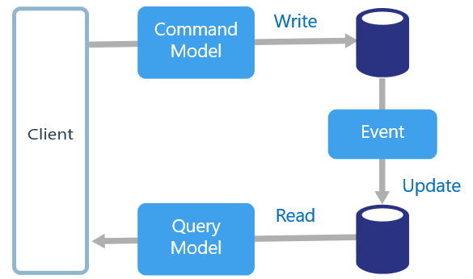
Rise of CQRS - Command and Query Responsibility Segragation
Data manipulation and retrieval in separate places
(physical data proliferation)
For performance and scalability, lower license fees and TCO

Slide 13
CQRS – Common concept in Oracle Database
Middleware
Middleware
Middleware
Active Data Guard Standby
Shard
(12c R2)
IMDB
SGA
Shard
(12c R2)
RAC
MV
MV
RAC
SAN
T
T
idx
idx
SAN
SAN
dbf

Slide 14
Logical Data Proliferation
From one single enterprise database – the single source of truth
To:
Generic Infrastructure Platform for running DevOps Products
Event Store
Big Data
distributed file system
Data Warehouse

Slide 15
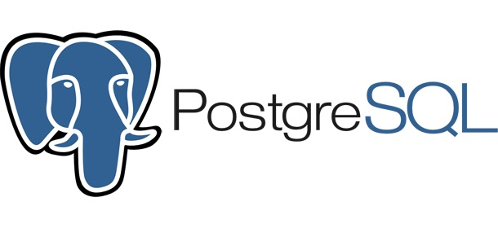

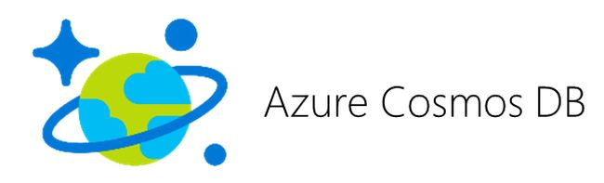
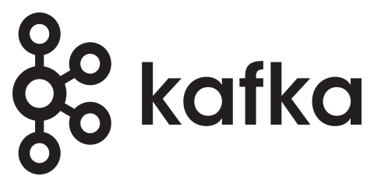
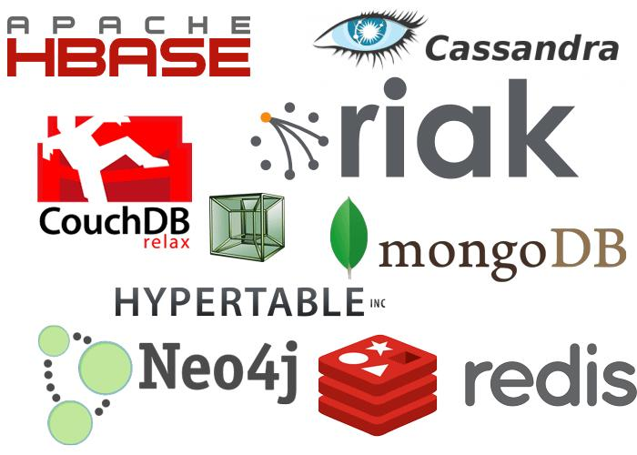
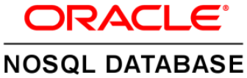
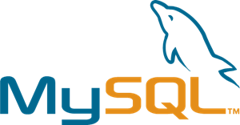

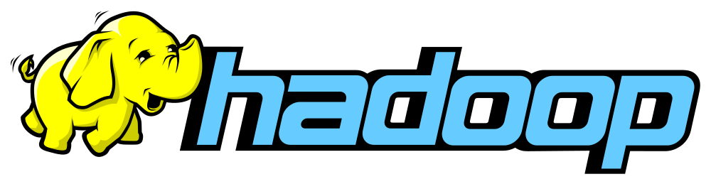
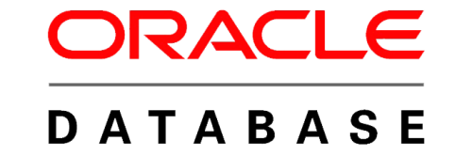
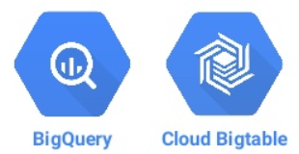
Datastore proliferation From one brand SQL to pluriform SQL & No(n)SQL
RDBMS
SQL
ACID

Slide 16

Smart Business
Organizations should only invest in things that
Allow them to create business value
Set them apart from the competiton
Are close to their core expertise
Are a unique risk
For most organizations these things do not include
Managing computers, investing in hardware
Managing operating systems or databases
Building custom software

Slide 17
In X Years’ Time
No organization can justify to have and manage their own IT means
To invest capital in infrastructure & platform licenses
To employ staff to run infrastructure, platforms (and create custom software for non-unique functionality)
To not leverage commodity IT with superior quality and economies of scale based pricing

Slide 18

The only way is up
From buy (for peak load) [software & hardware) to usage based rent
From on premises to cloud
From infra and platform to SaaS (standard applications)
From pay based on IT metrics to pay per Business measure
SaaS
PaaS
IaaS
On Premises

Slide 19
Oracle’s Cloud Strategy
DaaS
CX
Sales
ERP
HCM
EPM
Supply Chain
Industry specific
SaaS
SaaS Analytics
Management Cloud
IoT Apps & Cloud
Big Data & AI
Developer Cloud
High PaaS
Analytics Cloud
Integration Cloud
Mobile & IB Cloud
Integration Platform Cloud
API Platform Cloud
CASB &
IDCS
Managed Serverless
Block Chain
Autonomous Database (DWH, OLTP, IoT,…)
Managed Kubernetes
Event Hub
Low PaaS
ACC
Data Hub
NoSQL
MySQL
Container Cloud
DNS
Messaging
IaaS
LB
CDN
Compute
Networking
Storage

Slide 20

Future Observations
Each organization works with hybrid multi-vendor cloud
Many niche SaaS solutions used in any organization
Data proliferation across clouds & across types of data store
PaaS services increasingly similar across cloud vendors
Some key challenges:
Designing multi-service & multi-cloud solutions (and exit plans)
Integrating PaaS services and SaaS functions
Monitoring & Ops across clouds and services
Security

Slide 21
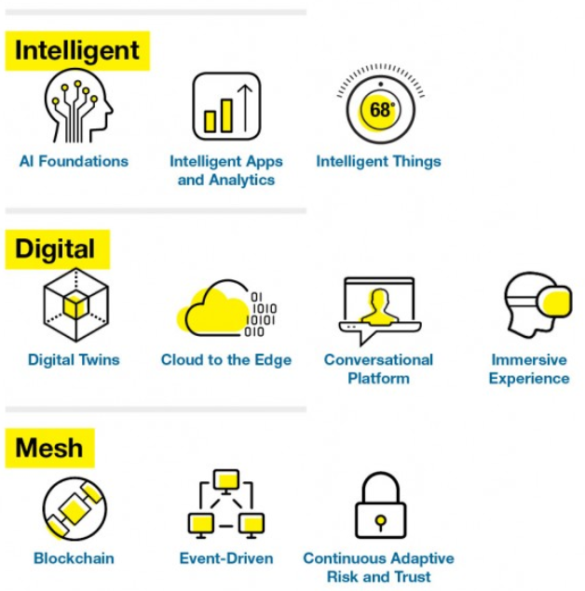
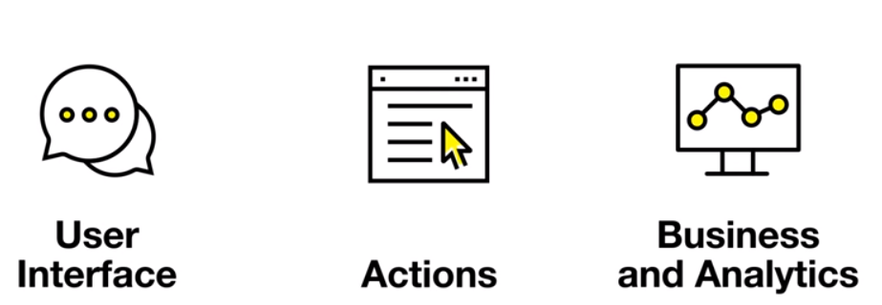
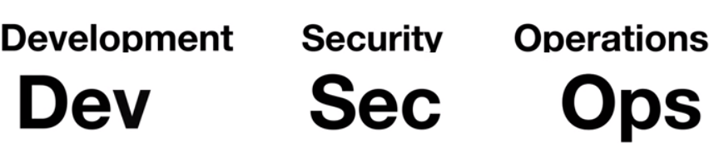
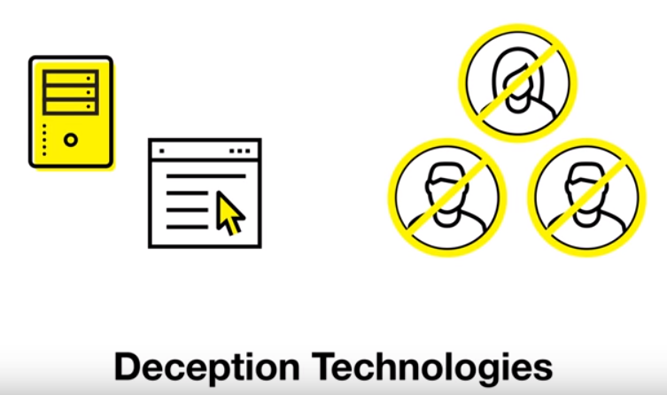
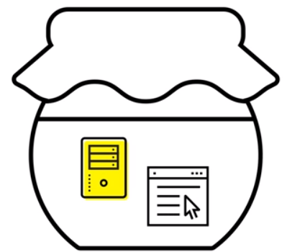
Gartner – Strategic Technology Trends 2018
Notes:
https://www.youtube.com/watch?v=TPbKyD2bAR4

Slide 22
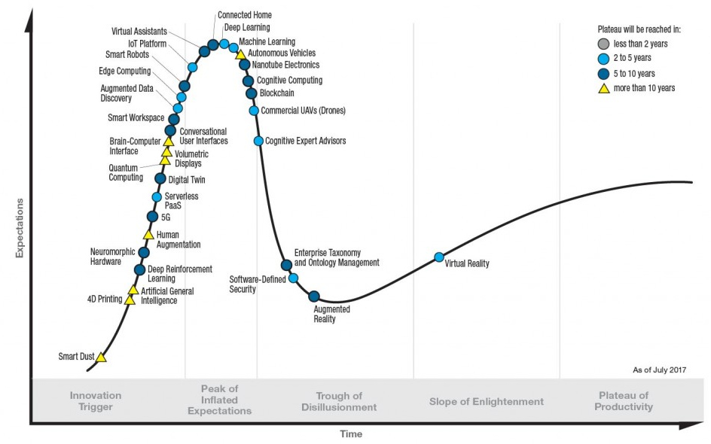
Gartner Hype Cycle for emerging technologies – July 2017
Notes:
https://www.gartner.com/smarterwithgartner/top-trends-in-the-gartner-hype-cycle-for-emerging-technologies-2017/

Slide 23
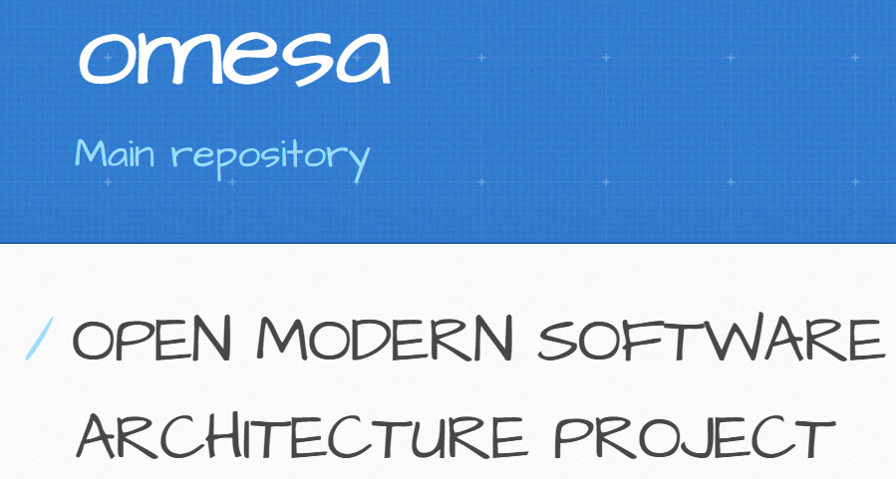
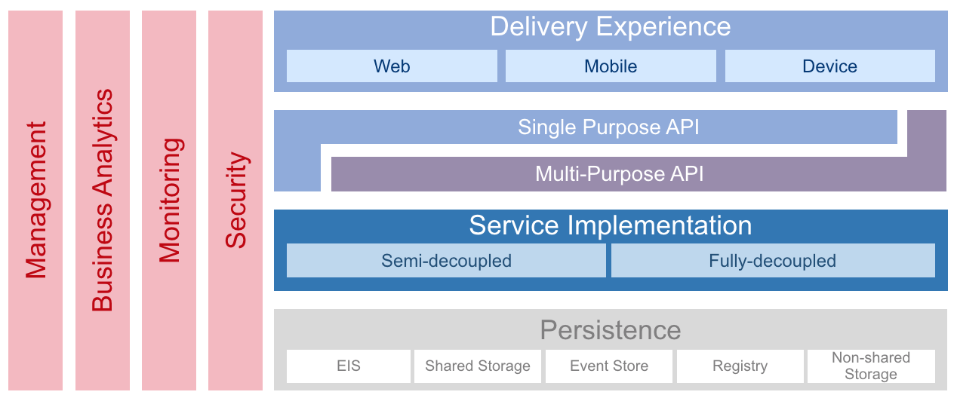
Architecture Evolution
Stateless
Event driven
Horizontally Scalable
CQRS & Event Sourcing
Streaming
Reactive
Container
Cloud Native
Microservice
Orchestration & Choreography
API
Service Mesh
Mash Up
SaaS Enablement
Serverless

Slide 24
Technology & Products to watch out for
Container
Kafka
Kubernetes
Docker
Cassandra (DataStax)
Istio
GPU
Ansible
Terraform
Vagrant
Sonar Qube
Jenkins
Quay (CoreOS)
Kibana
Travis CI
CI/CD (Pipelines)
Go
Rust
Ruby
Python
R
HTTP/2
Cloud Foundry
Prometheus
Vizceral
Grafana
Zipkin
Elastic Stack
Hadoop
Spark
Helm
Hyperledger
Git
PDB
ORDS
TypeScript
Graph QL
NoSQL
Slack
Pagerduty
OAuth
Redis
Alexa
Tensor Flow
DL4J
Caffe
Keras
AI
ML
NLP
Voice Recognition
Intelligent Bots
BYOL
TCO
FaaS
CDN
IoT
Blockchain
CNCF
Polyglot
Java

Slide 25
Tonight’s Agenda
Digital Disruption – Blockchain, Chat Bots & IoT
SaaS (Enablement) and UX – user oriented application development
Integrated platform for Integration – Integration & API Platform Cloud
dinner
Hybrid Cloud
Autonomous Systems & Autonomous Database – Database 18c
Security: Zero trust design & why the cloud is more secure
End to end control – operations across the hybrid landscape
Differentiating on Infrastructure – IaaS, Cloud Machine, Ravello, real traditional hardware
Cloud & Container Native and Serverless Computing
Java & Java EE – the modern platform for microservices and more
Wrap Up

