Slide 1

Planning Your Move to the Cloud: User Experience
Tim Dubois (Senior Director Oracle Applications User Experience) and Lucas Jellema (CTO AMIS & Oracle Developer Champion)
October 1st, Oracle OpenWorld 2017, San Francisco
Notes:
IT organizations face many challenges when integrating cloud applications with existing on-premises applications, and keeping a cohesive user interface is among the top. You want content from one application displayed in another, consolidated views, easy navigation between apps, and a consistent user experience for all. This session highlights a number of Oracle tools and best practices to help you find your path to the cloud.

Slide 2
Overview
Introductions
The only way is up
Finishing touch on Oracle SaaS out of the box
Internal theming, styling and configuration of menus & dashboards
External UI Mashups leveraging Oracle PaaS Cloud
Enabling SaaS in the wider corporate IT context
Integrating and synchronizing data and events
Cross SaaS UI
Other aspects of embedding SaaS in IT landscape
Summary
Notes:
Intro: (overall picture) move to the cloud – increasing number of SaaS solutions as well as PaaS products – in combination with some on premises; hybrid landscape (Cloud/on premises, multiple SaaS and some custom)

Slide 3

Smart Business
Organizations should only invest in things that
Allow them to create business value
Set them apart from the competiton
Are close to their core expertise
Are a unique risk
For most organizations these things do not include
Managing computers, investing in hardware
Managing operating systems or databases
Building custom software

Slide 4
In X Years’ Time
No organization can justify to have and manage their own IT means
To invest capital in infrastructure & platform licenses
To employ staff to run infrastructure, platforms (and create custom software for non-unique functionality)
To not leverage commodity IT with superior quality and economies of scale based pricing

Slide 5

The only way is up
From buy (for peak load) [software & hardware) to usage based rent
From pay based on IT metrics to pay per Business measure
From on premises to cloud
From infra and platform to SaaS (standard applications)
SaaS
PaaS
IaaS
On Premises

Slide 6
Objectives with SaaS
Providing business users with optimal UX to perform the tasks they have responsibility for
Efficient, pleasant, with few errors/high quality
Regardless of where the data resides they should see and be able to interact with all data relevant to their tasks
On a device and through a UX that fits their circumstances and needs
Notes:
Objective when introducing a SaaS: providing business users with optimal UX to perform the tasks they have responsibility for (efficient, pleasant, few errors/high quality);
this means that regardless of where the data resides (in which SaaS app or custom app) they should see and be able to interact with all data relevant to their tasks

Slide 7
Tim: External UI Mashups
<call out to Tim Dubois’ presentation on external UI integration and mashup in Oracle SaaS>

Slide 8
Enabling SaaS in the wider corporate IT context (<> green field)
Custom applications and 3rd party SaaS
On premises and in 3rd party clouds
Existing single sign on facility
Existing corporate data warehouse
Existing enterprise facilities for
Processing incoming and outgoing documents – paper and electronic
Scheduling and managing batch jobs
Human workflows, Authorization, Compliance and Auditing
Notification and communication
Physical environment of the enterprise and its assets
User Devices already in use

Slide 9
Synchronizing & integrating
SaaS needs operational data from other systems
Sales rep working in CRM needs latest status customer complaints
Events in one SaaS application need to trigger action in another
Opt-out of customer needs to be processed immediately
Transaction in one SaaS product requires information [& consent] from other applications
An on-line order can only be accepted if the required inventory is available and can be reserved
Data in SaaS applications needs to be made available to B2B partners, government agencies [and UI developers]
Status of physical assets needs to be recorded in SaaS
Live signals from IoT Devices need to be processed and stored

Slide 10

Typical saas integration requirements
Gov Agency
B2B Partner
3rd Parties/Public Internet
SaaS X
SaaS Y
PaaS X
Custom App B
Data Warehouse
On Premises
Custom App A
ERP

Slide 11
Common questions and challenges
What is the trigger?
push/poll (scheduled), application request/user action
Is the interaction synchronous or asynchronous
And if the latter: how to assess success?
How fresh must the data be, how fast must synchronization happen?
How much data is exchanged and how frequently does interaction take place?
What should happen if an exchange fails? How should errors be spotted and handled?
What is the availability of all systems involved? How should we deal with systems that temporary offline?
Common strategy:
decoupling through event queue & retry mechanism

Slide 12
Case: Evolution from broad custom ERP to mix of specialized custom plus saas
Custom Application
Finance
Planning & Scheduling
Procurement
Warehousing & Supply Chain Mgt
Core Business Activity

Slide 13
Evolution from broad custom ERP to mix of specialized custom plus saas
Oracle SaaS ERP Finance
3rd party SaaS
Planning & Scheduling
Custom Application
Core Business Activity
3rd party on premises Warehousing & Supply Chain Mgt
Oracle SaaS ERP
Procurement

Slide 14
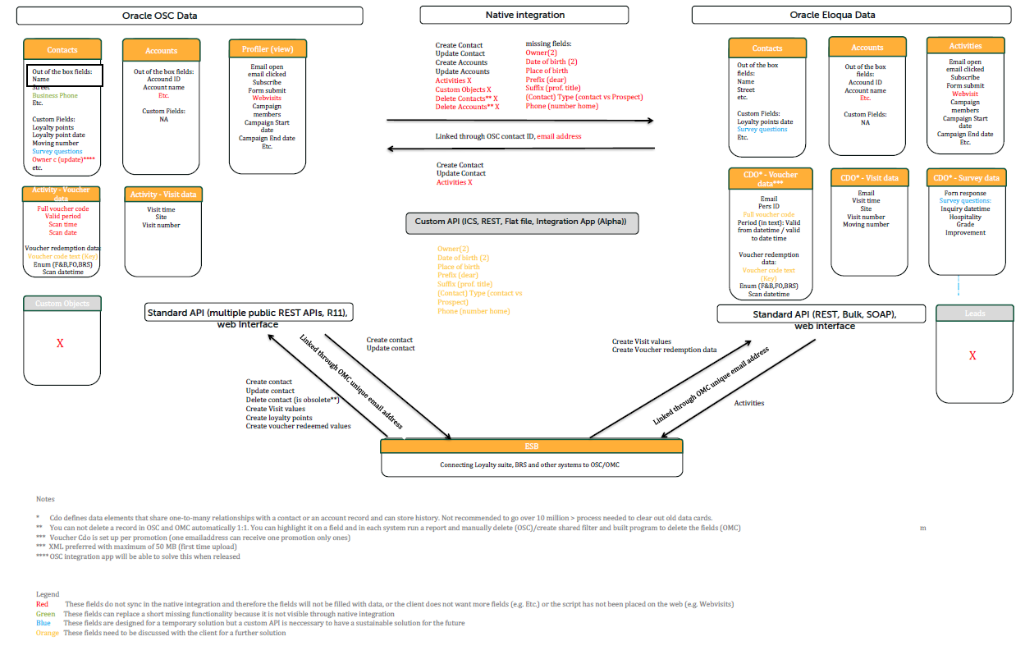
Case: Multi SaaS product CX plus custom on premises
Oracle Eloqua
Oracle Sales Cloud
ICS
(on Premises)
ESB
(on Premises)
Custom App

Slide 15
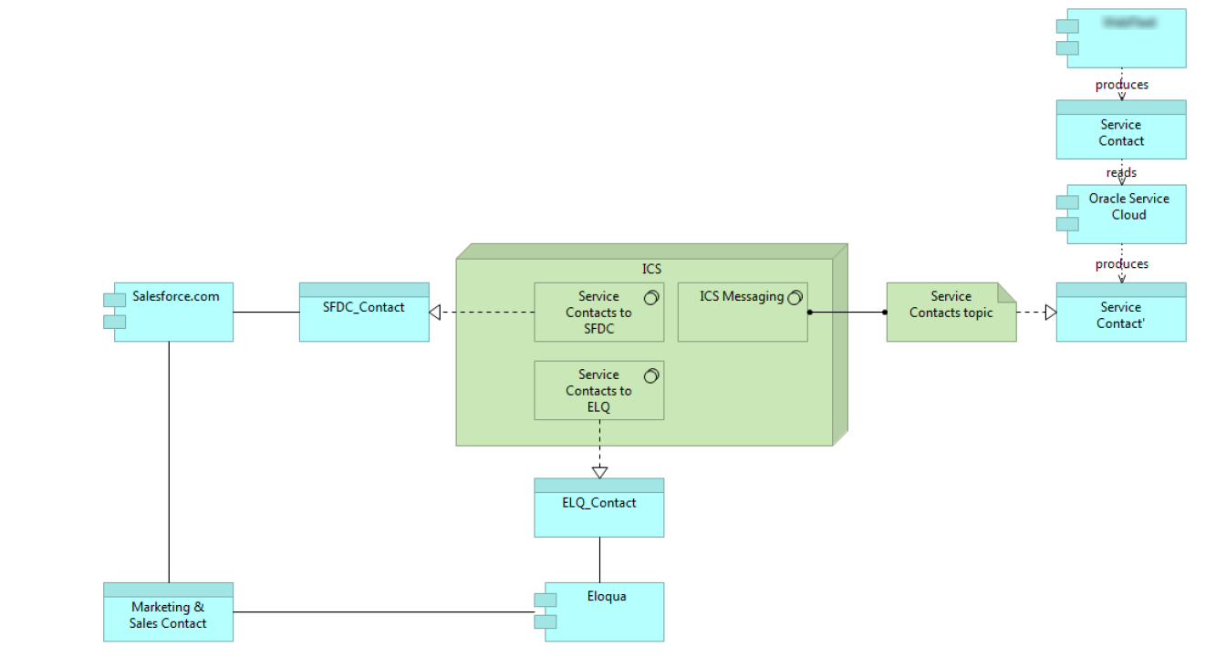
CASE: Mix of custom on premises and multi vendor SaaS
(on Premises)
Custom App
ICS
Oracle Service Cloud
SalesForce
Oracle Eloqua

Slide 16
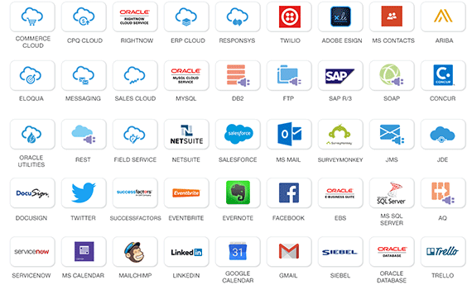

Swiss army knife of saas integration: Oracle Integration Cloud Service
Oracle Cloud
3rd Party
Salesforce
Oracle SaaS Applications
Oracle Integration Cloud Service
Oracle Applications, SAP, customer, legacy…
On-premises

Slide 17
Addressing SaaS Integration Challenge with Oracle PaaS
Gov Agency
B2B Partner
IOT
3rd Parties/Public Internet
API
SaaS X
ICS
OMC
Management
SaaS Y
PaaS X
CCS
SOA
Custom App B
EventHub
Functions
ACCS
Golden Gate
Data Integration
Messaging
Data Warehouse
On Premises
Custom App A
ERP
GG Agent
ICS Agent
SOA Suite

Slide 18
Cross SaaS ui
Tailor made UI for specific user groups & roles
Across multiple pages and with selected information
Across multiple SaaS & Custom Apps
On additional devices (mobile, wearable) and interaction channels(chat, voice)
Human workflow/business process no top of one or more SaaS & custom Apps
Non functional
Decouple from availability of SaaS UI
Save on user licenses
Enhanced security
Easier user provisioning

Slide 19
Typical saas UI Enablement requirements
Mobile App for service engineers
B2B Partner Portal
WebShop & Customer Service Web & ChatBot
3rd Parties/Public Internet
SaaS X
SaaS Y
PaaS X
Workflow
Custom App B
UI for Planning Staff
On Premises
Custom App A
ERP

Slide 20
Common questions and challenges
Single embedded (mashup) UI
Context rich (“deeplink”) navigation between SaaS Custom
Availability of UI (compared to availability of SaaS)
Which operations are to be supported (read only or more)
Where is the data to be used and how can it be accessed
Synchronous, format, authorization, volume
Shared Authentication between apps? (SSO)
Common UI questions
Which devices and channels, i18n, accessibility, theming/styling, non-functional requirements

Slide 21
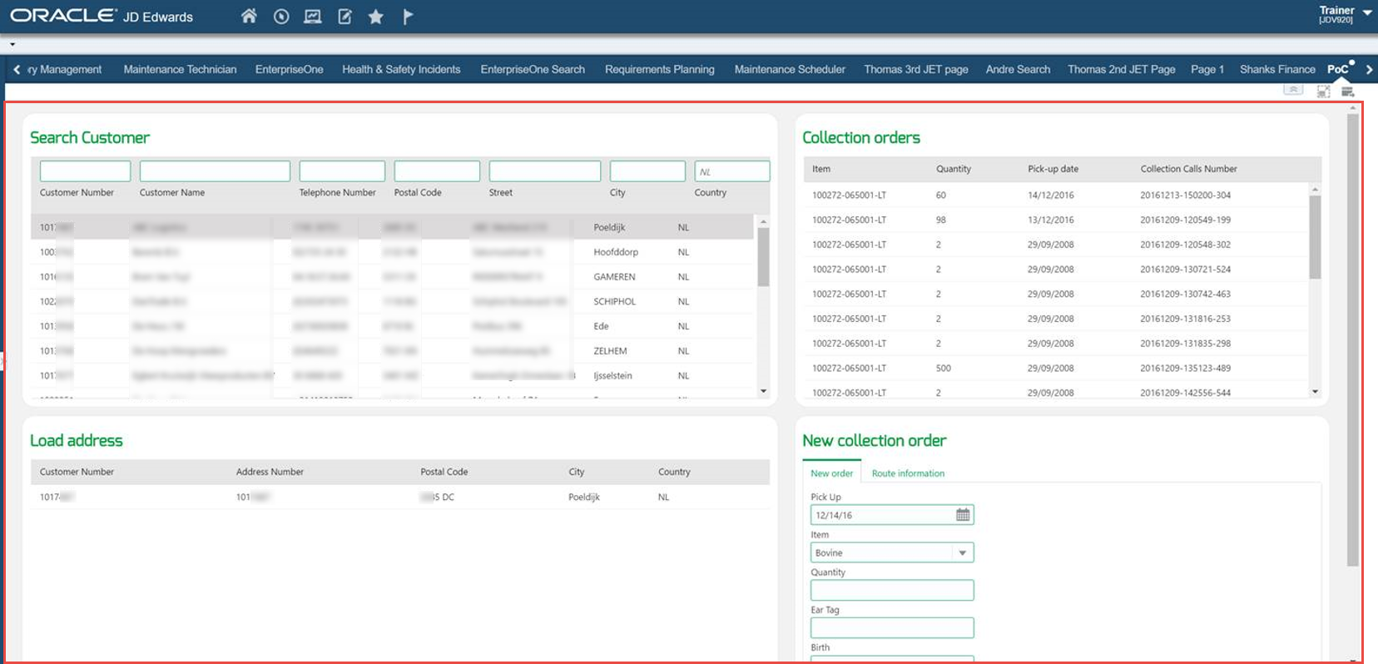


CASE: Oracle JET for user interfaces on top of ERP & SaaS – for example JD Edwards
Custom App

Slide 22











Case: [data from] On premises 3rd party ERP needs to be exposed in tailor made UI
Users
Portal
ElasticSearch
Data Sync
MW Svc
IFS
Back-end
System
Rental
Rental
Planning
Planning
Reference
HTML
JavaScript
http
JSON
REST
http
Java
API
XML
SOAP
http
ADF
WebCenter Portal
SOA Suite

Slide 23
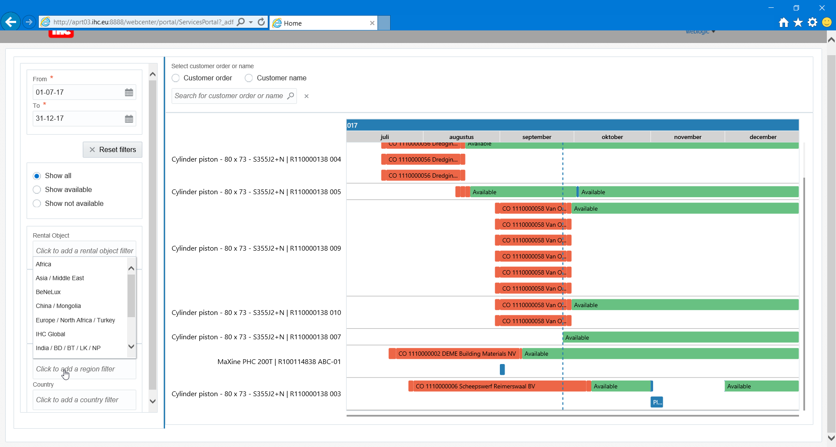
WebCenter Portal

Slide 24
Approach with custom UI
Unlock data from SaaS applications
Using out of the box APIs
Using ICS (or SOA CS) with Cloud Adapters for SaaS
By creating direct custom access paths (usually not supported)
Design APIs for the UI developers to work against
Or agree with APIs already designed
Implement APIs
MCS, API CS, Node on ACCS/OCCS, “Oracle Functions”, SOA CS
Implement UI
Oracle JET on ACCS or on mobile device, MAX, Visual Builder CS, Data Visualization CS, BI, ADF on JCS, Intelligent Bot CS, APEX on DBaaS
(optionally) Embed custom UI in one or more SaaS applications or in existing Enterprise Portal or external web site

Slide 25
Tackling saas UI Enablement with Oracle PaaS
Mobile App for service engineers
B2B Partner Portal
WebShop & Customer Service Web & ChatBot
Mobile
3rd Parties/Public Internet
Content & Experience
SaaS X
Intelligent Bots
MAX
JET on ACCS
API
SaaS Y
BI
PCS
PaaS X
Data Visualization
Workflow
Custom App B
APEX on DBaaS
Visual Builder
ADF on JCS
UI for Planning Staff
Conversations /Social Network
On Premises
Custom App A
Form, ADF, APEX, JET
ERP

Slide 26
Other aspects Of Saas enablement
Authentication & Single Sign On
Corporate Compliance & Auditing mechanisms
Corporate facilities for job scheduling, printing, (e)mailing, content management
Technical Application Management & End-to-End business monitoring
Data Quality: find and resolve data inconsistencies
Life Cycle Management and (integrated) Test environment
Cross enterprise reporting and data analytics
Central DWH, Big Data

Slide 27
Summary
Rise of Cloud & SaaS
Extend SaaS by creating and embedding UI mashups
Using Oracle PaaS: BI CS (OBI EE), DVCS, VBCS and JCS/JCS-SX & SaaS UX RDKs for ADF, JET, MAF
Enable SaaS in wider and hybrid context of IT landscape
UI mashup across SaaS applications – e,g. JET, VBCS, ICS, API CS
Alternative UI apps on mobile devices, smart wearables, chatbot – MCS, IBCS
Data & event synchronization across multiple SaaS and custom app & cloud ⬄ on premises – Event Hub CS, Message CS, ICS, Data Integration Platform CS
Plumbing – Authentication and SSO, Monitoring, Document Store, Print & (e)mail
Users ideally are fully unaware of the boundaries between applications

Slide 28



Blog: technology.amis.nl
Email: lucas.jellema@amis.nl
: lucasjellema
: lucas-jellema
: www.amis.nl, info@amis.nl +31 306016000 Edisonbaan 15, Nieuwegein

