Slide 1




Testing Cloud Native Applications Isolation, Automation (Node JS, Jest)
ISOLATION
more
less
Unit Test
isolated
sociable/ wired
Integration Test
Static Code Analysis
End to End Test
Smoke Test/Health Check/ Chaos Test
Lucas Jellema, CTO & Architect AMIS | Conclusion
Sources: bit.ly/cloud-native-latam2020

Slide 2
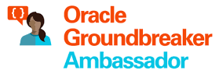



Lucas Jellema CTO for AMIS | Conclusion Cloud Solution Architect
lucas.jellema@amis.nl | technology.amis.nl | @lucasjellema | lucas-jellema

Slide 3
Why do we test?
Confidence (bordering on proof)
Functions according to specs
Does not contain [major] bugs
Delivers required business value [under real conditions]
Including PROD right NOW
Change implementation (refactor) with impunity
Establish and document specifications – for real (in executable tests)
Maintain velocity for adding and changing features as application grows more complex
Increase security and save money
Produce higher quality products
Confidence

Slide 4
Why do we test?
Collateral Bonus
Increase job satisfaction and professional pride of software developers
Create clean design (TDD) in terms of tests (before coding)
And create cleaner code
Provide usage examples of functions | components | APIs
Validate 3rd party libraries and APIs

Slide 5
A traditional application
UI
API
WebApp
Platform & Language runtime features (transaction management, HTTP request handling, state management & in memory caching, IAM, …
3rd party libraries & frameworks
Monolith, Microservice, Module
Custom Code
Database (RDBMS?)
Java EE
JVM
Operating System
Hardware

Slide 6
Cloud Native Application
Cache
CDN & WAF
API Gateway
Function
Event Hub
Web App
Container Engine
Function
Managed
Quick Provision & Decommission
Distributed
Automated
Pay per use/TCO
Vendor takes runtime responsibility
Enterprise grade platform accessible to startups
Rapid Innovation
Security & Availability
Scale
Vault
Mail
IAM
PaaS
Monitor
Alert & Notify
Scaling
Logging
IaaS
Notes:
Out of the box PaaS services and facilities
persistence, routing/throttling/buffer/queue/retry
IDM, key mgt, encryption/decryption
Distribution, CDN, regional failover
Monitor, log, alert/notification
Scalability (up & down)
Quick Rampup
Emphasis on interaction points: APIs, Events/ message format
Less emphasis on implementation of PaaS (platform) services
MongoDB API – implemented by Azure Cosmos DB, MongoDB, Minimongo and AWS Document DB and soon Oracle Autonomous JSON
Kafka API – Azure Event Hub, OCI Streaming, AWS Managed Streaming
JDBC/SQL – Relational Database (Oracle, SQL Server, PostgreSQL, MySQL) and even NoSQL (Oracle NoSQL, Cassandra, Hadoop)

Slide 7
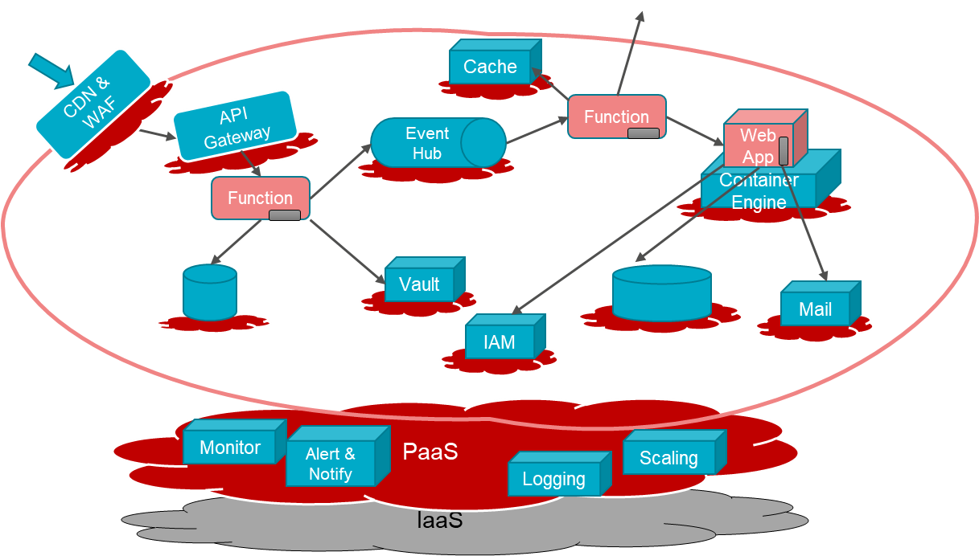
Characteristics of Cloud Native Applications
Modern – born in the cloud (era)
Emphasis on interaction (and decoupling) points:
Between custom components: APIs, Events/ message format
From custom to PaaS Services: Service APIs, Formats and Protocols
Less emphasis on [and insulation from?] implementation of PaaS (platform) services
MongoDB API – implemented by Azure Cosmos DB, MongoDB, Minimongo and AWS Document DB and soon Oracle Autonomous JSON
Kafka API – Azure Event Hub, OCI Streaming, AWS Managed Streaming
JDBC/SQL – Relational Database (Oracle, SQL Server, PostgreSQL, MySQL) and even NoSQL (Oracle NoSQL, Cassandra, Hadoop)
No explicit Infrastructure (serverless, software defined) & managed Platform components
Stateless and Dynamically Scalable (Elastic) – expand and contract
Pay per Use
Automation – no hands on ACC and Production (speed, repeatability, dynamic adjustment)
Infrastructure/Platform as Code & Application CI/CD [pipelines]

Slide 8
Some (PaaS) Cloud Capabilities for Cloud Native development
Functions (serverless application code)
API Gateway
Events / Queued Messages
Data Persistence
Cache
Security
Network access
Web Application Firewall (DDOS & more)
Authentication & Authorization
Credentials & Key Management, En|Decrypt
Automation – CI/CD & DevOps Pipelines
Monitoring
Metrics, notification, logging
Auditing
Cost Control
Monitoring
API Gateway
Function
Security (WAF, Network, Authorization
Event Topic
Data Persistence
Cache
CI/CD & DevOps Pipelines

Slide 9






Traditional Application: Tweets to NoSQL, Streaming & Email
Function
Object Storage
Function
Events
Notifications
NoSQL Database
API Gateway
Healthcheck
Streaming
#groundbreakerstour

Slide 10
Traditional Application: Tweets to NoSQL, Streaming & Email
A single unit to build | test | deploy | scale | fail
Synchronous interactions
No (built-in) monitoring | logging
API
WebApp
3rd party libraries & frameworks
log
Database (RDBMS?)
Java EE
JVM
NoSQL Database
Streaming
#groundbreakerstour
Operating System
Platform and Infrastructure to install | configure | secure | operate | maintain
Hardware
Logging?
Monitoring?

Slide 11
Demonstration of Cloud Native Application: Tweets to NoSQL, Streaming & Email
Function
Object Storage
Function
Events
Notifications
NoSQL Database
API Gateway
Healthcheck
Streaming
#groundbreakerstour

Slide 12


Cloud Native design Tweets to NoSQL, Streaming & Email
Store JSON file with all tweets in time period
Cloud Event for new JSON file
Create Tweet Records in NoSQL
Trigger function with event
Invoke Tweet Aggregator every X minutes
NoSQL Database
Function
Publish to Notification Topic
Expose function to external callers
Object Storage
Healthcheck
Write JSON document with Tweets
Custom code in multiple small units that each build | test | deploy | scale | fail
Asynchronous interactions
Managed Platform (and underlying Infra) with built in logging | monitoring | Ops
API Gateway
Streaming
Events
Publish each Tweet to Stream
Function
Retrieve X minutes worth of tweets
Notifications
Send Tweet Report as email
Get Twitter credentials in secure way from vault
Vault
Logging
OCIR
Monitoring
Compartments
#groundbreakerstour
API/Service

Slide 13

Decoupling
Encapsulation (of implementation)
Run time availability independence
Independent release / reconfigure
Independence of scaling
Volume Load Throttling/Absorption
Security Boundary
Failure isolation
NoSQL Database
Function
Object Storage
API Gateway
Streaming
Events
Function
Notification Topic
Vault
Logging
OCIR
Monitoring
Compartments
#groundbreakerstour
API/Service

Slide 14
Application Design
Function
Events
Notifications
Store JSON file with all tweets in time period
API Gateway
Healthcheck
Object Storage
Write JSON document with Tweets
Retrieve X minutes worth of tweets
Function
Tweet Summarizer
Function
Get Twitter credentials in secure way from vault
Vault
#groundbreakerstour

Slide 15

Application Design
Function
Events
Notifications
Store JSON file with all tweets in time period
API Gateway
Healthcheck
Object Storage
Write JSON document with Tweets
Function
Tweet Summarizer
Retrieve X minutes worth of tweets
Function
Get Twitter credentials in secure way from vault
Vault
#groundbreakerstour

Slide 16
Application Design
Function
Events
Notifications
Signed HTTP call to OCI REST API
API Gateway
Object Storage
Healthcheck
Tweet Summarizer
Write JSON document (to OCI Object Storage)
Retrieve selected Tweets from Twitter API
Function
Retrieve Twitter API Credentials (from Secret in OCI Vault)
Signed HTTP call to OCI REST API
Vault

Slide 17
Application Design
Function
Events
Notifications
Twitter API
Tweet Summarizer
Retrieve selected Tweets from Twitter API
API Gateway
Healthcheck
Retrieve Twitter API Credentials (from Secret in OCI Vault)
Coordinate actions
Vault
OCI API
Vault Service
Make signed HTTP call to OCI REST API
Write JSON document (to OCI Object Storage)
Object Storage
OCI API
Object Storage Service

Slide 18
Application Design
Function
Events
Notifications
Twitter API
Tweet Summarizer
Retrieve selected Tweets from Twitter API
API Gateway
Healthcheck
Retrieve Twitter API Credentials (from Secret in OCI Vault)
Project Fn FDK Adapter
Coordinate actions
Vault
OCI API
Vault Service
Make signed HTTP call to OCI REST API
Write JSON document (to OCI Object Storage)
Object Storage
OCI API
Object Storage Service

Slide 19
Tweet Summarizer
ENV: TWITTER_CREDENTIALS_FILE
TWITTER_CREDENTIALS_SECRET_OCID
Twitter API
ENV: TWITTER_REPORTS_BUCKET
tweet-retriever.js
func.js
tweet-summarizer.js
ENV: OCI_RESOURCE_PRINCIPAL_PRIVATE_PEM , OCI_RESOURCE_PRINCIPAL_RPST, PRIVATE_KEY_FILE, KEY_FINGERPRINT
, TENANCY_ID, USER_ID
twit
oci-secret-retriever.js
OCI API
Vault Service
fnproject@fdk
oci-api-requestor.js
url
ENV: REGION, COMPARTMENT_OCID
https
oci-object-writer.js
fs
OCI API
Object Storage Service
ENV: REGION, OCI_NAMESPACE

Slide 20
Types of Tests
ISOLATION
more
less
Unit Test
isolated
sociable/ wired
Integration Test
Static Code Analysis
End to End Test
Smoke Test/Health Check/ Chaos Test

Slide 21
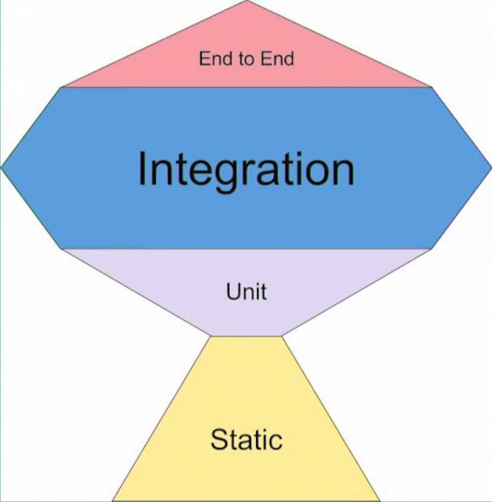
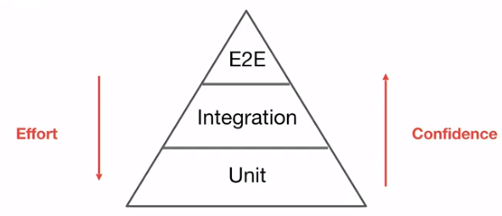
Types of Tests
ISOLATION
more
less
More:
Speed
Tests
Boundary Testing
Non-happy flows & corner cases
Mocks
Maintenance
Refactoring Protection
Technical
More:
Functional / Specification driven
Confidence
Bugs caught
Contract & Interaction
REAL (mocks poke holes in reality)
Side effect
Effort (per test)
Execution time
Unit and (most of) its internal dependencies; external dependenices are mocked
Unit Test
isolated
sociable/ wired
Integration Test
single unit, all dependencies are mocked
(aka Integration or BroadStack) test: tests include (unmocked) external dependencies; parts of the system can still be mocked
When used at runtime – E2E tests function as Smoke Test/Health Check – to test health of interactions at PaaS & IaaS level
Static Code Analysis
End to End Test
Verify code quality guideline adherence – without running any code
Some external dependencies are mocked; all internal units are used unmocked
Tests in full blown environment (ACC, PROD); focus on (continuous) health – end to end availability of connections, permissions, platform and infra components; focus on important functional flows
Smoke Test/Health Check/ Chaos Test

Slide 22
Types and Levels of Tests
End-to-End (aka Integration or BroadStack) test: tests include (unmocked) external dependencies
Component Test (aka integration) – all external dependencies are mocked; all internal units are used unmocked
Unit Test – single unit, all dependencies are mocked
Component (a mini-application deployed as one Serverless Function)
3rd party External API
Custom Module
Custom module
Custom Module
core module
core module
Internal API for separate application
3rd party module
Custom Module
core module
3rd party module
Database

Slide 23
Tweet Summarizer Component, Units & External Dependencies
Component: Tweet Summarizer
Twitter API
tweet-retriever.js
func.js
tweet-summarizer.js
twit
oci-secret-retriever.js
OCI API
Vault Service
fnproject@fdk
oci-api-requestor.js
url
https
oci-object-writer.js
fs
OCI API
Object Storage Service

Slide 24
Testing at Unit, Component and End-to-End level
(Mocking Units & Libries/Modules, External Services and <data> respectively)
Unit Test (aka Function or Module test)
Solitary: will apply to a single unit – and mock other units
Sociable (aka wired) : applies to unit and the units it invokes unless external | slow services are invoked in which case these units are mocked (note: social unit test and component test are similar)
Component Test will use all units in the component – and mocks for external services
End-to-End (aka broad stack or integration test) will use the entire component as well as real external services (and a predefined set of test data objects)

Slide 25
Unit Test – for each of custom units
Units as defined in technical design and by developer
Not necessarily meaningful to business
Component: Tweet Summarizer
SET ENV: TWITTER_REPORTS_BUCKET
tweet-summarizer. unit.test.js
mock-tweet-retriever.js
tweet-retriever.js
func.js
tweet-summarizer.js
twit
fnproject@fdk
oci-secret-retriever.js
url
oci-api-requestor.js
mock-oci-object-writer.js
https
oci-object-writer.js
fs

Slide 26
Unit Test – for unit tweet-retriever Mock modules twit (3rd party) and oci-secret-retriever (custom)
SET ENV: TWITTER_CREDENTIALS_FILE
TWITTER_CREDENTIALS_SECRET_OCID
Component: Tweet Summarizer
tweet-retriever.unit .test.js
tweet-retriever.js
Mock interaction with Twitter API
mock-twit.js
func.js
tweet-summarizer.js
twit
mock-oci-secret-retriever.js
fnproject@fdk
oci-secret-retriever.js
url
oci-api-requestor.js
https
oci-object-writer.js
fs

Slide 27
When and Why (isolated) Unit Test using Mocking
Focus on complex logic
Optimize performance – execution speed of test
Minimize side effects
Dependencies (internal or external) are not yet available
Invoking external dependencies may not be allowed or may cost money
Do not rigidly follow the principle of ‘always and only isolated unit tests’
Do not automatically create isolated unit tests for every unit
Think carefully about
The insight a test is supposed to provide – what do we need a test for?
When a test should fail (upon which type of change)
Integration tests typically provide more confidence in functioning according to specifications

Slide 28
Component Test – for each of units, using all units; mocks for external calls
SET ENV: TWITTER_REPORTS_BUCKET, TWITTER_CREDENTIALS_FILE, TWITTER_CREDENTIALS_SECRET_OCID, REGION, OCI_NAMESPACE, OCI_RESOURCE_PRINCIPAL_PRIVATE_PEM, OCI_RESOURCE_PRINCIPAL_RPST, PRIVATE_KEY_FILE, KEY_FINGERPRINT, TENANCY_ID, USER_ID
Component: Tweet Summarizer
tweet-retriever. component .test.js
SET ENV: TWITTER_CREDENTIALS_FILE
TWITTER_CREDENTIALS_SECRET_OCID, OCI_RESOURCE_PRINCIPAL_PRIVATE_PEM , OCI_RESOURCE_PRINCIPAL_RPST, PRIVATE_KEY_FILE, KEY_FINGERPRINT
, TENANCY_ID, USER_ID
tweet-summarizer. component .test.js
func. component .test.js
tweet-retriever.js
mock fnproject@fdk
func.js
tweet-summarizer.js
Mock interaction with Twitter API
oci-secret-retriever. component .test.js
twit
mock-twit.js
oci-api-requestor.component .test.js
fnproject@fdk
oci-secret-retriever.js
SET ENV: OCI_RESOURCE_PRINCIPAL_PRIVATE_PEM , OCI_RESOURCE_PRINCIPAL_RPST, PRIVATE_KEY_FILE, KEY_FINGERPRINT
, TENANCY_ID, USER_ID
SET ENV: REGION,COMPARTMENT_OCID, OCI_RESOURCE_PRINCIPAL_PRIVATE_PEM , OCI_RESOURCE_PRINCIPAL_RPST, PRIVATE_KEY_FILE, KEY_FINGERPRINT
, TENANCY_ID, USER_ID
oci-api-requestor.js
url
oci-object-writer.
component .test.js
mock-https.js
https
Mock interaction with OCI API for Vault and Object Storage
SET ENV: REGION, OCI_NAMESPACE, OCI_RESOURCE_PRINCIPAL_PRIVATE_PEM , OCI_RESOURCE_PRINCIPAL_RPST, PRIVATE_KEY_FILE, KEY_FINGERPRINT
, TENANCY_ID, USER_ID
oci-object-writer.js
fs

Slide 29
Tweet Summarizer - End-to-End Test (Integration Test) (possibly) for each unit – no mocks
SET ENV: TWITTER_REPORTS_BUCKET, TWITTER_CREDENTIALS_FILE, TWITTER_CREDENTIALS_SECRET_OCID, REGION, OCI_NAMESPACE, OCI_RESOURCE_PRINCIPAL_PRIVATE_PEM, OCI_RESOURCE_PRINCIPAL_RPST, PRIVATE_KEY_FILE, KEY_FINGERPRINT, TENANCY_ID, USER_ID
Component: Tweet Summarizer
tweet-retriever .test.js
Twitter API
SET ENV: TWITTER_CREDENTIALS_FILE
TWITTER_CREDENTIALS_SECRET_OCID, OCI_RESOURCE_PRINCIPAL_PRIVATE_PEM , OCI_RESOURCE_PRINCIPAL_RPST, PRIVATE_KEY_FILE, KEY_FINGERPRINT
, TENANCY_ID, USER_ID
func .test.js
tweet-summarizer .test.js
tweet-retriever.js
func.js
tweet-summarizer.js
oci-secret-retriever .test.js
twit
oci-secret-retriever.js
OCI API
Vault Service
fnproject@fdk
SET ENV: REGION,COMPARTMENT_OCID, OCI_RESOURCE_PRINCIPAL_PRIVATE_PEM , OCI_RESOURCE_PRINCIPAL_RPST, PRIVATE_KEY_FILE, KEY_FINGERPRINT
, TENANCY_ID, USER_ID
oci-api-requestor.js
url
oci-object-writer .test.js
https
SET ENV: REGION, OCI_NAMESPACE, OCI_RESOURCE_PRINCIPAL_PRIVATE_PEM , OCI_RESOURCE_PRINCIPAL_RPST, PRIVATE_KEY_FILE, KEY_FINGERPRINT
, TENANCY_ID, USER_ID
SET ENV: REGION, OCI_NAMESPACE, OCI_RESOURCE_PRINCIPAL_PRIVATE_PEM , OCI_RESOURCE_PRINCIPAL_RPST, PRIVATE_KEY_FILE, KEY_FINGERPRINT
, TENANCY_ID, USER_ID
oci-object-writer.js
fs
OCI API
Object Storage Service

Slide 30
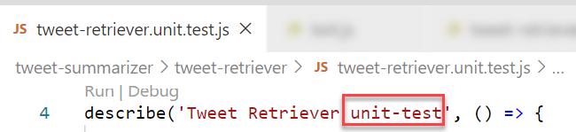
Running tests met Jest
In package.json:
"scripts": {
"test": "jest --coverage=true --coverageProvider=v8 -testNamePattern='unit-test' "
}
Using command line parameters to only run the desired category of tests (these filters check the string set in the Jest describe statement)
testNamePattern='<regular expression for tests to run>’
testPathIgnorePatterns='[<array of regular expressions for tests NOT to run>, '']'
…

Slide 31
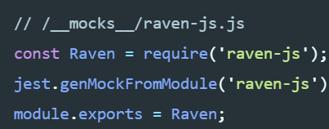
Mocking with Jest
To mock a custom or 3rd part module:
Create a folder __mock__ in the directory that contains the custom (self-owned) module or in the folder node_modules (npm modules)
Create a file <module>.js in the __mock__ folder
In this file:
Require the original module module.js
Jest.genMockFromModule module.js
<override functions with jest.fn mock functions>
Module.exports module
Add jest.mock(module.js) to the unit test (note: not inside the test and prior to the require of the module)
In case a module returns a constructor for an object, we need to provide a MockImplementation of of the object
TBD
Notes:
https://bambielli.com/til/2017-12-14-mocking-node-modules-with-jest/
https://bambielli.com/til/2018-01-07-mocking-constructors/

Slide 32
Tests are Code [too]
Tests are included in Source Code Control system
Tests are part of the Code Review
Tests should be tested
At least Static Code Analysis
Tests should be clean
Readable
Smart naming
Well organized (not too large, SRP)
Follow patterns
Use utilities (reusable, centrally maintained)
Consistent (tests of same type are similar; use templates to create tests)

Slide 33
Thank you for your attention I hope this was useful
Sources: bit.ly/cloud-native-latam2020
lucas.jellema@amis.nl | technology.amis.nl | @lucasjellema | lucas-jellema

