Slide 1




Code Café Lab Collaborative Explorations
Conclusion Code Café Lab – 7 February 2023
Notes:
https://unsplash.com/photos/K0haqOrJ_0M

Slide 2
Overview
Pitches – under one-minute introductions of candidates
Vote – Top 5 to investigate tonight
Top 3 Personal Preferences & Team Composition (a LP challenge)
Exploration in Teams
Dinner
More exploration
Regrouping – 10 minute review of each investigated technology
Team presents their findings – overview, screenshots?, demo???
Everyone can participate
Tentative conclusion?

Slide 3

Pitches
You are the jury
Determine your top 3 from the pitched topics

Slide 4

Mockaroo – Test Data Generator & API Mocker
Web UI for defining schema and downloading data
JSON, SQL (DML), CSV, XML and more formats for specific technologies
200+ predefined field types
define custom list of allowed values
use expressions to fine tune values
use RegExp masks to specify string patterns
also publish REST API that returns fake data
1K free requests per day

Slide 5

Sprkl – Personal Observability Platform for JavaScript devs
Development/Debug/Test time automatic instrumentation of code to get clear insight in execution paths, dependencies and bottlenecks
Leveraging OpenTelemetry for Node to dynamically inject instrumentation
Producing traces
Sprkl helps a developer research, plan, debug, test, and prevent issues, and investigate existing issues faster so she can focus on writing the best possible code.
Partial support for Java, Python, C# -more is coming

Slide 6

Carbon Cloud Footprint
Open source project to provide insight in energy usage and CO2 production from cloud computing (as well as costs)
Also provide recommendations on reductions (for AWS and GCP)
Initiative from Thoughtworks
Support for Azure, GCP and AWS
Based on thorough analysis of cloud services and data centers – per location

Slide 7

SigNoz – Open Source Monitoring Stack
“Understand issues in your deployed applications & solve them quickly”
Produce and process Logs, Metrics and Traces
Native support for OpenTelemetry
Alternative to NewRelic, DataDog, Jaeger/Prometheus/Grafana or Elastic stack, Zabbix, Splunk
Self-hosted
11.5 GitHub Stars

Slide 8

Docusaurus – technical and end user documentation
Docusaurus is a project for building, deploying, and maintaining open source project websites easily.
Generate documentation website for end users or technical audience
Docusaurus is a static-site generator. It builds a single-page application with fast client-side navigation, leveraging the full power of React to make your site interactive. It provides out-of-the-box documentation features but can be used to create any kind of site (personal website, product, blog, marketing landing pages, etc).
Processes Markdown files
Support for versioning, i18n, search and theme customizations
Alternative for Gatsby, Next.js, VuePress, MkDocs, Docsify, GitBook, Jekyll
42K GitHub Stars; has been around for 4+ years

Slide 9

OpenZiti – Zero Trust Networking
free and open source project focused on bringing zero trust to any application
With OpenZiti you can have zero trust, high performance networking on any Internet connection, without VPNs!
OpenZiti provides:
An overlay network
Tunneling Applications for all operating systems
Numerous SDKs making it easy to add zero trust concepts directly into your application
Provide access to applications in private networks – without providing network level access
zrok, JDBC drivers, BrowZer, kubeZtl

Slide 10
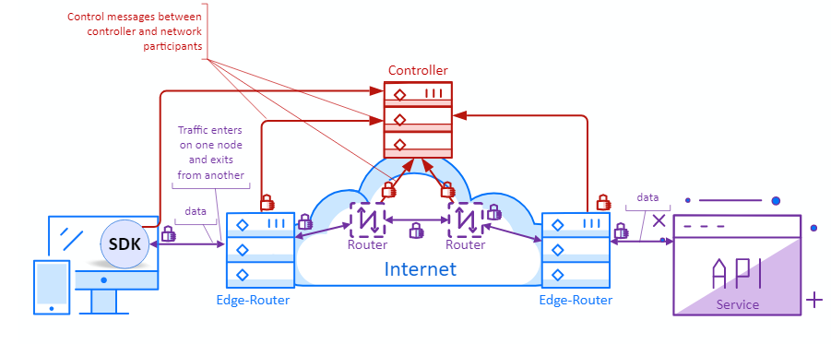
OpenZiti – connections over only outbound connections

Slide 11
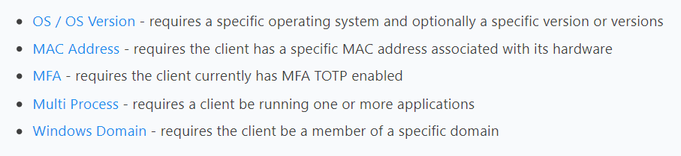
built in Go
4 years in GitHub
< 1K stars
E2E TLS
No DNS
Metrics
Policies
Posture Checks

Slide 12
SDKs – Android, Swift, C, .NET

Slide 13



Power Toys for Windows | Mac | Linux
Utilities for power users to tune and streamline their operating system experience for greater productivity.
Microsoft Power Toys, utilso (utilso.com) and DevUtils (devutils.com).
Windows, Linux and MacOS:
Various aspects – file management, window management, networking, mouse, keyboard, clipboard, process & job management, encoding/decoding, formatter, text recognition/extraction

Slide 14

CloudFlare Workers – Serverless Functions & Edge Jobs
Deploy serverless code instantly across the globe to give it exceptional performance, reliability, and scale.
Support for JS, Rust, C, and C++
100K requests each day are free
paid plans start at just $5 for 30 million requests
Edge storage: Store your static assets at the edge with Workers KV, our global, low-latency key-value data store.
access assets from code

Slide 15

Ceph – extremely scalable storage solution [for Kubernetes]
open source software-defined storage solution designed to address the block, file and object storage needs of modern enterprises
Ceph acts as interface between applications, tools, platforms etc. on the one hand and many different storage types on the other
it provides scaling and fault management capabilities transparently
Ceph can interact with different storage types in a single cluster – while allowing applications to interact with one storage interface provided by Ceph
This makes Ceph ideal for cloud, Openstack, Kubernetes, and other microservice and container-based workloads, as it can effectively address large data volume storage needs.
Ceph is an open source project backed by Canonical (company behind Ubuntu)

Slide 16

GitHub CoPilot - Your AI pair programmer
Copilot is GitHub’s new machine learning coding tool. It was created thanks to a collaboration between GitHub and OpenAI
Copilot is a machine learning agent that can help developers make blocks of code based on semantic hints and other basic directions.
Integration with VS Code is available
Copilot has a two month trial – then is charged at $10 per month

Slide 17

Bicep Deployment and Development
Bicep is a language for declaratively deploying Azure resources.
a DSL on top of ARM
somewhat comparable to Terraform
Free and supported
Extension in VS Code
Easy integration with Azure DevOps Pipelines
Transform existing ARM Template to Bicep

Slide 18

HTMX – Pure HTML based (inter)active webpages
“htmx completes HTML as a hypertext”
web development using only HTML
HTMX is a JavaScript library to replace client side JavaScript
HTMX extends HTML with attributes that define advanced behavior
AJAX requests (any HTTP verb) – to update/replace specific page elements
CSS transitions
instant push with SSE and WebSockets
Developing a simple static web application can be done faster with only HTML and CSS skills
Open Source, 10K GitHub stars, 2.5 years old
successor to intercooler.js (that was created in 2013)

Slide 19
Overview
Pitches – under one-minute introductions of candidates
Vote – Top 5 to investigate tonight
Top 3 Personal Preferences & Team Composition (a LP challenge)
Exploration in Teams
Dinner
More exploration
Regrouping – 10 minute review of each investigated technology
Team presents their findings – overview, screenshots?, demo???
Everyone can participate
Tentative conclusion?

Slide 20










Long List
Mockaroo – Generate Test Data and Run Mock APIs
Sprkl – Personal Observability Platform – monitoring during dev and test
Cloud Carbon Footprint – analyze and reduce cloud energy usage and resource cost
SigNoz – open source, native OpenTelemetry Monitoring stack
Docusaurus – generate static web sites from Markdown, e.g. for documentation
OpenZiti – Zero Trust Networking – secure, identity based access to private networks
PowerToys (utilso, DevUtils) – productivity tools for Windows, Linux, MacOS
CloudFlare WebWorkers – cheap, fast, global serverless edge functions & storage
Ceph – software defined storage solution (S[torage]aaS)
GitHub Copilot – Your AI powered Pair Programmer
Bicep – declarative Infrastructure as Code for Azure
htmx – HTML based rich interactive web applications
Notes:
https://docs.google.com/spreadsheets/d/1-9t-PgTaz2PcbVAk5g6x_d4OzmYdYQDJn-TN-dkZJds/edit?usp=sharing

Slide 21
Long List
Mockaroo – Generate Test Data and Run Mock APIs
Sprkl – Personal Observability Platform – monitoring during dev and test
Cloud Carbon Footprint – analyze and reduce cloud energy usage and resource cost
SigNoz – open source, native OpenTelemetry Monitoring stack
Docusaurus – generate static web sites from Markdown, e.g. for documentation
OpenZiti – Zero Trust Networking – secure, identity based access to private networks
PowerToys (utilso, DevUtils) – productivity tools for Windows, Linux, MacOS
CloudFlare WebWorkers – cheap, fast, global serverless edge functions & storage
Ceph – software defined storage solution (S[torage]aaS)
GitHub Copilot – Your AI powered Pair Programmer
Bicep – declarative Infrastructure as Code for Azure
htmx – HTML based rich interactive web applications
Notes:
https://docs.google.com/spreadsheets/d/1-9t-PgTaz2PcbVAk5g6x_d4OzmYdYQDJn-TN-dkZJds/edit?usp=sharing

Slide 22
Overview
Pitches – under one-minute introductions of candidates
Vote – Top 5 to investigate tonight
Top 3 Personal Preferences & Team Composition (a LP challenge)
Exploration in Teams
Dinner
More exploration
Regrouping – 10 minute review of each investigated technology
Team presents their findings – overview, screenshots?, demo???
Everyone can participate
Tentative conclusion?

