Slide 1


























Steampipe select * from <cloud>
Conclusion Code Café – 31 mei 2022
Lucas Jellema, CTO & Architect AMIS | Conclusion

Slide 2
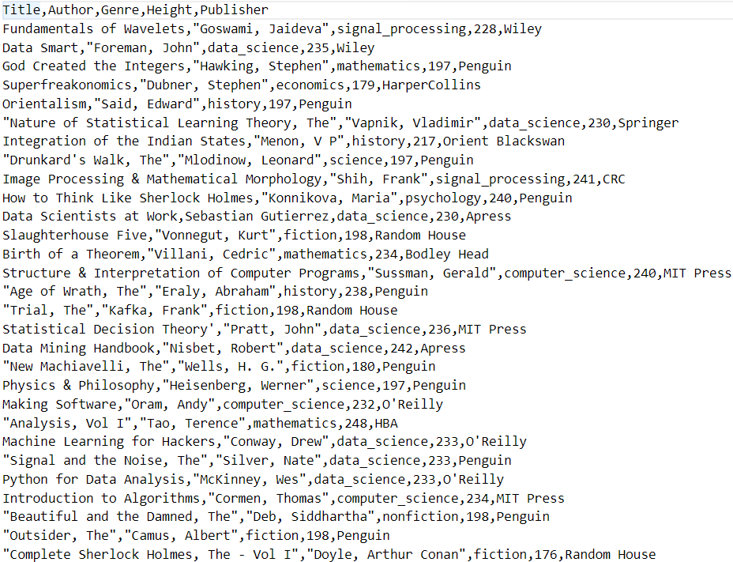
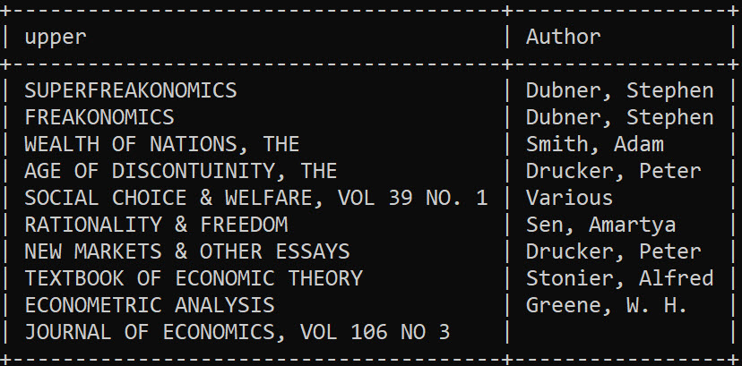
select * from CSV
select upper("Title") as title
, "Author“ as author
from
csv.books
where
"Genre" = 'economics'
books.csv

Slide 3
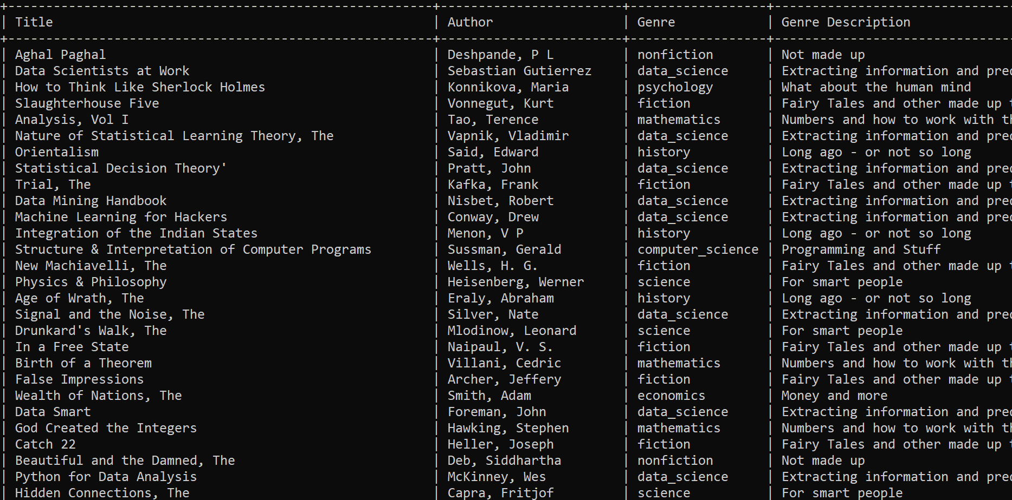
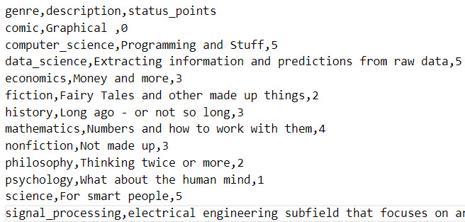
select * from multiple CSV files
select "Title"
, "Author"
, "Genre"
, "description" as "Genre Description"
, "status_points" as "Genre Status Score"
from
csv.books b
join
csv.genres g
on
b."Genre" = g."genre"
books.csv
genres.csv

Slide 4
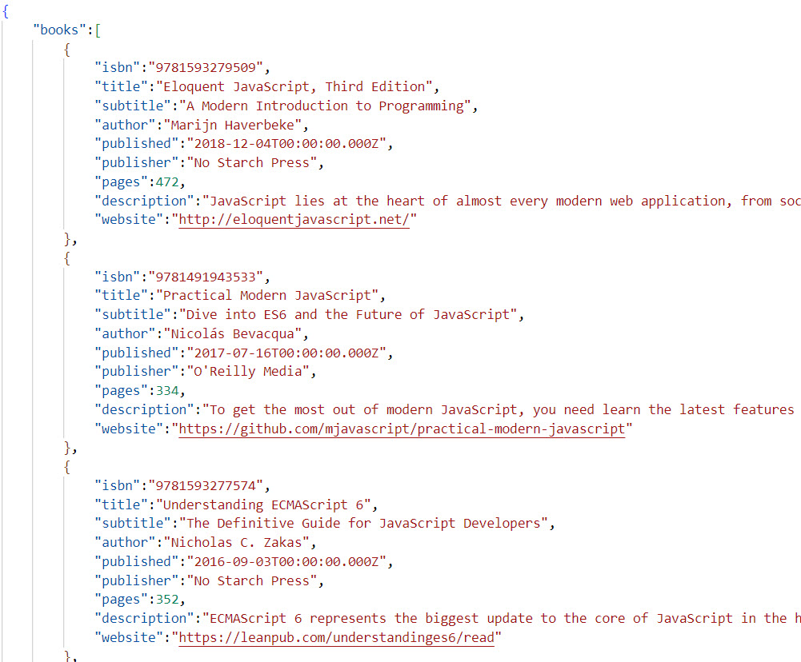
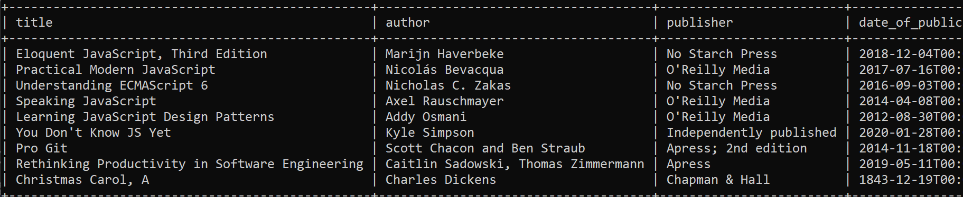
select * from JSON
select e.item ->> 'title' as title
, e.item ->> 'author' as author
, e.item ->> 'publisher' as publisher
, e.item ->> 'published' as date_of_publication
, e.item ->> 'subtitle' as subtitle
, e.item ->> 'description' as description
, e.item ->> 'website' as website
from json_file b
cross join
jsonb_path_query(b.content, '$.books[*]') as e(item)
where
b.path like '%books.json'
books.json

Slide 5
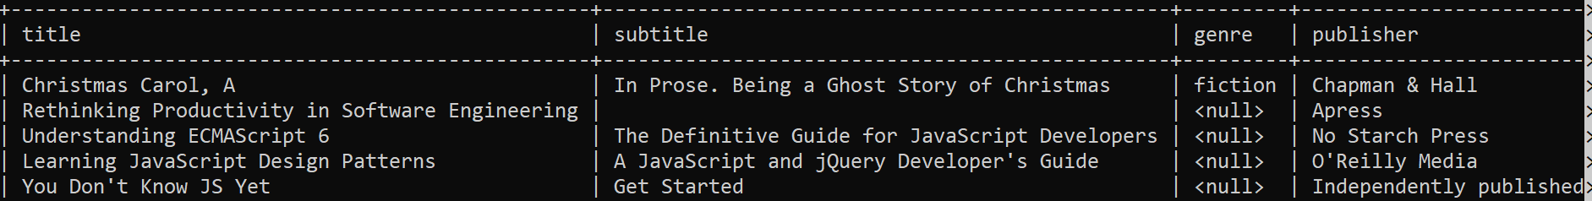
select * from multiple data sources (CSV, JSON, YAML, INI)
with books_from_json as
( select e.item ->> 'title' as title
, e.item ->> 'author' as author
..
from json_file b
cross join
jsonb_path_query(b.content, '$.books[*]') as e(item)
where
b.path like '%books.json'
)
, books_from_csv as
( select "Title" as title
, "Genre" as genre
from
csv.books
)
select bj.title
, bc.genre
..
from
books_from_json bj
join
books_from_csv bc
on
bj.title = bc.title
books.json
books.csv

Slide 6
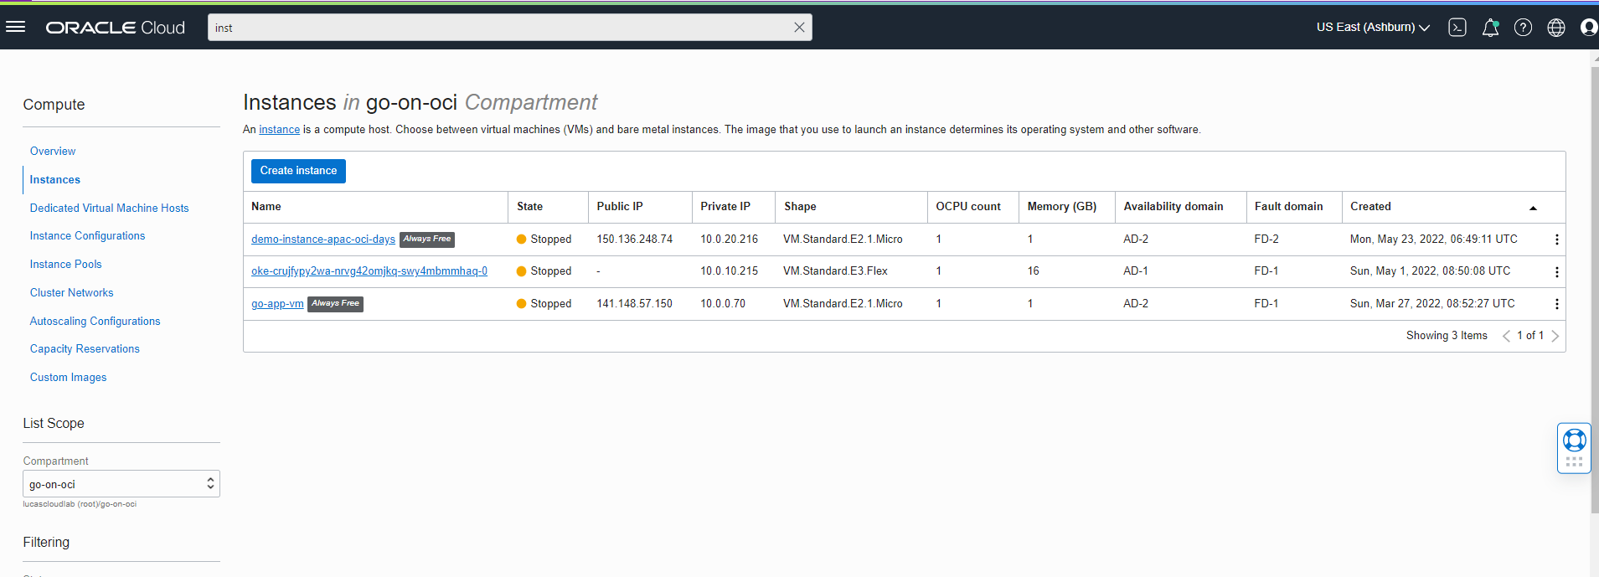
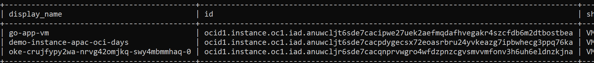
Query for Compute Instances on Oracle Cloud

Slide 7
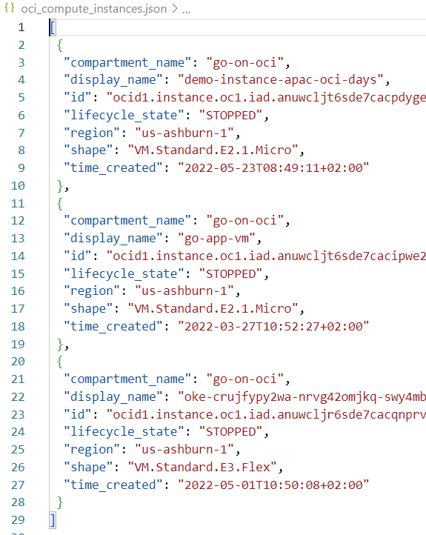
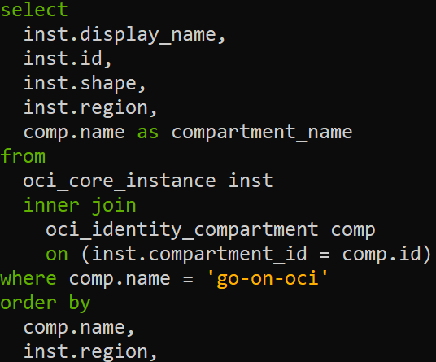
Query the Cloud
OCI REST API Calls
Result in tabular, csv, json format

Slide 8
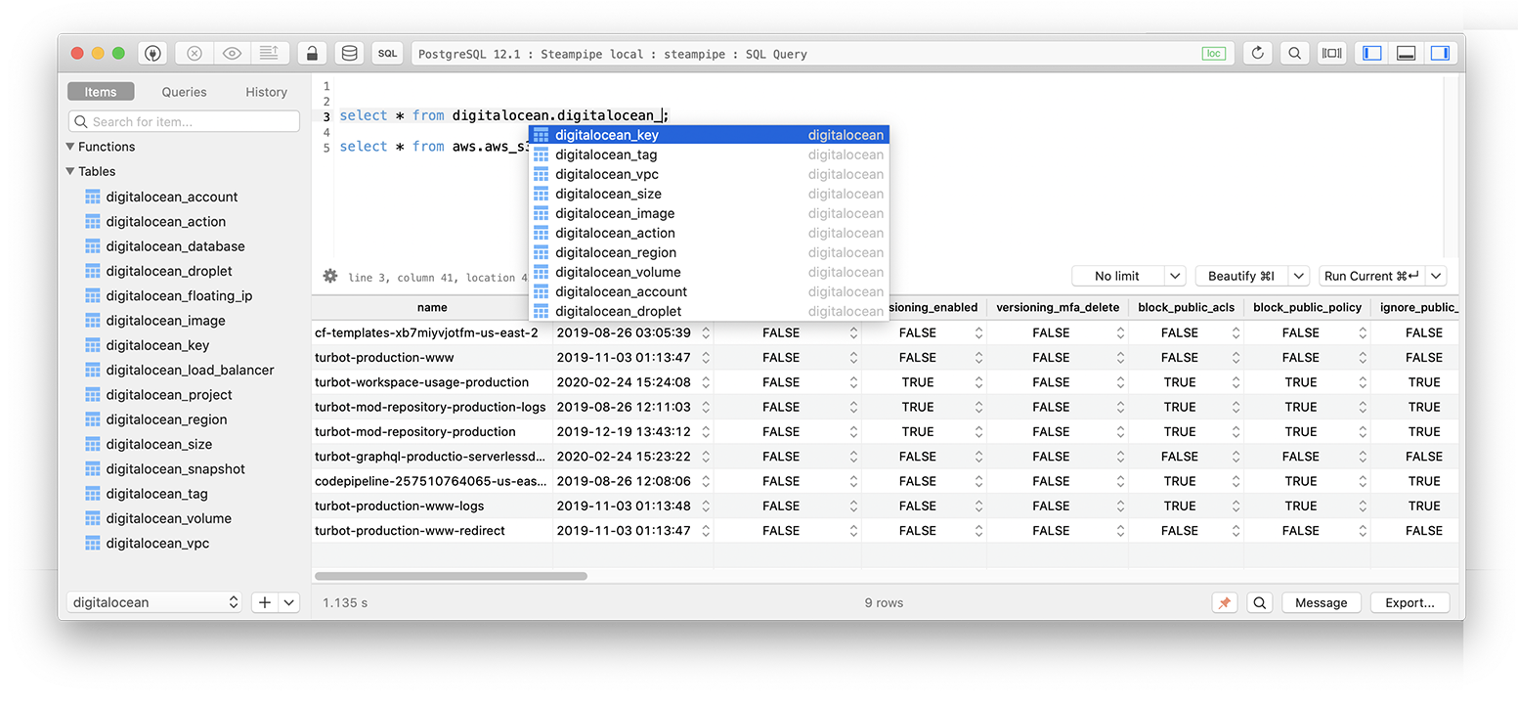
Steampipe query features
Output format: table, json, csv
Named queries (defined in .sql file, reused like views in SQL statements)
Interactive shell
Batch mode (background, one or more .sql scripts)
=> write results to standard output
steampipe query oci-vms.sql --output json > oci_compute_instances.json
Service Mode => start embedded PostgreSQL database – allowing access from any tool that can talk to PostgreSQL
leverage Steampipe database views
Container image is available
Aggregator connections
one query across multiple data sources
Cast values – for example text to int (::int)

Slide 9
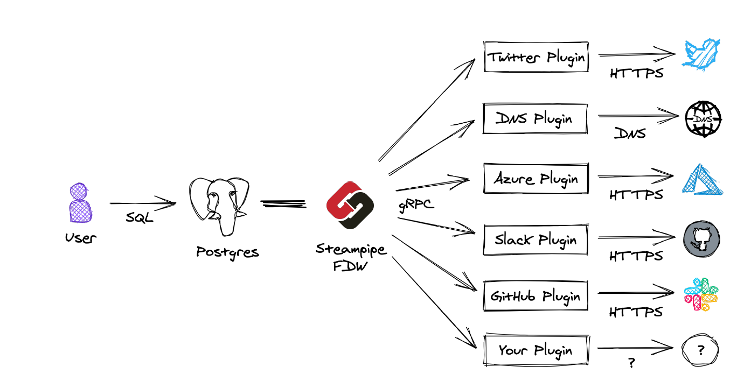
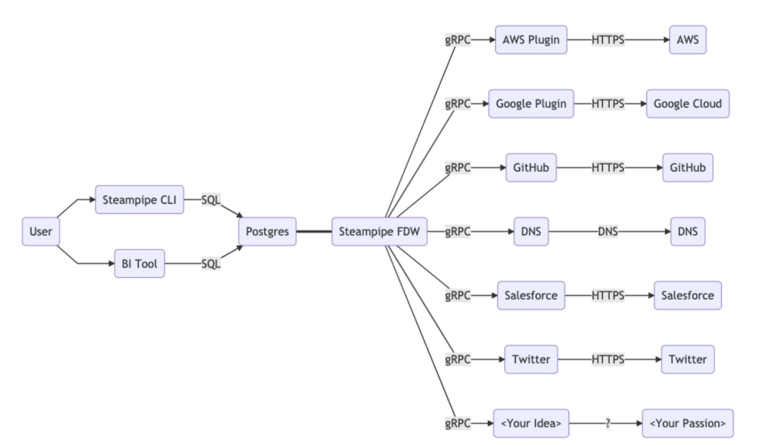
Steampipe – plugin framework with embedded PostgresSQL

Slide 10

Embedded PostgreSQL
each plugin corresponds to a database schema

Slide 11
Embedded PostgreSQL
each plugin corresponds to a database schema
each resource is exposed as a database view
data populated from external data source through foreign data wrapper
imap_message
gitlab_branch
{csv-file-name}
twitter_search_recent
azure_storage_blob
aws_ec2_instance

Slide 12
Under the hood
Steampipe leverages PostgreSQL Foreign Data Wrappers to provide a SQL interface to external services and systems.
Steampipe uses an embedded PostgreSQL database and you can use standard Postgres syntax to query Steampipe.
note: no data is persisted in Steampipe: every table access may correspond to one (or more) API calls
query results are cached for 5 minutes by default (configurable per data source)
select only columns actually needed. Do NOT use select *
[For non-key columns,] data for all rows must be collected, and then filtered
custom Steampipe plugins can be created and easily be integrated
Steampipe plugins are programmed in Go
Notes:
https://steampipe.io/docs/sql/querying-json

Slide 13
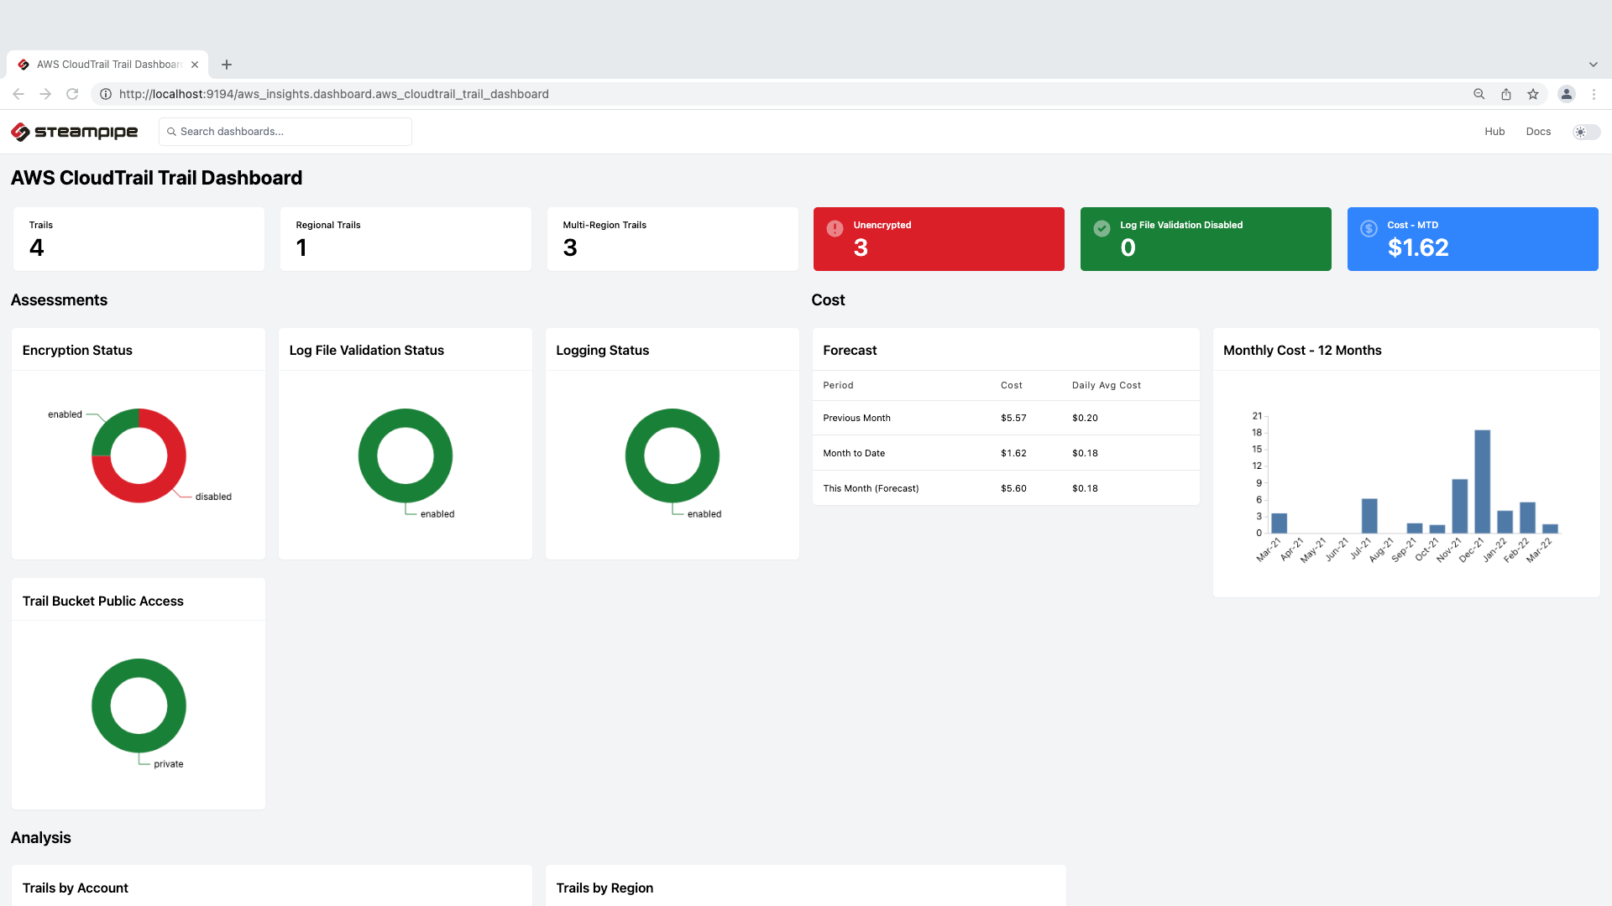
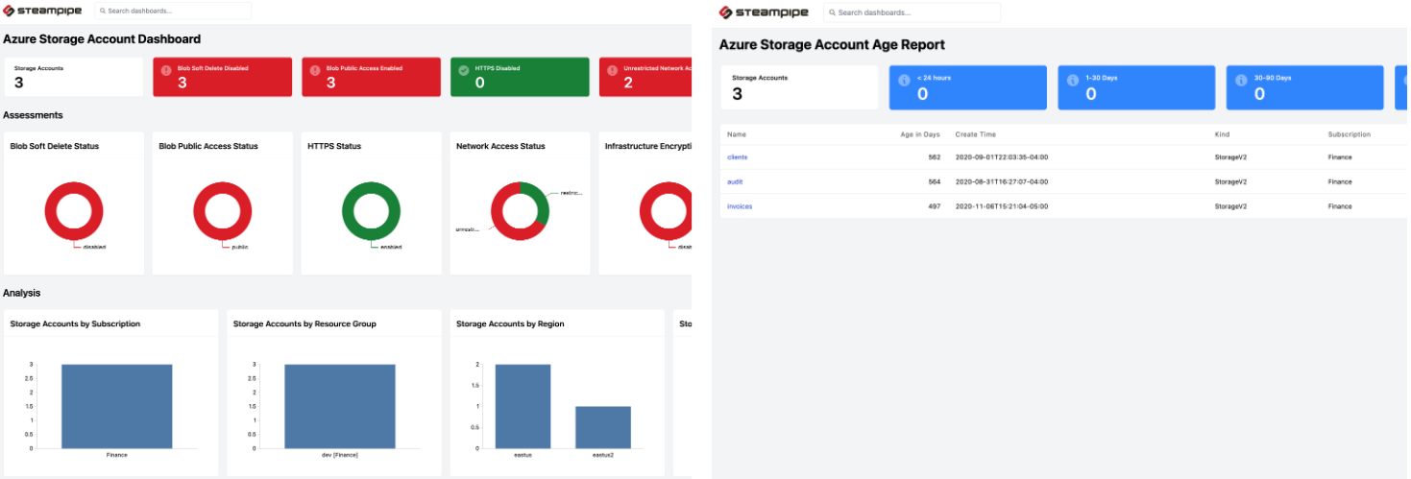
Steampipe Dashboards
Steampipe can run dashboards that consolidate and visualize results from Steampipe queries
Dashboards are defined in HCL (language of Terraform)
per element: define title, SQL query, type of widget, width
100s of predefined dashboards are available
Data can be downloaded from Dashboard
SQL queries can easily be copied from Dashboard
Queries can be parametrized – with values coming from user input UI elements – text or select (populated from SQL)

Slide 14
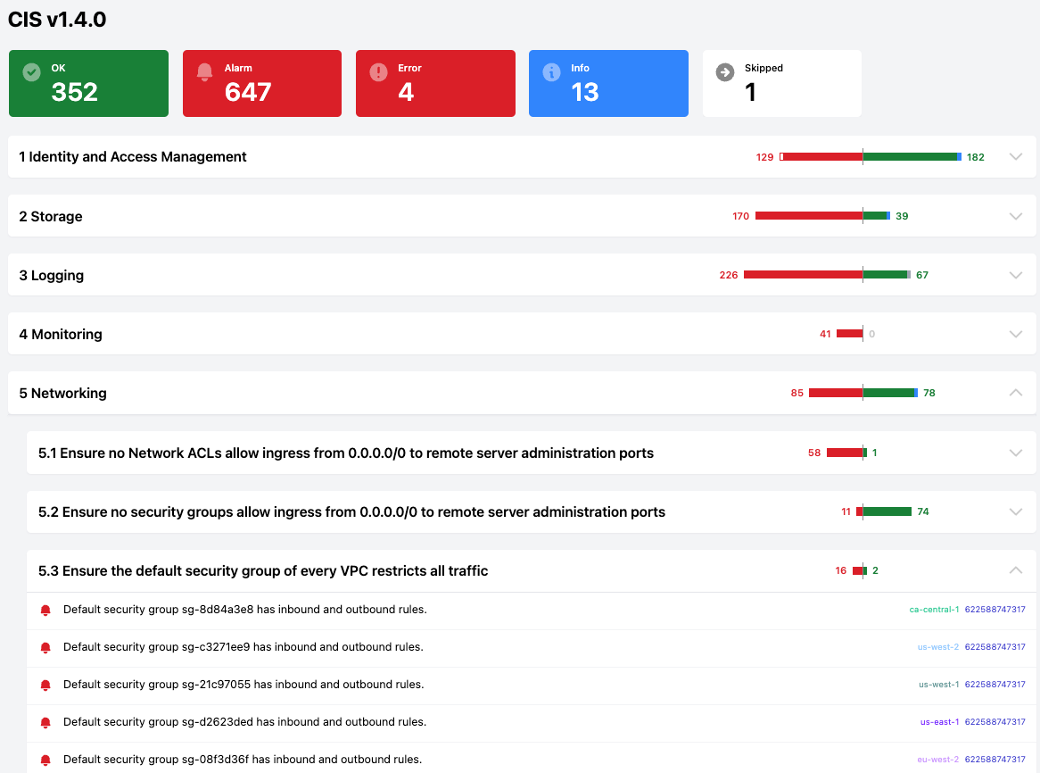
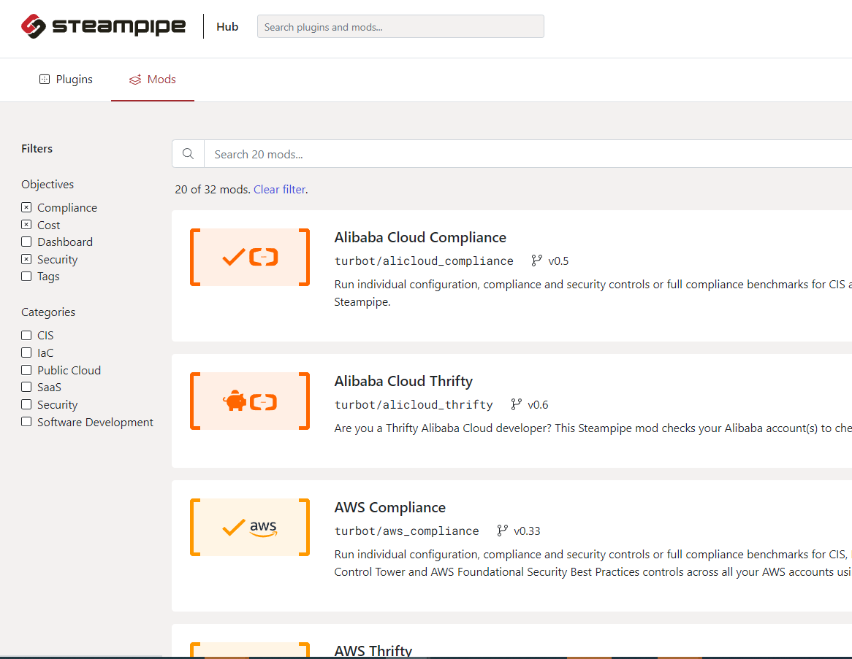
Steampipe Benchmarks & Controls
a generic mechanism for defining and running control frameworks such as CIS, NIST, HIPAA, etc, as well as your own customized groups of controls
simplified, consistent mechanism for defining, running, and returning output from disparate benchmark and control frameworks.
checks in the SQL results for violations of rules & recommendations
on security, cost control

Slide 15
Summary
steampipe.io
very convenient way of retrieving and combining resource (meta) data from many different sources
valuable for development and operations
not for runtime data retrieval in applications

