Slide 1
BIKESHARING USERS
Understanding the main differences between Cyclistic casual and member riders

Slide 2
AGENDA
Purpose
The case for casual riders during the year
The case for the rides of casual riders
How to increase the number of memberships

Slide 3
Purpose
Cyclistic users: members and casual riders
> 15k users/day
Goal: increase the number of members
Study: understand the differences between the casual riders and member riders
Notes:
Cyclistic is the main company that provides bike sharing services for the Cook County, that encompasses Chicago.
Cyclistic has on average more than 15,000 users daily, although the number of users and their profile varies with month, day of the week and hour of the day.
The users of Cyclistic are divided into two groups: members and casual riders.
To increase the profits, leadership concluded that we need to increase the number of members, because they bring more revenues than the casual riders.
I was assigned the task to answer the question: what is the difference between the members and casual riders?

Slide 4
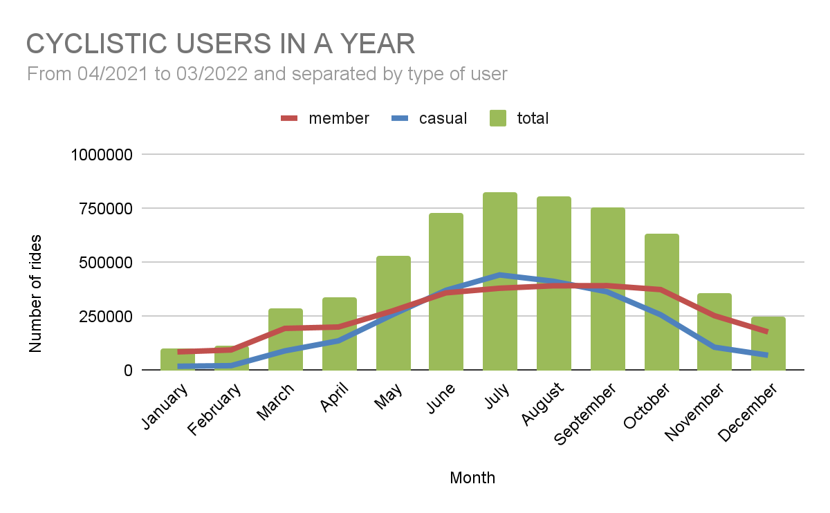
CASUAL RIDERS IN A YEAR
Casual riders peak in warmer months
Notes:
Member rides are the largest in the past 12 months, but the usage varies by month as shown in the chart.
Casual rides surpass the member rides from June to August. Also, casual members have a pretty low usage of the service during the Winter months.
Any marketing campaigns should focus in the Summer months

Slide 5
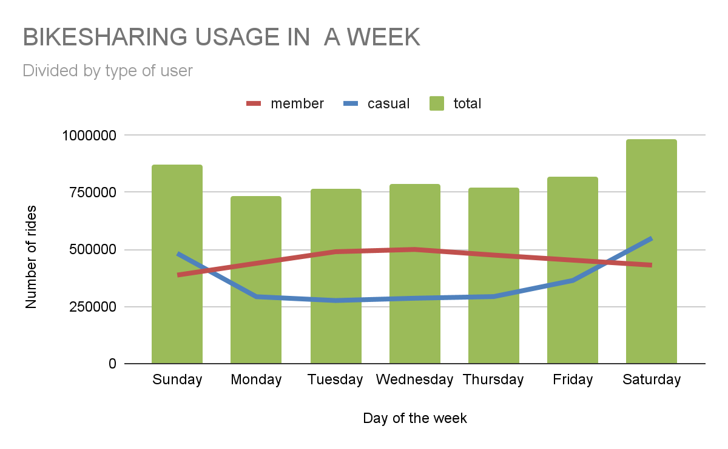
CASUAL RIDERS IN A WEEK
Weekends - peak of casual riders
Business days - peak of member riders
Notes:
Casual and member riders have a different usage in terms of the day of the week.
During the weekends, most of the rides are done by casual riders, as they peak and surpass members on Saturdays and Sundays.
Members have a slight peak during the business days, but the usage by members is sort of stable throughout the week.
One of the reasons is that casual riders use the bike to leisure unique activities while the members commute to work with the service.

Slide 6
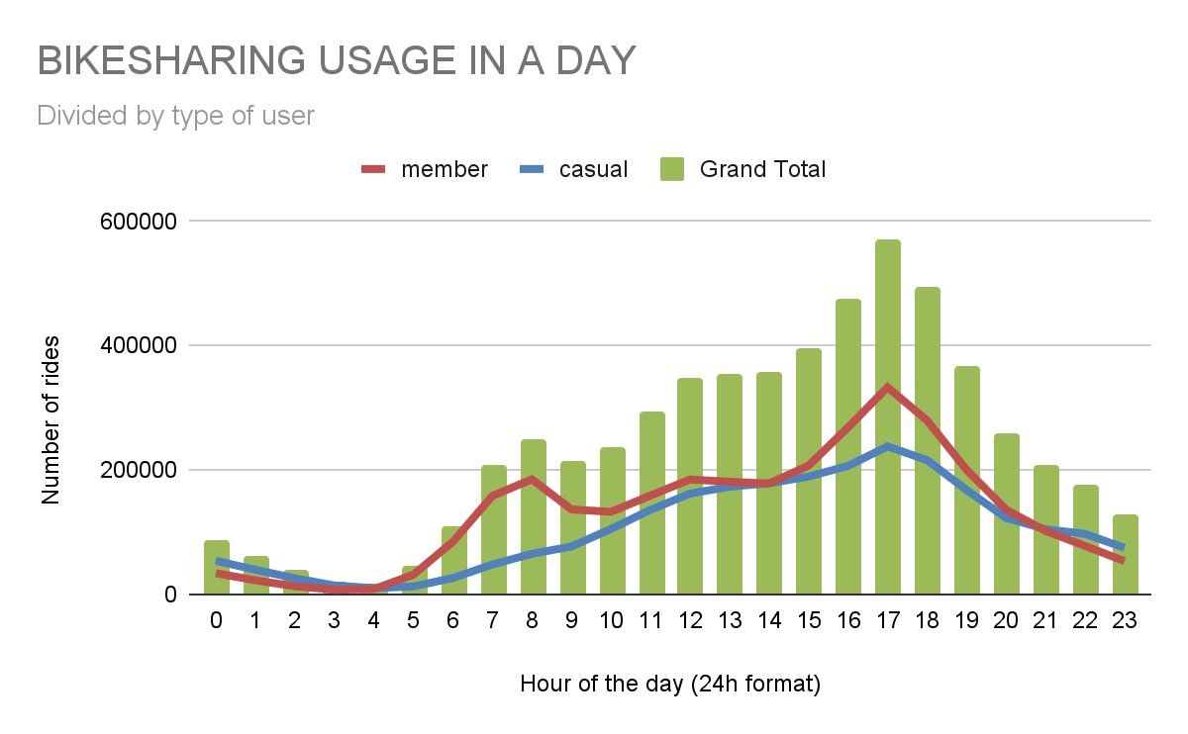
CASUAL RIDERS IN A DAY
Casual riders peak the use late afternoon
Member riders have two peaks: one in the morning and the second late afternoon
Notes:
In a day, the casual riders start increasing their usage in the morning to peak at the end of the business day (at 5pm).
Supporting the hypothesis that members users use the service for commute to work and back home, they have two peaks in an average day (at 8am and 5pm).
If you plot the data separated by day of the week, it is possible to observe that during the weekends, there is no morning peak for member riders as they show a very similar usage profile as the casual riders.

Slide 7
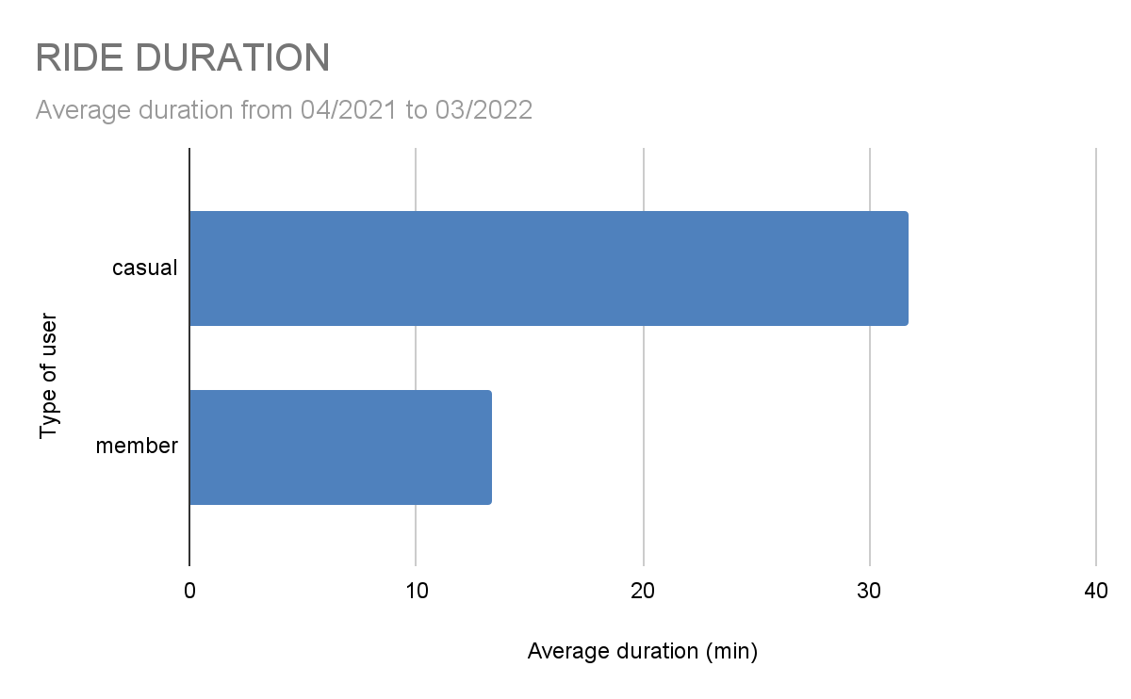
RIDE DURATION
Casual riders spend more time riding
Notes:
Casual riders spend on average ~ 31min using the service, while the members use for ~13min on average.
This behaviour is consistent for any month of the year, any day of the week, or any time of a day.

Slide 8
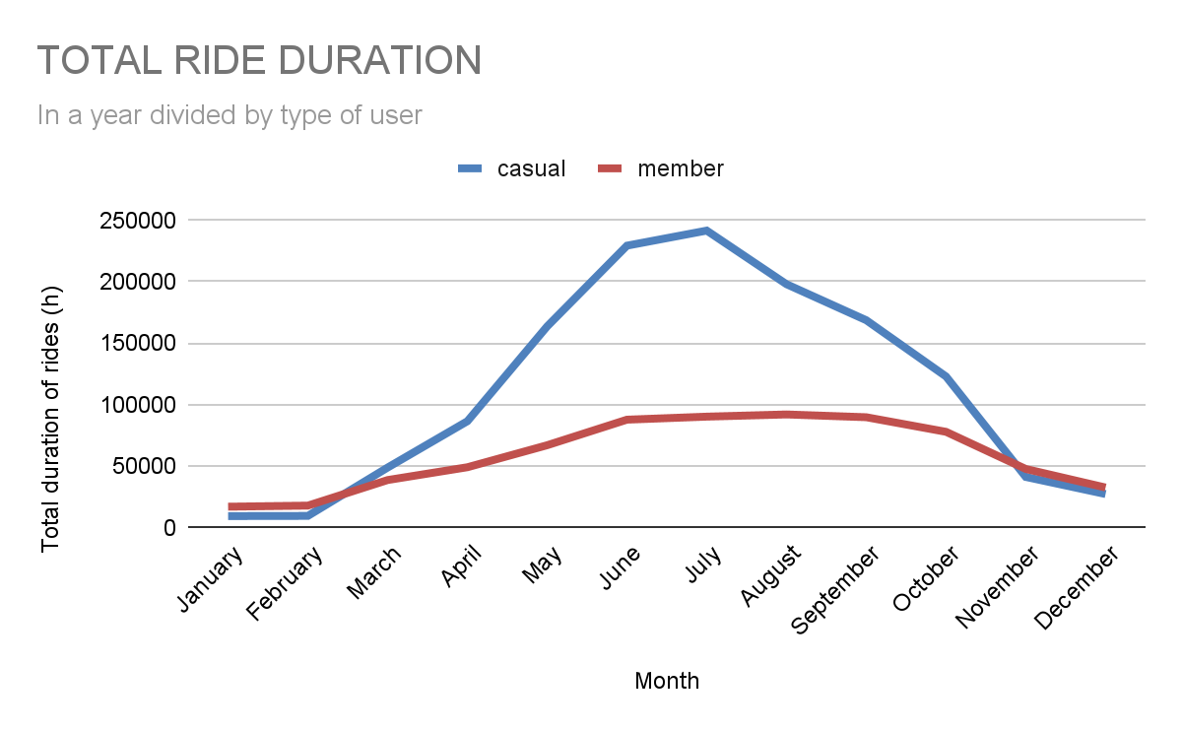
TOTAL RIDE DURATION
Casual riders prefer warmer months to ride
Notes:
During the winter, casual riders cycle less than members. However, the sum of the hours spent riding the bike in warmer months increases considerably as the casual riders spend 2.5x more time riding than the member riders. This behaviour is especially true during the weekends, but during the week, they spend a similar amount.

Slide 9
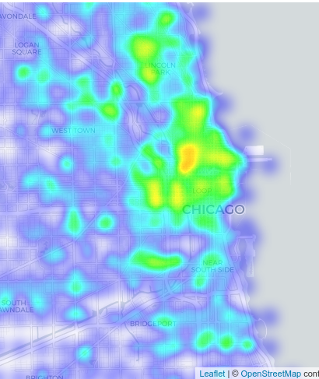
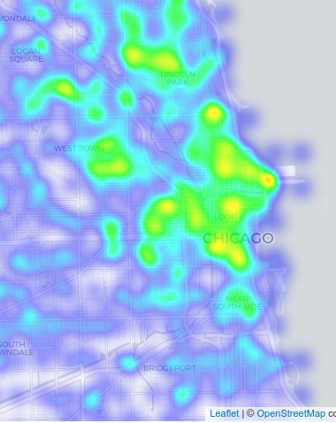
RIDING AREAS
Casual riders: concentrated on the shore front areas
Member riders: concentrated at the university area
members
casual riders
Notes:
The starting and ending stations differ between member and casual riders.
Casual riders are concentrated close to the navy pier, millenium park, lincoln park.
Member riders are concentrated mostly in the university area.
The 20 most used stations have been identified and can be used to decide advertisement locations.

Slide 10
ACTION! HOW TO INCREASE MEMBERSHIPS
Membership plans for warmer months; bigger discounts if you sign for the whole year
Advertisement campaigns during the Summer, especially in the areas close to the shore
Stands with promotional items in the most used stations during the weekends
Notes:
Since the casual riders seem to spend more time riding and it happens mostly during the summer months, it would be beneficial to have another type of membership that is focused on the warmer months (May to October), but if signing a annual membership, a bigger discount could be obtained.
A marketing campaign should be developed and be launched during the warmer months on the benefits of having a membership. The campaign should show images of people riding (in what would be a hour-long riding - calmly, relaxed, enjoying) in the areas that are most used by casual riders (navy pier, parks, shore front).
Since there is a concentration of casual riders during the weekends, promotional stands should be set up by the most used stations during the weekends. If signing for a plan, the new member would receive gifts.

Slide 11
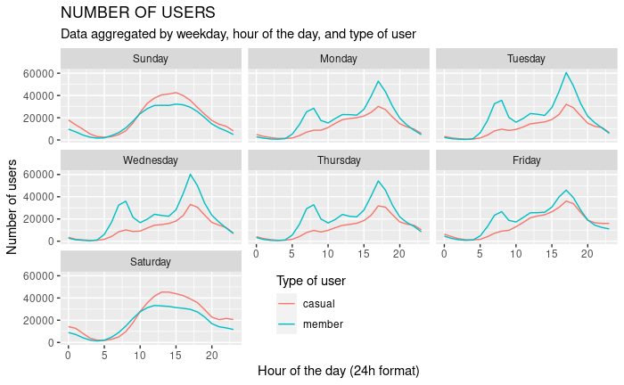
APPENDIX 1
Bikesharing for each day of the week

Slide 12
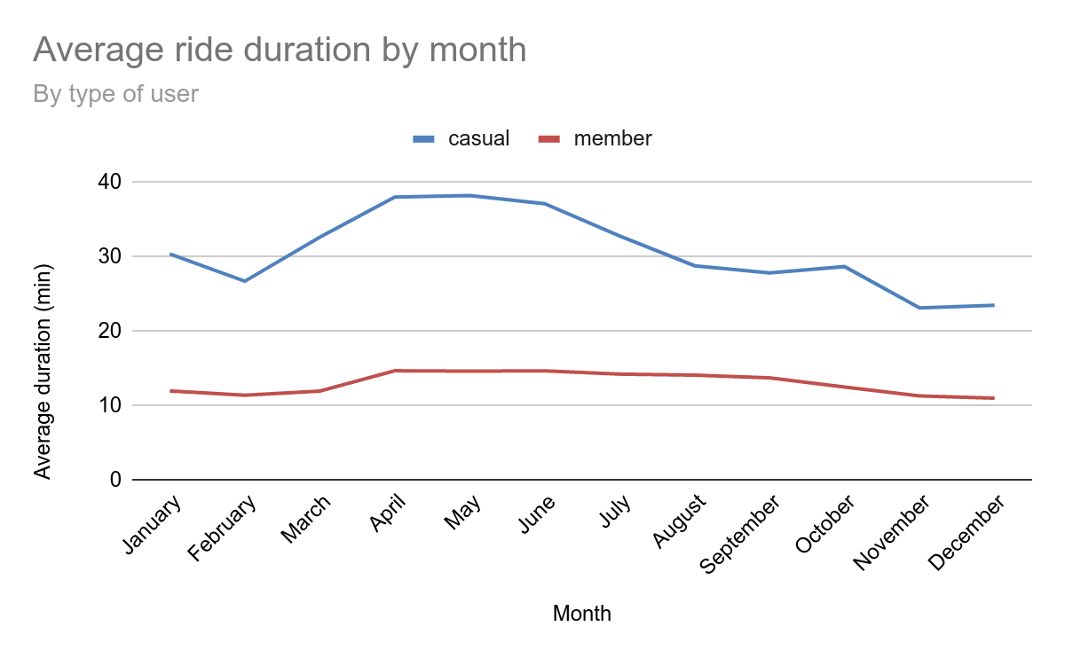
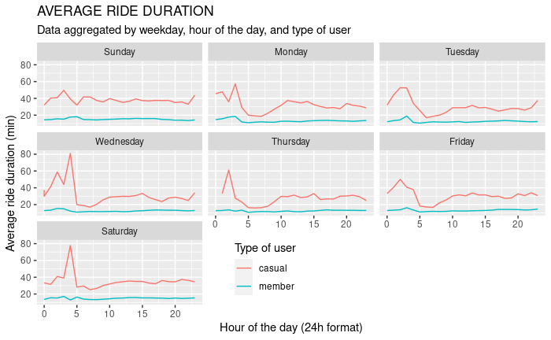
APPENDIX 2

Slide 13
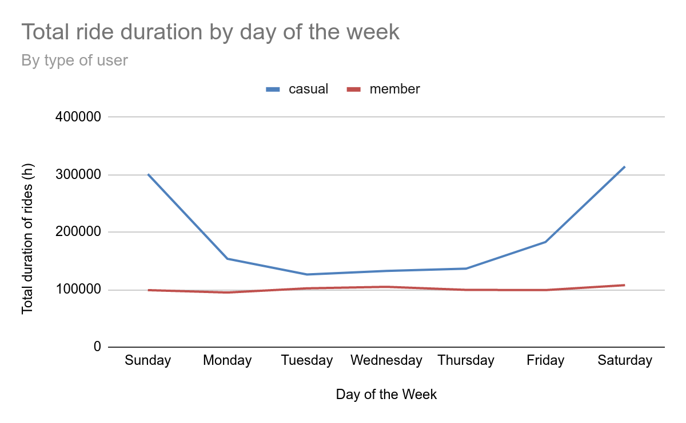
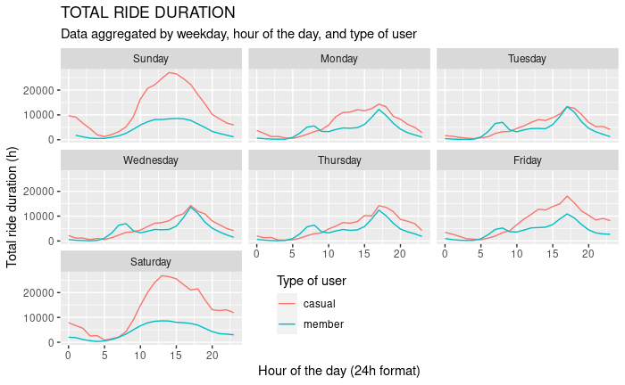
APPENDIX 3

Slide 14
APPENDIX 4
Stations - most used by casual | Number of riders
Streeter Dr & Grand Ave | 56277
Theater on the Lake | 17611
Millennium Park | 17331
Michigan Ave & Oak St | 17123
Lake Shore Dr & Monroe St | 14736
DuSable Lake Shore Dr & Monroe St | 14576
Wells St & Concord Ln | 14112
Clark St & Lincoln Ave | 13016
DuSable Lake Shore Dr & North Blvd | 12645
Stations - most used by members | Number of riders
No name (University area) | 35154
Clark St & Elm St | 18673
No name (University area) | 18477
Kingsbury St & Kinzie St | 17865
Wells St & Concord Ln | 17450
Wells St & Elm St | 15560
Broadway & Barry Ave | 13843
Dearborn St & Erie St | 13662
Streeter Dr & Grand Ave | 13650

