Slide 1

Sport Venue Tracker
Team: Luke Smith, Kyle McLeod, S. Rahman, Jeffin Kunnacherry, and Ernesto San Miguel

Slide 2
Viewing Sporting Events
Objective: Create Flask App designed to view sports events in the NFL, MLB, NBA, NHL, and MLS.

Slide 3
Intro
We present an exciting application designed to enhance your experience of attending professional sports events in the NFL, MLB, NBA, NHL, and MLS.
With our advanced features, you will be able to filter the map by specific criteria, such as league or sport, to customize your viewing experience.
Our goal is to create an interactive map that showcases the venues of all teams in these leagues, allowing you to track and explore their locations.

Slide 4


Technical Roadmap: Data Wrangling and Cleaning - Python
We begin by leveraging Kaggle Sports Stadium Locations dataset, extracting latitude and longitude information.
We then utilize Geoapify's Places API to fetch detailed venue data, including team name, latitude/longitude, and venue address.
By combining all the relevant data, we will create a comprehensive and structured dataframe for processing.

Slide 5
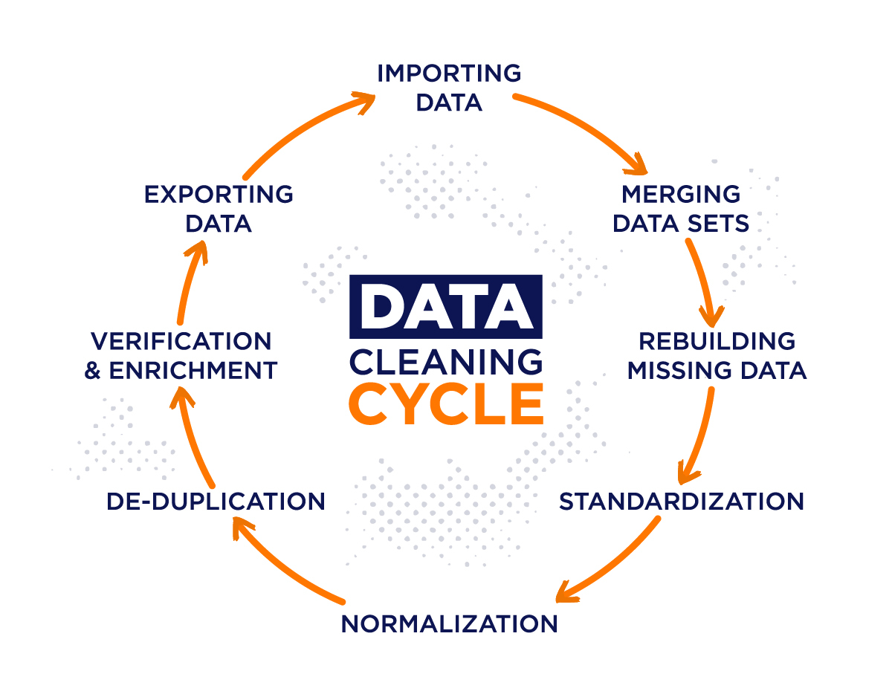

Slide 6
Technical Roadmap:
Map Build - JavaScript
With the Flask API set up, we proceed to build an interactive map using JavaScript.
Users can now explore the map, filter by specific criteria, and view information about any stadium they click on.
By leveraging Leaflet and GeoJSON technologies, we can seamlessly integrate the relevant data provided by the Flask API.
By implementing a Flask API in Python, we create a user-friendly application interface that presents a map, indicating each team's venue with distinguishable sport icons.

Slide 7
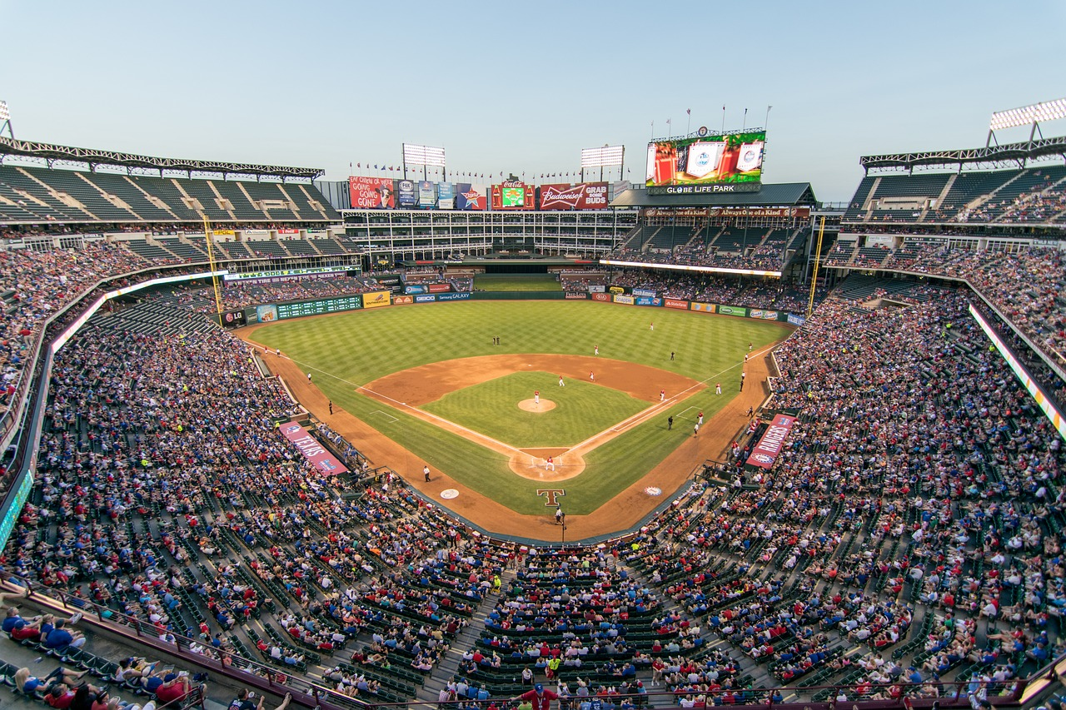
Technical Roadmap: MLB Batting and Pitching Data
To enhance the application's functionality, we incorporate MLB batting and pitching data.
This rich dataset, sourced from BaseballReference, allows us to analyze and derive valuable insights.

Slide 8
Machine Learning Model
01 By analyzing historical data and training the model, we aim to obtain insights into the potential home runs based on the teams and venues
02 We then incorporated a machine learning model to predict home run percentage based on the batting and pitching data obtained from Baseball-Reference.

