Slide 1
Statistical data analysis in R
Visiting professor
Viktor Ermakov

Slide 2
Lecture 11

Slide 3
Central limit theorem

Slide 4
In this lecture
1
Parameter vs. Statistic
Sampling distribution
Sampling from a Normal Distribution
Central limit theorem
The distribution of Student’s t statistic
The distribution of sample variance
Difference of independent sample means
Ratio of independent sample variances
2
3
4
5
6
7
8
Statistical data analysis in R. Viktor Ermakov – Visiting professor, UFSCar.

Slide 5
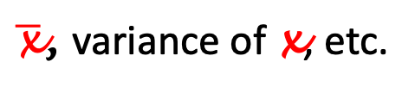
Parameter vs. Statistic
The purpose of statistical analysis is to make an inference about the population
x₁
Population
x₂
x₃
Experimental data
x₁
x₂
x₃
...
x_{n}
…
$\overline{\text{x}}$, variance of x, etc.
Statistic
x_{n}
unknown
f_{X}(x), 𝜇, 𝜎²
Parameter
Statistical data analysis in R. Viktor Ermakov – Visiting professor, UFSCar.
Notes:
The purpose of statistical analysis is to make an inference about the population.
﻿We are presented with a population about which we would like to learn. And while it would be desirable to examine every single member of the population, we find that it is either impossible or infeasible for us to do so, thus, we will only collect a sample instead.
The good sample is a sample that is representative of the population. A good way to achieve this is to sample randomly ﻿the population.
﻿When we have collected a random sample, the next task is to make some sense out of the experimental data.
﻿We summarize the data set with a descriptive statistic, a quantity calculated from the data like mean, median, mode, variance etc. But let's don't forget that our sample was random. . .
Remember that our population has a probability distribution associated with it, as well as mean and variance.
Each value associated with the whole population is called a PARAMETER, where as the value associated with our experimental data is called STATISTIC.
﻿The true value of a population parameter is an unknown constant. It can be
correctly determined only by a complete study of the population. But when it is impossible or practically not feasible we will use the concepts of statistical inference.

Slide 6


Parameter vs. Statistic
Every statistic is a random variable
numerical value of a statistic can’t give the exact value of the parameter
observed value of statistic depends on a particular sample
value of statistic vary with each new sample
Population
$$\overline{\text{x}}$$
=
𝜇
x₁
x₂
x₃
...
x_{n}
Statistical data analysis in R. Viktor Ermakov – Visiting professor, UFSCar.
Notes:
﻿Note that every statistic is a random variable. The statistic must serve as our source of information about the value of a parameter. There are three important points:
1. Because a sample is only a part of the population, the numerical value of a statistic cannot be expected to give us the exact value of a parameter
2. ﻿The observed value of a statistic depends on the particular sample that happens to be selected.
3. There will be some variability in the values of a statistic over different occasions of sampling.

Slide 7
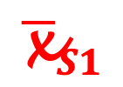
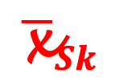
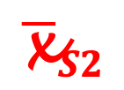
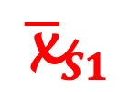
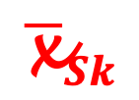
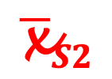
Sampling distribution of a statistic
$$\overline{\text{x}}S1$$
$$\overline{\text{x}}S2$$
…,
$$\overline{\text{x}}Sk$$
- random variable
,
,
x₁
Population
Sampling distribution
x₂
Sample 1
x₁
x₂
x₃
...
x_{n}
⇒
$$\overline{\text{x}}S1$$
Normal distribution
Z – distribution
t – distribution
𝞆² – distribution
F – distribution
...
x_{n}
⇒
$$\overline{\text{x}}S2$$
x₃
Sample 2
x₁
x₂
x₃
…
…
…
Sample k
x₁
x₂
x₃
...
x_{n}
⇒
$$\overline{\text{x}}Sk$$
x_{n}
Population distribution f_{X}(x)
Statistical data analysis in R. Viktor Ermakov – Visiting professor, UFSCar.
Notes:
﻿When we are interested in study about the population we start with getting a sample.
As I said before, the sample should be representative of the population. ﻿The fact that the value of the sample mean, or any other statistic, will vary with the sampling process is a key concept.
What if we repeat the process and get another sample?
And then another one or even many samples? Of cause we can join them to get one big sampl. But here I want to show what will happen with statistic of many samples from the same population.
Because any statistic and the sample mean in particular, varies from sample to sample, it is a random variable and has its own probability distribution.
The probability distribution associated with the population from which we sample is called the POPILATION DISTRIBUTION, and the probability distribution associated with our statistic is called its SAMPLING DISTRIBUTION. Clearly, the two are interrelated. To learn about the population distribution, it is imperative to know everything we can about the sampling distribution.
The statistic not only represent a mean, but can represent variance or standard deviation, or even difference of two means or ratio of two variances of two different populations. Depending on the statistic we can expect it to be a normal distribution, Z-distribution, t-distribution or chi-square distribution. These distributions are the most common ones.

Slide 8

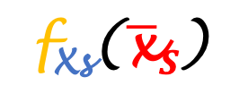

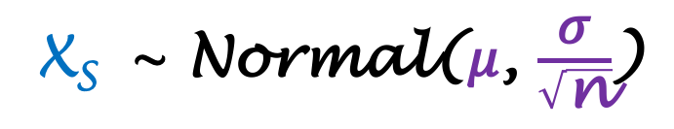
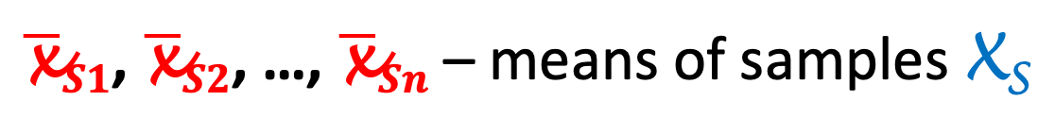
Sampling from a Normal distribution
$\overline{\text{x}}S1$, $\overline{\text{x}}S2$, …, $\overline{\text{x}}Sn$ – means of samples X_{S}
-?
Population
X_{S} ~ Normal(𝜇, $\frac{\text{σ}}{\sqrt{\text{n}}}$)
X ~ Normal(𝜇, 𝜎)
f(x)
f_{X}(x, 𝛍, 𝛅)
f_{Xs}($\overline{\text{x}}S$, 𝜇, $\frac{\text{σ}}{\sqrt{\text{n}}}$)
𝜎 = sd(x_{S})
x
𝛍
$$\overline{\text{x}}S$$
f_{X}(x)
=
f_{Xs}($\overline{\text{x}}S$)
Statistical data analysis in R. Viktor Ermakov – Visiting professor, UFSCar.
Notes:
Let's look on one specific and very common case when the population has a normal distribution with parameters mu and sigma.
Imagine, that we draw a lot of samples. We can analyze these samples and find the statistic for each one. The most common and practically useful information is to know the distribution of means of samples.
In other words, we are interested in the sampling distribution of means.
It turns out that the sampling distribution of means will be also normal with mean equal to the mean of the population and variance equal to the variance of the population divided by the number of observations. In our case N.
Let's see, how it can be represented on the graph. This green normal distribution represents the population distribution with parameters mu and sigma.
The yellow one, that is below, represents the distribution of means of sample. Now, they are equal and it corresponds to the case when we have only one observation in each sample.
But when we have more than one observation, the yellow distribution squeezes as a square root of N - the number of observations. Thus, the more observations we have, more precisely we determine the population mean using our statistic. This is an important result for the determination of population mean, confidence interval and hypothesis test.
In this conclusion, it is assumed that we know the standard deviation of the population. In reality, it is only an approximation using the standard deviation of the sample. They assumed to be equal when the sample size is big.
From this graph you see that the population distribution and sampling distribution are not the same thing.

Slide 9

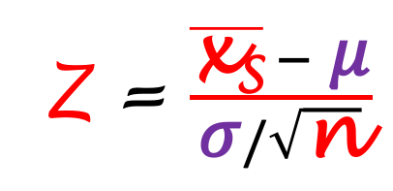


Central limit theorem
$\overline{\text{x}}S1$, $\overline{\text{x}}S2$, …, $\overline{\text{x}}Sn$ – means of samples X_{S}
-?
Population
﻿Whatever the population,
the distribution of X_{S} is
approximately normal
when n is large.
X ~
ANY
(𝜇, 𝜎)
Normal
f(x)
f_{Xs}($\overline{\text{x}}S$, 𝜇)
Z = $\frac{\overline{\text{x}\text{S}} − \text{μ}}{\text{σ}/\sqrt{\text{n}}}$
f_{X}(x, 𝜇)
x
𝛍
$$\overline{\text{x}}S$$
Statistical data analysis in R. Viktor Ermakov – Visiting professor, UFSCar.
Notes:
Let's see now, how can we generalize the concept of normally distributed sample means when the underlying distribution is not normal but any distribution, even a discreet one?
The question is, what will happen with the sample means in this case?
And the answer on this question is given by the Central limit theorem.
Central limit theorem gives a surprising result. It states that ﻿whatever the population, the distribution of means is approximately normal when N is large.
Let's see what it means. Imagine, that we are studying a process that has an exponential distribution with mean equal to mu. The exponential distribution is very asymmetric and doesn't look like a normal curve at all. But for the sampling distribution of means the shape of the population distribution doesn't matter.
The Central limit theorem says that means of samples will be distributed normally with the mean equal to the mean of the population.
﻿﻿We can even normalize this normal distribution to be standard normal distribution with mean equal to 0 and standard deviation equal to 1, or so called Z-distribution using this operation.

Slide 10
Central limit theorem
﻿What means “large” n ?
The shape of the underlying population distribution plays a role:
﻿Whatever the population,
the distribution of X_{S} is
approximately normal
when n is large.
approximately symmetric
samples may need to be only of size four or five
highly skewed or heavy-tailed
samples may need to be much larger
Regardless, for a given population distribution (with finite standard deviation) the approximation tends to be better for larger sample sizes.
n > 30
Statistical data analysis in R. Viktor Ermakov – Visiting professor, UFSCar.
Notes:
﻿The Central limit theorem states that the number of observations N should be large. But what it means a large N?
It is here that the shape of the underlying population distribution plays a role.
For populations with distributions that are approximately symmetric and mound-shaped, the samples may need to have only 4-5 observations,
while for highly skewed or heavy-tailed populations the samples may need to be much larger for the distribution of the sample means to begin to show a bell-shape.
Regardless, for a given population distribution (with finite standard deviation) the approximation tends to be better for larger sample sizes.
And if you want a simple answer on the question how large N should be, it is commonly accepted that N must be greater than 30.

Slide 11
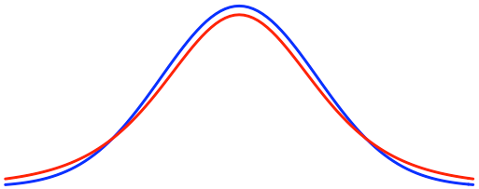
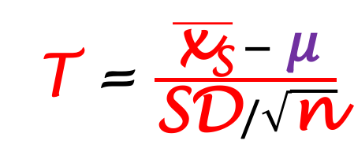
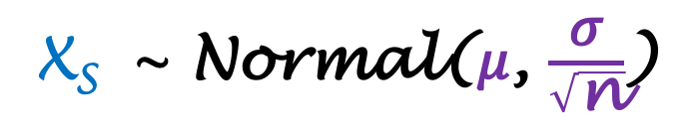

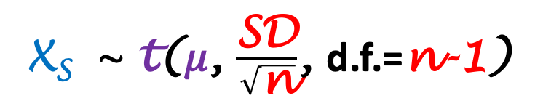
The distribution of Student’s t statistic
$\overline{\text{x}}S1$, $\overline{\text{x}}S2$, …, $\overline{\text{x}}Sn$ – means of samples X_{S}
-?
Population
When n is
large
small
⇒
𝜎 = sd(x_{S})
SD = sd(x_{S})
n > 30
n < 30
X_{S} ~ t(𝜇, $\frac{\text{SD}}{\sqrt{\text{n}}}$, d.f.=n-1)
X ~ Normal(𝜇, 𝜎)
X_{S} ~ Normal(𝜇, $\frac{\text{σ}}{\sqrt{\text{n}}}$)
f(x)
Z
T = $\frac{\overline{\text{x}\text{S}} − \text{μ}}{\text{SD}/\sqrt{\text{n}}}$
t(d.f.=5)
x
$$\overline{\text{x}}S$$
Statistical data analysis in R. Viktor Ermakov – Visiting professor, UFSCar.
Notes:
Central limit theorem describes distribution of sample means in a case of any population distribution with the large number of observations. In this case we can not only precisely define the population mean but even a population distribution by doing a distribution fitting, for example.
But what if we have only a few observations but we certain that the population distribution is normal. If we have only a small sample we don't know neither distribution mean nor variance yet.
When the number of observations is large we approximate population variance with sample variance. In this case, the sample distribution is normal with mean mu and standard deviation sigma over square root of N.
But when N is small we can not do that. We still will use the standard deviation of the sample, but the sampling distribution will no longer be normal but rather it will be a t-distribution with parameters mu and sample standard deviation over the square root on N. It has one more parameter that is called degrees of freedom that is equal to the number of observations minus one.
Graphically the t-distribution is very similar to the Z-distribution that is standard normal with mean 0 and standard deviation 1. See, how close to each other Z-distribution plotted in blue and t-distribution with degree of freedom equal to 5 in red.
In the case of a normal population and small number of observations we will calculate not a Z-score but a T-score using a similar formula.

Slide 12
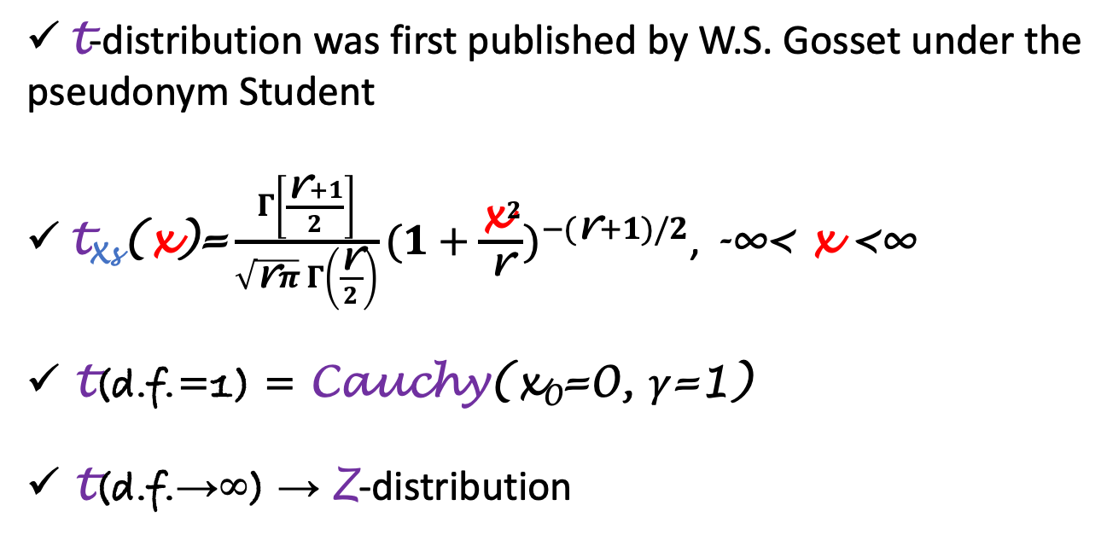
The distribution of Student’s t statistic
﻿ t-distribution was first published by W.S. Gosset under the pseudonym Student
$\text{t}\text{X}\text{s}\text{(}\text{x}\text{)}\text{=}\frac{Γ\left[\frac{\text{r}+1}{2}\right]}{\sqrt{\text{r}π} Γ\left(\frac{\text{r}}{2}\right)}{(1+\frac{{\text{x}}^{2}}{\text{r}})}^{−(\text{r}+1)/2}$, -∞< x <∞
t(d.f.=1) = Cauchy(x₀=0, 𝛾=1)
t(d.f.→∞) → Z-distribution
Population
X ~ Normal(𝜇, 𝜎)
Statistical data analysis in R. Viktor Ermakov – Visiting professor, UFSCar.
Notes:
﻿This distribution was first published by William Gosset under the pseudonym Student, and the distribution has consequently come to be known as Student’s t distribution.
﻿The probability density function of T-distribution takes this form. ﻿Any random variable X with this distribution is said to have Student’s t distribution with r degrees of freedom.
﻿There are a few things to note about the t-distribution. The t-distribution with degrees of freedom equal to 1 is the same as the Cauchy distribution with location parameter equal to 0 and scale parameter equal to 1. The Cauchy distribution is rather pathological and is a counterexample to many famous results.
As the number of observations increases, that we can express as degrees of freedom tend to infinity, the t-distribution approaches the standard normal distribution.

Slide 13
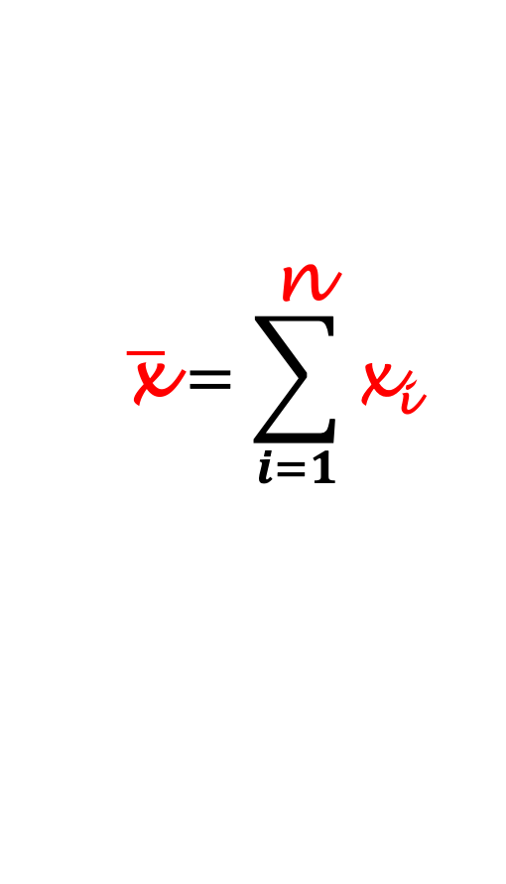
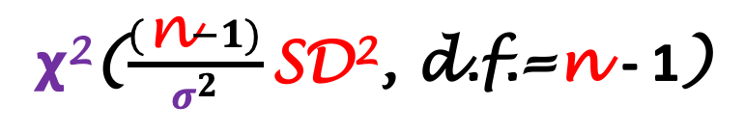
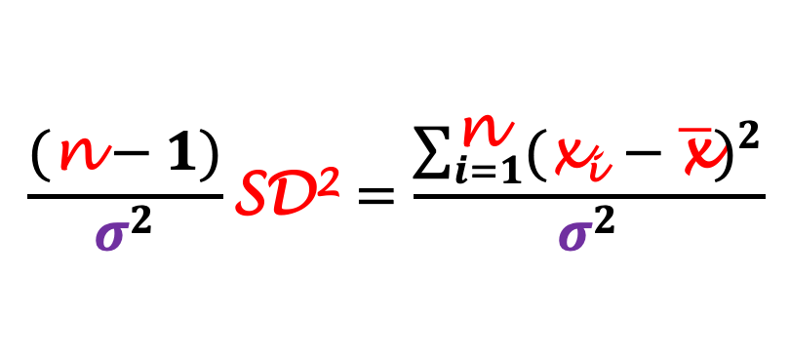
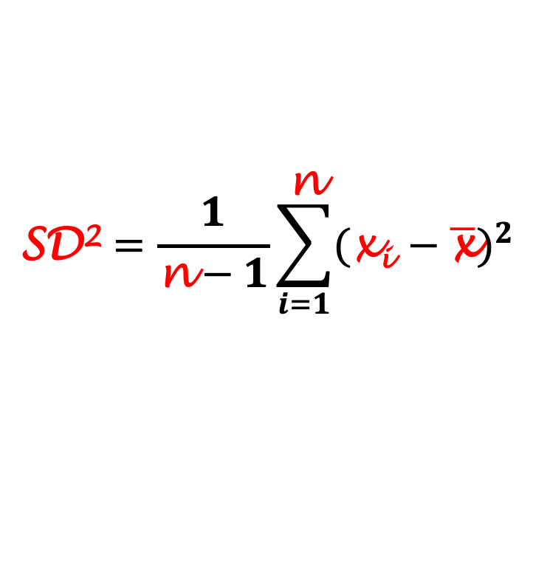
The distribution of sample variance
$$\overline{\text{x}}=\sum_{i=1}^{\text{n}}{\text{x}\text{i}}$$
Population
Sample
x₁
x₂
x₃
...
x_{n}
⇒
$$\text{SD}\text{2}=\frac{1}{\text{n}−1}\sum_{i=1}^{\text{n}}{{(\text{x}\text{i} −\overline{\text{x}})}^{2}}$$
X ~ Normal(𝜇, 𝜎)
$$\frac{(\text{n}−1)}{σ^{2}}\text{SD}\text{2}=\frac{\sum_{i=1}^{\text{n}}{{(\text{x}\text{i} −\overline{\text{x}})}^{2}}}{σ^{2}}$$
𝞆²($\frac{(\text{n}−1)}{σ^{2}}\text{SD}\text{2}$, d.f.=n - 1)
⇒
Statistical data analysis in R. Viktor Ermakov – Visiting professor, UFSCar.
Notes:
Before this moment we only were talking about the statistic that describes the sample mean. Let's now talk about the distribution of sample variance when the population is normal. Having a sample we can calculate its mean. And we know that the sampling distribution of means is a normal distribution in this case.
We also can calculate the variance of the sample using this formula. The question is what is the sampling distribution of the variance?
But before, we need to do some operations. We need to divide both parts by the population variance and multiply by the degrees of freedom.
In this form, the normalized sampling distribution of variance has a chi-square distribution with degrees of freedom equal to the number of observations minus one, as usual. This is an important distribution when it comes to the estimation of confidence interval of the variance and hypothesis test.

Slide 14

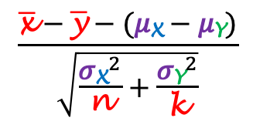
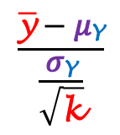
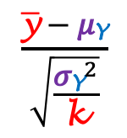
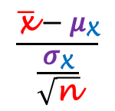
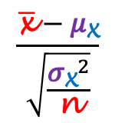
Difference of independent sample means
Sample X
x₁
x₂
x₃
...
x_{n}
Population X
$$\frac{\overline{\text{x}}−\text{μ}\text{X}}{\frac{\text{σ}\text{X}}{\sqrt{\text{n}}}}$$
$$\frac{\overline{\text{x}}−\text{μ}\text{X}}{\sqrt{\frac{{\text{σ}\text{X}}^{2}}{\text{n}}}}$$
Population
Z =
=
f(x)
X ~ Normal(𝜇_{X}, 𝜎_{X})
Z
$$\frac{\overline{\text{x}}−\overline{\text{y}}−(\text{μ}\text{X}−\text{μ}\text{Y})}{\sqrt{\frac{{\text{σ}\text{X}}^{2}}{\text{n}}+\frac{{\text{σ}\text{Y}}^{2}}{\text{k}}}}$$
f_{X}(x, 𝜇_{Y}, 𝜎_{Y})
Z =
Population Y
f_{Y}($y$, 𝜇_{Y}, 𝜎_{Y})
$$\frac{\overline{\text{y}}−\text{μ}\text{Y}}{\frac{\text{σ}\text{Y}}{\sqrt{\text{k}}}}$$
$$\frac{\overline{\text{y}}−\text{μ}\text{Y}}{\sqrt{\frac{{\text{σ}\text{Y}}^{2}}{\text{k}}}}$$
Z =
=
Y ~ Normal(𝜇_{Y}, 𝜎_{Y})
-3
-2
-1
0
𝛍_{X}
x
𝛍_{Y}
1
2
3
...
y_{k}
Sample Y
y₁
y₂
y₃
Statistical data analysis in R. Viktor Ermakov – Visiting professor, UFSCar.
Notes:
Until this moment we only were talking about one population.
But what if we have two populations? The most simple case if both populations are normally distributed. One with mean mu x and sigma x and another with mu y and sigma y.
Now we have to do double work because we need to collect and analyze two independent samples - X and Y. In general we, may have different number of observations - N observations of sample X and K observations of sample Y.
We know how to calculate Z-score of the sample X and the same is true for the sample Y.
We can combine these two expressions by subtracting one from another. And it also will follow the Z-distribution.
Let's see, how it will look on the graph.
We may have population X normally distributed over the mean mu X and population Y normally distributed with mean mu Y. These distributions also may have different widths.
But the sampling distribution of means differences of these two normal distributions will be standard normal with mean o and standard deviation 1. ﻿Even if the distribution of one or both of the samples is not normal, the distribution of means differences will still be approximately normal provided that both sample sizes are large. This case is important in hypothesis test when we need to see if two samples are from the same population.

Slide 15
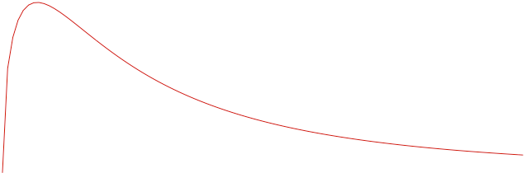


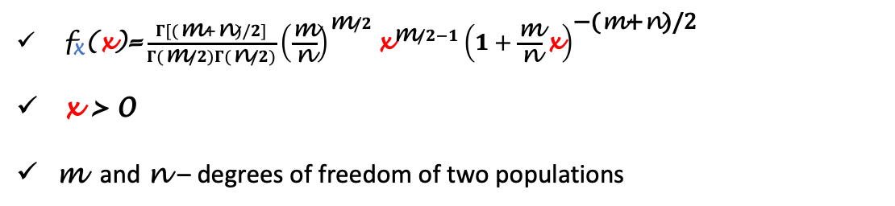
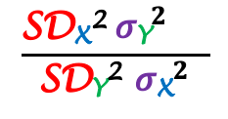
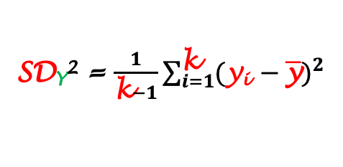
Ratio of independent sample variances
Sample X
x₁
x₂
x₃
...
x_{n}
Population X
SD_{X}² = $\frac{1}{\text{n}−1}\sum_{i=1}^{\text{n}}{{(\text{x}\text{i} −\overline{\text{x}})}^{2}}$
X ~ Normal(𝜇_{X}, 𝜎_{X})
$\text{f}\text{X}\text{(}\text{x}\text{)}\text{=}\frac{Γ[(\text{m}+\text{n})/2]}{Γ(\text{m}/2)Γ(\text{n}/2)}{\left(\frac{\text{m}}{\text{n}}\right)}^{\text{m}/2}{\text{x}}^{\text{m}/2−1}{\left(1+\frac{\text{m}}{\text{n}}\text{x}\right)}^{\text{−(}\text{m}\text{+}\text{n}\text{)/2}}$
x > 0
m and n – degrees of freedom of two populations
$$\frac{\text{SD}\text{X}\text{2} {\text{σ}\text{Y}}^{2}{}^{}}{\text{SD}\text{Y}\text{2} {\text{σ}\text{X}}^{2}}$$
F =
Population Y
f_{X}(x)
SD_{Y}² = $\frac{1}{\text{k}−1}\sum_{i=1}^{\text{k}}{{(\text{y}\text{i} −\overline{\text{y}})}^{2}}$
Y ~ Normal(𝜇_{Y}, 𝜎_{Y})
Sample Y
y₁
y₂
y₃
...
y_{k}
x
$$0$$
Statistical data analysis in R. Viktor Ermakov – Visiting professor, UFSCar.
Notes:
Now, that we've seen the sampling distribution of differences of two means, let's see how the sample variances of two normally distributed populations are related to one another. We may calculate variances for both samples.
And then look on their ratio. In such a form this ratio has the F-distribution.
Here is the probability density function of the F-distribution.
It has a support on positive values of X.
And it takes two parameters M and N that are degrees of freedom of both samples.
The F-distribution is very asymmetric and right-skewed. This distribution is important when we do hypothesis test of the ratio of population's variances.

Slide 16
In this lecture
1
Parameter vs. Statistic
Sampling distribution
Sampling from a Normal Distribution
Central limit theorem
The distribution of Student’s t statistic
The distribution of sample variance
Difference of independent sample means
Ratio of independent sample variances
2
3
4
5
6
7
8
Statistical data analysis in R. Viktor Ermakov – Visiting professor, UFSCar.

