Slide 1
Statistical data analysis in R
Visiting professor
Viktor Ermakov

Slide 2
Lecture 12

Slide 3
Statistical inferences

Slide 4
In this lecture
1
Forms of inference
Drawing inference about population mean
Drawing inference about population variance
Hypothesis tests
p-value
2
3
4
5
Statistical data analysis in R. Viktor Ermakov – Visiting professor, UFSCar.

Slide 5
Forms of inference
Population
The purpose of statistical analysis is to make an inference about the population
Sample
x₁
x₂
x₃
...
x_{n}
outliers
boxplot(x)
sd(x)
hist(x)
var(x)
mean(x)
Statistical inference
is the process of using data analysis
to deduce properties of an underlying distribution of probability
Statistical data analysis in R. Viktor Ermakov – Visiting professor, UFSCar.
Notes:
Remember that the purpose of statistical analysis is to make an inference about the population.
Inferences are generalizations about a population that are made on the basis of a sample collected from the population.
This generalization is called Statistical inference.
We know how to do descriptive statistics, calculate mean, make histograms or detect outliers. We also know that statistics that we compute from the sample are random variables that have their own sampling distributions. Knowing the sampling distribution and statistics we can generalize about the population.
But let’s move from descriptive statistics to inferential.
Let’s give a definition for the statistical inference. Statistical inference is the process of using data analysis to deduce properties of an underlying distribution of probability

Slide 6


Forms of inference
Population
𝜇
- !
There are two main form of inference:
- ?
estimation of population parameter
𝜎²
- !
- ?
testing of statistical hypothesis
2020
1990
h=158 cm
h=158 cm?
Statistical data analysis in R. Viktor Ermakov – Visiting professor, UFSCar.
Notes:
There are two main form of inferences: estimation of population parameter and testing of statistical hypothesis.
﻿The true value of a parameter is an unknown constant that can be correctly found only by an exhaustive study of the population, if indeed that were possible. Our objective may be to obtain a guess or an estimate of the unknown true value along with a determination of its accuracy.
This type of inference is called estimation of parameters.
Another situation is that we may have some information about the parameters. Then our sample will allow us to check if this information is true by stating and checking a statistical hypothesis.
And this method of inference is called testing of statistical hypothesis.
For example, imagine that we've red an issue of National Geographic from 1990 and figured out that a study revealed that average women’s height in Brazil was 158 cm.
But is it still true nowadays? In this case, it seems like we know the population mean but we need check is it still true?

Slide 7



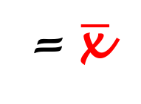

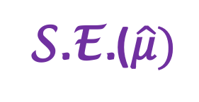
Forms of inference
Population
𝜇
- !
- ?
estimation of population parameter
𝜎²
- !
Point estimation
Interval estimation
- ?
$$\hat{\text{μ}}$$
= $\overline{\text{x} }$
x
Estimator
Standard error
x
𝜇
S.E.($\hat{\text{μ}})$
𝜇
single numerical value`
interval of plausible values
Statistical data analysis in R. Viktor Ermakov – Visiting professor, UFSCar.
Notes:
Let's talk in more details about estimation of population parameter.
There are two types of estimations - one is point estimation and another one is interval estimation. Here I depicted the estimation of the population mean.
Result of the point estimation is a single numerical value and this kind of estimation is very easy to do. Interval estimation defines the interval of plausible values.
﻿This single number of point estimation is likely to be close to the unknown value of the parameter. ﻿A statistic intended for estimating a parameter is called a point estimator, or simply an estimator. ﻿The standard deviation of an estimator is called its standard error.
It is usually denoted as S.E. in this case of mu, and estimator is denoted by the hat.
﻿When we estimate a population mean from a random sample, perhaps the most intuitive estimator is the sample mean.

Slide 8
Forms of inference
Population
testing of statistical hypothesis
𝜇
- !
- ?
Statistical hypothesis
- a statement about population
𝜎²
- !
- ?
Null hypothesis
H₀
: 𝜇 = 158 cm
1990
f(x)
f_{X}(x, 𝛍, 𝛅)
Alternative hypothesis
H₁
or
H_{a}
h=158 cm
H₀: 𝜇 = 158 cm
H₁: 𝜇 = 158 cm
H₁: 𝜇 > 158 cm
H₁: 𝜇 < 158 cm
x
158 cm
Statistical data analysis in R. Viktor Ermakov – Visiting professor, UFSCar.
Notes:
Now, let's talk a little bit more about testing of statistical hypothesis.
As we already seen, in this case we may know the parameter and check it's validity. We need to understand what is a statistical hypothesis.
Very generally, statistical hypothesis is a statement about the population. This statement has a very well defined structure.
That information that we have about the population we define as null hypothesis. It is denoted as Hsub0.
Remember that example with average women's height in Brazil? We know that the height has a normal distribution.
We may state the null hypothesis in this case as the mean of the population is equal to 158 cm.
Then we need to formulate an alternative hypothesis. It may be denoted as Hsub1 or HsubA.
In the our case about average women's height the alternative hypothesis may be stated such that mean mu in not equal to 158 cm.
But there are other ways to state it. We may say that mean is greater than 158 or smaller than 158 cm.
All these are the legitimate alternative hypothesis that are opposite to the null hypothesis in their own way.

Slide 9



Forms of inference
100(1-𝛼)%
confidence interval
Population
Confidence interval
Rejection region
Level of significance
𝜇
- !
95% confidence interval
0.95 confidence interval
𝜇
𝜎²
- !
f(x)
f_{X}(x, 𝛍, 𝛅)
f_{Xs}($\overline{\text{x}}S$, 𝜇, $\frac{\text{σ}}{\sqrt{\text{n}}}$)
x
𝛍
$$\overline{\text{x} }$$
$$\overline{\text{x}}S$$
Statistical data analysis in R. Viktor Ermakov – Visiting professor, UFSCar.
Notes:
But before we proceed and look in each particular case, we need to understand what is a confidence interval, rejection region and level of significance.
Let’s start with the confidence interval. It may be expressed in percent or just in the probability.
For example, 95% confidence interval or confidence interval 0.95 would be the same thing. In order to understand what it means we need to remember that population distribution and sampling distribution are not the same thing. Now we are interested in the sampling distribution.
And in particular in sampling distribution of mean. Imagine, that we know the mean mu of our population and we have a sample.
As you remember the more observations we have more narrow becomes our sampling distribution of means. Here green curve is the distribution of population that I draw as normal, but in general when the sample size is large we can have any distribution.
According to the Central limit theorem when our sample size is large the sampling distribution is normal with the mean equal to the mean of the population. So, it is depicted in yellow.
Lets imagine that our sample looked like that and has a mean X bar located to the right of real population mean
Let’s remove our measurements and population distribution because we are not interested in them anymore. We will focus on the mean of the sample, mean of the population and sampling distribution.

Slide 10

Forms of inference
100(1-𝛼)%
confidence interval
Population
𝜇
f(x)
f_{Xs}($\overline{\text{x}}S$, 𝜇, $\frac{\text{σ}}{\sqrt{\text{n}}}$)
𝛍
$$\overline{\text{x} }$$
$$\overline{\text{x} }$$
$$\overline{\text{x}}S$$
Statistical data analysis in R. Viktor Ermakov – Visiting professor, UFSCar.
Notes:
And let’s zoom in a little and remove all the unnecessary elements of the graph.

Slide 11



Forms of inference
100(1-𝛼)%
confidence interval
Population
𝜇
𝛼 - level of significance
f(x)
rejection region
!
1-𝛼
$$\overline{\text{x} }$$
𝛍
$$\overline{\text{x} }$$
$$\overline{\text{x}}S$$
Statistical data analysis in R. Viktor Ermakov – Visiting professor, UFSCar.
Notes:
The confidence interval ﻿is an interval that, before sampling, will cover the true value of the parameter with probability 1-alpha.
The interval must be computable from the sample data. In the case of hypothesis testing about population we also will use a confidence interval in order to establish, what value of our sample are acceptable. In the case of mean, what values of sample mean would support our belief about population mean mu.
For example, if we would get a sample mean that is not covered by the confidence interval, probably our belief is wrong and population mean is something different.
But in our case the sample mean is not that far from what we think the population mean should be. We'll talk how to calculate confidence interval a little bit later.
This alpha here is called a level of significance.
Because if we increase alpha our confidence interval decreases and our evaluation of the parameter become much more precise or more significant.
The meaning of this alpha on the plot of sampling distribution is the area under the curve out of confidence interval. These brown regions are called rejection regions. Rejection region may be two sided as in this case or left-sided or right-sided as we will see later.

Slide 12






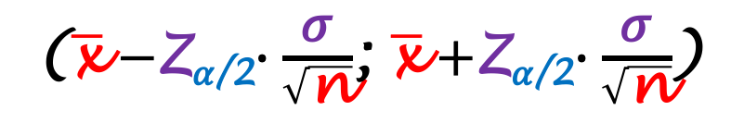
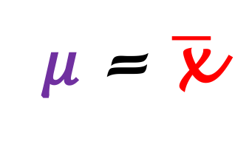


Drawing inference about population mean
Population
Point estimation:
⇒
𝜇 = $\overline{\text{x}}$
𝜎²
- ?
Sample
x₁
x₂
x₃
...
x_{n}
= sd(x)
n > 30
𝜇
f(x)
Interval estimation:
$$\frac{\text{σ}}{\sqrt{\text{n}}}$$
f_{Xs}($\overline{\text{x}}S$, 𝜇,
)
($\overline{\text{x}}−$Z_{𝛼/2}$∙\frac{\text{σ}}{\sqrt{\text{n}}}$; $\overline{\text{x}}+$Z_{𝛼/2}$∙\frac{\text{σ}}{\sqrt{\text{n}}}$)
Level of significance:
$$\frac{\text{σ}}{\sqrt{\text{n}}}$$
$$\frac{\text{σ}}{\sqrt{\text{n}}}$$
𝛼 = 0.05
1- 𝛼
$\overline{\text{x}}$-Z_{𝛼/2}$∙\frac{\text{σ}}{\sqrt{\text{n}}}$
𝛍
$\overline{\text{x}}$+Z_{𝛼/2}$∙\frac{\text{σ}}{\sqrt{\text{n}}}$
$$\overline{\text{x}}S$$
Confidence interval:
$$\overline{\text{x}}$$
= $\overline{\text{x}}$
-Z_{𝛼/2}
0
Z_{𝛼/2}
1- 𝛼 = 0.95
Statistical data analysis in R. Viktor Ermakov – Visiting professor, UFSCar.
Notes:
Let’s see how we will draw inferences from large sample.
Remember that the large sample considered to be a sample with more than 30 observations.
The point estimator of population mean mu will be a sample mean. It is just one number.
From the Central limit theorem and consideration of sampling distribution we know that whatever the population distribution, the sampling distribution is always normal.
But what is more important for us now is that the standard deviation of this distribution is equal to the standard deviation of the population sigma over the square root of the number of observations N.
At this point we may think that we don’t know the standard deviation of the distribution. But it’s not true.
Because our sample is large we can approximate the standard deviation of the population with the standard deviation of the sample. Then our sampling distribution is completely defined.
And don’t forget that we estimated mu to be equal to the sample mean.
Now in order to define interval of possible values of mu we need to set a level of significance alpha. Let it be 5% or 0.05. Then our confidence interval 1- alpha will be 0.95. Very simple math.
Let’s remove distracting elements from the graph and see how it will look like. This is our 95% confidence interval of the population mean!
And if you ask how to calculate the limits of this interval, it is easy to demonstrate that they are calculated using Z-score of alpha over two. How to demonstrate it?
We just need to normalize this normal distribution to be a standard normal or Z-distribution by subtracting X bar that we already know and then divide by sigma over square root of N that we also know.
Remember that this blue area is a confidence interval 1-alpha, it is symmetric. In this case limits of this area will correspond to Z-score of alpha over two
Summarizing our interval estimation we have this result.

Slide 13
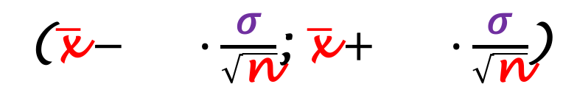
Drawing inference about population mean
Large sample
Small sample
Population
Point estimation:
⇒
𝜇 = $\overline{\text{x}}$
𝜎²
- ?
Sample
x₁
x₂
x₃
...
x_{n}
= sd(x)
n > 30
n < 30
𝜇
Interval estimation:
($\overline{\text{x}}− ∙\frac{\text{σ}}{\sqrt{\text{n}}}$; $\overline{\text{x}}+ ∙\frac{\text{σ}}{\sqrt{\text{n}}}$)
($\overline{\text{x}}−$Z_{𝛼/2}$∙\frac{\text{σ}}{\sqrt{\text{n}}}$; $\overline{\text{x}}+$Z_{𝛼/2}$∙\frac{\text{σ}}{\sqrt{\text{n}}}$)
T_{𝛼/2}
T_{𝛼/2}
Z_{𝛼/2}
Z_{𝛼/2}
Level of significance:
𝛼 = 0.05
d.f = n-1
Confidence interval:
1- 𝛼 = 0.95
Statistical data analysis in R. Viktor Ermakov – Visiting professor, UFSCar.
Notes:
This is a very important result.
But remember that we did it only for the large sample, assuming that we can approximate population standard deviation with sample standard deviation. Then we use a Z-scores.
If the sample size is small we can not approximate population standard deviation with sample standard deviation. instead of using Z-scores we will use T-scores from Student’s T-distribution with n-1 degrees of freedom

Slide 14



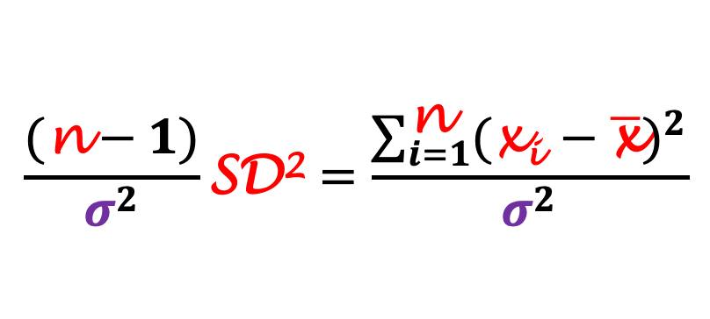
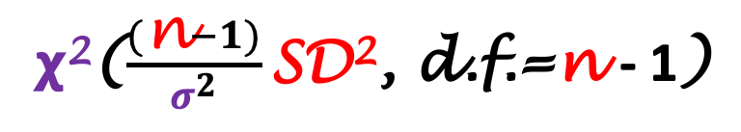
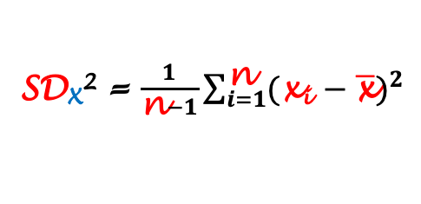
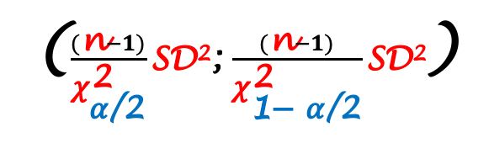
Drawing inference about population variance
Point estimation:
SD_{X}² = $\frac{1}{\text{n}−1}\sum_{i=1}^{\text{n}}{{(\text{x}\text{i} −\overline{\text{x}})}^{2}}$
Population
$$\frac{(\text{n}−1)}{σ^{2}}\text{SD}\text{2}=\frac{\sum_{i=1}^{\text{n}}{{(\text{x}\text{i} −\overline{\text{x}})}^{2}}}{σ^{2}}$$
𝜎
- ?
𝞆²($\frac{(\text{n}−1)}{σ^{2}}\text{SD}\text{2}$, d.f.=n - 1)
X ~ Normal(𝜇, 𝜎)
f_{X}(x)
Level of significance:
Interval estimation:
($\frac{(\text{n}−1)}{{\text{χ}}_{\text{α}\text{/2}}^{\text{2}}}\text{SD}\text{2}$; $\frac{(\text{n}−1)}{{\text{χ}}_{\text{1− }\text{α}\text{/2}}^{\text{2}}}\text{SD}\text{2}$)
𝛼 = 0.05
1- 𝛼
Confidence interval:
𝜒²
$$0$$
$${\text{χ}}_{\text{1− }\text{α}\text{/2}}^{\text{2}}$$
$${\text{χ}}_{\text{α}\text{/2}}^{\text{2}}$$
1- 𝛼 = 0.95
Statistical data analysis in R. Viktor Ermakov – Visiting professor, UFSCar.
Notes:
We can make an inference about the population variance or standard deviation only on assumption that the population distribution is normal.
We know how to calculate variance of the sample.
This value will be the point estimate for the population variance.
Also, we know that the variance of the sample normalized by the variance of the population over N minus one, the degrees of freedom, follows the chi-square distribution with N minus one degrees of freedom.
This distribution we will use to make inferences about interval of possible values.
The concept of confidence interval and level of significance remains the same. We can choose any value, in this example we may choose 0.05 and 0.95, meaning that we want to be 95% sure that the real value is in the interval. Now, the chi-square distribution is only positive, right skewed unlike the normal distribution and depends on the degrees of freedom or number of observations. But don’t be scared about this.
Remember that we did this normalization? This means that our chi-squared distribution is completely defined.
Now we need to set a confidence interval like this.
And using a software or a table, if you prefer old-fashioned way, find quantile values associated with 1-alpha over 2 and alpha over two.
Then, remembering this normalization we need to revert it back and construct confidence interval of population variance based on the sample variance.
The result will look like this that is a a formula for the interval estimation

Slide 15



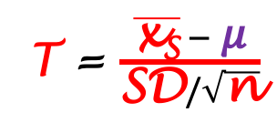

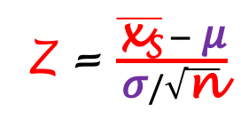
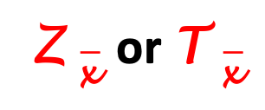


Hypothesis tests
$$\overline{\text{x}}$$
Population
Sample
x₁
x₂
x₃
...
x_{n}
⇒
⇒
Z $\overline{\text{x} }$ or T $\overline{\text{x} }$
𝜇
- !
- ?
Null hypothesis
H₀
H₀: 𝜇 = 158 cm
H₁: 𝜇 = 158 cm
𝜎²
- !
H₁: 𝜇 > 158 cm
H₁: 𝜇 < 158 cm
- ?
Alternative hypothesis
H₁
or
H_{a}
f(x)
Z = $\frac{\overline{\text{x}\text{S}} − \text{μ}}{\text{σ}/\sqrt{\text{n}}}$
Level of significance:
Z
T(n-1)
𝛼 = 0.05
T = $\frac{\overline{\text{x}\text{S}} − \text{μ}}{\text{SD}/\sqrt{\text{n}}}$
𝛼/2
1-𝛼
𝛼/2
Confidence interval:
$$\overline{\text{x}}S$$
1- 𝛼 = 0.95
-Z_{𝛼/2}
0
Z $\overline{\text{x} }$
Z_{𝛼/2}
Z $\overline{\text{x} }$
-T_{𝛼/2}
T $\overline{\text{x} }$
T_{𝛼/2}
T $\overline{\text{x} }$
Statistical data analysis in R. Viktor Ermakov – Visiting professor, UFSCar.
Notes:
Now that we know how to estimate parameters of population, construct confidence intervals for mean and variance let’s see how we can test hypothesis about mean and variance. When we did estimation the parameters of population were unknown.
When we test a hypothesis we pretend that we know the population parameter: for example mean or variance.
Then, having our sample we make estimation of this parameter and after that need to make a decision if the parameter of population is correct or not? Lets consider a test of hypothesis of population mean.
Remember that testing statistical hypothesis has a very well defined structure: we state a null hypothesis and opposite alternative hypothesis. Null hypothesis is the true that we believe.
Let’s say, that we believe that the population mean is equal to 158cm. The alternative hypothesis in this case is that mean is not equal to 158cm.
Or alternative hypothesis can be stated as the mean is greater or smaller than 158cm.
When we say that we know population mean, it means that we know its sampling distribution – it only can be Z- or Student’s T-distribution with N-1 degrees of freedom depending on the size of the sample that we have.
Just don’t forget that we get to these sampling distributions using Z- or T-transformations for the sample means. Here population mean mu is what we are testing.
Also, we remember what is level of significance and confidence interval.
We will test alternative hypothesis of mu not equal to 158 cm.
The confidence interval in this case we will construct in this way.
To the left and to the right we have rejection regions. Because they are on both sides, they called two-sided rejection regions.
The limits of these regions correspond to Z-score with alpha over two or T-score with alpha over two depending on the distribution.
This is because the area of the rejection region on each side should be equal to alpha over two.
After all these constructions are done, we can calculate Z- or T-score for the mean of our sample.
Then we see where on our graph falls this value. If it is inside our confidence interval, then we cannot reject the null hypothesis and it remains true because our experimental data support it.
But if it falls inside the rejection region, than we reject the null hypothesis because our experimental data don’t support it.

Slide 16
Hypothesis tests
$$\overline{\text{x}}$$
Population
Sample
x₁
x₂
x₃
...
x_{n}
⇒
⇒
Z $\overline{\text{x} }$ or T $\overline{\text{x} }$
𝜇
- !
Null hypothesis
H₀
H₀: 𝜇 = 158 cm
H₁: 𝜇 > 158 cm
H₀: 𝜇 = 158 cm
H₁: 𝜇 = 158 cm
Alternative hypothesis
H₁
or
H_{a}
f(x)
Z = $\frac{\overline{\text{x}\text{S}} − \text{μ}}{\text{σ}/\sqrt{\text{n}}}$
Level of significance:
Z
T(n-1)
𝛼 = 0.05
T = $\frac{\overline{\text{x}\text{S}} − \text{μ}}{\text{SD}/\sqrt{\text{n}}}$
1-𝛼
Confidence interval:
$$\overline{\text{x}}S$$
1- 𝛼 = 0.95
-Z_{𝛼/2}
0
Z_{𝛼/2}
Z $\overline{\text{x} }$
-T_{𝛼/2}
T_{𝛼/2}
T $\overline{\text{x} }$
Statistical data analysis in R. Viktor Ermakov – Visiting professor, UFSCar.
Notes:
Now we state the alternative hypothesis as mu is greater then 158 cm. Then we need to change the form of confidence interval.

Slide 17




Hypothesis tests
$$\overline{\text{x}}$$
Population
Sample
x₁
x₂
x₃
...
x_{n}
⇒
⇒
Z $\overline{\text{x} }$ or T $\overline{\text{x} }$
𝜇
- !
Null hypothesis
H₀
H₀: 𝜇 = 158 cm
H₁: 𝜇 > 158 cm
H₀: 𝜇 = 158 cm
H₁: 𝜇 < 158 cm
Alternative hypothesis
H₁
or
H_{a}
f(x)
Z = $\frac{\overline{\text{x}\text{S}} − \text{μ}}{\text{σ}/\sqrt{\text{n}}}$
Level of significance:
Z
T(n-1)
𝛼 = 0.05
𝛼
T = $\frac{\overline{\text{x}\text{S}} − \text{μ}}{\text{SD}/\sqrt{\text{n}}}$
1-𝛼
Confidence interval:
$$\overline{\text{x}}S$$
1- 𝛼 = 0.95
Z $\overline{\text{x} }$
0
Z_{𝛼}
Z $\overline{\text{x} }$
T $\overline{\text{x} }$
T_{𝛼}
T $\overline{\text{x} }$
Statistical data analysis in R. Viktor Ermakov – Visiting professor, UFSCar.
Notes:
In stead of been two-sided, now it is right sided in such a way that area under the curve of rejection region is equal to alpha.
By the same principle we calculate Z- or T-score of the sample mean and don’t reject the null hypothesis is the value falls inside confidence interval.
If it falls inside the rejection region we reject the null hypothesis.
The last alternative hypothesis is that mu is smaller than 158 cm.

Slide 18
Hypothesis tests
$$\overline{\text{x}}$$
Population
Sample
x₁
x₂
x₃
...
x_{n}
⇒
⇒
Z $\overline{\text{x} }$ or T $\overline{\text{x} }$
𝜇
- !
Null hypothesis
H₀
H₀: 𝜇 = 158 cm
H₁: 𝜇 < 158 cm
Alternative hypothesis
H₁
or
H_{a}
f(x)
Z = $\frac{\overline{\text{x}\text{S}} − \text{μ}}{\text{σ}/\sqrt{\text{n}}}$
Level of significance:
Z
T(n-1)
𝛼 = 0.05
T = $\frac{\overline{\text{x}\text{S}} − \text{μ}}{\text{SD}/\sqrt{\text{n}}}$
1-𝛼
Confidence interval:
$$\overline{\text{x}}S$$
1- 𝛼 = 0.95
-Z_{𝛼}
0
-T_{𝛼}
Statistical data analysis in R. Viktor Ermakov – Visiting professor, UFSCar.
Notes:
In this case the we have a symmetrical picture of rejection and confidence interval. And now it is called left-sided rejection region.
The hypothesis test about population variance will have the same principle but sampling distribution will be different. It will be chi-square but you also will construct left-, right- or two-sided rejection regions.

Slide 19
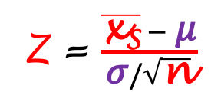

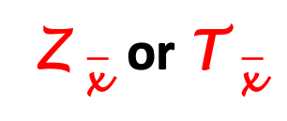



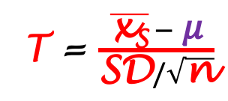
p-value
Population
f(x_{S})
𝜇
- !
Z = $\frac{\overline{\text{x}\text{S}} − \text{μ}}{\text{σ}/\sqrt{\text{n}}}$
Z
T(n-1)
T = $\frac{\overline{\text{x}\text{S}} − \text{μ}}{\text{SD}/\sqrt{\text{n}}}$
Z $\overline{\text{x} }$
0
$$\overline{\text{x}}S$$
T $\overline{\text{x} }$
...
x_{n}
⇒
$$\overline{\text{x}}$$
⇒
Z $\overline{\text{x} }$ or T $\overline{\text{x} }$
Sample
x₁
x₂
x₃
H₀: 𝜇 = 158 cm
H₁: 𝜇 = 158 cm
H₁: 𝜇 > 158 cm
H₁: 𝜇 < 158 cm
﻿The P–value is the probability, calculated under H₀, that the test statistic takes a value equal to or more extreme than the value actually observed.
Statistical data analysis in R. Viktor Ermakov – Visiting professor, UFSCar.
Notes:
We also need to understand a very important concept in statistical inference called a p-value.
Let’s recall the hypothesis test about population mean.
We know that sampling distribution of mean is Z- or Student’s T distribution with n-1 degrees of freedom depending of the sample size.
We also know how to calculate Z- or T- scores for the sample mean using Z- or T-transformations. Remember that mu in these formulas is the population mean that we test.
We can locate this scores on the graph but in this case we will not construct confidence interval and see if out sample value falls in it. We will do differently now.
First of all we need to decide, what alternative hypothesis we are testing?
Remember that there are two-sided, right-sided and left-sided?
Let’s look on the right-sided alternative hypothesis first.
This area here is called… well, p-value. And we will understand why?
The definition of p-value is that the p-value is the probability, calculated under null hypothesis, that the test statistic takes a value equal to or more extreme than the value actually observed. In our case the null hypothesis is defined by the Z- or T-distribution and Z- or T-transformation. In the right-sided test the values more critical that we observed are to the right of our observation and the area is represented in green.
For the left-sided hypothesis the more critical values are to the left of the observed value because every value to the right in this case is not important. In this case p-value, or area is smaller.
Then the questions is, what values are more critical in two-sided test?
The answer is that this value will be doubled and in the case of symmetrical sampling distribution the symmetrical region will be included into consideration of more critical values. We may reject or not reject the null hypothesis by considering only the p-value. If the p-value is very small than it is very unlikely that the null hypothesis is true because it is very unlikely to get a sample like that. As I said the concept of p–value is widely used in inferential statistics and it is very important to understand it.

Slide 20
In this lecture
1
Forms of inference
Drawing inference about population mean
Drawing inference about population variance
Hypothesis tests
p-value
2
3
4
5
Statistical data analysis in R. Viktor Ermakov – Visiting professor, UFSCar.

