Slide 1
Statistical data analysis in R
Visiting professor
Viktor Ermakov

Slide 2
Lecture 13

Slide 3
Regression analysis

Slide 4
In this lecture
1
Basics of linear regression
Estimation of intercept and slope
Hypothesis tests for regression line
Strength of line regression
2
3
4
Statistical data analysis in R. Viktor Ermakov – Visiting professor, UFSCar.

Slide 5
Basics of linear regression
X
~
Y
- ?
EY
= 𝛍(x)
x
(x₁, Y₁)
Study time ~ Score on a test
Height ~ Weight
(x₂, Y₂)
﻿ 𝛍(x) = β₀ + β₁x
Smoking frequency ~ Age of first heart attack
x₁ Y₁
﻿ 𝛍(x) = β₀ + β₁x + β₂x²
β - ?
Y_{i} = β₀ + β₁ x_{i} + 𝜀_{i}
x₂ Y₂
(x₃, Y₄)
﻿ 𝛍(x) = β₀ exp(β₁x)
x₃ Y₄
𝜀_{i} ∈ E ~normal(0, 𝜎)
…
…
(x_{n}, Y_{n})
x_{n} Y_{n}
Statistical data analysis in R. Viktor Ermakov – Visiting professor, UFSCar.
Notes:
Before this moment we mostly were talking about a single random variable, its population distribution, sampling distribution etc.
Now we will look on another problem, when we have two variable X and Y.
In general, and for the simplification we may consider variable X not be a random variable so we will substitute it with small x.
We believe that Y depends in some way on x.
Our measurements or data that we have in this case will be presented in forms of pairs of x and Y that usually are organized in a table.
Examples of this pairs might be: study time and score on a test, height and weight, smoking frequency and the age of the first heart attack.
﻿Given information about the relationship between x and Y, we would like to predict future values of Y for particular values of x. This turns out to be a difficult problem.
Instead we look at the easier problem: we estimate expectation of Y. We know that Y depends somehow on x, so we may express it as a function of x..
And try different functions with idea of estimation of parameters beta.
﻿But lets talk about linear regression. There are three assumptions that lies in its basis. First and the most obvious is that we will use linear function and estimate parameters beta 0 and beta 1.
The second is that observations of our random variable contain our predicted values and some errors epsilon.
﻿We lastly assume that the errors epsilons are independent and identically distributed random variables with normal distribution with mean 0 and variance σ.
Let’s see how it looks on the graph.

Slide 6


Basics of linear regression
Y
EY
= 𝛍(x)
﻿ 𝛍(x) = β₀ + β₁x
dist
Y_{i} = β₀ + β₁ x_{i} + 𝜀_{i}
β₀
β₁
𝜀_{i} ∈ E ~normal(0, 𝜎)
x₁
speed
x₂
$$x$$
Statistical data analysis in R. Viktor Ermakov – Visiting professor, UFSCar.
Notes:
This solid line is the regression line µ with its intercept beta 0 and slope beta 1.
The intuition is that for each given value of x, we observe a random value of Y which is normally distributed with a mean equal to the height of the regression line at that x value.
In this case we have x1 and x2 and if we repeat measurements for these values each time we’ll get a new value of Y.
﻿ We assume that the observations at these two locations are independent, but we also assume that their distributions have the same spread or identical standard deviations.
In reality the data points will look more like this. These data are from the cars dataset from dataset library in R. ﻿The speed represents how fast the car was going in miles per hour and dist ﻿measures how far it took for the car to stop, in units of feet. ﻿There is a pronounced upward trend to the data points, and the pattern looks approximately linear.

Slide 7

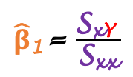
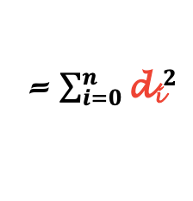
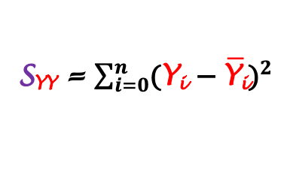
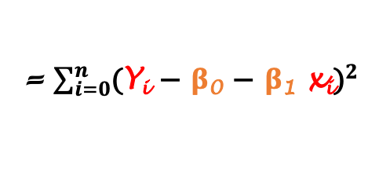
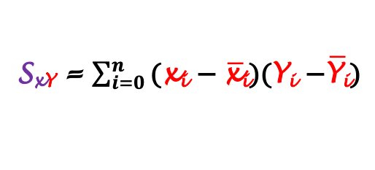
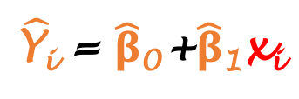
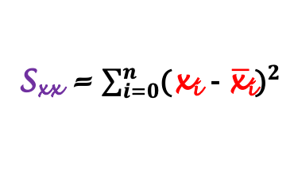
Estimation of intercept and slope
Method of least squares
Y
Y_{i} = β₀ + β₁ x_{i} + 𝜀_{i}
Y_{i} = β₀ + β₁ x_{i} + d_{i}
d_{i} = Y_{i} - β₀ - β₁ x_{i}
D
= $\sum_{i=0}^{n}{{\text{d}\text{i}}^{2}}$
= $\sum_{i=0}^{n}{{\text{(}\text{Y}\text{i}\text{ − }\text{β}\text{0}\text{ − }\text{β}\text{1} \text{xi}\text{)}}^{2}}$
β₁
$\hat{\text{Y}\text{i}}$ = $\hat{\text{β}}\text{0}$+$\hat{\text{β}}\text{1}\text{x}\text{i}$
Minimized using MLE
β₀
$\hat{\text{β}}\text{1}$= $\frac{\text{S}\text{x}\text{Y} }{\text{S}\text{xx}}$
$\hat{\text{β}}\text{0}$= $\overline{\text{Y}\text{i}}$ - $\hat{\text{β}}\text{1}\overline{\text{x}\text{i}}$
$$x$$
S_{xx} = $\sum_{i=0}^{n}{{\text{(}\text{x}\text{i} \text{− }\overline{\text{x}\text{i}}\text{)}}^{2}}$
S_{x}$\text{Y}$ = $\sum_{i=0}^{n}{\text{(}\text{x}\text{i} \text{− }\overline{\text{x}\text{i}}\text{)(}\text{Y}\text{i} \text{−}\overline{\text{Y}\text{i}}\text{)}}$
S$\text{YY}$ = $\sum_{i=0}^{n}{{\text{(}\text{Y}\text{i} \text{− }\overline{\text{Y}\text{i}}\text{)}}^{2}}$
Statistical data analysis in R. Viktor Ermakov – Visiting professor, UFSCar.
Notes:
﻿Now we can proceed to estimate the regression line and solve a few related inference problems. The problem of estimating the regression parameters beta 0 and beta 1 can be viewed as fitting the best straight line of the "y to x relationship" of data points.
The method that is used is called the method of least squares. It has an objective of determining the best fitting straight line. Moreover, this method is quite versatile because its application extends beyond the simple straight line regression model.
Remember, that the values Y are expressed in this form? This last term of the equation is the random variable.
It represents these distances from the regression line to the observed values, so we denote it as D for distances instead of epsilon.
Then we express these distances from this equation.
And then we will calculate the sum of squares of these distances D.
The sum of squares graphically represents the areas of these squares here.
This parameter D mas be minimized, for example, using maximum likelihood estimation method.
The result of this procedure leads to the following estimation. The slope beta 1 is calculated as the ratio of ﻿the sums of squared deviations from means of XY over XX. And intercept is calculated as difference of mean Y minus product of mean X multiplied by the slope.
The values of ﻿the sums of squared deviations in this case may be expressed in this way.
Then the resulting estimated line may be expressed in this way. Here the values Y hat are estimated values that are lay down on the line and not experimental points.

Slide 8

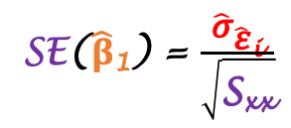


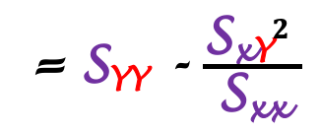

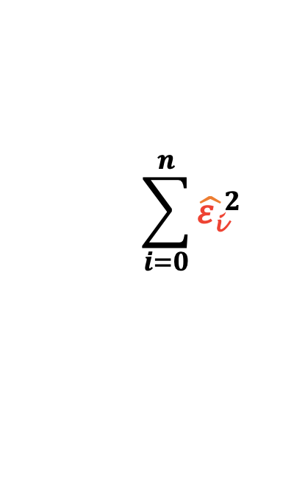

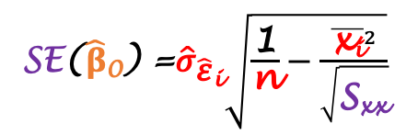
Estimation of intercept and slope
Method of least squares
Y
$\hat{\text{β}}\text{1}$= $\frac{\text{S}\text{x}\text{Y} }{\text{S}\text{xx}}$
$\hat{\text{β}}\text{0}$= $\overline{\text{Y}\text{i}}$ - $\hat{\text{β}}\text{1}\overline{\text{x}\text{i}}$
Y_{i} = β₀ + β₁ x_{i} + 𝜀_{i}
dist
$\hat{\text{ε}\text{i}}$ = Y_{i} - $\hat{\text{β}}\text{0}$- $\hat{\text{β}}\text{1}\text{x}\text{i}$
$$\sum_{i=0}^{n}{{\hat{\text{ε}\text{i}}}^{2}}$$
β₀
β₁
$\hat{\text{Y}\text{i}}$ = $\hat{\text{β}}\text{0}$+$\hat{\text{β}}\text{1}\text{x}\text{i}$
= S$\text{YY}$ - $\frac{{\text{S}\text{x}\text{Y}}^{2} }{\text{S}\text{xx}}$
SSE =
f($\hat{\text{Y}\text{i}}$ , ${\text{σ}}_{\hat{\text{ε}}\text{i}}$)
x_{i}
speed
$$x$$
${\hat{\text{σ}}}_{\hat{\text{ε}}\text{i}}^{2}$ = $\frac{\text{SSE}}{\text{n}\text{−2 }}$
SE($\hat{\text{β}}\text{1}$) = $\frac{{\hat{\text{σ}}}_{\hat{\text{ε}}\text{i}}}{\sqrt{\text{S}\text{xx}}}$
SE($\hat{\text{β}}\text{0}$) =${\hat{\text{σ}}}_{\hat{\text{ε}}\text{i}}\sqrt{\frac{\text{1}}{\text{n}}−\frac{{\overline{\text{x}\text{i}}}^{2}}{\sqrt{\text{S}\text{xx}}}}$
Statistical data analysis in R. Viktor Ermakov – Visiting professor, UFSCar.
Notes:
We can express residuals also from our initial assumption.
After rearrangement it will look like this.
This residuals are actually these errors on the graph - the distances between experimental points and regression line. The sum of squares of these residuals is the total area of the purple squares on the graph.
These errors were minimized together with the squares, and their sum of squares can be expressed in the following way.
This value is the sum or squares of residuals, or also called sum of square due to error, or SSE. These three estimators that we see here, beta 1, beta 0 and SSE, are the point estimators and are only one number each. We also may be interested in the interval estimation of these parameters.
Remember that we assumed our errors to be normally distributed with mean equal to the estimated value and standard deviation sigma?
So the variance of this distribution is equal to the SSE over N-2, where the N is the number of observations.
This N-2 is the degrees of freedom and the reduction of the degrees of freedom by two is due to the previous estimation of intercept and slope of the regression line.
It is not very easy to show but the standard deviation, also called standard error, of the least square estimators beta 1 and beta 0 are expressed using the estimator of standard deviation of errors.
These bunch of formulas for estimations are really necessary for the construction of confidence interval for the regression line. The confidence interval for the cars dataset that we’ve seen earlier will look lake that.

Slide 9


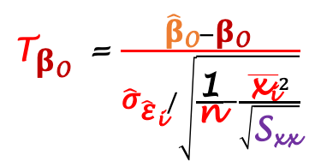
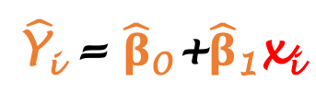
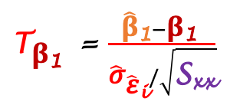



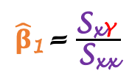
Hypothesis tests for regression line
${\text{T}}_{\text{β}\text{1} }$ = $\frac{\hat{\text{β}}\text{1}−\text{β}\text{1} }{{\hat{\text{σ}}}_{\hat{\text{ε}}\text{i}}/\sqrt{\text{S}\text{xx}}}$
Y
d.f. = n-2
${\text{T}}_{\text{β}\text{0} }$ = $\frac{\hat{\text{β}}\text{0}−\text{β}\text{0} }{{\hat{\text{σ}}}_{\hat{\text{ε}}\text{i}}/\sqrt{\frac{\text{1}}{\text{n}}−\frac{{\overline{\text{x}\text{i}}}^{2}}{\sqrt{\text{S}\text{xx}}}}}$
β₀
β₁
$$\hat{\text{β}}\text{0}$$
$$\hat{\text{β}}\text{1}$$
T_{β}
T( , n-2)
$\hat{\text{Y}\text{i}}$ = $\hat{\text{β}}\text{0}$+$\hat{\text{β}}\text{1}\text{x}\text{i}$
$$x$$
$\hat{\text{β}}\text{1}$= $\frac{\text{S}\text{x}\text{Y} }{\text{S}\text{xx}}$
$\hat{\text{β}}\text{0}$= $\overline{\text{Y}\text{i}}$ - $\hat{\text{β}}\text{1}\overline{\text{x}\text{i}}$
𝛼/2
1-𝛼
𝛼/2
$${\text{T}}_{\text{β}\text{1} }$$
-T_{𝛼/2}
0
T_{𝛼/2}
T_{β}
Statistical data analysis in R. Viktor Ermakov – Visiting professor, UFSCar.
Notes:
We can do tests of hypothesis for the parameters of the regression line on similar way if it would be parameters of the the population distribution.
For example, you may test a hypothesis that this new red dashed line is a regression line for the data. This regression line may be from your previous study and now you want to test if these new experimental data are also described by this line that you found before. We will test parameters beta 0 and beta 1.
These parameters beta 0 and beta 1 of the regression line have Student’s T sampling distribution. But in this case with N-2 degrees of freedom.
In this graph you can see the same structure of two sided confidence interval for parameter beta.
This loss in degrees of freedom by 2 is because we estimated two parameters from our data and one can be expressed using another.
In order to get this t-scores here we need to do t-transformation of the data.
The T-transformation in this case look like this for the slope beta 1 and intercept beta 0. Even though, these formulas may seem complex to you, look first at the numerator. It just shows how far the value we test is from the value we estimated. And the denominator just shows how many standard deviations the tested value is located from what we estimated. The same logic as standard normal Z-distribution.
Yes, and don’t forget that these distributions have N-2 degrees of freedom.
After that, the process of hypothesis test is the same as for the test of population mean. We need to set confidence interval, choose what type of confidence interval it is: left-sided, right-sided or two-sided. And see if you T-score is inside the confidence interval. In this case I draw two-sided confidence interval and placed my T-score for the tested value of the slope outside. Thus, I conducted my hypothesis test and concluded that line with this slope can not be a legitimate regression line for my data.

Slide 10





Hypothesis tests for regression line
Y
${\text{T}}_{\text{β}\text{1} }$ = $\frac{\hat{\text{β}}\text{1}−\text{β}\text{1} }{{\hat{\text{σ}}}_{\hat{\text{ε}}\text{i}}/\sqrt{\text{S}\text{xx}}}$
${\text{T}}_{\text{β}\text{1} }$ = $\frac{\hat{\text{β}}\text{1} }{{\hat{\text{σ}}}_{\hat{\text{ε}}\text{i}}/\sqrt{\text{S}\text{xx}}}$
${\text{T}}_{\text{β}\text{1} }$ = $\frac{\hat{\text{β}}\text{1}−\text{0} }{{\hat{\text{σ}}}_{\hat{\text{ε}}\text{i}}/\sqrt{\text{S}\text{xx}}}$
d.f. = n-2
β₀
β₁ = 0
T(T_{β}, n-2)
$$\hat{\text{β}}\text{0}$$
$$\hat{\text{β}}\text{1}$$
𝛼/2
1-𝛼
𝛼/2
$$x$$
-T_{𝛼/2}
-${\text{T}}_{\text{β}\text{1} }$
0
$${\text{T}}_{\text{β}\text{1} }$$
T_{𝛼/2}
T_{β}
Statistical data analysis in R. Viktor Ermakov – Visiting professor, UFSCar.
Notes:
Let me show you one important example.
Imagine that we have our data and these data don’t look like having a strong linear relationship or any trend.
But anyway we do a linear regression on these data and construct a regression line that almost never will have a slope equal to 0. Because it is infinitely small chance to get a slope 0 for the real data. But still, what if our random variable Y doesn’t really depend on x?
What if our real regression line should look like this and the slope is 0?
Then, we need, for sure, do the hypothesis test to check if the real slope, beta 1, is zero.
To do it we need just plug 0 into the formula.
Then the formula will be simplified. Remember that all these members of this equation are calculated from data.
The calculated T-score can be added to the graph to see where it falls. In this case I put it inside the 1-alpha confidence interval, meaning that the slope 0 can be considered as a real slope for these data. But it’s just an illustration of the concept.
Or we can calculate a p-value for this score that shows the probability of all possible and more critical outcomes and make a desition based on it.

Slide 11


Strength of line regression
Y
β₀
β₁
$$\hat{\text{β}}\text{0}$$
$$\hat{\text{β}}\text{1}$$
$$x$$
Statistical data analysis in R. Viktor Ermakov – Visiting professor, UFSCar.
Notes:
Let’s talk about another important concept that is the strength of linear regression. Consider a case when we have data that look like this.
Of cause, we can easily construct a regression line as we did before.
Now let’s look on another set of data.
We can construct a regression line for these data also.

Slide 12
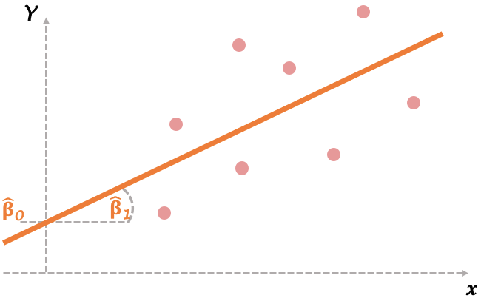
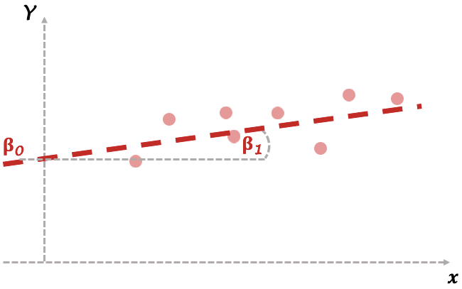


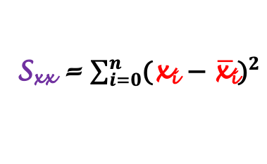

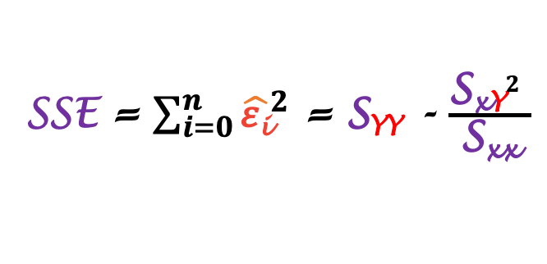
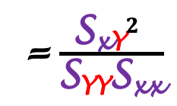
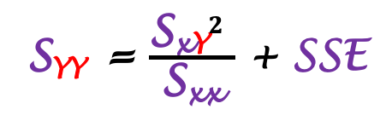
Strength of line regression
Strength of line regression =
how much of the variation in Y is explained
by the fitted regression line
how steep the fitted regression line
Total
variability of Y
Unexplained variability
SSE = $\sum_{i=0}^{n}{{\hat{\text{ε}\text{i}}}^{2}}$ = S$\text{YY}$ - $\frac{{\text{S}\text{x}\text{Y}}^{2} }{\text{S}\text{xx}}$
Variability explained by linear regression
S_{xx} = $\sum_{i=0}^{n}{{\text{(}\text{x}\text{i} \text{− }\overline{\text{x}\text{i}}\text{)}}^{2}}$
S$\text{YY}$ = $\frac{{\text{S}\text{x}\text{Y}}^{2} }{\text{S}\text{xx}}$ + SSE
= $\frac{{\text{S}\text{x}\text{Y}}^{2} }{\text{S}\text{YY}\text{S}\text{xx}}$
R² =
S_{x}$\text{Y}$ = $\sum_{i=0}^{n}{\text{(}\text{x}\text{i} \text{− }\overline{\text{x}\text{i}}\text{)(}\text{Y}\text{i} \text{−}\overline{\text{Y}\text{i}}\text{)}}$
Total
variability of Y
S$\text{YY}$ = $\sum_{i=0}^{n}{{\text{(}\text{Y}\text{i} \text{− }\overline{\text{Y}\text{i}}\text{)}}^{2}}$
Variability explained by linear regression
r = $\sqrt{\text{R}\text{2}}$
- correlation coefficient
Statistical data analysis in R. Viktor Ermakov – Visiting professor, UFSCar.
Notes:
The question is which regression line is stronger in these two cases?
And the strength of regression line is not how steep or abrupt the regression line is. Like, the bigger beta 1, the more stronger the regression line is. It is not that.
The strength shows how much of the variation in response variable is explained by the fitted regression line.
Some time ago we’ve seen that the sum of squares due to error is calculated using sums of squared deviations from the data.
When we rearrange this equation, the left side of it represents the variability of data on the y-axis.
The right side has two terms. This one shows the variability explained by the linear regression.
And this one is the residual part or unexplained variability.
Now if we take a variability explained by linear regression and divide it by the total variability of Y. Thus, this ratio will show the strength of our regression line.
The square root of this value is the correlation coefficient between x and Y.

Slide 13
In this lecture
1
Basics of linear regression
Estimation of intercept and slope
Hypothesis tests for regression line
Strength of line regression
2
3
4
Statistical data analysis in R. Viktor Ermakov – Visiting professor, UFSCar.

