Slide 1
Statistical data analysis in R
Visiting professor
Viktor Ermakov

Slide 2
Conditional probability
Lecture 5

Slide 3
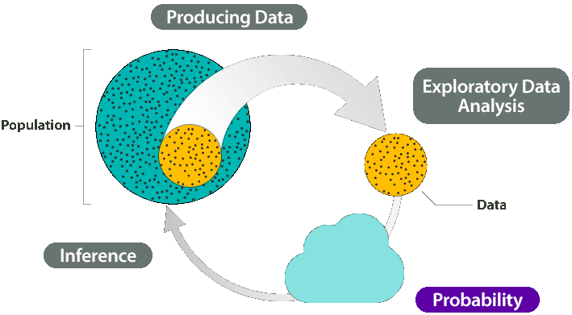
In this lecture
Conditional probability
Bayes’ theorem
Bayesian updating
Bayesian data analysis
Statistical data analysis in R. Viktor Ermakov – Visiting professor, UFSCar.

Slide 4
Notations
1
P(A)
P(Ā)
P(A⋃B)
P(AB)
P(A⋂B)
P(B|A)
Ā
A
B
P(AB)
or
P(A⋂B)
P(A⋃B)
1
Statistical data analysis in R. Viktor Ermakov – Visiting professor, UFSCar.

Slide 5
Conditional probability
﻿The probability of an event A must often be modified after information is obtained as to whether or not a related event B has taken place.
Information about some aspect of the experimental results may therefore necessitate a revision of the probability of an event concerning some other aspect of the results.
The revised probability of A when it is known that B has occurred is called the conditional probability of A given B and is denoted by P(A|B).
Statistical data analysis in R. Viktor Ermakov – Visiting professor, UFSCar.

Slide 6
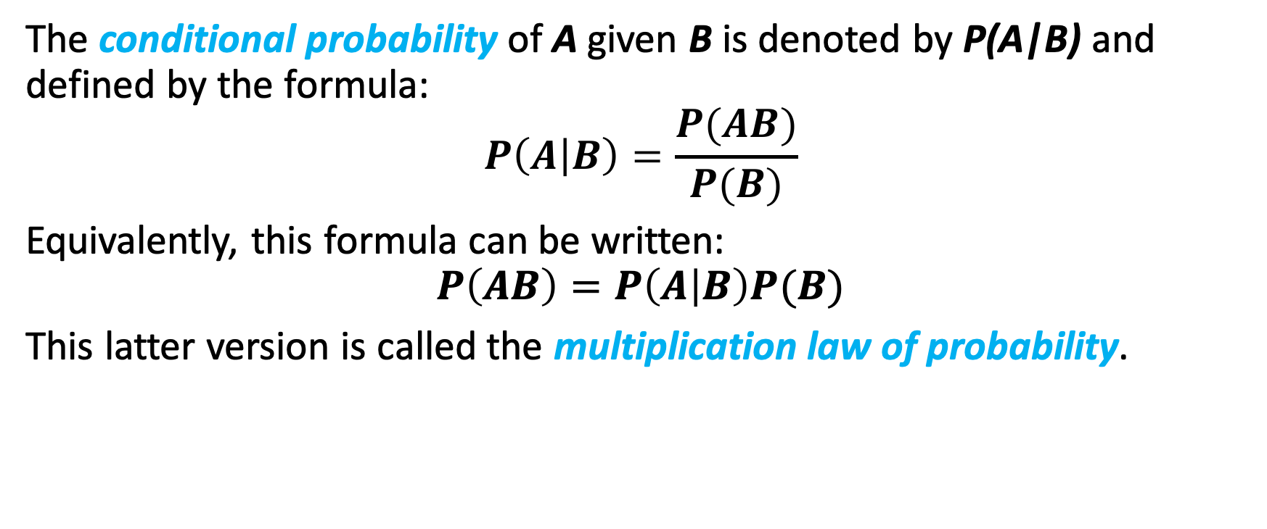
Conditional probability
﻿The conditional probability of A given B is denoted by P(A|B) and defined by the formula:
$$P\left(A | B\right)=\frac{P(AB)}{P(B)}$$
Equivalently, this formula can be written:
$$P\left(AB\right)=P\left(A | B\right)P(B)$$
This latter version is called the multiplication law of probability.
Statistical data analysis in R. Viktor Ermakov – Visiting professor, UFSCar.

Slide 7
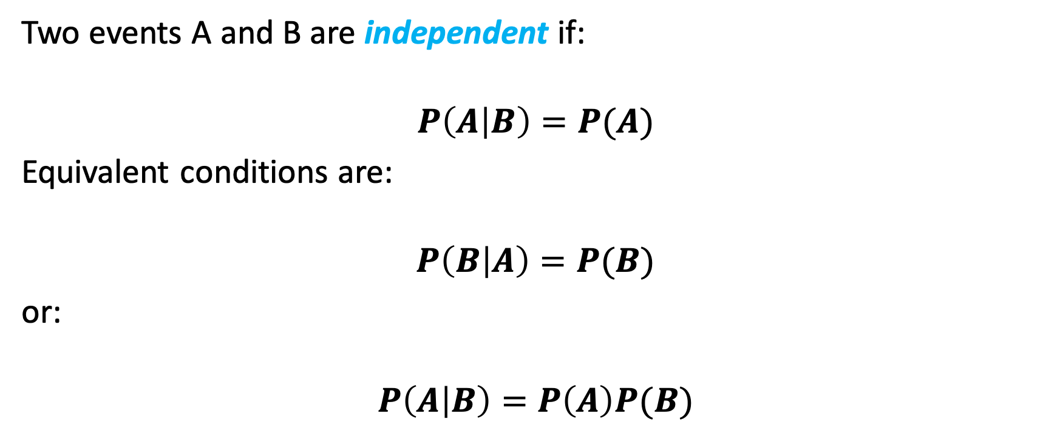
Independence
﻿Two events A and B are independent if:
$$P\left(A | B\right)=P(A)$$
Equivalent conditions are:
$$P\left(B | A\right)=P(B)$$
or:
$$P\left(A | B\right)=P\left(A\right)P(B)$$
Statistical data analysis in R. Viktor Ermakov – Visiting professor, UFSCar.

Slide 8
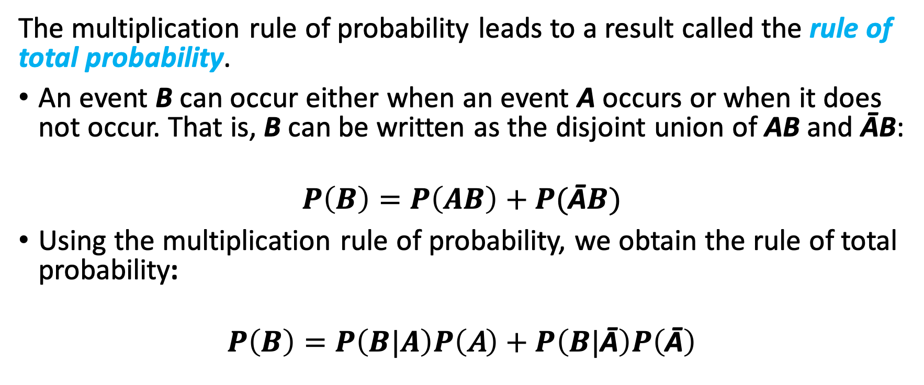
Rule of total probability
﻿The multiplication rule of probability leads to a result called the rule of total probability.
An event B can occur either when an event A occurs or when it does not occur. That is, B can be written as the disjoint union of AB and ĀB:
$$P\left(B\right)=P\left(AB\right)+P(\text{Ā}B)$$
﻿Using the multiplication rule of probability, we obtain the rule of total probability:
$$P\left(B\right)=P\left(B|A\right)P\left(\text{A}\right)+P\left(B|\text{Ā}\right)P\left(\text{Ā}\right)$$
Statistical data analysis in R. Viktor Ermakov – Visiting professor, UFSCar.

Slide 9
Rule of total probability
﻿The multiplication rule of probability leads to a result called the rule of total probability.
An event B can occur either when an event A occurs or when it does not occur. That is, B can be written as the disjoint union of AB and ĀB:
$$P\left(B\right)=P\left(AB\right)+P(\text{Ā}B)$$
﻿Using the multiplication rule of probability, we obtain the rule of total probability:
$$P\left(B\right)=P\left(B|A\right)P\left(\text{A}\right)+P\left(B|\text{Ā}\right)P\left(\text{Ā}\right)$$
Statistical data analysis in R. Viktor Ermakov – Visiting professor, UFSCar.

Slide 10
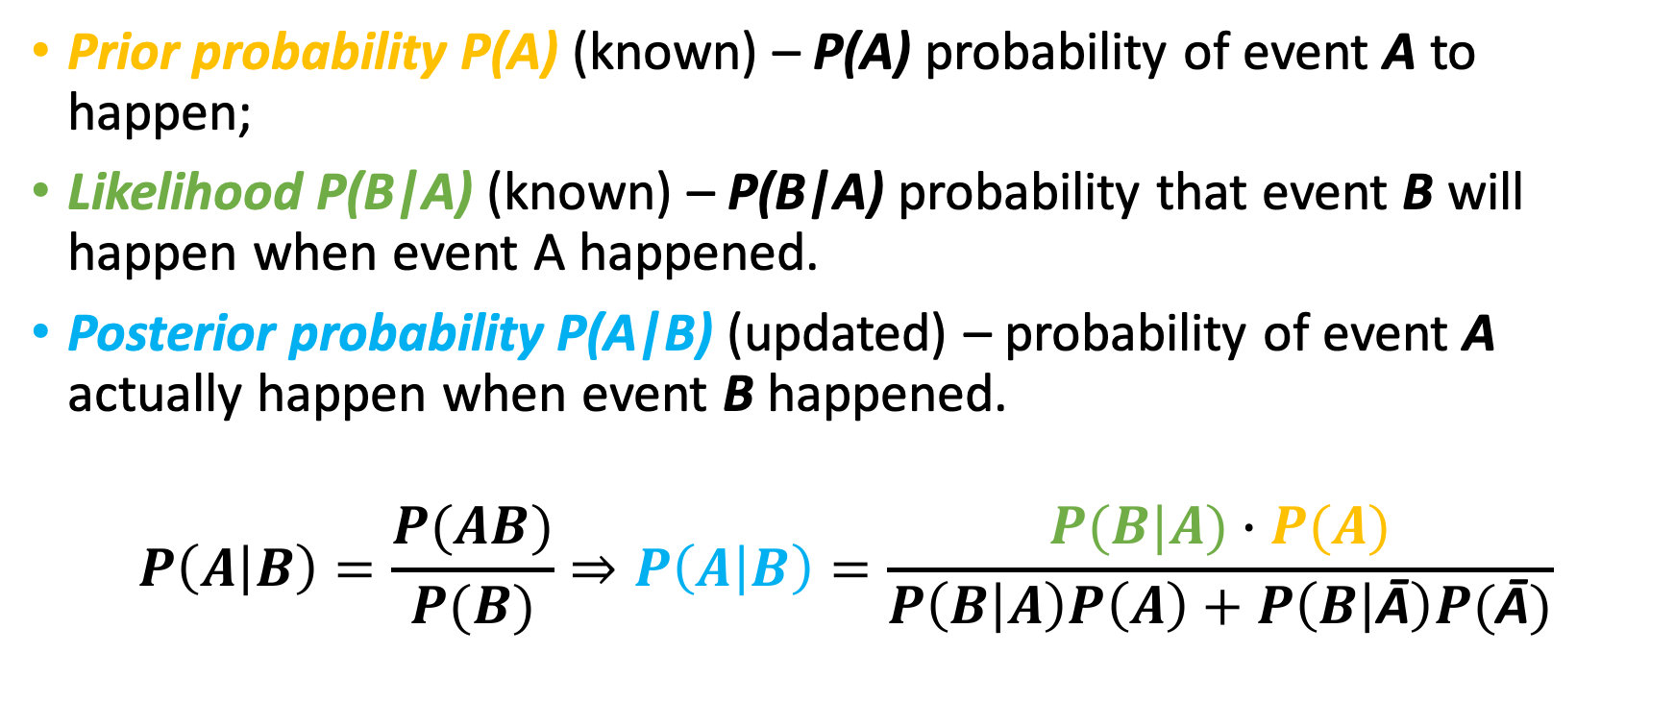
﻿Bayes’ Theorem
﻿Prior probability P(A) (known) – P(A) probability of event A to happen;
Likelihood P(B|A) (known) – P(B|A) probability that event B will happen when event A happened.
Posterior probability P(A|B) (updated) – probability of event A actually happen when event B happened.
$$P\left(A | B\right)=\frac{P(AB)}{P(B)}⇒P\left(A | B\right)=\frac{P(B|A)∙P(A)}{P\left(B | A\right)P\left(A\right)+P\left(B | \text{Ā}\right)P(\text{Ā})}$$
Statistical data analysis in R. Viktor Ermakov – Visiting professor, UFSCar.

Slide 11
Bayesian updating
Hypothesis | Prior | Likelihood | Unnormalized posterior | Posterior
H | P(H) | P(D|H) | P(D|H)P(H) | P(H|D)
H₄
H₆
H₈
H₁₀
H₁₂
H₂₀
Total | 1 |  |  | 1
Statistical data analysis in R. Viktor Ermakov – Visiting professor, UFSCar.

Slide 12
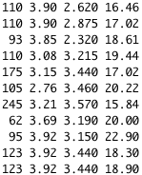

Bayesian data analysis
A method that figures out unknowns with associated probabilities.
Data
Model that will generate data
Priors – the information the the model has before see data.
Probability will represent uncertainty in all parts of the model
Model
Parameters
Statistical data analysis in R. Viktor Ermakov – Visiting professor, UFSCar.

