Slide 1
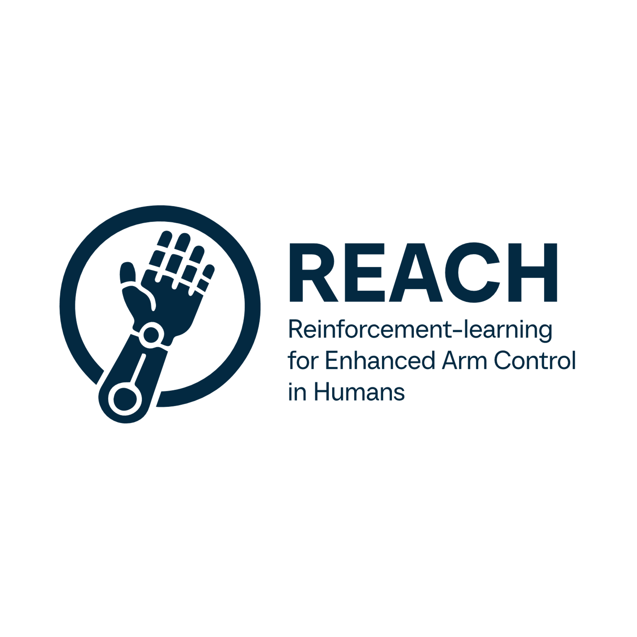
Mini Intro
Presented by: Taylor Davis, Lucas Larson, Clayton Ramsey, Victor Rodriguez
Mentor: Bailey Hall
Client: Biomechatronics Lab, NAU

Slide 2
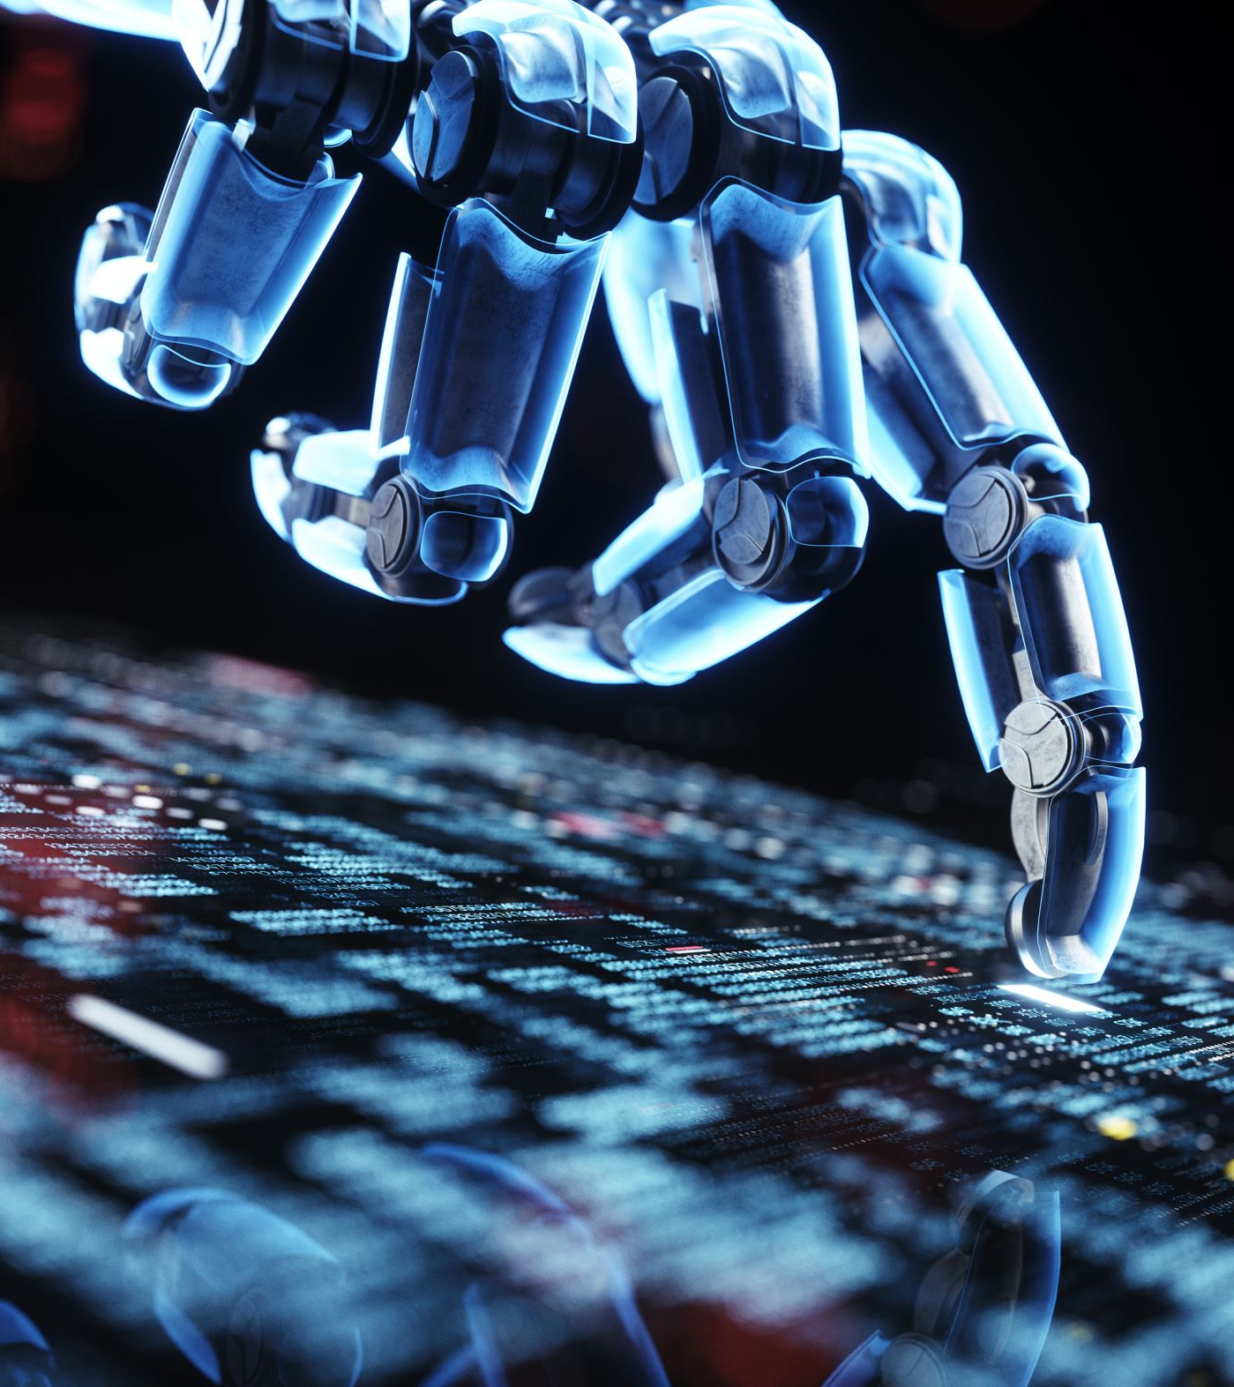
Helping People Regain Independence Through Intelligent Robotics
Assistive devices are limited, especially in complex real-world scenarios.
There is a need for smarter rehabilitation tech that adapts to real-life environments.

Slide 3

The Biomechatronics Lab & The Challenge
Client:
Dr. Zach Lerner, Associate Professor, Mechanical Engineering, NAU
Dr. Carlo da Cunha, Assistant Professor, Electrical Engineering, NAU
Problem:
Robotic arms are too rigid: they use hardcoded movements that break down in dynamic environments.
The lab needs a smarter, adaptive solution for real-world use.
Notes:
Our clients Dr. Lerner and Dr. da Cunha are both professors here on campus. Dr Lerner is the director of the Biomechatronics lab at NAU. They build various robotics for assisting humans. For example, in 2021 they built a robotic exoskeleton to improve ankle biomechanics. These robotics require meticulous programming and training to function. The problem is that teaching these robots in different environments is a slow process. Simple tasks have to implemented one by one and can break down in more complex environments. This is the bottleneck when trying to deploy adaptive robotics.

Slide 4
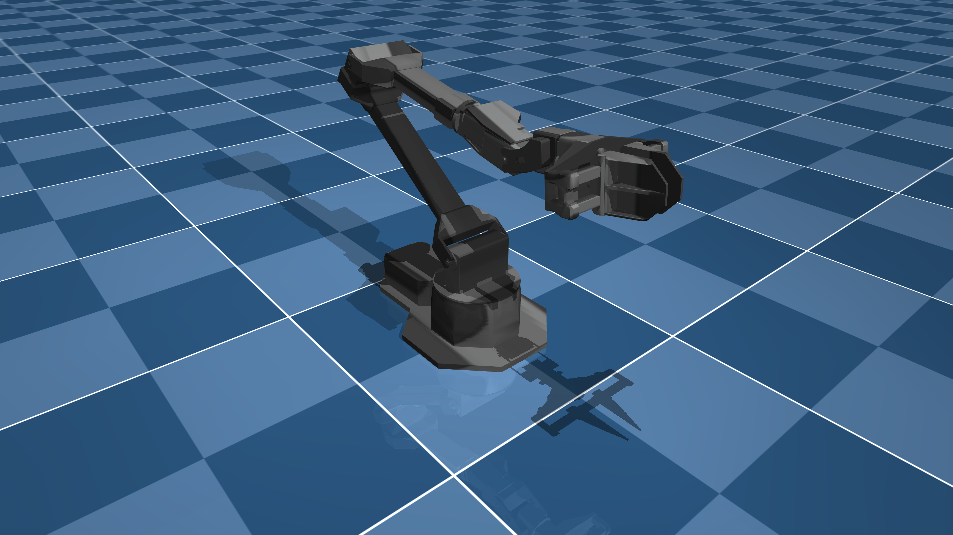
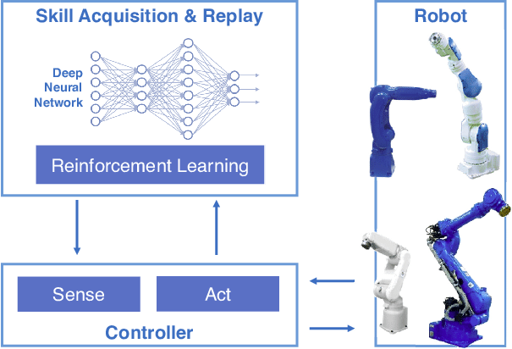
Building a Smart Control Framework with Reinforcement Learning
What we want to build:
A simulation-based RL framework that learns how to move a robotic arm to assist with daily tasks.
Goal: smooth, responsive, and energy-efficient assistance.
Notes:
To solve this, we will be building a simulation-based, reinforcement learning framework for training robotic limbs. This framework would allow users to import existing robotic models and define and demonstrate various complex tasks. The framework will abstract the reinforcement learning and allow the simulated robot to be trained on diverse environments and be much faster than the existing process.

Slide 5
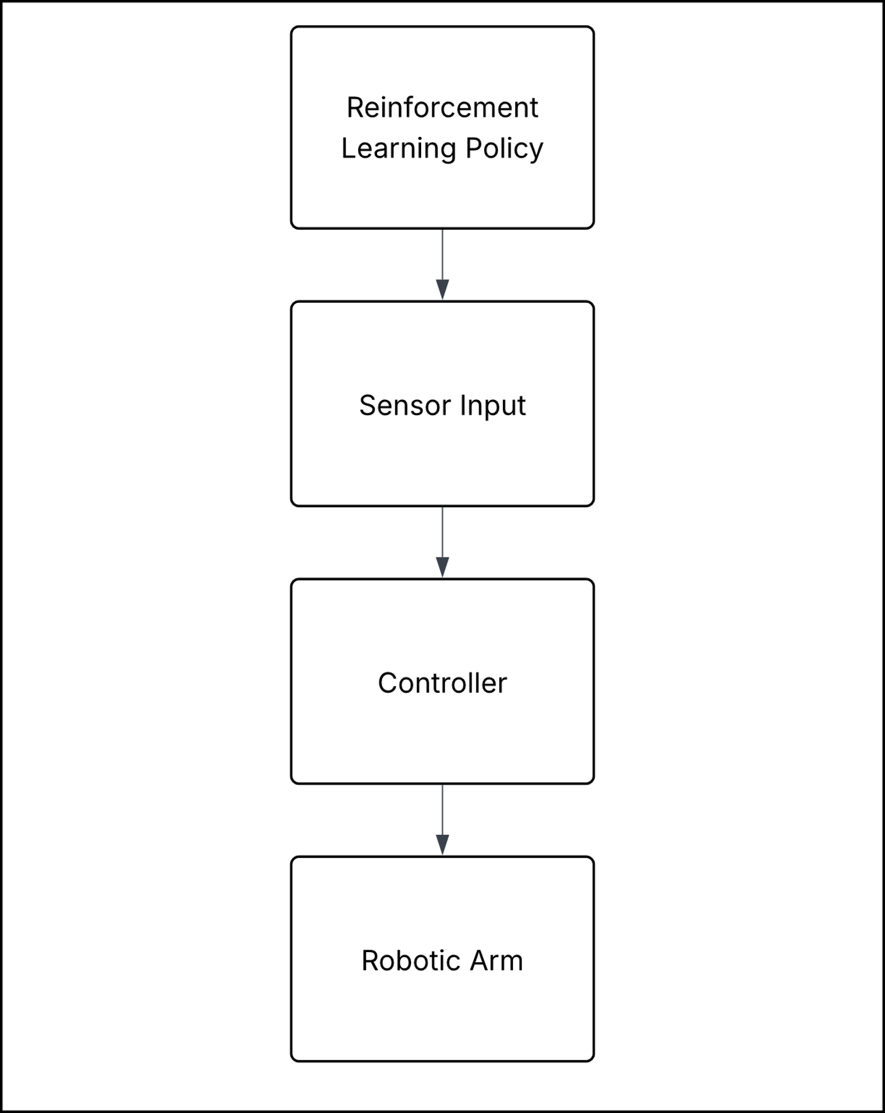
What the System Will Do
Train on tasks like shaking hands using RL algorithms
Detect objects in the environment via YOLO
Adapt to the environment using proprioceptive and visual input
Deploy to embedded hardware for real-time control

Slide 6

Roadmap
1: Start Small
Simple robots and tasks
Experiment with different algorithms
Biweekly meetings with the clients
Build iterative drafts
2: Schematic Specific Build
Ready for deployment to hardware counterpart
3: Develop the Full Framework
Add a layer of abstraction
Simple to add tasks
Key Technical Investigations:
Sim-to-Real transfer
Safety and impedance control
Complex Task Training on HPC Cluster

Slide 7
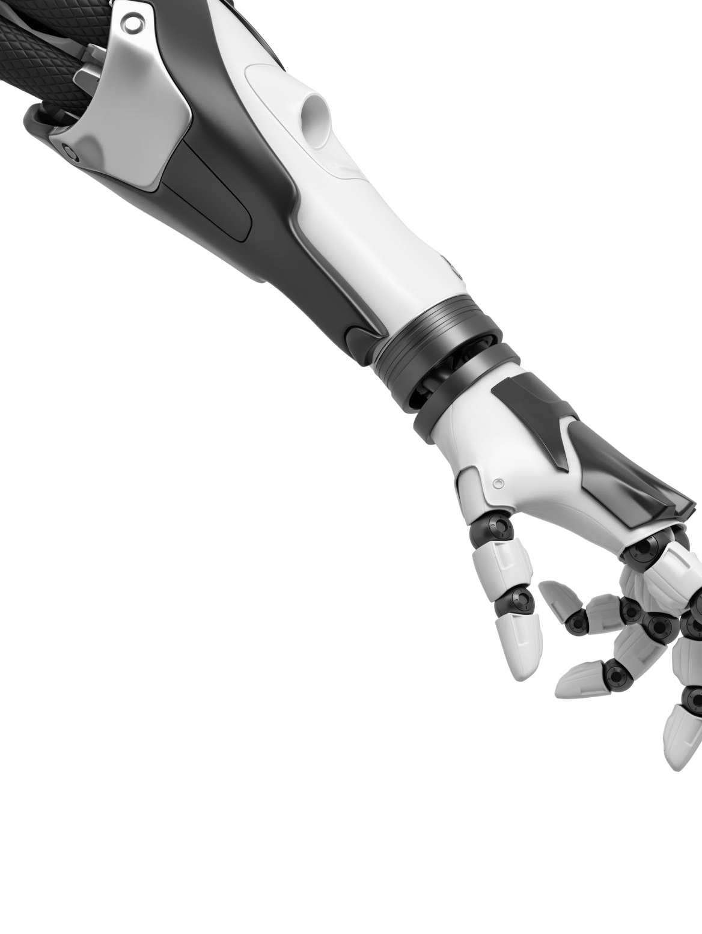
Why This Project Matters
Studies show that robot assisted rehabilitation is proven to be effective in regaining upper limb control
Team REACH is creating an RL-based framework to power wearable robotic arms for stroke rehab
Our work could improve safety, adaptability, and independence for people with upper-limb disabilities

Slide 8
Thank You
Any questions?

