Slide 1
Workshop
Introduction to Free Software Licensing in AI context

Slide 2
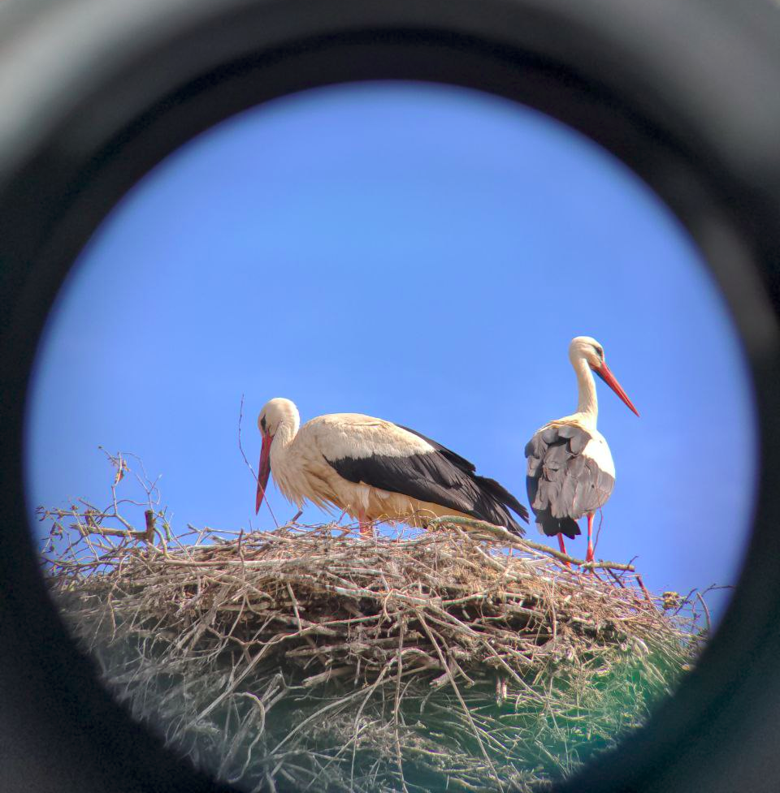
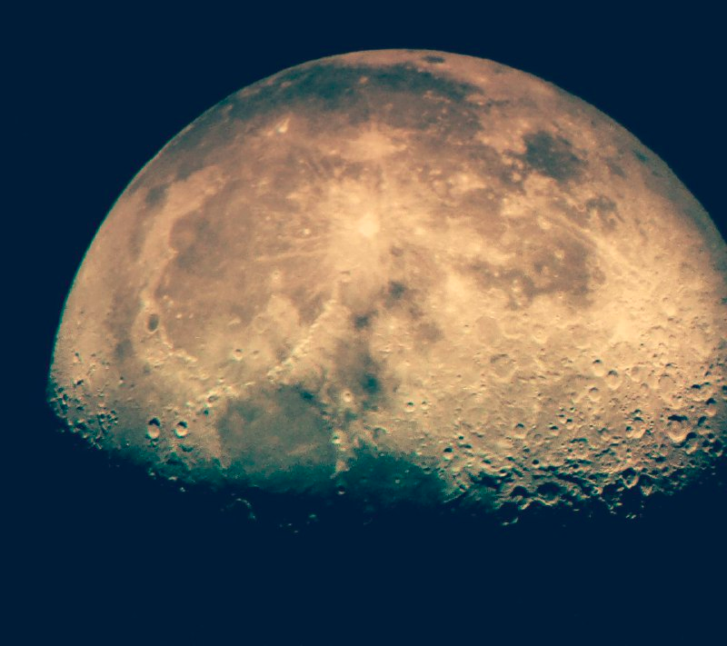
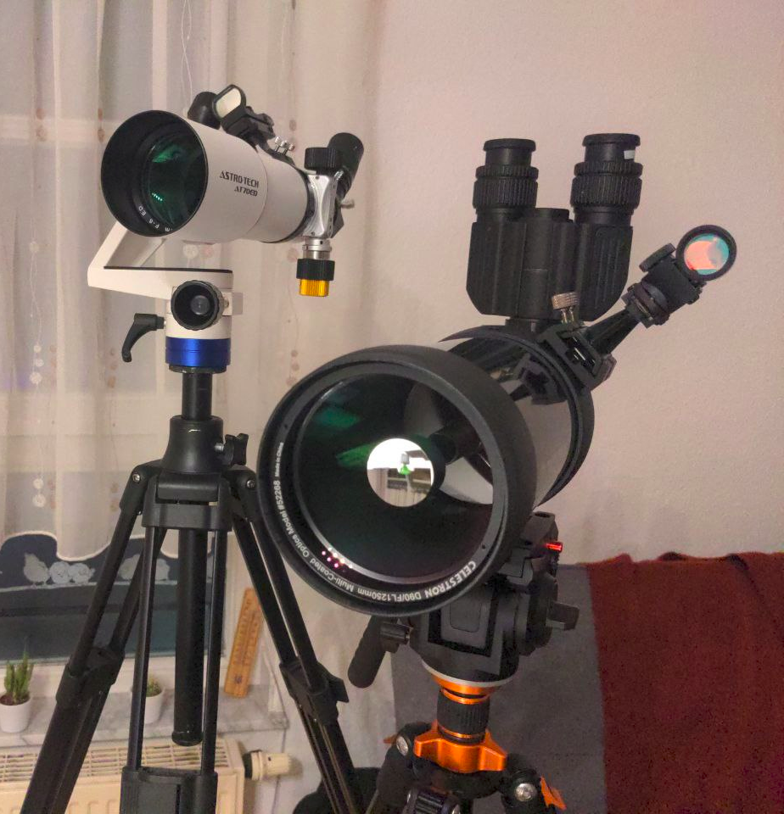
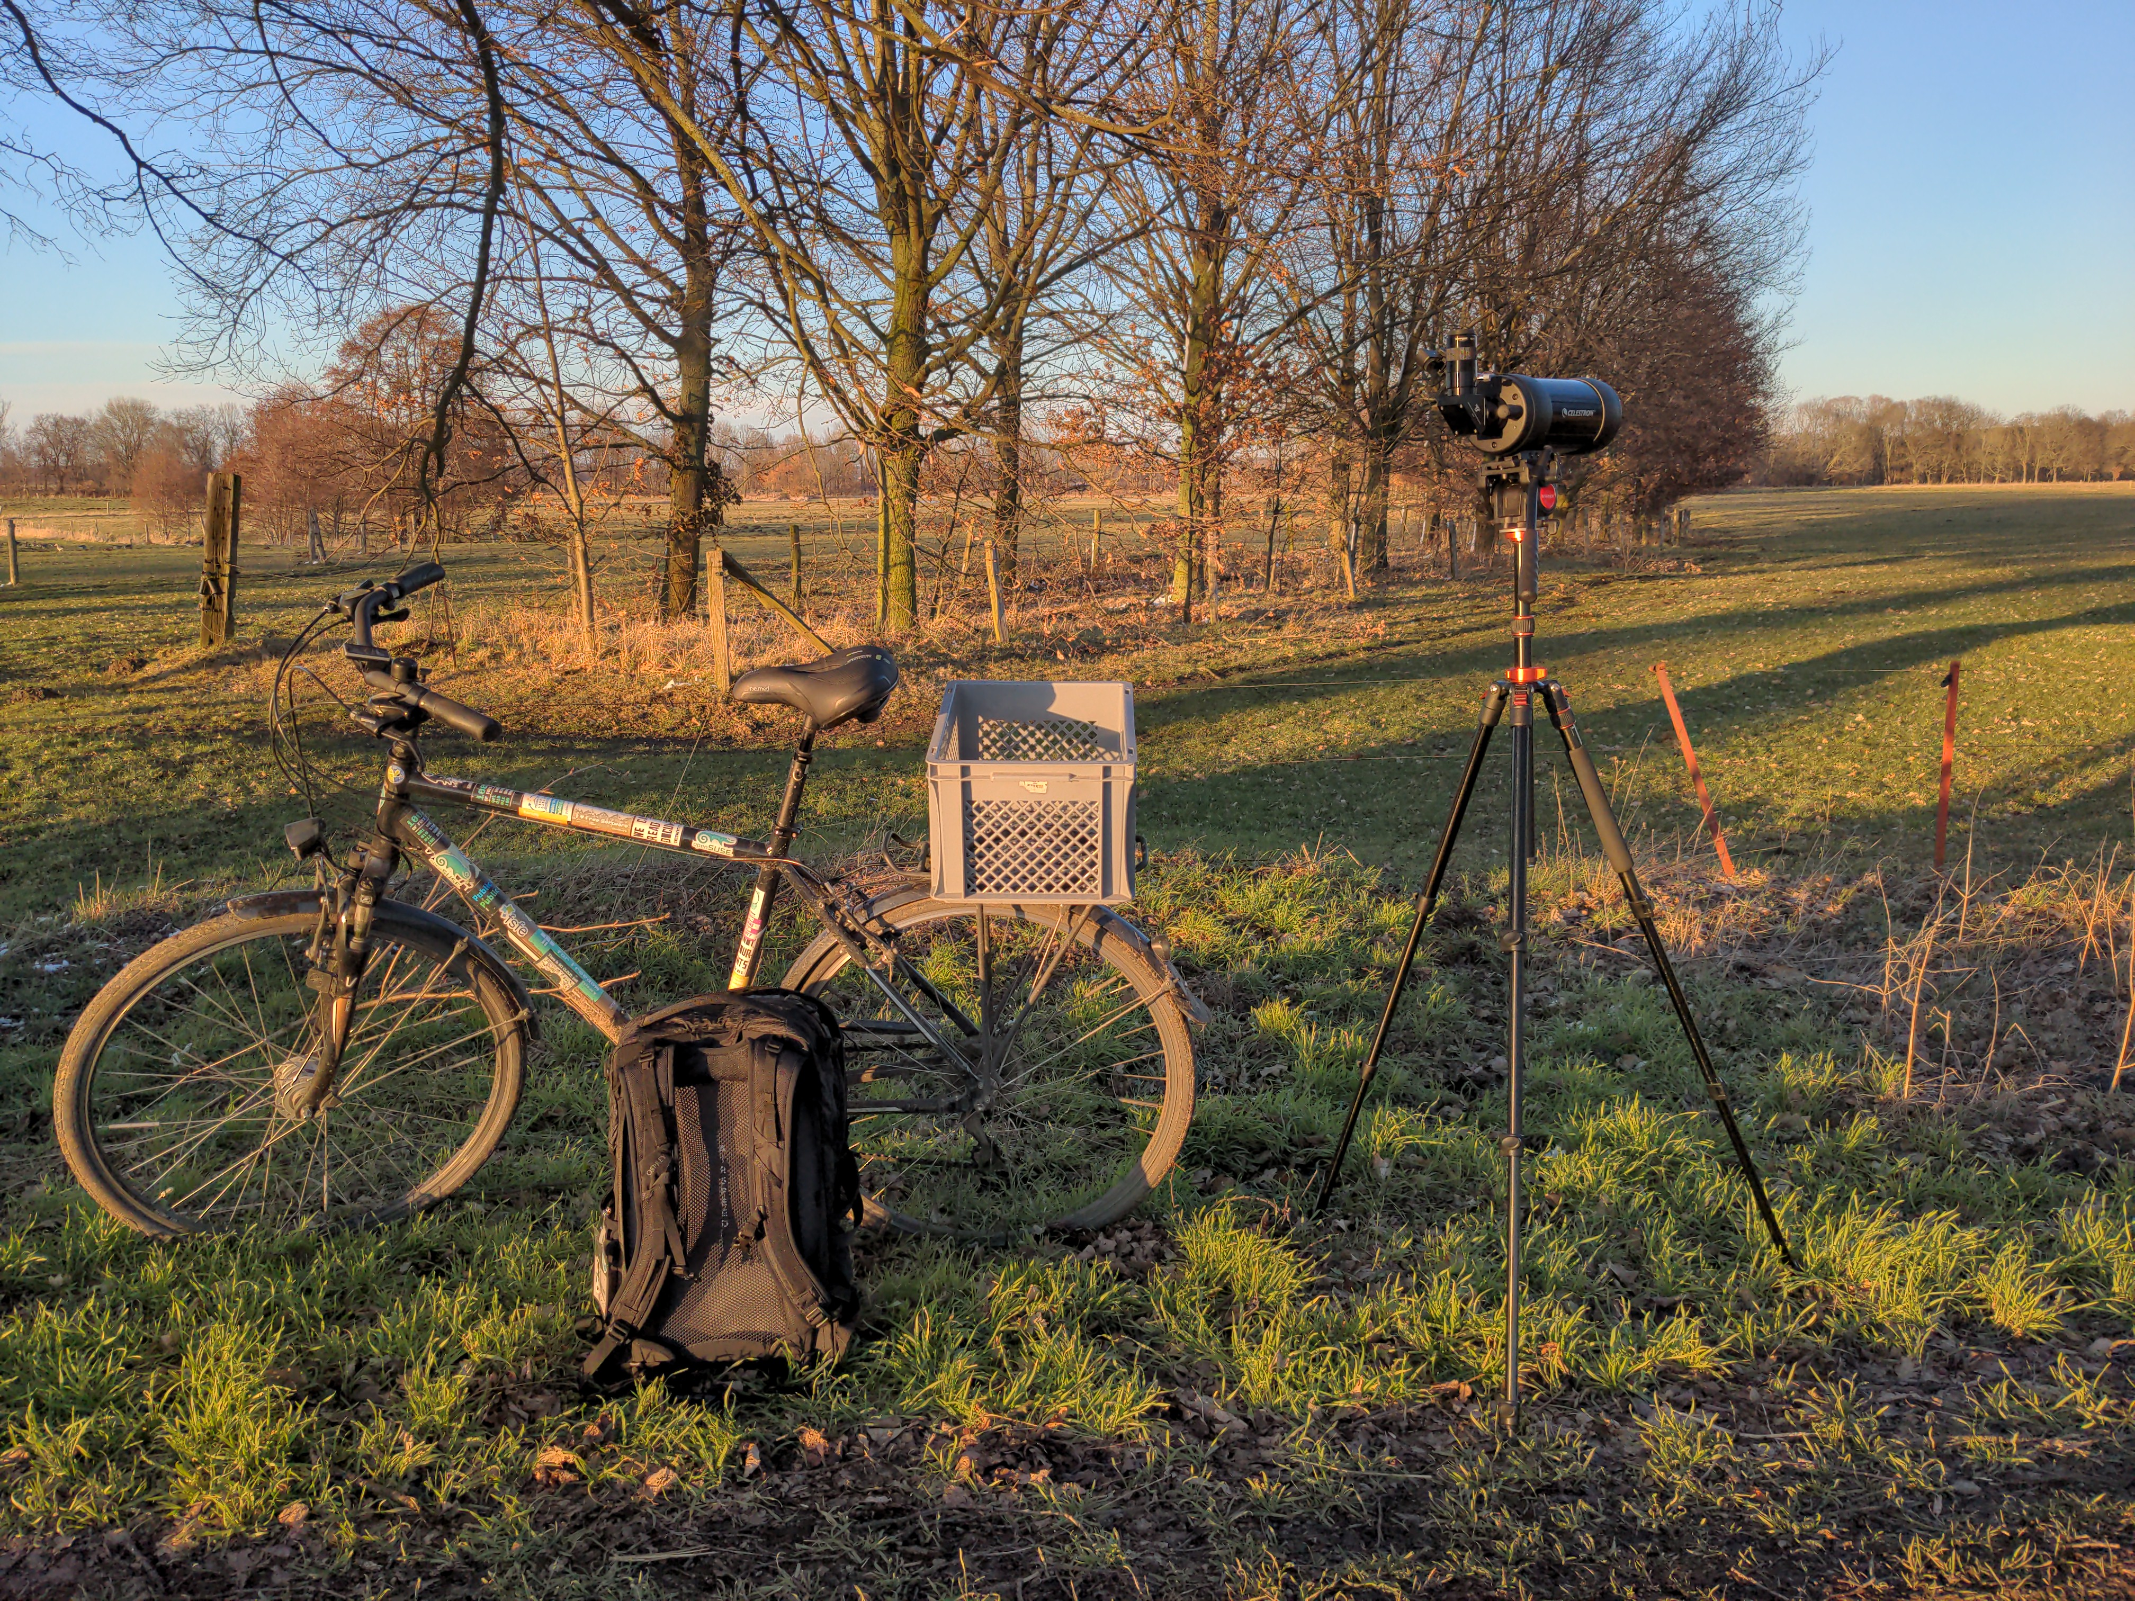
Dr. Lucas Lasota, MA, PhD
Senior Legal Project Manager, Legal Researcher and Lecturer
Affiliation: Humboldt University and Free Software Foundation Europe
Birds
On Mars

Slide 3

Agenda
Why “Free Software”?
FS licensing compliance issues
FS licensing and AI
This presentation does not configure neither legal nor business advice, but fits only educational and training purposes.

Slide 4

Why software licensing?
Copyright applies by default: very strong protection
    Injunctions, damages and criminal penalties
Licenses are the main legal instrument to waive and grant rights
No license does not configure public domain

Slide 5
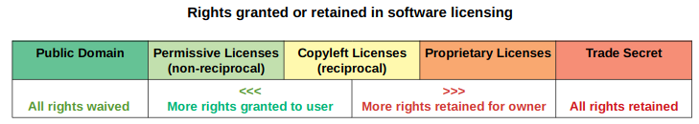

Licensing
Full spectrum of rights management

Slide 6
Software licensing models
Free and Open Source
Proprietary
Main purpose
Software freedom
. Reciprocal
(copyleft)
. Non-reciprocal
(permissive)
Main purpose
Limit ways to access
and control source code

Slide 7
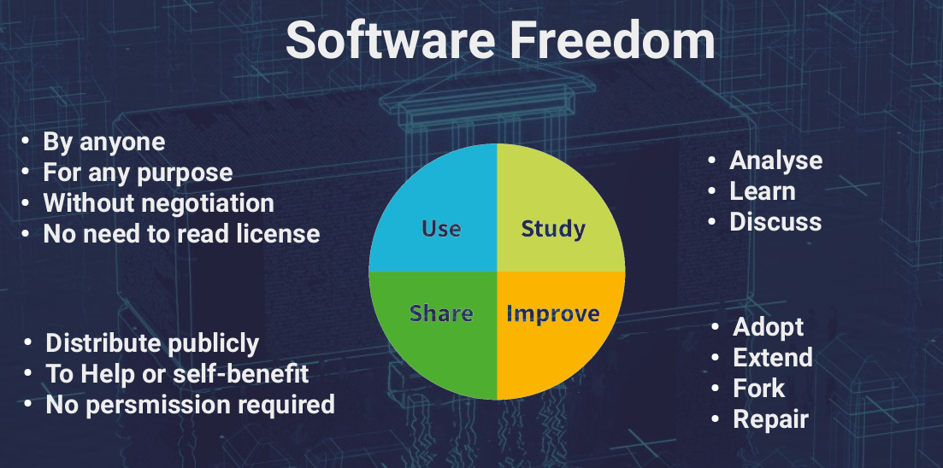
Free Software as an ethical movement

Slide 8



Social components of Free Software licenses
Sets the terms of use and distribution of the software
License
and
communities
Constitutes the bases for working environment among developers and users
Establishes the ground for software maintenance and further development

Slide 9






Free Software Licenses Types
Reciprocal
(copyleft)
Non-reciprocal
(permissive)
Main aspects
. If you distribute, you must
use the same license terms
. If you distribute, you must
provide source code
Main aspect
. If you distribute, you must
provide license/copyright notice

Slide 10
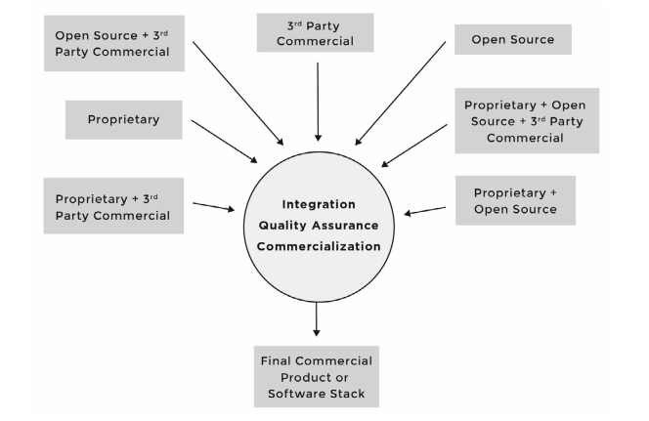
Free Software License Compliance
Source: Haddad, Ibrahim et al. Open Source Compliance in the Enterprise. The Linux Foundation, 2018, p. 18.

Slide 11
Compliance issues related to Free Software
Problem type | Solution
Inbound license obligations | License scan and mapping License compatibility workflow
Outbound license obligations | License compliance workflow (source code provision, licenses notices, etc)
Patents and trade secrets (NDA) involved? | IP management workflow
Project’s trademarks? | Trademark policy
Exporting or transferring technology of dual-use items? | Export control compliance workflow
Managing external contributions | Contribution policy Contribution licensing agreements (CLA, DCO, employment issues)
Source: Haddad, Ibrahim et al. Open Source Compliance in the Enterprise.
The Linux Foundation, 2018.

Slide 12


Slide 13
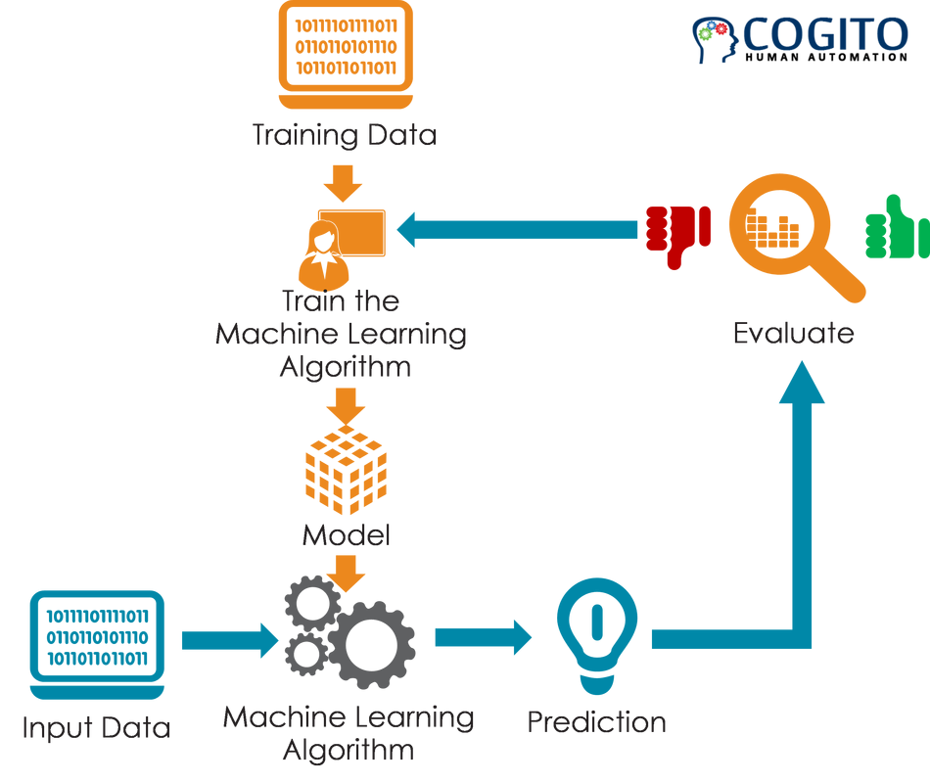
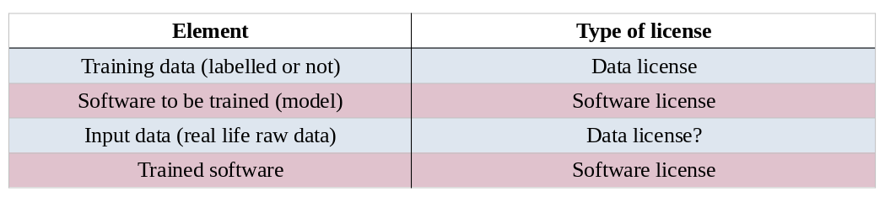
AI models and licensing
Source: What is a training data set in Machine Learning and rules to select them? Cogito, 2018.

Slide 14

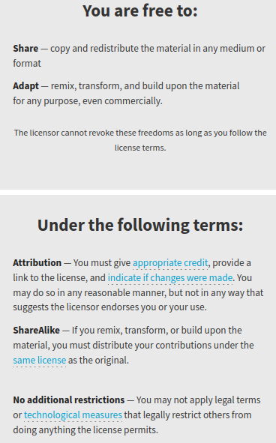
Content & Data Licensing
Audio/video/images
Documentation
Data and metadata
PS: Copyright exceptions for data mining
(Directive EU 2019/70)
- Non profit (research, cultural)
- Any other usage if not expressly reserved by right-holders
- Exceptions override contrary contractual provisions
Source: Creative Commons, About Licenses. CC BY 4.0 https://creativecommons.org/about/cclicenses/

Slide 15
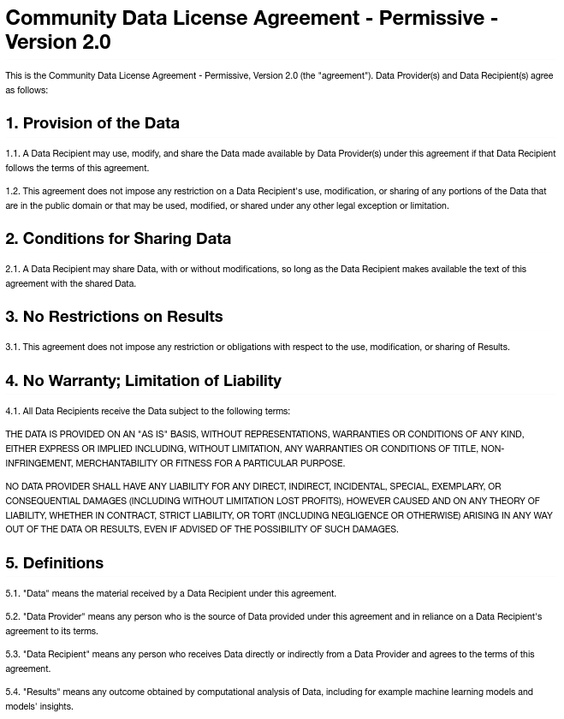

Slide 16
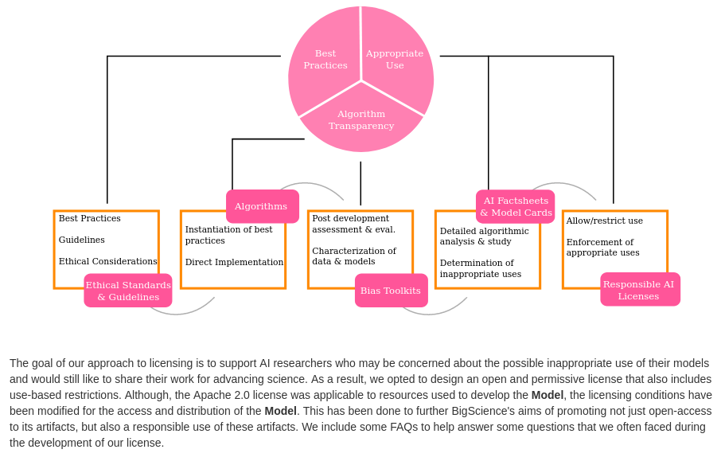
BigScience RAIL License model
Source: The BigScience RAIL License 2022. Available at: https://bigscience.huggingface.co/blog/the-bigscience-rail-license

Slide 17
Further resources
Bibliography on FOSS compliance
https://www.zotero.org/groups/4870654/foss_compliance/library
FSFE’s License Questions Team
https://fsfe.org/activities/licence-questions/licence-questions.html

Slide 18
Take aways
AI systems may involve several data and software elements that are licensed differently. These licenses operate differently and have diverse scope of application.
Free software licenses are the main instrument for safeguarding the “four freedoms”: use, study, improve, share. They come in two flavors: reciprocal and non-reciprocal.
License compliance issues are complex and involve not only copyright but other legal and operational elements (e.g. GitHub Copilot case). Establishing a FS compliance workflow is key.

Slide 19
Thank you!
Discussion warm up
How Free Software helps improving AI systems?
Illustrations kindly provided by Undraw

