Slide 1

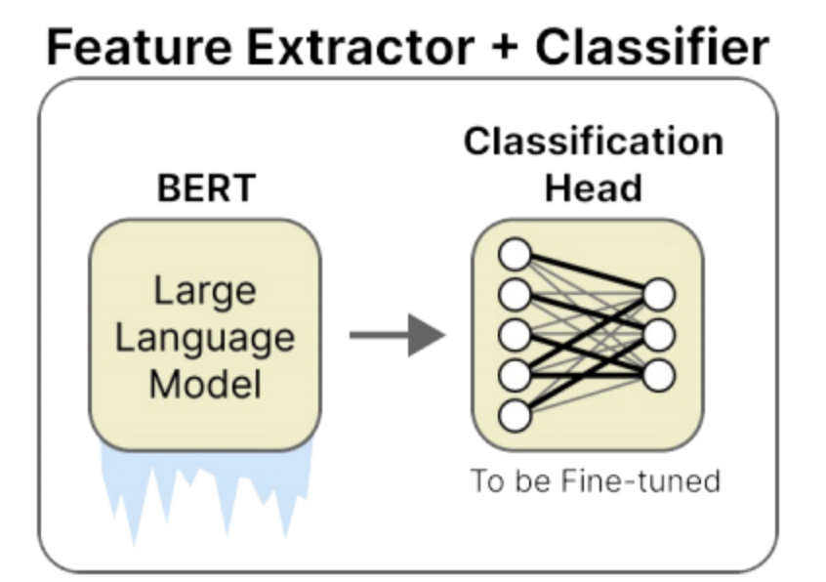

Globally Complete, Locally Grounded: SHAP-Guided Concept Discovery
Guangjie Li , Zhenling Chen
Deep neural networks achieve outstanding performance but often lack transparency. This presentation introduces a novel approach that integrates local attributions from SHAP into concept discovery for neural networks, creating explanations that are both globally sufficient and locally grounded.
Our method identifies influential segments using SHAP values, clusters them to obtain meaningful centers, and then aligns concept vectors with these centers. The result is a set of interpretable concepts that maintain high completeness while being anchored to important model features.

Slide 2
Related Work
Feature-Based Explanation Methods
Sample-Based Explanation Methods
Techniques: LIME, SHAP
Technique: Explaining predictions by identifying similar training examples
Key Point: Assign importance scores to input features, offering local explanations but lacking insight into the global reasoning process.
Key Point: Intuitive but do not provide a formal global framework.
Counterfactual Explanation Methods
Concept-Based Explanations
Focus: Determine "what to change" in the input to alter the model's output
Techniques:
TCAV uses human-annotated concepts for directional sensitivities.
Key Point: Provide actionable insights yet fall short in revealing the underlying factors driving predictions.
ACE automatically discovers concepts via clustering image patches.
Unsupervised methods (e.g., PCA) extract latent factors, though they may not align with human semantics.
Key Point: Unsupervised semantic discovery often requires inductive biases to achieve meaningful results.

Slide 3






The Challenge of Neural Network Interpretability
Black Box Nature
Local vs. Global Explanations
Human-Friendly Concepts
Deep neural networks achieve state-of-the-art performance across domains but their complex internal workings remain opaque to humans.
Traditional methods like SHAP provide local explanations for individual predictions but often fail to capture the global reasoning of the model.
Humans prefer to explain decisions using high-level concepts—grouping similar examples and reasoning in terms of abstract ideas.
Concept-Based Explanations
Concept-based explanations provide human-friendly insights by discovering vectors that represent high-level factors in the latent space. These approaches assume that concepts lie in a low-dimensional subspace of an intermediate DNN layer.
Completeness
Interpretability
Representation
How sufficient concepts are for reconstructing model decisions
How meaningful concepts are to humans
How concepts capture latent space directions

Slide 4
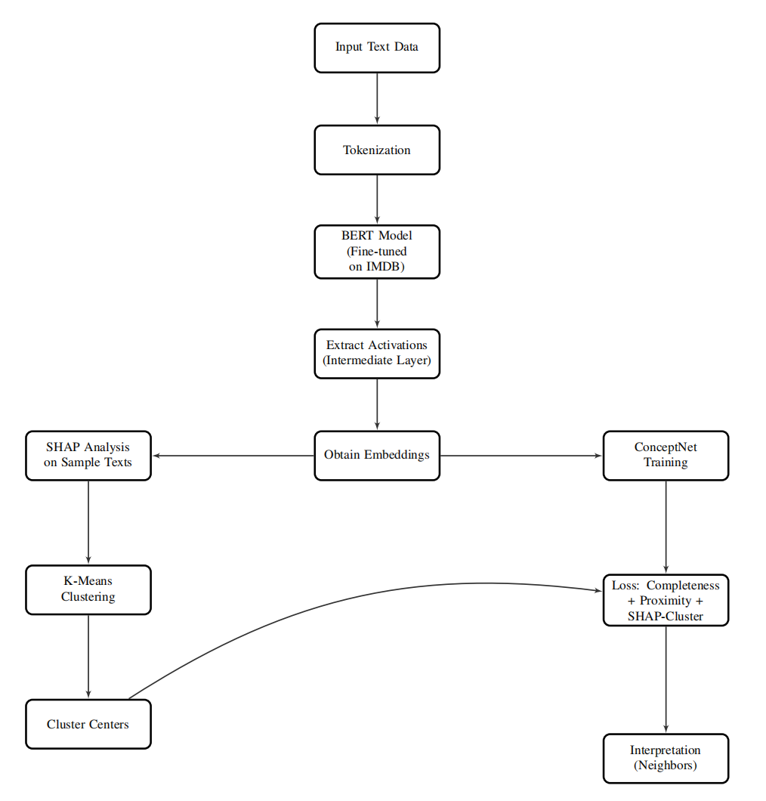
Our Approach: Bridging Local and Global Explanations
1. Fine-tuning & Activation Extraction
- Fine-tune a BERT model for sentiment classification.
- Extract intermediate activations to serve as feature representations.
2. SHAP Value Computation & Clustering
- Compute sentence-level SHAP values to identify influential features.
- Cluster the high-level embeddings to derive semantic cluster centers that capture key patterns.
3. ConceptNet Model Training with Composite Loss
- Train a ConceptNet model using a composite loss function that includes:
- Proximity Regularizer:Ensures concept vectors are close to the corresponding high-level features.
- SHAP-Cluster Regularizer:Enforces alignment between the cluster centers and the learned concepts.
4. Concept Interpretation via Nearest Neighbor Analysis
- Analyze the learned concept vectors by finding their nearest neighbors to interpret and validate the semantic meaning of each concept.

Slide 5
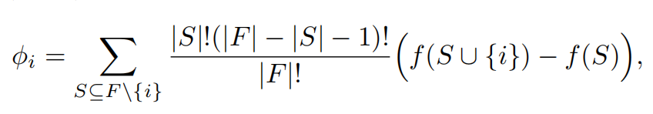


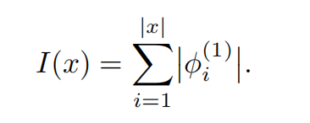
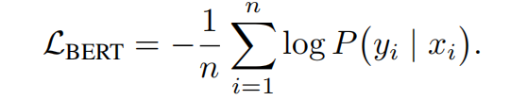
BERT Fine-Tuning & Activation Extraction
SHAP Analysis & Cluster Center Extraction
Pre-trained Model & Task
Use a pre-trained BERT model fine-tuned on IMDB sentiment
classification.
Each review xi is tokenized; sentiment label yi​∈{0,1}.
Model Structure
Defined as:
SHAP Value Computation
Compute sentence-level SHAP values for a subset of training samples.
For a token i in sentence x, the SHAP value is:
where is an intermediate embedding and h(⋅) is the classification head.
Importance Score & Selection
Aggregate absolute SHAP contributions for the positive class each sentence:
Training Objective
Minimize standard cross-entropy loss
Rank sentences by I(x) and select the top-k
Activation Extraction
Use a forward hook to extract activations from the penultimate
layer for later use.
Clustering for Semantic Centers
Cluster the corresponding BERT embeddings using K-means.
The resulting cluster centers μ1​,μ2​,…,μN​} capture dominant high-level semantics.

Slide 6





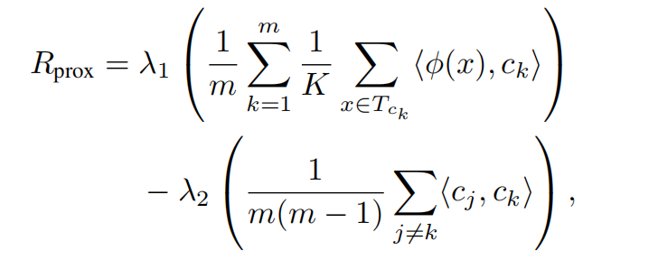
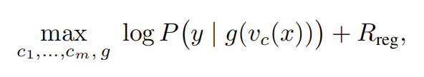

ConceptNet Training Overview
Proximity Regularization
Purpose
Encourages each concept vector to be close to its top-K nearest neighbors (patches or segments) in the training data.
Simultaneously maintains diversity among different concept vectors.
Mathematical Formulation
For each concept , denote as its set of top-K nearest neighbors.
The proximity regularizer is defined as:
Objective
Learn a set of m concept vectors {c1,c2,…,cm}⊂Rd such that the concept score
, is a sufficient statistic for predicting y.
Mapping to Prediction
Assume existence of a mapping g: so that:
Overall Objective Function
Maximize the log-likelihood of predictions with the composite regularizer:
λ1​ and λ2​ are hyperparameters that balance the two terms.

Slide 7
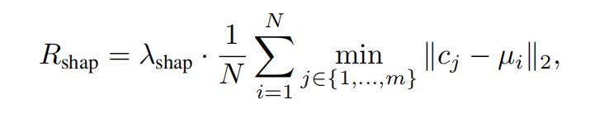

SHAP-Cluster Regularization & Final Loss
SHAP-Cluster Regularization
Aligns learned concept vectors with the cluster centers from the SHAP analysis.
The SHAP-cluster loss is:
Interpretation and Analysis of Concept Vectors
Concept Loading:
Load learned concept vectors from a NumPy file (shape: m × d, where m = number of concepts, d = embedding dimension).
Embedding Preparation:
Convert training embeddings (BERT activations) into a torch tensor for analysis.
Nearest Neighbor Search:
Compute Euclidean distances between each concept vector and all training embeddings.
Retrieve the top 150 training examples (neighbors) with the smallest distances for each concept.
Word Extraction & Frequency Analysis:
Extract words from the input sentences corresponding to the top-150 neighbors.
Filter out common stop words and punctuation, then count word frequencies.
Concept Characterization:
Report the 25 most common words for each concept to interpret its semantic meaning.
This term minimizes the average distance between each cluster center and its closest concept vector.
Final Objective
The complete loss function is:
Where:
Lpred​ is the prediction loss (cross-entropy).
The composite loss enforces that the concept scores are both predictive and semantically aligned with important features.

Slide 8
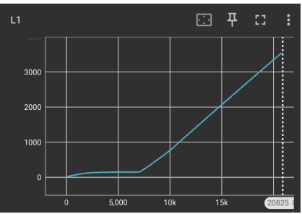
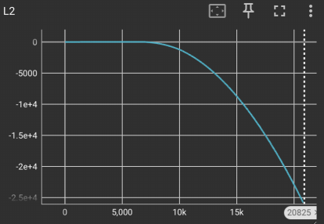
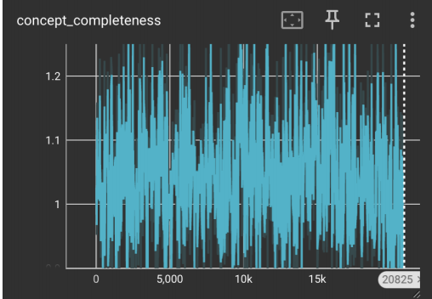
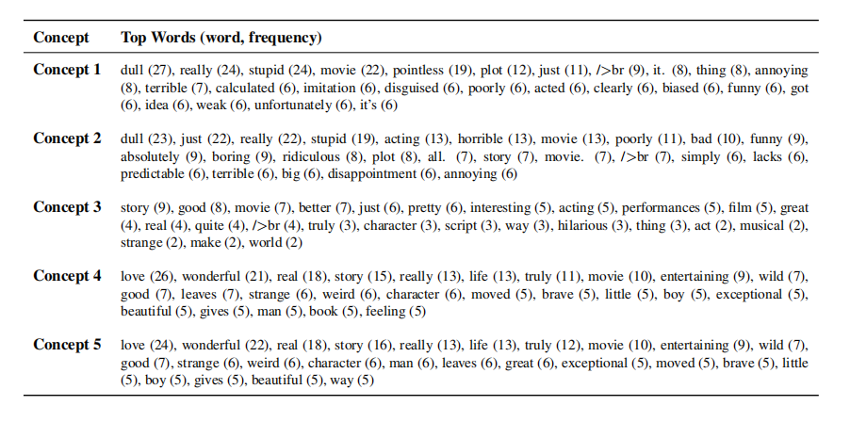
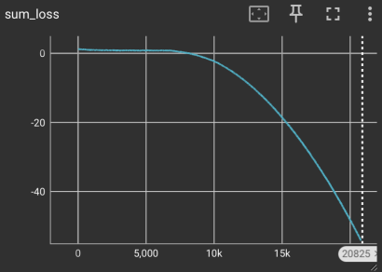
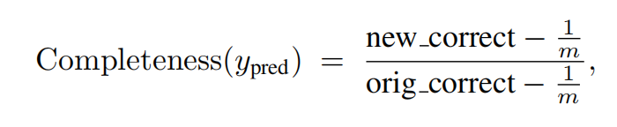
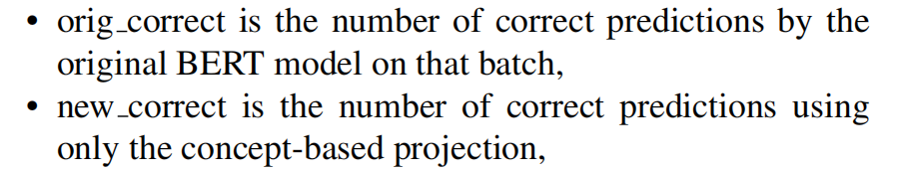
Evaluation Results
Completeness Score
Concept Analysis
Training Metrics
The completeness metric stabilizes around a value close to 1.0, indicating that our concept-based projection retains most of the predictive power of the original BERT model.
Semantic analysis of top neighbor patches confirms that each concept captures a coherent theme, ranging from strongly negative sentiment ("dull", "stupid") to positive sentiment ("love", "wonderful").
TensorBoard logs show the proximity term (L1) increasing as concept vectors move closer to their neighbors, while the orthogonality term (L2) decreases as concepts become more distinct from each other,and the total loss with shap term.

Slide 9
Discovered Concepts and Nearest Neighbors
Concept
Top Words (word, frequency)
Concept 1 (Negative)
dull (27), really (24), stupid (24), movie (22), pointless (19), plot (12), just (11), terrible (7), annoying (8)
Concept 2 (Negative)
dull (23), just (22), really (22), stupid (19), acting (13), horrible (13), movie (13), poorly (11), bad (10)
Concept 3 /Positive)
story (9), good (8), movie (7), better (7), just (6), pretty (6), interesting (5), acting (5), performances (5)
Concept 4 (Positive)
love (26), wonderful (21), real (18), story (15), really (13), life (13), truly (11), movie (10), entertaining (9)
Concept 5 (Positive)
love (24), wonderful (22), real (18), story (16), really (13), life (13), truly (12), movie (10), entertaining (9)
The learned concept vectors clearly capture high-level sentiment patterns. Concepts 1 and 2 are associated with negative sentiment words, while Concepts 3, 4, and 5 capture increasingly positive sentiments, demonstrating the effectiveness of our approach in discovering interpretable concepts.

Slide 10
Conclusions and Future Directions
5
~1.0
Discovered Concepts
Completeness Score
Key Innovations
Interpretable concept vectors that strongly correlate with sentiment
Indicating minimal loss of predictive power
Local proximity, orthogonality with SHAP-based regularization
We successfully integrated local attributions from SHAP into concept discovery, creating explanations that are both globally sufficient and locally grounded. Our method bridges concept-based interpretability with state-of-the-art language models, ensuring that learned concepts remain both semantically meaningful and highly predictive.
Future directions include extending to incorporating concept-based interpretability into generative language models, and integrating concept regularization directly into model fine-tuning for more robust or disentangled concepts.

Slide 11
Thank you
https://github.com/lucasli05/XAI_Shap-concept_NN_for_LLM

