Slide 1
Unit 6 Array and Pointer
Array indexing involves
  Multiplying index element by byte number
  Adding to array base address
Pointers correspond directly to memory addresses
  Can avoid indexing complexity
§2.14 Arrays versus Pointers
Chapter 2 — Instructions: Language of the Computer — <number>
Notes:
The University of Adelaide, School of Computer Science
Chapter 2 — Instructions: Language of the Computer

Slide 2
Example: Clearing and Array
clear1(int array[], int size) { int i; for (i = 0; i < size; i += 1) array[i] = 0; } // i->$t0, array[]->$a0, size->$a1 | clear2(int *array, int size) { int *p; for (p = &array[0]; p < &array[size]; p = p + 1) *p = 0; } //p->$t0, array[0]->$a0, size->$a1
move $t0,$zero # i = 0 loop1: sll $t1,$t0,2 # $t1 = i * 4 add $t2,$a0,$t1 # $t2=&array[i] sll $t4,$a1,2 # $t4 = size*4 sw $zero, 0($t2) # array[i] = 0 addi $t0,$t0,1 # i = i + 1 slt $t3,$t0,$t4 # set $t3 = 1 # if (i<size) bne $t3,$zero,loop1 # if(i<size) # goto loop1 | move $t0,$a0 # p = & array[0] sll $t1,$a1,2 # $t1 = size * 4 add $t2,$a0,$t1 # $t2 = # &array[size] loop2: sw $zero,0($t0) # Memory[p] = 0 addi $t0,$t0,4 # p = p + 4 slt $t3,$t0,$t2 # $t3 = #(p<&array[size]) bne $t3,$zero,loop2 # if (…) # goto loop2
Chapter 2 — Instructions: Language of the Computer — <number>
Notes:
The University of Adelaide, School of Computer Science
Chapter 2 — Instructions: Language of the Computer

Slide 3
Comparison of Array vs. Ptr
Multiply can be done by left shift bit
Array version requires new member address to add to the base array address inside loop
  Pointer version just add new member index inside the loop to get new pointer address;
  Pointer doesn’t need to add array base address to new member pointer address inside the loop
Chapter 2 — Instructions: Language of the Computer — <number>
Notes:
The University of Adelaide, School of Computer Science
Chapter 2 — Instructions: Language of the Computer

Slide 4
ARM & MIPS Similarities
ARM: the most popular embedded core
Similar basic set of instructions to MIPS
§2.16 Real Stuff: ARM Instructions
 | ARM | MIPS
Date announced | 1985 | 1985
Instruction size | 32 bits | 32 bits
Address space | 32-bit flat | 32-bit flat
Data alignment | Aligned | Aligned
Data addressing modes | 9 | 3
Registers | 15 × 32-bit | 32 × 32-bit
Input/output | Memory mapped | Memory mapped
Chapter 2 — Instructions: Language of the Computer — <number>
Notes:
The University of Adelaide, School of Computer Science
Chapter 2 — Instructions: Language of the Computer

Slide 5
Compare and Branch in ARM
Uses condition codes for result of an arithmetic/logical instruction
  Negative, zero, carry, overflow
  Compare instructions to set condition code
Each instruction can be conditional
  Top 4 bits of instruction word: condition value
Chapter 2 — Instructions: Language of the Computer — <number>
Notes:
The University of Adelaide, School of Computer Science
Chapter 2 — Instructions: Language of the Computer

Slide 6

Instruction Encoding
Chapter 2 — Instructions: Language of the Computer — <number>
Notes:
The University of Adelaide, School of Computer Science
Chapter 2 — Instructions: Language of the Computer

Slide 7
The Intel x86 ISA
Evolution with backward compatibility
  8080 (1974): 8-bit microprocessor
    Accumulator, plus 3 index-register pairs
  8086 (1978): 16-bit extension to 8080
    Complex instruction set (CISC)
  8087 (1980): floating-point coprocessor
    Adds FP instructions and register stack
  80286 (1982): 24-bit addresses, MMU
    Segmented memory mapping and protection
  80386 (1985): 32-bit extension (now IA-32)
    Additional addressing modes and operations
    Paged memory mapping as well as segments
§2.17 Real Stuff: x86 Instructions
Chapter 2 — Instructions: Language of the Computer — <number>
Notes:
The University of Adelaide, School of Computer Science
Chapter 2 — Instructions: Language of the Computer

Slide 8
The Intel x86 ISA
Further evolution…
  i486 (1989): pipelined, on-chip caches and FPU
    Compatible competitors: AMD, Cyrix, …
  Pentium (1993): superscalar, 64-bit datapath
    Later versions added MMX (Multi-Media eXtension) instructions
  Pentium Pro (1995), Pentium II (1997)
  Pentium III (1999)
    Added SSE (Streaming SIMD Extensions) and associated registers
  Pentium 4 (2001)
    New microarchitecture
    Added SSE2 instructions
Chapter 2 — Instructions: Language of the Computer — <number>
Notes:
The University of Adelaide, School of Computer Science
Chapter 2 — Instructions: Language of the Computer

Slide 9
The Intel x86 ISA
And further…
  AMD64 (2003): extended architecture to 64 bits
  EM64T – Extended Memory 64 Technology (2004)
    AMD64 adopted by Intel (with refinements)
    Added SSE3 instructions
  Intel Core (2006)
    Added SSE4 instructions, virtual machine support
  AMD64 (announced 2007): SSE5 instructions
    Intel declined to follow
If Intel didn’t extend with compatibility, its competitors would!
  Technical elegance ≠ market success
Chapter 2 — Instructions: Language of the Computer — <number>
Notes:
The University of Adelaide, School of Computer Science
Chapter 2 — Instructions: Language of the Computer

Slide 10
Basic x86 Addressing Modes
Two operands per instruction
Source/dest operand | Second source operand
Register | Register
Register | Immediate
Register | Memory
Memory | Register
Memory | Immediate
Chapter 2 — Instructions: Language of the Computer — <number>
Notes:
The University of Adelaide, School of Computer Science
Chapter 2 — Instructions: Language of the Computer

Slide 11

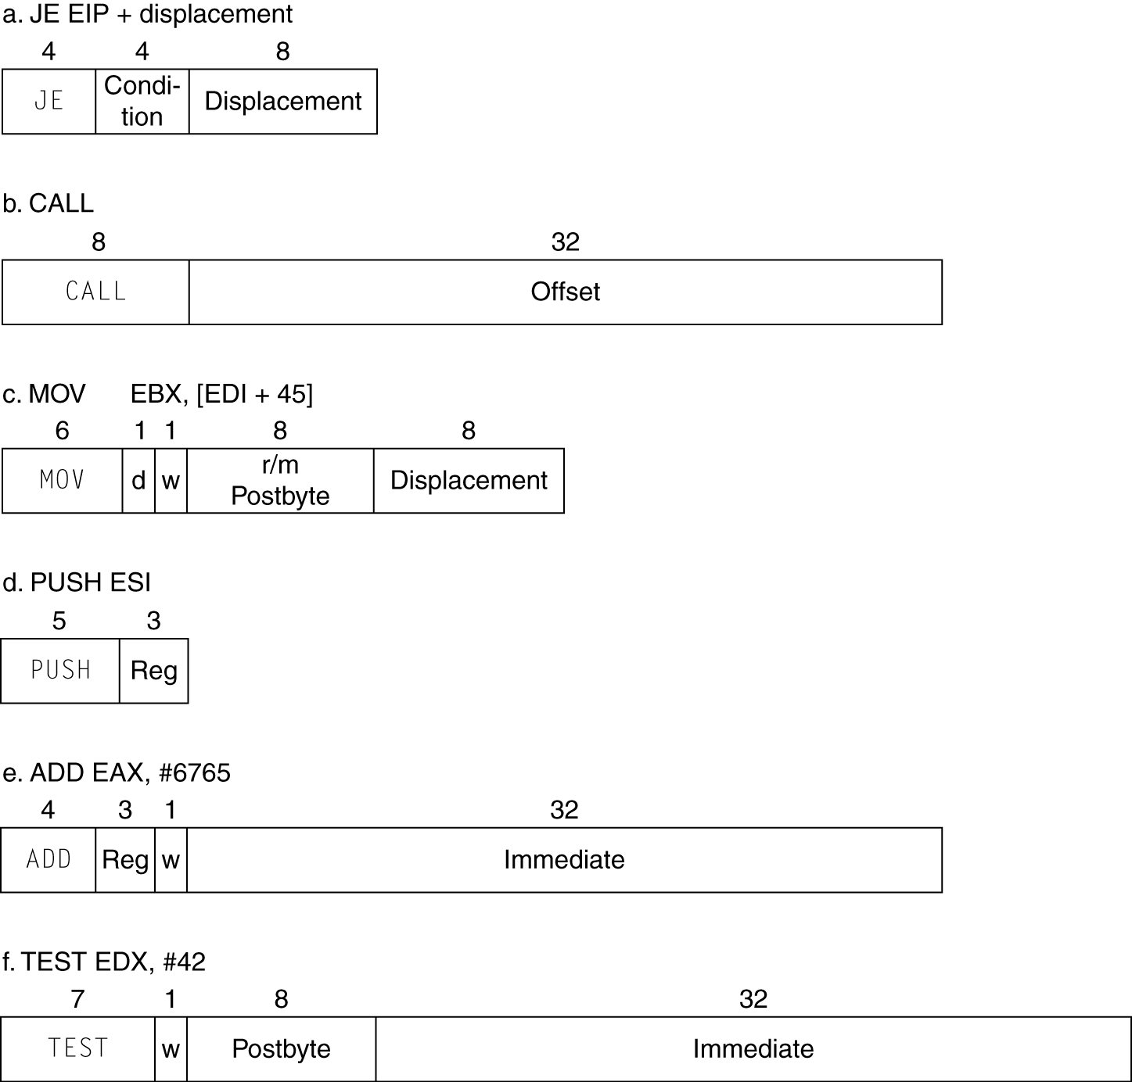
x86 Instruction Formats Samples
Chapter 2 — Instructions: Language of the Computer — <number>
Notes:
The University of Adelaide, School of Computer Science
Chapter 2 — Instructions: Language of the Computer

Slide 12
Implementing IA-32
Complex instruction set makes implementation difficult
  Hardware translates instructions to simpler microoperations
  Similar to RISC
  Market share makes this economically viable
Comparable performance to RISC
Chapter 2 — Instructions: Language of the Computer — <number>
Notes:
The University of Adelaide, School of Computer Science
Chapter 2 — Instructions: Language of the Computer

Slide 13
ARM v8 Instructions
In moving to 64-bit, ARM did a complete overhaul
ARM v8 resembles MIPS
  Changes from v7:
    No conditional execution field (ie, No condition code)
    Immediate field is 12-bit constant
    Dropped load/store multiple
    Addressing modes work for all word sizes
    Divide instruction
    Branch if equal/branch if not equal instructions
§2.18 Real Stuff: ARM v8 (64-bit) Instructions
Chapter 2 — Instructions: Language of the Computer — <number>

Slide 14
Fallacies
Powerful instruction ⇒ higher performance
  Fewer instructions required
  But complex instructions are hard to implement
    May slow down all instructions, including simple ones
  Compilers are good at making fast code from simple instructions
Use assembly code for high performance
  But modern compilers are better at dealing with modern processors
  More lines of code ⇒ more errors and less productivity
§2.19 Fallacies and Pitfalls
Chapter 2 — Instructions: Language of the Computer — <number>
Notes:
The University of Adelaide, School of Computer Science
Chapter 2 — Instructions: Language of the Computer

Slide 15

Fallacies
Backward compatibility ⇒ instruction set doesn’t change
  But they do create more instructions
x86 instruction set
Chapter 2 — Instructions: Language of the Computer — <number>
Notes:
The University of Adelaide, School of Computer Science
Chapter 2 — Instructions: Language of the Computer

Slide 16
Pitfalls
Sequential words are in sequential addresses ?
  Increment by 4, not by 1!
What are needed to make sure the subroutine procedures to return the values and control back to the calling main program ?
  Main program uses $a0 to $a3 to pass arguments to the calling procedure
  Subroutine uses $v0 to $v1 to pass the values back
  to the main routine
  Subroutine uses $ra to return control back to the calling main program
Chapter 2 — Instructions: Language of the Computer — <number>
Notes:
The University of Adelaide, School of Computer Science
Chapter 2 — Instructions: Language of the Computer

Slide 17
Concluding Remarks
Design principles
  1. Simplicity favors regularity
  2. Smaller is faster
  3. Make the common case fast
  4. Good design demands good compromises
Layers of software/hardware
  Compiler, assembler, hardware
MIPS: typical of RISC ISAs
§2.20 Concluding Remarks
Chapter 2 — Instructions: Language of the Computer — <number>
Notes:
The University of Adelaide, School of Computer Science
Chapter 2 — Instructions: Language of the Computer

Slide 18
Concluding Remarks
Measure MIPS instruction executions in benchmark programs
  Consider making the common case fast
  Consider compromises
Chapter 2 — Instructions: Language of the Computer — <number>
Notes:
The University of Adelaide, School of Computer Science
Chapter 2 — Instructions: Language of the Computer

Slide 19
Unit 6 Homework
1. Is it true that processor with more instructions mean higher
performance ? Give examples to support your point.
2. What are the differences between array and pointer
MIPS Assembly codes ?
3. What are the algorithms used in the MIPS instructions to make
sure the main program can call the subroutine and the subroutine
can return the values and control back to the main program ?
Chapter 2 — Instructions: Language of the Computer — <number>
Notes:
The University of Adelaide, School of Computer Science
Chapter 2 — Instructions: Language of the Computer

