Slide 1
Chapter 4
The Processor
Notes:
Morgan Kaufmann Publishers
Chapter 4 — The Processor

Slide 2
Introduction
§4.1 Introduction
CPU performance factors
  Instruction count
    Determined by ISA and compiler
  CPI and Cycle time
    Determined by CPU hardware
We will examine two MIPS implementations
  A simplified version
  A more realistic pipelined version
Simple subset, shows most aspects
  Memory reference: lw, sw
  Arithmetic/logical: add, sub, and, or, slt
  Control transfer: beq, j
Chapter 4 — The Processor — <number>
Notes:
Morgan Kaufmann Publishers
Chapter 4 — The Processor

Slide 3
Instruction Execution
PC → instruction memory, fetch instruction
Register numbers → register file, read registers
Depending on instruction class
  Use ALU to calculate
    Arithmetic result
    Memory address for load/store
    Branch target address
  Access data memory for load/store
  PC ← target address or PC + 4
Chapter 4 — The Processor — <number>
Notes:
Morgan Kaufmann Publishers
Chapter 4 — The Processor

Slide 4
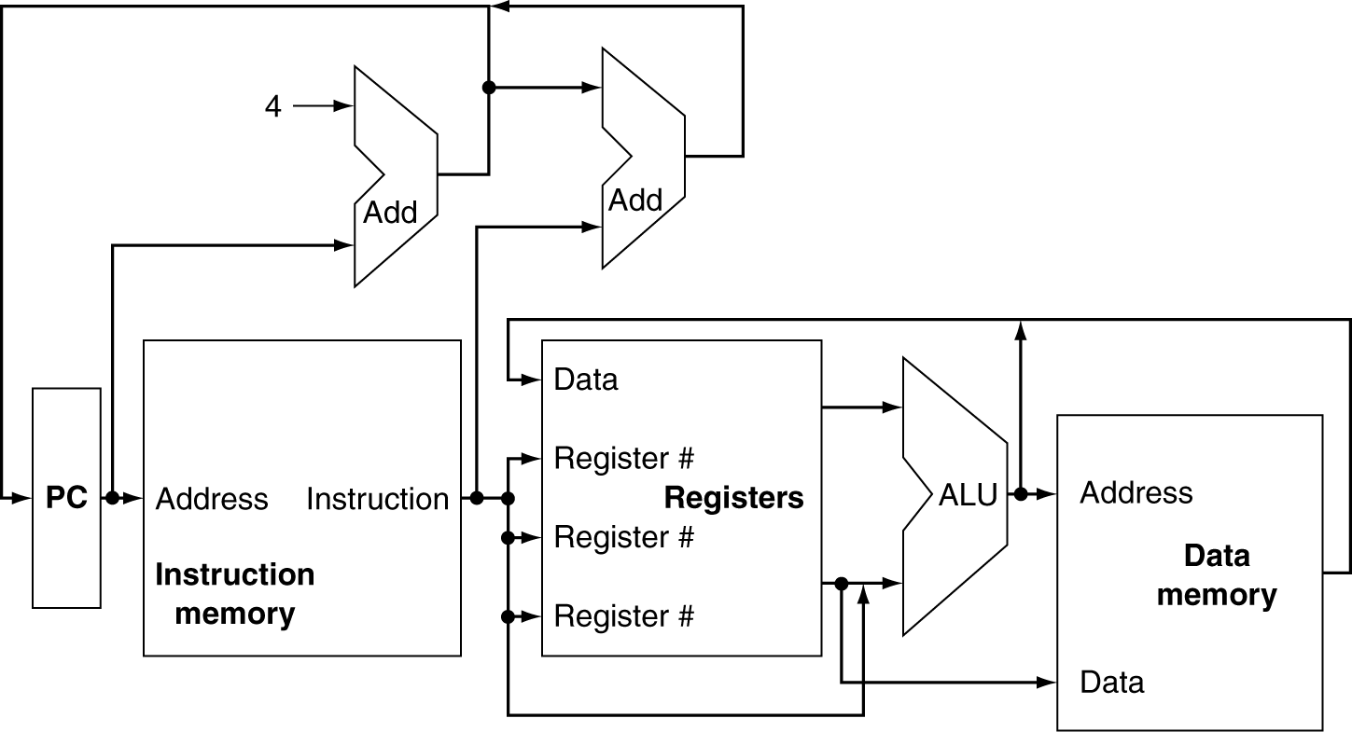
CPU Overview
Chapter 4 — The Processor — <number>
Notes:
Morgan Kaufmann Publishers
Chapter 4 — The Processor

Slide 5
Multiplexers
Can’t just join wires together
  Use multiplexers
Chapter 4 — The Processor — <number>
Notes:
Morgan Kaufmann Publishers
Chapter 4 — The Processor

Slide 6
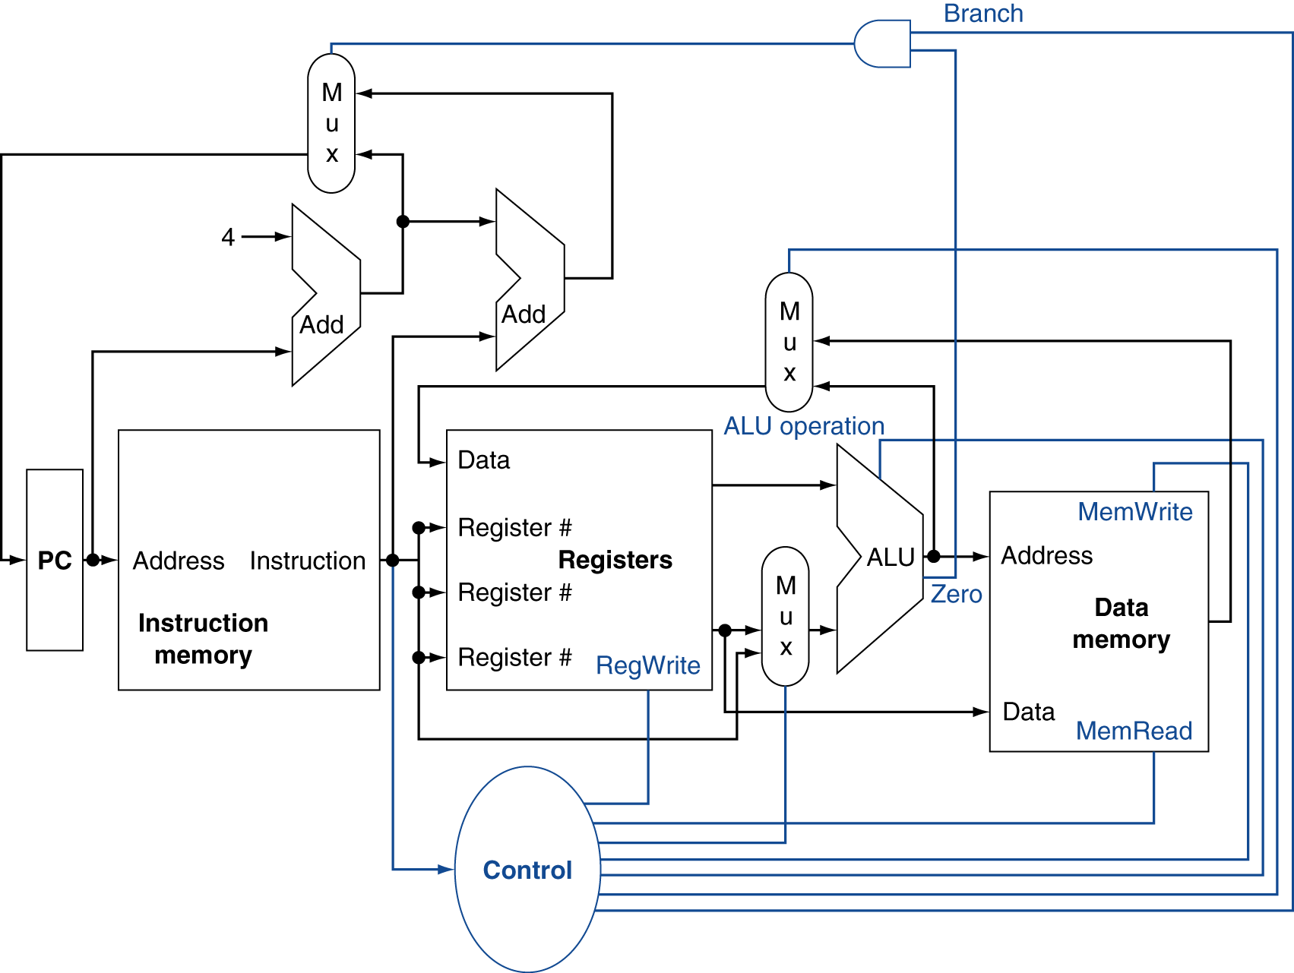
Control
Chapter 4 — The Processor — <number>
Notes:
Morgan Kaufmann Publishers
Chapter 4 — The Processor

Slide 7
Logic Design Basics
Information encoded in binary
  Low voltage = 0, High voltage = 1
  One wire per bit
  Multi-bit data encoded on multi-wire buses
Combinational element
  Operate on data
  Output is a function of input
State (sequential) elements
  Store information
§4.2 Logic Design Conventions
Chapter 4 — The Processor — <number>
Notes:
Morgan Kaufmann Publishers
Chapter 4 — The Processor

Slide 8
Combinational Elements
AND-gate
  Y = A & B
Adder
  Y = A + B
A
+
Y
B
A
Y
B
Arithmetic/Logic Unit
  Y = F(A, B)
Multiplexer
  Y = S ? I1 : I0
A
I0
M
u
x
Y
Y
ALU
I1
B
S
F
Chapter 4 — The Processor — <number>
Notes:
Morgan Kaufmann Publishers
Chapter 4 — The Processor

Slide 9
Sequential Elements
Register: stores data in a circuit
  Uses a clock signal to determine when to update the stored value
  Edge-triggered: update when Clk changes from 0 to 1
Clk
D
Q
D
Clk
Q
Chapter 4 — The Processor — <number>
Notes:
Morgan Kaufmann Publishers
Chapter 4 — The Processor

Slide 10
Sequential Elements
Register with write control
  Only updates on clock edge when write control input is 1
  Used when stored value is required later
Clk
D
Q
Write
Write
D
Clk
Q
Chapter 4 — The Processor — <number>
Notes:
Morgan Kaufmann Publishers
Chapter 4 — The Processor

Slide 11
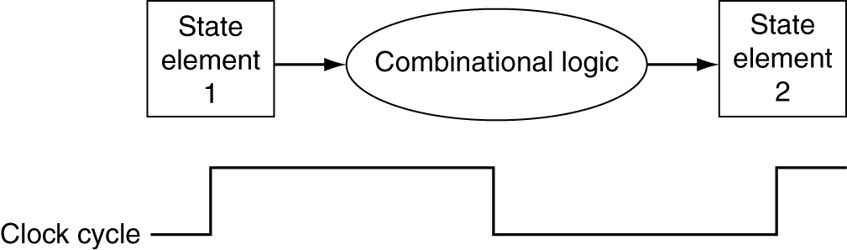
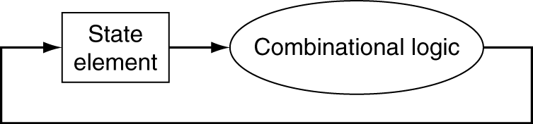
Clocking Methodology
Combinational logic transforms data during clock cycles
  Between clock edges
  Input from state elements, output to state element
  Longest delay determines clock period
Chapter 4 — The Processor — <number>
Notes:
Morgan Kaufmann Publishers
Chapter 4 — The Processor

Slide 12
Building a Datapath
Datapath
  Elements that process data and addresses
  in the CPU
    Registers, ALUs, mux’s, memories, …
We will build a MIPS datapath incrementally
  Refining the overview design
§4.3 Building a Datapath
Chapter 4 — The Processor — <number>
Notes:
Morgan Kaufmann Publishers
Chapter 4 — The Processor

Slide 13
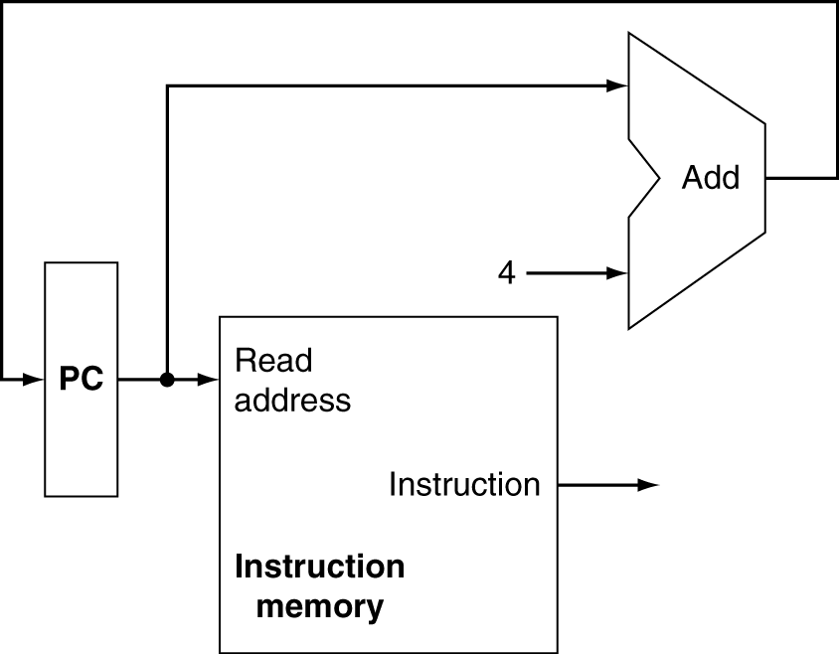
Instruction Fetch
Increment by 4 for next instruction
32-bit register
Chapter 4 — The Processor — <number>
Notes:
Morgan Kaufmann Publishers
Chapter 4 — The Processor

Slide 14
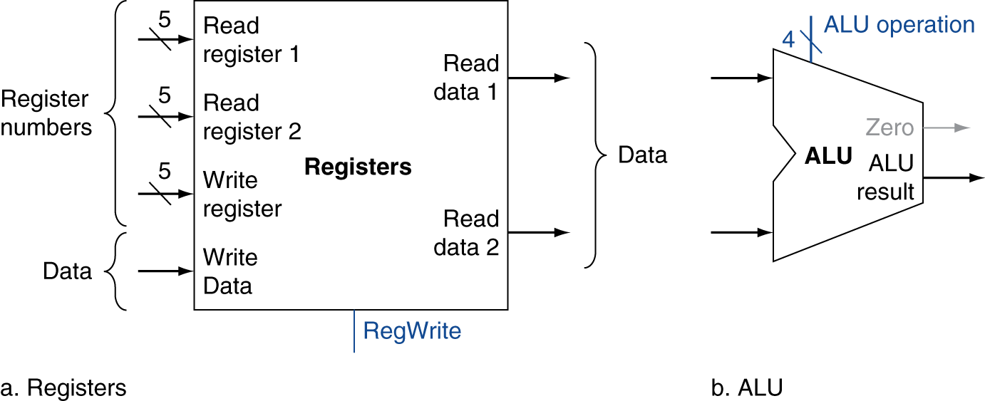
R-Format Instructions
Read two register operands
Perform arithmetic/logical operation
Write register result
Chapter 4 — The Processor — <number>
Notes:
Morgan Kaufmann Publishers
Chapter 4 — The Processor

Slide 15
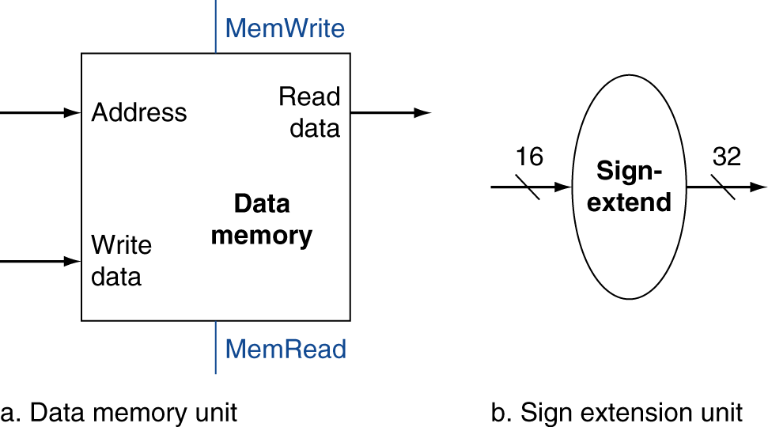
Load/Store Instructions
Read register operands
Calculate address using 16-bit offset
  Use ALU, but sign-extend offset
Load: Read memory and update register
Store: Write register value to memory
Chapter 4 — The Processor — <number>
Notes:
Morgan Kaufmann Publishers
Chapter 4 — The Processor

Slide 16
Branch Instructions
Read register operands
Compare operands
  Use ALU, subtract and check Zero output
Calculate target address
  Sign-extend displacement
  Shift left 2 places (word displacement)
  Add to PC + 4
    Already calculated by instruction fetch
Chapter 4 — The Processor — <number>
Notes:
Morgan Kaufmann Publishers
Chapter 4 — The Processor

Slide 17
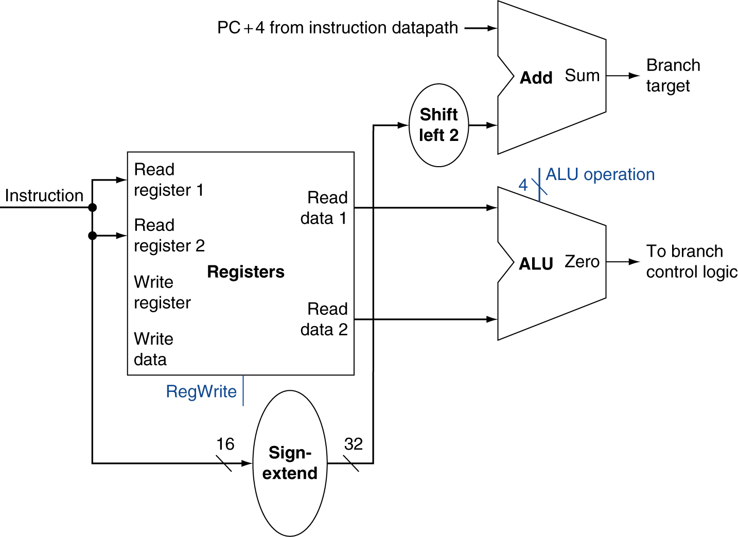
Branch Instructions
Just
re-routes wires
Sign-bit wire replicated
Chapter 4 — The Processor — <number>
Notes:
Morgan Kaufmann Publishers
Chapter 4 — The Processor

Slide 18
Composing the Elements
First-cut data path does an instruction in one clock cycle
  Each datapath element can only do one function at a time
  Hence, we need separate instruction and data memories
Use multiplexers where alternate data sources are used for different instructions
Chapter 4 — The Processor — <number>
Notes:
Morgan Kaufmann Publishers
Chapter 4 — The Processor

Slide 19
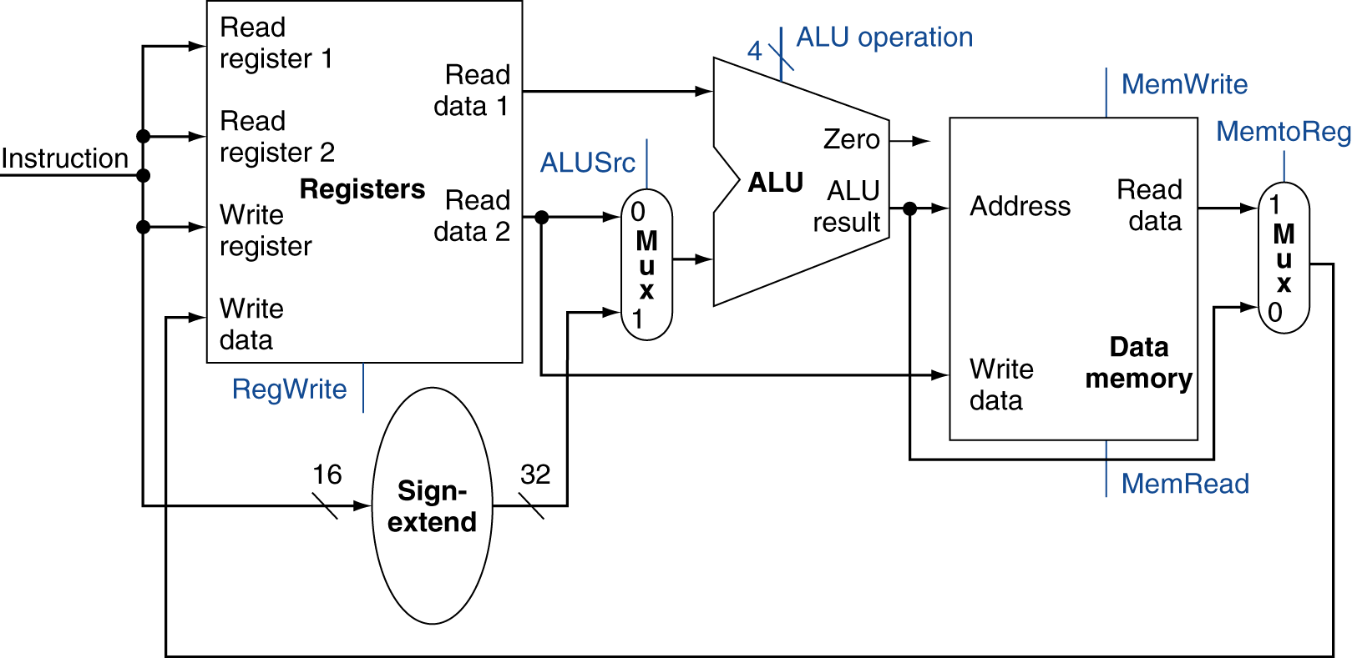
R-Type/Load/Store Datapath
Chapter 4 — The Processor — <number>
Notes:
Morgan Kaufmann Publishers
Chapter 4 — The Processor

Slide 20
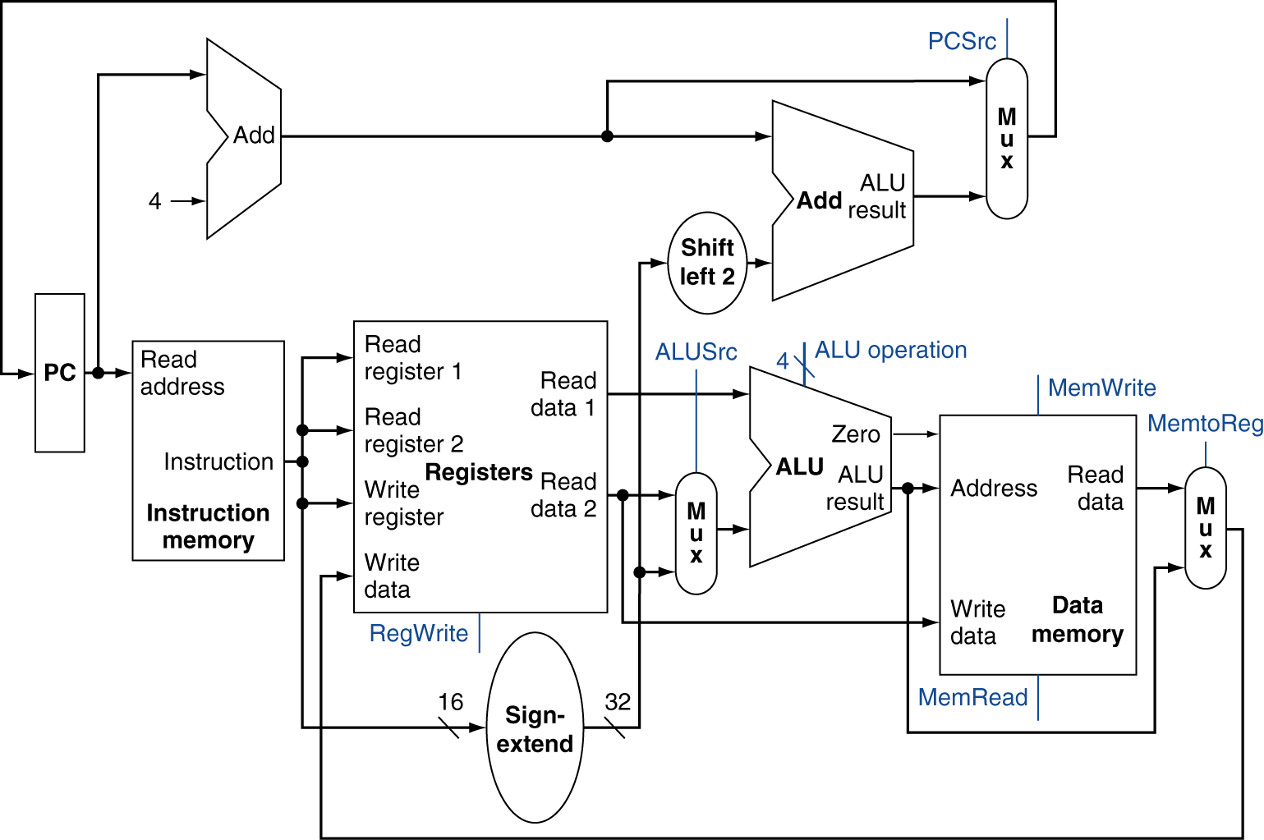
Full Datapath
Chapter 4 — The Processor — <number>
Notes:
Morgan Kaufmann Publishers
Chapter 4 — The Processor

Slide 21
ALU Control
ALU used for
  Load/Store: F = add
  Branch: F = subtract
  R-type: F depends on funct field
§4.4 A Simple Implementation Scheme
ALU control | Function
0000 | AND
0001 | OR
0010 | add
0110 | subtract
0111 | set-on-less-than
1100 | NOR
Chapter 4 — The Processor — <number>
Notes:
Morgan Kaufmann Publishers
Chapter 4 — The Processor

Slide 22
ALU Control
Assume 2-bit ALUOp derived from opcode
  Combinational logic derives ALU control
opcode | ALUOp | Operation | funct | ALU function | ALU control
lw | 00 | load word | XXXXXX | add | 0010
sw | 00 | store word | XXXXXX | add | 0010
beq | 01 | branch equal | XXXXXX | subtract | 0110
R-type | 10 | add | 100000 | add | 0010
 |  | subtract | 100010 | subtract | 0110
 |  | AND | 100100 | AND | 0000
 |  | OR | 100101 | OR | 0001
 |  | set-on-less-than | 101010 | set-on-less-than | 0111
Chapter 4 — The Processor — <number>
Notes:
Morgan Kaufmann Publishers
Chapter 4 — The Processor

Slide 23
The Main Control Unit
Control signals derived from instruction
R-type
0
rs
rt
rd
shamt
funct
31:26
25:21
20:16
15:11
10:6
5:0
Load/
Store
35 or 43
rs
rt
address
31:26
25:21
20:16
15:0
Branch
4
rs
rt
address
31:26
25:21
20:16
15:0
opcode
always read
read, except for load
write for R-type and load
sign-extend and add
Chapter 4 — The Processor — <number>
Notes:
Morgan Kaufmann Publishers
Chapter 4 — The Processor

Slide 24
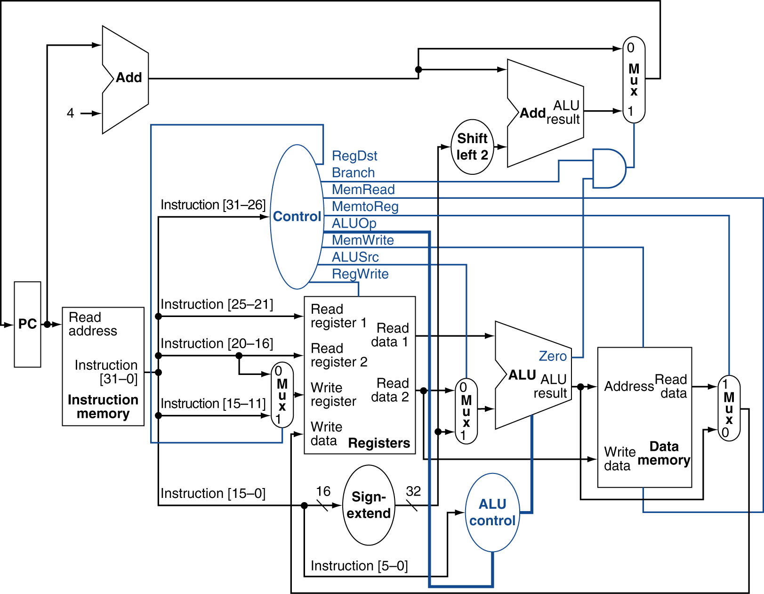
Datapath With Control
Chapter 4 — The Processor — <number>
Notes:
Morgan Kaufmann Publishers
Chapter 4 — The Processor

Slide 25
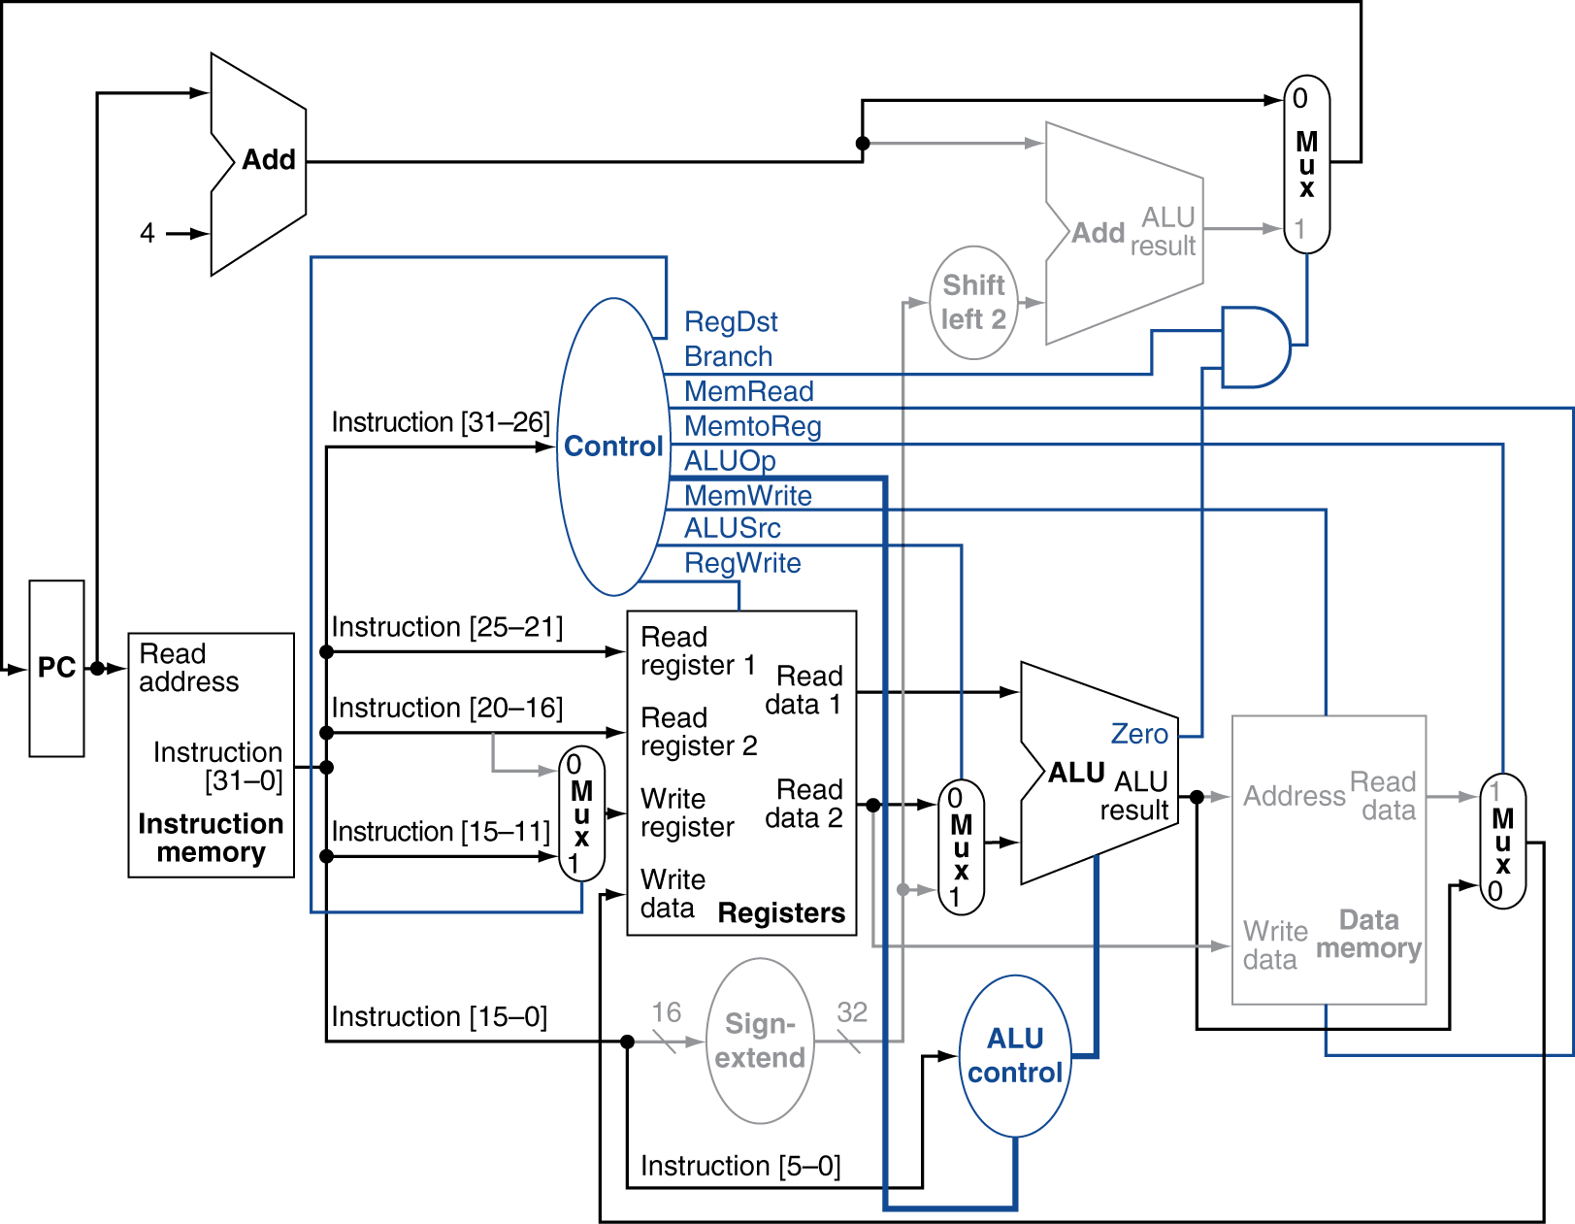
R-Type Instruction
Chapter 4 — The Processor — <number>
Notes:
Morgan Kaufmann Publishers
Chapter 4 — The Processor

Slide 26
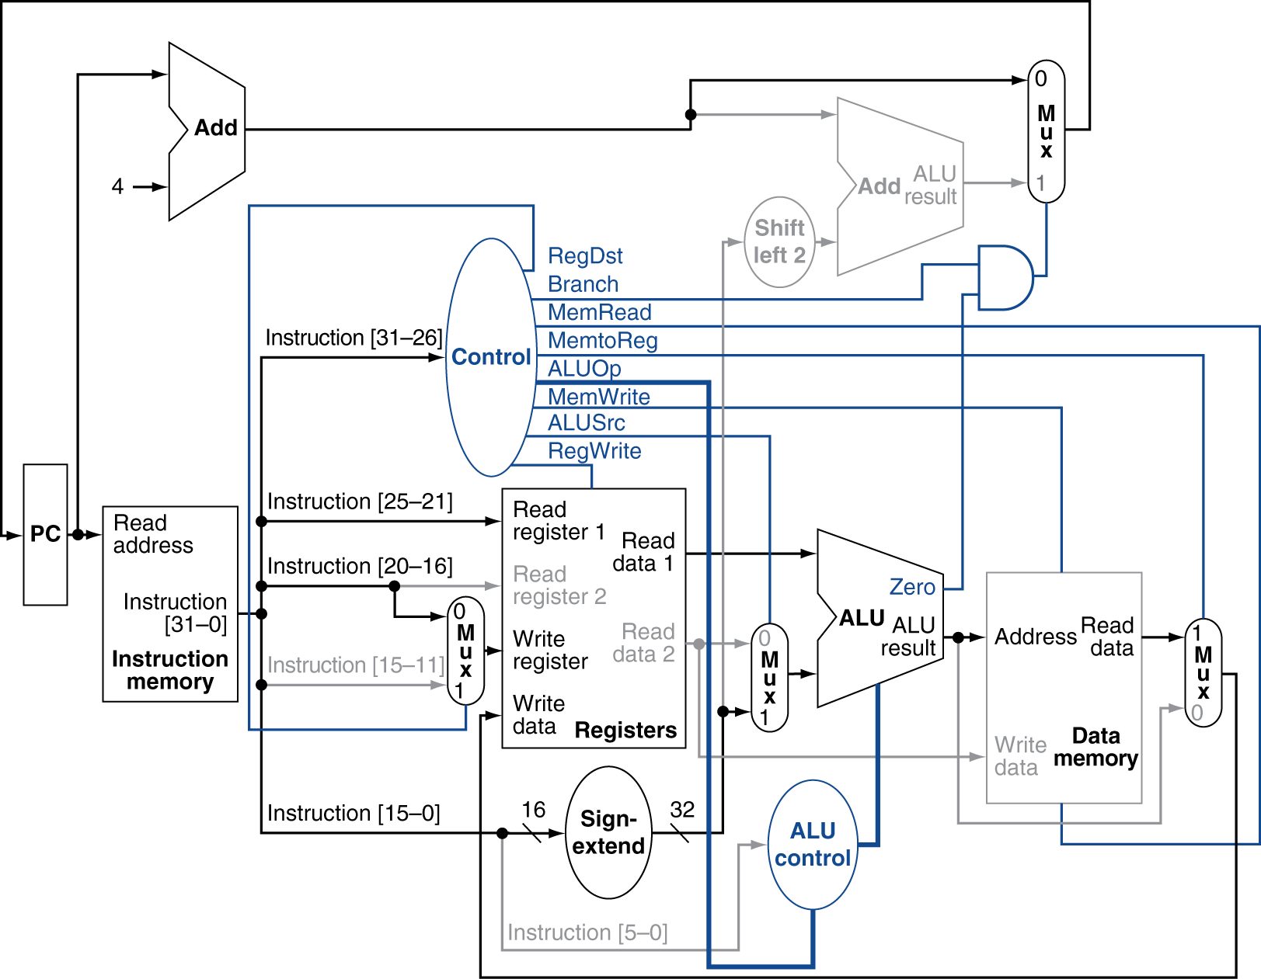
Load Instruction
Chapter 4 — The Processor — <number>
Notes:
Morgan Kaufmann Publishers
Chapter 4 — The Processor

Slide 27
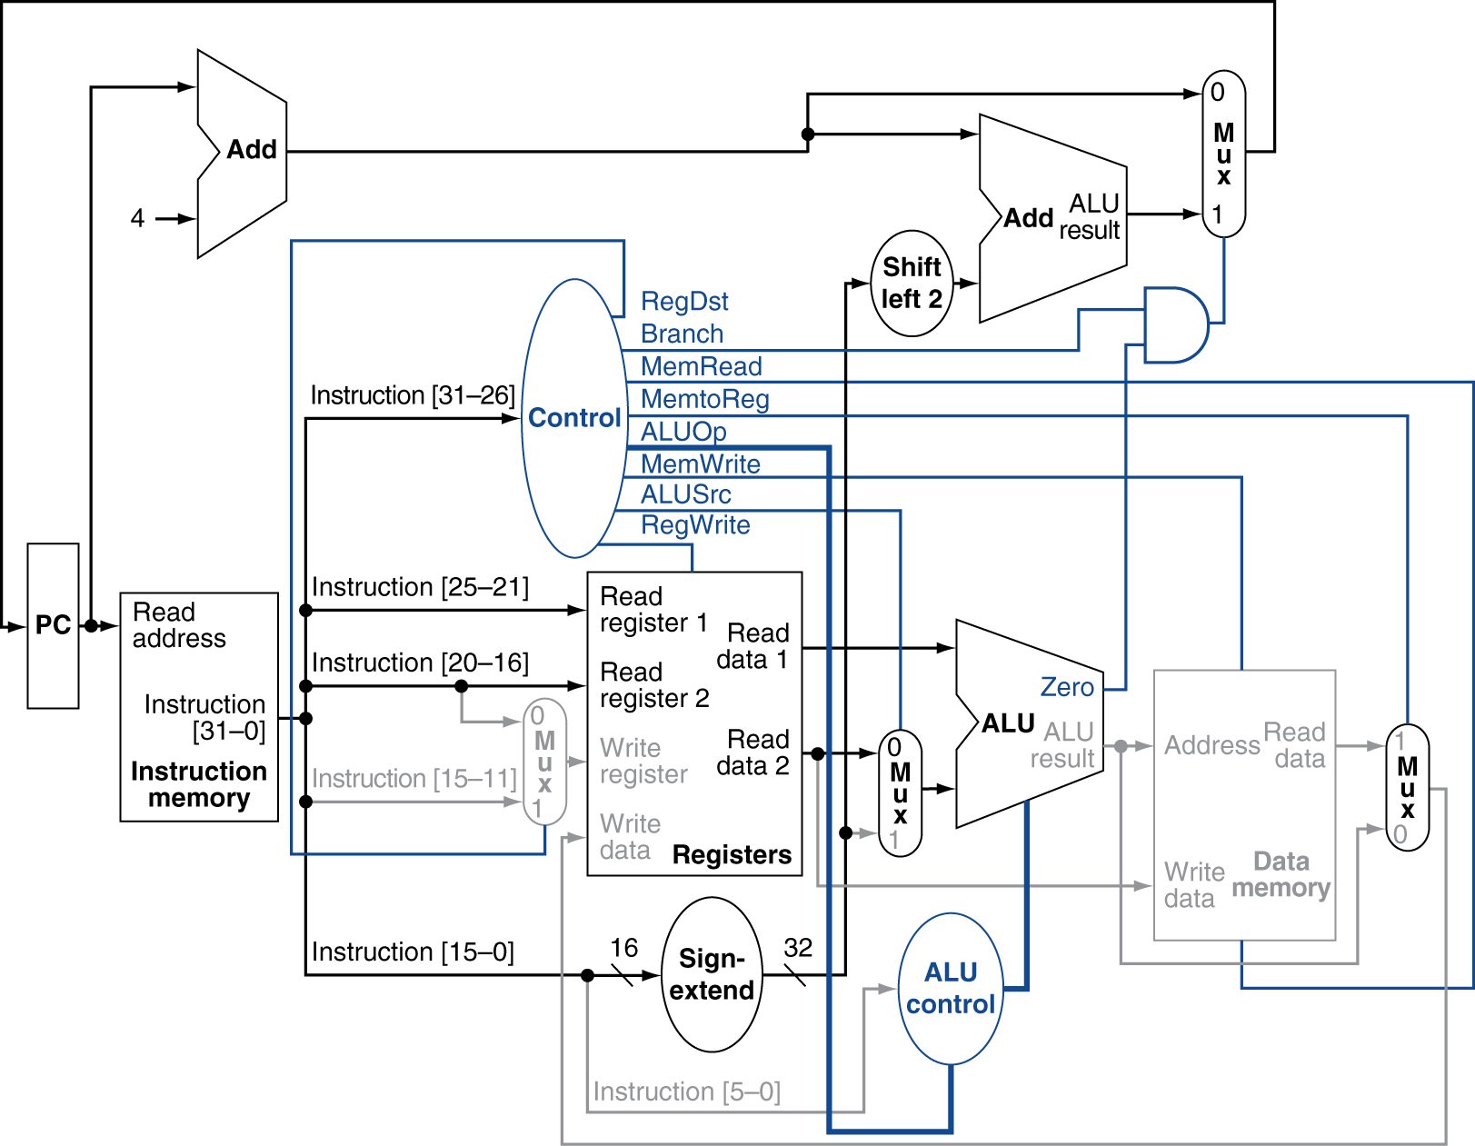
Branch-on-Equal Instruction
Chapter 4 — The Processor — <number>
Notes:
Morgan Kaufmann Publishers
Chapter 4 — The Processor

Slide 28
Implementing Jumps
Jump
2
address
31:26
25:0
Jump uses word address
Update PC with concatenation of
  Top 4 bits of old PC
  26-bit jump address
  00
Need an extra control signal decoded from opcode
Chapter 4 — The Processor — <number>
Notes:
Morgan Kaufmann Publishers
Chapter 4 — The Processor

Slide 29
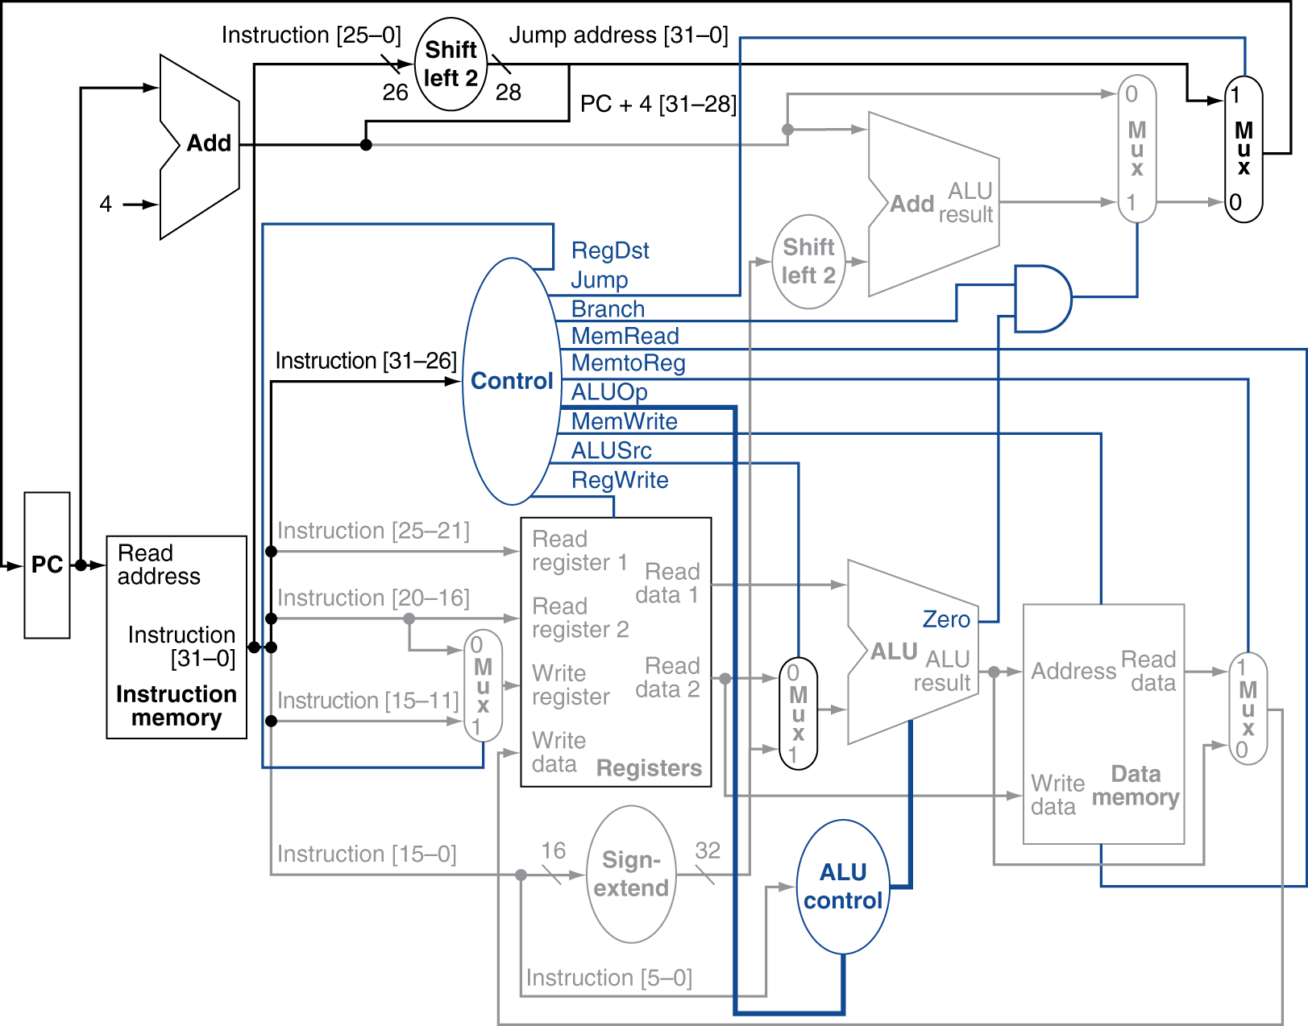
Datapath With Jumps Added
Chapter 4 — The Processor — <number>
Notes:
Morgan Kaufmann Publishers
Chapter 4 — The Processor

Slide 30
Performance Issues
Longest delay determines clock period
  Critical path: load instruction
  Instruction memory → register file → ALU → data memory → register file
Not feasible to vary period for different instructions
Violates design principle
  Making the common case fast
We will improve performance by pipelining
Chapter 4 — The Processor — <number>
Notes:
Morgan Kaufmann Publishers
Chapter 4 — The Processor

Slide 31
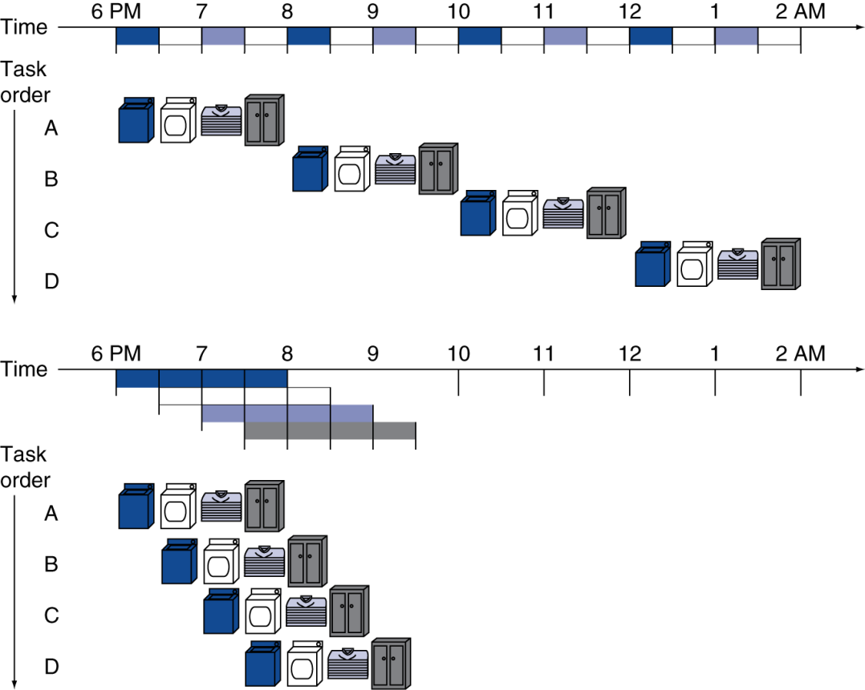
Pipelining Analogy
Pipelined laundry: overlapping execution
  Parallelism improves performance
§4.5 An Overview of Pipelining
Four loads:
  Speedup
  = 8/3.5 = 2.3
Non-stop:
  Speedup
  = 2n/0.5n + 1.5 ≈ 4
  = number of stages
Chapter 4 — The Processor — <number>
Notes:
Morgan Kaufmann Publishers
Chapter 4 — The Processor

Slide 32
MIPS Pipeline
Five stages, one step per stage
  IF: Instruction fetch from memory
  ID: Instruction decode & register read
  EX: Execute operation or calculate address
  MEM: Access memory operand
  WB: Write result back to register
Chapter 4 — The Processor — <number>
Notes:
Morgan Kaufmann Publishers
Chapter 4 — The Processor

Slide 33
Pipeline Performance
Assume time for stages is
  100ps for register read or write
  200ps for other stages
Compare pipelined datapath with single-cycle datapath
Instr | Instr fetch | Register read | ALU op | Memory access | Register write | Total time
lw | 200ps | 100 ps | 200ps | 200ps | 100 ps | 800ps
sw | 200ps | 100 ps | 200ps | 200ps |  | 700ps
R-format | 200ps | 100 ps | 200ps |  | 100 ps | 600ps
beq | 200ps | 100 ps | 200ps |  |  | 500ps
Chapter 4 — The Processor — <number>
Notes:
Morgan Kaufmann Publishers
Chapter 4 — The Processor

Slide 34
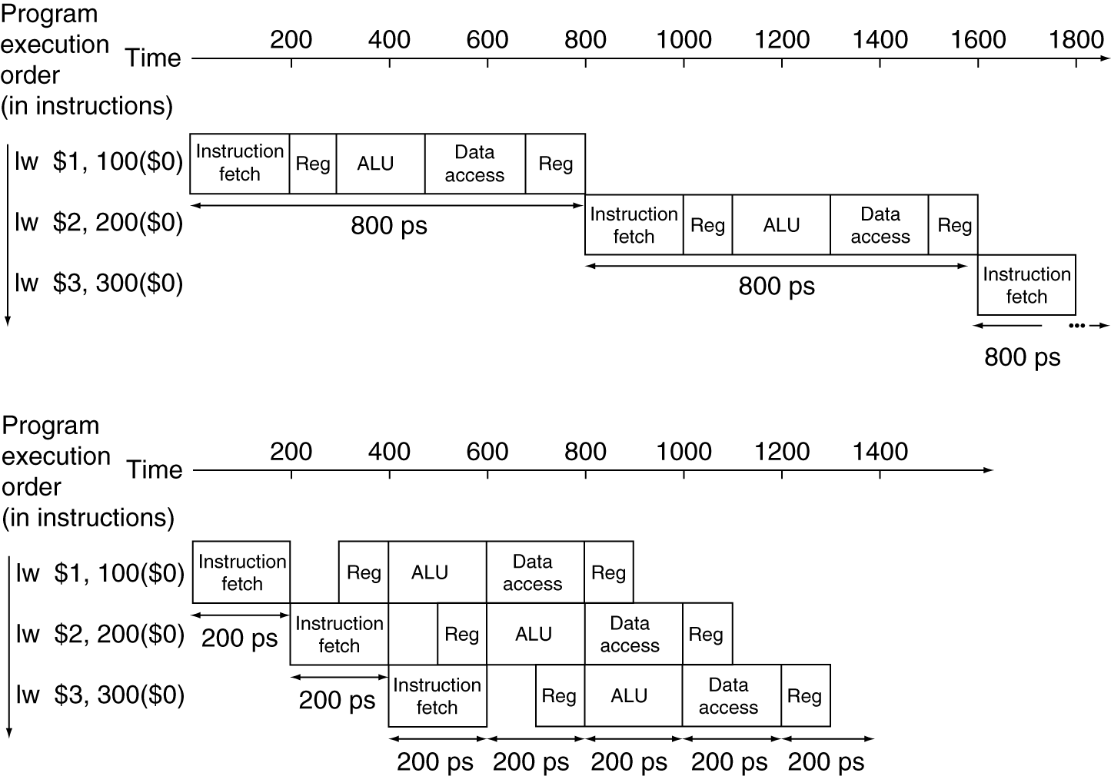
Pipeline Performance
Single-cycle (T_{c}= 800ps)
Pipelined (T_{c}= 200ps)
Chapter 4 — The Processor — <number>
Notes:
Morgan Kaufmann Publishers
Chapter 4 — The Processor

Slide 35
Pipeline Speedup
If all stages are balanced
  i.e., all take the same time
  Time between instructions_{pipelined}
  = Time between instructions_{nonpipelined}
  Number of stages
If not balanced, speedup is less
Speedup due to increased throughput
  Latency (time for each instruction) does not decrease
Chapter 4 — The Processor — <number>
Notes:
Morgan Kaufmann Publishers
Chapter 4 — The Processor

Slide 36
Pipelining and ISA Design
MIPS ISA designed for pipelining
  All instructions are 32-bits
    Easier to fetch and decode in one cycle
    c.f. x86: 1- to 17-byte instructions
  Few and regular instruction formats
    Can decode and read registers in one step
  Load/store addressing
    Can calculate address in 3rd stage, access memory in 4th stage
  Alignment of memory operands
    Memory access takes only one cycle
Chapter 4 — The Processor — <number>
Notes:
Morgan Kaufmann Publishers
Chapter 4 — The Processor

Slide 37
Hazards
Situations that prevent starting the next instruction in the next cycle
Structure hazards
  A required resource is busy
Data hazard
  Need to wait for previous instruction to complete its data read/write
Control hazard
  Deciding on control action depends on previous instruction
Chapter 4 — The Processor — <number>
Notes:
Morgan Kaufmann Publishers
Chapter 4 — The Processor

Slide 38
Structure Hazards
Conflict for use of a resource
In MIPS pipeline with a single memory
  Load/store requires data access
  Instruction fetch would have to stall for that cycle
    Would cause a pipeline “bubble”
Hence, pipelined datapaths require separate instruction/data memories
  Or separate instruction/data caches
Chapter 4 — The Processor — <number>
Notes:
Morgan Kaufmann Publishers
Chapter 4 — The Processor

Slide 39
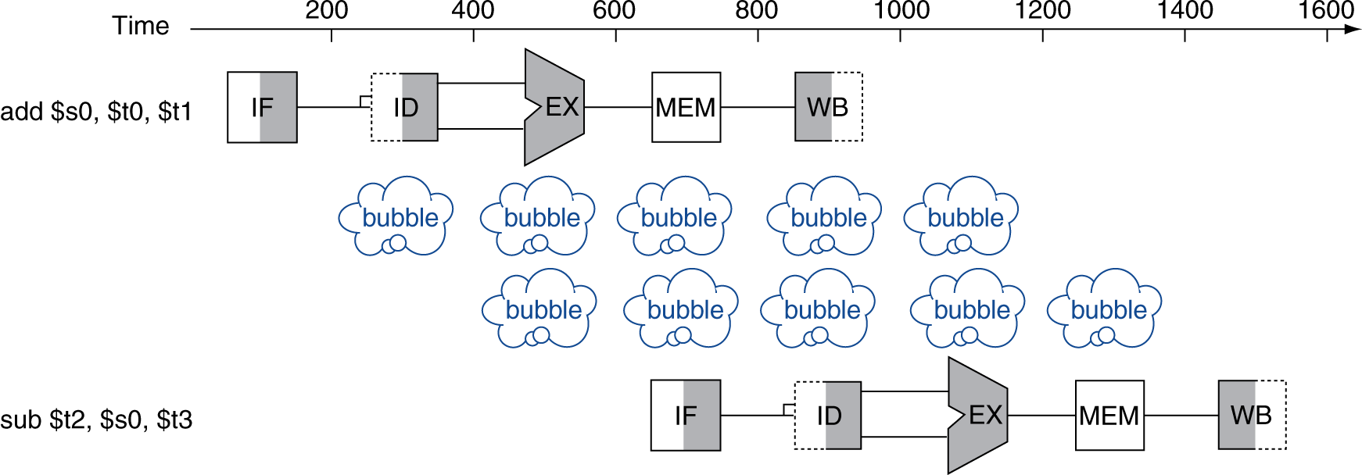
Data Hazards
An instruction depends on completion of data access by a previous instruction
  add $s0, $t0, $t1
  sub $t2, $s0, $t3
Chapter 4 — The Processor — <number>
Notes:
Morgan Kaufmann Publishers
Chapter 4 — The Processor

Slide 40
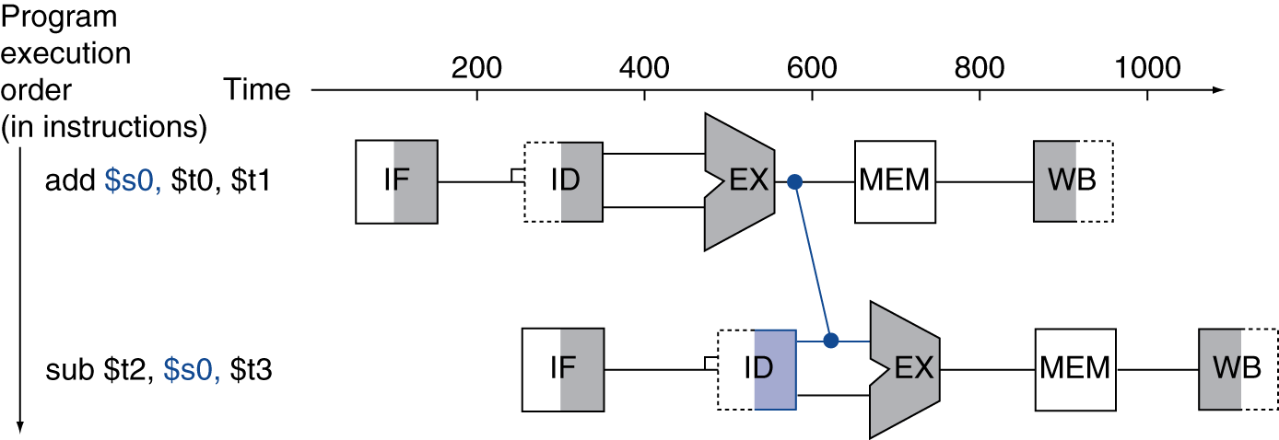
Forwarding (aka Bypassing)
Use result when it is computed
  Don’t wait for it to be stored in a register
  Requires extra connections in the datapath
Chapter 4 — The Processor — <number>
Notes:
Morgan Kaufmann Publishers
Chapter 4 — The Processor

Slide 41
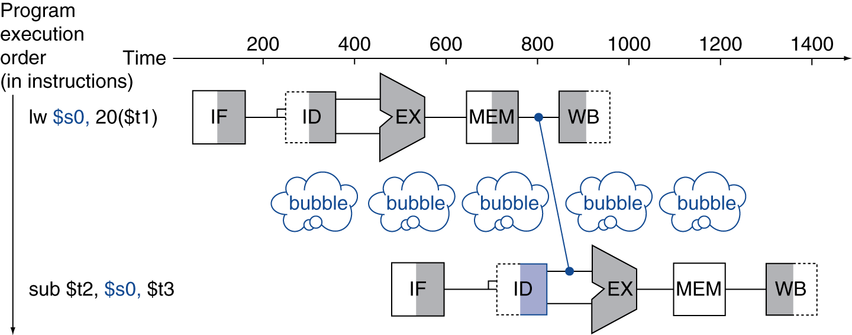
Load-Use Data Hazard
Can’t always avoid stalls by forwarding
  If value not computed when needed
  Can’t forward backward in time!
Chapter 4 — The Processor — <number>
Notes:
Morgan Kaufmann Publishers
Chapter 4 — The Processor

Slide 42
Code Scheduling to Avoid Stalls
Reorder code to avoid use of load result in the next instruction
C code for A = B + E; C = B + F;
lw $t1, 0($t0)
lw $t2, 4($t0)
add $t3, $t1, $t2
sw $t3, 12($t0)
lw $t4, 8($t0)
add $t5, $t1, $t4
sw $t5, 16($t0)
lw $t1, 0($t0)
lw $t2, 4($t0)
lw $t4, 8($t0)
add $t3, $t1, $t2
sw $t3, 12($t0)
add $t5, $t1, $t4
sw $t5, 16($t0)
stall
stall
13 cycles
11 cycles
Chapter 4 — The Processor — <number>
Notes:
Morgan Kaufmann Publishers
Chapter 4 — The Processor

Slide 43
Unit 9 Homework
1. How many types do MIPS instructions formats have ?
2. What are the commons for all types MIPS instructions ?
3. What are the benefits for doing the pipelined operations for MIPS instructions ?
4. What are the general five stages for a MIPS instruction ?
5. Describe the datapath flow for MIPS instruction “lw”
Chapter 4 — The Processor — <number>
Notes:
Morgan Kaufmann Publishers
Chapter 4 — The Processor

