Slide 1
Unit 10. Pipeline Multiple Instructions
Control Hazard
Branch determines flow of control
  Fetching next instruction depends on compare outcome
  Pipeline can’t always fetch correct instruction
In MIPS pipeline
  Need to compare registers and compute target early in the pipeline
Chapter 4 — The Processor — <number>
Notes:
Morgan Kaufmann Publishers
Chapter 4 — The Processor

Slide 2
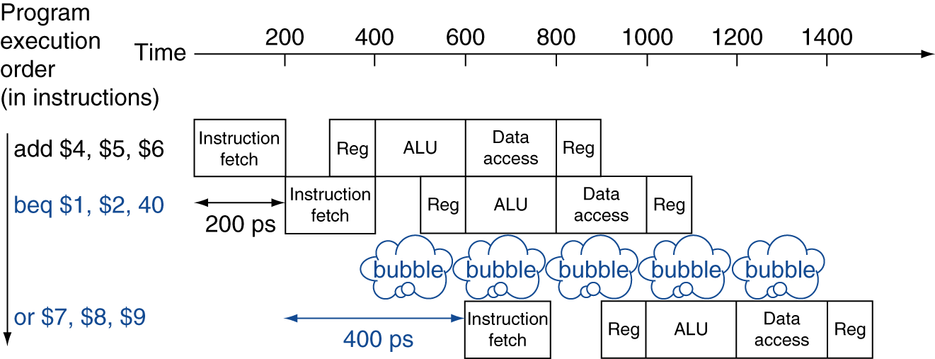
Stall on Branch
Wait until branch outcome determined before fetching next instruction
Chapter 4 — The Processor — <number>
Notes:
Morgan Kaufmann Publishers
Chapter 4 — The Processor

Slide 3
Branch Prediction
Longer pipelines can’t readily determine branch outcome early
  Stall penalty becomes unacceptable
Predict outcome of branch
  Only invalid if prediction is wrong
In MIPS pipeline
  Can predict branches not taken
  Fetch instruction following branch, with no delay
Chapter 4 — The Processor — <number>
Notes:
Morgan Kaufmann Publishers
Chapter 4 — The Processor

Slide 4
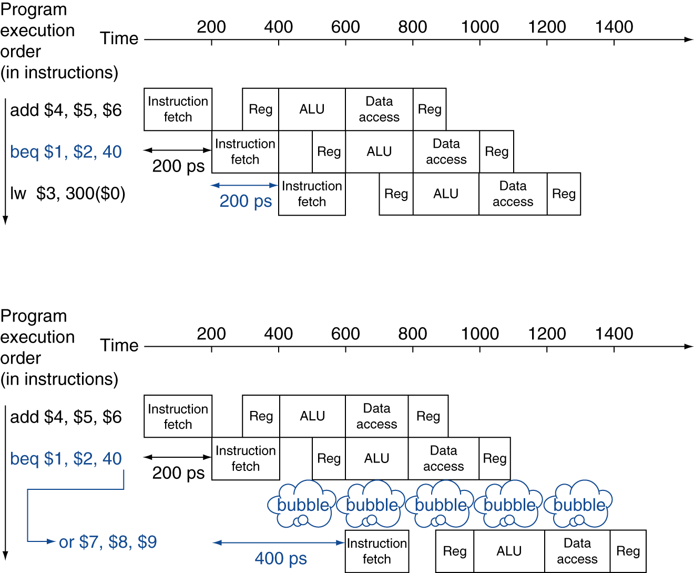
MIPS with Predict Not Taken
Prediction correct
Prediction incorrect
Chapter 4 — The Processor — <number>
Notes:
Morgan Kaufmann Publishers
Chapter 4 — The Processor

Slide 5
Pipeline Summary
The BIG Picture
Pipelining improves performance by increasing instruction throughput
  Executes multiple instructions in parallel
  Each instruction has the same latency
Subject to hazards
  Structure, data, control
Instruction set design affects complexity of pipeline implementation
Chapter 4 — The Processor — <number>
Notes:
Morgan Kaufmann Publishers
Chapter 4 — The Processor

Slide 6
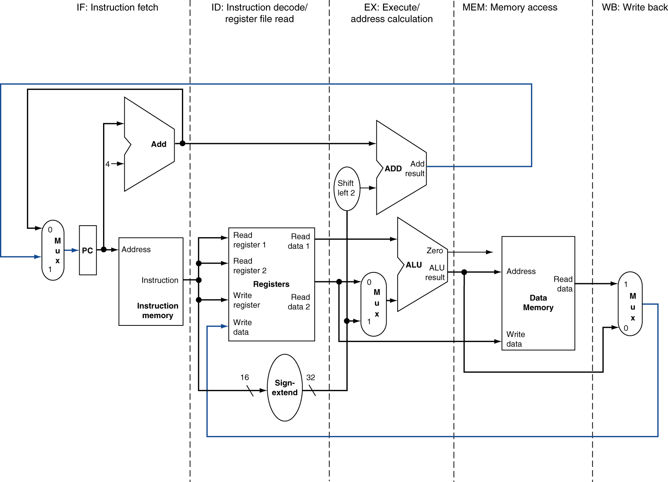
MIPS Pipelined Datapath
§4.6 Pipelined Datapath and Control
MEM
Right-to-left flow leads to hazards
WB
Chapter 4 — The Processor — <number>
Notes:
Morgan Kaufmann Publishers
Chapter 4 — The Processor

Slide 7
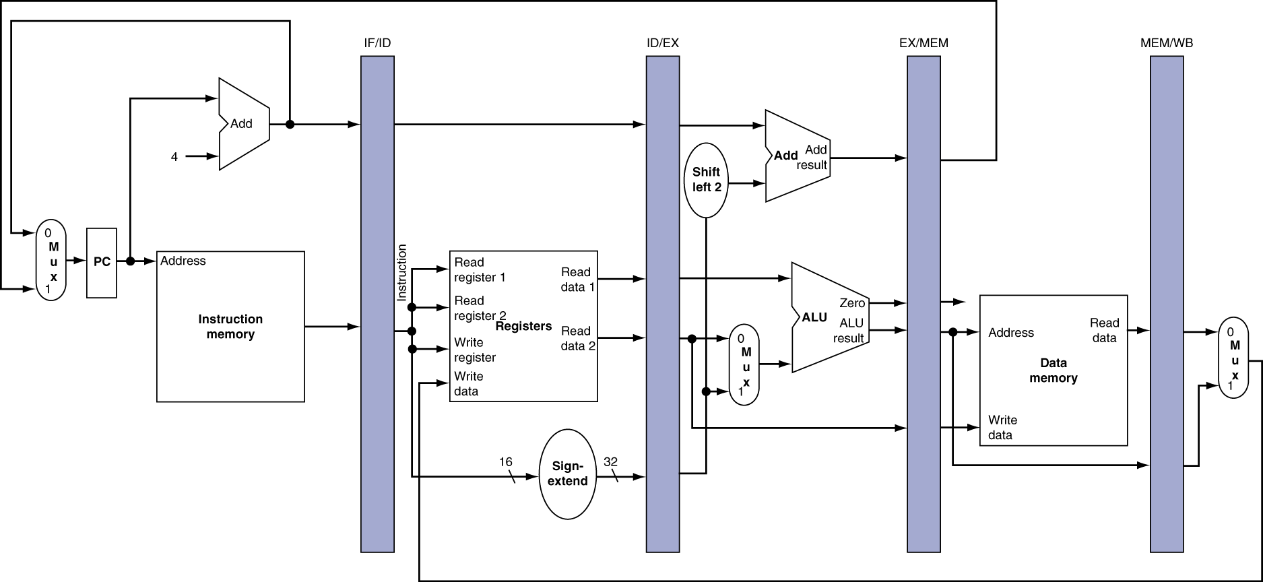
Pipeline registers
Need registers between stages
  To hold information produced in previous cycle
Chapter 4 — The Processor — <number>
Notes:
Morgan Kaufmann Publishers
Chapter 4 — The Processor

Slide 8
Pipeline Operation
Cycle-by-cycle flow of instructions through the pipelined datapath
  “Single-clock-cycle” pipeline diagram
    Shows pipeline usage in a single cycle
    Highlight resources used
  c.f. “multi-clock-cycle” diagram
    Graph of operation over time
We’ll look at “single-clock-cycle” diagrams for load & store
Chapter 4 — The Processor — <number>
Notes:
Morgan Kaufmann Publishers
Chapter 4 — The Processor

Slide 9
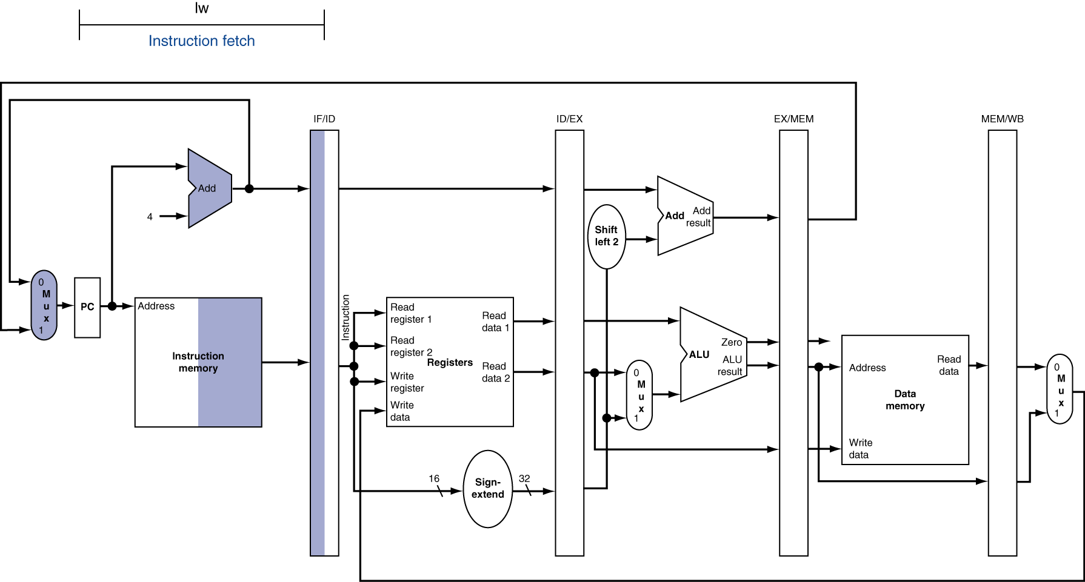
IF for Load, Store, …
Chapter 4 — The Processor — <number>
Notes:
Morgan Kaufmann Publishers
Chapter 4 — The Processor

Slide 10
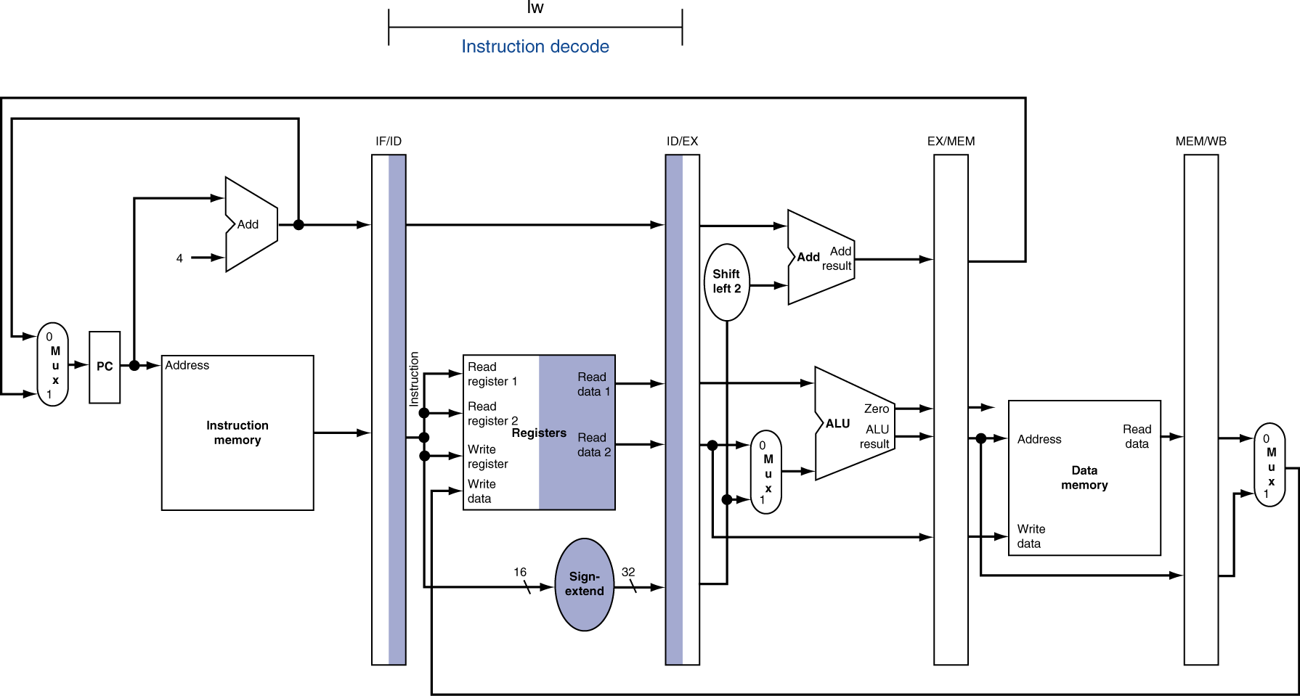
ID for Load, Store, …
Chapter 4 — The Processor — <number>
Notes:
Morgan Kaufmann Publishers
Chapter 4 — The Processor

Slide 11
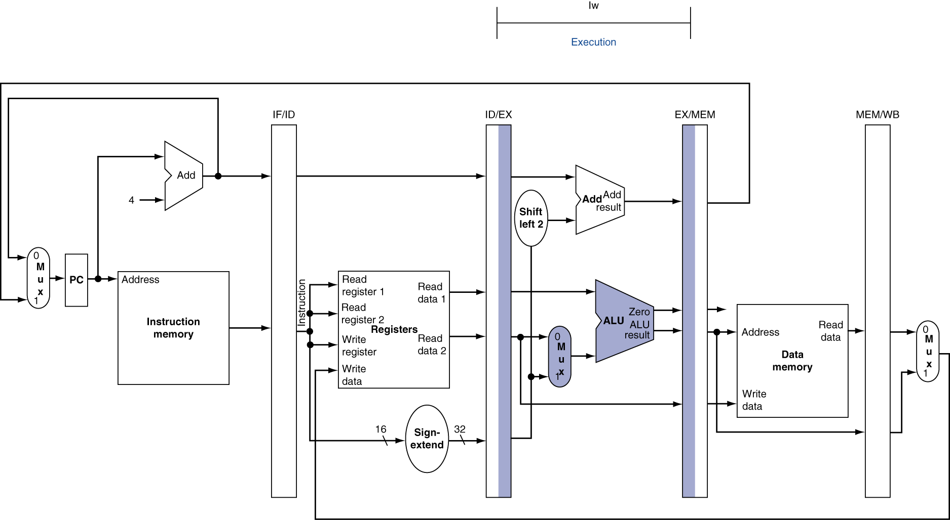
EX for Load
Chapter 4 — The Processor — <number>
Notes:
Morgan Kaufmann Publishers
Chapter 4 — The Processor

Slide 12
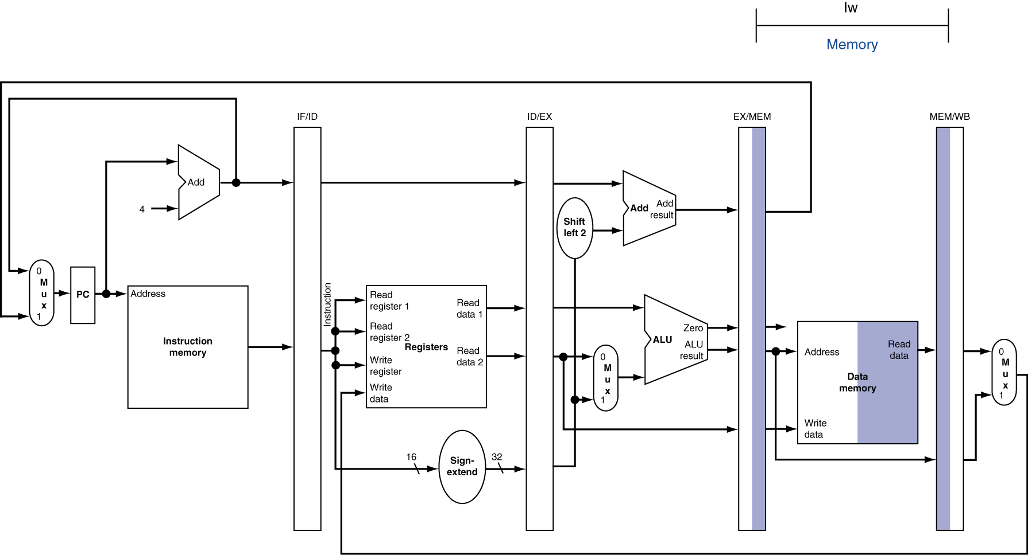
MEM for Load
Chapter 4 — The Processor — <number>
Notes:
Morgan Kaufmann Publishers
Chapter 4 — The Processor

Slide 13
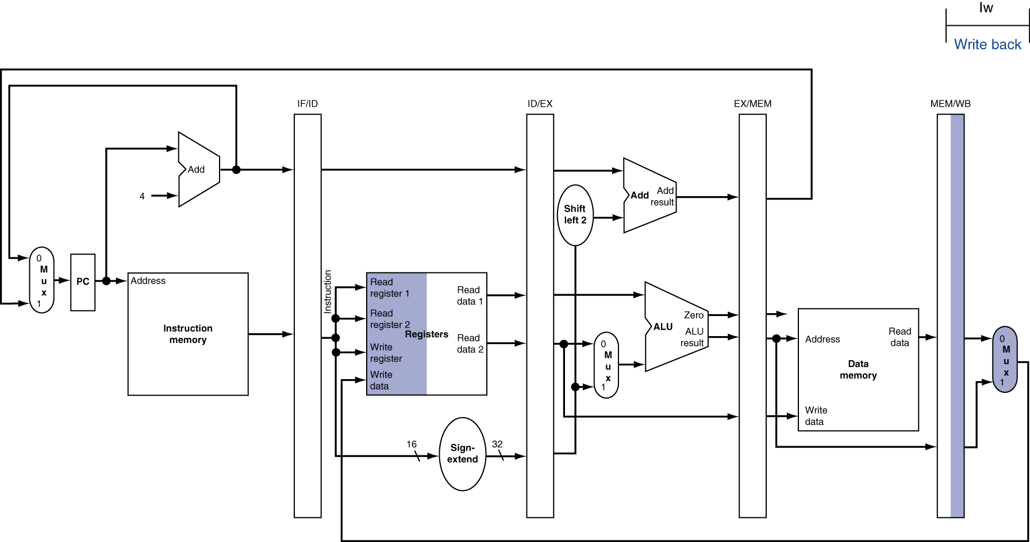
WB for Load
Wrong
register
number
Chapter 4 — The Processor — <number>
Notes:
Morgan Kaufmann Publishers
Chapter 4 — The Processor

Slide 14
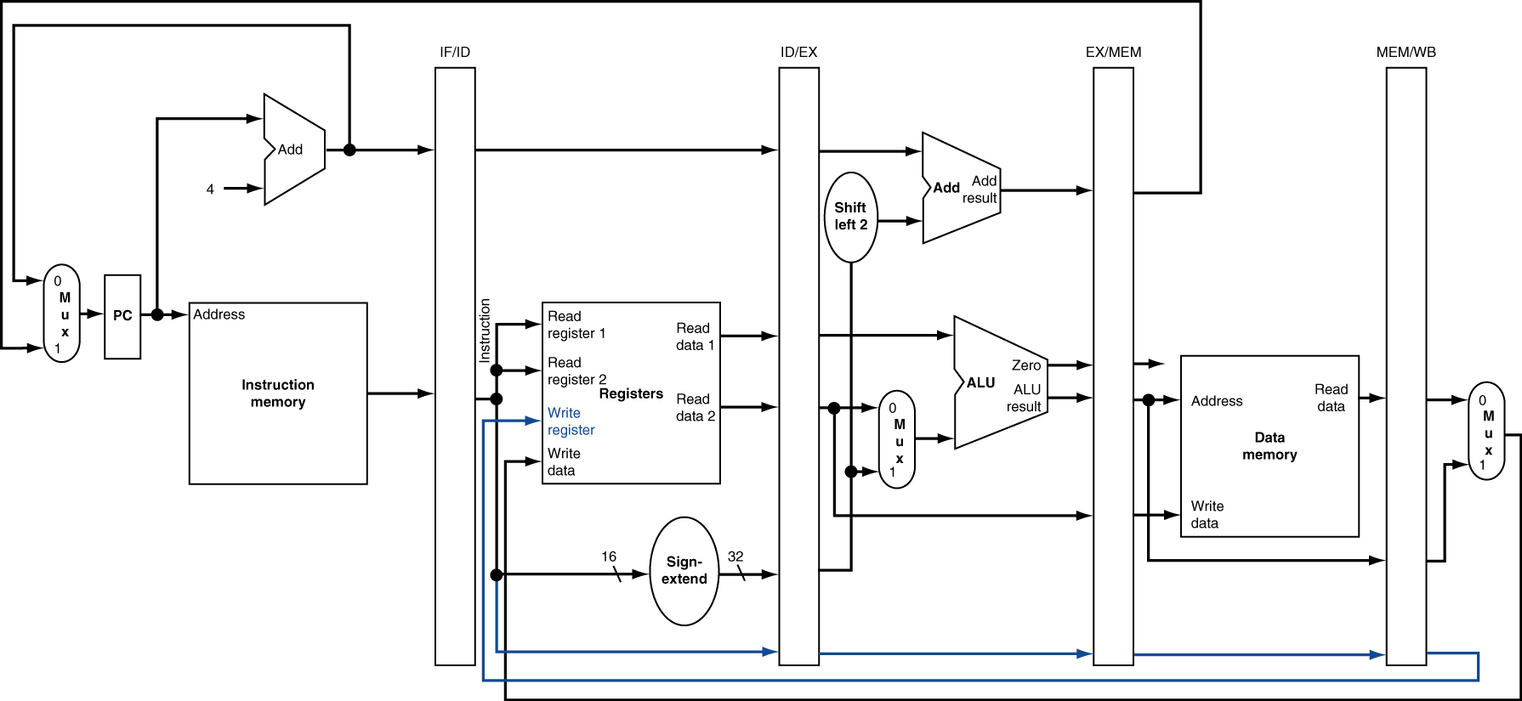
Corrected Datapath for Load
Chapter 4 — The Processor — <number>
Notes:
Morgan Kaufmann Publishers
Chapter 4 — The Processor

Slide 15

EX for Store
Chapter 4 — The Processor — <number>
Notes:
Morgan Kaufmann Publishers
Chapter 4 — The Processor

Slide 16
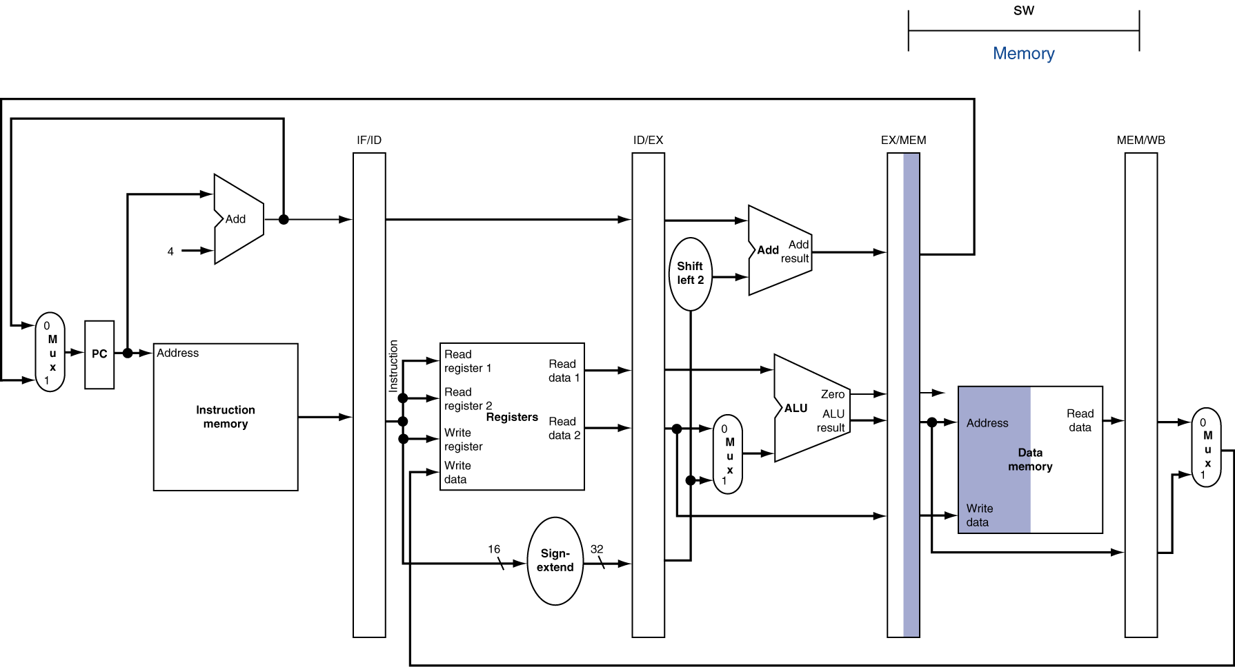
MEM for Store
Chapter 4 — The Processor — <number>
Notes:
Morgan Kaufmann Publishers
Chapter 4 — The Processor

Slide 17
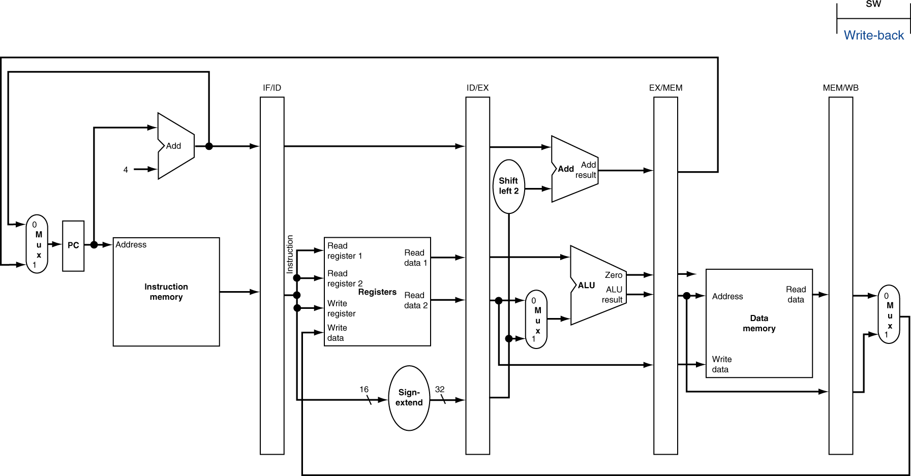
WB for Store
Chapter 4 — The Processor — <number>
Notes:
Morgan Kaufmann Publishers
Chapter 4 — The Processor

Slide 18
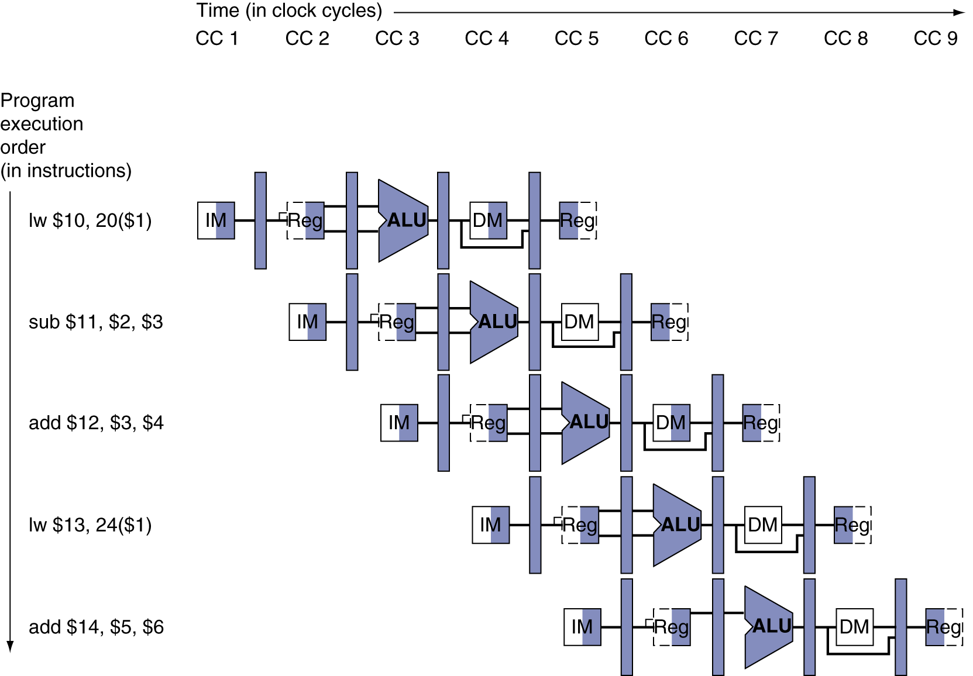
Multi-Cycle Pipeline Diagram
Form showing resource usage
Chapter 4 — The Processor — <number>
Notes:
Morgan Kaufmann Publishers
Chapter 4 — The Processor

Slide 19
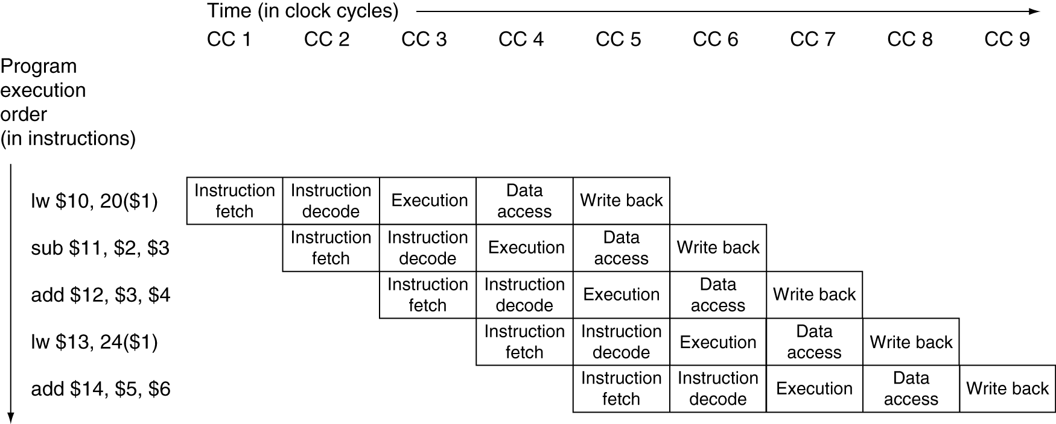
Multi-Cycle Pipeline Diagram
Traditional form
Chapter 4 — The Processor — <number>
Notes:
Morgan Kaufmann Publishers
Chapter 4 — The Processor

Slide 20
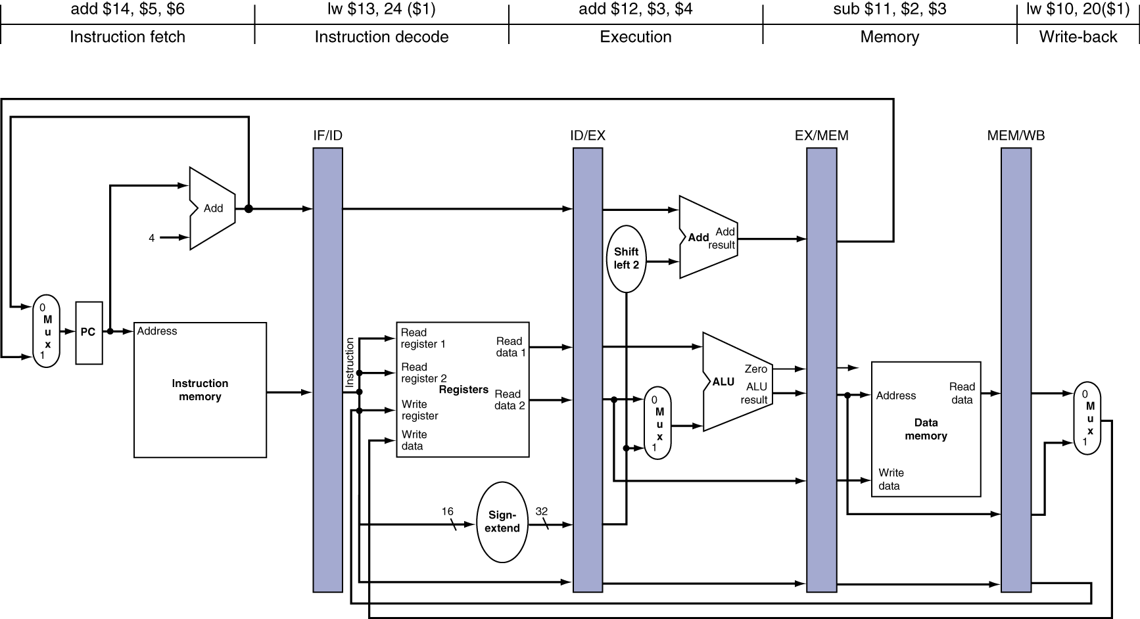
Single-Cycle Pipeline Diagram
State of pipeline in a given cycle
Chapter 4 — The Processor — <number>
Notes:
Morgan Kaufmann Publishers
Chapter 4 — The Processor

Slide 21
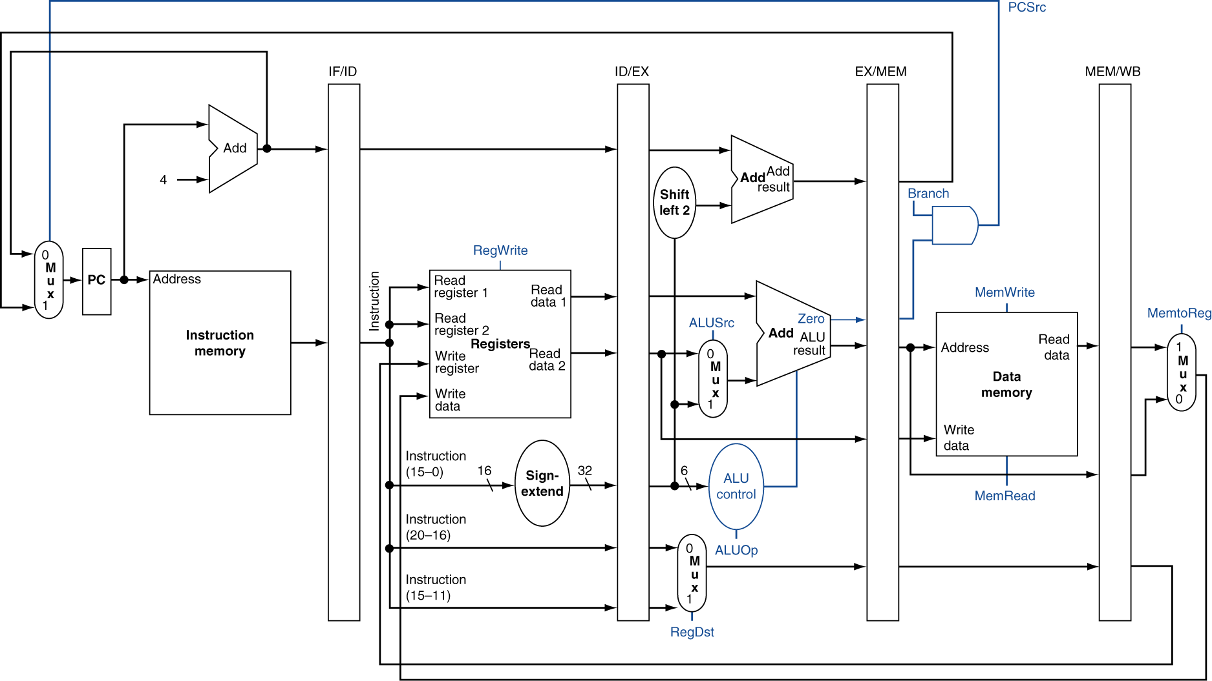
Pipelined Control (Simplified)
Chapter 4 — The Processor — <number>
Notes:
Morgan Kaufmann Publishers
Chapter 4 — The Processor

Slide 22
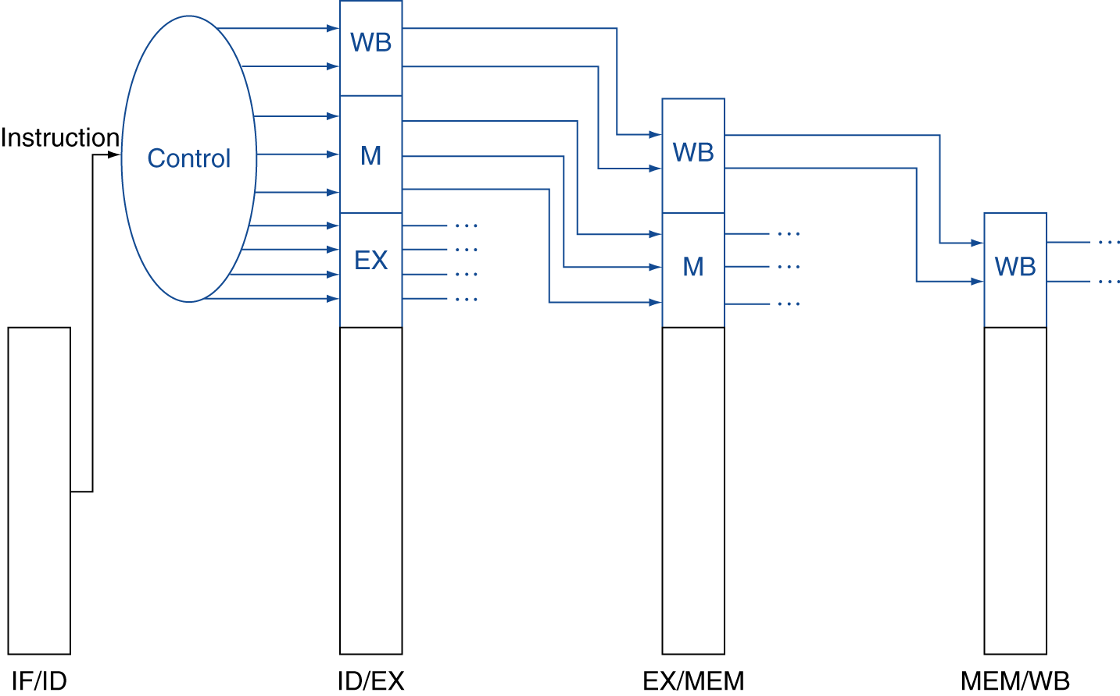
Pipelined Control
Control signals derived from instruction
  As in single-cycle implementation
Chapter 4 — The Processor — <number>
Notes:
Morgan Kaufmann Publishers
Chapter 4 — The Processor

Slide 23
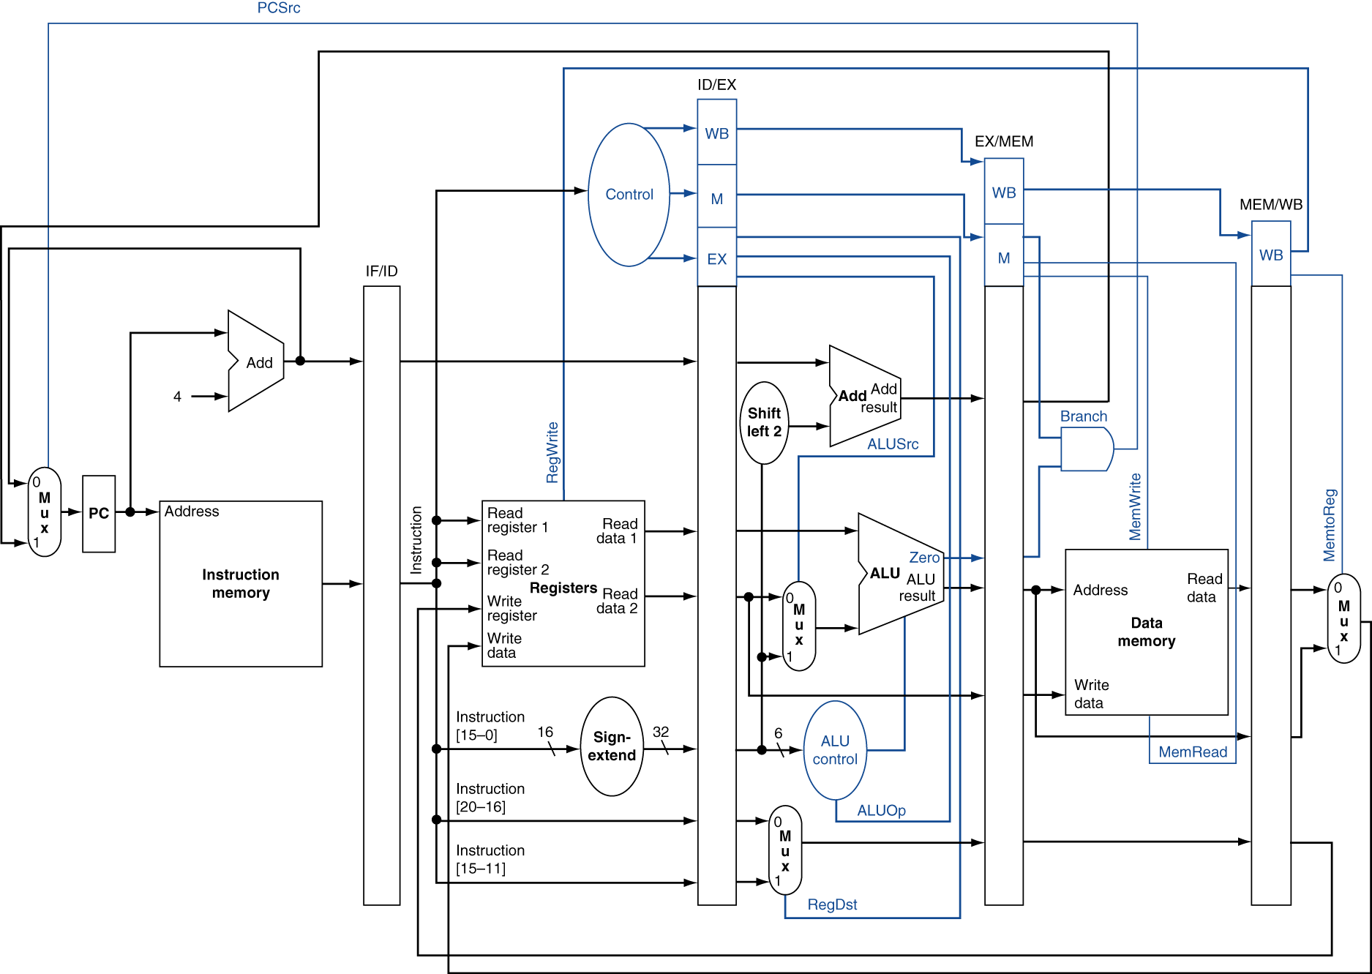
Pipelined Control
Chapter 4 — The Processor — <number>
Notes:
Morgan Kaufmann Publishers
Chapter 4 — The Processor

Slide 24
Data Hazards in ALU Instructions
Consider this sequence:
  sub $2, $1,$3
  and $12,$2,$5
  or $13,$6,$2
  add $14,$2,$2
  sw $15,100($2)
We can resolve hazards with forwarding
  How do we detect when to forward?
§4.7 Data Hazards: Forwarding vs. Stalling
Chapter 4 — The Processor — <number>
Notes:
Morgan Kaufmann Publishers
Chapter 4 — The Processor

Slide 25
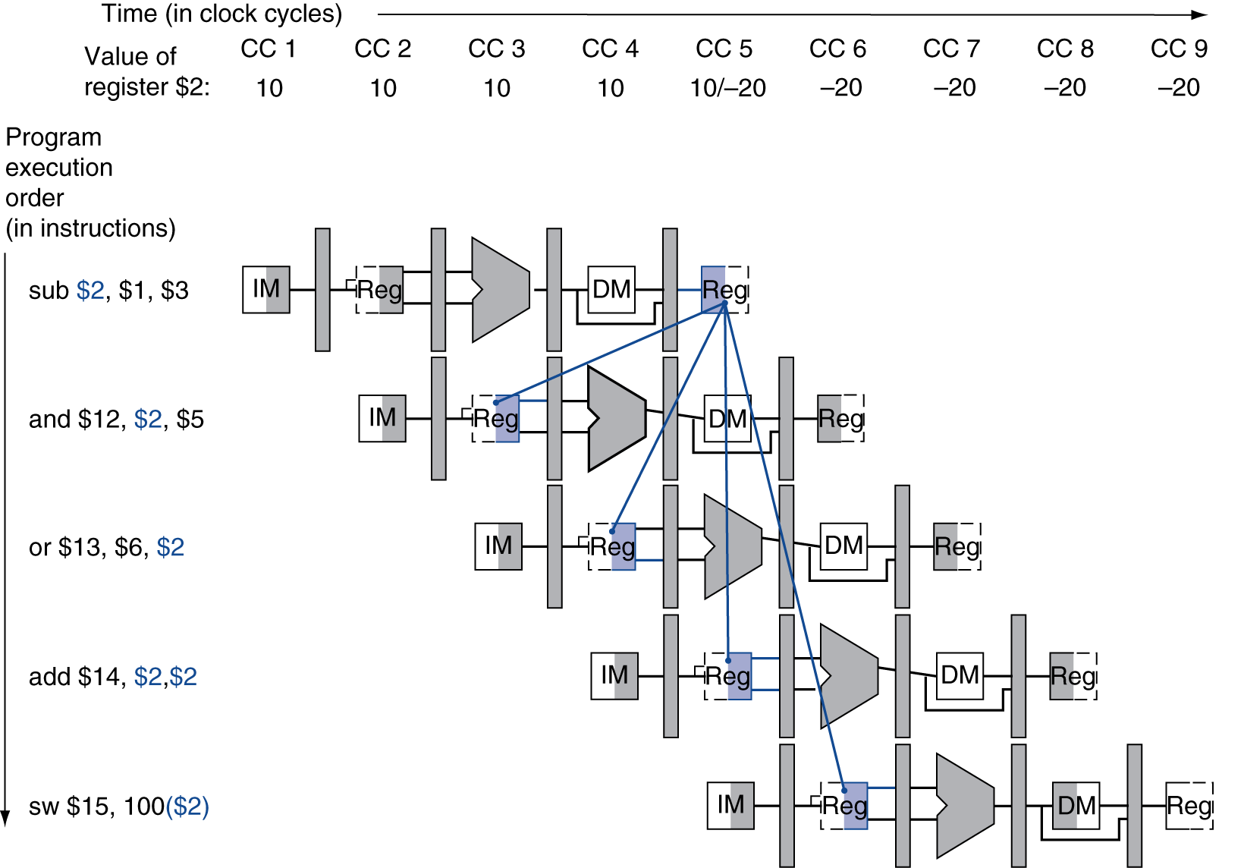
Dependencies & Forwarding
Chapter 4 — The Processor — <number>
Notes:
Morgan Kaufmann Publishers
Chapter 4 — The Processor

Slide 26
Detecting the Need to Forward
Pass register numbers along pipeline
  e.g., ID/EX.RegisterRs = register number for Rs sitting in ID/EX pipeline register
ALU operand register numbers in EX stage are given by
  ID/EX.RegisterRs, ID/EX.RegisterRt
Data hazards when
  1a. EX/MEM.RegisterRd = ID/EX.RegisterRs
  1b. EX/MEM.RegisterRd = ID/EX.RegisterRt
  2a. MEM/WB.RegisterRd = ID/EX.RegisterRs
  2b. MEM/WB.RegisterRd = ID/EX.RegisterRt
Fwd from
EX/MEM
pipeline reg
Fwd from
MEM/WB
pipeline reg
Chapter 4 — The Processor — <number>
Notes:
Morgan Kaufmann Publishers
Chapter 4 — The Processor

Slide 27
Detecting the Need to Forward
If the register name are the same on leading and following instructions
  EX/MEM.RegWrite, MEM/WB.RegWrite
And if the control signal is not $zero
  EX/MEM.RegisterRd ≠ 0,
  MEM/WB.RegisterRd ≠ 0
Chapter 4 — The Processor — <number>
Notes:
Morgan Kaufmann Publishers
Chapter 4 — The Processor

Slide 28
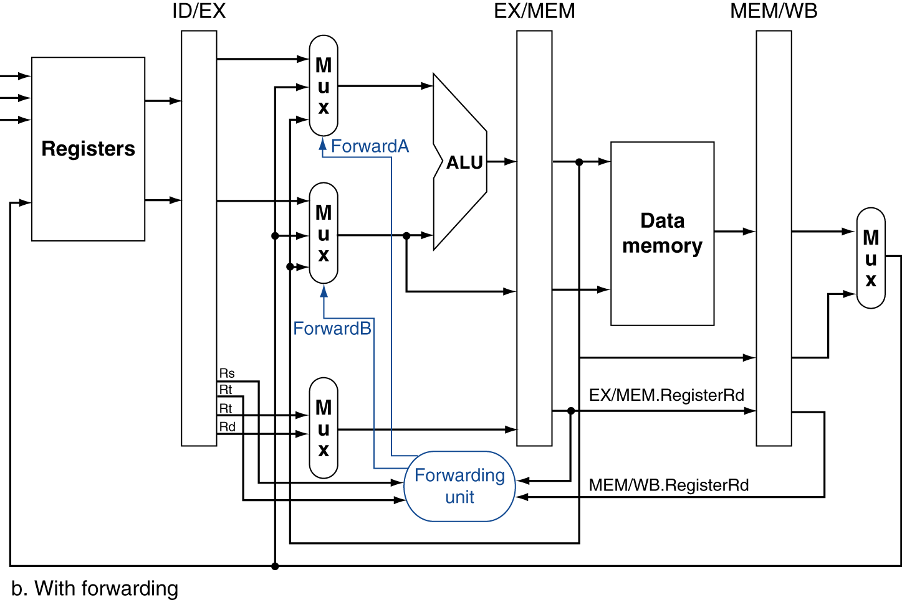
Forwarding Paths
Chapter 4 — The Processor — <number>
Notes:
Morgan Kaufmann Publishers
Chapter 4 — The Processor

Slide 29
Forwarding Conditions
EX hazard
  if (EX/MEM.RegWrite and (EX/MEM.RegisterRd ≠ 0)
  and (EX/MEM.RegisterRd = ID/EX.RegisterRs))
  ForwardA = 10
  if (EX/MEM.RegWrite and (EX/MEM.RegisterRd ≠ 0)
  and (EX/MEM.RegisterRd = ID/EX.RegisterRt))
  ForwardB = 10
MEM hazard
  if (MEM/WB.RegWrite and (MEM/WB.RegisterRd ≠ 0)
  and (MEM/WB.RegisterRd = ID/EX.RegisterRs))
  ForwardA = 01
  if (MEM/WB.RegWrite and (MEM/WB.RegisterRd ≠ 0)
  and (MEM/WB.RegisterRd = ID/EX.RegisterRt))
  ForwardB = 01
Chapter 4 — The Processor — <number>
Notes:
Morgan Kaufmann Publishers
Chapter 4 — The Processor

Slide 30
Double Data Hazard
Consider the sequence:
  add $1,$1,$2
  add $1,$1,$3
  add $1,$1,$4
Both hazards occur
  Want to use the most recent
Chapter 4 — The Processor — <number>
Notes:
Morgan Kaufmann Publishers
Chapter 4 — The Processor

Slide 31
Revised Forwarding Condition
MEM hazard
  if (MEM/WB.RegWrite and (MEM/WB.RegisterRd ≠ 0)
  and not (EX/MEM.RegWrite and (EX/MEM.RegisterRd ≠ 0)
  and (EX/MEM.RegisterRd = ID/EX.RegisterRs))
  and (MEM/WB.RegisterRd = ID/EX.RegisterRs))
  ForwardA = 01
  if (MEM/WB.RegWrite and (MEM/WB.RegisterRd ≠ 0)
  and not (EX/MEM.RegWrite and (EX/MEM.RegisterRd ≠ 0)
  and (EX/MEM.RegisterRd = ID/EX.RegisterRt))
  and (MEM/WB.RegisterRd = ID/EX.RegisterRt))
  ForwardB = 01
Chapter 4 — The Processor — <number>
Notes:
Morgan Kaufmann Publishers
Chapter 4 — The Processor

Slide 32
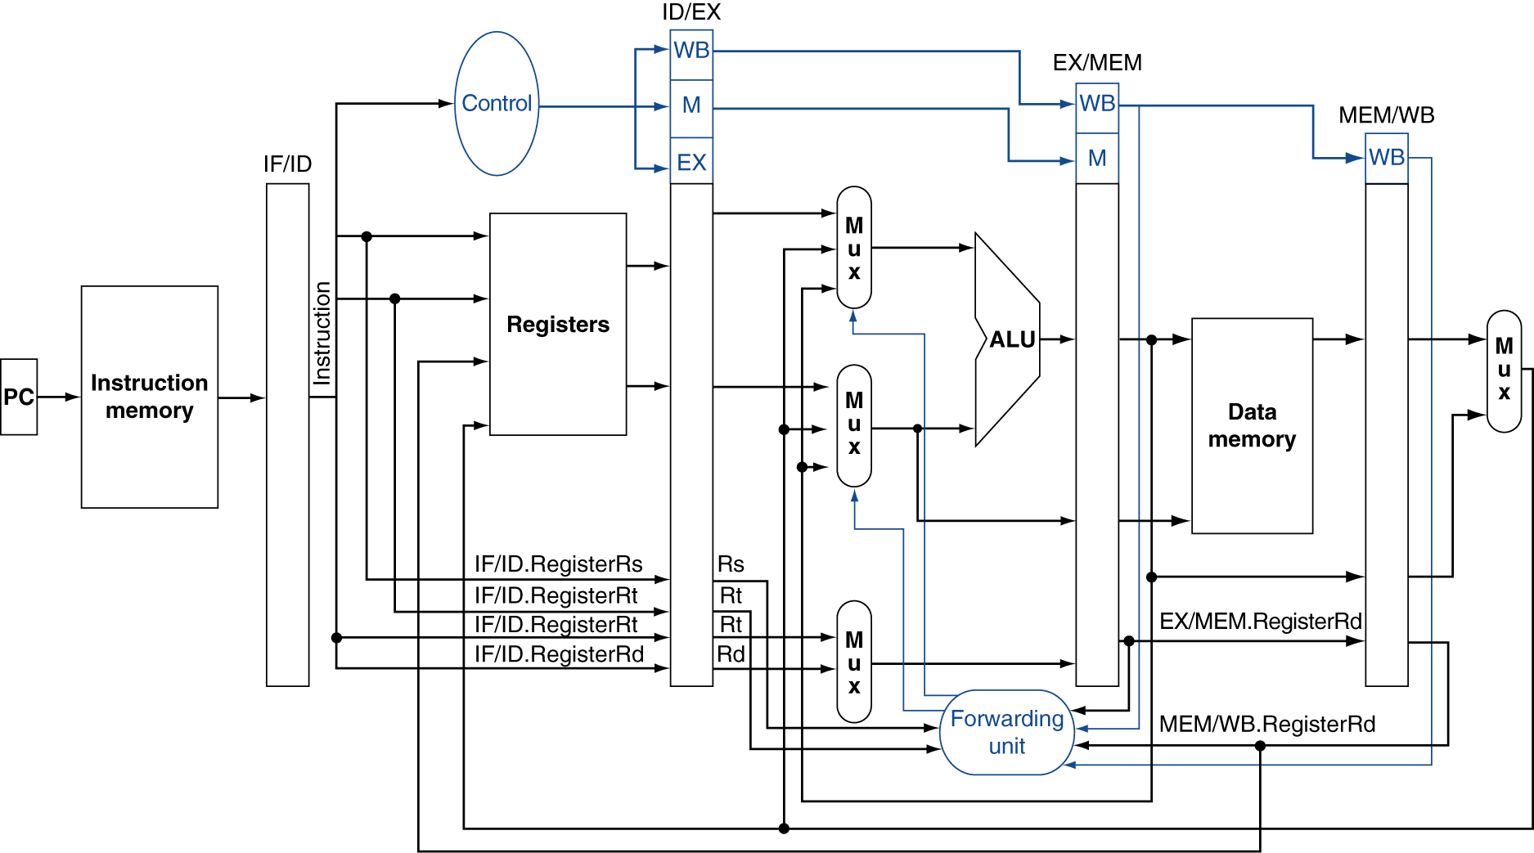
Datapath with Forwarding
Chapter 4 — The Processor — <number>
Notes:
Morgan Kaufmann Publishers
Chapter 4 — The Processor

Slide 33
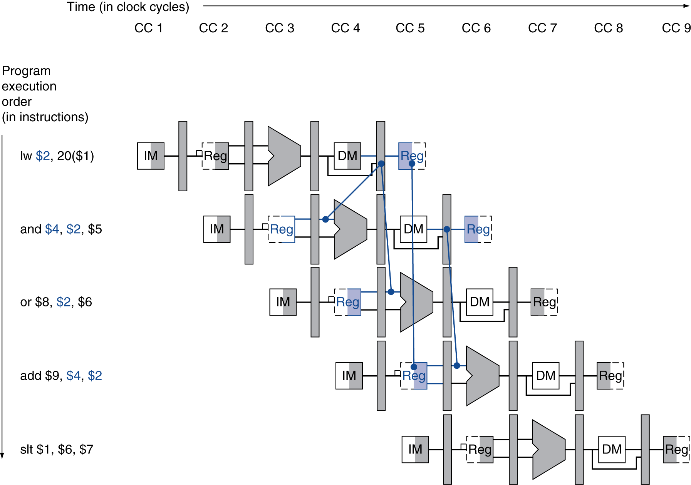
Load-Use Data Hazard
Need to stall for one cycle
Chapter 4 — The Processor — <number>
Notes:
Morgan Kaufmann Publishers
Chapter 4 — The Processor

Slide 34
Load-Use Hazard Detection
Check when using instruction is decoded in ID stage
ALU operand register numbers in ID stage are given by
  IF/ID.RegisterRs, IF/ID.RegisterRt
Load-use hazard when
  ID/EX.MemRead and
  ((ID/EX.RegisterRt = IF/ID.RegisterRs) or
  (ID/EX.RegisterRt = IF/ID.RegisterRt))
If detected, stall and insert bubble
Chapter 4 — The Processor — <number>
Notes:
Morgan Kaufmann Publishers
Chapter 4 — The Processor

Slide 35
How to Stall the Pipeline
Force control values in ID/EX register
to 0
  EX, MEM and WB do nop (no-operation)
Prevent update of PC and IF/ID register
Using instruction is decoded again
  Following instruction is fetched again
  1-cycle stall allows MEM to read data for lw
    Can subsequently forward to EX stage
Chapter 4 — The Processor — <number>
Notes:
Morgan Kaufmann Publishers
Chapter 4 — The Processor

Slide 36
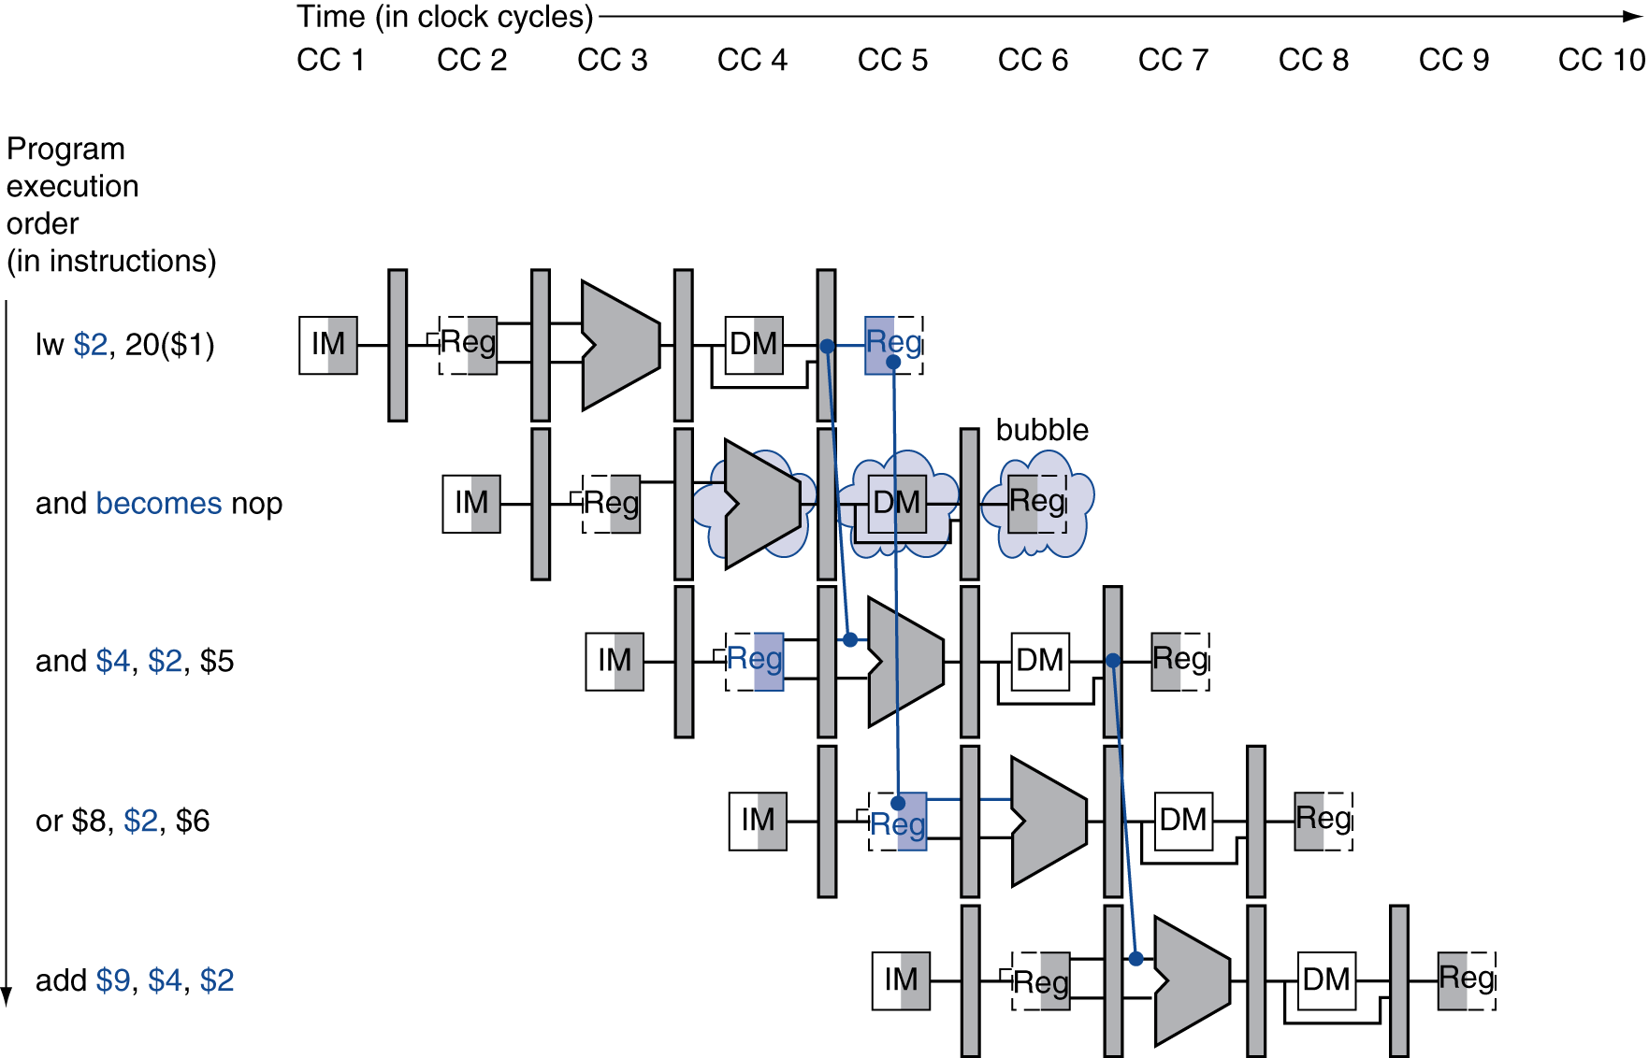
Stall/Bubble in the Pipeline
Stall inserted here
Chapter 4 — The Processor — <number>
Notes:
Morgan Kaufmann Publishers
Chapter 4 — The Processor

Slide 37
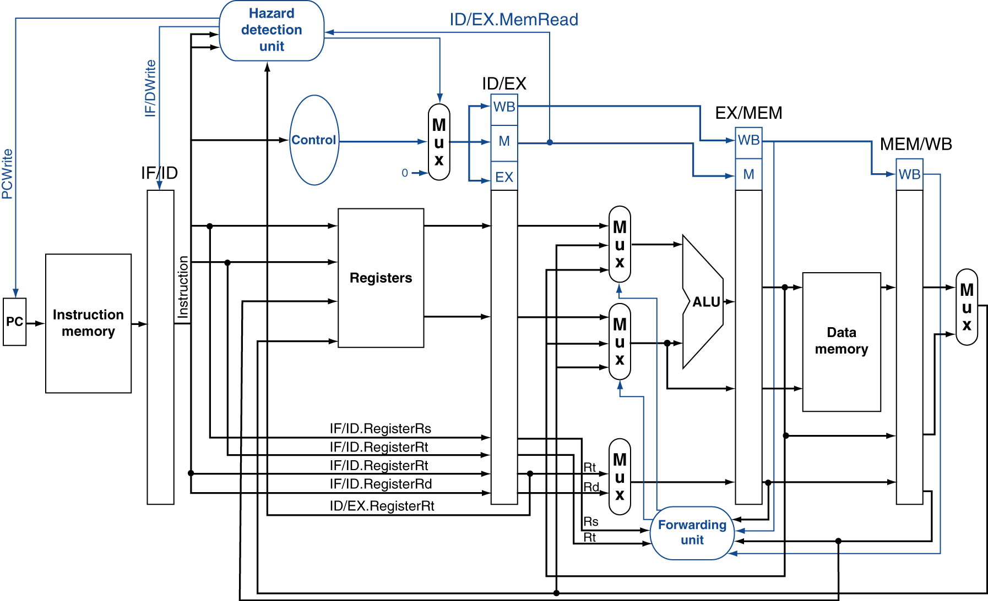
Datapath with Hazard Detection
Chapter 4 — The Processor — <number>
Notes:
Morgan Kaufmann Publishers
Chapter 4 — The Processor

Slide 38
Stalls and Performance
The BIG Picture
Stalls reduce performance
  But are required to get correct results
Compiler can arrange code to avoid hazards and stalls
  Requires knowledge of the pipeline structure
Chapter 4 — The Processor — <number>
Notes:
Morgan Kaufmann Publishers
Chapter 4 — The Processor

Slide 39
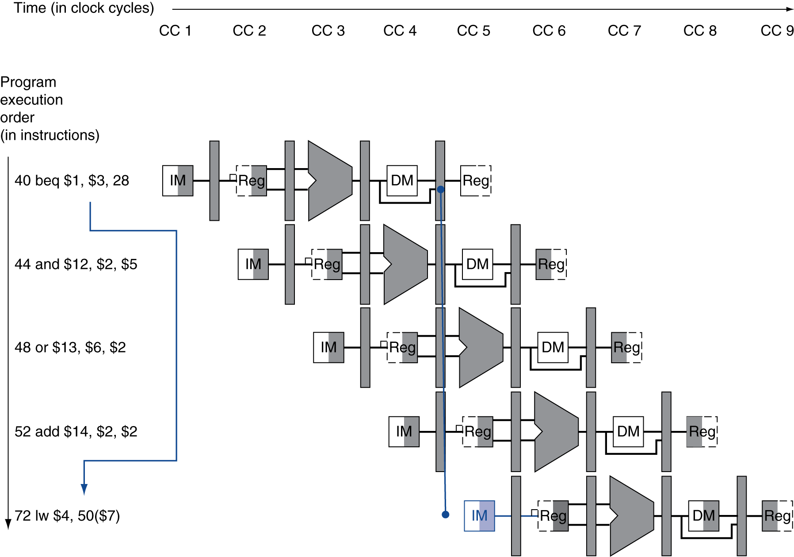
Branch Hazards
§4.8 Control Hazards
branch outcome determined in MEM
Flush these
instructions
(Set control
values to 0)
PC
Chapter 4 — The Processor — <number>
Notes:
Morgan Kaufmann Publishers
Chapter 4 — The Processor

Slide 40
Reducing Branch Delay
Example: branch taken
  36: sub $10, $4, $8
  40: beq $1, $3, 7
  44: and $12, $2, $5
  48: or $13, $2, $6
  52: add $14, $4, $2
  56: slt $15, $6, $7
  ...
  72: lw $4, 50($7)
Chapter 4 — The Processor — <number>
Notes:
Morgan Kaufmann Publishers
Chapter 4 — The Processor

Slide 41
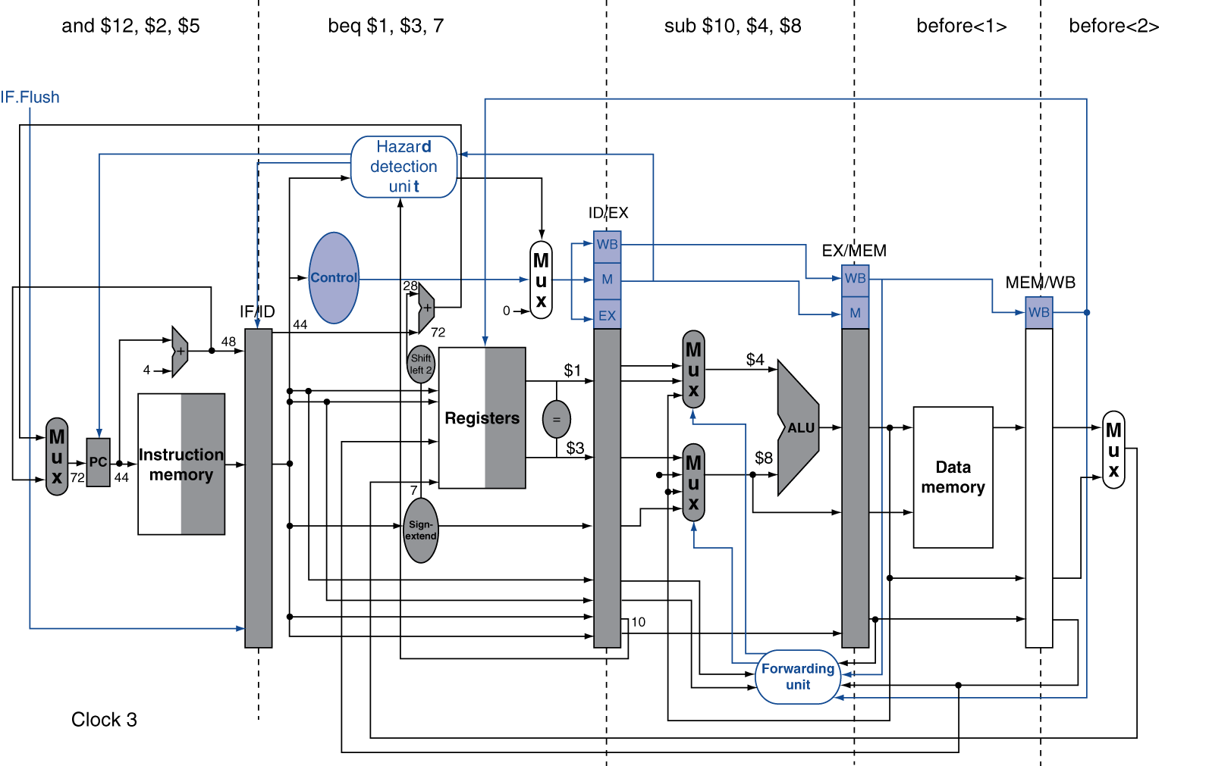
Example: Branch Taken
Chapter 4 — The Processor — <number>
Notes:
Morgan Kaufmann Publishers
Chapter 4 — The Processor

Slide 42
Data Hazards for Branches
If a comparison in EXE register is a destination of an instruction at least two stages earlier
add $1, $2, $3
IF
ID
EX
MEM
WB
add $4, $5, $6
IF
ID
EX
MEM
WB
…
IF
ID
EX
MEM
WB
beq $1, $4, target
IF
ID
EX
MEM
WB
Can resolve using forwarding
Chapter 4 — The Processor — <number>
Notes:
Morgan Kaufmann Publishers
Chapter 4 — The Processor

Slide 43
Data Hazards for Branches
If a comparison register is a destination of preceding ALU instruction or 2nd preceding load instruction
  Need 1 stall cycle
lw $1, addr
IF
ID
EX
MEM
WB
add $4, $5, $6
IF
ID
EX
MEM
WB
beq stalled
IF
ID
beq $1, $4, target
ID
EX
MEM
WB
Chapter 4 — The Processor — <number>
Notes:
Morgan Kaufmann Publishers
Chapter 4 — The Processor

Slide 44
Data Hazards for Branches
If a comparison register is a destination of immediately preceding load instruction
  Need 2 stall cycles
lw $1, addr
IF
ID
EX
MEM
WB
beq stalled
IF
ID
beq stalled
ID
beq $1, $0, target
ID
EX
MEM
WB
Chapter 4 — The Processor — <number>
Notes:
Morgan Kaufmann Publishers
Chapter 4 — The Processor

Slide 45
Dynamic Branch Prediction
In deeper and superscalar pipelines, branch penalty is more significant
Use dynamic prediction
  Branch prediction buffer (aka branch history table)
  Indexed by recent branch instruction addresses
  Stores outcome (taken/not taken)
  To execute a branch
    Check table, expect the same outcome
    Start fetching from fall-through or target
    If wrong, flush pipeline and flip prediction
Chapter 4 — The Processor — <number>
Notes:
Morgan Kaufmann Publishers
Chapter 4 — The Processor

Slide 46
1-Bit Predictor: Shortcoming
1 bit predictor will waste two times if wrong
  If mispredict on last time
  Then will mispredict again on first time because of the changed predict bit
Chapter 4 — The Processor — <number>
Notes:
Morgan Kaufmann Publishers
Chapter 4 — The Processor

Slide 47
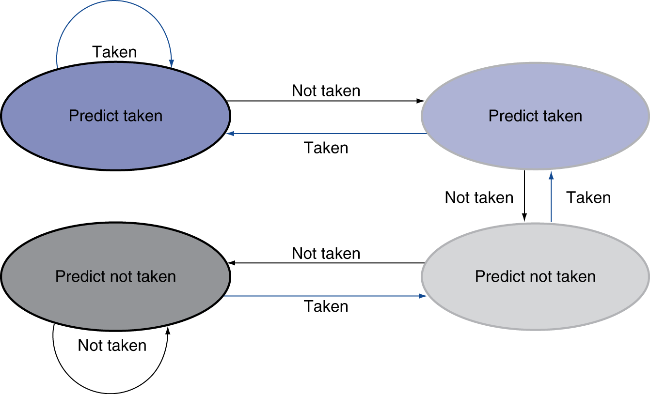
2-Bit Predictor
Only change prediction on two successive mispredictions
Chapter 4 — The Processor — <number>
Notes:
Morgan Kaufmann Publishers
Chapter 4 — The Processor

Slide 48
Calculating the Branch Target
Even with predictor, still need to calculate the target address
The branch to target address
Chapter 4 — The Processor — <number>
Notes:
Morgan Kaufmann Publishers
Chapter 4 — The Processor

Slide 49
Exceptions and Interrupts
§4.9 Exceptions
“Unexpected” events requiring change
in flow of control
  Different ISAs use the terms differently
Exception
  Arises within the CPU
    e.g., undefined opcode, overflow, syscall, …
Interrupt
  From an external I/O controller
Dealing with them without sacrificing performance is hard
Chapter 4 — The Processor — <number>
Notes:
Morgan Kaufmann Publishers
Chapter 4 — The Processor

Slide 50
Handling Exceptions
In MIPS, exceptions managed by a System Control Coprocessor (CP0)
Use “EPC” (“Exception Program Counter “) to save Exception instruction address
Use “Cause Register” to save Exception reason
Use “Rescue” register to Jump to rescue handler at 8000 00180
Chapter 4 — The Processor — <number>
Notes:
Morgan Kaufmann Publishers
Chapter 4 — The Processor

Slide 51
An Alternate Mechanism
Vectored Interrupts
  Handler address determined by the cause
Example:
  Undefined opcode: C000 0000
  Overflow: C000 0020
  …: C000 0040
Instructions either
  Deal with the interrupt, or
  Jump to rescue handler
Chapter 4 — The Processor — <number>
Notes:
Morgan Kaufmann Publishers
Chapter 4 — The Processor

Slide 52
Handler Actions
Read cause, and transfer to relevant handler
Determine action required
If restartable
  Take corrective action
  use EPC to return to program
Otherwise
  Terminate program
  Report error using EPC, cause, …
Chapter 4 — The Processor — <number>
Notes:
Morgan Kaufmann Publishers
Chapter 4 — The Processor

Slide 53
Exceptions in a Pipeline
Another form of control hazard
Consider overflow on add in EX stage
  add $1, $2, $1
  Prevent $1 from being clobbered
  Complete previous instructions
  Flush add and subsequent instructions
  Set Cause and EPC register values
  Transfer control to handler
Similar to mispredicted branch
  Use much of the same hardware
Chapter 4 — The Processor — <number>
Notes:
Morgan Kaufmann Publishers
Chapter 4 — The Processor

Slide 54
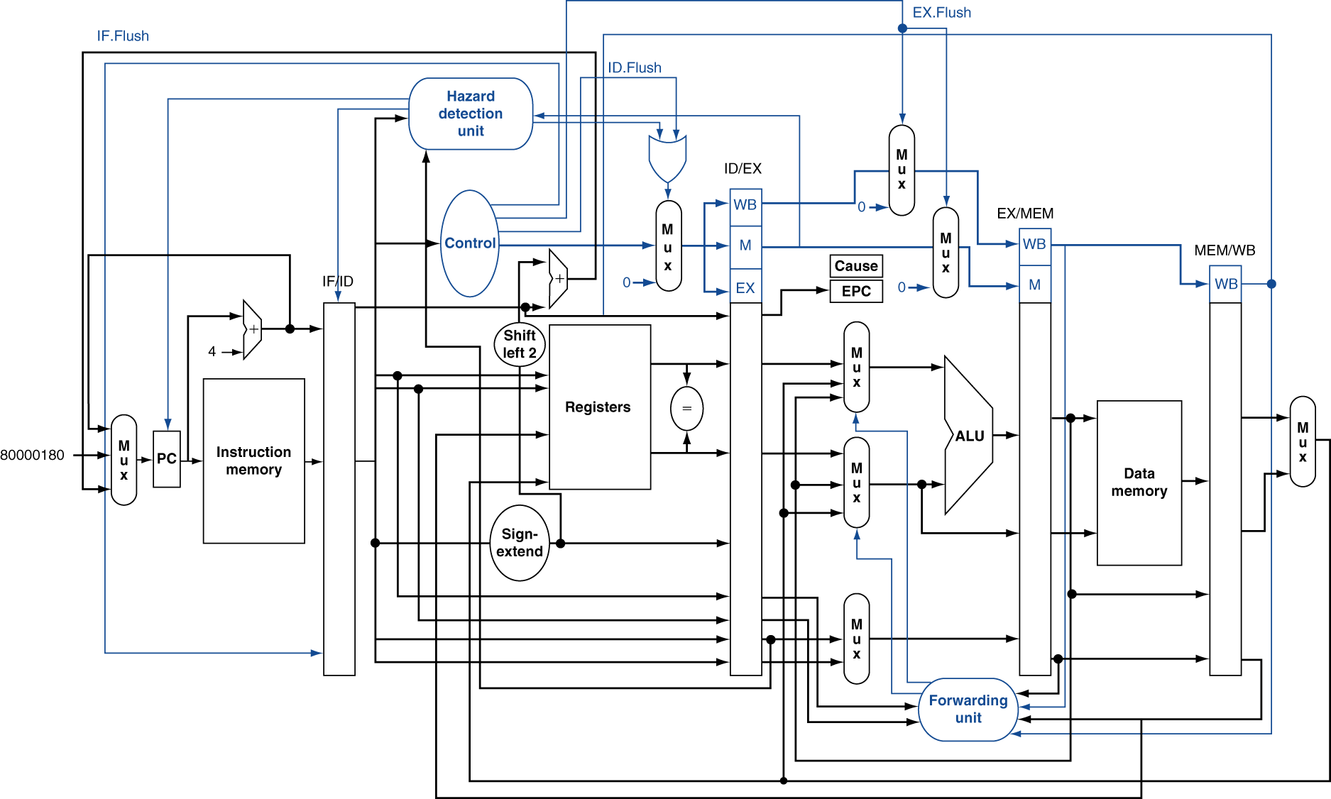
Pipeline with Exceptions
Chapter 4 — The Processor — <number>
Notes:
Morgan Kaufmann Publishers
Chapter 4 — The Processor

Slide 55
Exception Properties
Restartable exceptions
  Pipeline can flush the instruction
  Handler executes, then returns to the instruction
    Refetched and executed from scratch
PC saved in EPC register
  Identifies causing instruction
  Actually PC + 4 is saved
    Handler must adjust
Chapter 4 — The Processor — <number>
Notes:
Morgan Kaufmann Publishers
Chapter 4 — The Processor

Slide 56
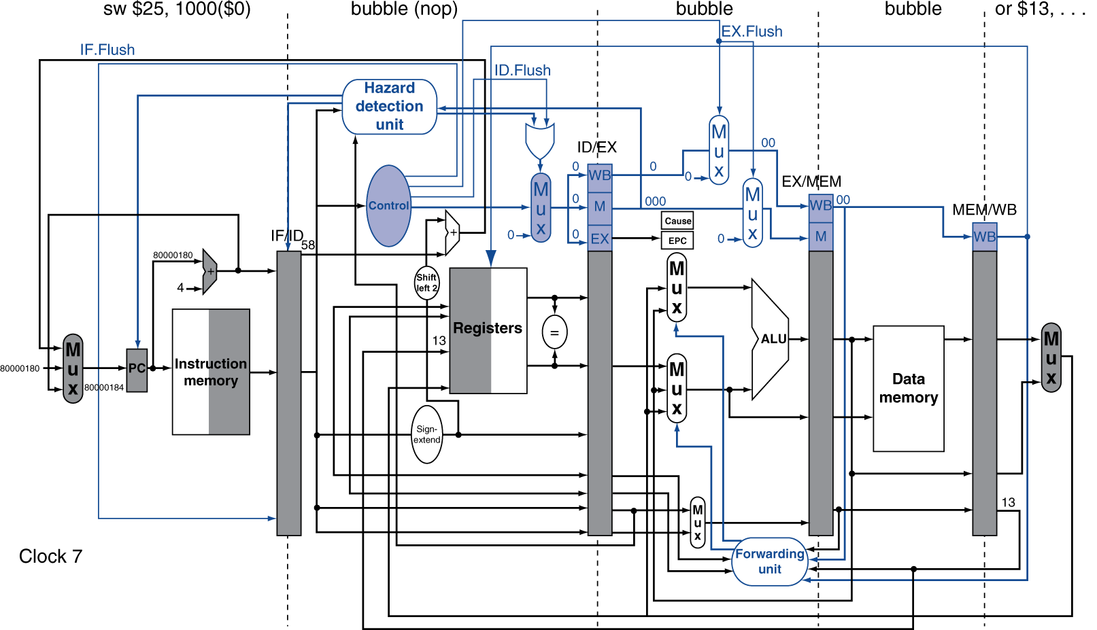
Exception Example
Chapter 4 — The Processor — <number>
Notes:
Morgan Kaufmann Publishers
Chapter 4 — The Processor

Slide 57
Multiple Exceptions
Pipelining overlaps multiple instructions
  Could have multiple exceptions at once
Simple approach: deal with exception from earliest instruction
  Flush subsequent instructions
  “Precise” exceptions
In complex pipelines
  Multiple instructions issued per cycle
  Out-of-order completion
  Maintaining precise exceptions is difficult!
Chapter 4 — The Processor — <number>
Notes:
Morgan Kaufmann Publishers
Chapter 4 — The Processor

Slide 58
Unit 10 Homework
1. Explain what is “pipelined instructions” and how does it work ? Use an example to
compare the non-pipeline and pipeline difference ?
2. What are the potential hazard problems in the pipeline instructions and how to solve each problem ?
3. What are “forwarding” and “stall” ? When and how do we use them ?
4. What is the branch hazard ? How to fix the branch hazard ?
5. What is exception ? How does MIPS handles the exception problem ?
§4.14 Concluding Remarks
Chapter 4 — The Processor — <number>
Notes:
Morgan Kaufmann Publishers
Chapter 4 — The Processor

