Slide 1
William Stallings
Data and Computer Communications
7th Edition
Chapter 5
Signal Encoding Techniques

Slide 2
Encoding Techniques
Digital data, digital signal
Analog data, digital signal
Digital data, analog signal
Analog data, analog signal

Slide 3
Digital Data, Digital Signal
Digital signal
  Discrete, discontinuous voltage pulses
  Each pulse is a signal element
  Binary data encoded into signal elements

Slide 4
Terms (1)
Unipolar
  All signal elements have same sign
Polar
  One logic state represented by positive voltage the other by negative voltage
Data rate
  Rate of data transmission in bits per second
Duration or length of a bit
  Time taken for transmitter to emit the bit

Slide 5
Terms (2)
Modulation rate
  Rate at which the signal level changes
  Measured in baud = signal elements per second
Mark and Space
  Binary 1 and Binary 0 respectively

Slide 6
Interpreting Signals
Need to know
  Timing of bits - when they start and end
  Signal levels
Factors affecting successful interpreting of signals
  Signal to noise ratio
  Data rate
  Bandwidth

Slide 7
Comparison of Encoding Schemes (1)
Signal Spectrum
  Lack of high frequencies reduces required bandwidth
  Lack of dc component allows ac coupling via transformer, providing isolation
  Concentrate power in the middle of the bandwidth
Clocking
  Synchronizing transmitter and receiver
  External clock
  Sync mechanism based on signal

Slide 8
Comparison of Encoding Schemes (2)
Error detection
  Can be built in to signal encoding
Signal interference and noise immunity
  Some codes are better than others
Cost and complexity
  Higher signal rate (& thus data rate) lead to higher costs
  Some codes require signal rate greater than data rate

Slide 9
Encoding Schemes
Nonreturn to Zero-Level (NRZ-L)
Nonreturn to Zero Inverted (NRZI)
Bipolar -AMI
Pseudoternary
Manchester
Differential Manchester
B8ZS
HDB3

Slide 10
Nonreturn to Zero-Level (NRZ-L)
Two different voltages for 0 and 1 bits
Voltage constant during bit interval
  no transition I.e. no return to zero voltage
e.g. Absence of voltage for zero, constant positive voltage for one
More often, negative voltage for one value and positive for the other
This is NRZ-L

Slide 11
Nonreturn to Zero Inverted
Nonreturn to zero inverted on ones
Constant voltage pulse for duration of bit
Data encoded as presence or absence of signal transition at beginning of bit time
Transition (low to high or high to low) denotes a binary 1
No transition denotes binary 0
An example of differential encoding

Slide 12
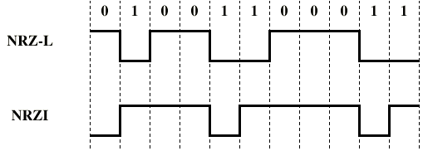
NRZ

Slide 13
Differential Encoding
Data represented by changes rather than levels
More reliable detection of transition rather than level
In complex transmission layouts it is easy to lose sense of polarity

Slide 14
NRZ pros and cons
Pros
  Easy to engineer
  Make good use of bandwidth
Cons
  dc component
  Lack of synchronization capability
Used for magnetic recording
Not often used for signal transmission

Slide 15
Multilevel Binary
Use more than two levels
Bipolar-AMI
  zero represented by no line signal
  one represented by positive or negative pulse
  one pulses alternate in polarity
  No loss of sync if a long string of ones (zeros still a problem)
  No net dc component
  Lower bandwidth
  Easy error detection

Slide 16
Pseudoternary
One represented by absence of line signal
Zero represented by alternating positive and negative
No advantage or disadvantage over bipolar-AMI

Slide 17
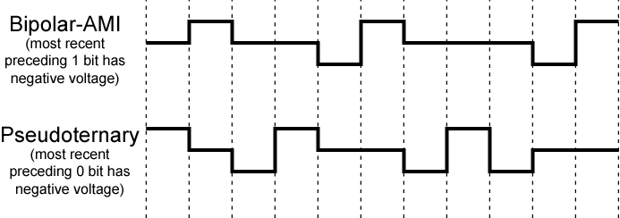
Bipolar-AMI and Pseudoternary

Slide 18
Trade Off for Multilevel Binary
Not as efficient as NRZ
  Each signal element only represents one bit
  In a 3 level system could represent log₂3 = 1.58 bits
  Receiver must distinguish between three levels
  (+A, -A, 0)
  Requires approx. 3dB more signal power for same probability of bit error

Slide 19
Biphase
Manchester
  Transition in middle of each bit period
  Transition serves as clock and data
  Low to high represents one
  High to low represents zero
  Used by IEEE 802.3
Differential Manchester
  Midbit transition is clocking only
  Transition at start of a bit period represents zero
  No transition at start of a bit period represents one
  Note: this is a differential encoding scheme
  Used by IEEE 802.5

Slide 20
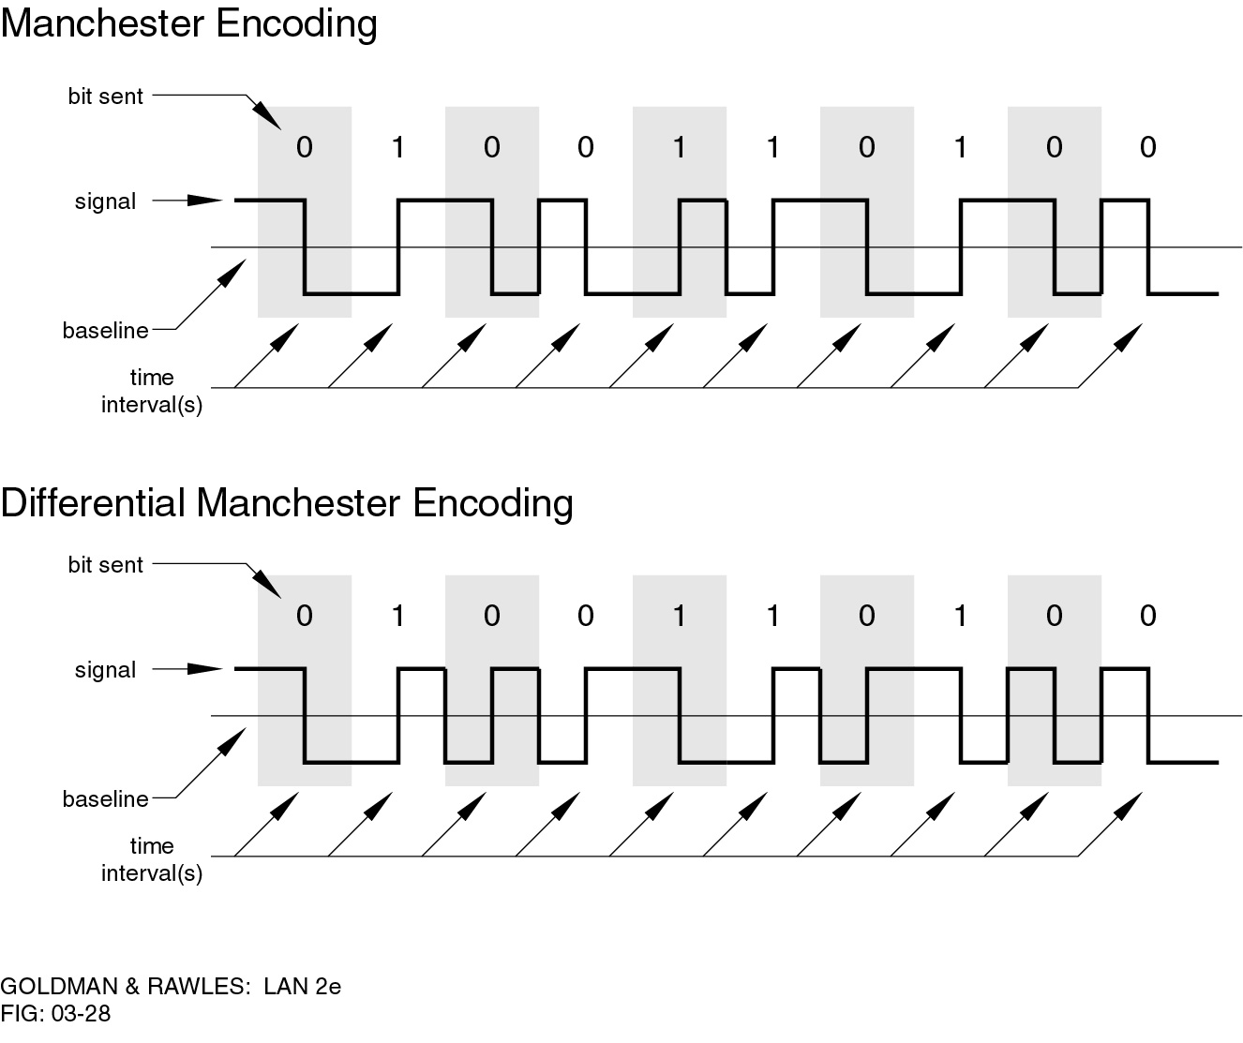
Manchester Encoding

Slide 21
Differential Manchester Encoding

Slide 22
Biphase Pros and Cons
Con
  At least one transition per bit time and possibly two
  Maximum modulation rate is twice NRZ
  Requires more bandwidth
Pros
  Synchronization on mid bit transition (self clocking)
  No dc component
  Error detection
    Absence of expected transition

Slide 23
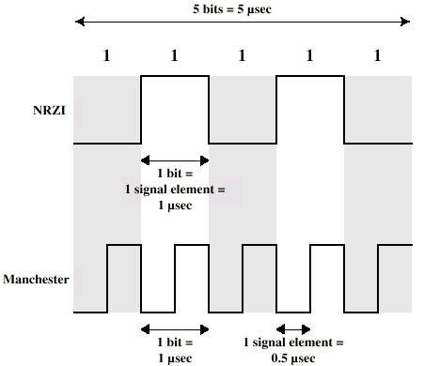
Modulation Rate

Slide 24
Scrambling
Use scrambling to replace sequences that would produce constant voltage
Filling sequence
  Must produce enough transitions to sync
  Must be recognized by receiver and replace with original
  Same length as original
No dc component
No long sequences of zero level line signal
No reduction in data rate
Error detection capability

Slide 25
B8ZS
Bipolar With 8 Zeros Substitution
Based on bipolar-AMI
If octet of all zeros and last voltage pulse preceding was positive encode as 000+-0-+
If octet of all zeros and last voltage pulse preceding was negative encode as 000-+0+-
Causes two violations of AMI code
Unlikely to occur as a result of noise
Receiver detects and interprets as octet of all zeros

Slide 26
HDB3
High Density Bipolar 3 Zeros
Based on bipolar-AMI
String of four zeros replaced with one or two pulses

Slide 27
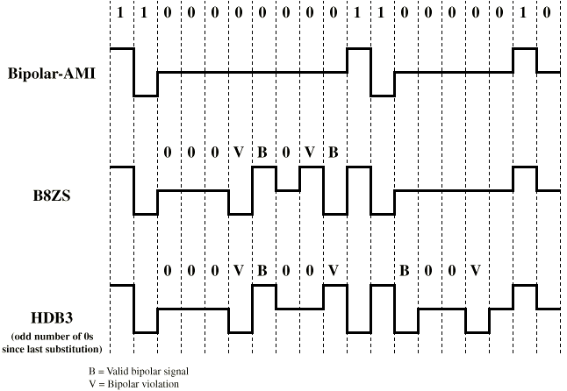
B8ZS and HDB3

Slide 28
Digital Data, Analog Signal
Public telephone system
  300Hz to 3400Hz
  Use modem (modulator-demodulator)
Amplitude shift keying (ASK)
Frequency shift keying (FSK)
Phase shift keying (PK)

Slide 29
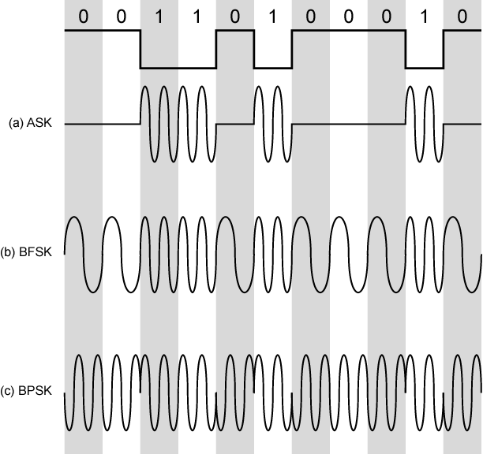
Modulation Techniques

Slide 30
Amplitude Shift Keying
Values represented by different amplitudes of carrier
Usually, one amplitude is zero
  i.e. presence and absence of carrier is used
Susceptible to sudden gain changes
Inefficient
Up to 1200bps on voice grade lines
Used over optical fiber

Slide 31
Binary Frequency Shift Keying
Most common form is binary FSK (BFSK)
Two binary values represented by two different frequencies (near carrier)
Less susceptible to error than ASK
Up to 1200bps on voice grade lines
High frequency radio
Even higher frequency on LANs using co-ax

Slide 32
Multiple FSK
More than two frequencies used
More bandwidth efficient
More prone to error
Each signalling element represents more than one bit

Slide 33
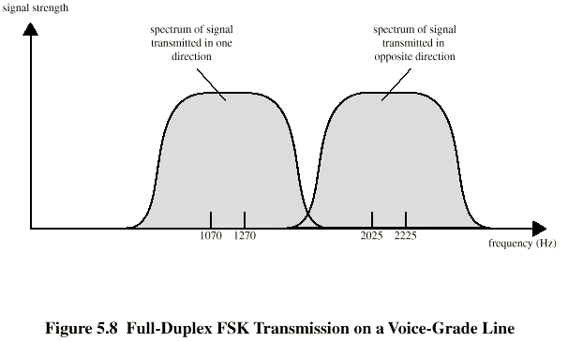
FSK on Voice Grade Line

Slide 34
Phase Shift Keying
Phase of carrier signal is shifted to represent data
Binary PSK
  Two phases represent two binary digits
Differential PSK
  Phase shifted relative to previous transmission rather than some reference signal

Slide 35
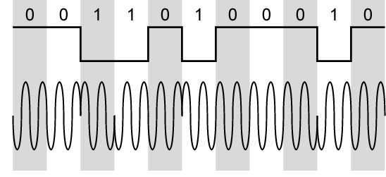
Differential PSK

Slide 36
Quadrature PSK
More efficient use by each signal element representing more than one bit
  e.g. shifts of π/2 (90º)
  Each element represents two bits
  Can use 8 phase angles and have more than one amplitude
  9600bps modem use 12 angles , four of which have two amplitudes
Offset QPSK (orthogonal QPSK)
  Delay in Q stream

Slide 37
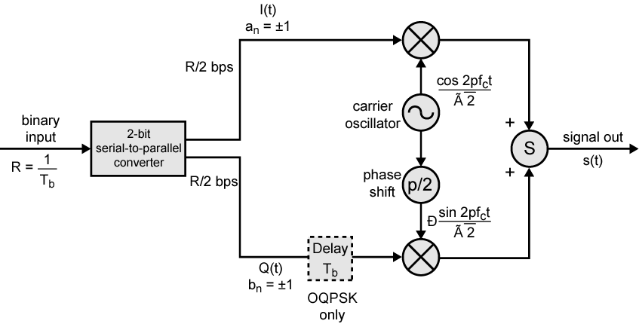
QPSK and OQPSK Modulators

Slide 38
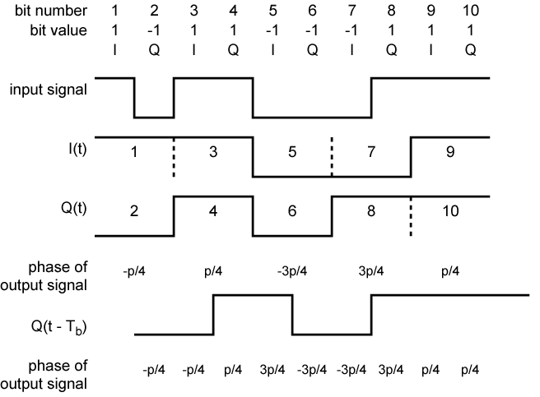
Examples of QPSF and OQPSK Waveforms

Slide 39
Performance of Digital to Analog Modulation Schemes
Bandwidth
  ASK and PSK bandwidth directly related to bit rate
  FSK bandwidth related to data rate for lower frequencies, but to offset of modulated frequency from carrier at high frequencies
  (See Stallings for math)
In the presence of noise, bit error rate of PSK and QPSK are about 3dB superior to ASK and FSK

Slide 40
Quadrature Amplitude Modulation
QAM used on asymmetric digital subscriber line (ADSL) and some wireless
Combination of ASK and PSK
Logical extension of QPSK
Send two different signals simultaneously on same carrier frequency
  Use two copies of carrier, one shifted 90°
  Each carrier is ASK modulated
  Two independent signals over same medium
  Demodulate and combine for original binary output

Slide 41
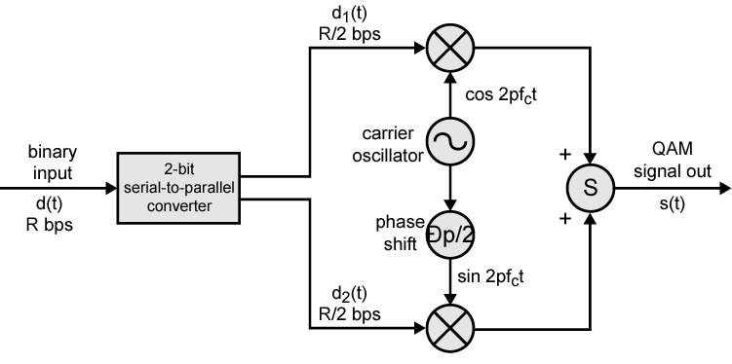
QAM Modulator

Slide 42
QAM Levels
Two level ASK
  Each of two streams in one of two states
  Four state system
  Essentially QPSK
Four level ASK
  Combined stream in one of 16 states
64 and 256 state systems have been implemented
Improved data rate for given bandwidth
  Increased potential error rate

Slide 43
Analog Data, Digital Signal
Digitization
  Conversion of analog data into digital data
  Digital data can then be transmitted using NRZ-L
  Digital data can then be transmitted using code other than NRZ-L
  Digital data can then be converted to analog signal
  Analog to digital conversion done using a codec
  Pulse code modulation
  Delta modulation

Slide 44
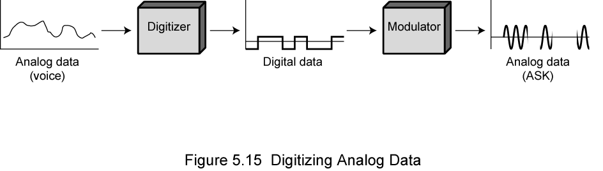
Digitizing Analog Data

Slide 45
Pulse Code Modulation(PCM) (1)
If a signal is sampled at regular intervals at a rate higher than twice the highest signal frequency, the samples contain all the information of the original signal
  (Proof - Stallings appendix 4A)
Voice data limited to below 4000Hz
Require 8000 sample per second
Analog samples (Pulse Amplitude Modulation, PAM)
Each sample assigned digital value

Slide 46
Pulse Code Modulation(PCM) (2)
4 bit system gives 16 levels
Quantized
  Quantizing error or noise
  Approximations mean it is impossible to recover original exactly
8 bit sample gives 256 levels
Quality comparable with analog transmission
8000 samples per second of 8 bits each gives 64kbps

Slide 47
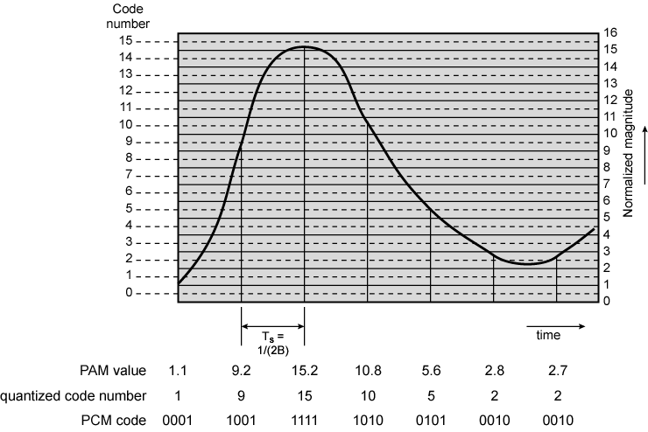
PCM Example

Slide 48
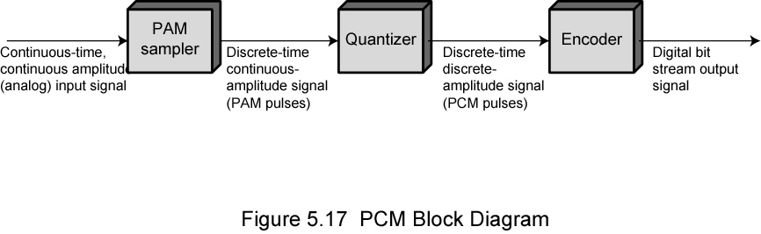
PCM Block Diagram

Slide 49
Nonlinear Encoding
Quantization levels not evenly spaced
Reduces overall signal distortion
Can also be done by companding

Slide 50
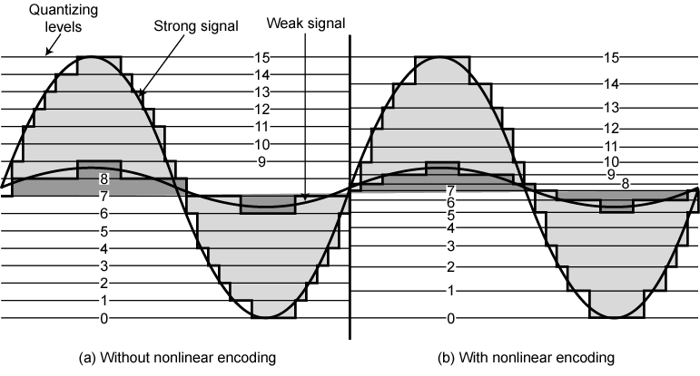
Effect of Non-Linear Coding

Slide 51
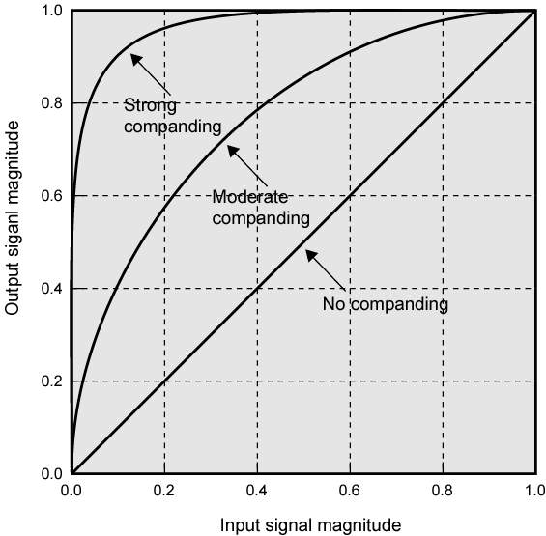
Typical Companding Functions

Slide 52
Delta Modulation
Analog input is approximated by a staircase function
Move up or down one level (δ) at each sample interval
Binary behavior
  Function moves up or down at each sample interval

Slide 53
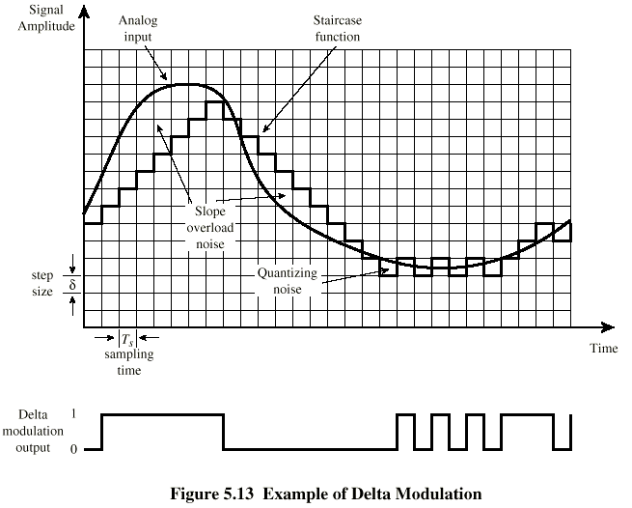
Delta Modulation - example

Slide 54
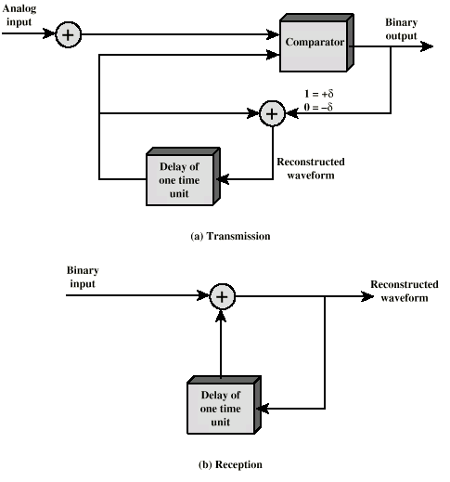
Delta Modulation - Operation

Slide 55
Delta Modulation - Performance
Good voice reproduction
  PCM - 128 levels (7 bit)
  Voice bandwidth 4khz
  Should be 8000 x 7 = 56kbps for PCM
Data compression can improve on this
  e.g. Interframe coding techniques for video

Slide 56
Analog Data, Analog Signals
Why modulate analog signals?
  Higher frequency can give more efficient transmission
  Permits frequency division multiplexing (chapter 8)
Types of modulation
  Amplitude
  Frequency
  Phase

Slide 57
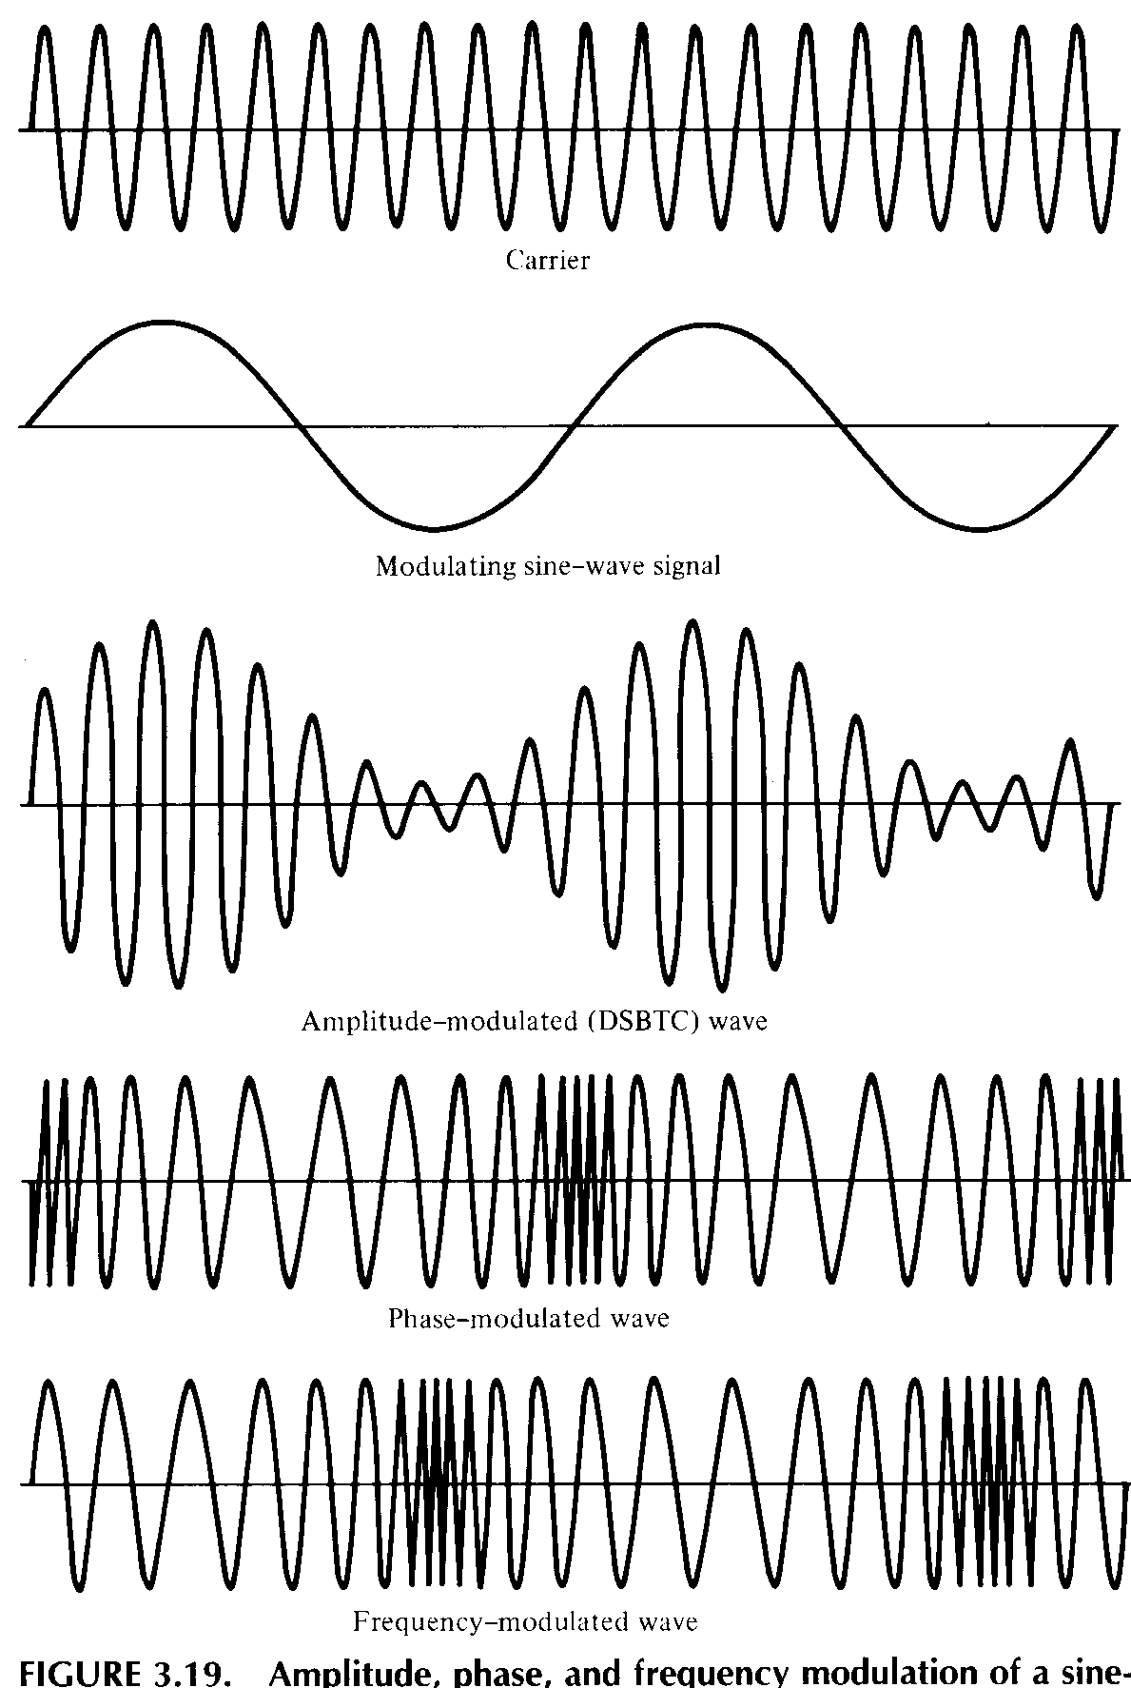
Analog
Modulation

Slide 58
Required Reading
Stallings chapter 5

