Slide 1
Operating System Design
Dr. Jerry Shiao, Silicon Valley University
Summer 2015
SILICON VALLEY UNIVERSITY CONFIDENTIAL

Slide 2
Protection
Overview
Protection refers to a mechanism to ensure that only the processes that have gained proper authorization from the Operating System can operate on resources defined by the Operating System.
  Resources are: Memory Segments, CPU, I/O Devices, Files, Programs.
  Mechanism must provide the means for specifying the controls to be imposed together, along with the means of enforcement.
Is Protection the same as Security?
  Security broader meaning:
    Security needs Protection is an internal control mechanism: Protection ineffective when user authentication is compromised.
    Security also must consider external environment: Compromised user authentication, malicious alterations by viruses, worms, Denial-of-Service.
Copyright @ 2009 John Wiley & Sons Inc.
SILICON VALLEY UNIVERSITY CONFIDENTIAL

Slide 3
Protection
Overview
In a protected environment, there are Domains and Objects.
Access Matrix as a model of protection.
  Access List, Capability List, Access-Rights.
Revocation of Access Rights.
Capability-Based Systems.
Language-Based Protection.
Copyright @ 2009 John Wiley & Sons Inc.
SILICON VALLEY UNIVERSITY CONFIDENTIAL

Slide 4
Protection
Protection
  Mechanism for controlling the access to the Operating System resources by:
    Programs.
    Processes.
    Users.
  In multiprogramming Operating System:
    Increase the reliability of any complex system that makes use of shared resources.
  What are the controls to be imposed and the means of enforcement?
  Different than Security: The measure of confidence that the integrity of the system and its data will be preserved.
Copyright @ 2009 John Wiley & Sons Inc.
SILICON VALLEY UNIVERSITY CONFIDENTIAL

Slide 5
Protection
Goals of Protection
  Protection at the Subsystem: Prevent mischievous, intentional violation of access restriction by user.
    System resources must be used consistent with stated policies.
    Protect the interfaces between component subsystems.
    Prevent contamination and malfunction of the subsystem.
  What are mechanisms?
    Determines HOW something will be done.
  What are Policies?
    Decides WHAT will be done.
  Role of protection in a computer system is to provide a mechanism for the enforcement of the polices governing resource use.
    Unprotected resource cannot defend itself against use by unauthorized or user.
Copyright @ 2009 John Wiley & Sons Inc.
SILICON VALLEY UNIVERSITY CONFIDENTIAL

Slide 6
Protection
Principles of Protection
  Key Principle of Protection:
    Principle of Least Privilege: Programs, users, and systems be given just enough privileges to perform their tasks.
  Managing Operating System with Principle of Least Privilege:
    Operating System features, programs, system calls, and data structures allows minimal damage when compromised.
    Fine grain Access Control: Enable privileges when needed (passwd).
    Audit Trail to trace protection and security activities in system.
  Managing users with Principle of Least Privilege:
    Operating System manages separate account for each user (RBAC).
    User enabled with privileges needed.
  Managing Computers with Principle of Least Privilege:
    Limit a Computer System to specific services or remote services.
    Enabling/Disabling services and using Access Control List.
Copyright @ 2009 John Wiley & Sons Inc.
SILICON VALLEY UNIVERSITY CONFIDENTIAL

Slide 7
Protection
Domain of Protection
  Computer System: Collection of Abstract Data Types.
    Operations depend on the Object Type.
    Hardware Objects:
      CPU – Execute Op.
      Memory – Read/Write Op.
      CD-ROM, DVD-ROM – Read Op.
      Tape Drives – Read/Write/Rewind Op.
    Software Objects:
      Data Files – Cr/Op/Rd/Wr/Cl/Del Op.
      Program Files – Cr/Rd/Wr/Ex/Del Op.
  Process Access ONLY Authorized Resources and Resources Required to Complete Task.
    Need-To-Know Principle (Principle of Least Privilege):
      Procedure access only parameters passed by calling procedure (NOT all variables of calling procedure).
      Compiler access subset of files (“.c” files, NOT arbitrary files).
      User cannot access private files used by the Compiler.
Copyright @ 2009 John Wiley & Sons Inc.
SILICON VALLEY UNIVERSITY CONFIDENTIAL

Slide 8

Protection
Domain Structure
Process executes within a Protection Domain:
Protection Domain: Resources a process may access.
  Access Rights = Ordered pair of Objects + { Rights-Set }
    Object = File “F”, Rights-Set = { read, write }
  Domain = Collection of Access Rights
O1, Domain D1 allows {read, write} and Domain D3 allows {execute}.
Domain defines a set of Objects and Types of operations that may be invoked on each Object.
Domain D2 and D3 share Access Rights <O2, {print}>.
Copyright @ 2009 John Wiley & Sons Inc.
SILICON VALLEY UNIVERSITY CONFIDENTIAL

Slide 9
Protection
Domain Structure
Protection Domain: Association with Process
  Static:
    Set of Resources available to the Process is Fixed throughout Process’ Lifetime.
    Need-to-Know Principle
      Process only needs the minimum Access Rights.
    Mechanism must be available to change content of a domain.
      Scenerio: Process may need Read Access in one period and Write Access in another.
        Domain with both Read and Write Access violates Need-to-Know Principle ( Process has more Access Rights then necessary).
        Modify the contents of a Domain, Domain will always reflect minimum Access Rights.
  Dynamic:
    Mechanism is available for process to switch Domains.
    Contents of Domain can also be allowed.
    Create new Domain with changed content and switching to new Domain.
Copyright @ 2009 John Wiley & Sons Inc.
SILICON VALLEY UNIVERSITY CONFIDENTIAL

Slide 10
Protection
Domain Structure
What is a Domain?
  User:
    Set of Objects associated with identity of User.
    Domain switching when user logs out, another user logs in.
  Process:
    Set of Objects associated with identity of Process.
    Domain Switching when one process sends message to another.
  Procedure:
    Set of Objects corresponds to local variables within Procedure.
    Domain Switching when procedure call is made.
  Operating System Dual Mode:
    Monitor (Kernel) Mode: Execute privileged instructions and has control of Operating System.
    User Mode: Execute unprivileged instructions,.
    Domain Switching with System Calls.
Copyright @ 2009 John Wiley & Sons Inc.
SILICON VALLEY UNIVERSITY CONFIDENTIAL

Slide 11
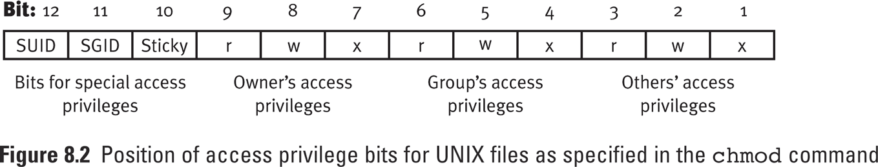
Protection
Domain Structure
UNIX Domain
  Domain Associated with User: User and Supervisor ( Root ).
    File System allows temporary User (Domain) to be switched.
    Special Access Bits: If the SUID Bit is set for an executable file (i.e. command or shell script), the process takes on the User privilege of the owner of the file when it executes.
    passwd Command: Allows user to change user’s password, but /etc/passwd file is owned by Kernel.
    sau@buildbed-vm:/usr/bin> ls -l /etc/passwd
    -rw-r--r-- 1 root root 2029 2012-10-02 15:43 /etc/passwd
    sau@buildbed-vm:/usr/bin> ls -l /usr/bin/passwd
    -rwsr-xr-x 1 root shadow 80268 2011-07-29 12:55 /usr/bin/passwd
chmod 4xxx <file-name> OR chmod u+s <file-name>
Copyright @ 2009 John Wiley & Sons Inc.
SILICON VALLEY UNIVERSITY CONFIDENTIAL

Slide 12

Protection
Domain Structure
MULTICS Domain
  D<i> and D<j> are Domain Rings, 0 to 7.
  If <j> less than <i>, then D<i> is a subset of D<j>
-- Segmented address space, where each segment is a ring belonging to a domain.
-- Domain switching when a process calling a procedure in a different segment (ring).
-- Segment has Access Bracket, allowing a segment to call a lower numbered segment (higher privilege) or call a higher numbered segment (lower privilege).
-- Lower numbered segment can only be reached through predefined gates (entry points).
Ring 0 process has most privileges.
Ring 1 process has less privileges.
Access Bracket:
b1 <= i <= b2
Copyright @ 2009 John Wiley & Sons Inc.
SILICON VALLEY UNIVERSITY CONFIDENTIAL

Slide 13
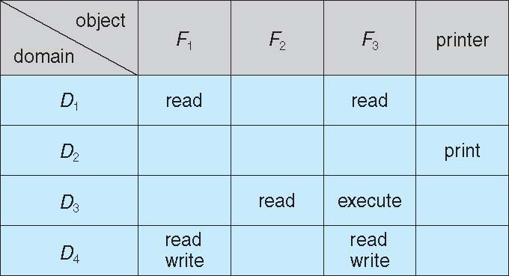
Protection
Access Matrix: Model of Protection
  Rows: Represents Domains.
  Columns: Represent Objects
  Entry is a set of Access Rights.
Process executing in Domain D1 has “read” privilege with Files F1 and F3.
Process executing in Domain D4 has the same privileges as D1, with additional “write” privilege with F1 and F3.
Copyright @ 2009 John Wiley & Sons Inc.
SILICON VALLEY UNIVERSITY CONFIDENTIAL

Slide 14
Protection
Access Matrix
  Matrix provides the mechanism for specifying different policies.
    Mechanism is implementing the matrix and following the properties.
    If a process in Domain D<i> tries to do “op” on object O<j>, then “op” must be in the Access Matrix.
    Example: Process executing in Domain D<i> can access objects in Row <i> ONLY as allowed by the Access Matrix entry’s Operation.
  Matrix provides the mechanism for implementing control for dynamic association between Process and Domain.
    Domain Switching: Adding Domains as Objects of Access Matrix.
      Switch – Switch from Domain D<i> to D<j>.
    Matrix entry modified: Adding Matrix as Object of Access Matrix.
      Use Special Access Rights in Matrix entry:
      Owner of O<j> - Add or Delete O<i> to O<j> (within column).
      Copy Operation from O<i> to O<j> (within column).
      Control – D<i> can modify D<j> Access Rights (within row).
Copyright @ 2009 John Wiley & Sons Inc.
SILICON VALLEY UNIVERSITY CONFIDENTIAL

Slide 15

Protection
Policy:
User Dictates Policy.
Who can access what Object and in what Mode (Domain).
Policy decision involve which Access Right are included in the Access Matrix Entry (whether the entry is blank or contains Rights).
Access Matrix
Mechanism:
Process executing in Domain can Access ONLY Objects in row (Implements the Access Matrix Entry).
Domain as Objects.
A process executing in D1 can switch to D2.
Copyright @ 2009 John Wiley & Sons Inc.
SILICON VALLEY UNIVERSITY CONFIDENTIAL

Slide 16

Protection
Copy Access Right denoted by asterisk (*) appended to the Access Right.
Copy allows Access Right copied only within the column (for the Object).
Copy can be a transfer (Access Right REMOVED from originating Object).
Limited Copy allows ONLY the Access Right to be copied, NOT the ability to Copy (Example below).
Access Matrix
Copyright @ 2009 John Wiley & Sons Inc.
SILICON VALLEY UNIVERSITY CONFIDENTIAL

Slide 17

Protection
Owner Access Right is mechanism to allow addition of new rights and removal of rights.
- Allow a process to change the entries ONLY in the Object’s column.
Access Matrix
Copyright @ 2009 John Wiley & Sons Inc.
SILICON VALLEY UNIVERSITY CONFIDENTIAL

Slide 18

Protection
Control Access Right applicable to Domain Objects.
Changes Access Matrix ONLY on the row.
Access Matrix entry D<2>,D<4> Control Access Right allows changes to D<4>.
Example removes “Read” Access.
Access Matrix
Copyright @ 2009 John Wiley & Sons Inc.
SILICON VALLEY UNIVERSITY CONFIDENTIAL

Slide 19
Protection
Implementation of Access Matrix
How Access Matrix (sparse matrix) be implemented?
Global Table
  Ordered Triplets < Domain, Object, Rights-set >.
  Executing operation on Object O<j> within Domain D<i>, the Global Table is searched for triplet < O<j>, D<i>, R<k> >.
  If triplet found (operation in Rights-set, R<k>), operation allowed to continue.
  Global Table very large and cannot be kept in memory, Virtual Memory technique required to manage the table.
  Special groupings of Objects, where everyone (Domain) can read (operation in Rights-set) the Object, then the Object must have entry in every domain.
Copyright @ 2009 John Wiley & Sons Inc.
SILICON VALLEY UNIVERSITY CONFIDENTIAL

Slide 20
Protection
Implementation of Access Matrix
Access List for Objects
  Each column in Access Matrix is an Access List for the Object
    List for each Object is an ordered pair { Domain, Rights-set }.
      Defines who can perform what operation on the Object.
      Domain 1 = Read, Write
      Domain 2 = Read
      Domain 3 = Read
    Domains contain access rights for the Object.
  Define a default set of Access Rights.
  Every access to the Object requires searching the Access List, which can be time consuming.
Copyright @ 2009 John Wiley & Sons Inc.
SILICON VALLEY UNIVERSITY CONFIDENTIAL

Slide 21
Protection
Implementation of Access Matrix
Capability List for Objects
  Each row in Access Matrix, is a Capability List for a Domain.
    Capability is an Object.
    Capability List is list of protected Objects, maintained by Operating System, and accessed by the user indirectly.
      List of Objects together with the operations allowed on those Objects.
      Object 1 – Read
      Object 4 – Read, Write, Execution
      Object 5 – Read, Write, Delete, Copy
    To provide protection, distinguish Capabilities from other kinds of Objects.
      Each Object is tagged as Capability or accessible data.
        All Object can be tagged with the Object’s type (Integer, Pointers, Booleans,
      Address space associated with program is split into two parts: one part contains program and other part contains the Capability List.
Copyright @ 2009 John Wiley & Sons Inc.
SILICON VALLEY UNIVERSITY CONFIDENTIAL

Slide 22
Protection
Implementation of Access Matrix
Comparision
Global Table:
  Simple, but table can be large and sparse: Virtual Memory often used to manage the table.
  Cannot take advantage of special groupings of Objects or Domains.
Access List:
  Users creates Access List by creating the Object and linking the Domains and operations allowed.
  Access List Only: Access-Rights (Domain, Rights-set) not localized because Access-Rights spread is over many Domains.
Capability List:
  Process in the Domain creates localized list of capabilities (Object, Rights-set).
  Capability Only: Useful for localizing information for a process.
Copyright @ 2009 John Wiley & Sons Inc.
SILICON VALLEY UNIVERSITY CONFIDENTIAL

Slide 23
Protection
Implementation of Access Matrix
Comparision
Combination of Access Lists and Capabilities.
  Combination: Process first access an Object, Access List is used and a Capability List for the Domain is created for the process.
    Additional references uses the Capability List.
    When Access List entry removed, the entry in Capability List also removed.
  Lock-Key Mechanism: Using Combination, but each object has an unique bit pattern (Lock), and Domain has list of unique bit patterns (Key).
  Example: File system using Access List and Capabilities.
    The File (Object) has Access List that is used to validate permission.
    File Table (Capability List) is created for the User (Domain) and additional Files (Objects) are linked.
    An index is returned for the File Table (Lock-Key Mechanism) and the index is used to access the File Table.
    When File is closed, the File Table entry is removed.
Copyright @ 2009 John Wiley & Sons Inc.
SILICON VALLEY UNIVERSITY CONFIDENTIAL

Slide 24
Protection
Implementation of Access Matrix
UNIX Database Management System makes decision on individual user access attempt.
  Operating System only grants user permission to access a file or use an application.
  Access Control mechanism is the Access Matrix.
    Subject: Entity capable of accessing objects (process that represents User).
    Object: Anything to which access is controlled (files, programs, segments of memory, software objects (Java objects)).
    Access Rights: Way in which an Object is accessed by a Subject (read, write, execute, and functions in software objects).
  Access Matrix implemented by decomposition into either:
    Access Control Lists: Each Object, lists Subjects (Users) and their permitted Access Rights.
    Capability Tickets: Authorized Objects and operations for a Subject (User).
Copyright @ 2009 John Wiley & Sons Inc.
SILICON VALLEY UNIVERSITY CONFIDENTIAL

Slide 25
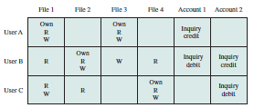
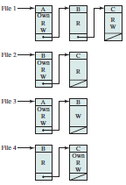
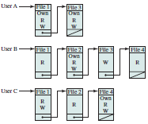
Protection
Access Matrix
File System or
Database Management
System
Access List
Capability List
Copyright @ 2009 John Wiley & Sons Inc.
SILICON VALLEY UNIVERSITY CONFIDENTIAL

Slide 26
Protection
Access Control
Role-Based Access Control (RBAC): Protection enhanced with concept of privileges.
  Implements Principle of Least Privilege.
  Definition of Privilege: Right to execute system call or use an option within the system call (i.e. Open File with Write access).
    Privilege similar to Rights-Set.
  Privilege assigned to process, limiting process to the access needed to perform the work.
Concept of Role: Privileges (Rights-Set) and programs can be assigned to Role.
  Role is a group of privileges (Rights-Set).
Users are assigned to Roles, not Objects (i.e. File).
  User takes Role, that enables a privilege, allowing User to access Files and run programs.
  Multiple Users can be assigned to one Role.
Copyright @ 2009 John Wiley & Sons Inc.
SILICON VALLEY UNIVERSITY CONFIDENTIAL

Slide 27
Protection
Access Control
Role-Based Access Control (RBAC): Protection enhanced with concept of privileges.
  Implements Principle of Least Privilege.
  Definition of Privilege: Right to execute system call or use an option within the system call (i.e. Open File with Write access).
    Privilege similar to Rights-Set.
  Privilege assigned to process, limiting process to the access needed to perform the work.
  Controls access based on the roles that users have within the system and on rules stating what accesses are allowed to users in given roles.
    Not on the identity of the User.
Concept of Role: Privileges (Rights-Set) and programs can be assigned to Role.
  Role is a group of privileges (Rights-Set).
Copyright @ 2009 John Wiley & Sons Inc.
SILICON VALLEY UNIVERSITY CONFIDENTIAL

Slide 28
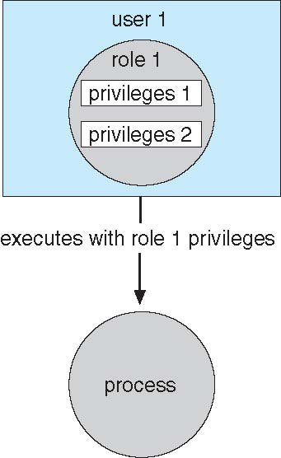
Protection
Access Control
User assigned Role(s), NOT
Objects (i.e. File).
User can take Role to
enable a privilege, allowing
the user to access an object
(File with Access-Rights) or
execute a programs.
Multiple Users can be
assigned to one Role.
Copyright @ 2009 John Wiley & Sons Inc.
SILICON VALLEY UNIVERSITY CONFIDENTIAL

Slide 29
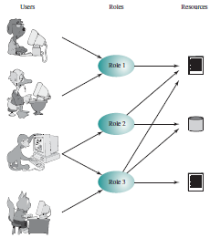
Protection
Access Control
RBAC represented in Access Matrix.
  Matrix depicts relationship of Users to Roles.
    Many more Users than Roles.
    Single User assigned to multiple
    Roles.
    Multiple Users assigned to single
    Role.
  Matrix depicts relationship of
  Roles to Objects.
    Objects are hardware resources
    ( CPU, Memory Segments,
    Printers, Disks, Tape Drives).
    Objects are software resources
    ( Files, Programs, Semaphores ).
Copyright @ 2009 John Wiley & Sons Inc.
SILICON VALLEY UNIVERSITY CONFIDENTIAL

Slide 30
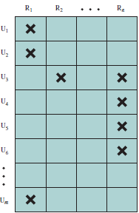
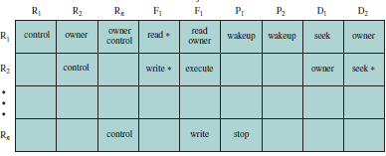
Protection
Role-Based Access Control (RBAC)
RBAC assigned Rights-Set of objects (i.e. Files) and other resources to Roles instead of individual users.
Roles likely to be Static.
User assigned to Multiple Roles. Multiple User assigned to Role.
Copyright @ 2009 John Wiley & Sons Inc.
SILICON VALLEY UNIVERSITY CONFIDENTIAL

Slide 31
Protection
RBAC in Solaris Environment
Users are given the minimal amount of privilege to accomplish their given responsibilies.
Applied to UNIX SuperUser (root) privileges.
  Role with limited SU capabilties:
    Primary Administrator: Full Root capability.
    System Administrator: Less strong ( role, not related to security (i.e. this role does not allow user to set passwords).
    Operator: Need privileges for Backups, Restores, and Printer Management.
  Role has attributes as user account (i.e. UID, Home Directory, Profile Shells, and set of unique capabilities).
    User logs in as themselves and switch to the role with “su” command.
    The Profile Shell understand RBAC and implement role capabilities.
  RBAC Configuration Files:
    /etc/user_attr: Defines which users can assume which roles and profile.
Copyright @ 2009 John Wiley & Sons Inc.
SILICON VALLEY UNIVERSITY CONFIDENTIAL

Slide 32
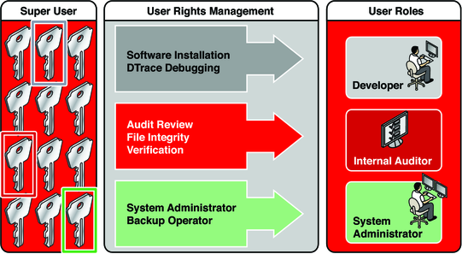
Protection
RBAC in Solaris Environment
Superuser creates roles:
  Superuser assigns the roles to users who are trusted to perform the tasks of the role. After user login, users assume roles that can run restricted administrative commands and GUI tools.
Copyright @ 2009 John Wiley & Sons Inc.
SILICON VALLEY UNIVERSITY CONFIDENTIAL

Slide 33
Protection
Revocation of Access Rights
Protection Systems need to revoke Access-Rights to Objects shared by different Users.
Revocation Issues:
  Immediate Versus Delayed (when will it take place)?
  Selective Users or All Users of an Object?
  Partial Access-Rights or All Access-Rights?
  Permanently revoked or can revoked Access-Rights be restored?
Revoke by Access List:
  Simple, follow Access List Object to Domains and remove one or all Access-Rights.
  Immediate, Selective or All Users, Partial or All Access-Rights, Permanent or Temporary.
Revoke by Capabilities:
  Capabilities distributed throughout the system, they must be found before revoked.
Copyright @ 2009 John Wiley & Sons Inc.
SILICON VALLEY UNIVERSITY CONFIDENTIAL

Slide 34
Protection
Revocation of Access Rights
Revoke by Capability List:
  Capabilities has different Object types (i.e. Files, Domains, Devices (Printer)) and distributed throughout the system.
    List of Pointers maintained with each Object. Pointers are to other capabilities (Objects).
      Revoke capabilty by removing pointer from List of Pointers.
    Global Table of Objects and Indirection. Searching the Global Table will locate all Objects for a Capability.
      Revoke capability by removing Object Entry ( Pointer ) from Global Table of Objects.
    Object associated with list of keys. Domain that owns the capability will have a set of keys (Objects).
      Global Table of Keys and Indirection. Searching the Global Table of Keys will locate all Objects for a Capability.
      Revoke capability by removing key from Global Table of Keys.
Copyright @ 2009 John Wiley & Sons Inc.
SILICON VALLEY UNIVERSITY CONFIDENTIAL

Slide 35
Protection
Capability-Based Systems
Hydra: Subsystem built on top of protection Kernel.
  Subsystem interacts with Kernel through Kernel-defined primitives.
Provides flexibility with User defined Object Types with User defined Access-Rights and System defined Access-Rights.
Operations on Objects are through pre-defined procedures.
  Object contains user-defined procedures that is used to perform an operation on the Object (Auxiliary Rights).
  Process must have right to execute the procedure.
  The Access-Rights of the procedure can exceed the rights held by the calling process.
    Amplification allows the procedure to perform the action, but revert back to the calling procedure Access-Right when procedure returns.
Copyright @ 2009 John Wiley & Sons Inc.
SILICON VALLEY UNIVERSITY CONFIDENTIAL

Slide 36
Protection
Language–Based Protection
Protection usually achieved through Kernel: Acts as security agent to validate attempt to protected resource.
  Overhead of access validation is high: Protection environment is large, should system designer compromise goals of protection?
Protection can be provided by a programming-language implementation.
  Policies might change over time on the Application Subsystem.
  Access Control for a shared resource in a system is making a declarative statement about the resource.
  The Programming Language’s typing facility can be integrated with the declarative statement.
Compiler-Based Enforcement
  Protection needs are simply declared, rather than programmed as a sequence of calls on procedures of an Operating System.
  A declarative notation is natural because access privileges are closely related to concept of data type.
Copyright @ 2009 John Wiley & Sons Inc.
SILICON VALLEY UNIVERSITY CONFIDENTIAL

Slide 37
Protection
Language–Based Protection
Relative Merits of Protection by Kernel as opposed to language-based?
  Kernel provides greater degree of security than language-based, that has to use the underlying mechanism from the Operating System for protection. Language-based coding errors is a security risk.
  Kernel is not as flexible in implementing protection. Language-based user-defined policy can be extended or replaced by recompiling Application Subsystem, without modifying the Operating System.
  Software protection enforcement when hardware-supported checking not available.
  Greater efficiency in verifying language-based protection off-line.
Protection in programming languages greater concern to systems with distributed architectures and stringent requirements on data security.
Copyright @ 2009 John Wiley & Sons Inc.
SILICON VALLEY UNIVERSITY CONFIDENTIAL

Slide 38
Protection
Summary
Computer Systems contain objects that must be protected.
  Hardware Objects (Memory, Real-Time Clock, I/O Devices).
  Software Objects (Files, Programs, Semaphores).
Access-Right: Permission to perform an operation on an Object.
Domain: Set of Access-Rights.
Process or User or Procedure is a Domain and may use any of the Access-Rights in the Domain to access and manipulate Objects.
  Process can switch from one Domain to another.
Access Matrix is a model used to illustrate the protection policy of a Computer System.
Access List is implementation of the Access Matrix associated with each Object.
Capability List is implementation of the Access Matrix associated with each Domain.
Revocation of Access-Rights is implemented using an Access List.
UNIX provides protection for File Objects:
  Access-Rights are Read, Write, and Execution protection.
  Domain is the User, as the Owner, Group, or Other of the File Object.
Solaris implements a Role-Based Access Control (RBAS).
Language-based protection is more flexible than the Operating System, when implementing protection.
Copyright @ 2009 John Wiley & Sons Inc.
SILICON VALLEY UNIVERSITY CONFIDENTIAL

Slide 39
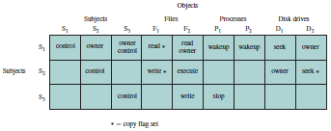
Protection
Access Matrix
Access Control Policy as Access Matrix
Access Control Matrix specifying the access rights of subject “S” to object “X”.
Copyright @ 2009 John Wiley & Sons Inc.
SILICON VALLEY UNIVERSITY CONFIDENTIAL

Slide 40
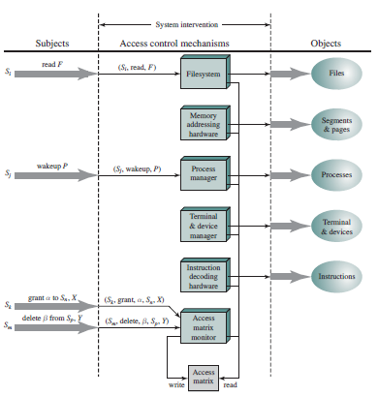
Protection
Access Matrix
Access Control
Function
Functional View: A separate Access Control Module is associated with each type of Object. The module evaluates each request by a Subject to access an Object to determine if the access right exists.
Copyright @ 2009 John Wiley & Sons Inc.
SILICON VALLEY UNIVERSITY CONFIDENTIAL

Slide 41
Protection
Capability-Based Systems
Cambridge CAP System
  Access to a Memory Segment or hardware required that the current process held the necessary capabilities.
Simplier than Hydra: Using two kinds of capabilitites.
Data Capability: Access-Rights provided are Read / Write / Execute of the storage segments associated with Object.
Software Capability: Protected procedure that is part of a subsystem.
  Process executing the procedure will acquire the right to Read or Write the contents of a software capability.
Copyright @ 2009 John Wiley & Sons Inc.
SILICON VALLEY UNIVERSITY CONFIDENTIAL

Slide 42
Protection
Language–Based Protection
Compiler-Based Enforcement
  Protection available to the application program through use of Software Capability to system resources.
    Storage reference must occur indirectly through a Software Capability: Prevents any process from accessing a resource outside of its protection environment.
  Arbitrary restrictions on resource use during particular code segment.
  Program can distinguish areas of code where protection is needed.
    Mechanism must reply on more assumptions about the operational state of the Operating System.
  Principle assumption is that the code generated by the compiler will not be modified prior or during execution.
Copyright @ 2009 John Wiley & Sons Inc.
SILICON VALLEY UNIVERSITY CONFIDENTIAL

Slide 43
Protection
Language–Based Protection
Protection in Java
Java designed to run in a distributed environment.
  JVM (Java Virtual Machine) has many built-in protection mechanisms.
  Programs composed of classes: Collection of data fields and functions (methods) that operate on these fields.
  Untrusted Classes loaded over network or within JVM:
    Protection domain of loaded class depends on URL from which the class was loaded and digital signatures on the class file.
    Trusted server places class in domain different from untrusted server.
  Stack Inspection during access of protected resource:
    A method in the calling sequence must assert the privilege to access the resource.
    Stack inspection (checkPermissions() API) used to determine if the request should be allowed.
    Examines stack frames on the stack, from current to oldest, to find the method that requested the access (doPrivileged() API).
    If domain of a method in the stack without access permissions is found, the request is not allowed.
Copyright @ 2009 John Wiley & Sons Inc.
SILICON VALLEY UNIVERSITY CONFIDENTIAL

Slide 44

Protection
Language–Based Protection
Protection in Java
Get() executes doPrivileged() assert successfully privilege to access the resource.
Open() executes successfully.
Method, gui, from “untrusted” protection domain.
Gui() performs get() and open() operation.
Open() executes checkPermission() to perform stack inspection.
In untrusted applet open(), there is no evidence of privilege was asserted before request to open() the resource, open() execution fails.
Copyright @ 2009 John Wiley & Sons Inc.
SILICON VALLEY UNIVERSITY CONFIDENTIAL

