Slide 1
Operating System Design
Dr. Jerry Shiao, Silicon Valley University
Summer 2015
SILICON VALLEY UNIVERSITY CONFIDENTIAL

Slide 2
Distributed Coordination
Overview
Apply Centralized Synchronization mechanisms to a Distributed Environment.
In Distributed Environment:
  Event Ordering
  Mutual Exclusion
  Atomicity
  Concurrency Control
  Deadlock Handling
    Schemes for handling Deadlock Prevention, Deadlock Avoidance, and Deadlock Detection.
  Election Algorithms
  Reaching Agreement
Copyright @ 2009 John Wiley & Sons Inc.
SILICON VALLEY UNIVERSITY CONFIDENTIAL

Slide 3
Distributed Coordination
Event Ordering
Centralized System: Order two events occur controlled through single common memory and clock.
  Resource Allocation: Resource used after resource is granted.
Distributed System: No common memory or clock.
  Which two events occurred first?
Happened-Before Relation: Partial Ordering of events in Distributed System.
  Partial Ordering need to be extended to a consistent Total Ordering of all events in the system.
  In Sequential Process: All events executing in single process is totally ordered. Based on Law of Causality.
  Law of Causality: A message can be received ONLY after it has been sent.
Copyright @ 2009 John Wiley & Sons Inc.
SILICON VALLEY UNIVERSITY CONFIDENTIAL

Slide 4
Distributed Coordination
Event Ordering
Happened-Before Relation:
  Denoted by “→” on a set of events (Sending and Receiving Message constitutes an Event):
  If A and B are events in the same process, and A was executed before B, then A → B
  If A event of sending a message by one process and B event of receiving that message by another process, then A → B
  If A → B and B → C then A → C
  Since event cannot happen before itself, the “→” relation is an irreflexive (binary relationship in a set where no element is related to itself) partial ordering.
  Two events, A and B, not related by the “→” relation (A did not happen before B, and B did not happen before A), then the two events were executed concurrently.
Copyright @ 2009 John Wiley & Sons Inc.
SILICON VALLEY UNIVERSITY CONFIDENTIAL

Slide 5
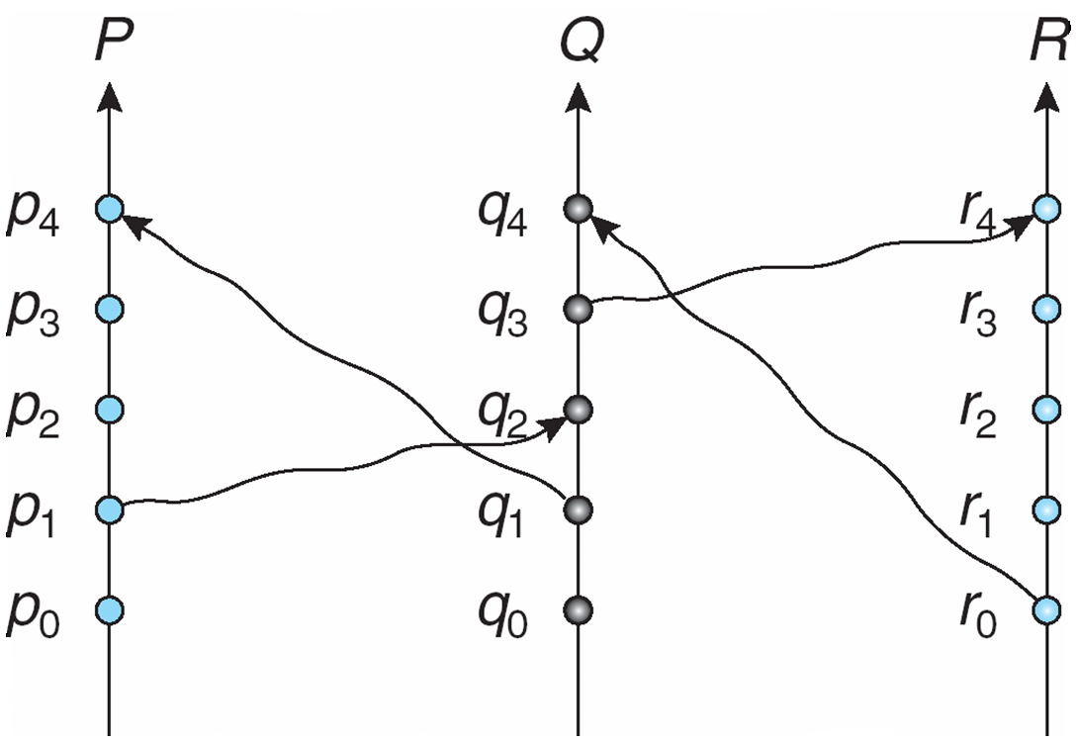
Distributed Coordination
Horizontal direction represents space (different processes).
The Vertical direction represents time.
The Labeled Veritical lines denotes processes or (processors).
Event Ordering
Space-Time Diagram
Label dots denote events.
Wavy line denotes message sent from one process to another.
Three Concurrent Processes
Copyright @ 2009 John Wiley & Sons Inc.
SILICON VALLEY UNIVERSITY CONFIDENTIAL

Slide 6
Distributed Coordination
Happened-Before Relation.
p1 → q2
r0 → q4
q3 → r4
p1 → q4 (since p1 → q2 and q2 → q4)
Event Ordering
Space-Time Diagram
Concurrent events denoted by NO paths between the events.
q0 and p2.
r0 and q3.
r0 and p3.
q3 and p3.
Three Concurrent Processes
Copyright @ 2009 John Wiley & Sons Inc.
SILICON VALLEY UNIVERSITY CONFIDENTIAL

Slide 7
Distributed Coordination
Implementation
How to determine Event A happened before Event B without common clock (enforce the global ordering requirement in a Distributed Environment)?
  Associate each system event Timestamp.
  A → B: Timestamp A less than Timestamp B.
Within each process Pi a logical clock, LCi is associated with system event.
  The logical clock is a simple counter, incremented between two successive events executed within a process.
    Logical clock is monotonically increasing.
Copyright @ 2009 John Wiley & Sons Inc.
SILICON VALLEY UNIVERSITY CONFIDENTIAL

Slide 8
Distributed Coordination
Implementation
Global Ordering Requirement Across Processes.
  Unsynchronized Clocks in processes.
A process advances its logical clock when it receives a message whose timestamp is greater than the current value of its logical clock
If the timestamps of two events A and B are the same, then the events are concurrent
  We may use the process identity numbers to break ties and to create a total ordering
Copyright @ 2009 John Wiley & Sons Inc.
SILICON VALLEY UNIVERSITY CONFIDENTIAL

Slide 9
Distributed Coordination
Mutual Exclusion
Maintaining Critical Sections in Distributed System.
Centralized Environment:
  One Process in the system coordinates the entry into Critical Section.
  Each Process wanting to invoke Mutual Exclusion sends Request Message to the Coordinator.
  The Coordinator checks if another Process is in its Critical Section.
    If another Process is in its Critical Section, Coordinator queues the Request Message and the Process waits.
    If no Process is in its Critical Section, Coordinator sends Reply Message to the Process.
  Process receives the Reply Message, the process enter Critical Section.
  When Process completes its Critical Section, the process sends a Release Message to the Coordinator.
  The Coordinator will send Reply Message from its queue (i.e. FCFS Scheduling) when it receives a Release Message.
  Three Messages per Critical-Section Entry: Request, Reply, Release.
Copyright @ 2009 John Wiley & Sons Inc.
SILICON VALLEY UNIVERSITY CONFIDENTIAL

Slide 10
Distributed Coordination
Mutual Exclusion
Fully Distributed Environment:
  Distribute the decision making across the entire system.
Assumptions:
  The system consists of n Processes; each Process P_{i} resides at a different Processor.
  Each Process has a critical section that requires Mutual Exclusion.
Requirement:
  If P_{i} is executing in its Critical Section, then no other Process P_{j} is executing in its critical section.
Two algorithms to ensure the mutual exclusion execution of processes in their critical sections:
  Using Event Ordering and Time Stamp Approach.
  Using Token Passing Approach.
Copyright @ 2009 John Wiley & Sons Inc.
SILICON VALLEY UNIVERSITY CONFIDENTIAL

Slide 11
Distributed Coordination
Mutual Exclusion
Approach: Event Ordering and Time Stamp
When process P_{i} wants to enter its critical section, it generates a new timestamp, TS, and sends the message request (P_{i}, TS) to all other processes in the system.
When process P_{j} receives a request message, it may reply immediately or it may defer sending a reply back.
When process P_{i} receives a reply message from all other processes in the system, it can enter its critical section.
After exiting its critical section, the process sends reply messages to all its deferred requests.
Copyright @ 2009 John Wiley & Sons Inc.
SILICON VALLEY UNIVERSITY CONFIDENTIAL

Slide 12
Distributed Coordination
Mutual Exclusion
Approach: Event Ordering and Time Stamp
The decision whether process P_{j} replies immediately to a request(P_{i}, TS) message or defers its reply is based on three factors:
  If P_{j} is in its critical section, then it defers its reply to P_{i}
  If P_{j} does not want to enter its critical section, then it sends a reply immediately to P_{i}
  If P_{j} wants to enter its critical section but has not yet entered it, then it compares its own request timestamp with the timestamp TS
    If its own request timestamp is greater than TS, then it sends a reply immediately to P_{i} (P_{i} asked first)
    Otherwise, the reply is deferred
Copyright @ 2009 John Wiley & Sons Inc.
SILICON VALLEY UNIVERSITY CONFIDENTIAL

Slide 13
Distributed Coordination
Mutual Exclusion
Approach: Event Ordering and Timestamp
Desirable Behavior:
  Freedom from Deadlock is ensured.
  Freedom from starvation is ensured, since entry to the Critical Section is scheduled according to the Timestamp ordering.
    The Timestamp ordering ensures that processes are served in a first-come, first served order.
  The number of messages per critical-section entry is
  2 x (n – 1)
  This is the minimum number of required messages per critical-section entry when processes act independently and concurrently.
Copyright @ 2009 John Wiley & Sons Inc.
SILICON VALLEY UNIVERSITY CONFIDENTIAL

Slide 14
Distributed Coordination
Mutual Exclusion
Approach: Event Ordering and Timestamp
P1 P2 P3
P1 and P3 want to enter their Critical Sections. P1 sends message Request (P1,TS=10) to P2 and P3.
P3 sends message Request (P3,TS=4) to P2 and P3.
P2 does not want to enter its Critical Section.
P1 Critical Section
P3 Critical Section
P1, TS=10
P1, TS=10
P1, TS=10
P3, TS=4
P3, TS=4
P3 defers Reply to P1 because Timestamp for P3 (TS=4) is LESS than Timestamp for P1 (TS=10)
Copyright @ 2009 John Wiley & Sons Inc.
SILICON VALLEY UNIVERSITY CONFIDENTIAL

Slide 15
Distributed Coordination
Mutual Exclusion
Approach: Event Ordering and Timestamp
P1 sends Reply to P3, since its Timestamp (10) is greater than the Timestamp (4) from P3.
P1 P2 P3
P3 enters into its Critical Section, while P1 Request is queued.
P1 Critical Section
P3 Critical Section
Reply P1, TS=10
P1, TS=10
P1, TS=10
Reply P3, TS=4
Reply P3, TS=4
P3 defers Reply to P1 because Timestamp for P3 (TS=4) is LESS than Timestamp for P1 (TS=10)
Copyright @ 2009 John Wiley & Sons Inc.
SILICON VALLEY UNIVERSITY CONFIDENTIAL

Slide 16
Distributed Coordination
Mutual Exclusion
Approach: Event Ordering and Timestamp
UnDesirable Behavior
The processes need to know the identity of all other processes in the system, which makes the dynamic addition and removal of processes more complex.
If one of the processes fails, then the entire scheme collapses.
  This can be dealt with by continuously monitoring the state of all the processes in the system.
Processes that have not entered their critical section must pause frequently to assure other processes that they intend to enter the critical section.
  This protocol is therefore suited for small, stable sets of cooperating processes.
Copyright @ 2009 John Wiley & Sons Inc.
SILICON VALLEY UNIVERSITY CONFIDENTIAL

Slide 17
Distributed Coordination
Mutual Exclusion
Approach: Token-Passing
Circulate a token among processes in system.
  Token is special type of message.
  Possession of Token entitles holder to enter Critical Section.
  After Process exits its Critical Section, the Token is passed to next process in the ring.
  If Process receiving Token does not enter its Critical Section, it passes the Token to the next Process.
Processes logically organized in a ring structure.
Unidirectional ring guarantees freedom from starvation.
Two types of failures:
  Lost token – election must be called.
  Failed processes – new logical ring established.
Copyright @ 2009 John Wiley & Sons Inc.
SILICON VALLEY UNIVERSITY CONFIDENTIAL

Slide 18
Distributed Coordination
Atomicity
Atomic Transaction: Program unit where all operations associated with it are executed to completion (i.e. uninterruptable).
Distributed System: Atomicity of transaction may require several sites participating in execution of a single transaction.
Ensuring atomicity in a distributed system requires a Transaction Coordinator, which is responsible for the following:
  Starting the execution of the transaction
  Breaking the transaction into a number of subtransactions, and distribution these subtransactions to the appropriate sites for execution
  Coordinating the termination of the transaction, which may result in the transaction being committed at all sites or aborted at all sites
Copyright @ 2009 John Wiley & Sons Inc.
SILICON VALLEY UNIVERSITY CONFIDENTIAL

Slide 19
Distributed Coordination
Atomicity
Two-Phase Commit Protocol
Assumes fail-stop model
Execution of the protocol is initiated by the Transaction Coordinator that initiated the transaction, after the last step of the transaction has been reached.
When the protocol is initiated, the transaction may still be executing at some of the local sites.
The protocol involves all the local sites at which the transaction executed.
Example: Let T be a transaction initiated at site S_{i} and let the transaction coordinator at S_{i} be C_{i}
Copyright @ 2009 John Wiley & Sons Inc.
SILICON VALLEY UNIVERSITY CONFIDENTIAL

Slide 20
Distributed Coordination
Atomicity
Two-Phase Commit Protocol
Example: Transaction T completes at the site Si (initiated the T).
Phase 1:
  C_{i} adds <prepare T> record to the log.
  C_{i} sends <prepare T> message to all sites.
  When a site receives a <prepare T> message, the transaction manager determines if it can commit the transaction.
    If no: add <no T> record to the log and respond to C_{i} with <abort T>.
    If yes:
      Add <ready T> record to the log.
      Force all log records for T onto stable storage.
      Send <ready T> message to C_{i.}
Copyright @ 2009 John Wiley & Sons Inc.
SILICON VALLEY UNIVERSITY CONFIDENTIAL

Slide 21
Distributed Coordination
Atomicity
Two-Phase Commit Protocol
Phase 1 (Cont):
Coordinator collects responses:
  All respond “ready”,
  decision is commit.
  At least one response is “abort”,
  decision is abort.
  At least one participant fails to respond within time out period,
  decision is abort.
  Site at anytime, can send unconditional <abort T> to the coordinator.
  Coordinator site can also unconditionally <abort T>, since it is also executing Transaction T.
Copyright @ 2009 John Wiley & Sons Inc.
SILICON VALLEY UNIVERSITY CONFIDENTIAL

Slide 22
Distributed Coordination
Atomicity
Two-Phase Commit Protocol
Phase 2:
Coordinator adds a decision record
<abort T> or <commit T>
to its log and forces record onto stable storage.
Once that record reaches stable storage it is irrevocable (even if failures occur).
Coordinator sends a message to each participant informing it of the decision (commit or abort).
Participants take appropriate action locally, logs and forces <commit T> onto stable storage.
Sites sends an <acknowledge T> to the coordinator, at the end of Phase 2.
Copyright @ 2009 John Wiley & Sons Inc.
SILICON VALLEY UNIVERSITY CONFIDENTIAL

Slide 23
Distributed Coordination
Atomicity
Two-Phase Commit Protocol Failure Handling
Failure of a Particular Site: After recover at the Site:
The log contains a <commit T> record
  In this case, the site executes redo(T)
The log contains an <abort T> record
  In this case, the site executes undo(T)
The contains a <ready T> record; consult C_{i}
  The Ci has requested site commit the Transaction T result: Consult Ci whether Transaction T was committed or aborted.
  If Ci is up, Ci sends back whether committed or aborted.
  If C_{i} is down, site sends query-status T message to the other sites whether committed or aborted.
The log contains no control records concerning T
  In this case, the site executes undo(T)
Copyright @ 2009 John Wiley & Sons Inc.
SILICON VALLEY UNIVERSITY CONFIDENTIAL

Slide 24
Distributed Coordination
Atomicity
Two-Phase Commit Protocol Failure Handling
Failure of the Coordinator: Sites must decide the state of T.
If an active site contains a <commit T> record in its log, the T must be committed.
If an active site contains an <abort T> record in its log, then T must be aborted.
If some active site does not contain the record <ready T> in its log then the failed coordinator C_{i} did not decide to commit T.
  Rather than wait for C_{i} to recover, it is preferable to abort T.
All active sites have a <ready T> record in their logs, but no additional control records (<abort T> or <commit T>).
  In this case we must wait for the coordinator to recover.
  Blocking problem – T is blocked pending the recovery of site S_{i.} The sites can hold locks on data until Ci recovers.
Copyright @ 2009 John Wiley & Sons Inc.
SILICON VALLEY UNIVERSITY CONFIDENTIAL

Slide 25
Distributed Coordination
Concurrency Control
Centralized Concurrency: Multiple Atomic Transaction can execute in a manner where these transactions execute serially in some arbitrary order.
  Concurrency Control algorithms allow Transactions to overlap their execution, but maintain serializability.
T0 T1
T0 T1
Read (A)
Write (A)
Read (B)
Write (B)
Read (A)
Write (A)
Read (A)
Write (A)
Read (A)
Write (A)
Read (B)
Write (B)
Read (B)
Write (B)
Read (B)
Write (B)
Serial Schedule: Transaction T0 followed by T1
Concurrent Serializable Schedule: Transaction T0 and T1 does NOT access same data item.
Copyright @ 2009 John Wiley & Sons Inc.
SILICON VALLEY UNIVERSITY CONFIDENTIAL

Slide 26
Distributed Coordination
Concurrency Control
Distributed Environment Concurrency: Concurrency Control algorithms allow Transactions to overlap their execution, but maintain serializability.
Modify the centralized concurrency schemes to accommodate the distribution of Transactions.
Transaction Manager coordinates execution of Transactions (or subtransactions) that access data at local sites.
Local transaction only executes at that site.
Global transaction executes at several sites.
Copyright @ 2009 John Wiley & Sons Inc.
SILICON VALLEY UNIVERSITY CONFIDENTIAL

Slide 27
Distributed Coordination
Concurrency Control
Locking Protocols
Can use the two-phase locking protocol in a distributed environment by changing how the lock manager is implemented.
Nonreplicated Data Scheme – Each site maintains a local Lock Manager which administers lock and unlock requests for those data items that are stored in that site.
  When Transaction wishes to lock data item Q at site Si, it sends a message to the Lock Manager at site Si.
    At site Si, the request is granted ONLY if data item Q is unlocked or locked in a compatible mode.
    Site Si Lock Manager sends Reply Message to requestor.
  Simple implementation involves two message transfers for handling lock requests, and one message transfer for handling unlock requests.
  Deadlock handling is more complex.
Copyright @ 2009 John Wiley & Sons Inc.
SILICON VALLEY UNIVERSITY CONFIDENTIAL

Slide 28
Distributed Coordination
Concurrency Control
Locking Protocols
Single-Coordinator Approach:
A single Lock Manager resides in a single chosen site, all lock and unlock requests are made a that site.
Simple implementation.
Simple deadlock handling.
Disadvantage:
  Possibility of bottleneck.
  Vulnerable to loss of concurrency controller if single site fails.
Multiple-Coordinator Approach: Distributes Lock Manager function over several sites.
  Each Lock Manager administers lock/unlock Requests for a subset of the data items.
  Reduces degree of bottleneck, but multiple sites complicates deadlock handling.
Copyright @ 2009 John Wiley & Sons Inc.
SILICON VALLEY UNIVERSITY CONFIDENTIAL

Slide 29
Distributed Coordination
Concurrency Control
Locking Protocols
Majority Protocol Approach:
Maintains a Lock Manager at each site.
  Each Lock Manager controls all data or replicas of data at that site.
Transaction locking a replicated data item Q, sends Lock Request to greater than half of the sites in which Q is stored.
  Transaction operates on Q ONLY when it has obtained Lock from majority of the replicas.
Avoids drawbacks of central control by dealing with replicated data in a decentralized manner.
Drawbacks:
  More complicated to implement: Need 2(n/2 + 1) messages for Lock Requests and (n/2 + 1) messages for unLock Requests.
  Deadlock-handling algorithms must be modified; possible for deadlock to occur even in locking only data item.
Copyright @ 2009 John Wiley & Sons Inc.
SILICON VALLEY UNIVERSITY CONFIDENTIAL

Slide 30
Distributed Coordination
Concurrency Control
Locking Protocols
Biased Protocol Approach:
Maintains a Lock Manager at each site.
  Each Lock Manager controls all data at that site.
  Shared and Exclusive Locks are handled differently.
  Shared Locks: Transaction needs lock on shared data item Q, Request ONLY a lock on Q at one site with replica of Q.
  Exclusive Locks: Transaction needs lock on exclusive data item Q, Request lock from ALL sites with replica of Q.
Similar to majority protocol, but requests for shared locks prioritized over requests for exclusive locks.
Less overhead on read operations (shared data items) than in majority protocol; but has additional overhead on writes (exclusive data items).
Like majority protocol, deadlock handling is complex.
Copyright @ 2009 John Wiley & Sons Inc.
SILICON VALLEY UNIVERSITY CONFIDENTIAL

Slide 31
Distributed Coordination
Concurrency Control
Locking Protocols
Primary Copy Approach:
One of the sites at which a data item replica resides is designated as the Primary Site.
  Request to lock a data item is made at the primary site of that data item.
Concurrency control for replicated data handled in a manner similar to that of unreplicated data.
  Primary Site can handle multiple data item replicas.
  Single site to send Lock Request.
Simple implementation, but if Primary Site fails, the data item is unavailable, even though other sites may have a replica.
Copyright @ 2009 John Wiley & Sons Inc.
SILICON VALLEY UNIVERSITY CONFIDENTIAL

Slide 32
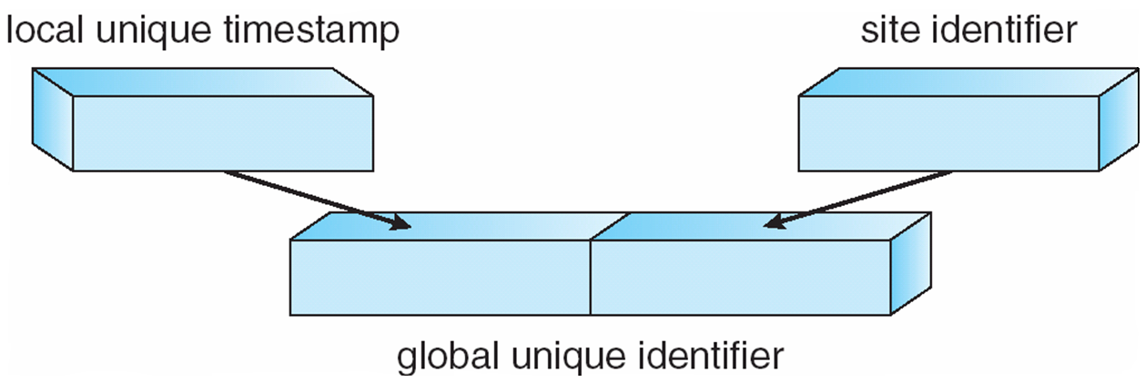
Distributed Coordination
Concurrency Control
TimeStamping
Unique TimeStamp is used to decide the serialization order.
Generate unique timestamps in distributed scheme:
  Each site generates a unique local timestamp.
  The global unique timestamp is obtained by concatenation of the unique local timestamp with the unique site identifier.
  Use a Logical Clock defined within each site to ensure the fair generation of timestamps.
  Site advances its Logical Clock whenever Transaction Ti with TimeStamp greater than the current Logical Clock.
Copyright @ 2009 John Wiley & Sons Inc.
SILICON VALLEY UNIVERSITY CONFIDENTIAL

Slide 33
Distributed Coordination
Deadlock Handling
Distributed Algorithms for Deadlock-Prevention, Deadlock-Avoidance, and Deadlock-Detection.
Resource-Ordering Deadlock-Prevention – Define a global ordering among the system resources.
  Assign a unique number to all system resources.
  A process may request a resource with unique number i only if it is not holding a resource with a unique number greater than i.
  Simple to implement; requires little overhead.
Banker’s algorithm – Designate one of the processes in the system as the process that maintains the information necessary to carry out the Banker’s algorithm.
  Also implemented easily, but high overhead, every Resource Request must be channeled through the Banker.
Copyright @ 2009 John Wiley & Sons Inc.
SILICON VALLEY UNIVERSITY CONFIDENTIAL

Slide 34
Distributed Coordination
Deadlock Handling
DeadLock-Prevention using TimeStamp with Resource Preemption:
  Priority numbers assigned to each Process.
  Priority numbers are used to decide whether a process P_{i} should wait for a process P_{j}; otherwise P_{i} is rolled back.
  The scheme prevents deadlocks
    For every edge P_{i} → P_{j} in the wait-for graph, P_{i} has a higher priority than P_{j}
    Thus a cycle cannot exist.
  Possibility of Starvation. Process with low priority could always be rolled back.
    TimeStamp for each process in the system.
Copyright @ 2009 John Wiley & Sons Inc.
SILICON VALLEY UNIVERSITY CONFIDENTIAL

Slide 35
Distributed Coordination
Deadlock Handling
Wait-Die NonPreemptive Scheme:
  Based on a nonpreemptive technique.
  If P_{i} requests a resource currently held by P_{j}, P_{i} is allowed to wait only if it has a smaller timestamp than does P_{j} (P_{i} is older than P_{j}).
    Otherwise, P_{i} is rolled back (dies): A younger process is killed before it can be caught in a wait cycle.
  Example: Suppose that processes P₁, P₂, and P₃ have timestamps 5, 10, and 15 respectively
    if P₁ request a resource held by P₂, then P₁ will wait
    If P₃ requests a resource held by P₂, then P₃ will be rolled back
Copyright @ 2009 John Wiley & Sons Inc.
SILICON VALLEY UNIVERSITY CONFIDENTIAL

Slide 36
Distributed Coordination
Deadlock Handling
Wound-Wait Preemptive Scheme.
  Based on a preemptive technique; counterpart to the wait-die system
  If P_{i} requests a resource currently held by P_{j}, P_{i} is allowed to wait only if it has a larger timestamp than does P_{j} (P_{i} is younger than P_{j}). Otherwise P_{j} is rolled back (P_{j} is wounded by P_{i}).
  Example: Suppose that processes P₁, P_{2,} and P₃ have timestamps 5, 10, and 15 respectively
    If P₁ requests a resource held by P₂, then the resource will be preempted from P₂ and P₂ will be rolled back.
    If P₃ requests a resource held by P₂, then P₃ will wait.
  The Wound-Wait algorithm preempts the younger process. When the younger process re-requests resource, it has to wait for older process to finish. This is the better of the two algorithms.
Copyright @ 2009 John Wiley & Sons Inc.
SILICON VALLEY UNIVERSITY CONFIDENTIAL

Slide 37
Distributed Coordination
Deadlock Handling
Differences in Wait-Die Scheme and Wound-Wait Scheme.
  In Wait-Die Scheme: Older process will wait for a younger process to release its resource. Younger process will not wait for older process and younger process will roll-back.
  In Wound-Wait Scheme: Older process will preempt the younger process for the resource and younger process rolled-back. Younger process will wait for older process.
  Younger process will tend to be rolled-back more in Wait-Die Scheme because the rolled-back Younger process will request the same resource again and get rolled-back.
  Younger process will be rolled-back less in Wound-Wait Scheme because the Younger process is allowed to wait for the resource held by older process.
Copyright @ 2009 John Wiley & Sons Inc.
SILICON VALLEY UNIVERSITY CONFIDENTIAL

Slide 38
Distributed Coordination
Deadlock Handling
Deadlock Detection
Using a Wait-For Graph to describe the Resource-Allocation State, a cycle in the graph would represent a Deadlock.
  How to maintain Wait-For Graph for Distributed System?
  Local wait-for graphs at each local site. The nodes of the graph correspond to all the processes that are currently either holding or requesting any of the resources local to that site
  May also use a global wait-for graph. This graph is the union of all local wait-for graphs.
Copyright @ 2009 John Wiley & Sons Inc.
SILICON VALLEY UNIVERSITY CONFIDENTIAL

Slide 39
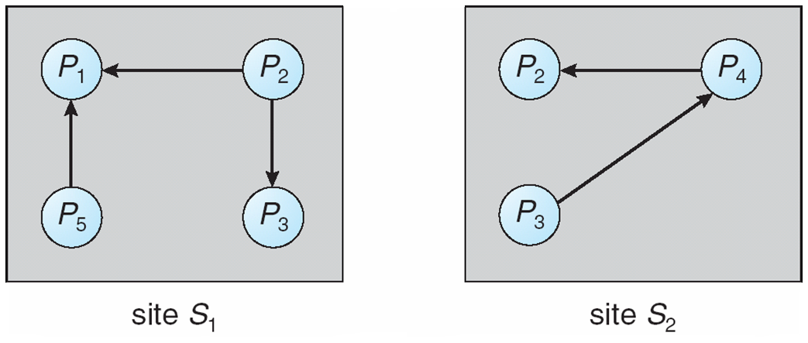
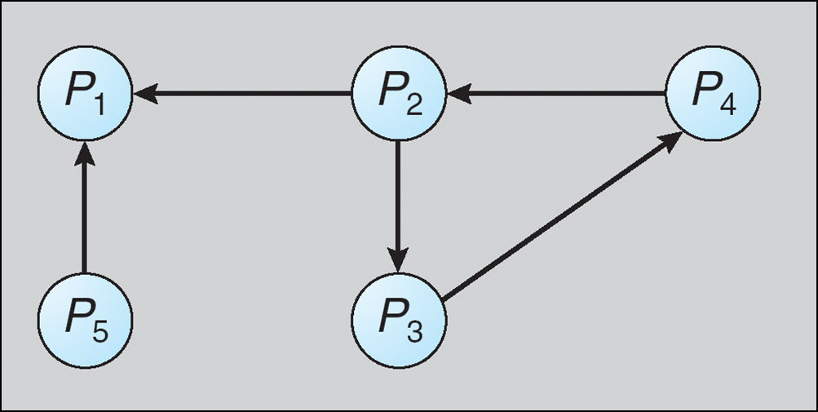
Distributed Coordination
Deadlock Handling
Deadlock Detection
Local Wait-For Graphs for Local Processes and Resources.
Process P3 in Site S1 needs a Resource held by Process P4 in Site S2, a Request Message is sent by P3 to Site S2. This is represented by the edge:
P3 → P4 in Site S2.
No cycles in Local Wait-For Graphs does NOT mean there are no Deadlocks.
The UNION of all Local Wait-For Graphs must be acyclic to imply the Distributed System cannot be in a Deadlock State.
Copyright @ 2009 John Wiley & Sons Inc.
SILICON VALLEY UNIVERSITY CONFIDENTIAL

Slide 40
Distributed Coordination
Deadlock Handling
Deadlock Detection: Centralized Approach
Each site keeps a local wait-for graph.
A global wait-for graph is maintained in a single coordination process, the Deadlock-Detection Coordinator.
  Two Types of Wait-For Graphs because of communication delays in the system.
  Real Graph: Describes the real, but unknown state of the system at any point in time.
  Constructed Graph: Approximation generated by the Coordinator during execution of its algorithm.
    If a deadlock exists, then it is reported properly as a cycle.
    If a deadlock is reported, then the system is in a Deadlocked State.
Copyright @ 2009 John Wiley & Sons Inc.
SILICON VALLEY UNIVERSITY CONFIDENTIAL

Slide 41
Distributed Coordination
Deadlock Handling
Deadlock Detection: Centralized Approach
There are three different options (points in time) when the Wait-For Graph may be constructed:
  1. Whenever a new edge is inserted or removed in one of the local Wait-For Graphs.
  Local site sends a message to the Coordinator: Coordinator updates its Global Wait-For Graph.
  2. Periodically, when a number of changes have occurred in a Wait-For Graph.
  Local site sends a number of changes in a single message to the Coordinator.
  3. Whenever the coordinator needs to invoke the cycle-detection algorithm.
Copyright @ 2009 John Wiley & Sons Inc.
SILICON VALLEY UNIVERSITY CONFIDENTIAL

Slide 42
Distributed Coordination
Deadlock Handling
Deadlock Detection: Centralized Approach
Invoking the Deadlock-Detection Algorithm uses the Global Wait-For Graph.
  Cycle found, a victim is selected to be rolled-back.
  Coordinator notifies ALL sites of the victim: Sites roll-back the victim process.
Unnecessary rollbacks may occur as a result of false cycles.
Copyright @ 2009 John Wiley & Sons Inc.
SILICON VALLEY UNIVERSITY CONFIDENTIAL

Slide 43
Distributed Coordination
Deadlock Handling
Deadlock Detection: Centralized Approach
Unnecessary Rollbacks: Occur as a result of false cycles.
  False cycles may exist in Global Wait-For Graph.
    Caused by unsynchronized arrival of messages to Delete and Insert graph edges in the Global Wait-For Graph: Coordinator receives the Insert edge before the Delete edge message.
    Process has been aborted (unrelated to the Deadlock) and removes a cycle in the Global Wait-For Graph, but the Coordinator already acting on the detected cycle and roll-back a process unnecessarily.
Copyright @ 2009 John Wiley & Sons Inc.
SILICON VALLEY UNIVERSITY CONFIDENTIAL

Slide 44
Distributed Coordination
Deadlock Handling
Deadlock Detection: Centralized Approach
Coordinator Requests ALL Local Wait-For Graphs Approach: Detects Deadlocks and does not detect False Deadlocks.
  Append unique identifiers (timestamps) to requests form different sites.
    Local Requests do not need identifiers.
  When process P_{i}, at site A, requests a resource from process P_{j}, at site B, a request message with timestamp TS is sent.
  The edge P_{i} → P_{j} with the label TS is inserted in the local wait-for of A. The edge is inserted in the local wait-for graph of B only if B has received the request message and cannot immediately grant the requested resource
Copyright @ 2009 John Wiley & Sons Inc.
SILICON VALLEY UNIVERSITY CONFIDENTIAL

Slide 45
Distributed Coordination
Deadlock Handling
Deadlock Detection: Centralized Approach
Coordinator Requests ALL Local Wait-For Graphs Approach: Detects Deadlocks and does not detect False Deadlocks.
  Detection Algorithm:
  1. The controller sends an initiating message to each site in the system.
  2. On receiving this message, a site sends its local Wait-For Graph to the coordinator.
  3. When the controller has received a reply from each site, it constructs a global Wait-For Graph as follows:
    (a) The constructed graph has a vertex for every process system.
    (b) The graph has an edge Pi → Pj if and only if
      there is an edge Pi → Pj in one of the Wait-For Graphs, or
      an edge Pi → Pj with some label TS appears in more than one Wait-For Graph.
  If the constructed graph contains a cycle ⇒ deadlock
Copyright @ 2009 John Wiley & Sons Inc.
SILICON VALLEY UNIVERSITY CONFIDENTIAL

Slide 46
Distributed Coordination
Deadlock Handling
Deadlock Detection: Fully Distributed Approach
All controllers share equally the responsibility for detecting deadlock.
Every site constructs a Wait-For Graph that represents a part of the total graph.
We add one additional node P_{ex} to each local Wait-For Graph.
  An edge Pi → Pex exists if Pi is waiting for a data item in another site being held by any process.
  An edge Pex → Pj exists if Pex (Process at another site) is waiting to acquire a resource held by Pj in the local site.
If a local Wait-For Graph contains a cycle that does not involve node P_{ex}, then the system is in a Deadlock state.
A cycle involving P_{ex} implies the possibility of a deadlock.
  To ascertain whether a deadlock does exist, a distributed deadlock-detection algorithm must be invoked.
Copyright @ 2009 John Wiley & Sons Inc.
SILICON VALLEY UNIVERSITY CONFIDENTIAL

Slide 47
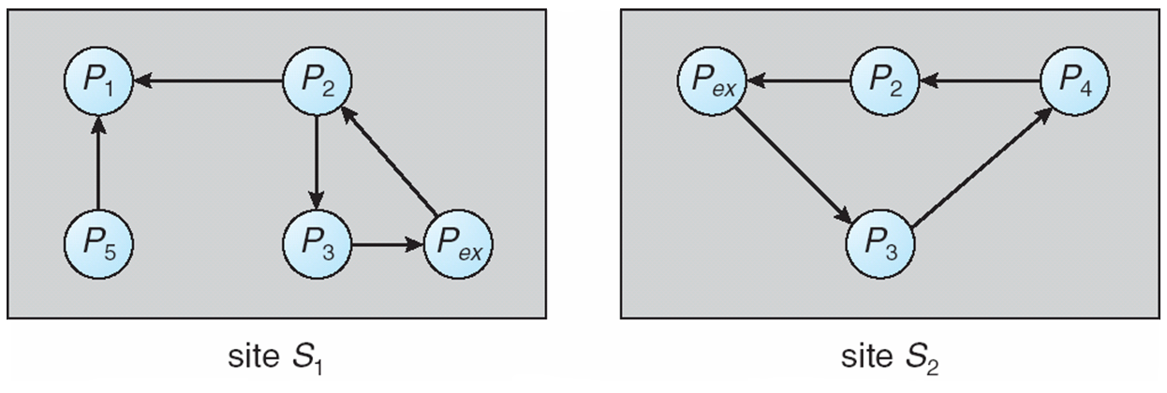
Distributed Coordination
Deadlock Handling
Deadlock Detection: Fully Distributed Approach
  An edge Pi → Pex exists if Pi is waiting for a data item in another site being held by any process. An edge Pex → Pj exists if Pex (Process at another site) is waiting to acquire a resource held by Pj in the local site.
  If a local graph contains a cycle involving Pex, then this implies the possibility of a deadlock.
Copyright @ 2009 John Wiley & Sons Inc.
SILICON VALLEY UNIVERSITY CONFIDENTIAL

Slide 48
Distributed Coordination
Deadlock Handling
Deadlock Detection: Fully Distributed Approach
Distributed Deadlock-Detection Algorithm: At site, the local Wait-For Graph must contain a cycle involving Pex.
Pex → Pk1 → Pk2 → . . . → Pkn → Pex
Process Pkn in site Si is waiting to acquire a data item located at some other site, Sj.
Site Si sends site Sj the Deadlock-Detection Message and site Sj updates its local Wait-For Graph and checks for cycle involing Pex.
Site S1 discovers the cycle:
Pex → P2 → P3 → Pex
Site S1 sends message to S2 describing the cycle.
Site S1 : Pex → P2 → P3 → Pex.
Site S2 : Pex → P3 → P4 → P2 → Pex.
Copyright @ 2009 John Wiley & Sons Inc.
SILICON VALLEY UNIVERSITY CONFIDENTIAL

Slide 49
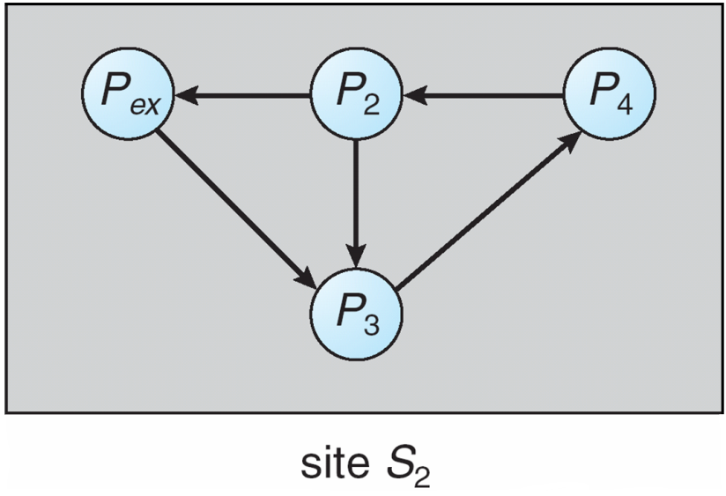
Distributed Coordination
Deadlock Handling
Deadlock Detection: Fully Distributed Approach
Distributed Deadlock-Detection Algorithm: ( Cont )
S2 receives the Deadlock-Detection Message, it updates its local Wait-For Graph, obtaining the graph containing the cycle that does NOT include Pex.
P2 → P3 → P4 → P2.
Local Wait-For Graph contains a cycle that does NOT contain Pex.
A recovery scheme is invoked at S2 to remove the cycle.
Copyright @ 2009 John Wiley & Sons Inc.
SILICON VALLEY UNIVERSITY CONFIDENTIAL

Slide 50
Distributed Coordination
Deadlock Handling
Deadlock Detection: Fully Distributed Approach
Distributed Deadlock-Detection Algorithm: ( Cont )
Reduce Deadlock-Detection Message traffic:
  Multiple Deadlock-Detection Message can be sent, when sites discovers the cycle with Pex.
  Assign each process Pi a unique identifier.
  Local Wait-For Graph with a Pex cycle, will send Deadlock-Detection Message ONLY when:
  ID(Pkn) < ID(Pk2)
  Relationship between processes could be:
  ID(P1) < ID(P2) < ID(P3) < ID(P4)
Copyright @ 2009 John Wiley & Sons Inc.
SILICON VALLEY UNIVERSITY CONFIDENTIAL

Slide 51
Distributed Coordination
Deadlock Handling
Deadlock Detection: Fully Distributed Approach
Distributed Deadlock-Detection Algorithm: ( Cont )
Reduce Deadlock-Detection Message traffic: ( Cont )
Both sites discovers cycle in local Wait-For Graph:
  Site S1: Pex → P2 → P3 → Pex
    The edge with Pex is P3 → Pex → P2 = ID(P3) > ID(P2)
  Site S2: Pex → P3 → P4 → P2 → Pex
    The edge with Pex is P2 → Pex → P3 = ID(P2) < ID(P3). Send Deadlock-Detection Message.
Copyright @ 2009 John Wiley & Sons Inc.
SILICON VALLEY UNIVERSITY CONFIDENTIAL

Slide 52
Distributed Coordination
Election Algorithms
Coordinator process used in Distributed Systems to:
  Enforce Mutual Exclusion.
  Maintaining Global Wait-For Graph for Deadlock Detection.
  Replacing lost Token.
  Controlling an input or output device on the system.
Failure of Coordinator requires restarting the Coordinator at some OTHER site.
  Algorithm used to determine where new copy of coordinator is restarted are called Election Algorithms.
Election Algorithms uses an unique priority number, associated with each active process in the system: Assume that the priority number of process P_{i} is I.
  Coordinator is always the process with the largest priority number.
  When Coordinator fails, Election Algorithm just elect the active process with the largest priority number.
  The elected Process’s number must be sent to ALL processes in the system.
Copyright @ 2009 John Wiley & Sons Inc.
SILICON VALLEY UNIVERSITY CONFIDENTIAL

Slide 53
Distributed Coordination
Election Algorithms
Two algorithms, the Bully Algorithm and a Ring Algorithm, can be used to elect a new coordinator in case of failures.
Bully Algorithm:
  Applicable to systems where every process can send a message to every other process in the system.
  If process P_{i} sends a request that is not answered by the coordinator within a time interval T, assume that the coordinator has failed; P_{i} tries to elect itself as the new coordinator.
  P_{i} sends an election message to every process with a higher priority number, P_{i} then waits for any of these processes to answer within T.
Copyright @ 2009 John Wiley & Sons Inc.
SILICON VALLEY UNIVERSITY CONFIDENTIAL

Slide 54
Distributed Coordination
Election Algorithms
Two algorithms, the Bully Algorithm and a Ring Algorithm, can be used to elect a new coordinator in case of failures.
Bully Algorithm:
  Applicable to systems where every process can send a message to every other process in the system.
  If process P_{i} sends a request that is not answered by the coordinator within a time interval T, assume that the coordinator has failed; P_{i} tries to elect itself as the new coordinator.
  P_{i} sends an election message to every process with a higher priority number, P_{i} then waits for any of these processes to answer within T.
Copyright @ 2009 John Wiley & Sons Inc.
SILICON VALLEY UNIVERSITY CONFIDENTIAL

Slide 55
Distributed Coordination
Election Algorithms
Two algorithms, the Bully Algorithm and a Ring Algorithm, can be used to elect a new coordinator in case of failures.
Bully Algorithm:
  If no response within T, assume that all processes with numbers greater than i have failed; P_{i} elects itself the new coordinator.
  If answer is received, P_{i} begins time interval T´, waiting to receive a message that a process with a higher priority number has been elected.
    Some higher priority process is electing itself coordinator.
  If no message is sent within T´, assume the process with a higher number has failed; P_{i} should restart the algorithm.
Copyright @ 2009 John Wiley & Sons Inc.
SILICON VALLEY UNIVERSITY CONFIDENTIAL

Slide 56
Distributed Coordination
Election Algorithms
Bully Algorithm: (Cont)
  If P_{i} is not the coordinator, then, at any time during execution, P_{i} may receive one of the following two messages from process P_{j.}
    P_{j} is the new coordinator (j > i). P_{i}, in turn, records this information.
    P_{j} started an election (j < i). P_{i}, sends a response to P_{j} and begins its own election algorithm, provided that Pi has not already initiated such an election.
  After a failed process recovers, it immediately begins execution of the same algorithm.
  If there are no active processes with higher numbers, the recovered process forces all processes with lower number to let it become the coordinator process, even if there is a currently active coordinator with a lower number (reason algorithm named “Bully Algorithm”).
Copyright @ 2009 John Wiley & Sons Inc.
SILICON VALLEY UNIVERSITY CONFIDENTIAL

Slide 57
Distributed Coordination
Election Algorithms
Ring Algorithm expects links between processes are unidirectional.
  Each process sends its message to the neighbor on the right.
  Each process has Active List: List containing the priority number of all active processes in the system, after Ring Algorithm completes.
Ring Algorithm:
  If process Pi detects a coordinator failure, it creates a new active list that is initially empty. It then sends a message elect(i) to its right neighbor, and adds the number i to its active list.
  If P_{i} receives a message elect(j) from the process on the left, it must respond in one of three ways:
Copyright @ 2009 John Wiley & Sons Inc.
SILICON VALLEY UNIVERSITY CONFIDENTIAL

Slide 58
Distributed Coordination
Election Algorithms
Ring Algorithm: (Cont)
  If P_{i} receives a message elect(j) from the process on the left, it must respond in one of three ways:
    If this is the first elect message it has seen or sent, P_{i} creates a new active list with the numbers i and j
      It then sends the message elect(i), followed by the message elect(j)
    If i ≠ j, the message received does not contain Pi’s number, then Pi adds j to its active list and forwards message to the right.
    If i = j, then P_{i} receives the message elect(i)
      The active list for P_{i} contains all the numbers of the active processes in the system
        P_{i} can now determine the largest number in the active list to identify the new coordinator process
Copyright @ 2009 John Wiley & Sons Inc.
SILICON VALLEY UNIVERSITY CONFIDENTIAL

Slide 59
Distributed Coordination
Reaching Agreement
System reliability require mechanism that allows a set of process to agree on a common “value”.
Such agreement may not take place due to:
  Faulty communication medium.
  Faulty processes:
    Processes may send garbled or incorrect messages to other processes.
    A subset of the processes may collaborate with each other in an attempt to defeat the scheme.
Copyright @ 2009 John Wiley & Sons Inc.
SILICON VALLEY UNIVERSITY CONFIDENTIAL

Slide 60
Distributed Coordination
Reaching Agreement
Unreliable Communications:
Process P_{i} at site A, has sent a message to process P_{j} at site B; to proceed, P_{i} needs to know if P_{j} has received the message
Detect failures using a time-out scheme
  When P_{i} sends out a message, it also specifies a time interval during which it is willing to wait for an acknowledgment message form P_{j}
  When P_{j} receives the message, it immediately sends an acknowledgment to P_{i}
  If P_{i} receives the acknowledgment message within the specified time interval, it concludes that P_{j} has received its message
    If a time-out occurs, P_{j} needs to retransmit its message and wait for an acknowledgment
  Continue until P_{i} either receives an acknowledgment, or is notified by the system that B is down
Copyright @ 2009 John Wiley & Sons Inc.
SILICON VALLEY UNIVERSITY CONFIDENTIAL

Slide 61
Distributed Coordination
Reaching Agreement
Unreliable Communications: (Cont)
Suppose that P_{j} also needs to know that P_{i} has received its acknowledgment message, in order to decide on how to proceed.
  In the presence of failure, it is not possible to accomplish this task.
  It is not possible in a distributed environment for processes P_{i} and P_{j} to agree completely on their respective states.
    Pi sends a message to Pj.
    Pj sends an acknowledgement to Pi.
    Pi receives the acknowledgement, but Pj cannot be certain that Pi has received the acknowledgement, because of the possibility of failure on communication medium.
Copyright @ 2009 John Wiley & Sons Inc.
SILICON VALLEY UNIVERSITY CONFIDENTIAL

Slide 62
Distributed Coordination
Reaching Agreement
Faulty Processes:
Assuming communication medium is reliable, processes can fail in unpredictable ways.
Consider a system of n processes, of which no more than m are faulty
  Suppose that each process P_{i} has some private value of V_{i}
Devise an algorithm that allows each nonfaulty P_{i} to construct a vector X_{i} = (A_{i,1}, A_{i,2}, …, A_{i,n}) such that::
  If P_{j} is a nonfaulty process, then A_{ij} = V_{j.}
  If P_{i} and P_{j} are both nonfaulty processes, then X_{i} = X_{j}.
  For multiple rounds of exchanges to create multiple vectors, if at least 2 of 3 values in the vectors agree, then the process can make a decision if the process is trustworthy.
Copyright @ 2009 John Wiley & Sons Inc.
SILICON VALLEY UNIVERSITY CONFIDENTIAL

Slide 63
Distributed Coordination
Summary
Sychronizing actions in a Distributed System is problematic because of no common memory and no common clock.
Order of events in a Distributed System can be aligned partially using the Happened-Before Relationship:
  Happened-Before Relationship with a Timestamp for total event ordering.
Critical Sections in a Distributed System using Mutual Exclusion:
  Centralized Approach: One of the processes in the system coordinate the entry to Critical Section.
  Fully Distributed Approach: Decision making distributed across the system using Request/Reply Messaging and Timestamp.
  Token-Passing Approach: Circulates a Token to allow a process to enter its Critical Section.
Atomicity in a Distributed System needs all processes to complete operations associated with the same program unit.
  Requires a Transaction Coordinator at each site.
  A Transaction either commits at all sites or aborts at all sites: Using Two-Phase Commit Protocol (2PC Protocol).
Copyright @ 2009 John Wiley & Sons Inc.
SILICON VALLEY UNIVERSITY CONFIDENTIAL

Slide 64
Distributed Coordination
Summary (Cont)
Concurrency-Control Schemes in Distributed System:
  Transaction Manager maintains log and participates in the Concurrency-Control Scheme to coordinate concurrent execution of Transactions.
  Single-Coordinator with Lock Manager for delaying transactions on shared sites.
  Global Timestamp with Local Timestamp and site identifier for Deadlock Handling.
  Deadlock-Prevention Scheme using Wait-Die Nonpreemptive Scheme and Would-Wait Preemptive Scheme.
  Deadlock Detection can be managed using a Global Wait-For Graph consolidated from the Local Wait-For Graphs from the sites.
    Methods for organizing the Wait-For Graph are Centralized Approach and Fully Distributed Approach.
  Coordinator used extensively in Distributed System, but require mechanisms for recovering failed Coordinator.
    Bully Algorithm and Ring Algorithm used to elect new Coordinator in case of failure.
Copyright @ 2009 John Wiley & Sons Inc.
SILICON VALLEY UNIVERSITY CONFIDENTIAL

