Slide 1
Operating System Design
Dr. Jerry Shiao, Silicon Valley University
Summer 2015
SILICON VALLEY UNIVERSITY CONFIDENTIAL

Slide 2
Real-Time Systems
Overview
Characteristics of Real-Time Systems
  Differ from General-Purpose Systems:
    General Purpose systems less restrictive, deadline NOT mandatory.
    User-oriented applications (Spreadsheet, Word Processor, Browser) do NOT require rigid response time.
    Batch-processing systems has no timing requirements.
Features of Real-Time Systems
  Must produce results within certain time limits.
  Embedded Systems: Computing device that is not obvious to the user (i.e. Household applicances, Automobile systems).
Implementing Real-Time Operating System
  Timing Requirements of Real-Time System.
Real-Time CPU Scheduling
  Scheduling for Hard Real-Time and Soft Real-Time.
An Example: VxWorks 5.x
Copyright @ 2009 John Wiley & Sons Inc.
SILICON VALLEY UNIVERSITY CONFIDENTIAL

Slide 3
Real-Time Systems
Overview (Cont)
What is Multimedia?
  Difference in how conventional data (text files, programs, binaries) are handled and continuous-media data.
  Continuous-media data must be delivered (streamed) according to time restrictions (30 Frames per Second).
Compression
  The algorithms used to compress multimedia data.
Requirements of Multimedia Kernels
  Design of Operating System different for a multimedia systems.
CPU Scheduling
Disk Scheduling
Network Management
An Example: Cineblitz
Copyright @ 2009 John Wiley & Sons Inc.
SILICON VALLEY UNIVERSITY CONFIDENTIAL

Slide 4
Real-Time Systems
What are Real-Time Systems?
  Computer System that requires not only that the computing results are “correct”, but results produced within specified deadline (i.e. the result is always deterministic).
Embedded in Specialized Devices:
  Microware Ovens, Dishwashers, Thermostats, Cameras, Cell Phones, Automobile Control Systems, Airplane Control Systems, Networking Devices (Switches, Routers).
Safety-Critical Systems: Missed deadline “catastrophic”.
  Weapons Systems, Antilock Brake Systems, Flight Control Systems, Health Monitoring Systems (Pacemakers).
Hard Real-Time Systems: Guaranteed critical Real-Time Tasks MUST be completed within deadlines.
Soft Real-Time Systems: Critical Real-Time Tasks will receive priority over other tasks.
Copyright @ 2009 John Wiley & Sons Inc.
SILICON VALLEY UNIVERSITY CONFIDENTIAL

Slide 5
Real-Time Systems
System Characteristics
Single purpose
  Serves single purpose: Control Antilock Brakes, Airplane Nav System.
Small size
  Physical size is a constraint: Cell Phone, Wristwatch, Microwave Oven.
  Small Footpring: Lack CPU processing, memory, disk-less.
Inexpensively mass-produced
  Microprocessors inexpensive.
  Reduce cost with System-On-Chip (SOC).
    CPU, Memory, MMU, peripheral ports (USB) contained in IC.
Specific timing requirements
  Support timing requirements or Real-Time Tasks.
  Scheduling Algorithms gives highest scheduling priorities.
  Minimize response time to Interrupt Events.
Copyright @ 2009 John Wiley & Sons Inc.
SILICON VALLEY UNIVERSITY CONFIDENTIAL

Slide 6
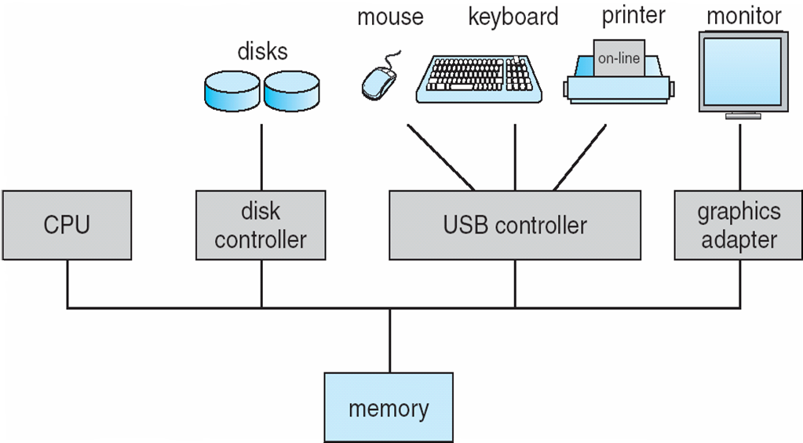
Real-Time Systems
System Characteristics
Bus-Oriented Organization
Buses interconnect individual components.
Copyright @ 2009 John Wiley & Sons Inc.
SILICON VALLEY UNIVERSITY CONFIDENTIAL

Slide 7
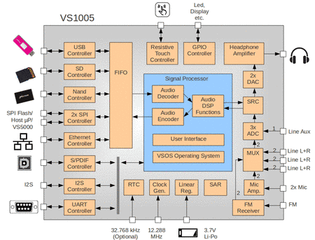
Real-Time Systems
CPU, memory (including cache), MMU, peripheral ports, USB ports contained in single Integrated Circuit.
System Characteristics
System-On-Chip
Copyright @ 2009 John Wiley & Sons Inc.
SILICON VALLEY UNIVERSITY CONFIDENTIAL

Slide 8
Real-Time Systems
Features of Real-Time Kernels
Most real-time systems do not provide the features found in a standard desktop system.
  Peripheral Devices: Displays, CD Drives, DVD Drives.
  Windows XP 40+ Million Lines of Source Code.
  Linux 15+ Million Lines of Source Code.
Reasons include:
  Real-time systems are typically single-purpose.
  Real-time systems often do not interface with a user.
  Features found in a desktop PC require fast processors and large memory, more substantial hardware than available in a Real-Time system.
  Cost important factor for Real-Time System.
Copyright @S2009 John Wiley & Sons Inc.
SILICON VALLEY UNIVERSITY CONFIDENTIAL

Slide 9
Real-Time Systems
Features of Real-Time Kernels
Address Translation used in Real-Time Systems
  MMU for Virtual Memory:
    Increases cost and power consumption.
    Translation time, Logical to Physical Address (TLB miss) prohibitive.
    Memory protection between processes.
    NVRAM (Flash Memory) provides Demand Paging and Swapping.
  Real-Addressing Mode: Logical Address = Physical Address.
    No memory protection between processes.
    Physical location where programs are loaded pre-defined.
    MMU disabled.
    Common in Real-Time System with Hard Real-Time constraints.
  Relocation Register set to memory location of process.
    MMU set to Physical = Logical + Relocation Register.
    No memory protection between processes.
Copyright @S2009 John Wiley & Sons Inc.
SILICON VALLEY UNIVERSITY CONFIDENTIAL

Slide 10
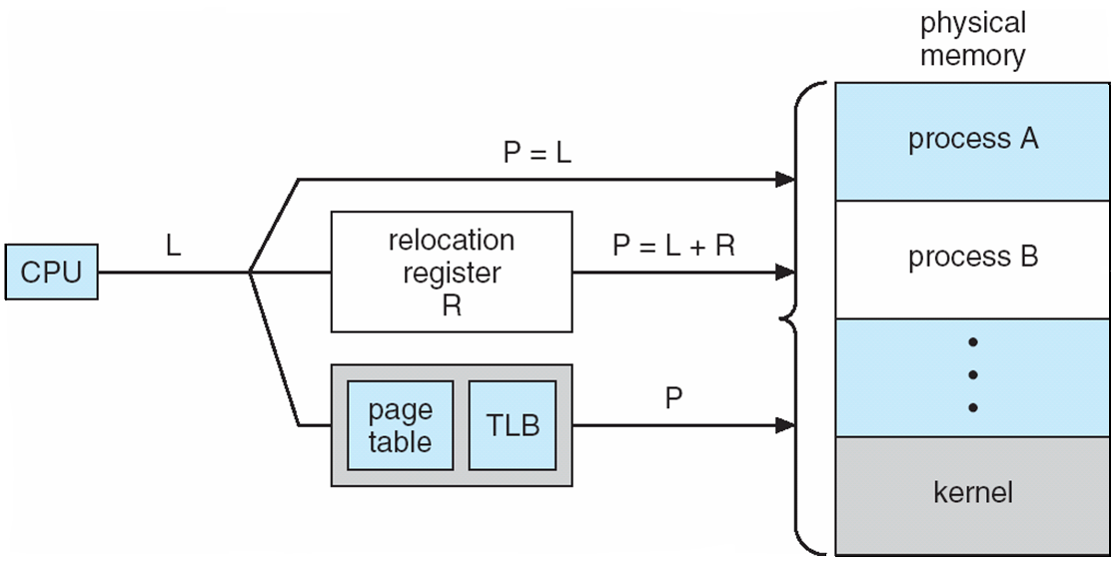
Real-Time Systems
Features of Real-Time Kernels
Address Translation used in Real-Time Systems
Copyright @S2009 John Wiley & Sons Inc.
SILICON VALLEY UNIVERSITY CONFIDENTIAL

Slide 11
Real-Time Systems
Implementing Real-Time Operating Systems
Real-Time Operating Systems must provide:
  Preemptive, Priority-Based Scheduling.
    Operating System must respond to Real-Time process as soon as the process requires CPU: Operating System MUST be preemptive and Real-Time Process assigned highest scheduling priority.
    Preemptive Soft Real-Time Systems: Solaris, Windows XP, Linux, guaranteed assign highest scheduling priority.
    Preemptive Hard Real-Time Systems: Guaranteed serviced within deadline requirements.
  Preemptive Kernels: Preemption of task running in Kernel Mode.
    NOTE: Nonpreemptive Kernel allows Kernel Mode task to run until it exits, blocks or voluntarily yields control of the CPU: Commercial Desktop Operating System (Windows XP) nonpreemptive.
    Preemption points in long-duration System Calls: Placed in “safe” locations in Kernel (Kernel data structure not being modified).
    Synchronization of Priority: Priority Inversion.
Copyright @S2009 John Wiley & Sons Inc.
SILICON VALLEY UNIVERSITY CONFIDENTIAL

Slide 12
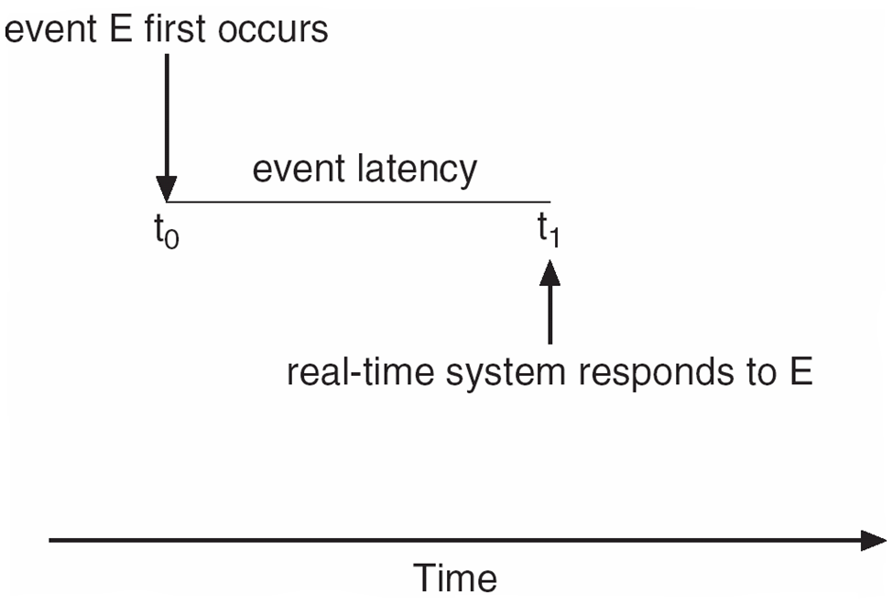
Real-Time Systems
Implementing Real-Time Operating Systems
Real-Time Operating System Event Driven
  Waiting for event: Either software ( timer expires ) or hardware ( sensor detects condition requiring immediate action ).
Real-Time Operating Systems must provide:
  Latency must be minimized.
    Event Latency: Amount of time that elapses from when an event occurs to when it is serviced.
Events:
Antilock Brakes: 3-5 MilliSecond to detect wheel is sliding.
Airplane Radar System: Period of several seconds.
Copyright @S2009 John Wiley & Sons Inc.
SILICON VALLEY UNIVERSITY CONFIDENTIAL

Slide 13
Real-Time Systems
Implementing Real-Time Operating Systems
Real-Time Operating Systems must provide:
  Latency must be minimized (Cont)
  Two types of latencies affecting Real-Time System performance.
    Interrupt Latency
      Period of time from the arrival of an interrupt at the CPU, save state of the current process, to start of the Interrupt Service Routine (ISR) that services the interrupt.
        Between arrival of an interrupt and the start of the Interrupt Service Routine: Dispatch Latency.
      Real-Time Operating Systems MUST minimize Interrupt Latency to ensure Real-Time Task receives attention.
      Amount of time interrupts are disabled while Kernel data structures are being updated, MUST be short.
      Hard Real Time Systems: Interrupt Latency MUST be bounded to guarantee deterministic behavior.
Copyright @S2009 John Wiley & Sons Inc.
SILICON VALLEY UNIVERSITY CONFIDENTIAL

Slide 14
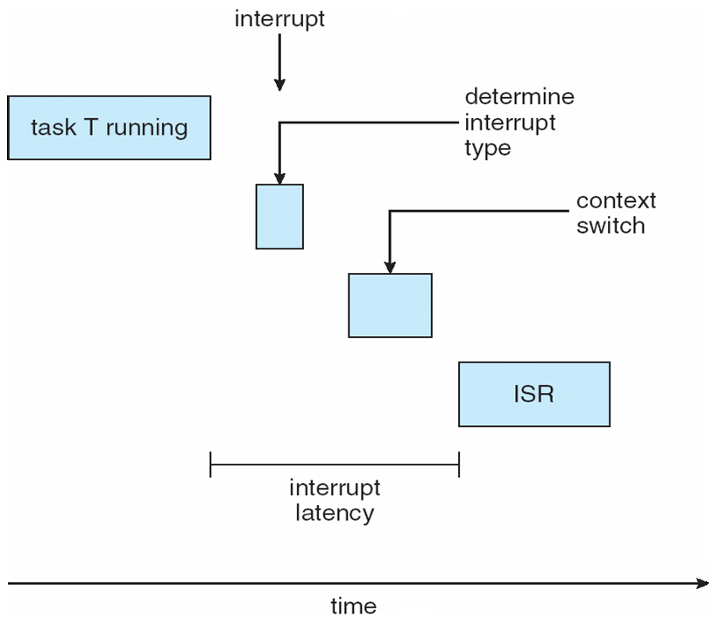
Real-Time Systems
Implementing Real-Time Operating Systems
Real-Time Operating Systems must provide:
  Latency must be minimized (Cont)
  Two types of latencies affecting Real-Time System performance.
    Interrupt Latency
Copyright @S2009 John Wiley & Sons Inc.
SILICON VALLEY UNIVERSITY CONFIDENTIAL

Slide 15
Real-Time Systems
Implementing Real-Time Operating Systems
Real-Time Operating Systems must provide:
  Latency must be minimized (Cont)
  Two types of latencies affecting Real-Time System performance.
    Dispatch Latency: Amount of time required for the Scheduling Dispatcher to stop one process and start another .
      Minimized by Real-Time Operating System: Preemptive Kernel help keep Dispatch Latency low.
    Conflict Phase of Dispatch Latency:
      Preemption of any process running in the Kernel.
      Release by low-priority processes of resources needed
Copyright @S2009 John Wiley & Sons Inc.
SILICON VALLEY UNIVERSITY CONFIDENTIAL

Slide 16
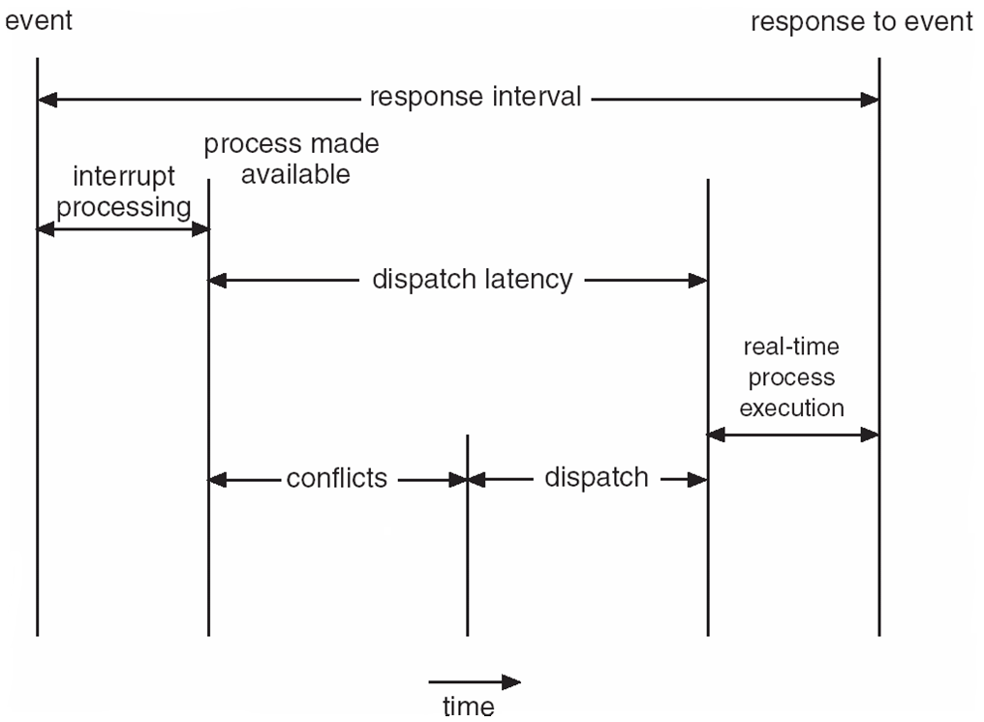
Real-Time Systems
Implementing Real-Time Operating Systems
Real-Time Operating Systems must provide:
  Latency must be minimized (Cont)
Dispatch Latency:
In Conflict Phase are two components:
Preemption of any process running in the Kernel.
Release low-priority processes of resources needed by high-priority process.
Copyright @S2009 John Wiley & Sons Inc.
SILICON VALLEY UNIVERSITY CONFIDENTIAL

Slide 17
Real-Time Systems
Implementing Real-Time Operating Systems
Real-Time Operating Systems must provide:
  Latency must be minimized (Cont)
  Priority Inversion: Resolve Dispatch Latency issue caused by high-priority process waiting for Kernel data currently owned by lower-priority processes.
Unbounded Priority Inversion
Priority
Task H
Task M
Task L
Critical Section Execution
Normal Execution
Copyright @S2009 John Wiley & Sons Inc.
SILICON VALLEY UNIVERSITY CONFIDENTIAL

Slide 18
Real-Time Systems
Priority Inheritance:
  Low-priority task has priority raised until completes critical section (releases shared resource).
  Nested resource locks can lead to deadlock.
    Avoid deadlock by allowing each task to own one shared resource.
    Do not allow nested locks.
    Overhead raising priority and then lowering priority.
Task M request resource.
Task L priority raised. Executes critical section.
Task L Completes critical section. Priority lowered.
Task M receives resource. Executes critical section.
Task M
Task L
Summer 2014
SILICON VALLEY UNIVERSITY CONFIDENTIAL
Critical Section Execution
Normal Execution

Slide 19
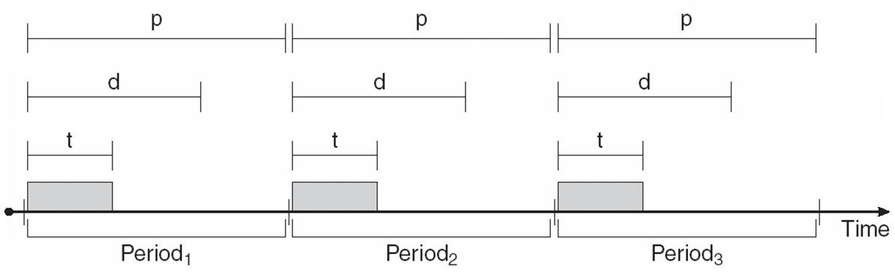
Real-Time Systems
Real-Time CPU Scheduling
Scheduling for Hard Real-Time Systems.
  Periodic Processes require the CPU at specified intervals (periods).
  p is the duration of the period.
  d is the deadline by when the process must be serviced.
  t is the fixed processing time once CPU is acquired.
  Priority can be assigned based on deadline or rate requirements.
Copyright @S2009 John Wiley & Sons Inc.
SILICON VALLEY UNIVERSITY CONFIDENTIAL

Slide 20
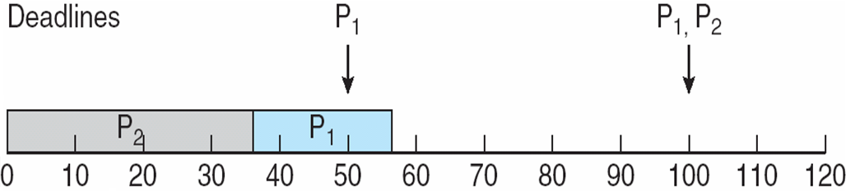
Real-Time Systems
Real-Time CPU Scheduling
Admission Control will use deadline requirements to admit or reject a process, on guarantee that the process will complete on-time.
Rate-Monotonic Scheduling Admission Control
  Periodic Tasks using Static Priority Policy with Preemption.
  Priority inversely based on its period: Shorter the period, higher priority.
  Assign higher priority to task that uses CPU quickly (short period).
  Processing time of periodic period is same for each CPU Burst.
P1 = 50 P2 = 100
T1 = 20 T2 = 35
1) P2 higher priority than P1.
2) P2 executes and completes at T2 (35).
3) P1 executes at 35.
4) P1 completed at 55.
P1 period has intervals of 50. P1 MISS the period.
WITHOUT Rate-Monotonic Scheduling.
Copyright @S2009 John Wiley & Sons Inc.
SILICON VALLEY UNIVERSITY CONFIDENTIAL

Slide 21

Real-Time Systems
Real-Time CPU Scheduling
Rate-Monotonic Scheduling
  CPU Utilization: T1/P1 (20/50=.40) + T2/P2 (35/100=.35) = .75 (75%)
P1 = 50 P2 = 100
T1 = 20 T2 = 35
Shorter Periods = Higher Prioiity.
P1 higher priority than P2. Completes T1 (20) within Period.
P2 starts T2 (35), but interrupted at 50 by P1.
P1 runs until time 70, and P2 completes at 75.
With Rate-Monotonic Scheduling.
P1 Period has intervals of 50. P1 completes within Period.
P2 Period has intervals of 100. P2 completes within Period.
Copyright @S2009 John Wiley & Sons Inc.
SILICON VALLEY UNIVERSITY CONFIDENTIAL

Slide 22

Real-Time Systems
Real-Time CPU Scheduling
Rate-Monotonic Scheduling
Limitation: CPU Utilization is Bounded.
  Two processes, Bound = 83%. Bound is 69% when processes approach infinity,
  CPU Utilization = T1/P1 (25/50=.50) +T2/P2 (35/80=.44) = .94 (94%)
With Rate-Monotonic Scheduling.
P1 = 50 P2 = 80
T1 = 25 T2 = 35
1) T1 CPU Burst completes at 25.
2) T2 CPU Burst (25) preempted at 50 by P1. T2 has 10 left.
3) T1 CPU Burst completes at 25.
4) T2 CPU Burst (10) completes at 85.
5) P2 MISSED Period at 80.
1`
2`
3`
4`
Copyright @S2009 John Wiley & Sons Inc.
SILICON VALLEY UNIVERSITY CONFIDENTIAL

Slide 23

Real-Time Systems
Real-Time CPU Scheduling
Earliest-Deadline-First Scheduling Admission Control
Priorities are assigned according to deadlines: Earlier the deadline, the higher the priority, later the deadline, the lower the priority.
Process ready to be scheduled:
  Deadline requirements announced to the system.
  Priorities adjusted to reflect Deadline of schedulable process.
P1 = 50 P2 = 80
T1 = 25 T2 = 35
1) At 0, P1 is the earliest deadline, CPU Burst T1 = 25.
2) At 25, T2 CPU Burst = 35. P2 (Deadline = 80) has higher priority than P1 (Deadline = 100)
3) At 60, T1 CPU Burst = 25.
4) At 85, T2 CPU Burst = 15, preempted by P1 (Deadline=150) over P2 (Deadline=160)
5) At 100, T1 CPU Burst = 25, At 125, T2 completes CPU Burst = 20.
2`
4`
Copyright @S2009 John Wiley & Sons Inc.
SILICON VALLEY UNIVERSITY CONFIDENTIAL

Slide 24
Real-Time Systems
Real-Time CPU Scheduling
Proportional Share Scheduling
Total CPU time,T shares, are allocated among all processes in the system.
An application receives N shares where N < T.
This ensures each application will receive N / T of the total processor time.
Works in conjunction with Admission Control Policy: Only admit a Client requesting equal or less than number of shares that are available.
  Process does not get scheduled, if Admission Control denies entry.
Copyright @S2009 John Wiley & Sons Inc.
SILICON VALLEY UNIVERSITY CONFIDENTIAL

Slide 25
Real-Time Systems
Real-Time CPU Scheduling
Pthread Scheduling
The Pthread API provides functions for managing Real-Time threads.
Pthreads defines two scheduling classes for Real-Tme Threads:
  SCHED_FIFO - Threads are scheduled using a FCFS strategy with a FIFO queue. There is no time-slicing for threads of equal priority.
  SCHED_RR - Similar to SCHED_FIFO except time-slicing occurs for threads of equal priority.
Pthread API:
  pthread attr getsched policy(pthread attr t *attr, int *policy)
  pthread attr setsched policy(pthread attr t *attr, int *policy)
  Param attr: Pointer to set of attributes for the thread.
  Param policy: Pointer to integer value SCHED_FIFO, SCHED_RR, SCHED_OTHER.
Copyright @S2009 John Wiley & Sons Inc.
SILICON VALLEY UNIVERSITY CONFIDENTIAL

Slide 26
Real-Time Systems
Real-Time CPU Scheduling
VxWorks 5.x
Supports Hard Real-Time Operating System.
WindRiver Systems: VxWorks and Windriver Linux.
  Acquired by Intel Corporation.
  Automobiles, Consumer and Industrial Devices, Networking Equipment (Switches and Routers), Space Equipment (Mars terrain rovers).
VxWorks centered on the Wind microkernel.
  Supports processes and threads using Pthread API.
  Supports two scheduling models: Preemptive Scheduing and Nonpreemptive Round-Robin scheduling with 256 priority levels.
  Hard Real-Time supports bounded interrupt and dispatch latency times for interrupts.
  Interprocess Communication using shared memory and message passing. Tasks can communicate using Pipes (FIFO queue).
  Supports semaphores and mutex locks with Priority Inheritence .
Copyright @S2009 John Wiley & Sons Inc.
SILICON VALLEY UNIVERSITY CONFIDENTIAL

Slide 27
Real-Time Systems
Real-Time CPU Scheduling
VxWorks 5.x (Cont)
Component Libraries: POSIX, Java, TCP/IP Networking.
All components optional, Embedded System can be customized to the customer requirements.
Two levels of Virtual Memory:
  Allows control of the cache on a per-page basis: Cache-coherency Policy used to ensure caches of shared data are not different.
  Virtual Memory component (VxVMI) and MMU: Allows task to mark data areas as “private”. Kernel code pages and Interrupt Vector can be marked as “Read-Only”.
VxWorks 5 does not distinguish between User and Kernel mode: Applications run in Kernel mode and is able to address all address space.
  VxVMI used to prevent user applications from writing Kernel space.
VxWorks 6 supports Kernel Mode and User Mode: VxWorks Real-Time Processes run in User Mode and Kernel runs in Kernel Mode.
Copyright @S2009 John Wiley & Sons Inc.
SILICON VALLEY UNIVERSITY CONFIDENTIAL

Slide 28
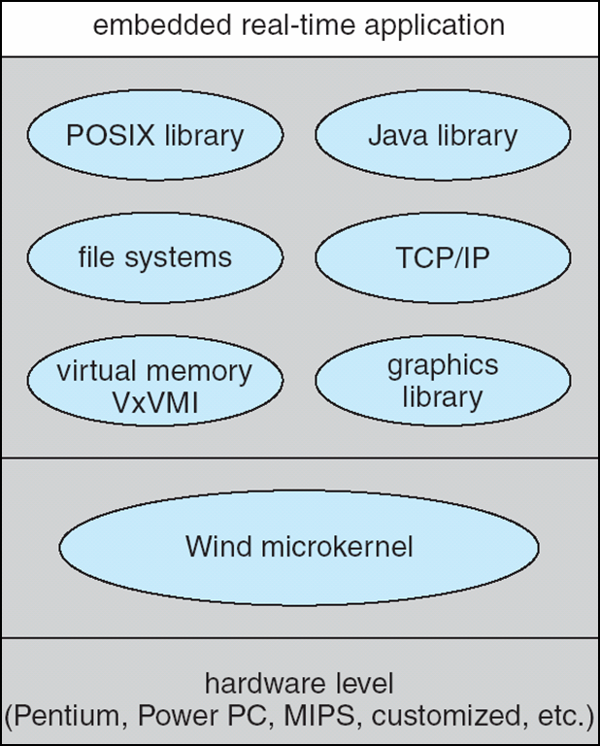
Real-Time Systems
Real-Time CPU Scheduling
VxWorks 5.x (Cont)
Wind microKernel has bare
minimum of features.
Add more features (networking,
file systems, memory
management etc. specialized
libraries are included.
By this approach the system will
only have the features that are
actually needed and the footprint
will be as small as possible.
Copyright @S2009 John Wiley & Sons Inc.
SILICON VALLEY UNIVERSITY CONFIDENTIAL

Slide 29
Real-Time Systems
Summary
Real-Time System require results to arrive within deadline period.
Embedded specialized (single function) Real-Time Systems in consumer and industrial devices.
Soft Real-Time Systems (higher priority than user processes) and Hard Real-Time Systems (guaranteed deadline periods).
Scheduler supporting Real-Time Systems:
  Priority-based algorithm with preemption.
  Kernel can be preempted.
Minimize Interrupt and Dispatch Latency.
Real-Time Scheduling Algorithms:
  Rate-monotonic scheduling assigns higher priority to processes requiring the CPU more often.
  Earliest-Deadline-First scheduling assigns priority using deadlines.
  Proportional Share Scheduling divides up processor time into shares.
  Pthread API provides library intreface to schedule Real-Time threads.
Copyright @S2009 John Wiley & Sons Inc.
SILICON VALLEY UNIVERSITY CONFIDENTIAL

Slide 30
Multimedia Systems
Operating System Data: Text Files, Programs, Binaries, Word-Processing Documents, Spreadsheets.
What is Multimedia?
  Continuous-media (audio and video) data.
Multimedia data includes
  MP3 Audio, MPEG Streaming Video, and Video Clips
  Live Webcasts of Speeches or Sporting Events
  Multimedia applications includes separate audio and video tracks.
Multimedia data may be delivered to:
  Desktop PC’s.
  Small Devices: Handheld devices (PDAs, smart phones).
Common standards used for representing multimedia video and audio files.
Copyright @ 2009 John Wiley & Sons Inc.
SILICON VALLEY UNIVERSITY CONFIDENTIAL

Slide 31
Multimedia Systems
Media Delivery
Multimedia data is stored in the file system like other ordinary data.
However, multimedia data must be accessed with specific timing requirements.
For example, video must be displayed at 24-30 frames per second. Multimedia video data must be delivered at a rate which guarantees 24-30 frames/second.
Video file must be accessed from the File System at a rate consistent with the rate at which the video is being displayed.
  Continuous-media data is data with specific rate requirements.
Copyright @ 2009 John Wiley & Sons Inc.
SILICON VALLEY UNIVERSITY CONFIDENTIAL

Slide 32
Multimedia Systems
Media Delivery
Local Playback: Data delivered from local File System.
  DVD on laptop. MP3 Audio File on handheld MP3 Player.
Streaming is delivering a multimedia file from a server to a client - the deliver occurs over a network connection.
  Personnel computer, PDA, Cell Phone.
There are two different types of streaming:
  Progressive download - The client begins playback of the multimedia file as it is delivered (HTTP Web Server). The file is stored on the client computer (YouTube, ESPN and CNN).
  Real-time streaming - The multimedia file is delivered by Streaming Server to, but not stored on, the client’s computer.
  Real-time Streaming preferable: Media files too large to store, more secure, long videos, Internet Radio, TV Broadcasts.
Copyright @ 2009 John Wiley & Sons Inc.
SILICON VALLEY UNIVERSITY CONFIDENTIAL

Slide 33
Multimedia Systems
Media Delivery
Random Access Feature: Progressive Download or Real-Time Streaming.
  Ability to move around within the Media Stream (position within the file).
Real-Time Streaming:
  Live Streaming: Deliver an event, concert or lecture, live as it is actually occurring.
    Radio program broadcast, Live webcams, Video Conferencing.
    Live Delivery does NOT allow Random Access Feature (no late viewing of earlier points in the media stream).
  On-Demand Streaming: Does not take place as the event is occurring.
    Full-length movies and archive lectures.
    No notion of arriving late.
    Client may or may not have Random Access to the stream.
  Streaming Media Products: RealPlayer, Apple QuickTime, Windows Media Player.
Copyright @ 2009 John Wiley & Sons Inc.
SILICON VALLEY UNIVERSITY CONFIDENTIAL

Slide 34
Multimedia Systems
Characteristics of Multimedia Systems
Multimedia files can be quite large.
  100 Minutes MPEG-1 Video File = 1.125 GBytes of storage.
  100 Minutes HDTV = 15 GBytes of storage.
  Streaming Server with Digital Video Library require several TeraBytes of storage.
Continuous media data may require very high data rates.
  Digital frame of color video at resolution of 800 X 600 Pixels. Using 24 bits to represent color of each pixel, single frame needs 800 X 600 X 24 = 11.520 Mbits of data. Frames displayed at 30 frames per second: Bandwidth in excess of 345 Mbps is required.
Multimedia applications may be sensitive to timing delays during playback of the media.
  Start delivery of continuous-media file during playback, delivery must continue at the rate, otherwise the video will be subject to pauses or stalls.
Copyright @ 2009 John Wiley & Sons Inc.
SILICON VALLEY UNIVERSITY CONFIDENTIAL

Slide 35
Multimedia Systems
Operating System Issues
Deliver of Continuous-media data, Operating System must guarantee specific rate and timing requirements.
Quality of Service (QOS) Requirements:
  Influences CPU Scheduling, Disk Scheduling, and Network Management.
  Compression and Decoding require CPU processing.
  Multimedia task must be scheduled with enough priorities to ensure deadline requirements of continuous-media data are meet.
  File system must meet the rate requirements of continuous-media data.
  Network Protocols must support bandwidth requirements: Minimize Delay and Jitter.
Copyright @ 2009 John Wiley & Sons Inc.
SILICON VALLEY UNIVERSITY CONFIDENTIAL

Slide 36
Multimedia Systems
Compression
The size and rate requirements of multimedia systems, require compressing multimedia files into a smaller form.
  Useful for streaming across Network.
  Compression Ratio: Ratio of orig file size to compressed file.
Files compressed (Encoded) as lossy or lossless:
  Lossy: Some of the original data are lost when file is decoded.
    Images (pictures), audio, and video can tolerate “lost” data.
    Eliminate very high or low frequencies undetectable by human ear.
    Video lossy compression stores ONLY differences between frames.
  Lossless: Ensures the compressed file can be restored (Decoded) to its original form.
    Text file, computer programs (Zipped files).
Copyright @ 2009 John Wiley & Sons Inc.
SILICON VALLEY UNIVERSITY CONFIDENTIAL

Slide 37
Multimedia Systems
Compression
Lossy Compression Schemes: MPEG Compression (Moving Picture Experts Group) for continuous-media:
  MPEG is a set of file formats and compression standards for Digital Video.
    Layers 3 and 2 apply to audio and video portion of media file.
    Layer 1 (Systems Layer) has timing information for MPEG player to multiplex and synchronize audio and video during playback.
  MPEG-1: Digital video and audio stream. Resolution is 352 X 240 @ 30 frames/second. Rate of 1.5Mbps.
    Quality of VCR videos.
    MP3 Audio is MPEG-1 Layer 3 (audio portion).
    Compression Ratio of 200:1.
    Download short video clips over Internet.
Copyright @ 2009 John Wiley & Sons Inc.
SILICON VALLEY UNIVERSITY CONFIDENTIAL

Slide 38
Multimedia Systems
Compression
Lossy Compression Schemes: MPEG Compression (Moving Picture Experts Group) for continuous-media:
  MPEG-2: Used for compressing DVD and high-definition television (HDTV).
    Levels and Profiles of video compression.
    Level: Resolution of the video.
    Profile: Characterize video quality.
    Higher Level/Profile, higher required data rate (1.5 Mbps to 15 Mbps).
    High data rate makes MPEG-2 more suitable for local playback.
  MPEG-3: Discontinued, and never released. Sometime confused with MP3 (MPEG-1 Audio Layer 3).
Copyright @ 2009 John Wiley & Sons Inc.
SILICON VALLEY UNIVERSITY CONFIDENTIAL

Slide 39
Multimedia Systems
Compression
Lossy Compression Schemes: MPEG Compression (Moving Picture Experts Group) for continuous-media:
  MPEG-4 - Used to transmit audio, video, and graphics, including 2-D and 3-D animation layers. Allows end users to interact with the file during playback.
    Virtual tour of home, moving room to room.
    Scalable level of quality, allowing delivery over slow network connections (56Kbps modems) or high-speed networks.
    MPEG-4 audio and video delivered over wireless devices (Handheld computers, PDAs, Cell Phones).
Copyright @ 2009 John Wiley & Sons Inc.
SILICON VALLEY UNIVERSITY CONFIDENTIAL

Slide 40
Multimedia Systems
Requirements of Multimedia Kernels
  Differ from requirements of traditional applications (Word Processor, compilers, spreadsheets).
The operating system must guarantee the specific data rate and timing requirements of continuous media.
  Audio and Video data playback demands deliver within certain deadline and continuous fixed rate.
Periodic Processes: Processes that request data at constant intervals or periods.
  Frame unable to be displayed at deadline are omitted.
  At 30 Frames/second = 1/30th = 3.34 hundreths of a second.
Rate requirements and deadlines are known as Quality-of-Service (QoS) guarantees.
Copyright @ 2009 John Wiley & Sons Inc.
SILICON VALLEY UNIVERSITY CONFIDENTIAL

Slide 41
Multimedia Systems
Requirements of Multimedia Kernels
Quality of Service (QOS) Levels:
  Best-Effort Service: System makes a Best-Effort attempt to satisfy the requirements, NO Guarantees are made.
  Soft QOS: Treats different types of traffic in different ways, giving certain traffic streams higher priority than other streams. NO Guarantees are made.
  Hard QOS: Quality-Of-Service requirements are Guaranteed.
Traditional Operating Systems uses:
  Best-Effort Service.
  Over-provisioning: Assume the total amount of resources available is larger than a worst-case workload.
Multimedia Systems cannot behave as traditional Operating Systems: the system MUST provide continuous-media applications with the guarantees of hard QOS.
Copyright @ 2009 John Wiley & Sons Inc.
SILICON VALLEY UNIVERSITY CONFIDENTIAL

Slide 42
Multimedia Systems
Requirements of Multimedia Kernels
Parameters Defining QOS for Multimedia Applications:
  Throughput: Total amount of work during certain interval. Throughput is the required Data Rate.
  Delay: Elapsed time from when a request is submitted to when the result is produced (Time when a Client requests a media stream to when the stream is delivered).
  Jitter: Related to Delay (where Delay refers to the time a user must wait to receive a Stream, jitter refers to delays during playback.
    Unacceptable for continuous-media application.
    Acceptable for on-demand Real-Time streaming.
    Jitter compensated by buffering data (5 seconds) before playback.
  Reliability: How errors are handled during transmission and processing of continuous media.
    Errors occur due to lost packets or processing delays by CPU.
Copyright @ 2009 John Wiley & Sons Inc.
SILICON VALLEY UNIVERSITY CONFIDENTIAL

Slide 43
Multimedia Systems
Requirements of Multimedia Kernels
Parameters Defining QOS for Multimedia Applications: (Cont)
  QOS Negotiation between Client and Server:
    Client negotiates a data rate (Speed of the Client’s connection to the network), agreeing to a certain level of quality.
    Many Media Players allow Client to configure the Media Player according to the speed of the client’s connection to the network.
  QOS Guarantee provided by using Admission Control:
    Admitting a request for service ONLY if the server has sufficient resources to satisfy the request.
Copyright @ 2009 John Wiley & Sons Inc.
SILICON VALLEY UNIVERSITY CONFIDENTIAL

Slide 44
Multimedia Systems
Requirements of Multimedia Kernels
Parameters Defining QOS for Multimedia Applications: (Cont)
  Admission Control with Semaphores:
    Semaphores as a method of implementing simple Admission-Control Policy.
    Initialize Semaphore to the number of resources available.
      After all resources are in use, wait( ) blocks until signal ( ).
  Admission Control with Resource Managers:
    Resource Reservation method:
      Resource Manager for each type of resource (CPU, Memory, File System, Devices, Network).
      Request for resource has QOS requirements : Required Data Rate.
      QOS may be negotiated between Client and Server.
Copyright @ 2009 John Wiley & Sons Inc.
SILICON VALLEY UNIVERSITY CONFIDENTIAL

Slide 45
Multimedia Systems
CPU Scheduling
Soft Real-Time Systems give scheduling priority to critical processes.
  No guarantee as to WHEN the critical process scheduled.
Hard Real-Time Systems require critical process will be serviced within a guaranteed period of time.
  Multimedia systems require hard Real-Time scheduling to ensure critical tasks will be serviced within timing deadlines.
  Most hard realtime CPU scheduling algorithms assign Real-Time processes static priorities that do not change over time.
    Dynamic priority for non-Real-Time processes, with the intent of giving higher priority to interactive processes.
Copyright @ 2009 John Wiley & Sons Inc.
SILICON VALLEY UNIVERSITY CONFIDENTIAL

Slide 46
Multimedia Systems
Disk Scheduling
Disk scheduling algorithms must be optimized for continuous media.
  Timing deadlines and Rate requirements.
  Disks have relatively low transfer rates and relatively high latency rates.
  Reducing latency rates may result in Scheduling Policy that does NOT prioritize according to deadlines.
Earliest-Deadline-First (EDF) Scheduling.
  Queue to order requests according to the time each request must be completed (deadline).
  Similar to Shortest-Seek-Time-First (SSTF) , instead of servicing request closest to current cylinder, service request with the closest deadline first.
  EDF could have higher seek times, since movement does not regard current position.
Copyright @ 2009 John Wiley & Sons Inc.
SILICON VALLEY UNIVERSITY CONFIDENTIAL

Slide 47
Multimedia Systems
Disk Scheduling (Cont)
SCAN-EDF Scheduling.
  SCAN-EDF scheduling is similar to EDF except that requests with the same or relatively close deadlines are batched together and ordered according to a SCAN policy.
Batching Requests has many techniques:
  Only requirement is reordering requests within batch must not prevent request from being serviced within its deadline.
  Batch Requests according to relatively close deadline.
  Batch Requests within a threshold (within 100MilliSeconds).
Copyright @ 2009 John Wiley & Sons Inc.
SILICON VALLEY UNIVERSITY CONFIDENTIAL

Slide 48
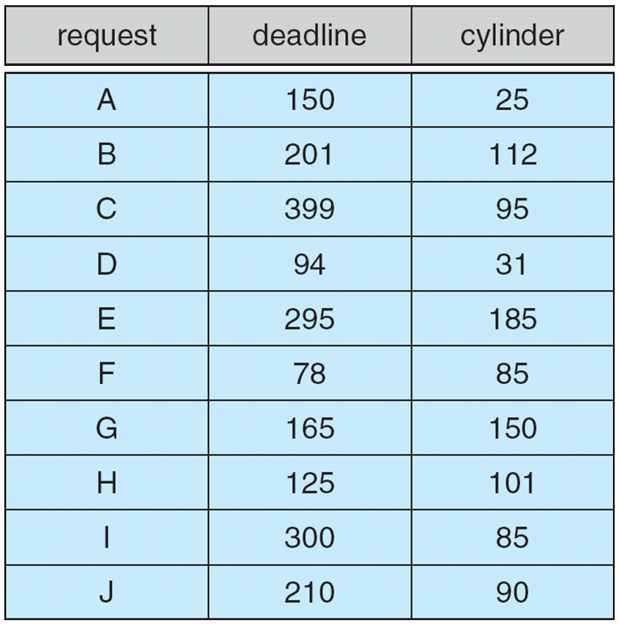
Multimedia Systems
Disk Scheduling (Cont)
SCAN-EDF Scheduling
  Batch within 100 Milli-
  second threshold.
  Current = Cylinder 50.
Batch D, F
Batch A, G, H
Batch B, E, J
Copyright @ 2009 John Wiley & Sons Inc.
SILICON VALLEY UNIVERSITY CONFIDENTIAL

Slide 49
Multimedia Systems
Network Management
Preserving rate requirements is foremost QOS issue.
Techniques for CPU Scheduling and Disk Scheduling algorithms can serve QOS requirements.
Streaming across Internet can affect QOS Demands.
  Network encounters congestion, delays, and other network traffic issues beyond control of the originator of the data.
  Multimedia data, timing requirements must be synchronized between server delivering content and client playing it back.
RTP (Real-Time Transport Protocol)
  Internet standard for delivering Real-Time data (audio/video).
  Provides features that allow a receiver to remove jitter introduced by delays and congestion in the network.
Copyright @ 2009 John Wiley & Sons Inc.
SILICON VALLEY UNIVERSITY CONFIDENTIAL

Slide 50
Multimedia Systems
Network Management
Three general methods for delivering content from a server to a client across a network:
  Unicasting - The server delivers the content to a single client. Multiple clients requires separate unicast to each client.
    Most streaming media delivered across unicast channels.
  Broadcasting - The server delivers the content to all clients, regardless whether they want the content or not.
  Multicasting - The server delivers the content to a group of receivers who indicate they wish to receive the content.
    Clients should be physically close to the server or to intermediate routers supporting multicasting protocol (IGMP).
Copyright @ 2009 John Wiley & Sons Inc.
SILICON VALLEY UNIVERSITY CONFIDENTIAL

Slide 51
Multimedia Systems
Network Management
Deliver of Streaming Media
Stream from Web Server using Hypertext Transport Protocol (HTTP)
  Clients use Media Player (QuickTime, RealPlayer, Windows Media Player) to play back media from Web Server.
  Client request Metafile:
    Contains location (URL) of streaming media file.
    Metafile received by Client Web Browser, starts the Media Player (Real Audio stream needs RealPlayer, streaming Windows media needs Windows Media Player).
    Media Player contacts Web Server and Web Server delivers streaming media using standard HTTP.
  HTTP stateless protocol: Web Server does not maintain state (status) of connection and the delivery of streaming media.
Copyright @ 2009 John Wiley & Sons Inc.
SILICON VALLEY UNIVERSITY CONFIDENTIAL

Slide 52
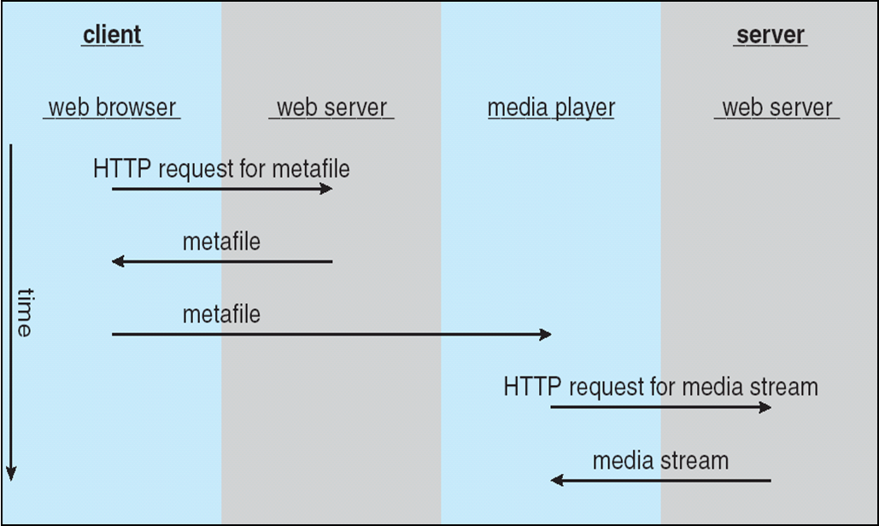
Multimedia Systems
Network Management
Deliver of Streaming Media (Cont)
  Streaming Media from conventional Web Server:
Copyright @ 2009 John Wiley & Sons Inc.
SILICON VALLEY UNIVERSITY CONFIDENTIAL

Slide 53
Multimedia Systems
Network Management
Real-Time Streaming Protocol (RTSP)
  RTSP designed to communicate between streaming Servers and Media Players on the Client.
  Allows Client to Pause or Seek to random positions in the stream.
  Metafile between Server and Client delivered using HTTP.
  Streaming media delivered from a streaming Server using RTSP commands:
    SETUP - The server allocates resources for a client session.
    PLAY - T server delivers a stream to a client session.
    PAUSE - The server suspends delivery of a stream.
    TEARDOWN - The server breaks down the connection and releases the resources allocated for the session.
  Using RTSP instead of HTTP offers advantages related to networking issues (Using RTP for transport).
Copyright @ 2009 John Wiley & Sons Inc.
SILICON VALLEY UNIVERSITY CONFIDENTIAL

Slide 54
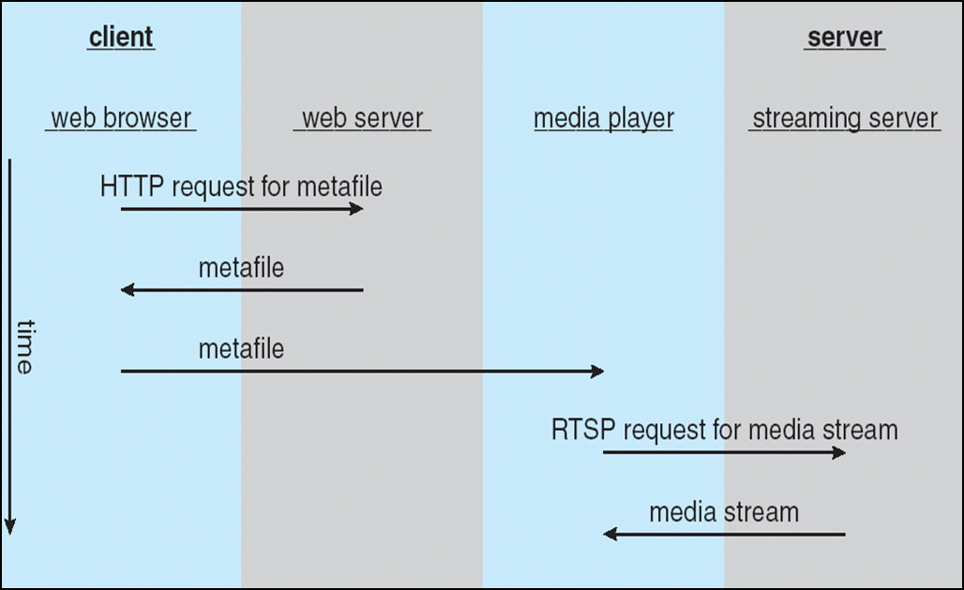
Multimedia Systems
Network Management
Real-Time Streaming Protocol (RTSP)
Copyright @ 2009 John Wiley & Sons Inc.
SILICON VALLEY UNIVERSITY CONFIDENTIAL

Slide 55
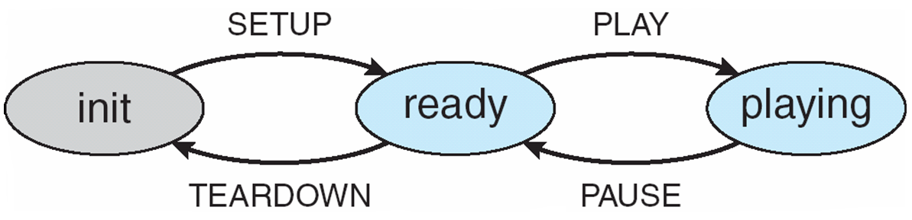
Multimedia Systems
Network Management
Real-Time Streaming Protocol (RTSP)
  RTSP Server will be in following states:
    Init, Ready, Playing
  Transition between states occur when Server receives one of the RTSP commands from the Client.
Copyright @ 2009 John Wiley & Sons Inc.
SILICON VALLEY UNIVERSITY CONFIDENTIAL

Slide 56
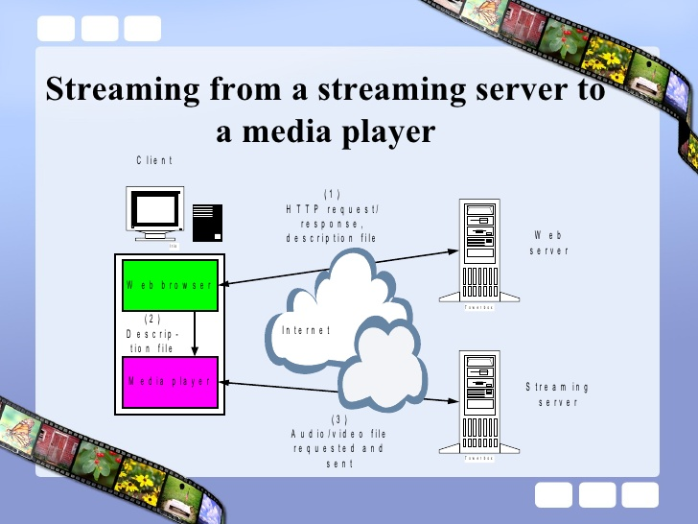
Multimedia Systems
www.slideshare.net/esumit/rtsp
SILICON VALLEY UNIVERSITY CONFIDENTIAL

Slide 57
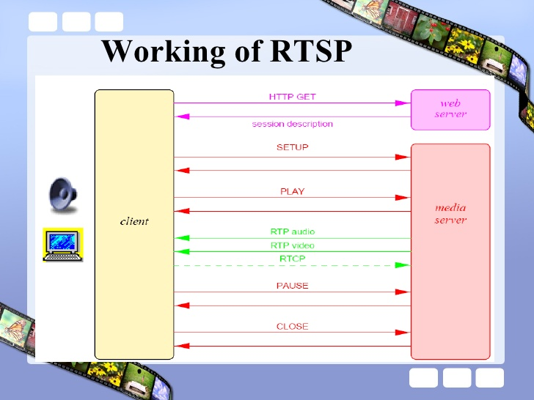
Multimedia Systems
www.slideshare.net/esumit/rtsp
SILICON VALLEY UNIVERSITY CONFIDENTIAL

Slide 58
Multimedia Systems
CineBlitz Multimedia Storage Server
High-performance Media Server supports:
  Real-Time Clients: Continuous media with Rate requirements (video/audio).
  Non-Real-Time Clients: Conventional data with no associated Rate requirements.
Disk Scheduling: Services request in cycles.
  Disk Scheduler services request in cycles.
  At each cycle, request are placed in C-SCAN ordering.
www.slideshare.net/esumit/rtsp
SILICON VALLEY UNIVERSITY CONFIDENTIAL

Slide 59
Multimedia Systems
CineBlitz Multimedia Storage Server
Admission Controls provides hard QOS guarantees to meet Real-Time Client requirements.
  Admits client ONLY if there are sufficient resources (disk bandwidth, buffer space) for data retrieval at the required rate.
  Monitors system resources: disk bandwidth, disk latency, available buffer space.
  Bound Requests into Service queue:
    Service time for each request is first estimated.
    Request is admitted ONLY if the sum of the estimated service times for all admitted request does not exceed duration of service cycle.
    S
www.slideshare.net/esumit/rtsp
SILICON VALLEY UNIVERSITY CONFIDENTIAL

Slide 60
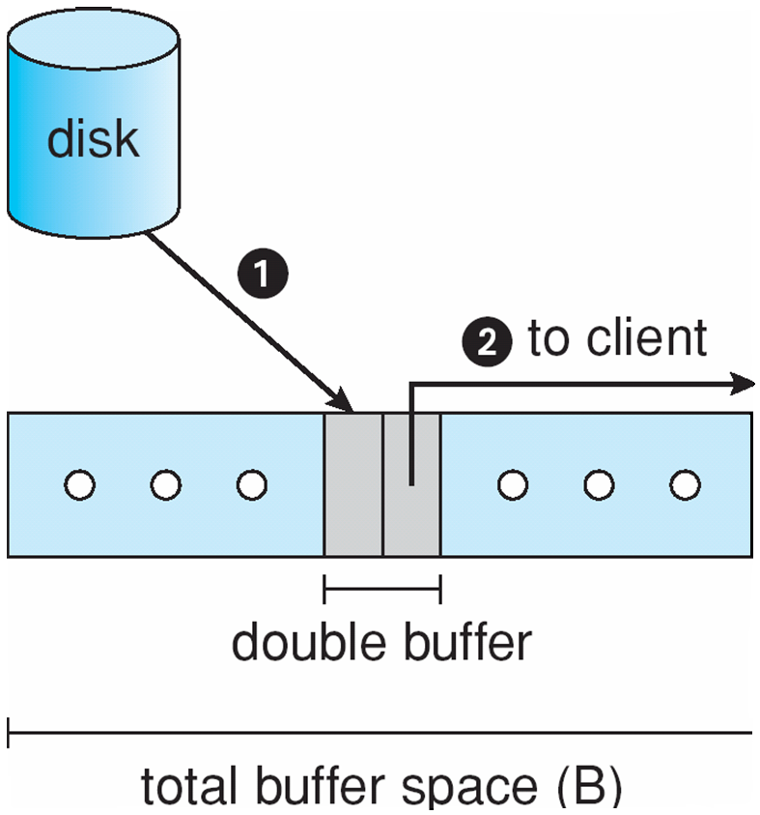
Multimedia Systems
CineBlitz Multimedia Storage Server
www.slideshare.net/esumit/rtsp
SILICON VALLEY UNIVERSITY CONFIDENTIAL

Slide 61
Multimedia Systems
Summary
Multimedia files include video and audio files, delivered to desktop computers, PDAs, Cell Phones.
Multimedia data have specific rate and deadline requirements.
  Specific timing requirements require data to be compressed before delivery to a client for playback.
  Delivered from local file system or multimedia server using streaming technique.
Multimedia has Quality-Of-Service (QOS) requirements.
  Multimedia systems provide QOS using Admission Control.
  Admission Control: System accepts a request ONLY if the QOS level (rate requirement) can be meet.
  Operating System provides CPU Scheduling and Disk Scheduling to support deadline requirements of the continuous media streaming.
  Network Management uses RTSP/RTP protocols to handle delays and jitter caused by the Network and control the playback.
www.slideshare.net/esumit/rtsp
SILICON VALLEY UNIVERSITY CONFIDENTIAL

