Slide 1

Cluster validation
  Clustering methods: Part 3
  Pasi Fränti
15.4.2014
  Speech and Image Processing Unit
  School of Computing
  University of Eastern Finland

Slide 2
Part I:
Introduction

Slide 3


Cluster validation
Precision = 5/5 = 100%
Recall = 5/7 = 71%
Supervised classification:
Class labels known for ground truth
Accuracy, precision, recall
Cluster analysis
No class labels
Validation need to:
Compare clustering algorithms
Solve number of clusters
Avoid finding patterns in noise
Oranges:
Apples:
P
Precision = 3/5 = 60%
Recall = 3/3 = 100%

Slide 4
Measuring clustering validity
  Internal Index:
  Validate without external info
  With different number of clusters
  Solve the number of clusters
  External Index
  Validate against ground truth
  Compare two clusters:
  (how similar)
?
?
?
?

Slide 5
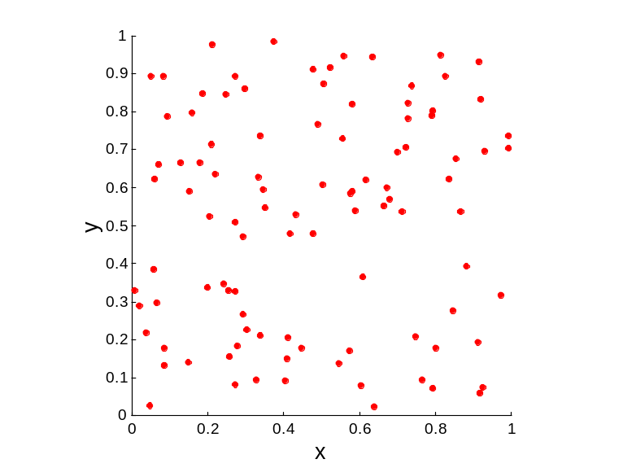
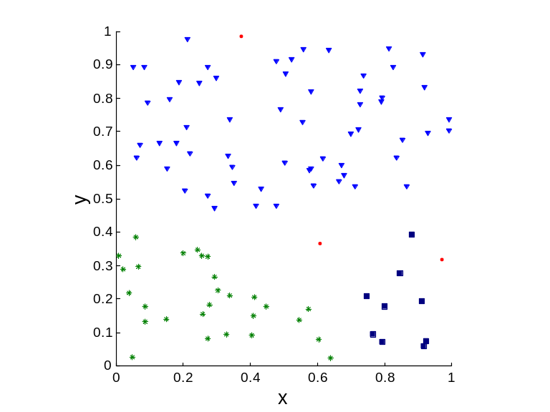
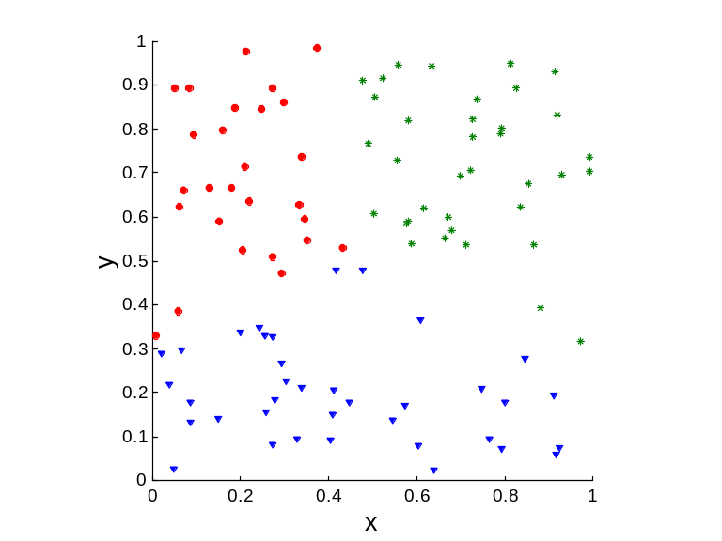
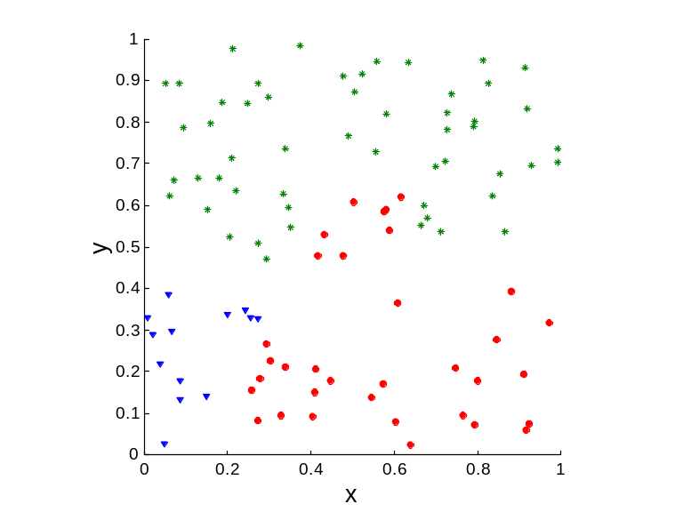
Clustering of random data
Random Points
DBSCAN
K-means
Complete Link

Slide 6
Cluster validation process
Distinguishing whether non-random structure actually exists in the data (one cluster).
Comparing the results of a cluster analysis to externally known results, e.g., to externally given class labels.
Evaluating how well the results of a cluster analysis fit the data without reference to external information.
Comparing the results of two different sets of cluster analyses to determine which is better.
Determining the number of clusters.

Slide 7
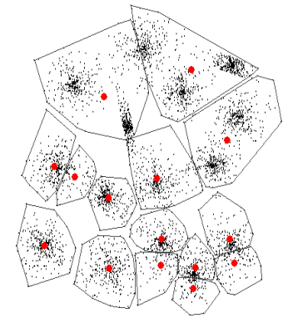
Cluster validation process
Cluster validation refers to procedures that evaluate the results of clustering in a quantitative and objective fashion. [Jain & Dubes, 1988]
  How to be “quantitative”: To employ the measures.
  How to be “objective”: To validate the measures!
INPUT:
DataSet(X)
Clustering Algorithm
Partitions P
Codebook C
Validity Index
m*
Different number of clusters m

Slide 8
Part II:
Internal indexes

Slide 11
Internal indexes
Ground truth is rarely available but unsupervised validation must be done.
Minimizes (or maximizes) internal index:
  Variances of within cluster and between clusters
  Rate-distortion method
  F-ratio
  Davies-Bouldin index (DBI)
  Bayesian Information Criterion (BIC)
  Silhouette Coefficient
  Minimum description principle (MDL)
  Stochastic complexity (SC)

Slide 12
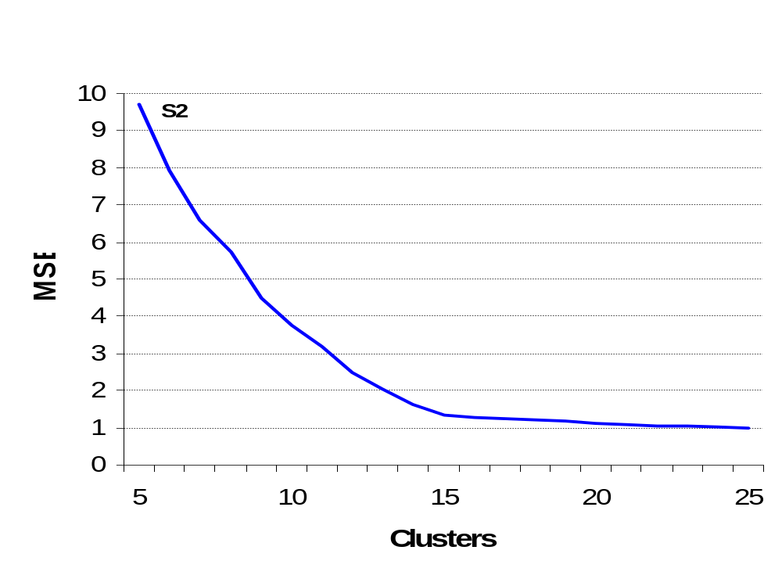
Mean square error (MSE)
The more clusters the smaller the MSE.
Small knee-point near the correct value.
But how to detect?
Knee-point between
14 and 15 clusters.

Slide 13
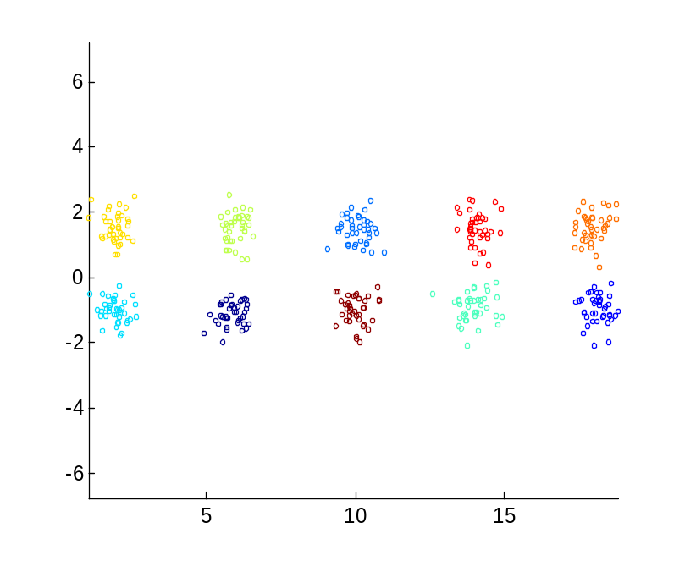
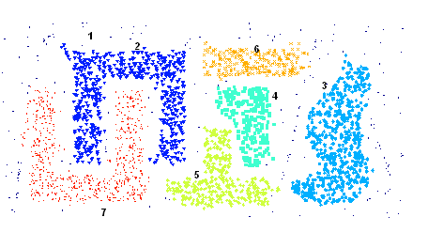
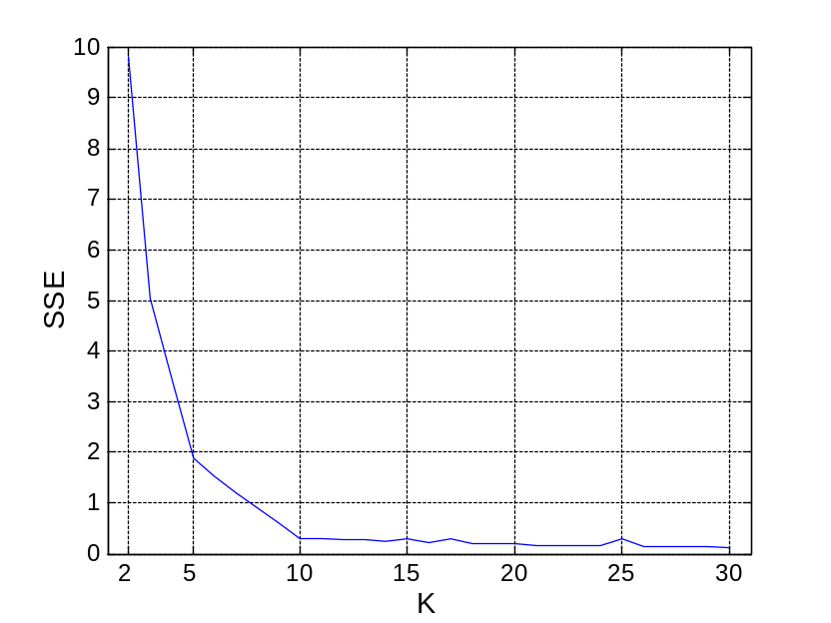
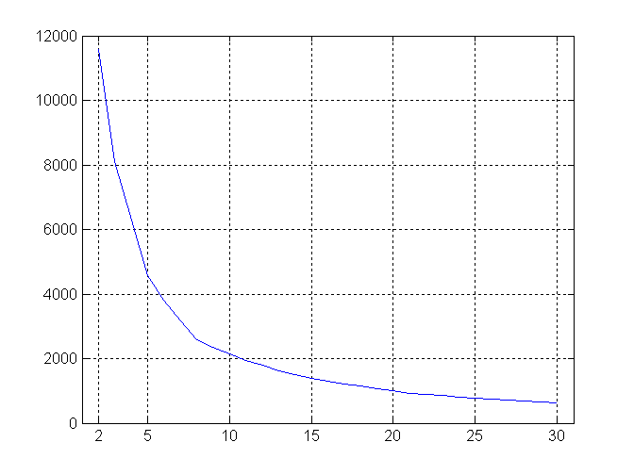
Mean square error (MSE)
5 clusters
10 clusters

Slide 14
From MSE to cluster validity
Minimize within cluster variance (MSE)
Maximize between cluster variance
Inter-cluster variance is maximized
Intra-cluster variance is minimized

Slide 15
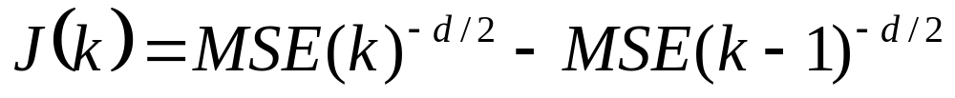
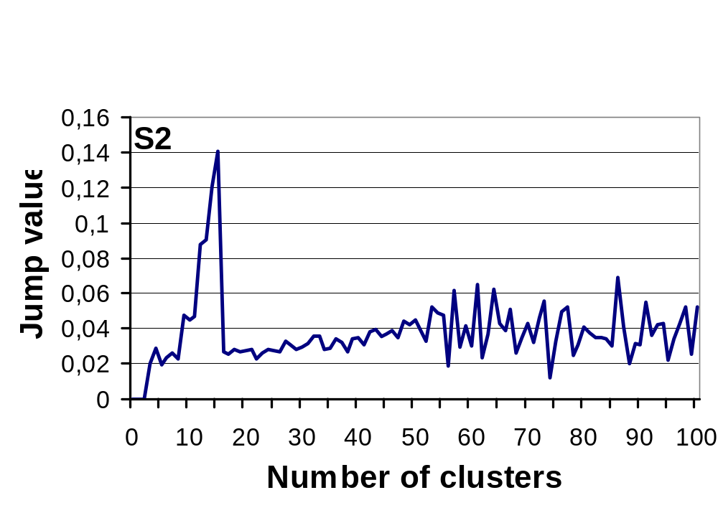
Jump point of MSE
(rate-distortion approach)
First derivative of powered MSE values:
Biggest jump on 15 clusters.

Slide 16
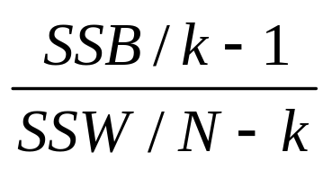
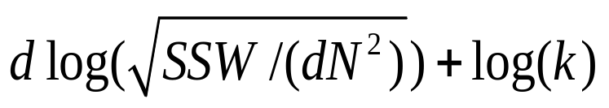
Sum-of-squares based indexes
SSW / k ---- Ball and Hall (1965)
k²|W| ---- Marriot (1971)
---- Calinski & Harabasz (1974)
log(SSB/SSW) ---- Hartigan (1975)
---- Xu (1997)
  (d is the dimension of data; N is the size of data; k is the number of clusters)
  SSW = Sum of squares within the clusters (=MSE)
  SSB = Sum of squares between the clusters

Slide 17
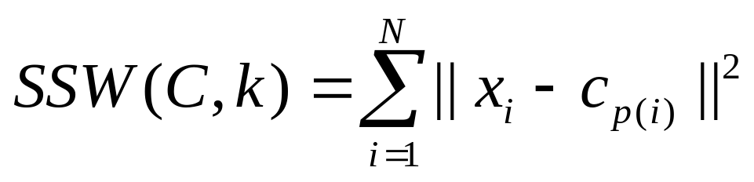
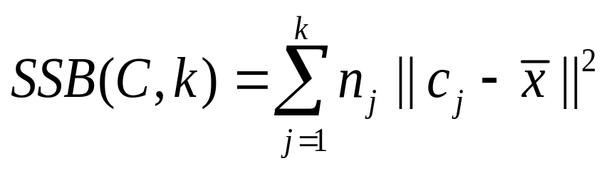
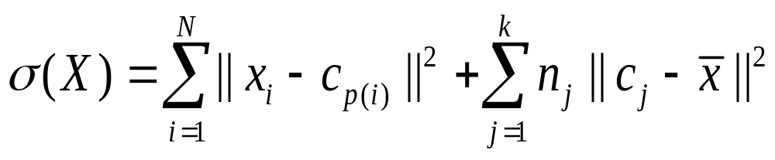
Variances
Within cluster:
Between clusters:
Total Variance of data set:
SSW
SSB

Slide 18
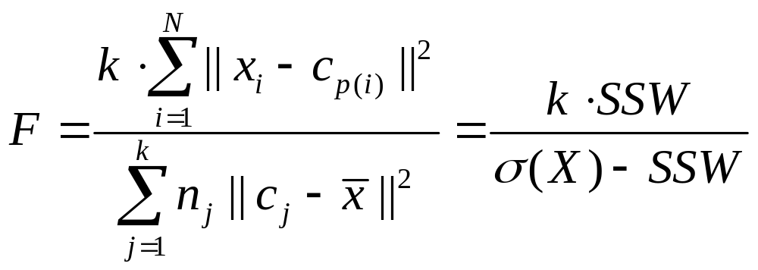
F-ratio variance test
Variance-ratio F-test
Measures ratio of between-groups variance against the within-groups variance (original f-test)
F-ratio (WB-index):
SSB

Slide 19
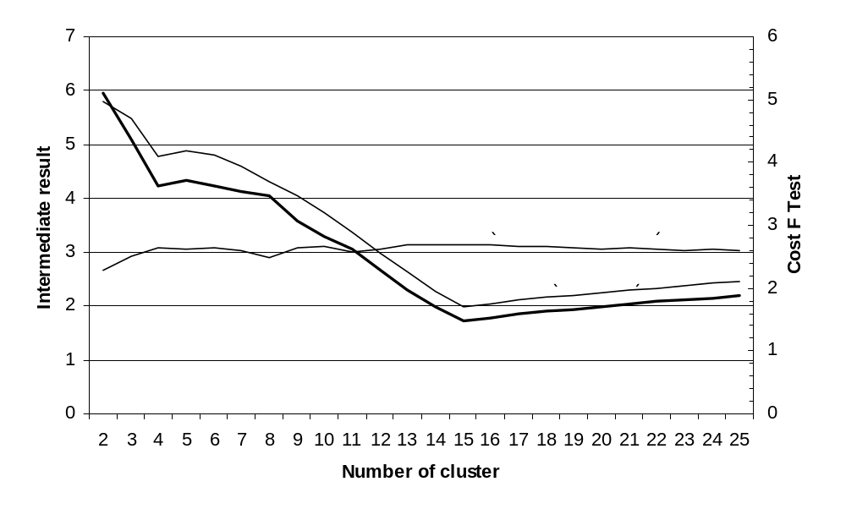
Calculation of F-ratio

Slide 20
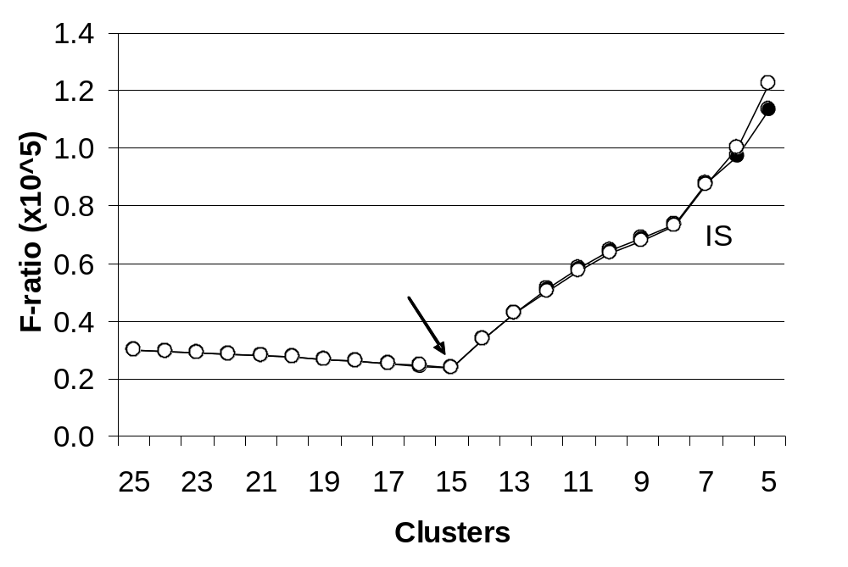
F-ratio for dataset S1

Slide 21
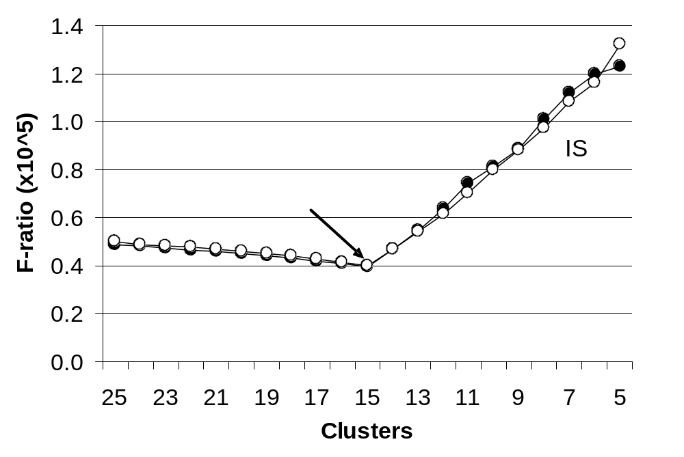
F-ratio for dataset S2

Slide 22
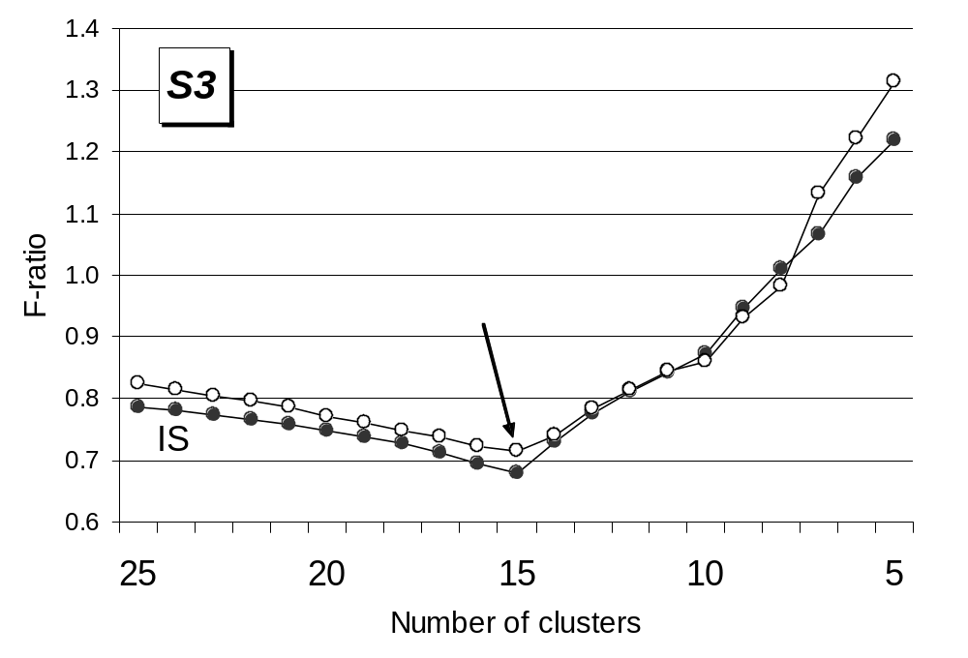
F-ratio for dataset S3

Slide 23
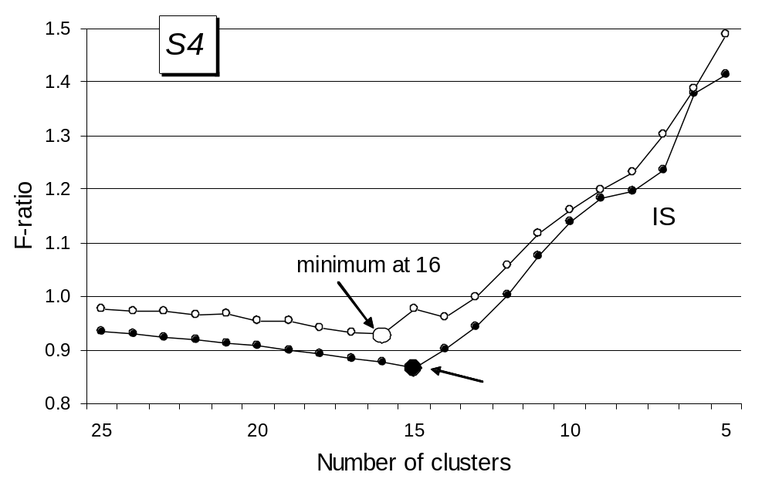
F-ratio for dataset S4

Slide 24
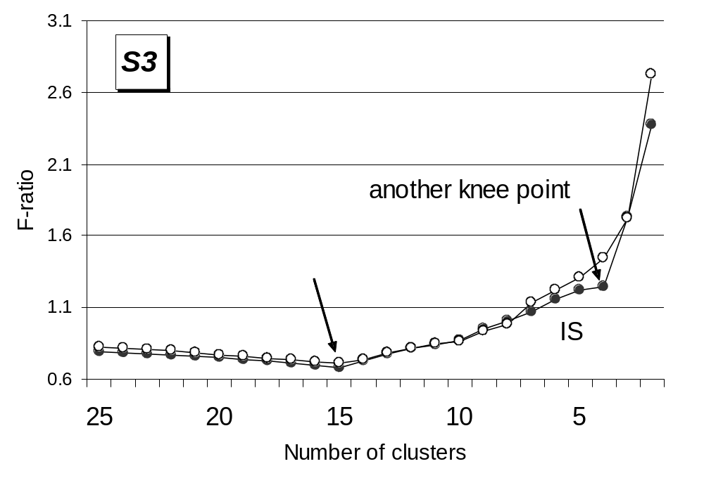
Extension of the F-ratio for S3

Slide 25
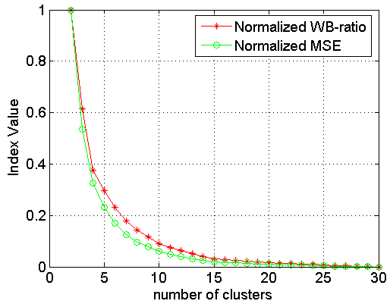
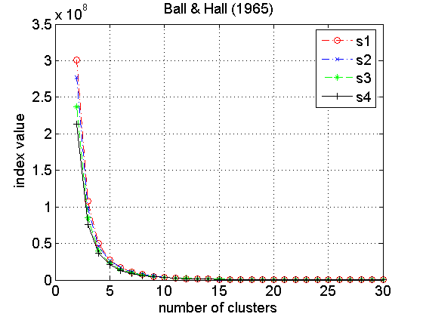
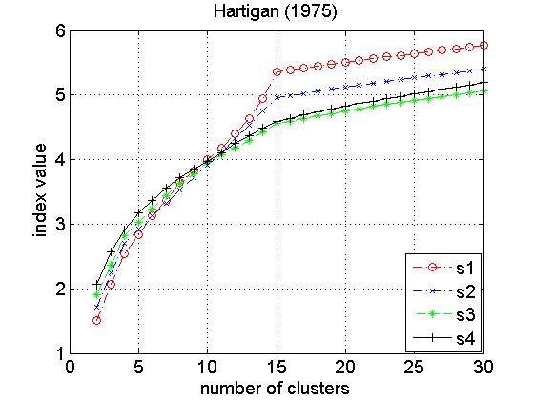
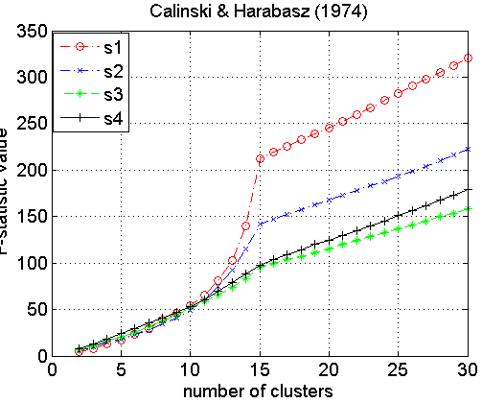
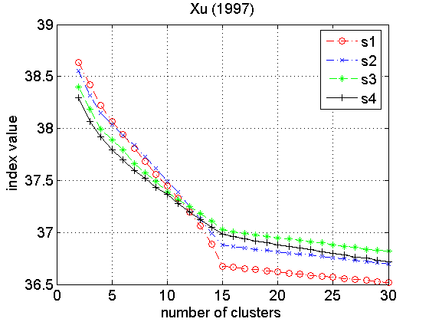
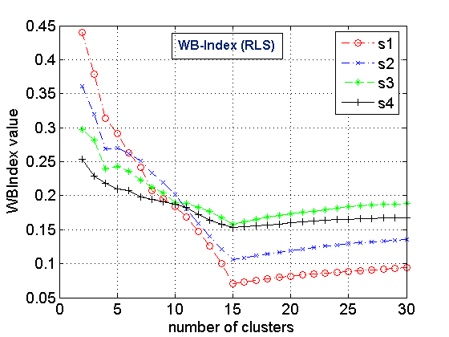
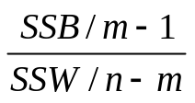

Sum-of-square based index
SSW / SSB & MSE
SSW / m
log(SSB/SSW)
m* SSW/SSB

Slide 26
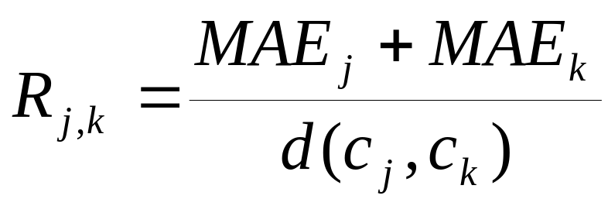
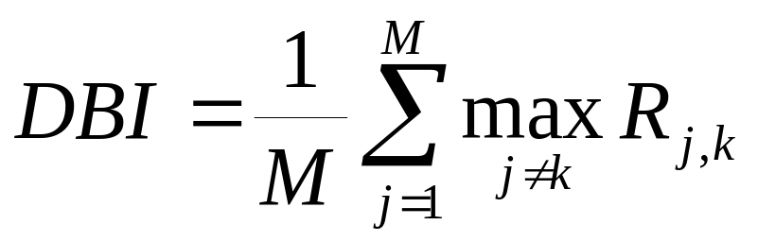
Davies-Bouldin index (DBI)
Minimize intra cluster variance
Maximize the distance between clusters
Cost function weighted sum of the two:

Slide 27
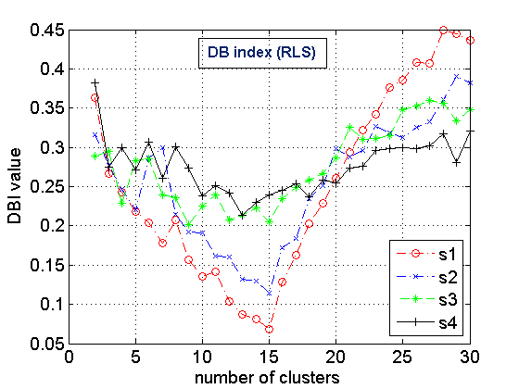
Davies-Bouldin index (DBI)

Slide 28
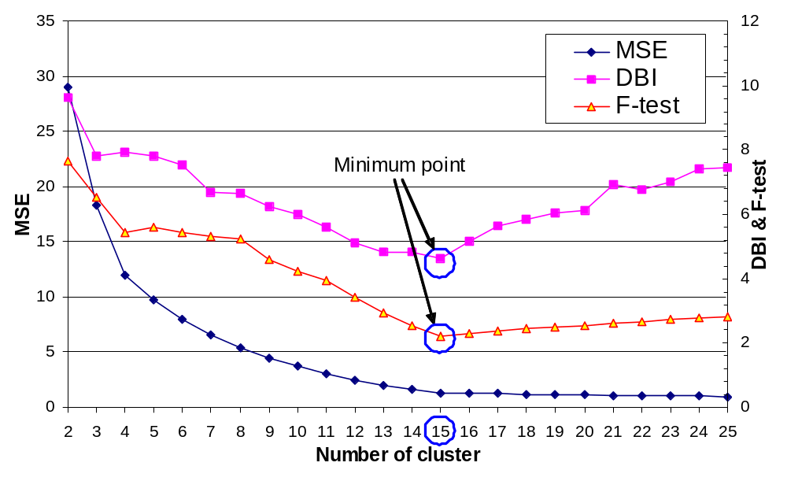
Measured values for S2

Slide 29
Silhouette coefficient
[Kaufman&Rousseeuw, 1990]
Cohesion: measures how closely related are objects in a cluster
Separation: measure how distinct or well-separated a cluster is from other clusters
cohesion
separation

Slide 30
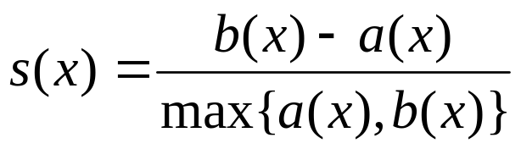
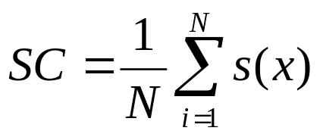
Silhouette coefficient
Cohesion a(x): average distance of x to all other vectors in the same cluster.
Separation b(x): average distance of x to the vectors in other clusters. Find the minimum among the clusters.
silhouette s(x):
s(x) = [-1, +1]: -1=bad, 0=indifferent, 1=good
Silhouette coefficient (SC):

Slide 31
Silhouette coefficient
x
x
cohesion
a(x): average distance in the cluster
separation
b(x): average distances to others clusters, find minimal

Slide 32
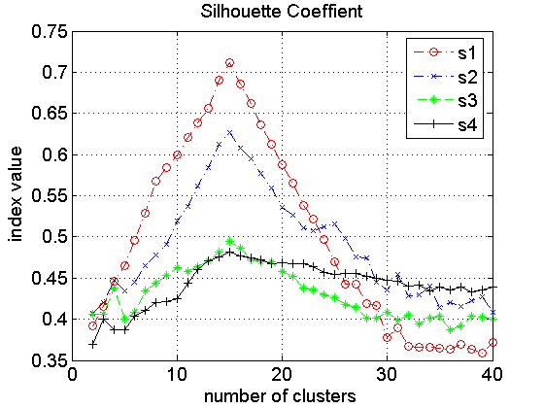
Performance of
Silhouette coefficient

Slide 33
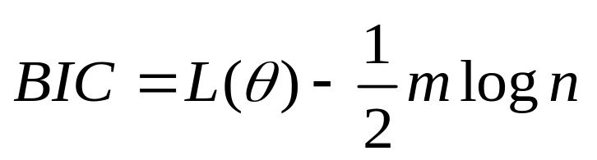
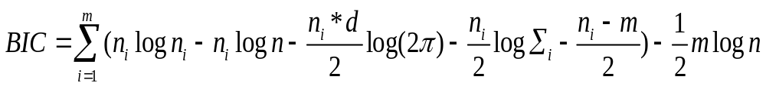
Bayesian information criterion (BIC)
BIC= Bayesian Information Criterion
  L(θ) -- log-likelihood function of all models;
  n -- size of data set;
  m -- number of clusters
  Under spherical Gaussian assumption, we get :
Formula of BIC in partitioning-based clustering
  d -- dimension of the data set
  n_{i} -- size of the i^{th} cluster
  ∑ _{i} -- covariance of i^{th} cluster

Slide 34
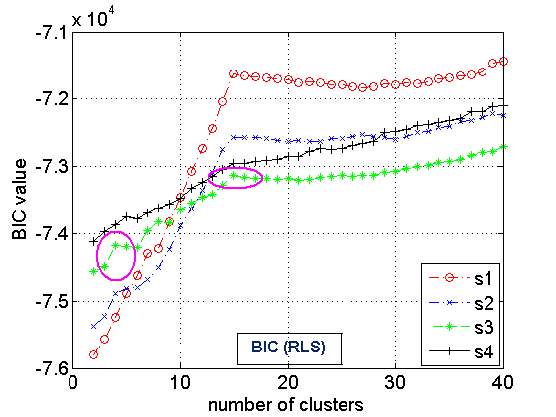
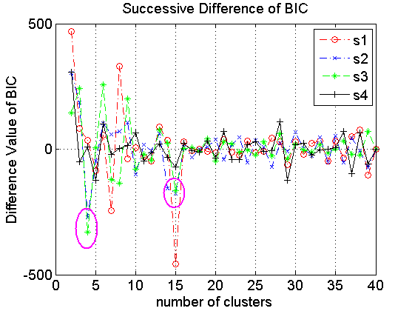
Knee Point Detection on BIC
Original BIC = F(m)
SD(m) = F(m-1) + F(m+1) – 2∙F(m)

Slide 35
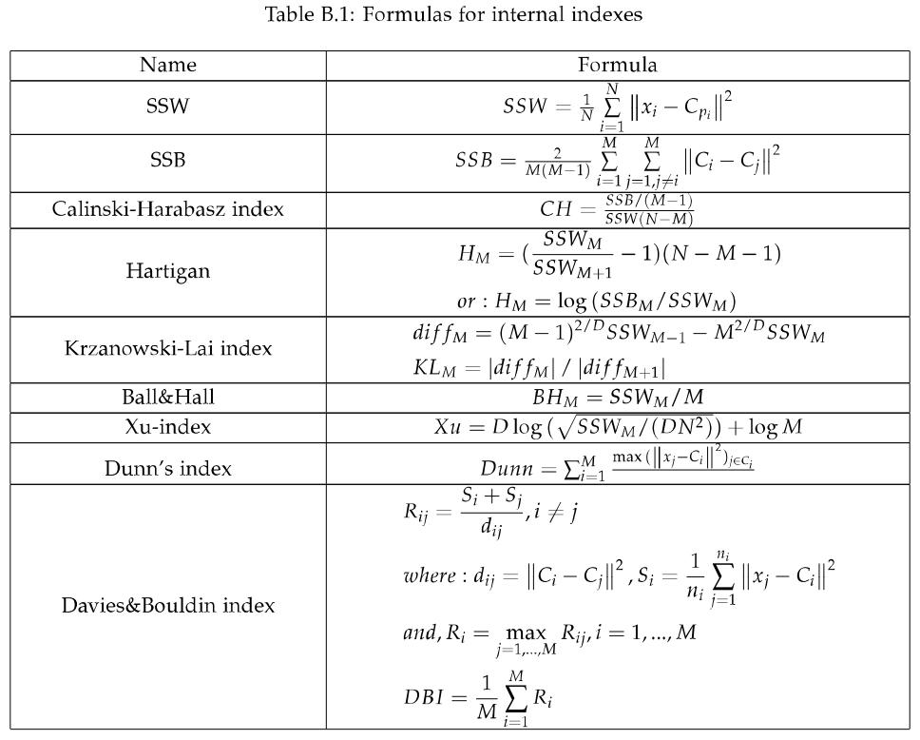
Internal indexes

Slide 36
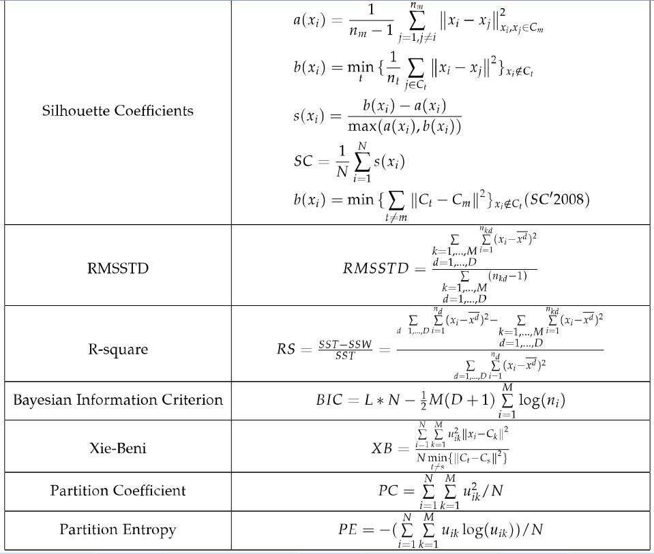
Internal indexes
Soft partitions

Slide 37
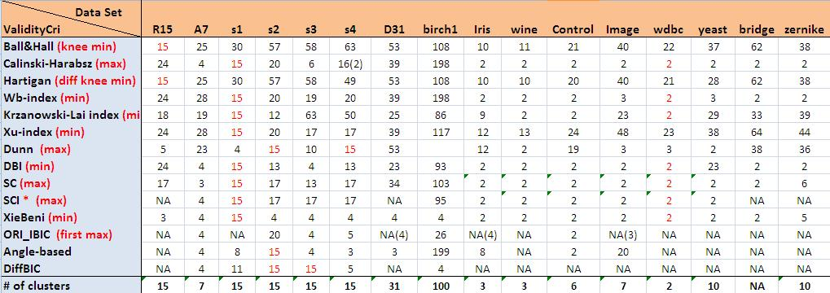
Comparison of the indexes
K-means

Slide 38
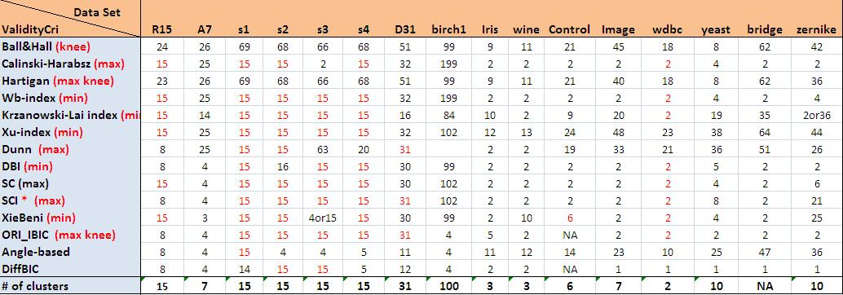
Comparison of the indexes
Random Swap

Slide 39
Part III:
Stochastic complexity for
binary data

Slide 40
Stochastic complexity
Principle of minimum description length (MDL): find clustering C that can be used for describing the data with minimum information.
Data = Clustering + description of data.
Clustering defined by the centroids.
Data defined by:
  which cluster (partition index)
  where in cluster (difference from centroid)

Slide 41
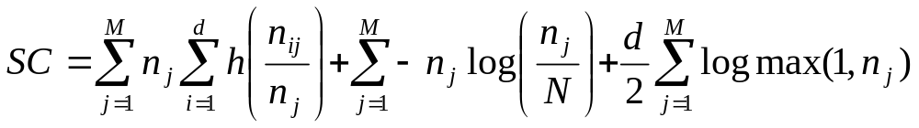
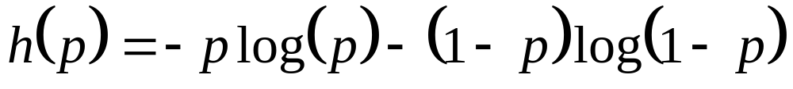
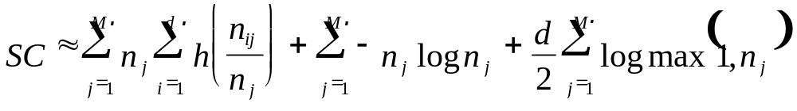
Solution for binary data
where
This can be simplified to:

Slide 42
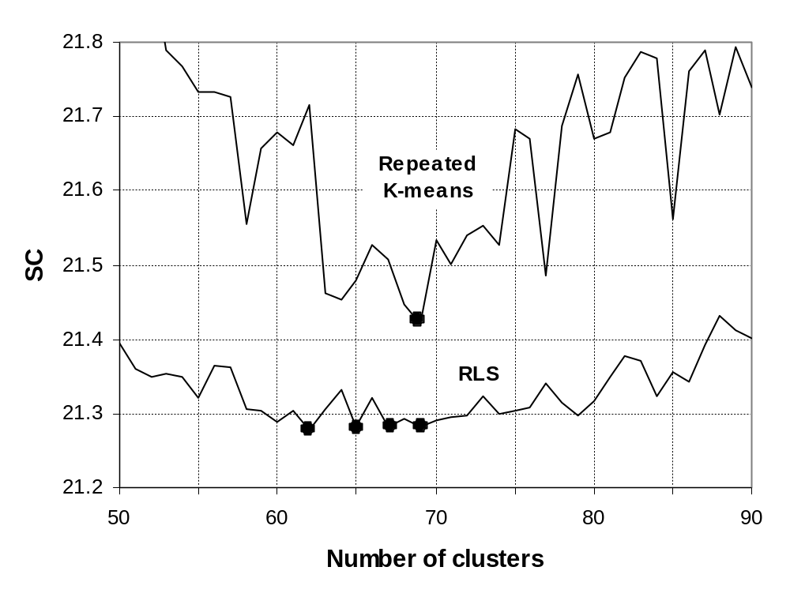
Number of clusters by stochastic complexity (SC)

Slide 43
Part IV:
External indexes

Slide 44




Pair-counting measures
Measure the number of pairs that are in:
  Same class both in P and G.
  Same class in P but different in G.
  Different classes in P but same in G.
  Different classes both in P and G.
G
P
a
a
b
d
b
d
c
c

Slide 45


Rand and Adjusted Rand index
[Rand, 1971] [Hubert and Arabie, 1985]
G
P
Agreement: a, d
Disagreement: b, c
a
a
b
d
b
d
c
c

Slide 46

External indexes
If true class labels (ground truth) are known, the validity of a clustering can be verified by comparing the class labels and clustering labels.
n_{ij} = number of objects in class i and cluster j

Slide 47
Rand statistics
Visual example

Slide 48

Pointwise measures

Slide 49
Rand index
(example)
Vectors assigned to: | Same cluster | Different clusters
Same cluster in ground truth | 20 | 24
Different clusters in ground truth | 20 | 72
Rand index = (20+72) / (20+24+20+72) = 92/136 = 0.68
Adjusted Rand = (to be calculated) = 0.xx

Slide 50
External indexes
Pair counting
Information theoretic
Set matching

Slide 51
Pair-counting measures
Agreement: a, d
Disagreement: b, c
G
P
a
a
b
d
b
d
c
c
Rand Index:
Adjusted Rand Index:

Slide 52










Information-theoretic measures
- Based on the concept of entropy
- Mutual Information (MI) measures the information that two clusterings share and Variation of Information (VI) is the complement of MI

Slide 53
Set-matching measures
Categories
  Point-level
  Cluster-level
Three problems
  How to measure the similarity of two clusters?
  How to pair clusters?
  How to calculate overall similarity?

Slide 54



Similarity of two clusters
P₁
n₁=1000
Jaccard
P₃
n₃=200
P₂
n₂=250
Sorensen-Dice
Braun-Banquet
 | P2, P3 | P2, P1
Criterion H/NVD/CSI | 200 | 250
J | 0.80 | 0.25
SD | 0.89 | 0.40
BB | 0.80 | 0.25

Slide 55
Pairing
Matching problem in weighted bipartite graph
G
P
G
P
P₁
G₁
G₂
P₂
G₃
P₃

Slide 56
Pairing
Matching or Pairing?
Algorithms
  Greedy
  Optimal pairing

Slide 57

Normalized Van Dongen
Matching based on number of shared objects
Clustering P: big circles
Clustering G: shape of objects

Slide 58






Pair Set Index (PSI)
  - Similarity of two clusters
  j: the index of paired cluster with P_{i}
  _{- Total SImilarity}
- Optimal pairing using Hungarian algorithm
G_{j}
P_{i}
S=100%
S=50%

Slide 59




Pair Set Index (PSI)
Adjustment for chance
size of clusters in P : n₁>n₂>…>n_{K} size of clusters in G : m₁>m₂>…>m_{K’}

Slide 60
Properties of PSI
Symmetric
Normalized to number of clusters
Normalized to size of clusters
Adjusted
Range in [0,1]
Number of clusters can be different

Slide 61

Random partitioning
Changing number of clusters in P from 1 to 20
G
1
1000
2000
3000
P
Randomly partitioning into two cluster

Slide 62


Linearity property
Enlarging the first cluster
Wrong labeling some part of each cluster
G
1000
2000
3000
P1
1250
2000
3000
P2
2000
3000
P3
2500
3000
P4
3000
G
1000
2000
3000
P1
900
1900
2900
P2
800
1800
2800
P3
500
1500
2500
P4
334
1333
2333

Slide 63

Cluster size imbalance
1
3000
G1
1000
2000
P1
800
1800
3000
1
G2
1000
2000
2500
P2
800
1800
2500

Slide 64

Number of clusters
G1
1000
2000
P1
800
1800
G2
1000
2000
3000
P2
800
1800
2800

Slide 65
Part V:
Cluster-level measure

Slide 66


Comparing partitions of centroids
Point-level differences
Cluster-level mismatches

Slide 67



Centroid index (CI)
[Fränti, Rezaei, Zhao, Pattern Recognition, 2014]
Given two sets of centroids C and C’,
find nearest neighbor mappings (C→C’):
Detect prototypes with no mapping:
Centroid index:
Number of zero mappings!

Slide 68

Example of centroid index
Data S₂
1
1
2
Counts
1
2
1
Mappings
1
1
0
CI = 2
1
1
1
1
1
Index-value equals to the count of zero-mappings
0
Value 1 indicate same cluster

Slide 69

Example of the Centroid index
1
0
1
1
Two clusters
but only one allocated
3
1
Three mapped
into one

Slide 70



Adjusted Rand vs. Centroid index
Merge-based (PNN)
ARI=0.91
CI=0
ARI=0.82
CI=1
Random Swap
K-means
ARI=0.88
CI=1

Slide 71



Centroid index properties
Mapping is not symmetric (C→C’ ≠ C’→C)
Symmetric centroid index:
Pointwise variant (Centroid Similarity Index):
  Matching clusters based on CI
  Similarity of clusters

Slide 72




Centroid index
Distance to ground truth
(2 clusters):
1 ↔ GT CI=1 CSI=0.50
2 ↔ GT CI=1 CSI=0.50
3 ↔ GT CI=1 CSI=0.50
4 ↔ GT CI=1 CSI=0.50
1
1
0.56
1
0.53
1
0.56
3
2
4
0
0.87
0
0.87
1
0.65

Slide 73
Mean Squared Errors
Data set | Clustering quality (MSE)
 | KM | RKM | KM++ | XM | AC | RS | GKM | GA
Bridge | 179.76 | 176.92 | 173.64 | 179.73 | 168.92 | 164.64 | 164.78 | 161.47
House | 6.67 | 6.43 | 6.28 | 6.20 | 6.27 | 5.96 | 5.91 | 5.87
Miss America | 5.95 | 5.83 | 5.52 | 5.92 | 5.36 | 5.28 | 5.21 | 5.10
House | 3.61 | 3.28 | 2.50 | 3.57 | 2.62 | 2.83 | - | 2.44
Birch₁ | 5.47 | 5.01 | 4.88 | 5.12 | 4.73 | 4.64 | - | 4.64
Birch₂ | 7.47 | 5.65 | 3.07 | 6.29 | 2.28 | 2.28 | - | 2.28
Birch₃ | 2.51 | 2.07 | 1.92 | 2.07 | 1.96 | 1.86 | - | 1.86
S₁ | 19.71 | 8.92 | 8.92 | 8.92 | 8.93 | 8.92 | 8.92 | 8.92
S₂ | 20.58 | 13.28 | 13.28 | 15.87 | 13.44 | 13.28 | 13.28 | 13.28
S₃ | 19.57 | 16.89 | 16.89 | 16.89 | 17.70 | 16.89 | 16.89 | 16.89
S₄ | 17.73 | 15.70 | 15.70 | 15.71 | 17.52 | 15.70 | 15.71 | 15.70

Slide 74
Adjusted Rand Index
Data set | Adjusted Rand Index (ARI)
 | KM | RKM | KM++ | XM | AC | RS | GKM | GA
Bridge | 0.38 | 0.40 | 0.39 | 0.37 | 0.43 | 0.52 | 0.50 | 1
House | 0.40 | 0.40 | 0.44 | 0.47 | 0.43 | 0.53 | 0.53 | 1
Miss America | 0.19 | 0.19 | 0.18 | 0.20 | 0.20 | 0.20 | 0.23 | 1
House | 0.46 | 0.49 | 0.52 | 0.46 | 0.49 | 0.49 | - | 1
Birch ₁ | 0.85 | 0.93 | 0.98 | 0.91 | 0.96 | 1.00 | - | 1
Birch ₂ | 0.81 | 0.86 | 0.95 | 0.86 | 1 | 1 | - | 1
Birch ₃ | 0.74 | 0.82 | 0.87 | 0.82 | 0.86 | 0.91 | - | 1
S₁ | 0.83 | 1.00 | 1.00 | 1.00 | 1.00 | 1.00 | 1.00 | 1.00
S₂ | 0.80 | 0.99 | 0.99 | 0.89 | 0.98 | 0.99 | 0.99 | 0.99
S₃ | 0.86 | 0.96 | 0.96 | 0.96 | 0.92 | 0.96 | 0.96 | 0.96
S₄ | 0.82 | 0.93 | 0.93 | 0.94 | 0.77 | 0.93 | 0.93 | 0.93

Slide 75
Normalized Mutual information
Data set | Normalized Mutual Information (NMI)
 | KM | RKM | KM++ | XM | AC | RS | GKM | GA
Bridge | 0.77 | 0.78 | 0.78 | 0.77 | 0.80 | 0.83 | 0.82 | 1.00
House | 0.80 | 0.80 | 0.81 | 0.82 | 0.81 | 0.83 | 0.84 | 1.00
Miss America | 0.64 | 0.64 | 0.63 | 0.64 | 0.64 | 0.66 | 0.66 | 1.00
House | 0.81 | 0.81 | 0.82 | 0.81 | 0.81 | 0.82 | - | 1.00
Birch ₁ | 0.95 | 0.97 | 0.99 | 0.96 | 0.98 | 1.00 | - | 1.00
Birch ₂ | 0.96 | 0.97 | 0.99 | 0.97 | 1.00 | 1.00 | - | 1.00
Birch ₃ | 0.90 | 0.94 | 0.94 | 0.93 | 0.93 | 0.96 | - | 1.00
S₁ | 0.93 | 1.00 | 1.00 | 1.00 | 1.00 | 1.00 | 1.00 | 1.00
S₂ | 0.90 | 0.99 | 0.99 | 0.95 | 0.99 | 0.93 | 0.99 | 0.99
S₃ | 0.92 | 0.97 | 0.97 | 0.97 | 0.94 | 0.97 | 0.97 | 0.97
S₄ | 0.88 | 0.94 | 0.94 | 0.95 | 0.85 | 0.94 | 0.94 | 0.94

Slide 76
Normalized Van Dongen
Data set | Normalized Van Dongen (NVD)
 | KM | RKM | KM++ | XM | AC | RS | GKM | GA
Bridge | 0.45 | 0.42 | 0.43 | 0.46 | 0.38 | 0.32 | 0.33 | 0.00
House | 0.44 | 0.43 | 0.40 | 0.37 | 0.40 | 0.33 | 0.31 | 0.00
Miss America | 0.60 | 0.60 | 0.61 | 0.59 | 0.57 | 0.55 | 0.53 | 0.00
House | 0.40 | 0.37 | 0.34 | 0.39 | 0.39 | 0.34 | - | 0.00
Birch ₁ | 0.09 | 0.04 | 0.01 | 0.06 | 0.02 | 0.00 | - | 0.00
Birch ₂ | 0.12 | 0.08 | 0.03 | 0.09 | 0.00 | 0.00 | - | 0.00
Birch ₃ | 0.19 | 0.12 | 0.10 | 0.13 | 0.13 | 0.06 | - | 0.00
S₁ | 0.09 | 0.00 | 0.00 | 0.00 | 0.00 | 0.00 | 0.00 | 0.00
S₂ | 0.11 | 0.00 | 0.00 | 0.06 | 0.01 | 0.04 | 0.00 | 0.00
S₃ | 0.08 | 0.02 | 0.02 | 0.02 | 0.05 | 0.00 | 0.00 | 0.02
S₄ | 0.11 | 0.04 | 0.04 | 0.03 | 0.13 | 0.04 | 0.04 | 0.04

Slide 77
Centroid Index
Data set | C-Index (CI₂)
 | KM | RKM | KM++ | XM | AC | RS | GKM | GA
Bridge | 74 | 63 | 58 | 81 | 33 | 33 | 35 | 0
House | 56 | 45 | 40 | 37 | 31 | 22 | 20 | 0
Miss America | 88 | 91 | 67 | 88 | 38 | 43 | 36 | 0
House | 43 | 39 | 22 | 47 | 26 | 23 | --- | 0
Birch ₁ | 7 | 3 | 1 | 4 | 0 | 0 | --- | 0
Birch ₂ | 18 | 11 | 4 | 12 | 0 | 0 | --- | 0
Birch ₃ | 23 | 11 | 7 | 10 | 7 | 2 | --- | 0
S₁ | 2 | 0 | 0 | 0 | 0 | 0 | 0 | 0
S₂ | 2 | 0 | 0 | 1 | 0 | 0 | 0 | 0
S₃ | 1 | 0 | 0 | 0 | 0 | 0 | 0 | 0
S₄ | 1 | 0 | 0 | 0 | 1 | 0 | 0 | 0

Slide 78
Centroid Similarity Index
Data set | Centroid Similarity Index (CSI)
 | KM | RKM | KM++ | XM | AC | RS | GKM | GA
Bridge | 0.47 | 0.51 | 0.49 | 0.45 | 0.57 | 0.62 | 0.63 | 1.00
House | 0.49 | 0.50 | 0.54 | 0.57 | 0.55 | 0.63 | 0.66 | 1.00
Miss America | 0.32 | 0.32 | 0.32 | 0.33 | 0.38 | 0.40 | 0.42 | 1.00
House | 0.54 | 0.57 | 0.63 | 0.54 | 0.57 | 0.62 | --- | 1.00
Birch ₁ | 0.87 | 0.94 | 0.98 | 0.93 | 0.99 | 1.00 | --- | 1.00
Birch ₂ | 0.76 | 0.84 | 0.94 | 0.83 | 1.00 | 1.00 | --- | 1.00
Birch ₃ | 0.71 | 0.82 | 0.87 | 0.81 | 0.86 | 0.93 | --- | 1.00
S₁ | 0.83 | 1.00 | 1.00 | 1.00 | 1.00 | 1.00 | 1.00 | 1.00
S₂ | 0.82 | 1.00 | 1.00 | 0.91 | 1.00 | 1.00 | 1.00 | 1.00
S₃ | 0.89 | 0.99 | 0.99 | 0.99 | 0.98 | 0.99 | 0.99 | 0.99
S₄ | 0.87 | 0.98 | 0.98 | 0.99 | 0.85 | 0.98 | 0.98 | 0.98

Slide 79
High quality clustering
 | Method | MSE
GKM | Global K-means | 164.78
RS | Random swap (5k) | 164.64
GA | Genetic algorithm | 161.47
RS_{8M} | Random swap (8M) | 161.02
GAIS-2002 | GAIS | 160.72
+ RS_{1M} | GAIS + RS (1M) | 160.49
+ RS_{8M} | GAIS + RS (8M) | 160.43
GAIS-2012 | GAIS | 160.68
+ RS_{1M} | GAIS + RS (1M) | 160.45
+ RS_{8M} | GAIS + RS (8M) | 160.39
+ PRS | GAIS + PRS | 160.33
+ RS_{8M} + | GAIS + RS (8M) + | 160.28

Slide 80
Centroid index values
Main algorithm: + Tuning 1 + Tuning 2 | RS_{8M} | GAIS 2002 |  |  | GAIS 2012
 | × × | × × | RS_{1M} × | RS_{8M} × | × × | RS_{1M} × | RS_{8M} × | × | RS_{8M}
RS_{8M} | --- | 19 | 19 | 19 | 23 | 24 | 24 | 23 | 22
GAIS (2002) | 23 | --- | 0 | 0 | 14 | 15 | 15 | 14 | 16
+ RS_{1M} | 23 | 0 | --- | 0 | 14 | 15 | 15 | 14 | 13
+ RS_{8M} | 23 | 0 | 0 | --- | 14 | 15 | 15 | 14 | 13
GAIS (2012) | 25 | 17 | 18 | 18 | --- | 1 | 1 | 1 | 1
+ RS_{1M} | 25 | 17 | 18 | 18 | 1 | --- | 0 | 0 | 1
+ RS_{8M} | 25 | 17 | 18 | 18 | 1 | 0 | --- | 0 | 1
+ PRS | 25 | 17 | 18 | 18 | 1 | 0 | 0 | --- | 1
+ RS_{8M} + PRS | 24 | 17 | 18 | 18 | 1 | 1 | 1 | 1 | ---

Slide 81

Summary of external indexes
(existing measures)

Slide 83
Part VI:
Efficient implementation

Slide 84
Strategies for efficient search
Brute force: solve clustering for all possible number of clusters.
Stepwise: as in brute force but start using previous solution and iterate less.
Criterion-guided search: Integrate cost function directly into the optimization function.

Slide 85

Brute force search strategy
Search for each separately
100 %
Number of clusters

Slide 86

Stepwise search strategy
Start from the previous result
30-40 %
Number of clusters

Slide 87

Criterion guided search
Integrate with the cost function!
3-6 %
Number of clusters

Slide 88


Stopping criterion for
stepwise search strategy

Slide 89

Comparison of search strategies

Slide 90
Open questions
Iterative algorithm (K-means or Random Swap) with criterion-guided search
… or …
Hierarchical algorithm ???
Potential topic for MSc or PhD thesis !!!

Slide 91
Literature
G.W. Milligan, and M.C. Cooper, “An examination of procedures for determining the number of clusters in a data set”, Psychometrika, Vol.50, 1985, pp. 159-179.
E. Dimitriadou, S. Dolnicar, and A. Weingassel, “An examination of indexes for determining the number of clusters in binary data sets”, Psychometrika, Vol.67, No.1, 2002, pp. 137-160.
D.L. Davies and D.W. Bouldin, "A cluster separation measure “, IEEE Transactions on Pattern Analysis and Machine Intelligence, 1(2), 224-227, 1979.
J.C. Bezdek and N.R. Pal, "Some new indexes of cluster validity “, IEEE Transactions on Systems, Man and Cybernetics, 28(3), 302-315, 1998.
H. Bischof, A. Leonardis, and A. Selb, "MDL Principle for robust vector quantization“, Pattern Analysis and Applications, 2(1), 59-72, 1999.
P. Fränti, M. Xu and I. Kärkkäinen, "Classification of binary vectors by using DeltaSC-distance to minimize stochastic complexity", Pattern Recognition Letters, 24 (1-3), 65-73, January 2003.

Slide 92
Literature
G.M. James, C.A. Sugar, "Finding the Number of Clusters in a Dataset: An Information-Theoretic Approach". Journal of the American Statistical Association, vol. 98, 397-408, 2003.
P.K. Ito, Robustness of ANOVA and MANOVA Test Procedures. In: Krishnaiah P. R. (ed), Handbook of Statistics 1: Analysis of Variance. North-Holland Publishing Company, 1980.
I. Kärkkäinen and P. Fränti, "Dynamic local search for clustering with unknown number of clusters", Int. Conf. on Pattern Recognition (ICPR’02), Québec, Canada, vol. 2, 240-243, August 2002.
D. Pellag and A. Moore, "X-means: Extending K-Means with Efficient Estimation of the Number of Clusters", Int. Conf. on Machine Learning (ICML), 727-734, San Francisco, 2000.
S. Salvador and P. Chan, "Determining the Number of Clusters/Segments in Hierarchical Clustering/Segmentation Algorithms", IEEE Int. Con. Tools with Artificial Intelligence (ICTAI), 576-584, Boca Raton, Florida, November, 2004.
M. Gyllenberg, T. Koski and M. Verlaan, "Classification of binary vectors by stochastic complexity ". Journal of Multivariate Analysis, 63(1), 47-72, 1997.

Slide 93
Literature
M. Gyllenberg, T. Koski and M. Verlaan, "Classification of binary vectors by stochastic complexity ". Journal of Multivariate Analysis, 63(1), 47-72, 1997.
X. Hu and L. Xu, "A Comparative Study of Several Cluster Number Selection Criteria", Int. Conf. Intelligent Data Engineering and Automated Learning (IDEAL), 195-202, Hong Kong, 2003.
Kaufman, L. and P. Rousseeuw, 1990. Finding Groups in Data: An Introduction to Cluster Analysis. John Wiley and Sons, London. ISBN: 10:0471878766.
[1.3] M.Halkidi, Y.Batistakis and M.Vazirgiannis: Cluster validity methods: part 1, SIGMOD Rec., Vol.31, No.2, pp.40-45, 2002
R. Tibshirani, G. Walther, T. Hastie. Estimating the number of clusters in a data set via the gap statistic. J.R.Statist. Soc. B(2001) 63, Part 2, pp.411-423.
T. Lange, V. Roth, M, Braun and J. M. Buhmann. Stability-based validation of clustering solutions. Neural Computation. Vol. 16, pp. 1299-1323. 2004.

Slide 94
Literature
Q. Zhao, M. Xu and P. Fränti, "Sum-of-squares based clustering validity index and significance analysis", Int. Conf. on Adaptive and Natural Computing Algorithms (ICANNGA’09), Kuopio, Finland, LNCS 5495, 313-322, April 2009.
Q. Zhao, M. Xu and P. Fränti, "Knee point detection on bayesian information criterion", IEEE Int. Conf. Tools with Artificial Intelligence (ICTAI), Dayton, Ohio, USA, 431-438, November 2008.
W.M. Rand, “Objective criteria for the evaluation of clustering methods,” Journal of the American Statistical Association, 66, 846–850, 1971
L. Hubert and P. Arabie, “Comparing partitions”, Journal of Classification, 2(1), 193-218, 1985.
P. Fränti, M. Rezaei and Q. Zhao, "Centroid index: Cluster level similarity measure", Pattern Recognition, 2014. (accepted)

