Slide 1
Lecture 7: Clustering
Machine Learning
Queens College

Slide 2
Clustering
Unsupervised technique.
Task is to identify groups of similar entities in the available data.
  And sometimes remember how these groups are defined for later use.

Slide 3
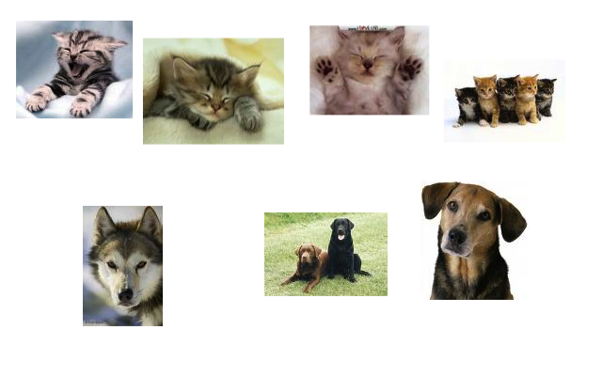
People are outstanding at this

Slide 4
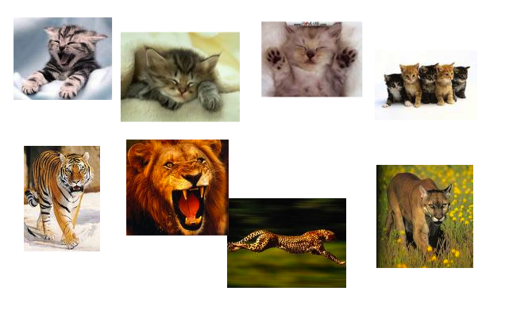
People are outstanding at this

Slide 5
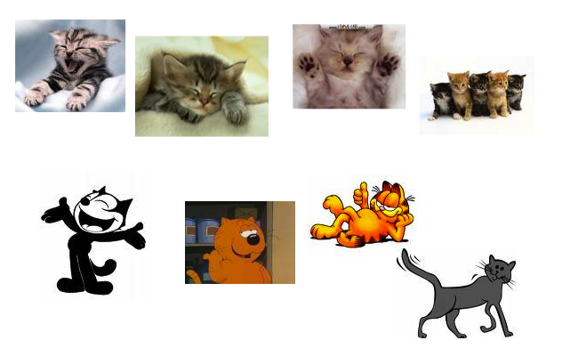
People are outstanding at this

Slide 6
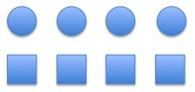
Dimensions of analysis

Slide 7
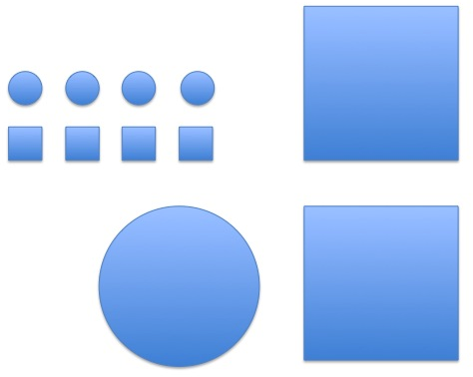
Dimensions of analysis

Slide 8
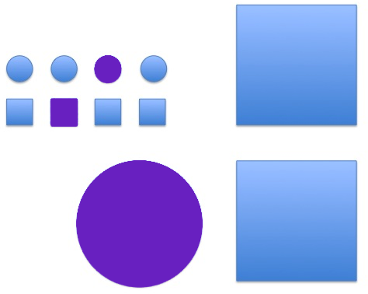
Dimensions of analysis

Slide 9
Dimensions of analysis
Notes:
one area where humans far exceed machine capabilities are in identifying possible dimensions of analysis

Slide 10
How would you do this computationally or algorithmically?
Notes:
we’ll talk about a way in a minute, but let’s start with brainstorming.

Slide 11
Machine Learning Approaches
Possible Objective functions to optimize
  Maximum Likelihood/Maximum A Posteriori
  Empirical Risk Minimization
  Loss function Minimization
  What makes a good cluster?

Slide 12
Cluster Evaluation
Intrinsic Evaluation
  Measure the compactness of the clusters.
  or similarity of data points that are assigned to the same cluster
Extrinsic Evaluation
  Compare the results to some gold standard or labeled data.
  Not covered today.

Slide 13
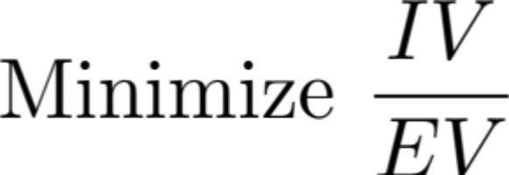
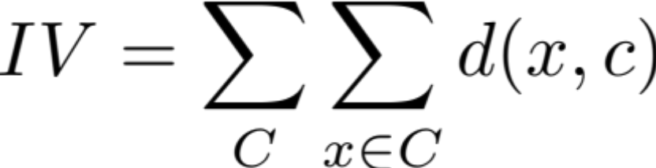
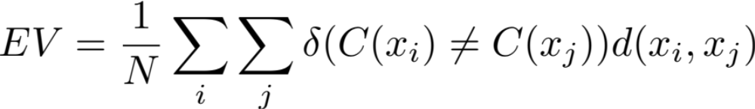
Intrinsic Evaluation cluster variability
Intercluster Variability (IV)
  How different are the data points within the same cluster?
Extracluster Variability (EV)
  How different are the data points in distinct clusters?
Goal: Minimize IV while maximizing EV

Slide 14
Degenerate Clustering Solutions

Slide 15
Degenerate Clustering Solutions

Slide 16
Two approaches to clustering
Hierarchical
  Either merge or split clusters.
Partitional
  Divide the space into a fixed number of regions and position their boundaries appropriately

Slide 17
Hierarchical Clustering

Slide 18
Hierarchical Clustering

Slide 19
Hierarchical Clustering

Slide 20
Hierarchical Clustering

Slide 21
Hierarchical Clustering

Slide 22
Hierarchical Clustering

Slide 23
Hierarchical Clustering

Slide 24
Hierarchical Clustering

Slide 25
Hierarchical Clustering

Slide 26
Hierarchical Clustering

Slide 27
Hierarchical Clustering

Slide 28
Hierarchical Clustering

Slide 29
Agglomerative Clustering

Slide 30
Agglomerative Clustering

Slide 31
Agglomerative Clustering

Slide 32
Agglomerative Clustering

Slide 33
Agglomerative Clustering

Slide 34
Agglomerative Clustering

Slide 35
Agglomerative Clustering

Slide 36
Agglomerative Clustering

Slide 37
Agglomerative Clustering

Slide 38
Agglomerative Clustering

Slide 39
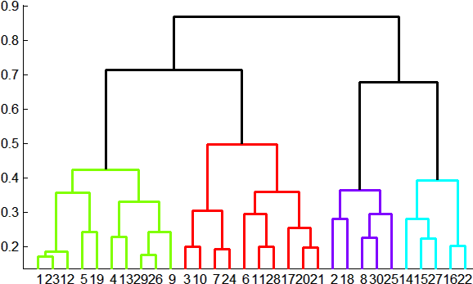
Dendrogram

Slide 40
K-Means
K-Means clustering is a partitional clustering algorithm.
  Identify different partitions of the space for a fixed number of clusters
  Input: a value for K – the number of clusters
  Output: K cluster centroids.

Slide 41
K-Means

Slide 42
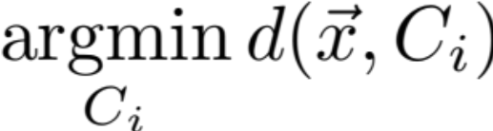
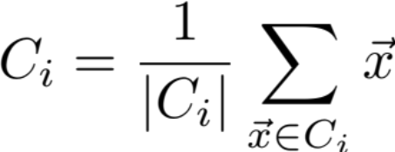
K-Means Algorithm
Given an integer K specifying the number of clusters
Initialize K cluster centroids
  Select K points from the data set at random
  Select K points from the space at random
For each point in the data set, assign it to the cluster center it is closest to
Update each centroid based on the points that are assigned to it
If any data point has changed clusters, repeat

Slide 43
How does K-Means work?
When an assignment is changed, the distance of the data point to its assigned cluster is reduced.
  IV is lower
When a cluster centroid is moved, the mean distance from the centroid to its data points is reduced
  IV is lower.
At convergence, we have found a local minimum of IV

Slide 44
K-means Clustering

Slide 45
K-means Clustering

Slide 46
K-means Clustering

Slide 47
K-means Clustering

Slide 48
K-means Clustering

Slide 49
K-means Clustering

Slide 50
K-means Clustering

Slide 51
K-means Clustering

Slide 52
Potential Problems with
K-Means
Optimal?
  Is the K-means solution optimal?
  K-means approaches a local minimum, but this is not guaranteed to be globally optimal.
Consistent?
  Different seed centroids can lead to different assignments.

Slide 53
Suboptimal K-means Clustering

Slide 54
Inconsistent K-means Clustering

Slide 55
Inconsistent K-means Clustering

Slide 56
Inconsistent K-means Clustering

Slide 57
Inconsistent K-means Clustering

Slide 58
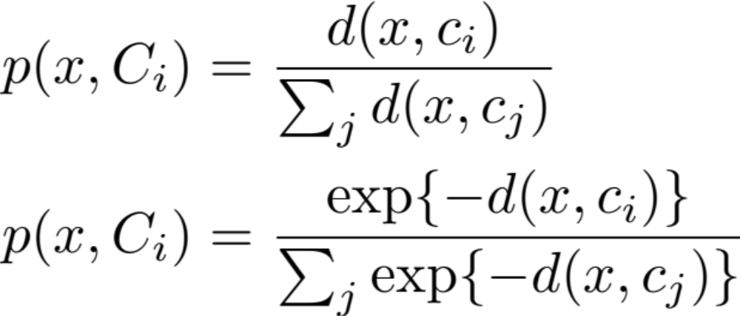
Soft K-means
In K-means, each data point is forced to be a member of exactly one cluster.
What if we relax this constraint?

Slide 59
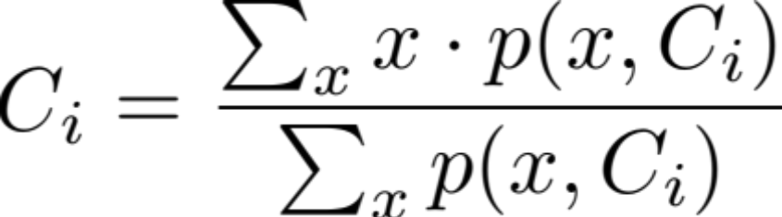
Soft K-means
Still define a cluster by a centroid, but now we calculate a centroid as a weighted center of all data points.
Now convergence is based on a stopping threshold rather than changing assignments

Slide 60
Another problem for K-Means

Slide 61
Next Time
Evaluation for Classification and Clustering
  How do you know if you’re doing well

