Slide 1
Lecture 8: Evaluation
Machine Learning
Queens College

Slide 2
Today
Evaluation Measures
  Accuracy
  Significance Testing
  Cross-validation
  F-Measure
  Error Types
    ROC Curves
    Equal Error Rate
  AIC/BIC

Slide 3
How do you know that you have a good classifier?
Is a feature contributing to overall performance?
Is classifier A better than classifier B?
Internal Evaluation:
  Measure the performance of the classifier.
External Evaluation:
  Measure the performance on a downstream task

Slide 4
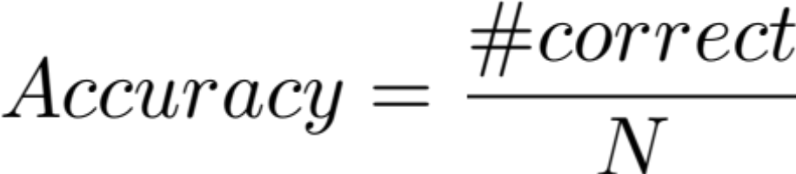
Accuracy
Easily the most common and intuitive measure of classification performance.

Slide 5
Significance testing
Say I have two classifiers.
A = 50% accuracy
B = 75% accuracy
B is better, right?

Slide 6
Significance Testing
Say I have another two classifiers
A = 50% accuracy
B = 50.5% accuracy
Is B better?

Slide 7
Basic Evaluation
Training data – used to identify model parameters
Testing data – used for evaluation
Optionally: Development / tuning data – used to identify model hyperparameters.
Difficult to get significance or confidence values

Slide 8
Cross validation
Identify n “folds” of the available data.
Train on n-1 folds
Test on the remaining fold.
In the extreme (n=N) this is known as
“leave-one-out” cross validation
n-fold cross validation (xval) gives n samples of the performance of the classifier.

Slide 9
Cross-validation visualized
Available Labeled Data
Identify n partitions
Train
Train
Train
Train
Dev
Test
Fold 1

Slide 10
Cross-validation visualized
Available Labeled Data
Identify n partitions
Test
Train
Train
Train
Train
Dev
Fold 2

Slide 11
Cross-validation visualized
Available Labeled Data
Identify n partitions
Dev
Test
Train
Train
Train
Train
Fold 3

Slide 12
Cross-validation visualized
Available Labeled Data
Identify n partitions
Train
Dev
Test
Train
Train
Train
Fold 4

Slide 13
Cross-validation visualized
Available Labeled Data
Identify n partitions
Train
Train
Dev
Test
Train
Train
Fold 5

Slide 14
Cross-validation visualized
Available Labeled Data
Identify n partitions
Train
Train
Train
Dev
Test
Train
Fold 6
Calculate Average Performance

Slide 15
Some criticisms of cross-validation
While the test data is independently sampled, there is a lot of overlap in training data.
  The model performance may be correlated.
  Underestimation of variance.
  Overestimation of significant differences.
One proposed solution is to repeat 2-fold cross-validation 5 times rather than 10-fold cross validation

Slide 16
Significance Testing
Is the performance of two classifiers different with statistical significance?
Means testing
  If we have two samples of classifier performance (accuracy), we want to determine if they are drawn from the same distribution (no difference) or two different distributions.

Slide 17



T-test
One Sample t-test
Independent t-test
  Unequal variances and sample sizes
Once you have a t-value, look up the significance level on a table, keyed on the t-value and degrees of freedom

Slide 18
Significance Testing
Run Cross-validation to get n-samples of the classifier mean.
Use this distribution to compare against either:
  A known (published) level of performance
    one sample t-test
  Another distribution of performance
    two sample t-test
If at all possible, results should include information about the variance of classifier performance.

Slide 19
Significance Testing
Caveat – including more samples of the classifier performance can artificially inflate the significance measure.
  If x and s are constant (the sample represents the population mean and variance) then raising n will increase t.
  If these samples are real, then this is fine. Often cross-validation fold assignment is
  not truly random. Thus subsequent
  xval runs only resample the same
  information.

Slide 20



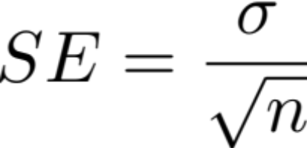

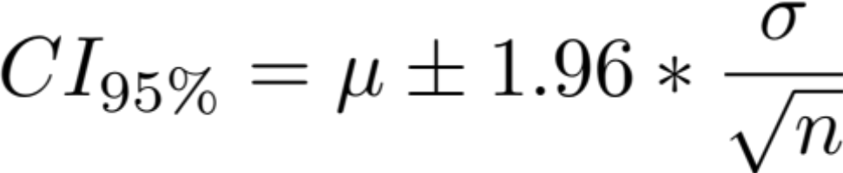
Confidence Bars
Variance information can be included in plots of classifier performance to ease visualization.
Plot standard deviation, standard error or confidence interval?

Slide 21
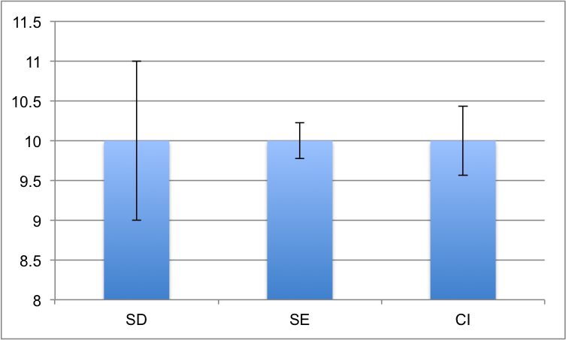
Confidence Bars
Most important to be clear about what is plotted.
95% confidence interval has the clearest interpretation.

Slide 22
Baseline Classifiers
Majority Class baseline
  Every data point is classified as the class that is most frequently represented in the training data
Random baseline
  Randomly assign one of the classes to each data point.
    with an even distribution
    with the training class distribution

Slide 23
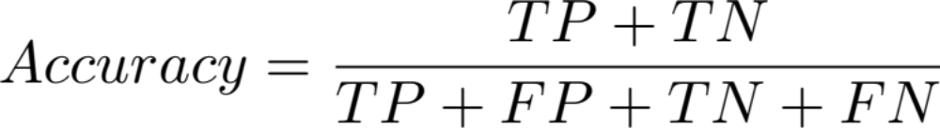
Problems with accuracy
Contingency Table
 |  | True Values
 |  | Positive | Negative
Hyp Values | Positive | True Positive | False Positive
 | Negative | False Negative | True Negative

Slide 24

Problems with accuracy
Information Retrieval Example
  Find the 10 documents related to a query in a set of 100 documents
 |  | True Values
 |  | Positive | Negative
Hyp Values | Positive | 0 | 0
 | Negative | 10 | 90

Slide 25
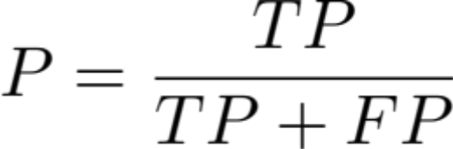
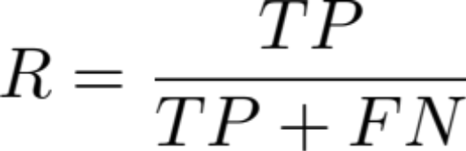
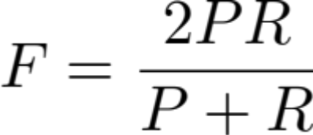
Problems with accuracy
Precision: how many
hypothesized
events were true events
Recall: how many of the true
events were identified
F-Measure: Harmonic mean
of precision and recall
 |  | True Values
 |  | Positive | Negative
Hyp Values | Positive | 0 | 0
 | Negative | 10 | 90

Slide 26
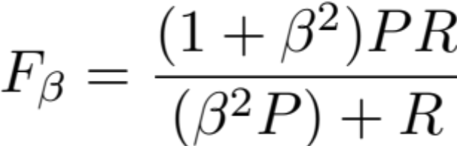
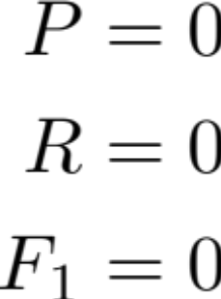
F-Measure
F-measure can be weighted to favor Precision or Recall
  beta > 1 favors recall
  beta < 1 favors precision
 |  | True Values
 |  | Positive | Negative
Hyp Values | Positive | 0 | 0
 | Negative | 10 | 90

Slide 27
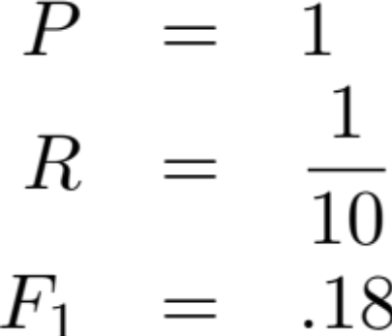
F-Measure
 |  | True Values
 |  | Positive | Negative
Hyp Values | Positive | 1 | 0
 | Negative | 9 | 90

Slide 28
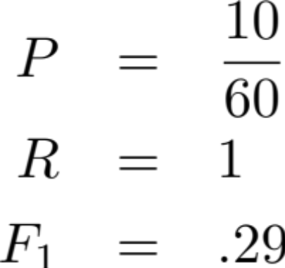
F-Measure
 |  | True Values
 |  | Positive | Negative
Hyp Values | Positive | 10 | 50
 | Negative | 0 | 40

Slide 29
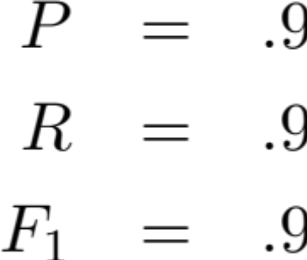
F-Measure
 |  | True Values
 |  | Positive | Negative
Hyp Values | Positive | 9 | 1
 | Negative | 1 | 89

Slide 30
F-Measure
Accuracy is weighted towards majority class performance.
F-measure is useful for measuring the performance on minority classes.

Slide 31
Types of Errors
False Positives
  The system predicted TRUE but the value was FALSE
  aka “False Alarms” or Type I error
False Negatives
  The system predicted FALSE but the value was TRUE
  aka “Misses” or Type II error

Slide 32
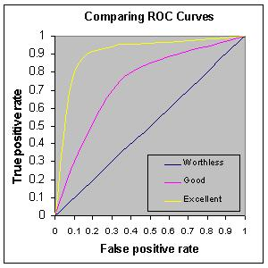
ROC curves
It is common to plot classifier performance at a variety of settings or thresholds
Receiver Operating Characteristic (ROC) curves plot true positives against
false positives.
The overall performance
is calculated by the Area
Under the Curve (AUC)

Slide 33
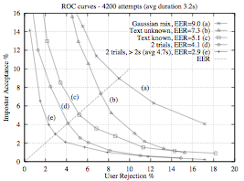
ROC Curves
Equal Error Rate (EER) is commonly reported.
EER represents
the highest
accuracy of the
classifier
Curves provide
more detail
about
performance
Gauvain et al. 1995

Slide 34

Goodness of Fit
Another view of model performance.
Measure the model likelihood of the
unseen data.
However, we’ve seen that model likelihood is likely to improve by adding parameters.
Two information criteria measures include a cost term for the number of parameters in the model

Slide 35
Akaike Information Criterion
Akaike Information Criterion (AIC) based on entropy
The best model has the lowest AIC.
  Greatest model likelihood
  Fewest free parameters
Information in the parameters
Information lost by the modeling

Slide 36
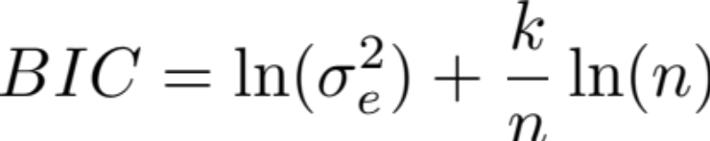
Bayesian Information Criterion
Another penalization term based on Bayesian arguments
  Select the model that is a posteriori most probably with a constant penalty term for wrong models
  If errors are normally distributed.
  Note compares estimated models when x is constant

Slide 37
Next Time
Evaluation for Clustering
  How do you know if you’re doing well

