Slide 1
Lecture 8: Evaluation 2
Clustering evaluation
Machine Learning
Queens College

Slide 2
Today
Cluster Evaluation
  Internal
    We don’t know anything about the desired labels
  External
    We have some information about the labels

Slide 3
Internal Evaluation
Clusters have been identified.
How successful a partitioning of the data set was constructed through clustering?
Internal measures have the quality that they can be directly optimized.

Slide 4
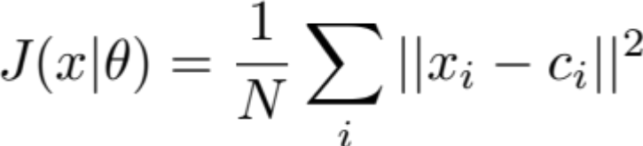
Intracluster variability
How far is a point from its cluster centroid
Intuition: every point assigned to a cluster should be closer to the center of that cluster than any other cluster
K-means optimizes this measure.

Slide 5

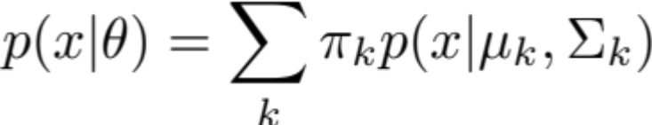
Model Likelihood
Intuition: the model that fits the data best represents the best clustering
Requires a probabilistic model.
Can be included in AIC and BIC measures to limit the number of parameters.
GMM style:

Slide 6
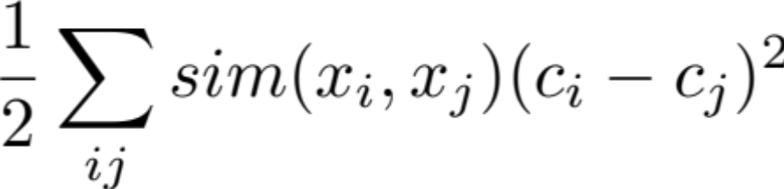
Point similarity vs. Cluster similarity
Intuition: two points that are similar should be in the same cluster
Spectral Clustering optimizes this function.

Slide 7
Internal Cluster Measures
Which cluster measure is best?
  Centroid distance
  Model likelihood
  Point distance
It depends on the data and the task.

Slide 8
External Cluster Evaluation
If you have a little bit of labeled data, unsupervised (clustering) techniques can be evaluated using this knowledge.
Assume for a subset of the data points, you have class labels.
How can we evaluate the success of the clustering?

Slide 9
External Cluster Evaluation
Can’t we use Accuracy?
  or “Why is this hard?”
The number of clusters may not equal the number of classes.
It may be difficult to assign a class to a cluster.

Slide 10
Some principles.
Homogeneity
  Each cluster should include members of as few classes as possible
Completeness
  Each class should be represented in as few clusters as possible.

Slide 11
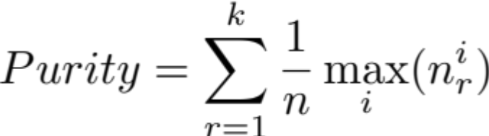
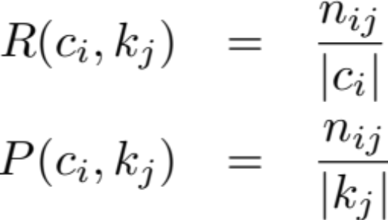
Some approaches
Purity
F-measure
  Cluster definitions of Precision and Recall
  Combined using harmonic
  mean as in traditional
  f-measure
points of class
i in cluster r

Slide 12
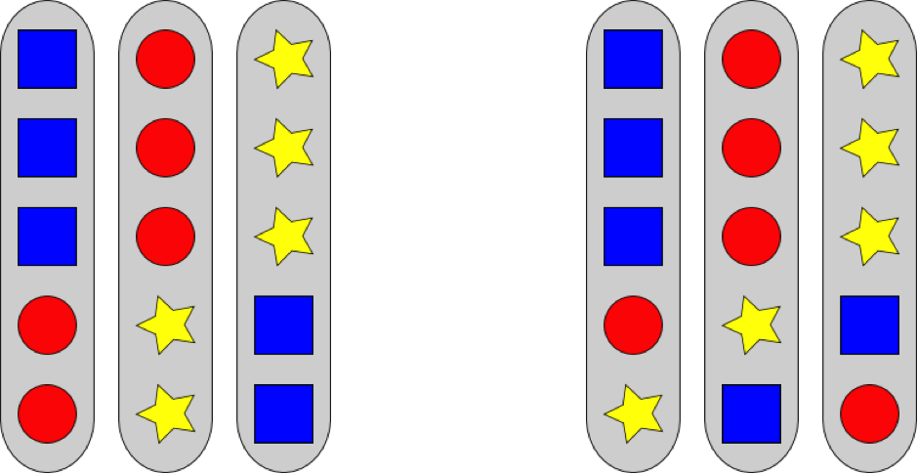
The problem of matching
F-measure: 0.6
F-measure: 0.6

Slide 13
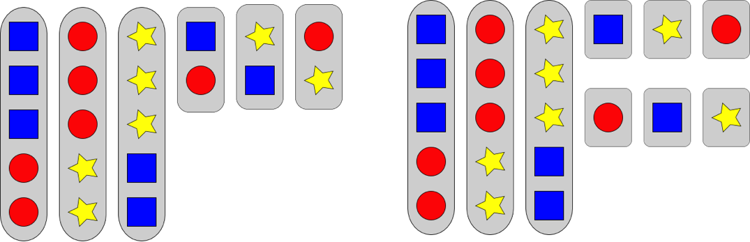
The problem of matching
F-measure: 0.5
F-measure: 0.5

Slide 14
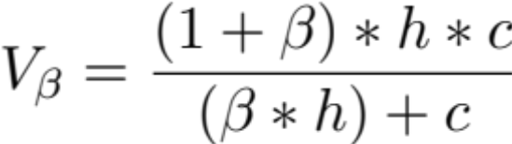
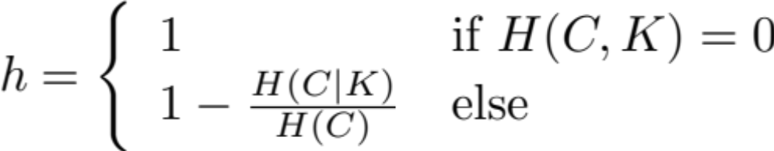
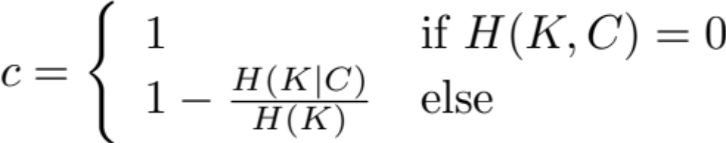
V-Measure
Conditional Entropy based measure to explicitly calculate homogeneity and completeness.

Slide 15
Contingency Matrix
Want to know how much the introduction of clusters is improving the information about the class distribution.
3 | 1 |  |  | 4
 | 1 | 2 | 1 | 4
1 | 1 | 2 |  | 4
 | 1 |  | 3 | 4
4 | 4 | 4 | 4

Slide 16
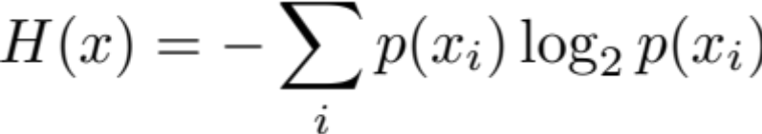
Entropy
Entropy calculates the amount of “information” in a distribution.
Wide distributions have a lot of information
Narrow distributions have very little
Based on Shannon’s limit of the number of bits required to transmit a distribution
Calculation of entropy:

Slide 17
Pair Based Measures
Statistics over every pair of items.
  SS – same cluster, same class
  SD – same cluster, different class
  DS – different cluster, same class
  DD – different cluster different class
These can be arranged in a contingency matrix similar to when accuracy is constructed.

Slide 18
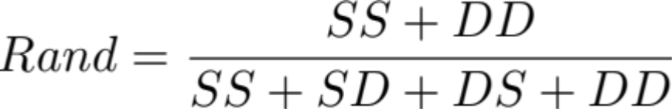
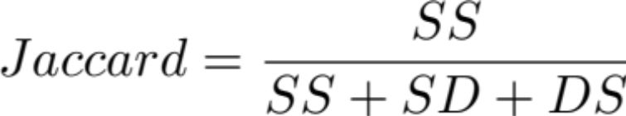
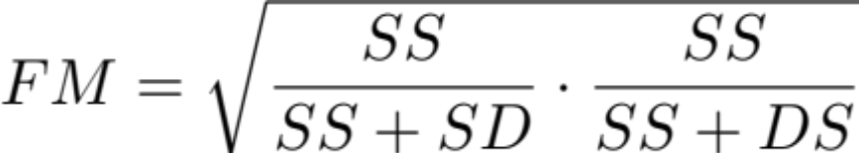
Pair Based Measures
Rand:
Jaccard
Folkes-Mallow

Slide 19
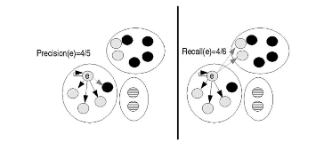
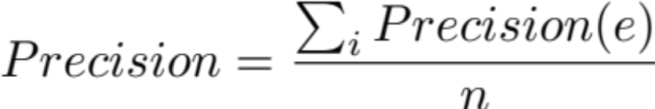
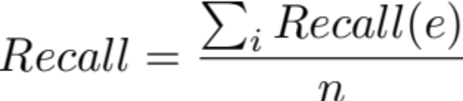
B-cubed
Similar to pair based counting systems, B-cubed calculates an element by element precision and recall.

Slide 20
External Evaluation Measures
There are many choices.
Some should almost certainly never be used
  Purity
  F-measure
Others can be used based on task or other preferences
  V-Measure
  VI
  B-Cubed

Slide 21
Next Time
Support Vector Machines

