Slide 1
Clustering
Clustering of data is a method by which large sets of data is grouped into clusters of smaller sets of similar data.
The example below demonstrates the clustering of balls of same colour. There are a total of 10 balls which are of three different
colours. We are interested in clustering of balls of the three different colours into three different groups.
The balls of same colour are clustered into a group as shown below :
Thus, we see clustering means grouping of data or dividing a large data set into smaller data sets of some similarity.

Slide 2

Clustering Algorithms
A clustering algorithm attempts to find natural groups of components (or data) based on some similarity. Also, the clustering algorithm finds the centroid of a group of data sets.To determine cluster membership, most algorithms evaluate the distance between a point and the cluster centroids. The output from a clustering algorithm is basically a statistical description of the cluster centroids with the number of components in each cluster.

Slide 3


Data Structures
Data matrix
  (two modes)
Dissimilarity matrix
  (one mode)

Slide 4

Cluster Centroid and Distances
Cluster centroid :
The centroid of a cluster is a point whose parameter values are the mean of the parameter values of all the points in the clusters.
Distance
Generally, the distance between two points is taken as a common metric to as sess the similarity among the components of a population. The commonly used dist ance measure is the Euclidean metric which defines the distance between t wo points p= ( p1, p2, ....) and q = ( q1, q2, ....) is given by :

Slide 5
Measure the Quality of Clustering
Dissimilarity/Similarity metric: Similarity is expressed in terms of a distance function, which is typically metric: d(i, j)
There is a separate “quality” function that measures the “goodness” of a cluster.
The definitions of distance functions are usually very different for interval-scaled, boolean, categorical, ordinal and ratio variables.
Weights should be associated with different variables based on applications and data semantics.
It is hard to define “similar enough” or “good enough”
  the answer is typically highly subjective.

Slide 6
Type of data in clustering analysis
Interval-scaled variables:
Binary variables:
Nominal, ordinal, and ratio variables:
Variables of mixed types:

Slide 7


Interval-valued variables
Standardize data
  Calculate the mean absolute deviation:
  where
  Calculate the standardized measurement (z-score)
Using mean absolute deviation is more robust than using standard deviation

Slide 8


Similarity and Dissimilarity Between Objects
Distances are normally used to measure the similarity or dissimilarity between two data objects
Some popular ones include: Minkowski distance:
  where i = (x_{i1}, x_{i2}, …, x_{ip}) and j = (x_{j1}, x_{j2}, …, x_{jp}) are two p-dimensional data objects, and q is a positive integer
If q = 1, d is Manhattan distance

Slide 9

Similarity and Dissimilarity Between Objects (Cont.)
If q = 2, d is Euclidean distance:
  Properties
    d(i,j) ≥ 0
    d(i,i) = 0
    d(i,j) = d(j,i)
    d(i,j) ≤ d(i,k) + d(k,j)
Also one can use weighted distance, parametric Pearson product moment correlation, or other disimilarity measures.

Slide 10



Binary Variables
A contingency table for binary data
Simple matching coefficient (invariant, if the binary variable is symmetric):
Jaccard coefficient (noninvariant if the binary variable is asymmetric):
Object j
Object i

Slide 11


Dissimilarity between Binary Variables
Example
  gender is a symmetric attribute
  the remaining attributes are asymmetric binary
  let the values Y and P be set to 1, and the value N be set to 0

Slide 12

Nominal Variables
A generalization of the binary variable in that it can take more than 2 states, e.g., red, yellow, blue, green
Method 1: Simple matching
  m: # of matches, p: total # of variables
Method 2: use a large number of binary variables
  creating a new binary variable for each of the M nominal states

Slide 13


Ordinal Variables
An ordinal variable can be discrete or continuous
order is important, e.g., rank
Can be treated like interval-scaled
  replacing x_{if} by their rank
  map the range of each variable onto [0, 1] by replacing i-th object in the f-th variable by
  compute the dissimilarity using methods for interval-scaled variables

Slide 14
Ratio-Scaled Variables
Ratio-scaled variable: a positive measurement on a nonlinear scale, approximately at exponential scale, such as Ae^{Bt} or Ae^{-Bt}
Methods:
  treat them like interval-scaled variables — not a good choice! (why?)
  apply logarithmic transformation
y_{if} = log(x_{if})
  treat them as continuous ordinal data treat their rank as interval-scaled.

Slide 15


Variables of Mixed Types
A database may contain all the six types of variables
  symmetric binary, asymmetric binary, nominal, ordinal, interval and ratio.
One may use a weighted formula to combine their effects.
  f is binary or nominal:
    d_{ij}^{(f)} = 0 if x_{if} = x_{jf} , or d_{ij}^{(f)} = 1 o.w.
  f is interval-based: use the normalized distance
  f is ordinal or ratio-scaled
    compute ranks r_{if} and
    and treat z_{if} as interval-scaled

Slide 16
Distance-based Clustering
Assign a distance measure between data
Find a partition such that:
  Distance between objects within partition (I.e. same cluster) is minimized
  Distance between objects from different clusters is maximised
Issues :
  Requires defining a distance (similarity) measure in situation where it is unclear how to assign it
  What relative weighting to give to one attribute vs another?
  Number of possible partition us superexponential

Slide 17
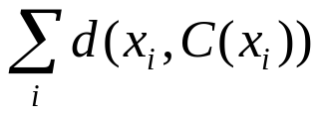
K-Means Clustering
This method initially takes the number of components of the population equal to the final required number of clusters. In this step itself the final required number of clusters is chosen such that the points are mutually farthest apart. Next, it examines each component in the population and assigns it to one of the clusters depending on the minimum distance. The centroid's position is recalculated everytime a component is added to the cluster and this continues until all the components are grouped into the final required number of clusters.
Basic Ideas : using cluster centre (means) to represent cluster
Assigning data elements to the closet cluster (centre).
Goal: Minimise square error (intra-class dissimilarity) : =
Variations of K-Means
  Initialisation (select the number of clusters, initial partitions)
  Updating of center
  Hill-climbing (trying to move an object to another cluster).

Slide 18
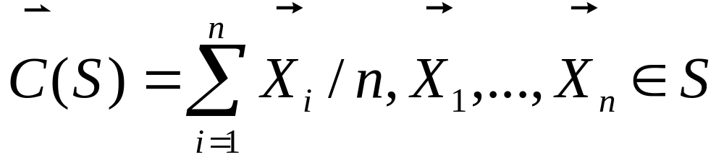
K-Means Clustering Algorithm
1) Select an initial partition of k clusters
2) Assign each object to the cluster with the closest center:
3) Compute the new centers of the clusters:
4) Repeat step 2 and 3 until no object changes cluster

Slide 19

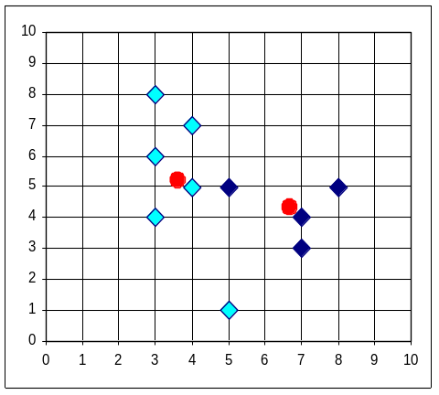


The K-Means Clustering Method
Example

Slide 20
Comments on the K-Means Method
Strength
  Relatively efficient: O(tkn), where n is # objects, k is # clusters, and t is # iterations. Normally, k, t << n.
  Often terminates at a local optimum. The global optimum may be found using techniques such as: deterministic annealing and genetic algorithms
Weakness
  Applicable only when mean is defined, then what about categorical data?
  Need to specify k, the number of clusters, in advance
  Unable to handle noisy data and outliers
  Not suitable to discover clusters with non-convex shapes

Slide 21
Variations of the K-Means Method
A few variants of the k-means which differ in
  Selection of the initial k means
  Dissimilarity calculations
  Strategies to calculate cluster means
Handling categorical data: k-modes (Huang’98)
  Replacing means of clusters with modes
  Using new dissimilarity measures to deal with categorical objects
  Using a frequency-based method to update modes of clusters
  A mixture of categorical and numerical data: k-prototype method

Slide 22
Hierarchical Clustering
Given a set of N items to be clustered, and an NxN distance (or similarity) matrix, the basic process hierarchical clustering is this:
1.Start by assigning each item to its own cluster, so that if you have N items, you now have N clusters, each containing just one item. Let the distances (similarities) between the clusters equal the distances (similarities) between the items they contain.
2.Find the closest (most similar) pair of clusters and merge them into a single cluster, so that now you have one less cluster.
3.Compute distances (similarities) between the new cluster and each of the old clusters.
4.Repeat steps 2 and 3 until all items are clustered into a single cluster of size N.

Slide 23
Hierarchical Clustering
Use distance matrix as clustering criteria. This method does not require the number of clusters k as an input, but needs a termination condition
Step 0
Step 1
Step 2
Step 3
Step 4
agglomerative
(AGNES)
a
a b
b
a b c d e
c
c d e
d
d e
e
divisive
(DIANA)
Step 4
Step 3
Step 2
Step 1
Step 0

Slide 24
More on Hierarchical Clustering Methods
Major weakness of agglomerative clustering methods
  do not scale well: time complexity of at least O(n²), where n is the number of total objects
  can never undo what was done previously
Integration of hierarchical with distance-based clustering
  BIRCH (1996): uses CF-tree and incrementally adjusts the quality of sub-clusters
  CURE (1998): selects well-scattered points from the cluster and then shrinks them towards the center of the cluster by a specified fraction
  CHAMELEON (1999): hierarchical clustering using dynamic modeling

Slide 25

AGNES (Agglomerative Nesting)
Introduced in Kaufmann and Rousseeuw (1990)
Implemented in statistical analysis packages, e.g., Splus
Use the Single-Link method and the dissimilarity matrix.
Merge nodes that have the least dissimilarity
Go on in a non-descending fashion
Eventually all nodes belong to the same cluster

Slide 26
A Dendrogram Shows How the Clusters are Merged Hierarchically
  Decompose data objects into a several levels of nested partitioning (tree of clusters), called a dendrogram.
  A clustering of the data objects is obtained by cutting the dendrogram at the desired level, then each connected component forms a cluster.

Slide 27
DIANA (Divisive Analysis)
Introduced in Kaufmann and Rousseeuw (1990)
Implemented in statistical analysis packages, e.g., Splus
Inverse order of AGNES
Eventually each node forms a cluster on its own

Slide 28
Computing Distances
single-link clustering (also called the connectedness or minimum method) : we consider the distance between one cluster and another cluster to be equal to the shortest distance from any member of one cluster to any member of the other cluster. If the data consist ofsimilarities, we consider the similarity between one cluster and another cluster to be equal to the greatest similarity from any member of one cluster to any member of the other cluster.
complete-link clustering (also called the diameter or maximum method): we consider the distance between one cluster and another cluster to be equal to the longest distance from any member of one cluster to any member of the other cluster.
average-link clustering : we consider the distance between one cluster and another cluster to be equal to the average distance from any member of one cluster to any member of the other cluster.

Slide 29
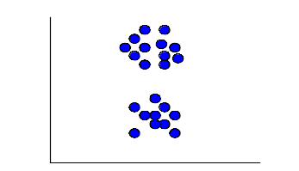
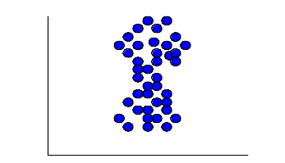
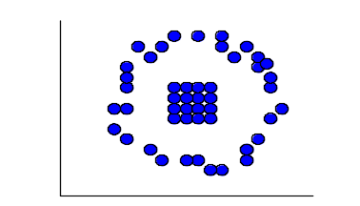
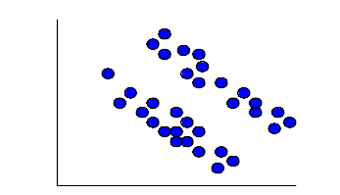
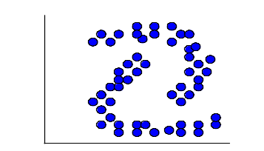
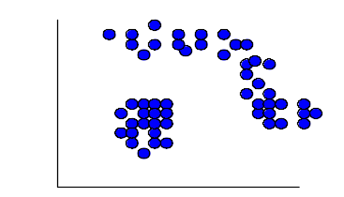
Distance Between Two Clusters
single-link clustering (also called the connectedness or minimum method) : we consider the distance between one cluster and another cluster to be equal to the shortest distance from any member of one cluster to any member of the other cluster. If the data consist of similarities, we consider the similarity between one cluster and another cluster to be equal to the greatest similarity from any member of one cluster to any member of the other cluster.
complete-link clustering (also called the diameter or maximum method): we consider the distance between one cluster and another cluster to be equal to the longest distance from any member of one cluster to any member of the other cluster.
average-link clustering : we consider the distance between one cluster and another cluster to be equal to the average distance from any member of one cluster to any member of the other cluster.
Min
distance
Average
distance
Max
distance
Single-Link Method / Nearest Neighbor
Complete-Link / Furthest Neighbor
Their Centroids.
Average of all cross-cluster pairs.

Slide 30
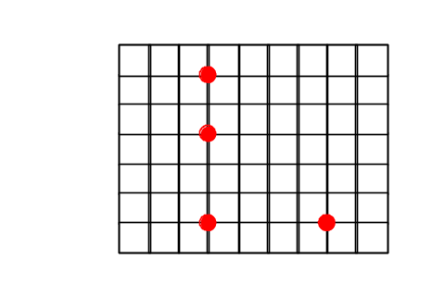
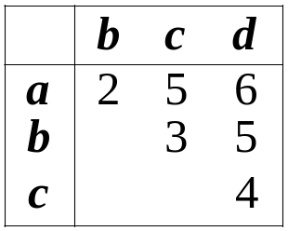
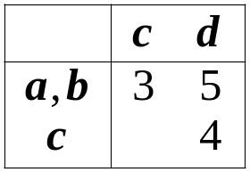
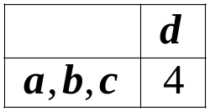
Single-Link Method
Euclidean Distance
a
a,b
b
a,b,c
a,b,c,d
c
d
c
d
d
(1)
(2)
(3)
Distance Matrix

Slide 31
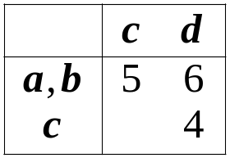
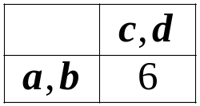
Complete-Link Method
Euclidean Distance
a
a,b
a,b
b
a,b,c,d
c,d
c
d
c
d
(1)
(2)
(3)
Distance Matrix

Slide 32
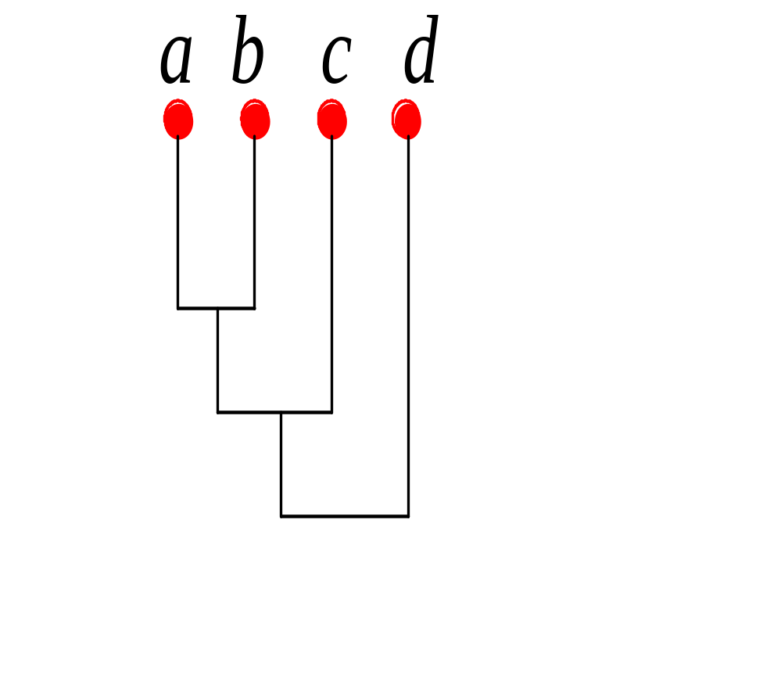
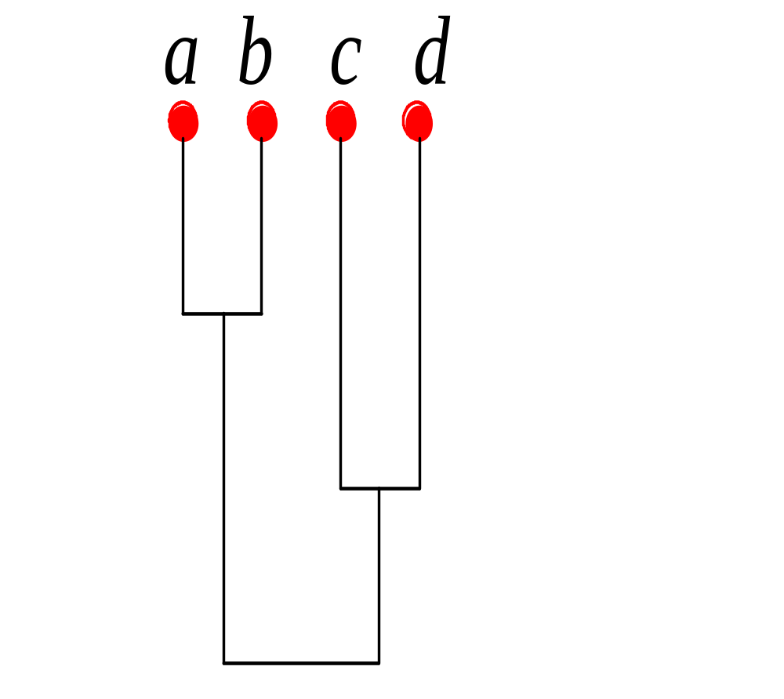
Compare Dendrograms
Single-Link
Complete-Link
0
2
4
6

Slide 33
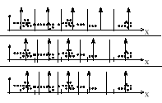
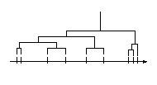
K-Means vs Hierarchical Clustering

