Slide 1
Study Case B2W Challenge
Lucas Massaroppe

Slide 2
overview
1. Motivating problem
2. 'SALES.CSV' DATASET
3. 'comp_prices.CSV' DATASET
4. conclusions

Slide 3
Motivating problem
Adjust/optimize the relationship between Price and Demand
Achieve commercial targets

Slide 4
But How?

Slide 5
Motivating problem
Analyzing two datasets:
'sales.cvs': contains B2W's transactional information from 9 different products;
'comp_prices.csv': contains 6 competitors' information from the same 9 different product;
Data available for the year of 2015.

Slide 6
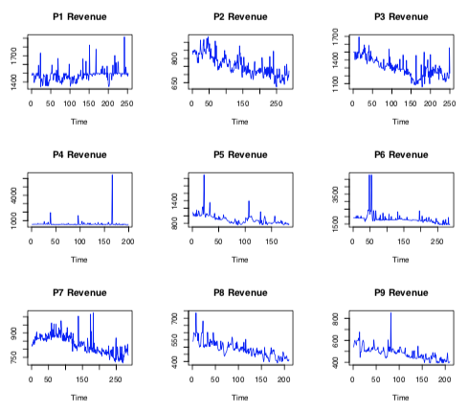
'sales.csv' dataset
Plot of the products revenue

Slide 7
'SALES.CSV' DATASET
KPSS Test:
Although only three have stationary behavior, the KPSS test suggests that we treat the set as non-stationary in the trend;
Nonlinear.

Slide 8
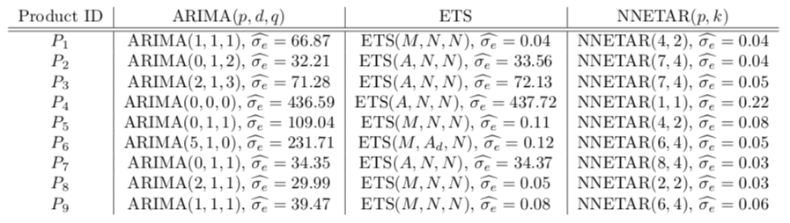
Prediction Models

Slide 9
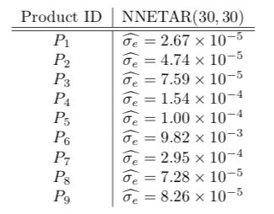
Prediction Models Tuned
NNETAR(p, k) was chosen due to its ability to:
model nonlinear dynamics;
and possible seasonality.
Fine tuning process:
p = k = 30 are imposed to the neural network, so that it can capture the monthly variation and the nature of the nonlinear dynamics of the data

Slide 10
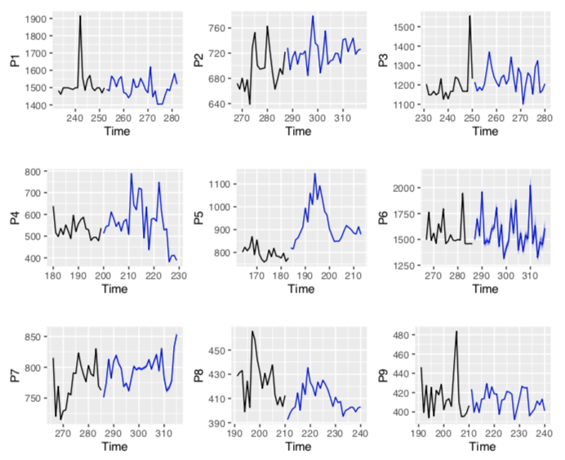
'sales.csv' dataset
Plot of the products revenue forecast

Slide 11
'comp_prices.CSV' DATASET
Nonstationary
Nonlinear
Dimensionality reduction

Slide 12
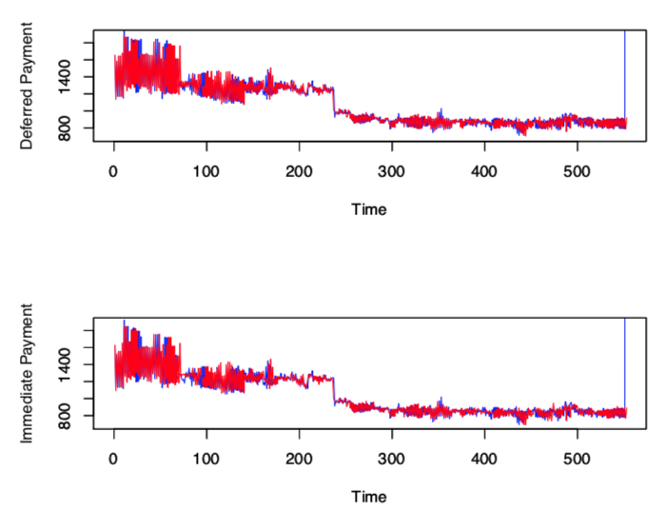
'comp_prices.csv' dataset
Plot of payment type
Diurnal: blue line (12am --- 12pm)
Nocturnal: red line (12pm --- 12am)
No differentiation between diurnal and nocturnal

Slide 13
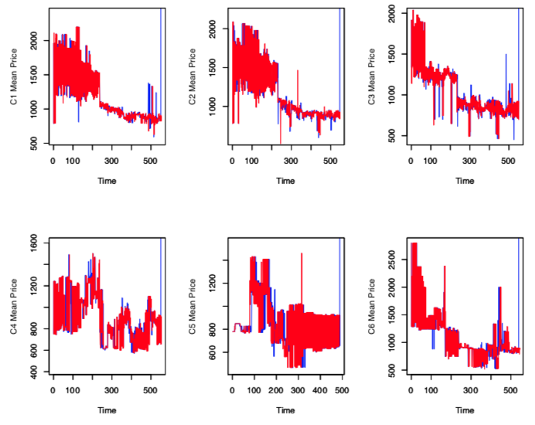
'comp_prices.csv' dataset
Competitors prices plots
Diurnal: blue line (12am --- 12pm)
Nocturnal: red line (12pm --- 12am)
No differentiation between diurnal and nocturnal

Slide 14
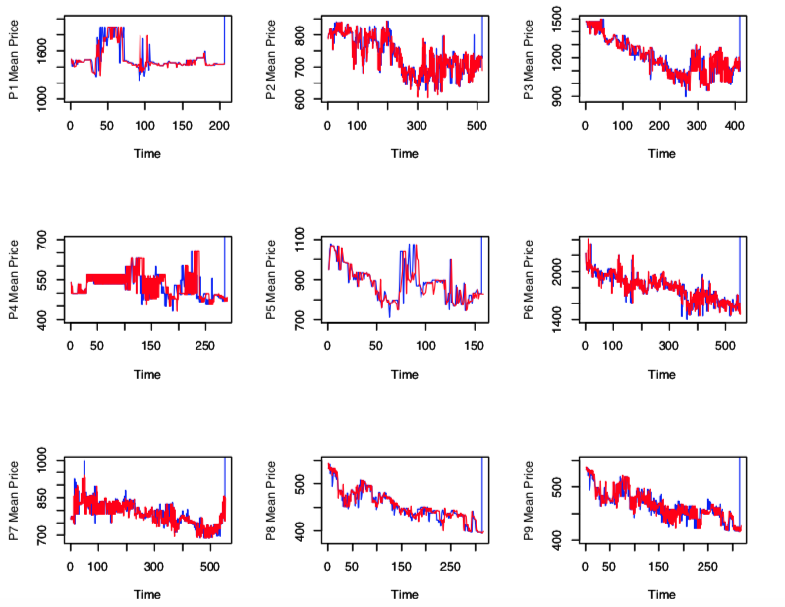
'comp_prices.csv' dataset
Plot of the products revenue
Diurnal: blue line (12am --- 12pm)
Nocturnal: red line (12pm --- 12am)
No differentiation between diurnal and nocturnal

Slide 15
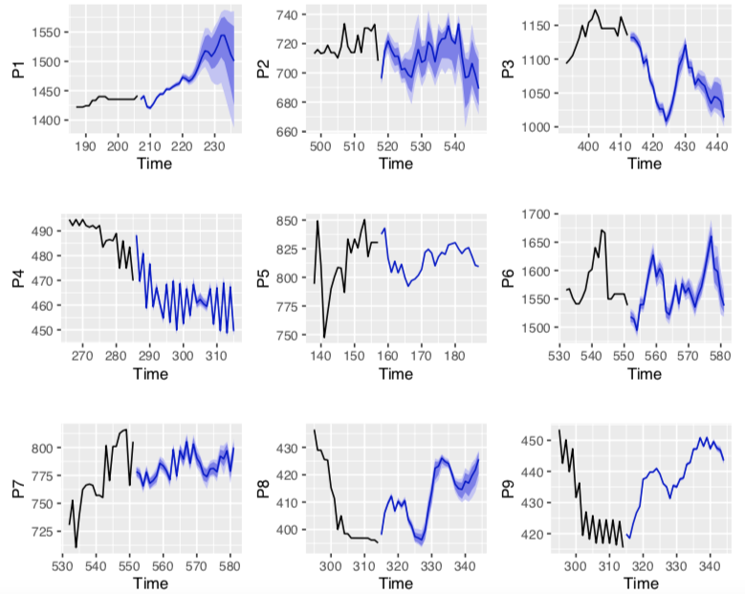
'comp_prices.csv' dataset
Plot of the products revenue forecast

Slide 16
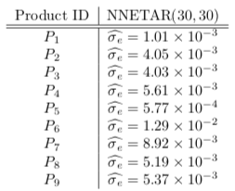
Prediction Models Tuned
NNETAR(p, k) was chosen due to its ability to:
model nonlinear dynamics;
and possible seasonality.
Fine tuning process:
p = k = 30 are imposed to the neural network, so that it can capture the monthly variation and the nature of the nonlinear dynamics of the data

Slide 17
Comparison Between prediction models
B2W
COMPETITORS

Slide 18
conclusions
The predictive models developed for B2W outperforms those for the competition
Higher quality of measure (low additive noise)
More work needs to be done to fine tuning of the model
Adjustment with interest rate, taxes, market etc.

