Slide 1

The Ruby Language
Lucas Mundim
Marcelo Murad

Slide 2

Some history

Slide 3
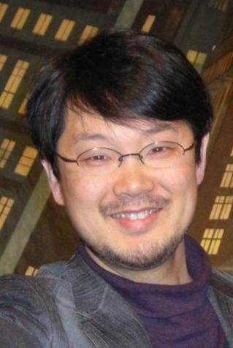
Yukihiro "Matz" Matsumoto

Slide 4
"wanted a scripting language that was more powerful than Perl, and more object-oriented than Python. That's why I decided to design my own language"
Matz

Slide 5
History
* 1993, Feb 24 - Matz starts work on Ruby
* 1993, April - First “hello world” works in Ruby
* 1995, December 21 - Ruby 0.95 was released to the public
* 1996, December 25 - Ruby 1.0 was released
* 1998, December - ruby-talk first english mailing list was started
* 2000 - First english book
* 2001 - RubyConf started
* 2001, December 15 - Pickaxe book on Ruby was released
* 2003, August - Ruby 1.8.0 was released
* 2004, July - Web application framework Ruby on Rails released
* 2007, March - Ruby 1.8.6 was released
* 2008, May - Ruby 1.8.7 was released
* 2009, January 30 - Ruby 1.9.1 stable was released

Slide 6
What is Ruby?

Slide 7
dynamic object-oriented programming language

Slide 8
a strong focus on simplicity and productivity

Slide 9
an elegant, natural syntax

Slide 10
roots in Perl, Smalltalk, Eiffel, Ada, and Lisp

Slide 11
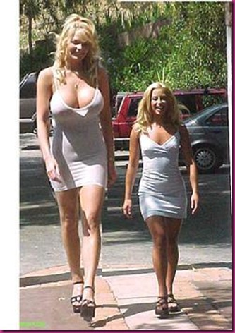
VHLL
Very High-Level Language

Slide 12
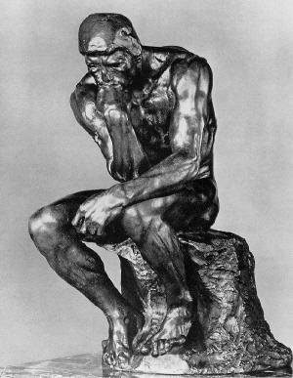
Philosophy

Slide 13
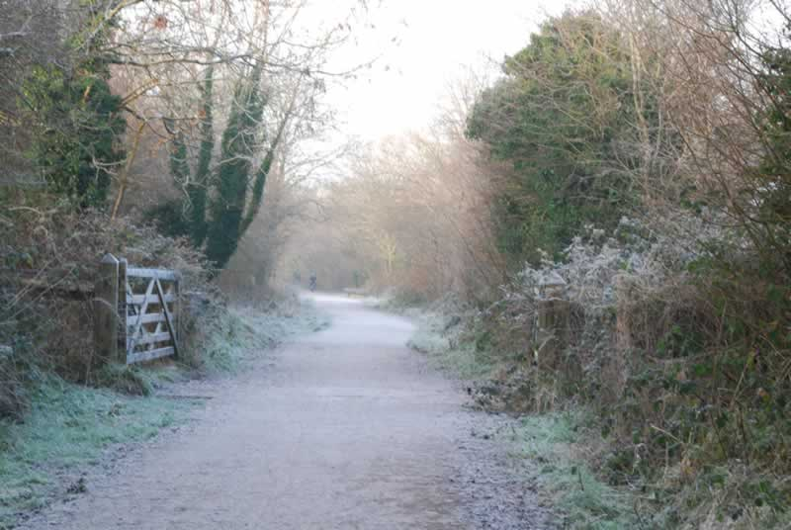
The Ruby way

Slide 14

Simplicity
“Perfection is achieved, not when there is nothing left to add, but when there is nothing left to take away.”

Slide 15
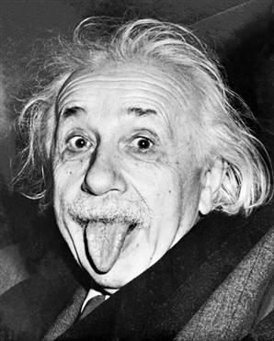
“Everything should be as simple as possible, but no simpler.”
Albert Einstein

Slide 16
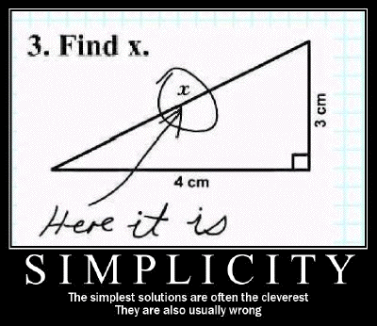
Simple, but not too simple

Slide 17
%author = map { /^\d{6}$/ ? $_ : [ split( /\|/, $_, 2 ) ] }
map { split( /=/, $_, 2 ) }
grep { /^\d{6}=[^|]+\|/ } <FH>;
Embrace brevity, but do not
sacrifice readability

Slide 18
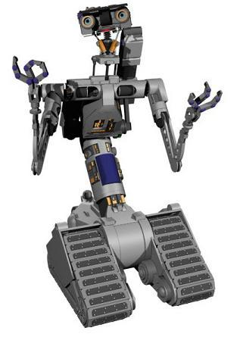
Computers exist for humans,
not humans for computers

Slide 19
human-centered
machine-centered

Slide 20
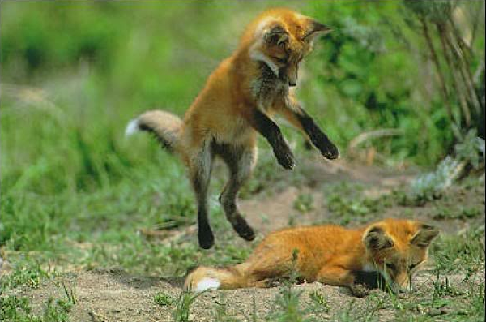
Principle of
least surprise

Slide 21
“least surprise”
should refer to Matz as the designer

Slide 22
Ruby is not:
Java
.Net
Perl
PHP
Python
Perl
etc...

Slide 23
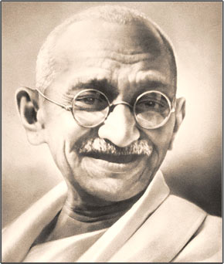
Don’t fight it

Slide 24
Don’t write 200 lines of code when 10 will do

Slide 25
Do not fear change at runtime; do not fear what is dynamic

Slide 26

Running Ruby

Slide 27
# ruby program.rb
Or
program.rb
#!/usr/bin/ruby
puts “hello world”
# ./program.rb

Slide 28
Syntax

Slide 29
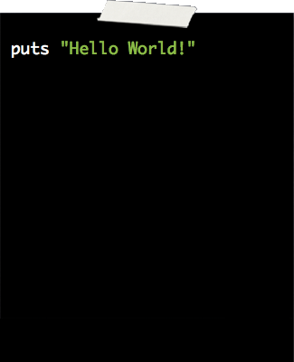
No ;s needed
Optional ()s

Slide 30
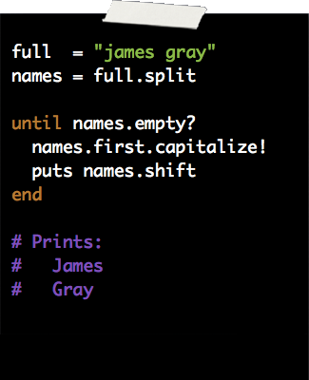

Objectified Syntax
obj.attribute = methods
dangerous! and query? methods

Slide 31
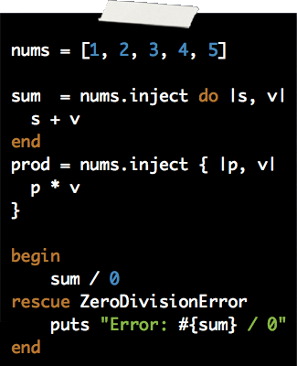
Simple, flexible syntax
Simple declarations:
  local_var = ...
  @instance_var = ...
  $global_var = ...
do...end or {...}
Real exception handling, like Java
String interpolation: any Ruby code inside #{...}

Slide 32
Keywords
BEGIN
break
do
false
next
rescue
then
when
END
case
else
for
nil
retry
true
while
alias
class
elsif
if
not
return
undef
yield
and
def
end
in
or
self
unless
begin
defined?
ensure
module
redo
super
until

Slide 33
Variables and Identifiers
Local variables starts with lowercase or _
Global variables starts with $
Instance variables @
Class variables @@
Constants starts with uppercase

Slide 34
Examples
Locals – alpha, ident, somevar (could be local variables)
Globals – $beta, $B12vitamin, $NOT_CONSTANT
Instance – @foobar, @thx1138, @NOT_CONST
Class – @@phydeaux, @@my_var, @@NOT_CONST
Constant – K6chip, Length, LENGTH
Pseudovariables – self, nil, __FILE__

Slide 35
Comments
x = y + 5 # this is a comment
# this is too
print “# but this isn't”
=begin
This is an example of
a multiline comment
=end

Slide 36
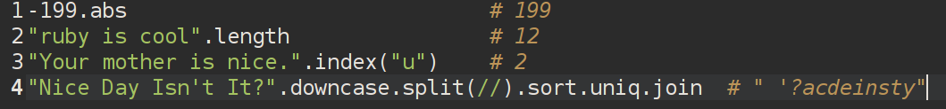
Everything, including a literal, is an object, so this works:

Slide 37
number = Math.abs(number) // Java code
number = number.abs

Slide 38
Objects
Everything is an object
3.succ # 4
“abc”.upcase # “ABC”
[2,1,5,3,4].sort # [1,2,3,4,5]
someObject.someMethod # some result
All objects are an instance of a class
“abc”.class # String
“abc”.class.class # Class
All objects have an id
“abc”.object_id # -605989528
“abc”.object_id # -605924298

Slide 39
Objects
- Variables are a reference to a object
- Variables doesn't have a type
- Variables are not objects
- variables atribution share references
x = “abc”
x.object_id # -605989528
y = x
y.object_id # -605989528

Slide 40
Class definition
class ClassName
#...
end
Inheritance
class ClassName < OtherClass
#...
end

Slide 41
Instance methods
class MyClass
def my_new_method(arg1, arg2, arg3) # 3 arguments
# Code for the method would go here
End
def my_other_new_method
# Code for the method would go here
end
end

Slide 42
Class methods
class Demo
def Demo.meth1
# ...
end
def self.meth2
# ...
end
class <<self
def meth3
# ...
end
end
end

Slide 43
Access control
class MyClass
def method1 # default is 'public'
#...
end
protected # subsequent methods will be 'protected'
def method2 # will be 'protected'
#...
end
private # subsequent methods will be 'private'
def method3 # will be 'private'
#...
end
public # subsequent methods will be 'public'
def method4 # and this will be 'public'
#...
end
end

Slide 44
Access control
class Accounts
def initialize(checking, savings)
@checking = checking
@savings = savings
end
private
def debit(account, amount)
account.balance -= amount
end
def credit(account, amount)
account.balance += amount
end
public
#...
def transfer_to_savings(amount)
debit(@checking, amount)
credit(@savings, amount)
end
#...
end
class MyClass
def method1
end
# ... and so on
public :method1, :method4
protected :method2
private :method3
end

Slide 45
class Myclass
attr_accessor :myvar2
@@count = 0
def initialize
@@count += 1
@myvar = 10
end
def self.getcount
@@count
end
def getcount
@@count
end
def getmyvar
@myvar
end
def setmyvar(myvar)
@myvar = myvar
end
def myvar=(myvar)
@myvar=myvar
end
end

Slide 46
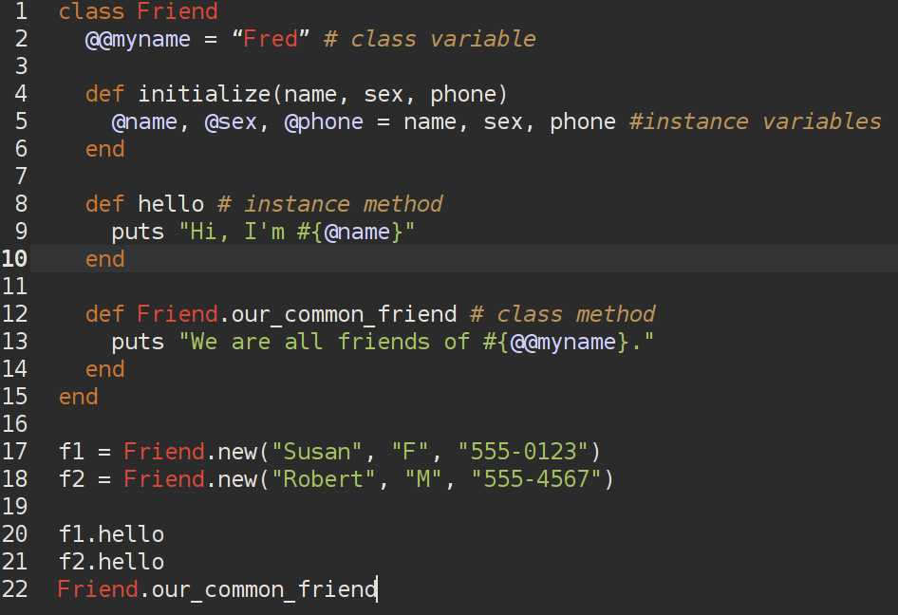

Slide 47
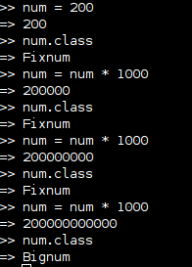
Object class change at runtime
num = 81
6.times do
puts "#{num.class}: #{num}"
num *= num
end
produces:
Fixnum: 81
Fixnum: 6561
Fixnum: 43046721
Bignum: 1853020188851841
Bignum: 3433683820292512484657849089281
Bignum: 11790184577738583171520872861412518665678211592275841109096961

Slide 48
Standard types

Slide 49
Numbers
3.times { print "X " }
1.upto(5) {|i| print i, " " }
99.downto(95) {|i| print i, " " }
50.step(80, 5) {|i| print i, " " }
produces:
X X X 1 2 3 4 5 99 98 97 96 95 50 55 60 65 70 75 80
123456 => 123456 # Fixnum
0d123456 => 123456 # Fixnum
123_456 => 123456 # Fixnum - underscore ignored
-543 => -543 # Fixnum - negative number
0xaabb => 43707 # Fixnum - hexadecimal
0377 => 255 # Fixnum - octal
-0b10_1010 => -42 # Fixnum - binary (negated)
123_456_789_123_456_789 => 123456789123456789 # Bignum

Slide 50
Strings
a = "\nThis is a double quoted string\n"
a = %Q{\nThis is a double quoted string\n}
a = <<BLOCK
This is a multi-line double quoted string
BLOCK
a = %/\nThis is a double quoted string\n/

Slide 51
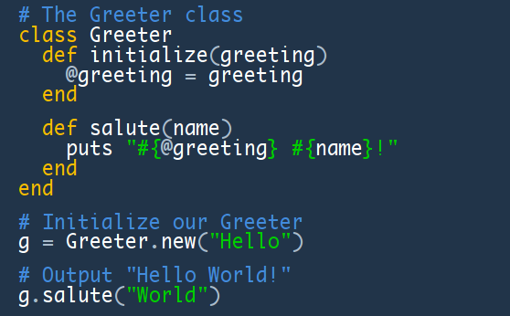
String interpolation

Slide 52
Ranges
digits = 0..9
digits.include?(5) true
→
digits.min 0
→
digits.max 9
→
digits.reject {|i| i < 5 } [5, 6, 7, 8, 9]
→
digits.each {|digit| dial(digit) } 0..9
→
(1..10) === 5 → true
(1..10) === 15 → false
(1..10) === 3.14159 → true
('a'..'j') === 'c' → true
('a'..'j') === 'z' → false
(1..10).to_a → [1, 2, 3, 4, 5, 6, 7, 8, 9, 10]
('bar'..'bat').to_a → ["bar", "bas", "bat"]
1..10
'a'..'z'
my_array = [ 1, 2, 3 ]
0...my_array.length

Slide 53
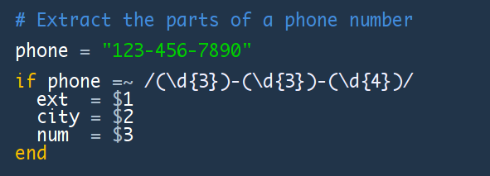
Regular Expressions
/pattern/
/pattern/options
%r{pattern}
%r{pattern}options
Regexp.new( 'pattern' [ , options ] )
def show_regexp(a, re)
if a =~ re
"#{$`}<<#{$&}>>#{$'}"
else
"no match"
end
end
show_regexp('very interesting', /t/) → very in<<t>>eresting
show_regexp('Fats Waller', /a/) → F<<a>>ts Waller
show_regexp('Fats Waller', /ll/) → Fats Wa<<ll>>er
show_regexp('Fats Waller', /z/) → no match
name = "Fats Waller"
name =~ /a/ → 1
name =~ /z/ → nil
/a/ =~ name → 1

Slide 54
Arrays
[1, 2, 3]
[1, 2, “my string”]
[1, 2, [3, 4], 5]
[“alpha”, “beta”, “gamma”, “delta”]
%w[alpha beta gamma delta]
%w(Jan Fev Mar Abr Mai Jun Jul)
%w/am is are was were be being been/
val = myarray[0]
print stats[j]
x[i] = x[i+1]

Slide 55
Hashes
{1=>1, 2=>4, 3=>9, 4=>16}
{“cat”=>”cats”, “ox”=>”oxen”}
{“hydrogen”=>1, “helium”=>2, “carbon”=>12}
{“odds”=>[1,3,5,7,9], “evens”=>[2,4,6,8]}
{“foo”=>123, [4,5,6]=>”my array”, “867-5309”=>”Jenny”}
print phone_numbers[“Jenny”]
plurals[“octopus”] = “octopi”

Slide 56
Symbols
:Object
:my_variable
:"Ruby rules"
a = "cat"
:'catsup' → :catsup
:"#{a}sup" → :catsup
:'#{a}sup' → :"\#{a}sup"

Slide 57
Shell command
filter = "*.c"
files = `ls #{filter}`
files = %x{ls #{filter}}

Slide 58
General Delimited Input
%q Single-quoted string
%Q, Double-quoted string
%w, %W Array of strings
%r Regular expression pattern
%x Shell command
%q/this is a string/
%q-string-
%q(a (nested) string)
%w{this is an array of strings}
%x{ls -l}

Slide 59
Operators and modifiers
[ ] [ ]= Element reference, element set
** Exponentiation
! ~ + - Not, complement, unary plus and minus
(method names for the last two are +@ and
-@)
* / % Multiply, divide, and modulo
+ - Plus and minus
>> << Right and left shift
& “And” (bitwise for integers)
^ | Exclusive “or” and regular “or” (bitwise for
integers)
<= < > >= Comparison operators
<=> == === != =~ !~ Equality and pattern match operators (!=
and !~ may not be defined as methods)
&& Logical “and”
|| Logical “or”
.. … Range (inclusive and exclusive)
? : Ternary if-then-else
= %= ~= /= -= += |= &= Assignment
>>= <<= *= &&= ||= **=
Defined? Check if symbol defined
Not Logical negation
or and Logical composition
if unless while until Expression modifiers
begin/end Block expression

Slide 60
If and unless statements
“if” Form
if x < 5 then
statement1
end
if x < 5 then
statement1
else
statement2
end
statement1 if y ==3
x = if a>0 then b else c end
“unless” Form
unless x >= 5 then
statement1
end
unless x < 5 then
statement2
else
statement1
end
statement1 unless y !=3
x = unless a<=0 then c else b end

Slide 61
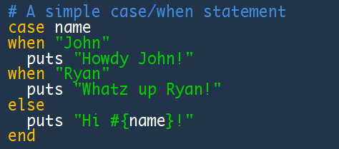
Case statement

Slide 62
Loops
List = %w[alpha bravo charlie delta echo gamma]
#Loop 1 (while)
i=0
while i < list.size do
print “#{list[i]}”
i += 1
end
#Loop 3 (for)
for x in list do
print “#{x} ”
end
#Loop 5 ('loop' method)
i=0
n=list.size-1
loop do
print “#{list[i]} ”
i += 1
break if i > n
end
#Loop 2 (until)
i=0
until i == list.size do
print “#{list[i]}”
i += 1
end
#Loop 4 ('each' interator)
list.each do |x|
print “#{x} ”
end
#Loop 6 ('loop' method)
i=0
n=list.size-1
loop do
print “#{list[i]} ”
i += 1
break unless i <= n
end

Slide 63
#Loop 7 ('times' iterator)
n=list.size
n.times do |i|
print “#{list[i]}”
end
#Loop 9 (for)
n=list.size-1
for i in 0..n do
print “#{list[i]} ”
end
#Loop 8 ('upto' iterator)
n=list.size-1
0.upto(n) do |i|
print “#{list[i]}”
end
#Loop 10 (each_index)
list.each_index do |x|
print “#{list[x]} ”
end
Bônus
def repeat(condition)
yield
retry if not condition
end
j = 0
repeat (j >= 10) do
j+=1
puts j
end
def my_seq
for i in 1..10 do
yield i
end
end
my_seq {|x| puts x**3}

Slide 64
Exceptions
raise
raise “Alguma mensagem”
raise ArgumentError
raise ArgumentError, “Bad data”
raise ArgumentError.new(“Bad data”, caller[0])
begin
x = Math.sqrt(y/z)
# ...
rescue ArgumentError
puts “Error taking square root.
rescue ZeroDivisionError
puts “Attempted division by zero.”
end
begin
#error-prone code...
rescue
#Handle exceptions
ensure
#This code is always executed
end

Slide 65
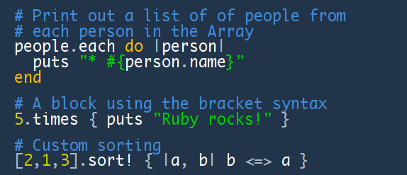
Blocks – The ruby secret
Blocks are like anonymous methods:

Slide 66
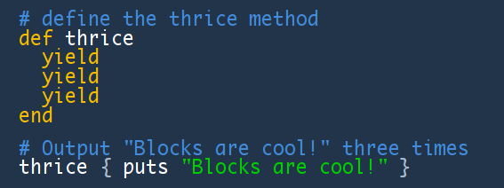
Yield
Use yield from within a method to hand control over to a block:

Slide 67
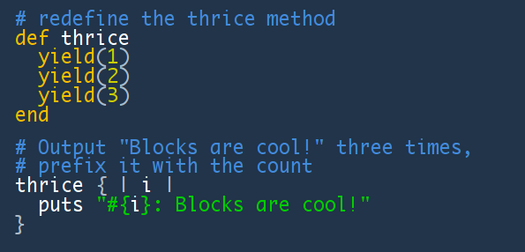
Blocks With Parameters
You can also use parameters with yield:

Slide 68
Ruby is Highly Dynamic
Uses dynamic typing (vs. static)
Full support for introspection
Support for method redefinition
Create your own domain-specific languages
Modules vs. multiple inheritance
method_missing, etc...

Slide 69
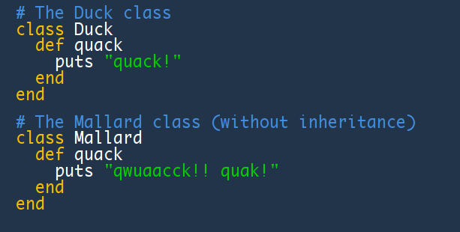
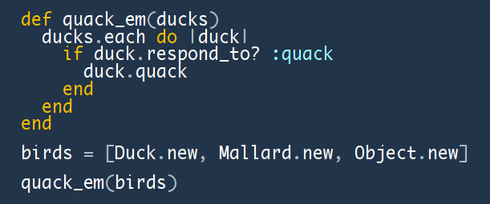
Dynamic Typing
If it quacks like a duck…
…it must be a duck.

Slide 70
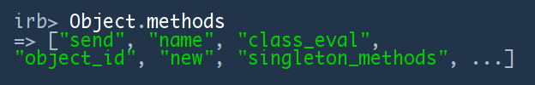

Introspection
What are the methods of the object?
Does an object have a method?

Slide 71
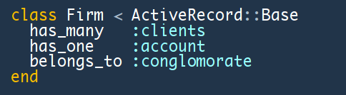
Domain-Specific Languages
Ruby’s simple and powerful conceptual foundation allows for the creation of simple sub-languages called domain-specific languages.
Here’s an example from Rails:

Slide 72
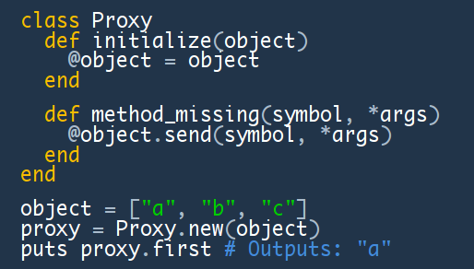
Method Missing, etc.
A simple proxy object:

Slide 73
Modules and mixin
module Debug
def who_am_i?
"#{self.class.name} (\##{self.id}): #{self.to_s}"
end
end
class Phonograph
include Debug
# ...
end
class EightTrack
include Debug
# ...
end
ph = Phonograph.new("West End Blues")
et = EightTrack.new("Surrealistic Pillow")
ph.who_am_i? → "Phonograph (#935520): West End Blues"
et.who_am_i? → "EightTrack (#935500): Surrealistic Pillow"

Slide 74
Referências
- The Ruby Way (Second Edition) – Hal Fulton
- Programming Ruby (Second Edition) – Dave Thomas

