Slide 1
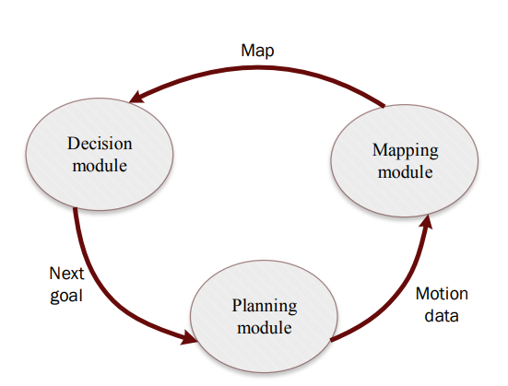
Project: Learning Exploration via Reinforcement Learning
Agent’s exploration framework is split into 3 distinct processes:
Decision Module (Goal Planning) - FCQN
Planning Module (Path Finding) - RRT n *
SLAM (Simultaneous Localization and Mapping) - 2D LiDAR with BHM
Reference: Haoran Li, Qichao Zhang, Dongbin Zhao, " Deep reinforcement learning based automatic exploration for navigation in unknown environment", IEEE Transactions on Neural Networks and Learning Systems
Adapted from Donovan Loh (Intern)
Notes:
Rapidly-Exploring Random Tree Star - path planning algorithim

Slide 2
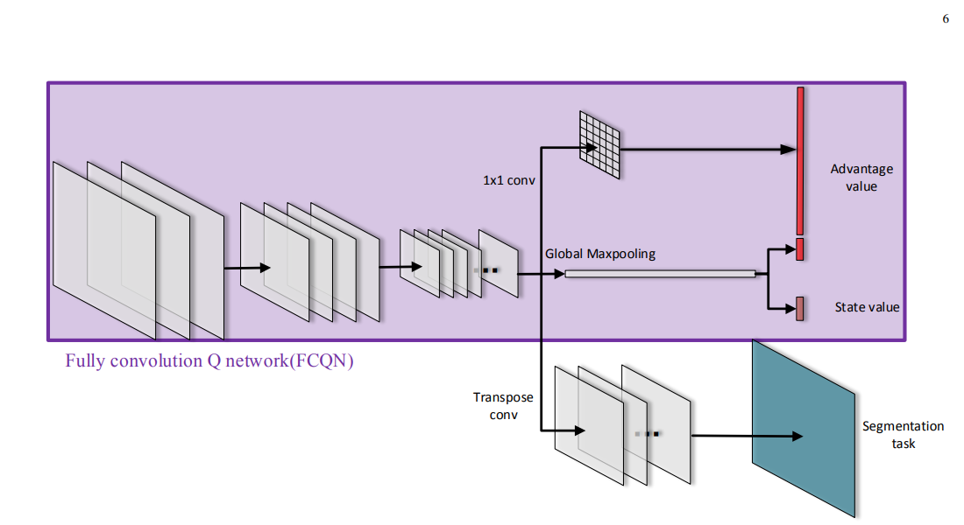
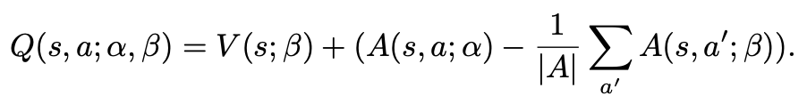
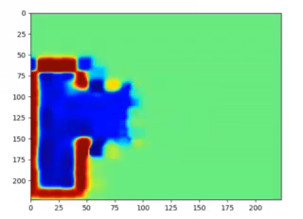


3 Channels – Occupancy map, Current position, Previous Positions
Convolutional and Max Pooling Layers
2D training environment
Bayesian Hilbert Maps (BHM) for Occupancy Mapping
Notes:
State function V - measures how good it is to be in a particular state
Advantage function - relative measure of the importance of each action
Q-value - the value of choosing a particular action in this state

Slide 3
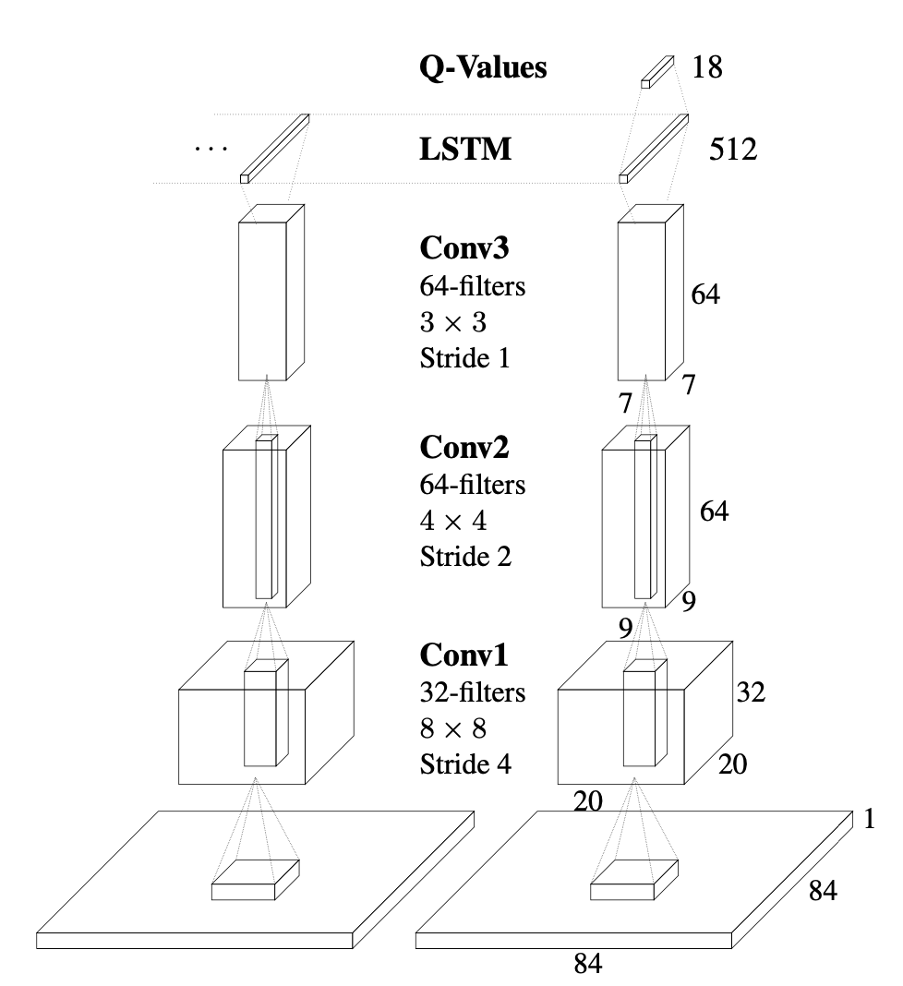


Recurrent Neural Networks
An unrolled RNN cell
DRQN (Deep Recurrent Q Network) Architecture (Used on Atari Games)
An unrolled LSTM (Long Short Term Memory) Cell
Reference: Matthew Hausknecht, Peter Stone, "Deep Recurrent Q-Learning for Partially Observable MDPs”, https://arxiv.org/abs/1507.06527
https://colah.github.io/posts/2015-08-Understanding-LSTMs/

Slide 4
C_{t+1}
LSTM
State S_{t}
Q-Values
Hidden State C_{t}
LSTM
State S_{t-1}
Q-Values
C_{t-1}
Initial Hidden State C_{t=0} - learned at the start of each episode

Slide 5
Training and Inference Details
Training:
6000 iterations
Original model learning rate = 2x10^-6
New model learning rate = 1x10^-6 (seems to be more stable)
Inference:
Same 7 Valid starting points - 5 episodes per starting point (35 episodes total)
Minimum Exploration rate of 0.77 for each completed episode

Slide 6
Inference Results
Metric | Original Model | Model (with LSTM layer)
Average Path Length | 2440 | 1520
Average Explored Region Rate | 0.775 | 0.777
Average Exploration Efficiency (Relative Entropy reduced per unit length) | 4.25 | 6.68
Original model - drone gets “stuck” easily (cannot find remaining unexplored region)
LSTM layer seems to reduce this likelihood
Model with LSTM layer produces more “invalid” goalpoints

