Slide 1
USER’s NEEDS OF INVESTING IN ALTCOIN
Candidate: Ngo duc long

Slide 2

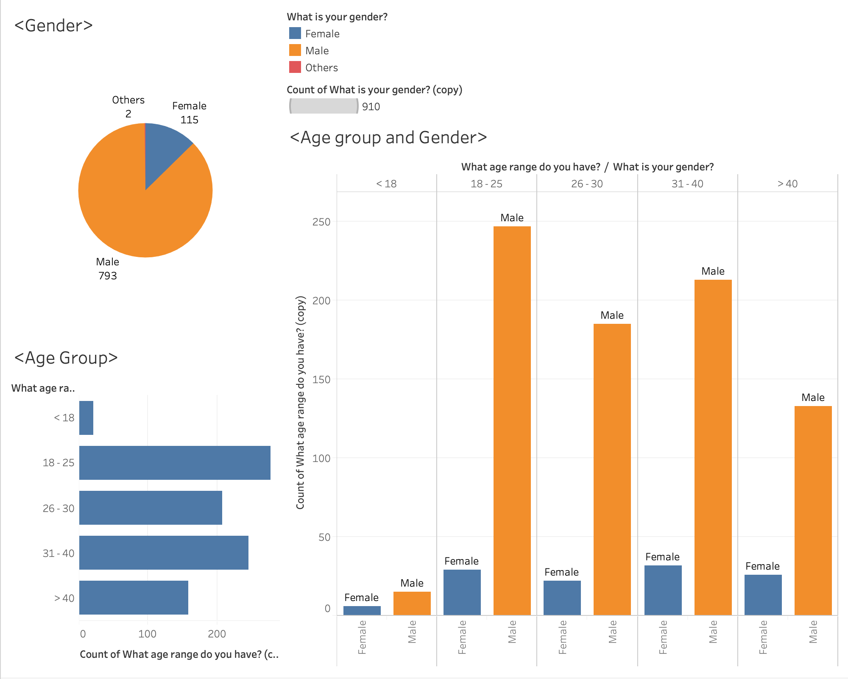
1. Gender and age group:
The subset of people who participated in the survey has 793 Male and only 115 Female, occupied approximate 80% and 20% respectively.
The people who took part in this survey is also divided into 4 age group with the majority in the age of 18-25 and 31-40.
Following by the age group of 26-30 and above 40 while the number of below 18 people took part in the survey in very less compared to other age group

Slide 3
1. Gender and age group:
While comparing age group with respect to Gender, we witnessed that the percentage of Male taking part in the survey is dominant in every age group compared to Female
And, We can also find that the pattern of age group remains the same between genders with the highest age group of 18-25 and lowest of below 18.

Slide 4
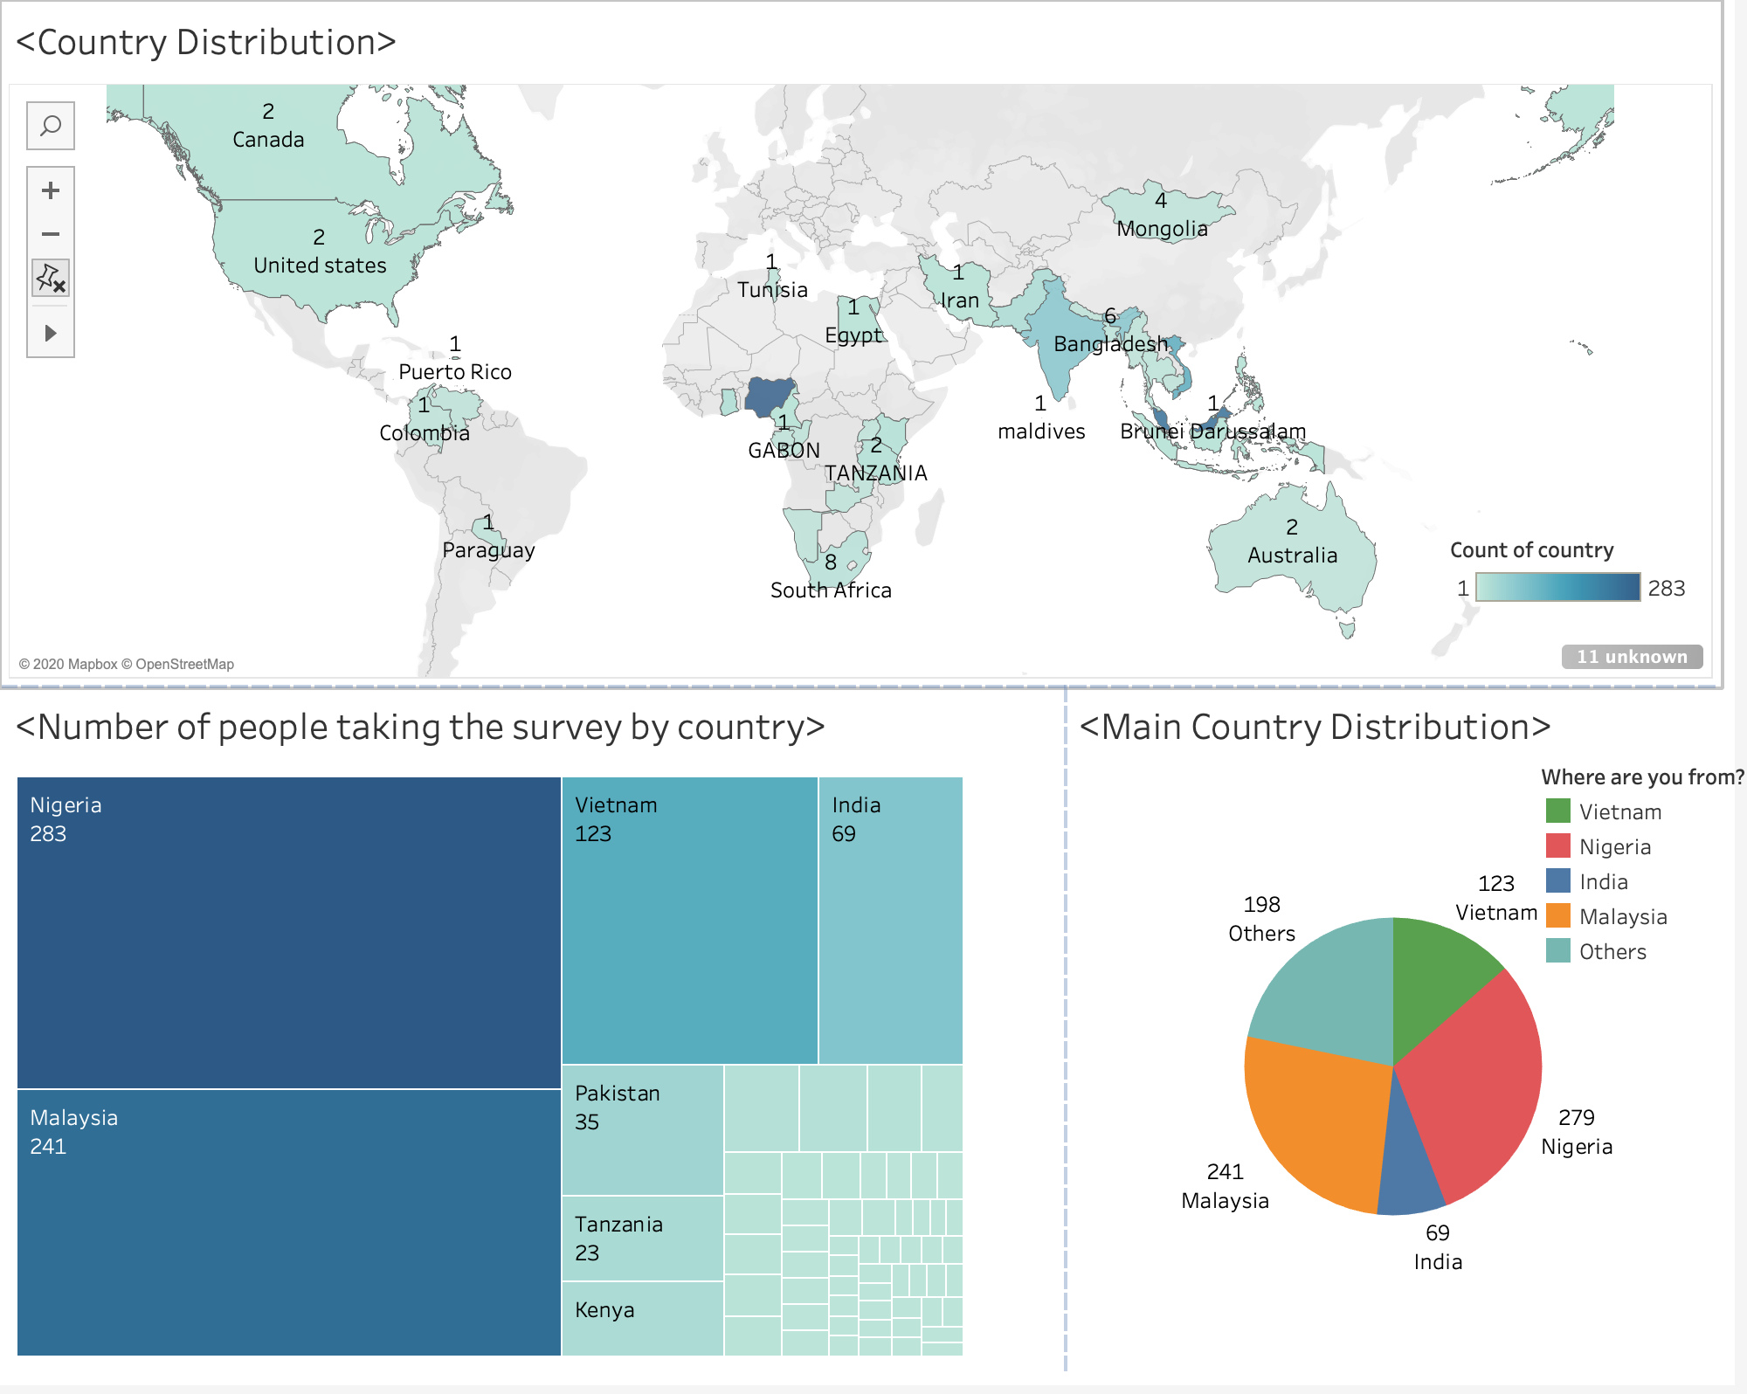
2. Distribution of countries:
The subset of people who participated in the survey comes from different continents all around the world with the majority in Asia and Africa.
From the pie chart, we can see the distribution of 4 main countries which has the highest people participated in the survey.
Nigeria and Malaysia are dominant with 283 and 241 people in this survey respectively while Vietnam being the third country to have most people joining the survey

Slide 5
2. Distribution of countries:
The treemap in the bottom left corner also reflects this distribution with India, Pakistan and Tanzania right behind the top 3 countries.

Slide 6
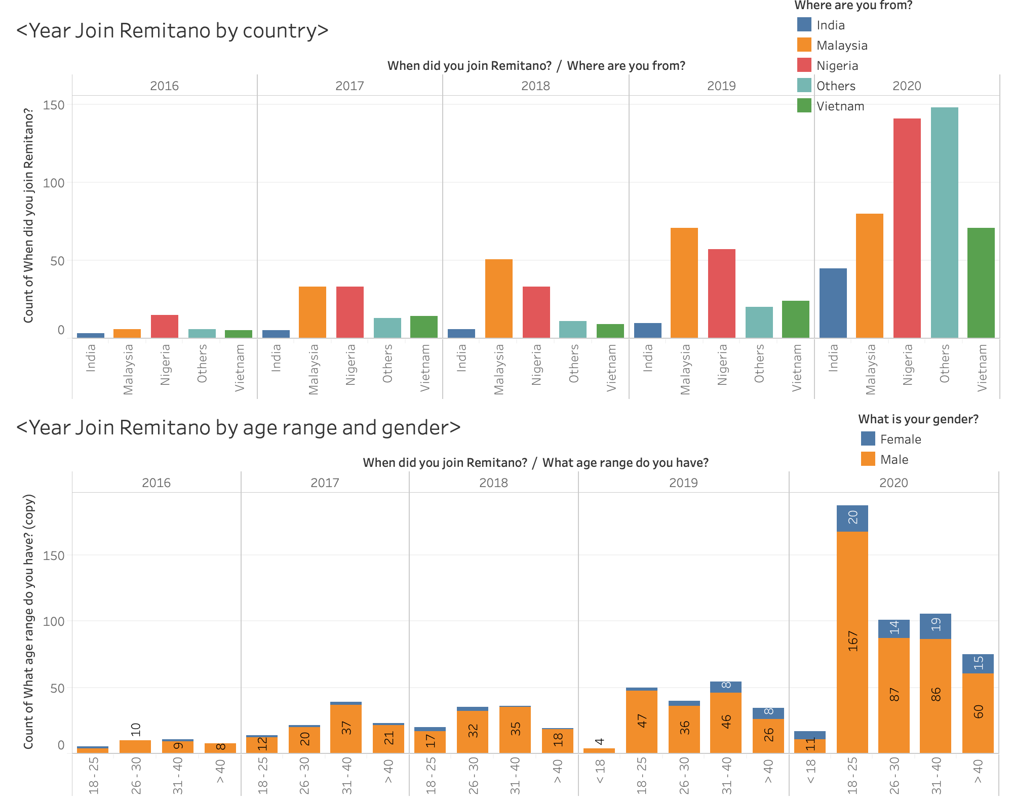
3. Country and age with regards to year:
Remitano User increases steadily from 2016 and 2019 but double in the year of 2020.
In 4 years from 2016 to 2019, Remitano Users mostly locate in one of the 4 countries Malaysia, Nigeria, Vietname and India with Malaysia and Nigeria share the top and second position. But in the year of 2020, Remitano is widely used in other countries.

Slide 7
3. Country and age with regards to year:
From 2016-2019, the age group distribution is quite even among 4 age groups namely 18-25, 26-30,31-40 and above 40
But in 2020, more young people start to use Remitano as the age range of 18-25 rocketed and gained dominant among other age group.

Slide 8
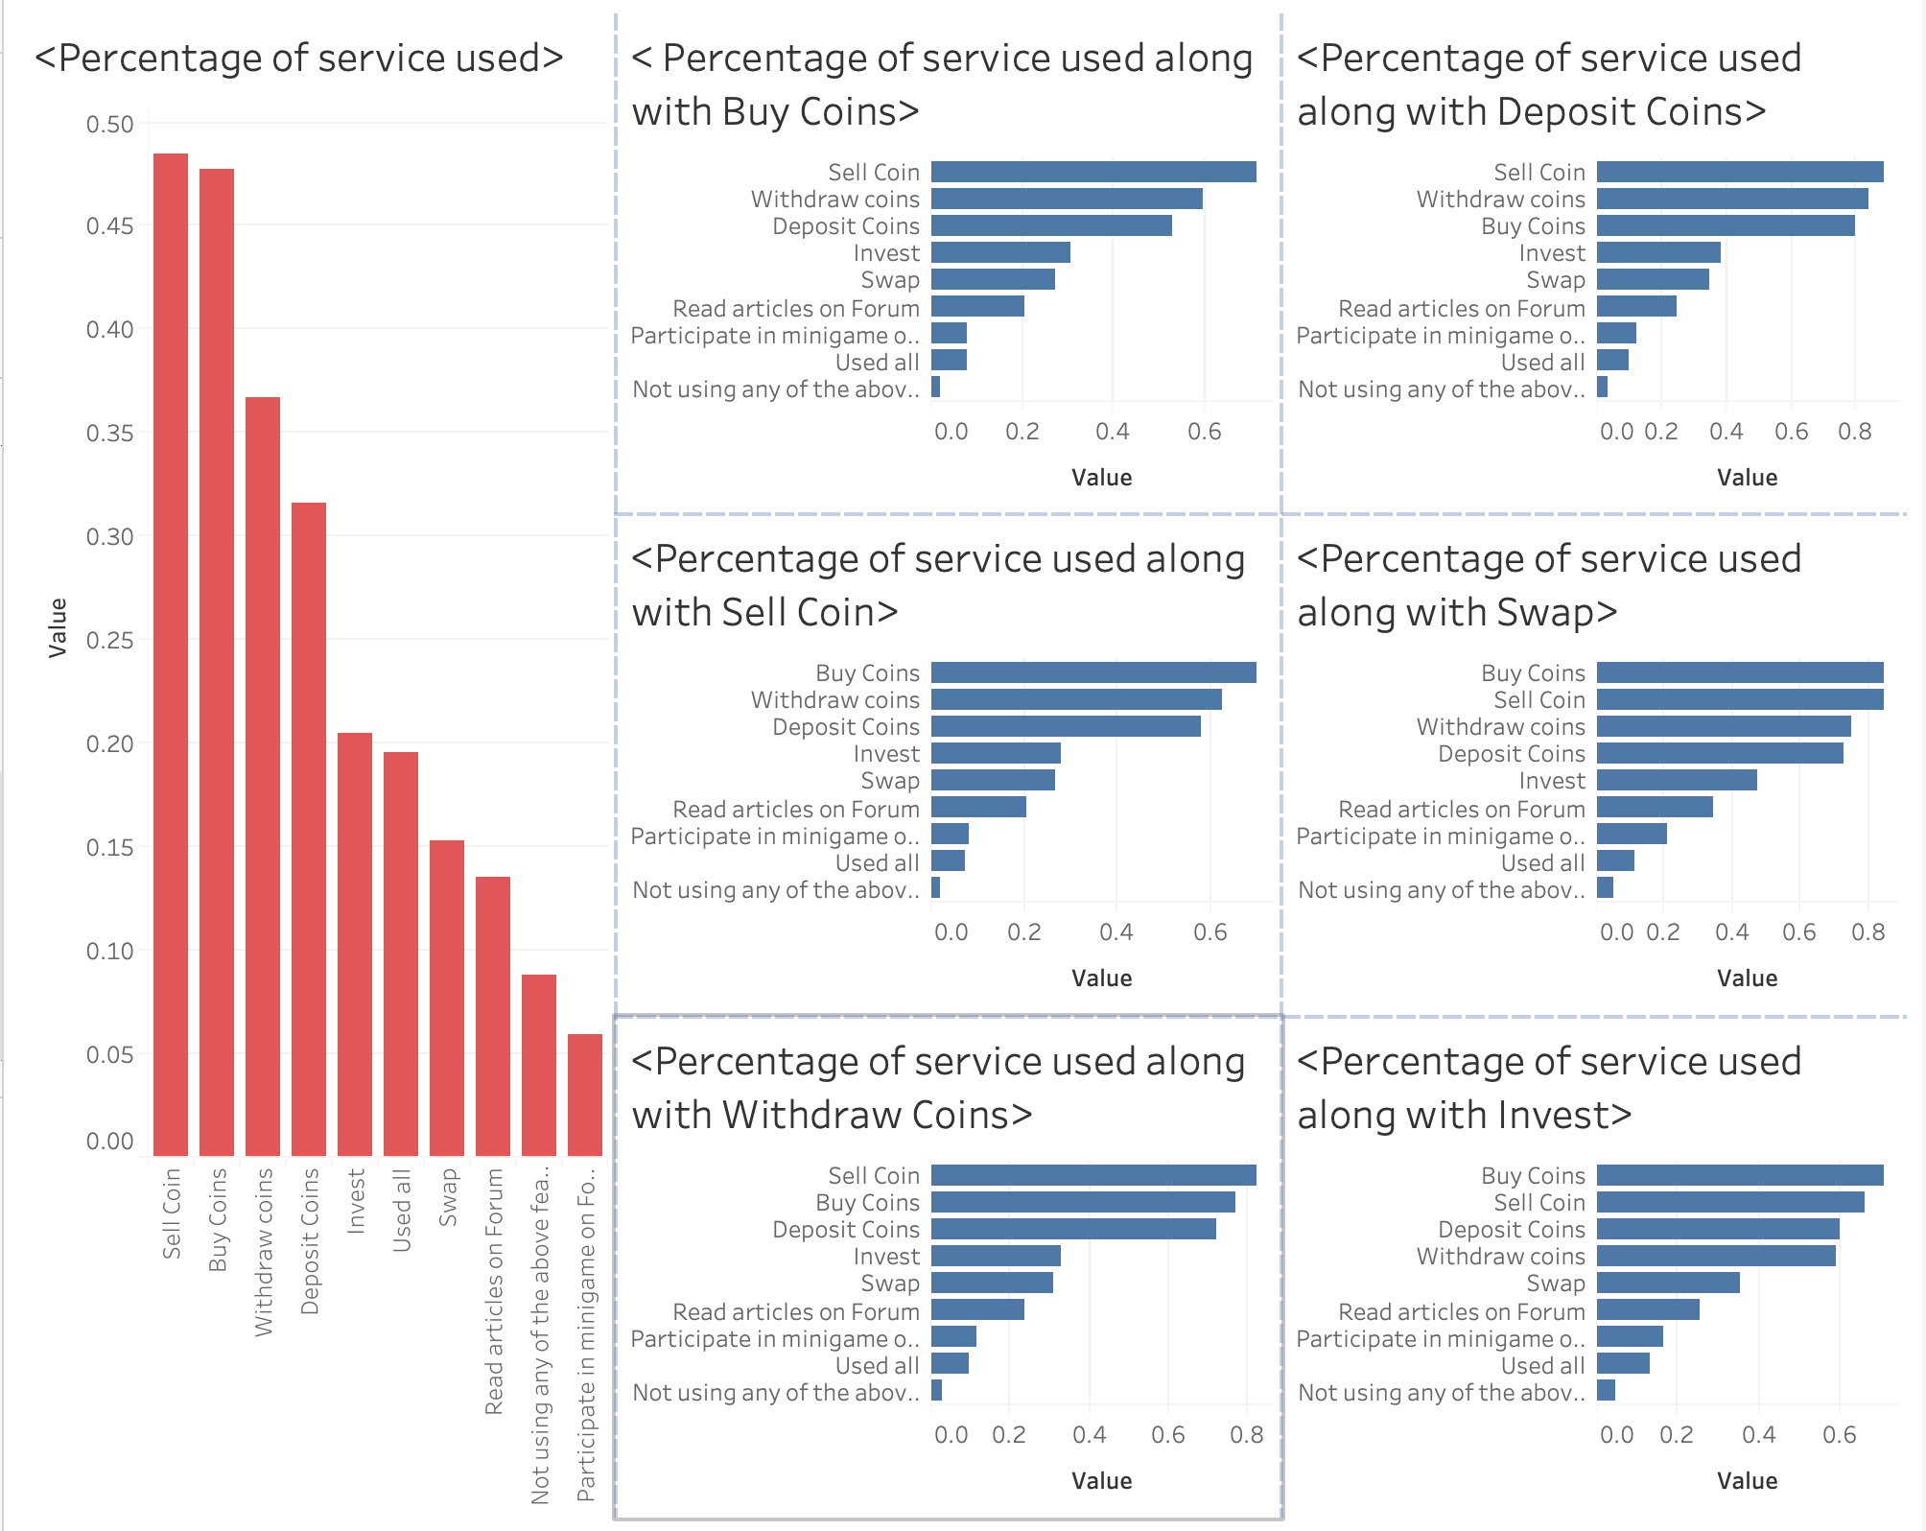
4. Feature used on Remitano:
The first bar chart in the left corner reflects the proportion of users using each feature on Remitano with nearly 50% of users adopt Remitano to Sell and Buy coins
Followed by 37% and 32% of customers use to Withdraw and Deposite Coin respectively.

Slide 9
4. Feature used on Remitano:
The rest 6 bar charts are the percentage of people who previously consume services use additional services.
These bar charts are to show the correlation of services along with which is the group of services that being used together.
From the charts, we can conclude that Sell, Buy, Withdraw and Deposit Coin is the group of services that being use together the most.

Slide 10
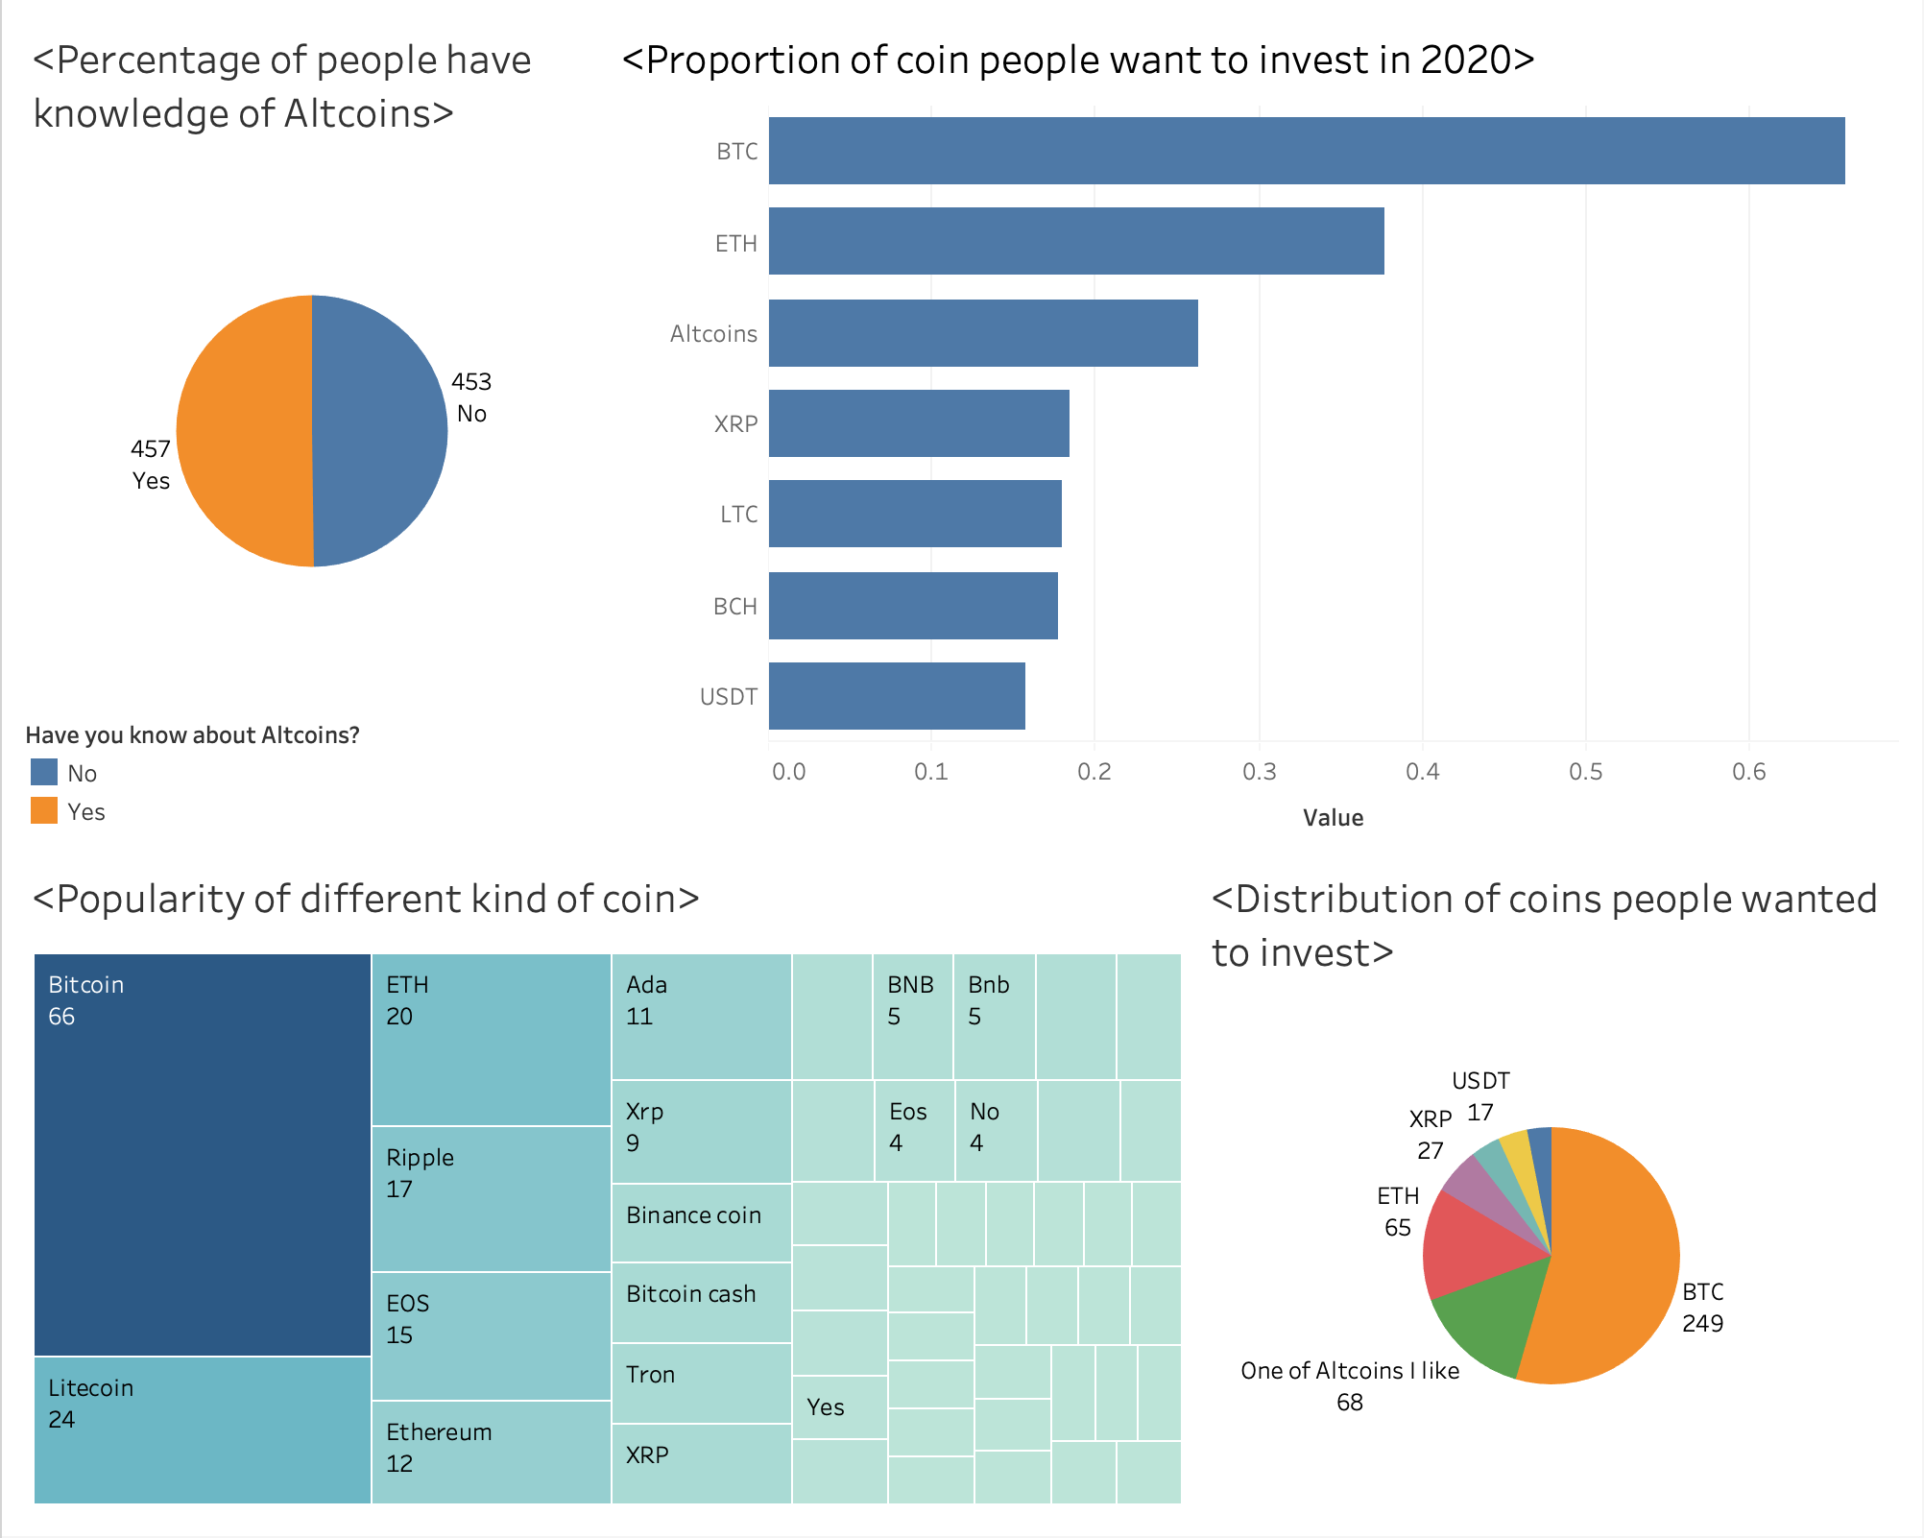
5. Which are the popular coins ?
The pie chart at the top left corner shows that only 50% of people have knowledge of Altcoin.
The treemap at the bottom left shows the popularity of coin where Bitcoin dominants leaving others far behind.
Out of that 50% people having knowledge of Altcoin, 65% wants to invest in Bitcoin. Following by ETH and Altcoins with 37% and 27% respectively.
And if users are to choose the only coin to invest, most people will still go for Bitcoin(BTC) while others will invest in One of the Altcoins or ETH ( as shown in the graph at the bottom right)

Slide 11
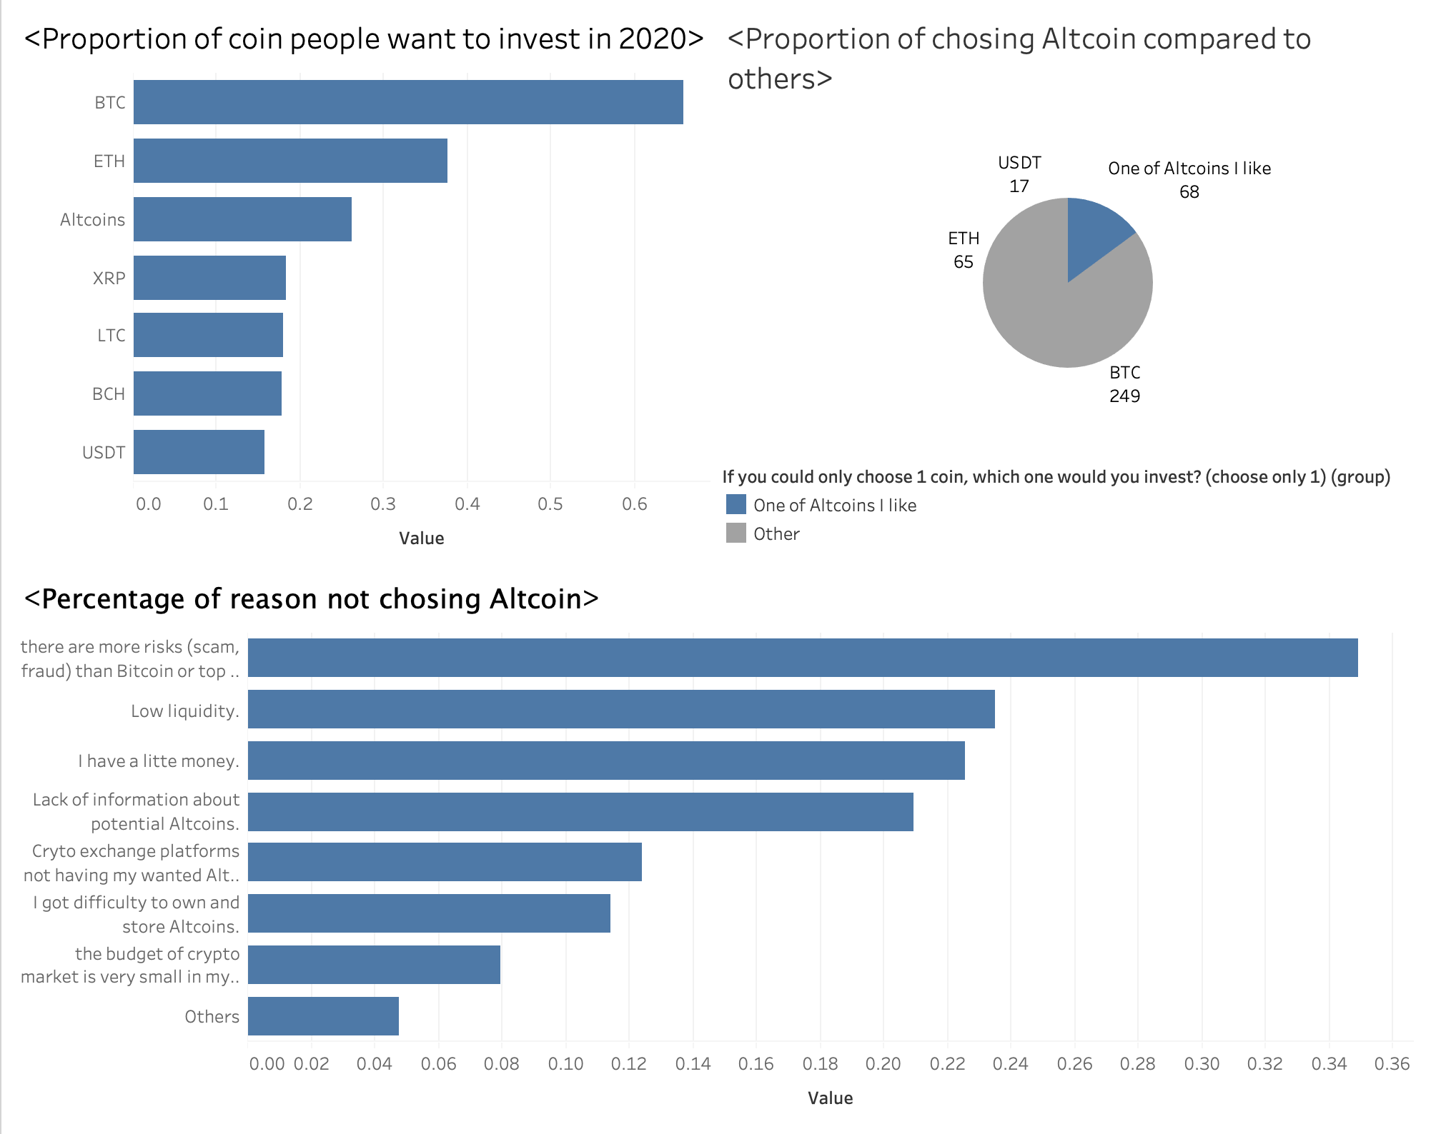
6. Why not altcoin ?
As the pie chart shows, only 25% of the customer choose Altcoin
And only 20% of customer choose One of Altcoins to be their primary coin to invest with (pie chart at the upper right corner)
The primary reason for this is because there are more risks ( scam, fraud) compared to Bitcoin.
Other reasons might be low liquidity, customer having little money and lack of information.

Slide 12
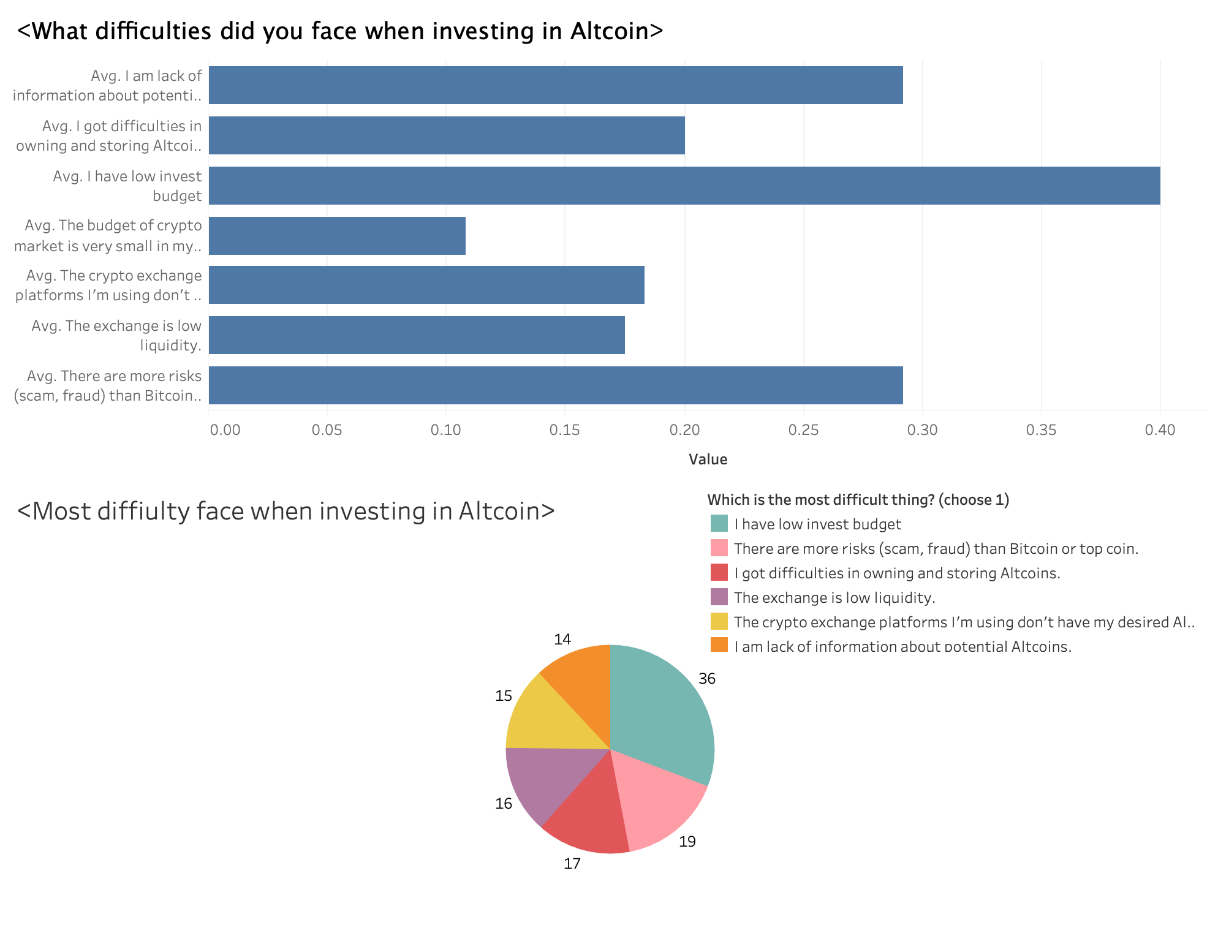
7. Difficulty investing in altcoin
As the horizontal bar suggests, 40% of the people have knowledge and want to invest in Altcoin have difficulty with low budget.
While 28% are lack of information and worry of possible scam and fraud.
When it comes to the most difficult things, low budget for invest still holding investor back.

Slide 13
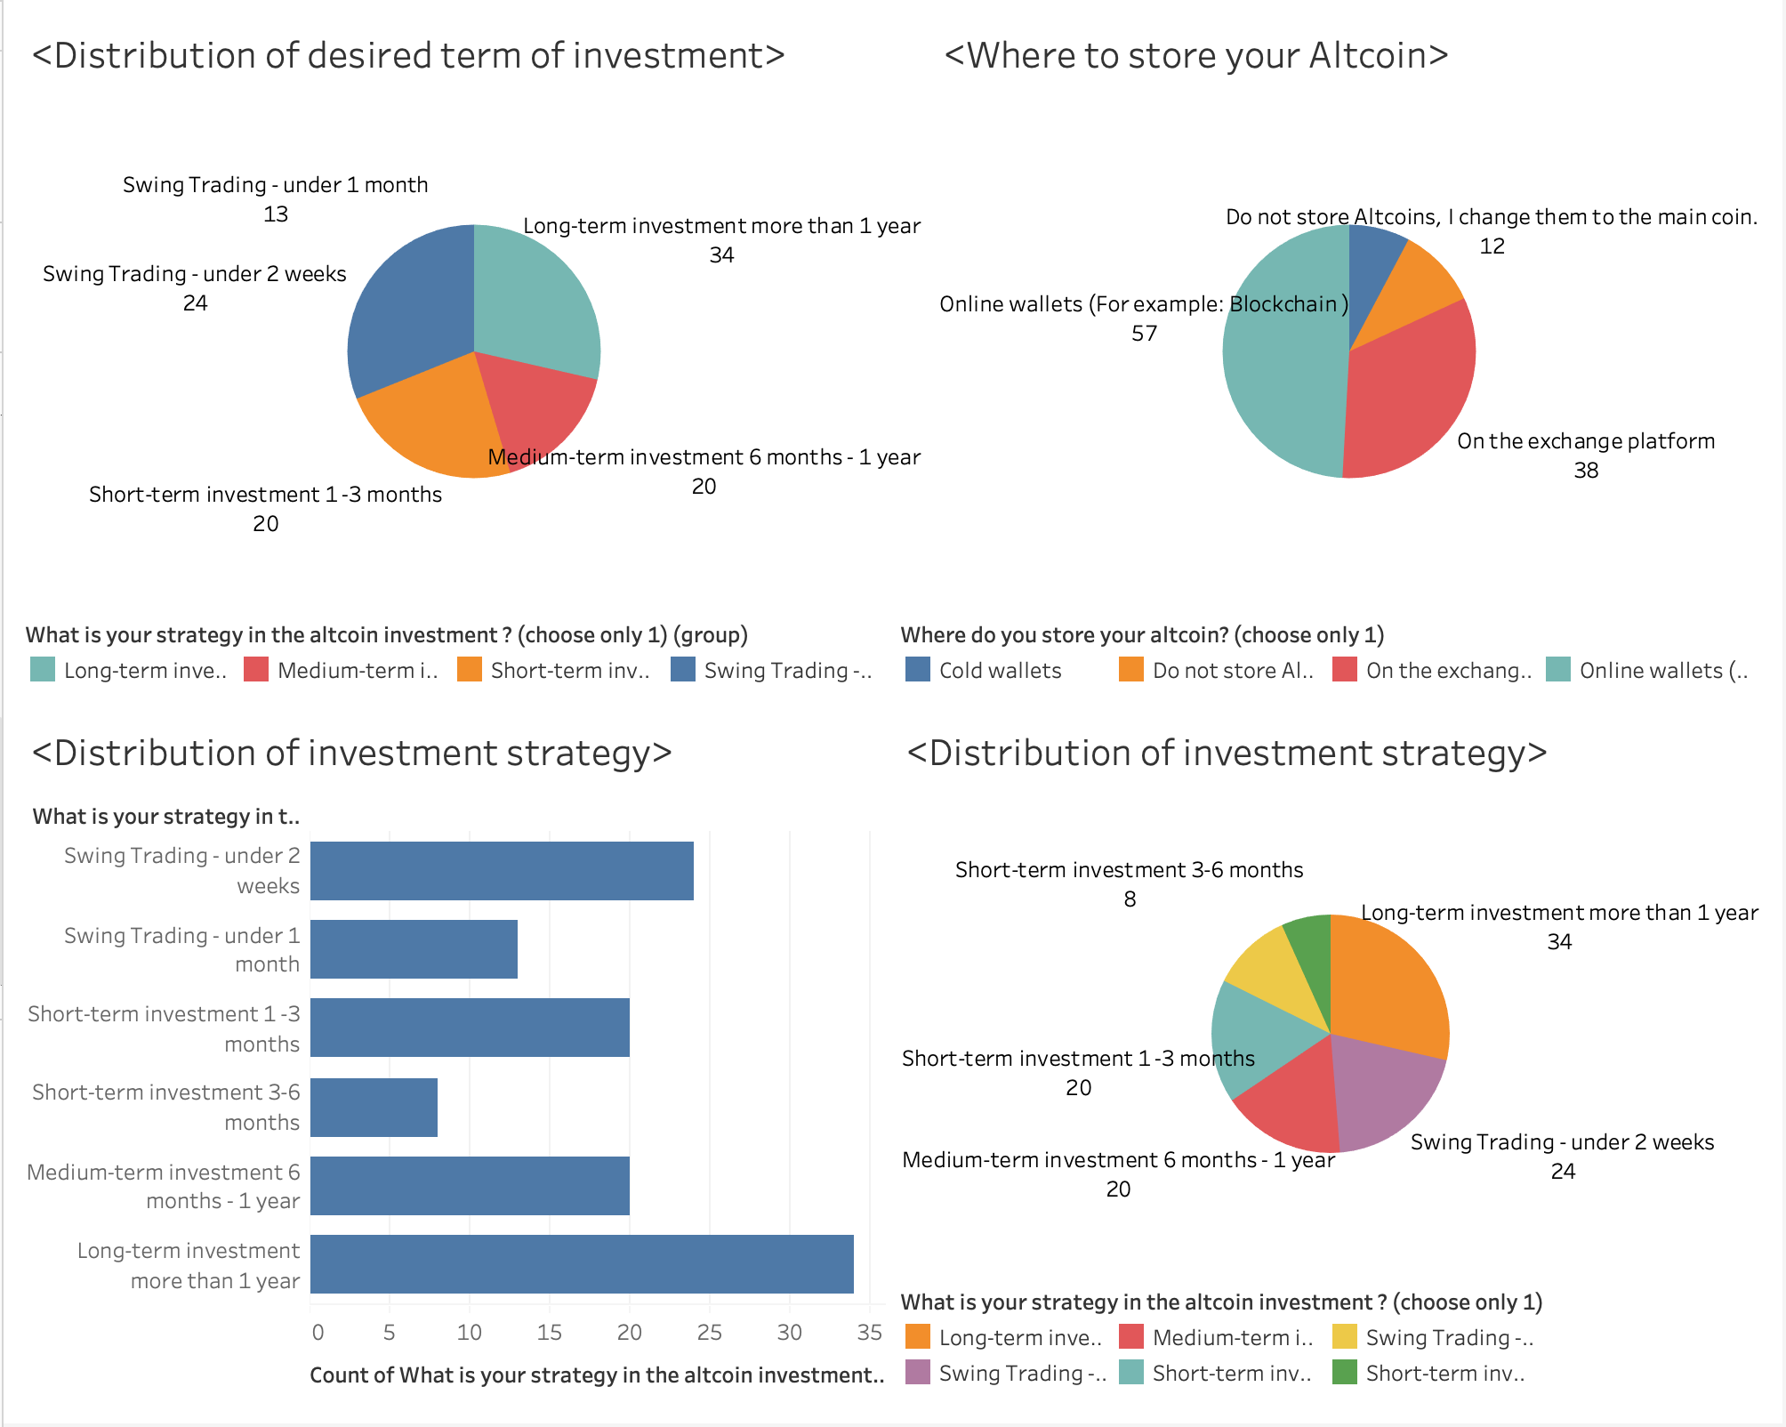
8. Investment strategy and altcoin storage:
From the pie chart in the upper right corner, we can find that 50% of the users store Altcoin using Online Wallets and 30% using Exchange platform
The pie chart in the upper left corner shows that most customer invest Long-term and Swing-trading with 30% while Short-term investment and Medium-term investment are less popular with 25% and 15% respectively.

Slide 14
8. Investment strategy and altcoin storage:
To be more specify, customers’ strategies are to invest long-term or very short-term. 30% people want to invest more than 1 year. In the contrary, 20% of the investor do Swing Trading in less than 2 weeks.
While little trader goes for 3-6 months investment.

Slide 15
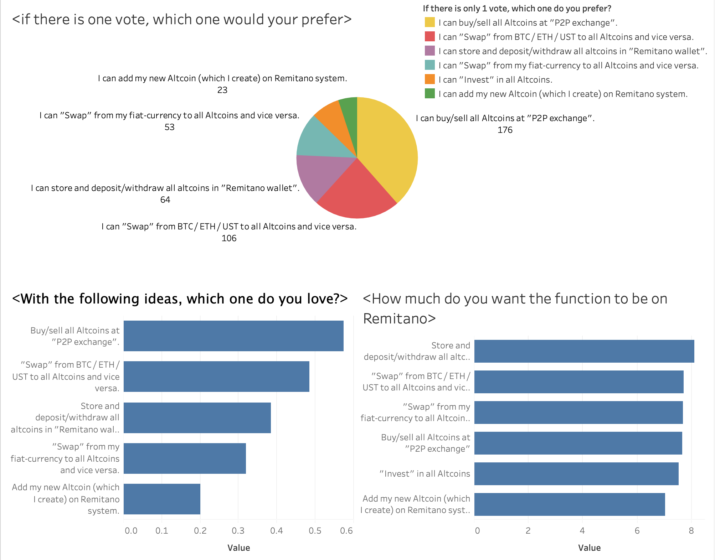
9. Desire for possible upcoming features on remitano:
Most customer would love to have buy/sell all Altcoins at “P2P exchange” with nearly 60%, following by ”swap” from BTC/ETH/UST to all Altcoins and vice versa.
The same trend follows even if customer can only choose just 1 feature.’
Customers want all the function on Remitano while there are not much of the differences between score of every function while they all range from 7 to 8 (horizontal bar at the bottom right corner)

Slide 16
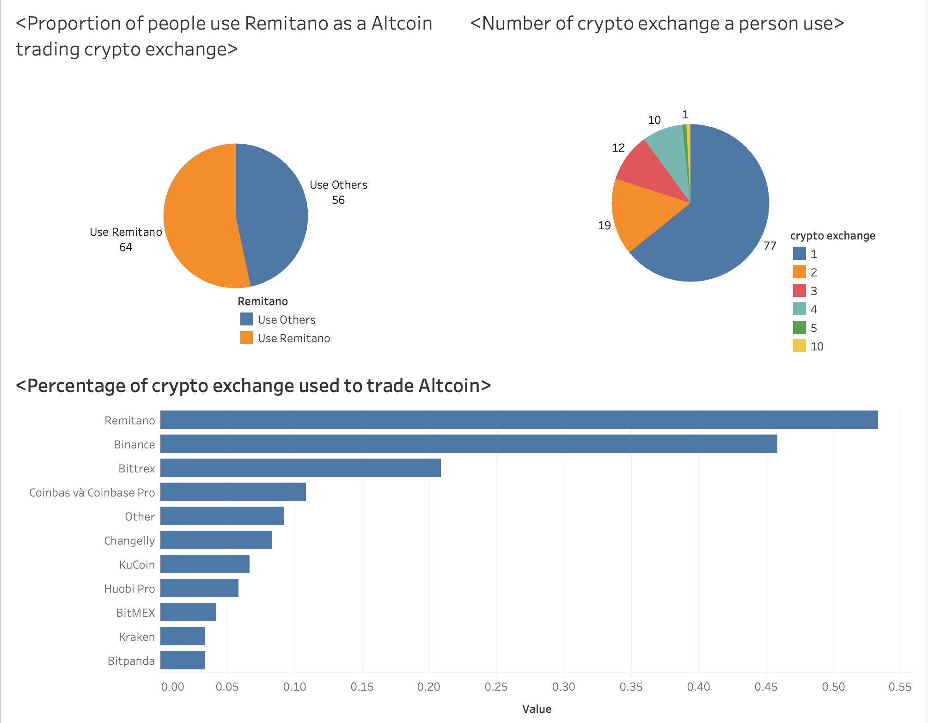
10. Popular crypto exchange:
Remitano is the most popular crypto exchange in the list with nearly 55% following by Binance with 45% while others are only less than 22%
The pie chart at the upper right corner illustrates the number or crypto exchange customers tend to use. In which, nearly 70% users think that one crypto exchange is enough while 15% use 2 and only 2 people use more than 4 crypto exchange.

Slide 17
THE END
Link to the cleaned dataset : https://drive.google.com/file/d/1R7NX9nQ4zhY9tGnUYrTGpO0RCtIoS90t/view?usp=sharing
Link to the Tableau Workbook:
https://drive.google.com/file/d/1DKZKVoY5xoRlLlf-7NHoMdwH27VVy4fI/view?usp=sharing

