Slide 1
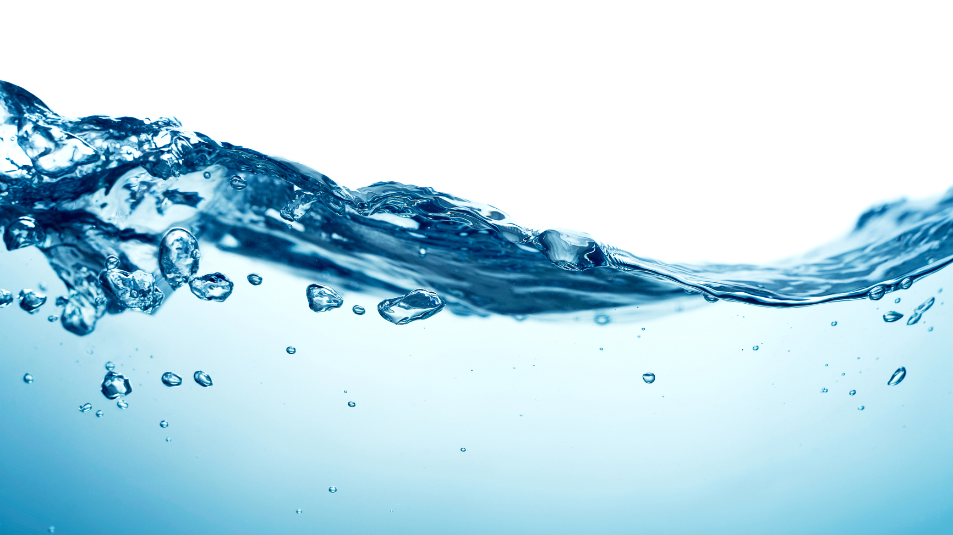

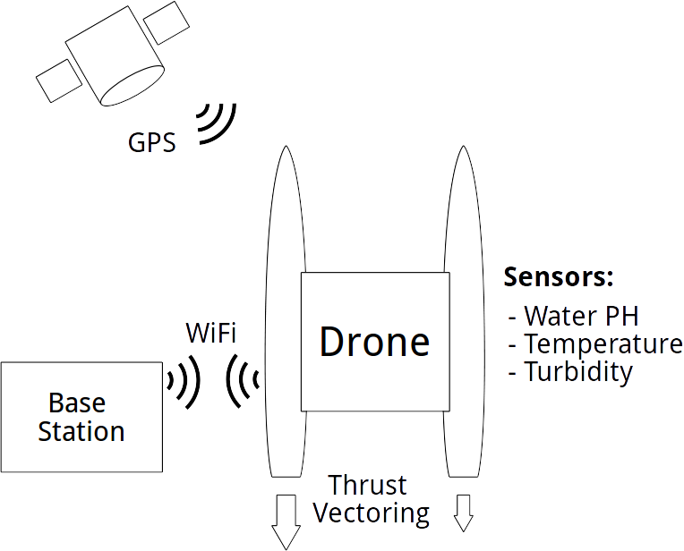
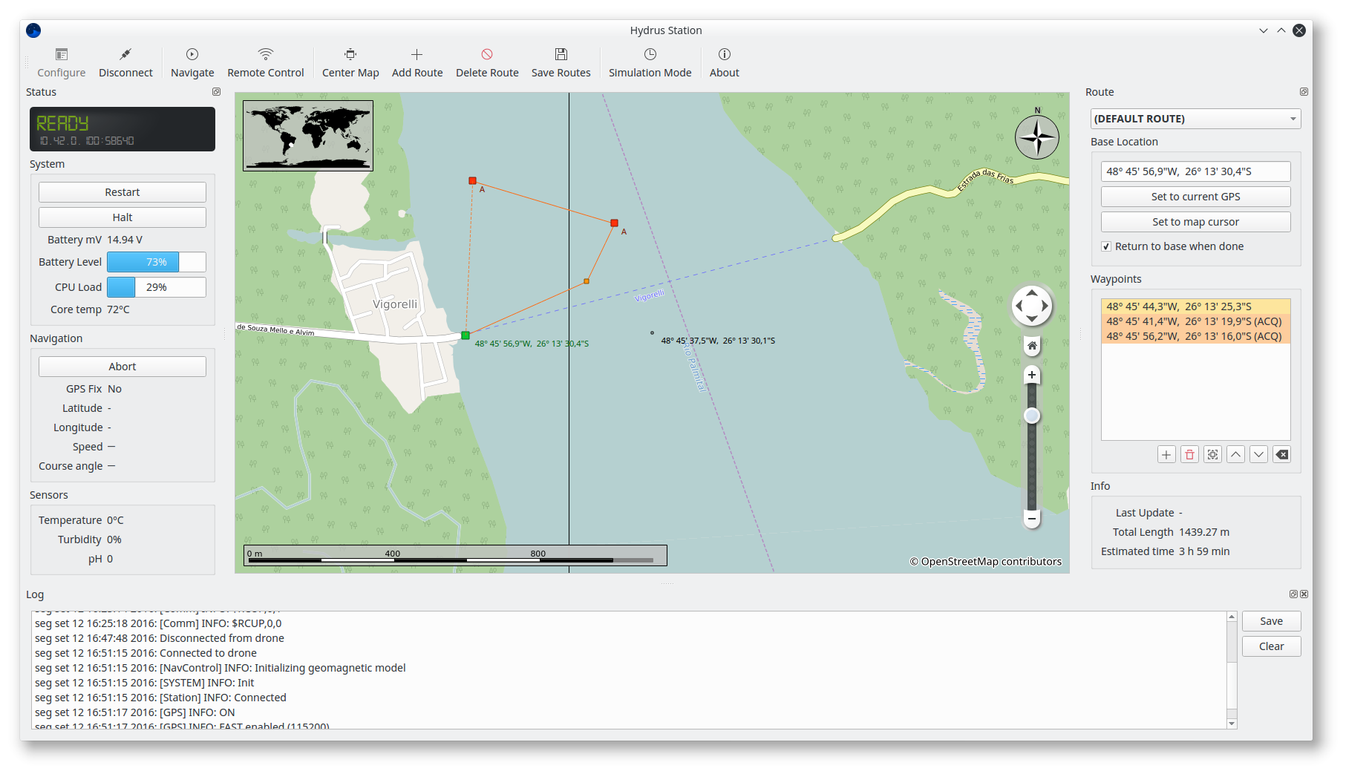
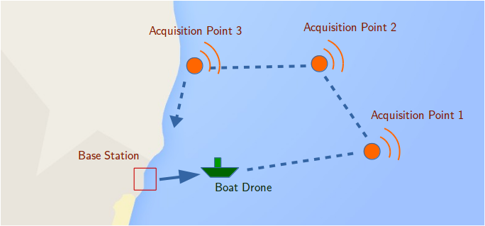


Hydrus: Autonomous Boat Drone for Water Quality Monitoring
Lucas Pires Camargo, Guilherme Pangratz, Êmili Bohrer
UFSC – Federal University of Santa Catarina
Objectives
Create an autonomous drone platform for monitoring of water quality metrics.
The boat should be able to navigate via GPS and utilize sensors to acquire and log data.
Concept
Lack of basic sanitation is a very serious problem in Brazil.
Monitoring water quality in reservoirs and other hydric resources is of strategic importance to the population.
The automatic measurement approach may help to efficiently monitor wide areas.
Methods
Navigation control was implemented by fusing GPS and magnetometer compass data. A specialized controller handles thrust vectoring.
The drone sensors read PH, turbidity, and temperature data from water using predefined GPS coordinates.
Results and Conclusions
Our boat was able to navigate successfully and perform the specified functionality.
We have a flexible platform that can be extended for other applications in the future.
Station Software

