Slide 1
Hydrus – Autonomous Drone for Hydrologic Monitoring
Lucas Pires Camargo
Guilherme Augusto Pangratz
Êmili Bohrer
Professor: Giovani Gracioli
University: Federal University of Santa Catarina – UFSC

Slide 2
Instructions
This slide is for orientation purposes only. You may delete it from your presentation.
The Title Slide and Final Slide have to be presented
Must be written in English
Please pay attention to the required content
You may not exceed the maximum slides for each section
Edit ‘Hydrus – Autonomous Drone for Hydrologic Monitoring’ on each slide footer with your project’s name

Slide 3
Required content
This slide is for orientation purposes only. You may delete it from your presentation.
What is the project? (1 slide)
Motivation (1 slide)
Project Technologies (3 slides)
  Hardware and why
  Operating System and why
  Programming languages and why
Biggest technical issue and workaround (2 slides)
Why the project is innovative? (1 slide)
Free slide (1 slide) **The team may use this slide as they wish**

Slide 4

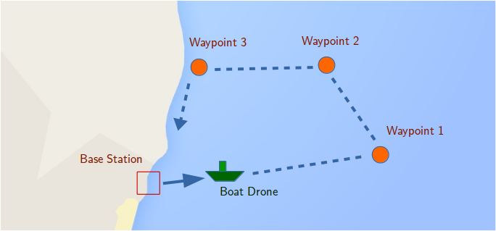
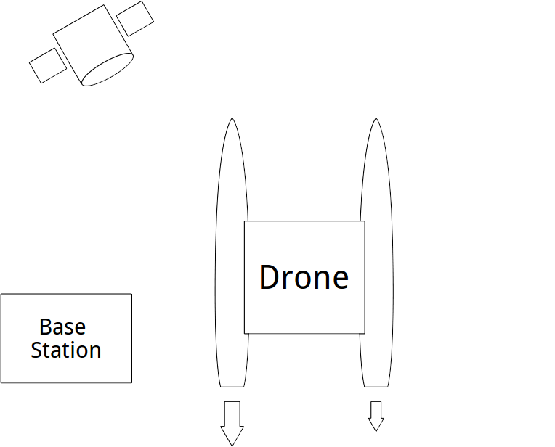
The Hydrus Project
An autonomous boat drone for data acquisition, and water quality sensing.
Able to navigate autonomously, via GPS, and collect water quality data along the way.

Slide 5
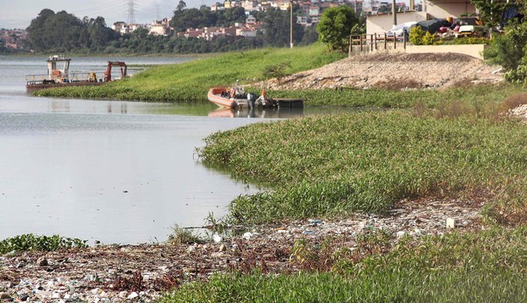
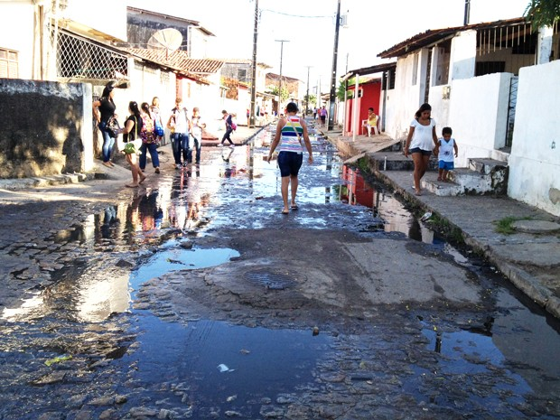
Why is it important?
65% of sewage in Brazil is dumped untreated (IGBE + SNIS 2014)
Manual monitoring of water in reservoirs is expensive, slow, and sparse.
Advances in technology and lowering costs can help solve problems more easily.
Our drone can…
  Increase the number of measurements.
  Geotag all measurements by default.
Open sewage in João Pessoa, PB
Source: goo.gl/34XWrf
Garbage floating in a SP reservoir
Source: goo.gl/SnBXYp

Slide 6
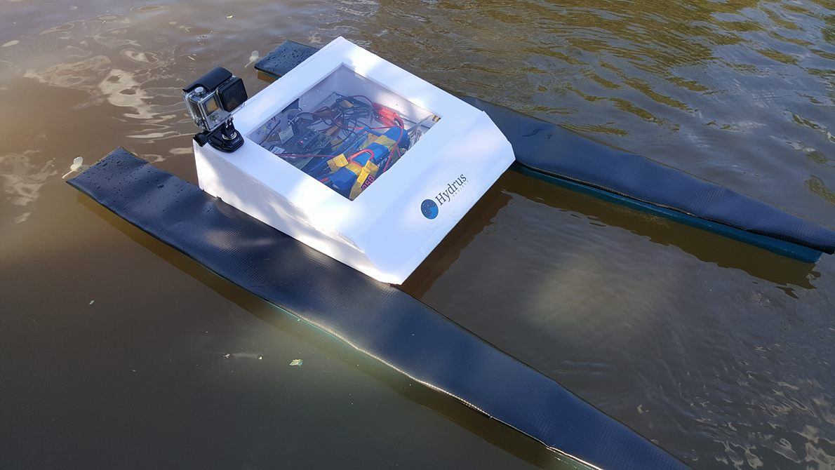
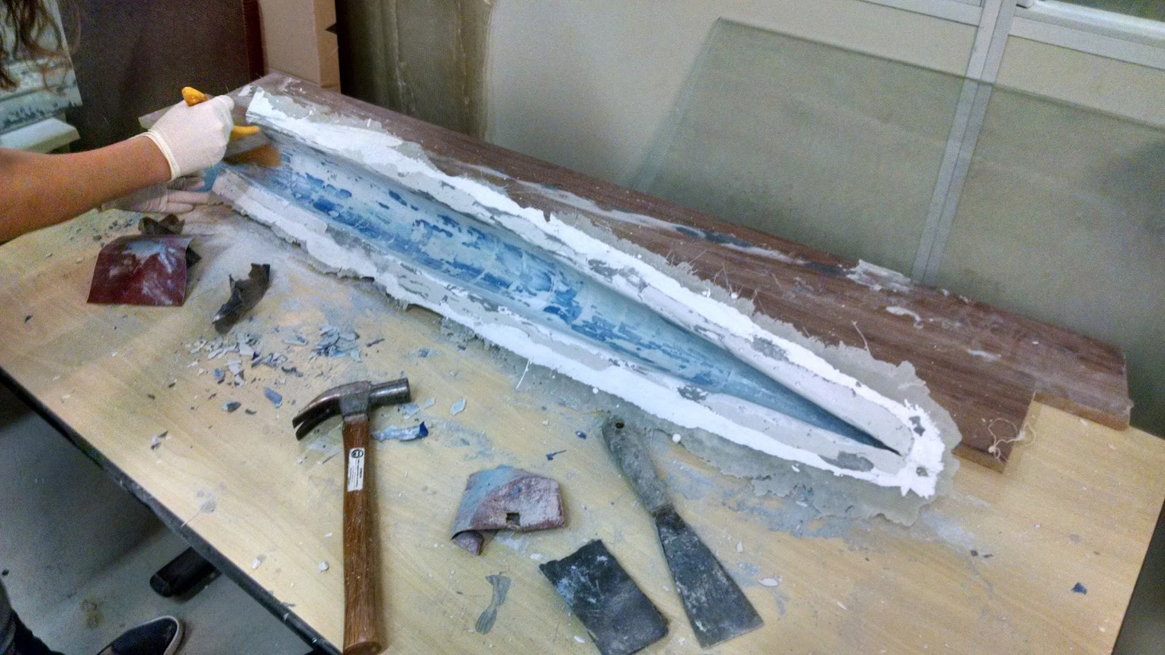
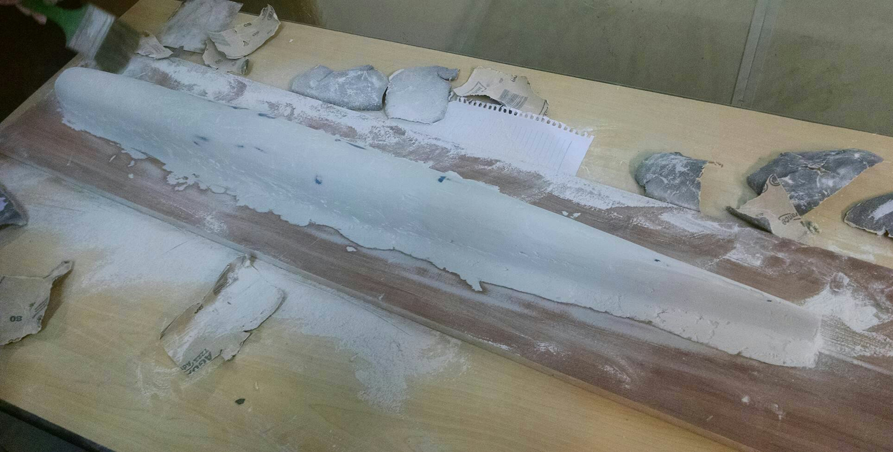
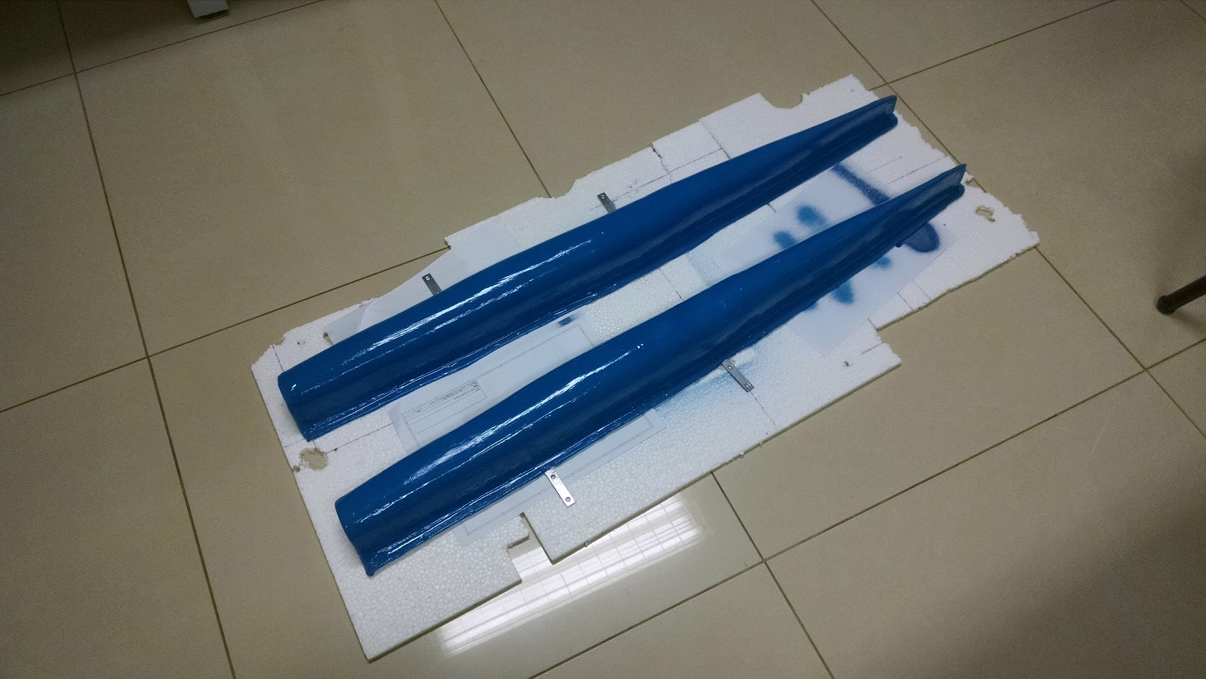
Boat Frame
We decided to build our own boat from scratch.
Laminated fiberglass on a custom mold.
Adequate size and build for our application.
The hulls
The mold
Hydrus V1
The plug
“From zero to boat in a couple of months”

Slide 7
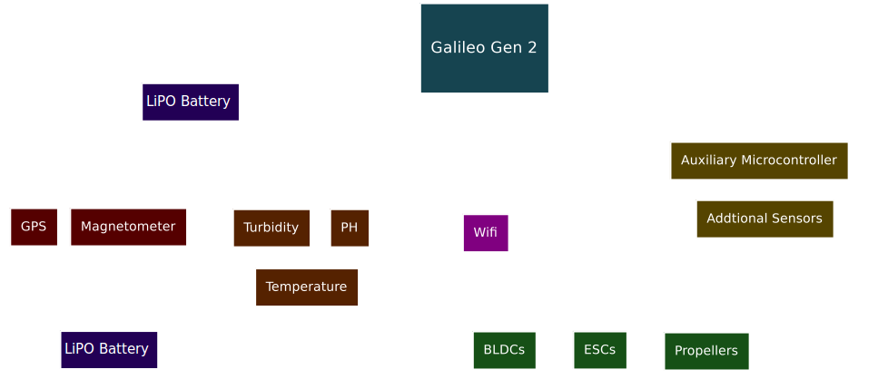
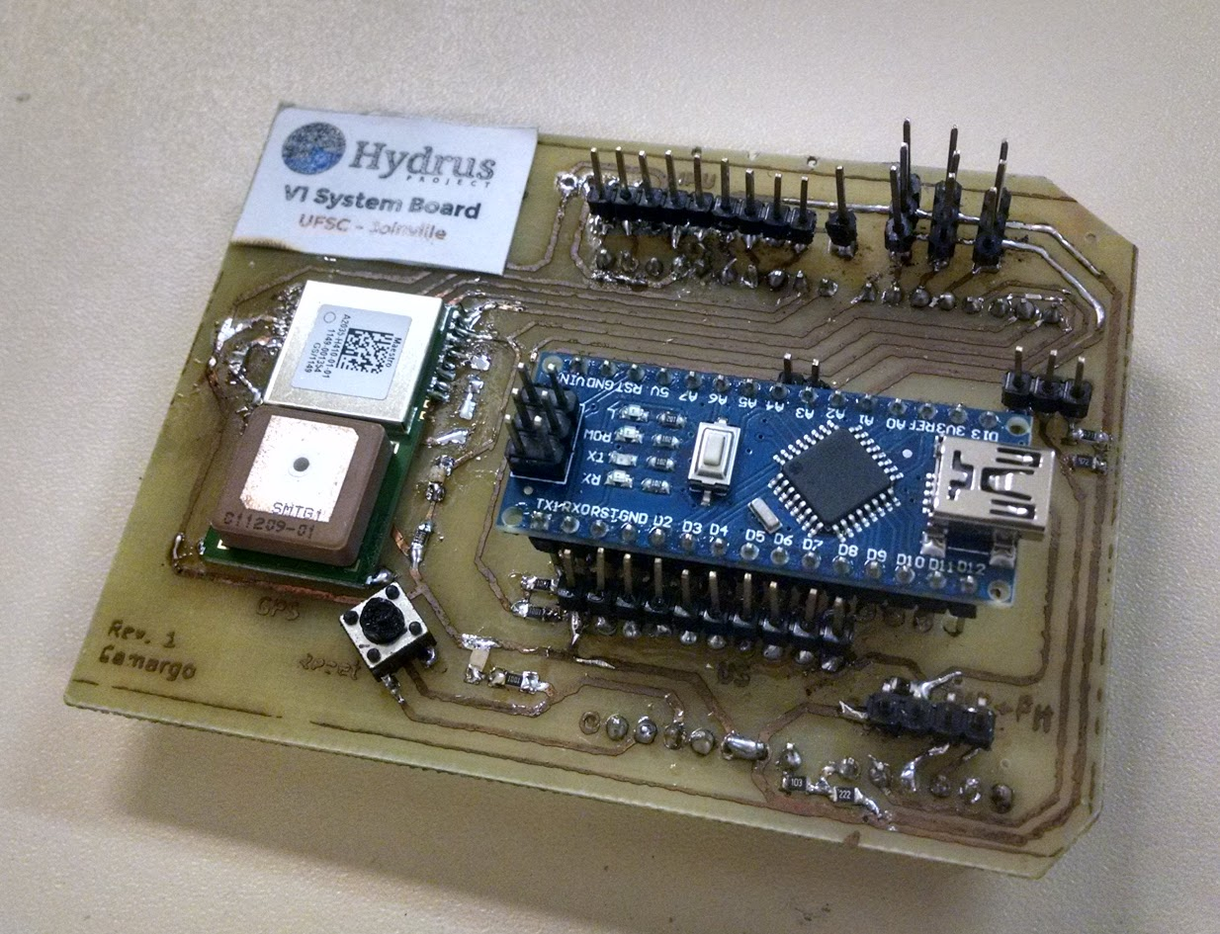
Hardware
GPS and magnetometer for navigation.
WiFi module for base communication.
PH, turbidity, and temperature sensors.
Additional sensors can be connected to auxiliary µC.
Our custom Galileo shield

Slide 8
Software
Custom built C / C++ firmware, with standard IoT image.
Cyclic executive scheduler + blackboard architecture.
System Task
Blackboard
Task | Execute (A) | Execute (B) | Period
System | ✓ | ✓ | 0.02s
Sense | ✓ | ✓ | 0.02s
Nav | ✓ |  | 0.04s
Comm |  | ✓ | 0.04s
Sensing Task
Sensor data
Scheduler
Navigation data
Navigation Task
System state
Comm. Task
Cyclic task Schedule. Major period is 0.04s

Slide 9
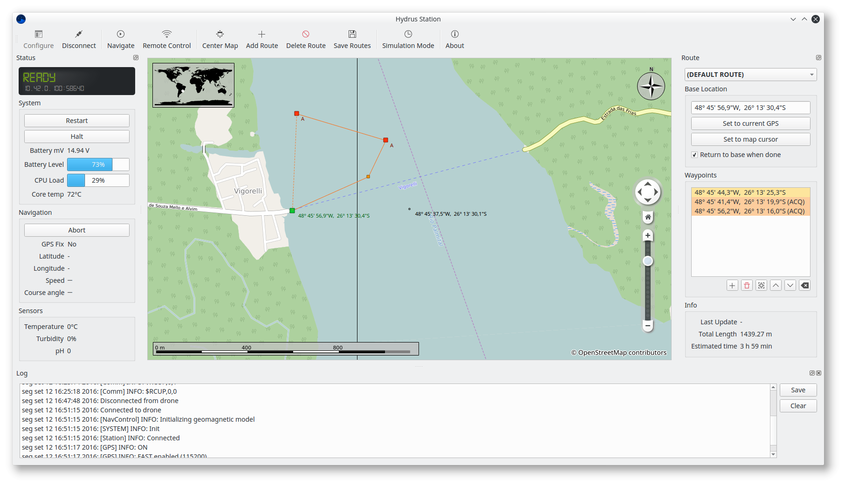
Base Station Software
Main toolbar
Drone status
Route planner
Map View
Log viewer

Slide 10
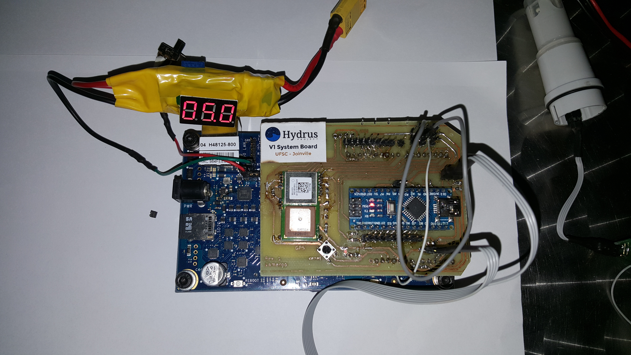
Technical issues
We found the Galileo Gen 2 board to be very sensitive.
  Inadequate inrush current protection: we had the regulator catch fire because we plugged the board to a lithium battery (14.5V).
  There should be a separate I2C bus for the onboard peripherals: any interference would bring the sketch to a halt.
  We bricked one probably because the IOREF jumper was loose...

Slide 11
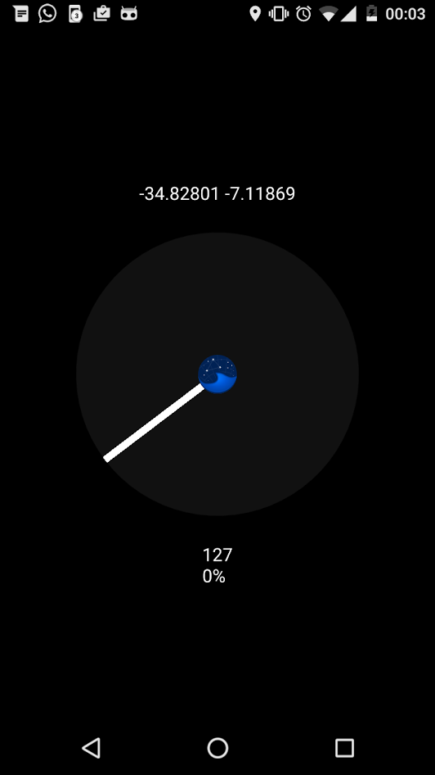
Workarounds
A couple of boards were brought back to life by supplying +5V directly.
We created a GPS-publisher phone app for situations it was hard to get the GPS module to fix to the satellites.
  Overcast weather, old almanac data, etc
5V_ALWAYS_ON
Regulator + Filter
Galileo Gen 2
Simple solution for blownup regulator (U6)
Helper Android application

Slide 12
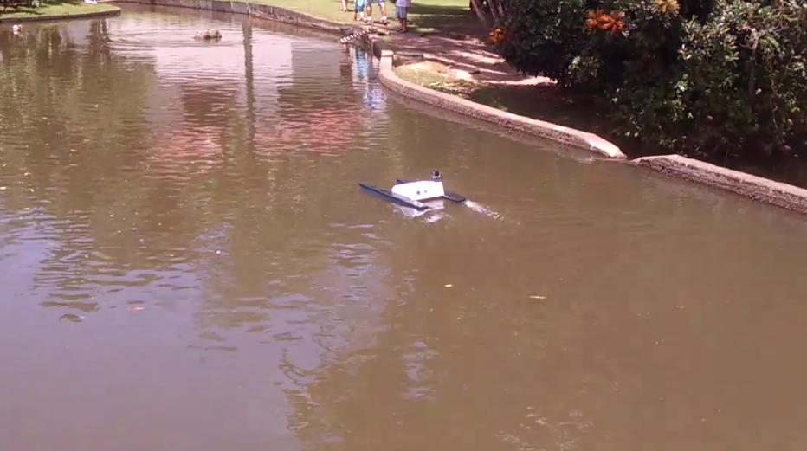
Why the project is innovative?
A handmade, low-cost boat drone that can navigate autonomously, and collect data on water quality along the way.
Modular hardware and software. Custom physical frame.
Our drone is a framework that can be easily extended to support additional sensors and applications.
Item | Price (USD)
Boat frame | $60.00
Battery + Powertrain | $51.00
Galileo Gen 2 | $77.00
Sensors and Modules | $129.00
Total | $317.00

Slide 13
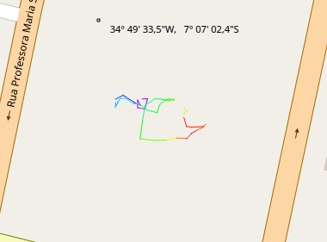
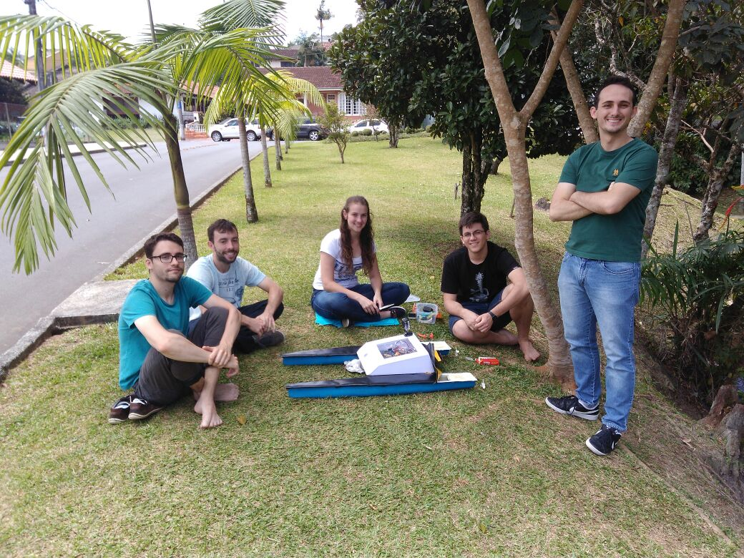
Results and Future Plans
The drone is able to reach programmed waypoints and navigate correctly.
The companion application allows the user to plot collected data spatially.
We plan to study the usage of the boat for sonar bathymetry applications.
We also want to investigate additional energy sources, such as solar.
Min
Max
Plot of collected temperature data on a mock route

