Slide 1

The Hydrus Project
Autonomous Aquatic Vehicle for Water Quality Monitoring
Lucas Pires Camargo
Guilherme Augusto Pangratz
Êmili Bohrer
Dr. Prof. Giovani Gracioli
UFSC – Federal University of Santa Catarina

Slide 2
Outline

Slide 3
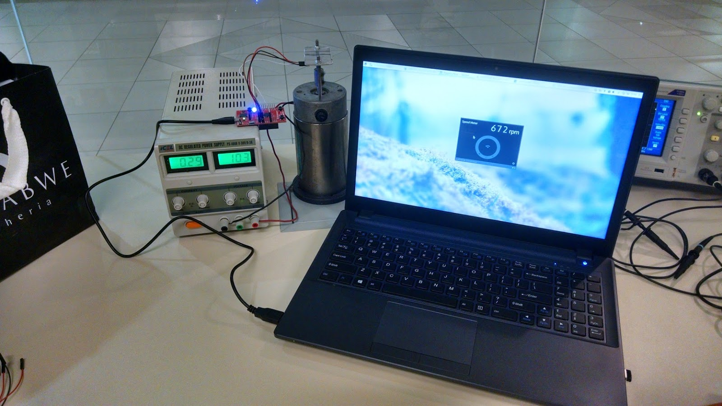
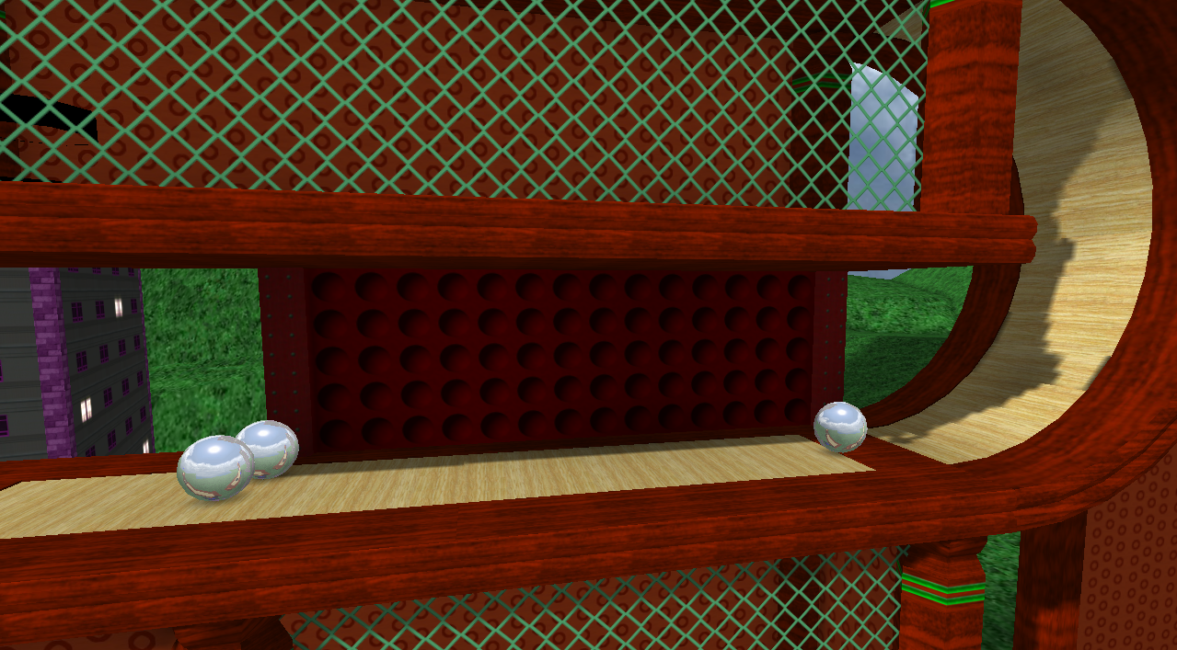
Who is this guy?
Mechatronics Engineering student at Federal University of Santa Catarina.
Researched real-time operating systems under Prof. Giovani at LISHA, published paper.
1-year exchange program at University of Tampere, Masters Degree Program in Software Development.
Worked with Intel Finland on a project developing use-cases and a proof-of-concept for RealSense.
FOSS nerd :)
Instrumentation and control
Game engine development

Slide 4

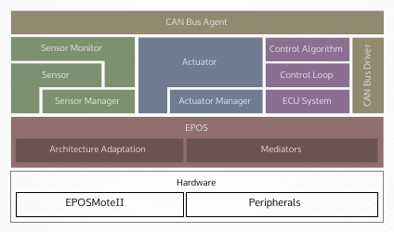
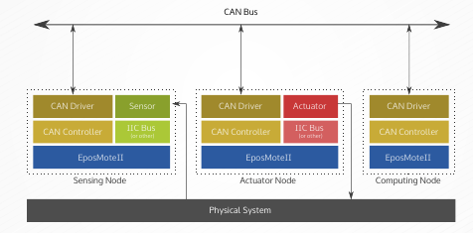
Research at LISHA
Focused on RTOS and their application in control systems.
Control architecture integrated into EPOS, the operating Sytem developed at LISHA

Slide 5
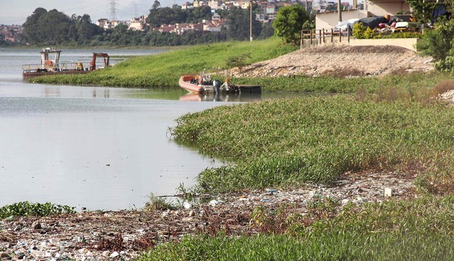
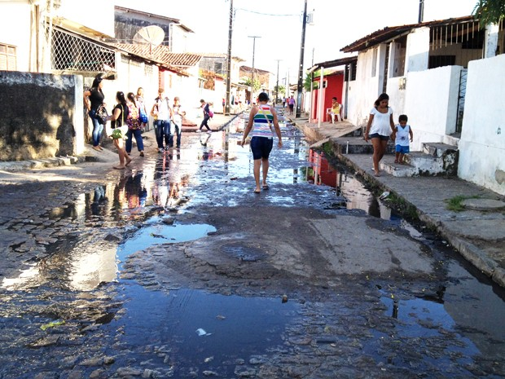
Context
Brazil has a lot of problems concerning basic sanitation
  65% of sewage in Brazil is dumped untreated (IGBE + SNIS 2014)
  Manual monitoring of water in reservoirs is expensive, slow, and sparse
  Hopefully, advances in technology and lowering costs can improve monitoring speed and functionality
Garbage floating in a SP reservoir
Open sewage near João Pessoa, PB

Slide 6
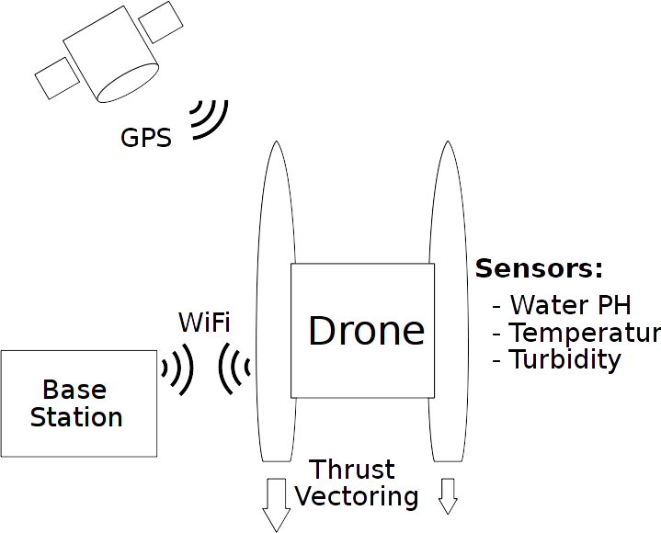
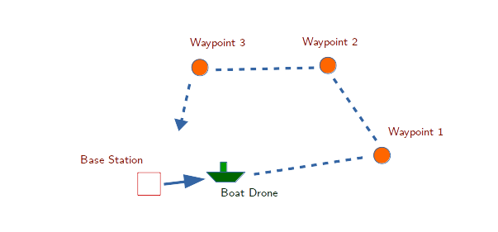
The Hydrus Project
An autonomous boat drone for data acquisition, and water quality sensing.
Able to navigate autonomously, via GPS, and collect water quality data along the way.

Slide 7
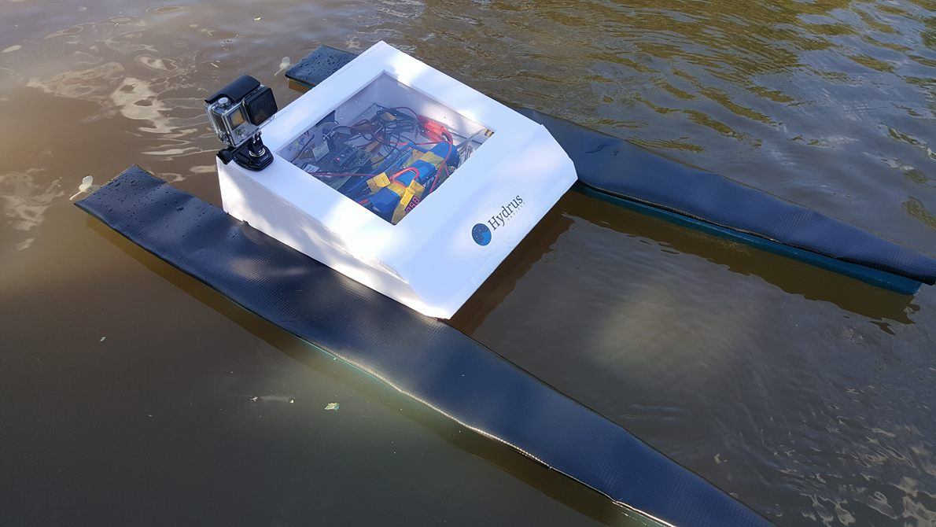
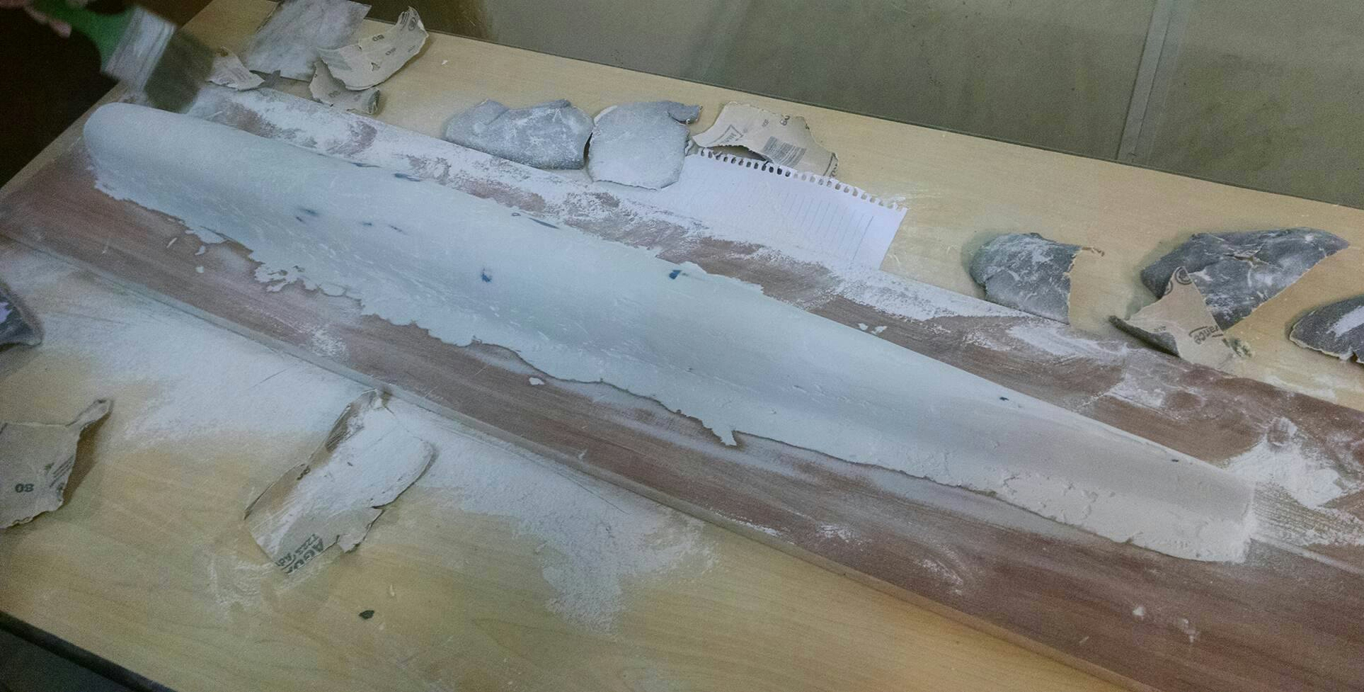
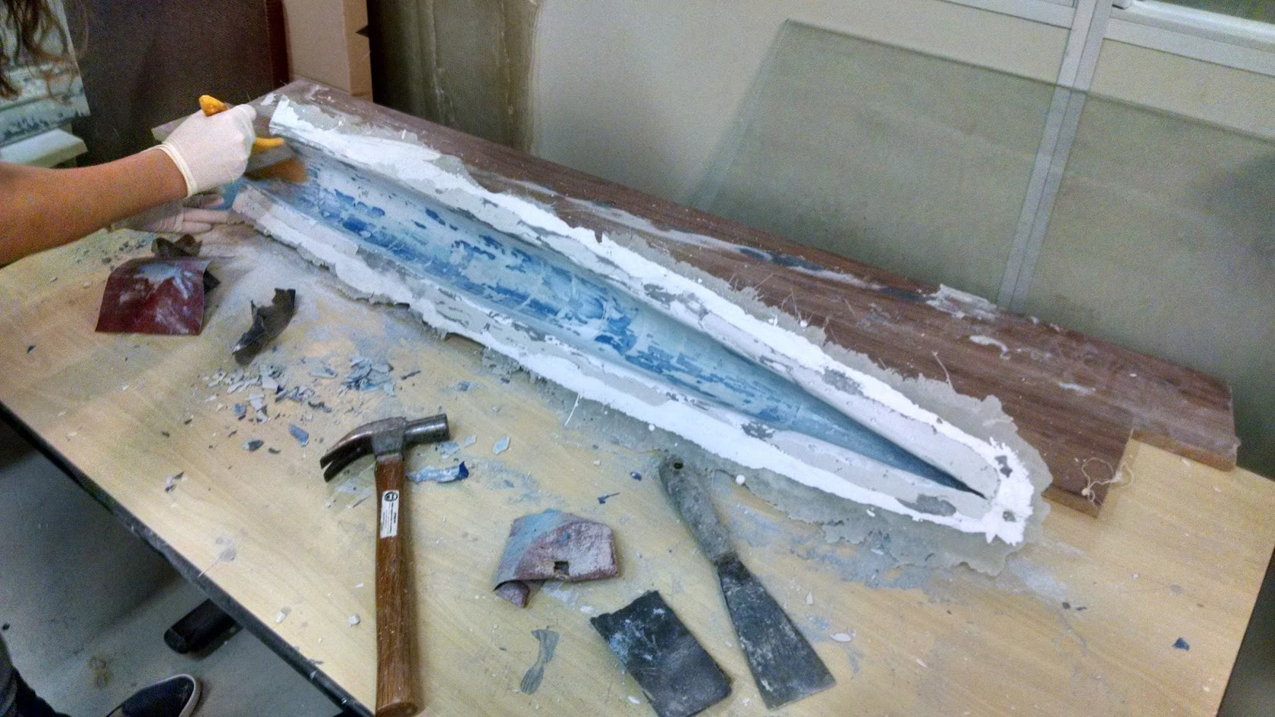
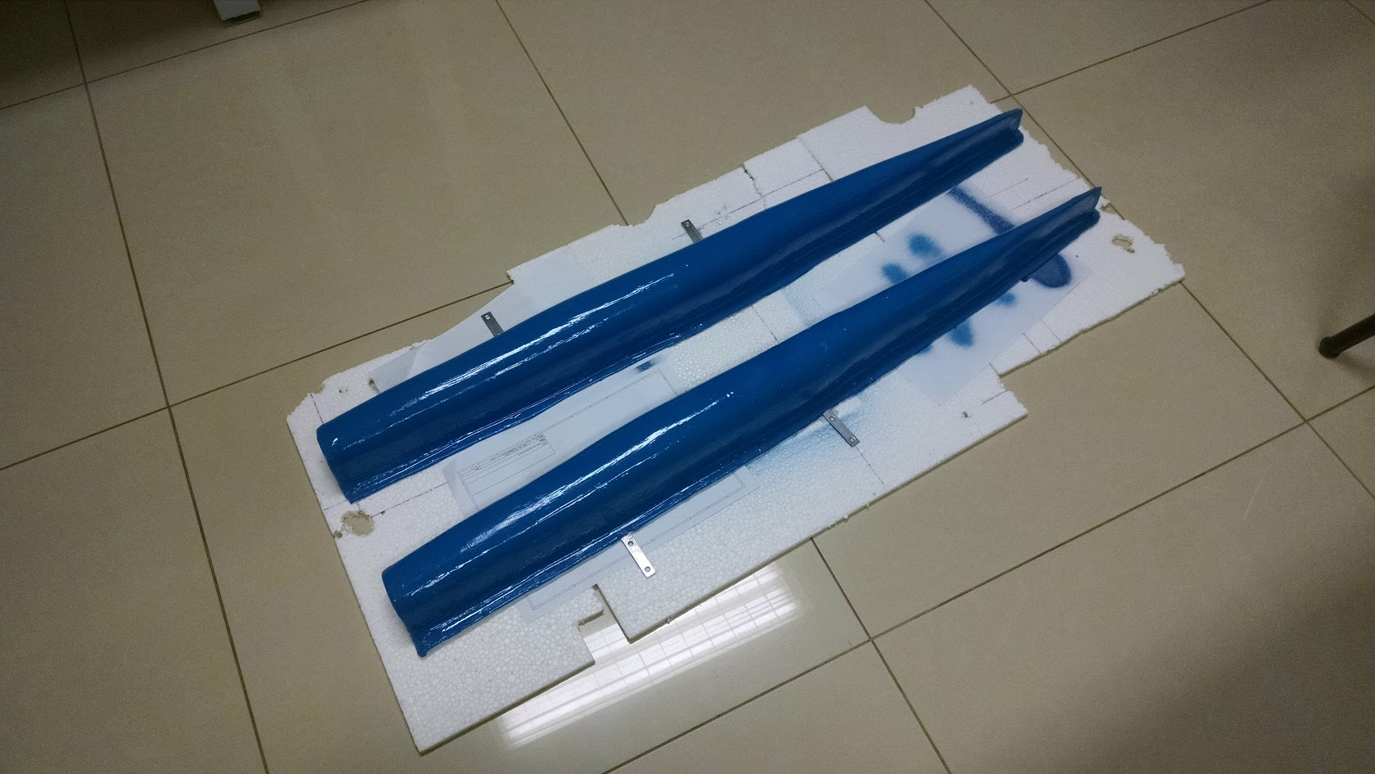
Implementation
The boat frame was built from scratch at UFSC, using infrastructure from the Naval Engineering program.
As per competition rules, the hardware was built around the Galileo Gen 2 platform.
Hydrus v1

Slide 8
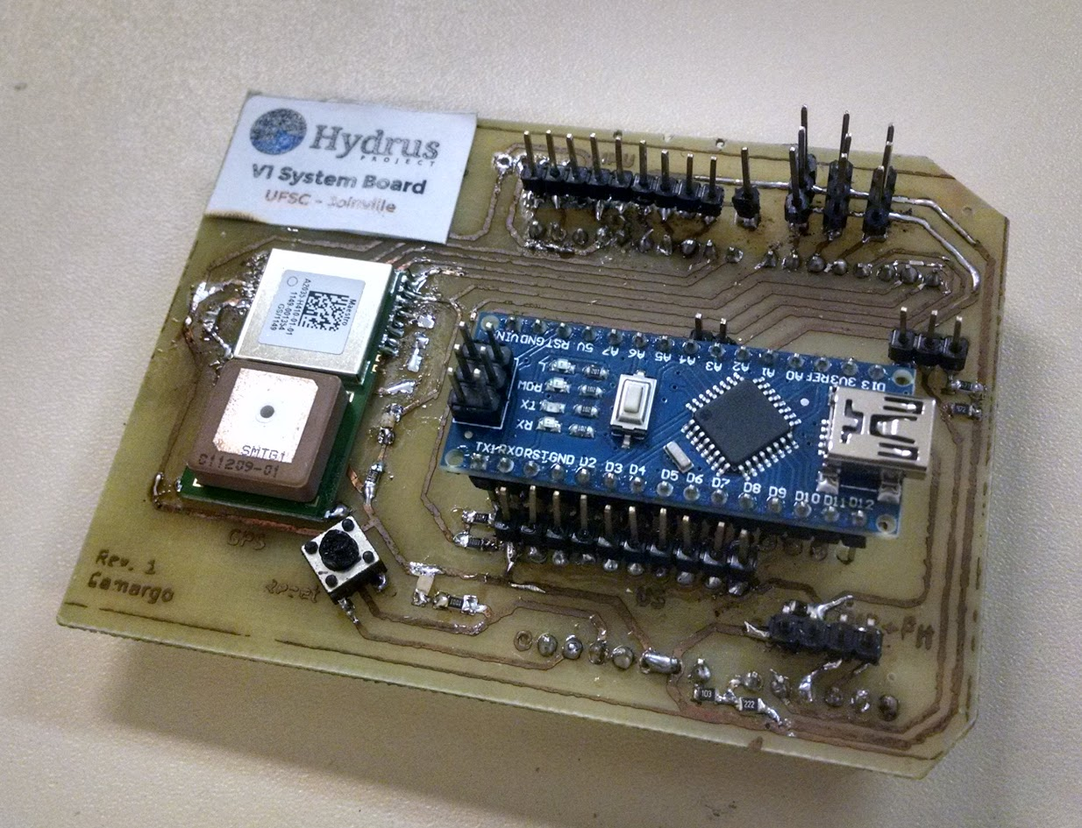
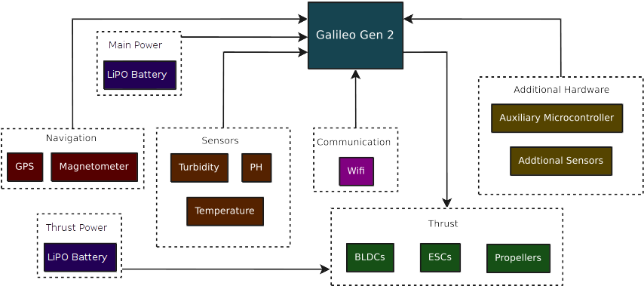
Hardware
GPS and magnetometer for navigation.
WiFi module for base communication.
PH, turbidity, and temperature sensors.
Additional sensors can be connected to auxiliary µC.
Custom shield for Galileo

Slide 9
Embedded Software
Custom built C / C++ firmware, atop standard IoT image.
Cyclic executive scheduler + blackboard architecture.
System Task
Blackboard
Task | Execute (A) | Execute (B) | Period
System | ✓ | ✓ | 0.02s
Sense | ✓ | ✓ | 0.02s
Nav | ✓ |  | 0.04s
Comm |  | ✓ | 0.04s
Sensing Task
Sensor data
Scheduler
Navigation data
Navigation Task
System state
Cyclic task Schedule. Major period is 0.04s
Comm. Task

Slide 10
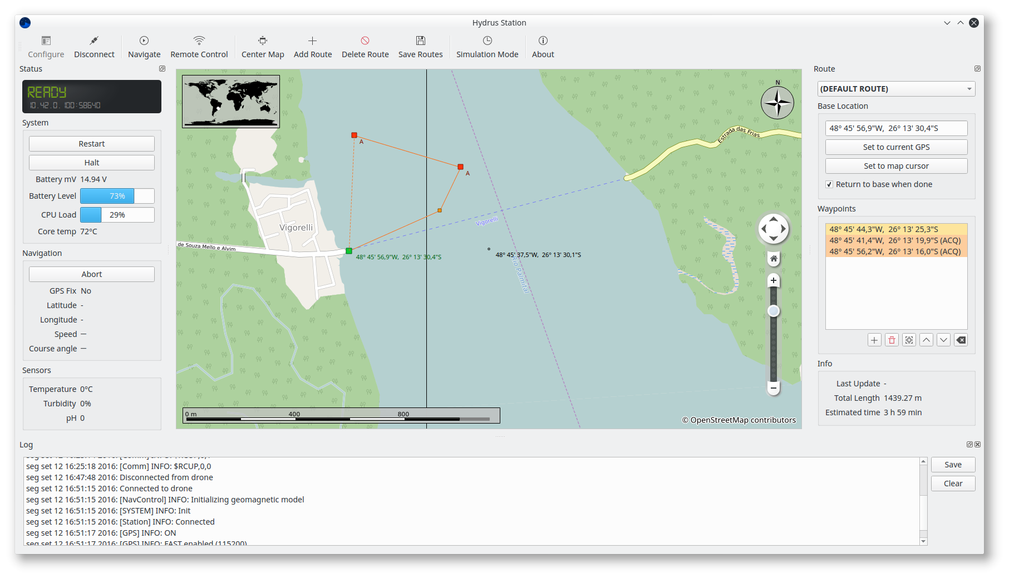
Interface Software
Main toolbar
Drone status
Route planner
Map View
Log viewer

Slide 11
A better look at the Hydrus v1 autonomous aquatic vehicle

Slide 12
(insert video here)

Slide 13
Current Status
This project is my current term paper subject. Hydrus v2 is in development.
The hardware platform is being moved away from the discontinued Galileo towards a dual platform setup:
  Raspberry Pi Zero W
  EPOS 2 atop Emote III
Improvements are mainly hardware consolidation, removal of hacks and workarounds, and preparation for future work.

Slide 14
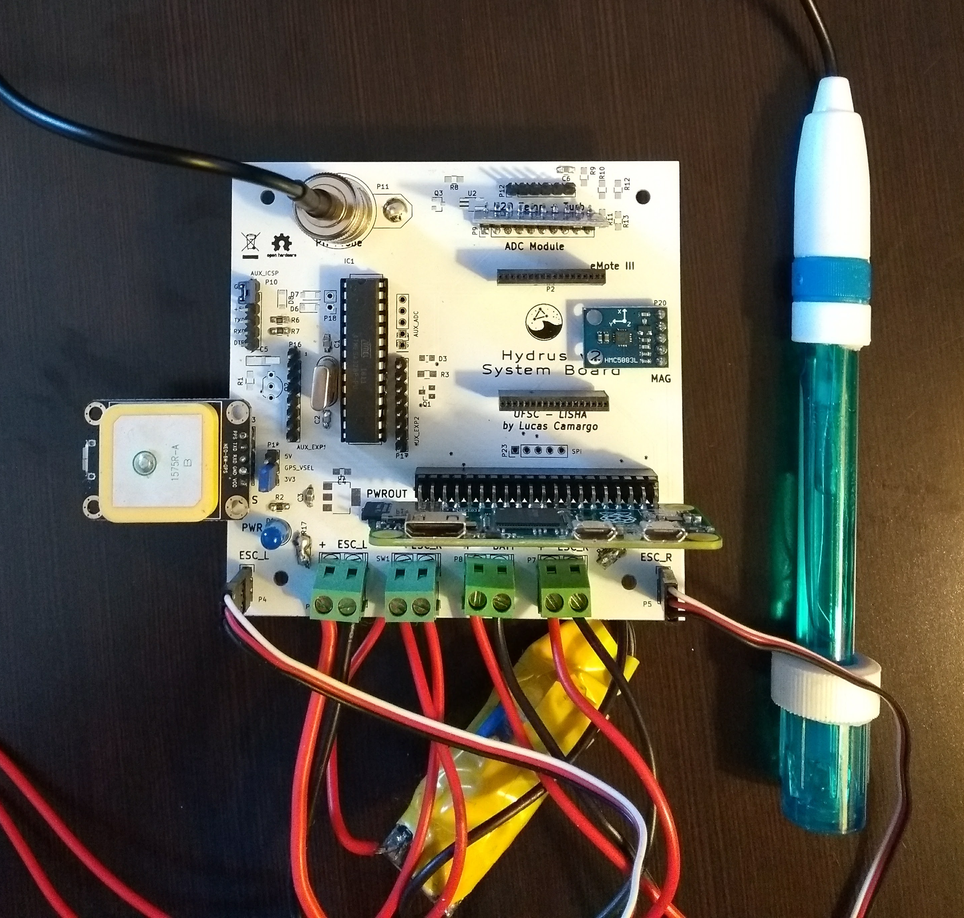
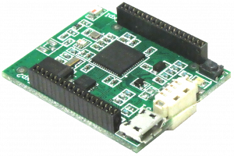
Future Work
We have a flexible platform that can be adapted to provide a variety of solutions.
Next steps involve researching solar power integration, and bathymetry sensors.
Looking for partnerships and new applications.
Hydrus v2 hardware platform
EPOS Mote III

Slide 15
Thank you!
Any questions?
Contact:
camargo@lisha.ufsc.br
giovani@lisha.ufsc.br

