Slide 1
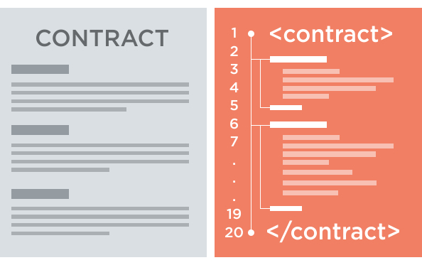
SECURITY CHALLENGES IN SMART CONTRACTS
Lucas pelloni
Ile cepilov

Slide 2
Content

Slide 3
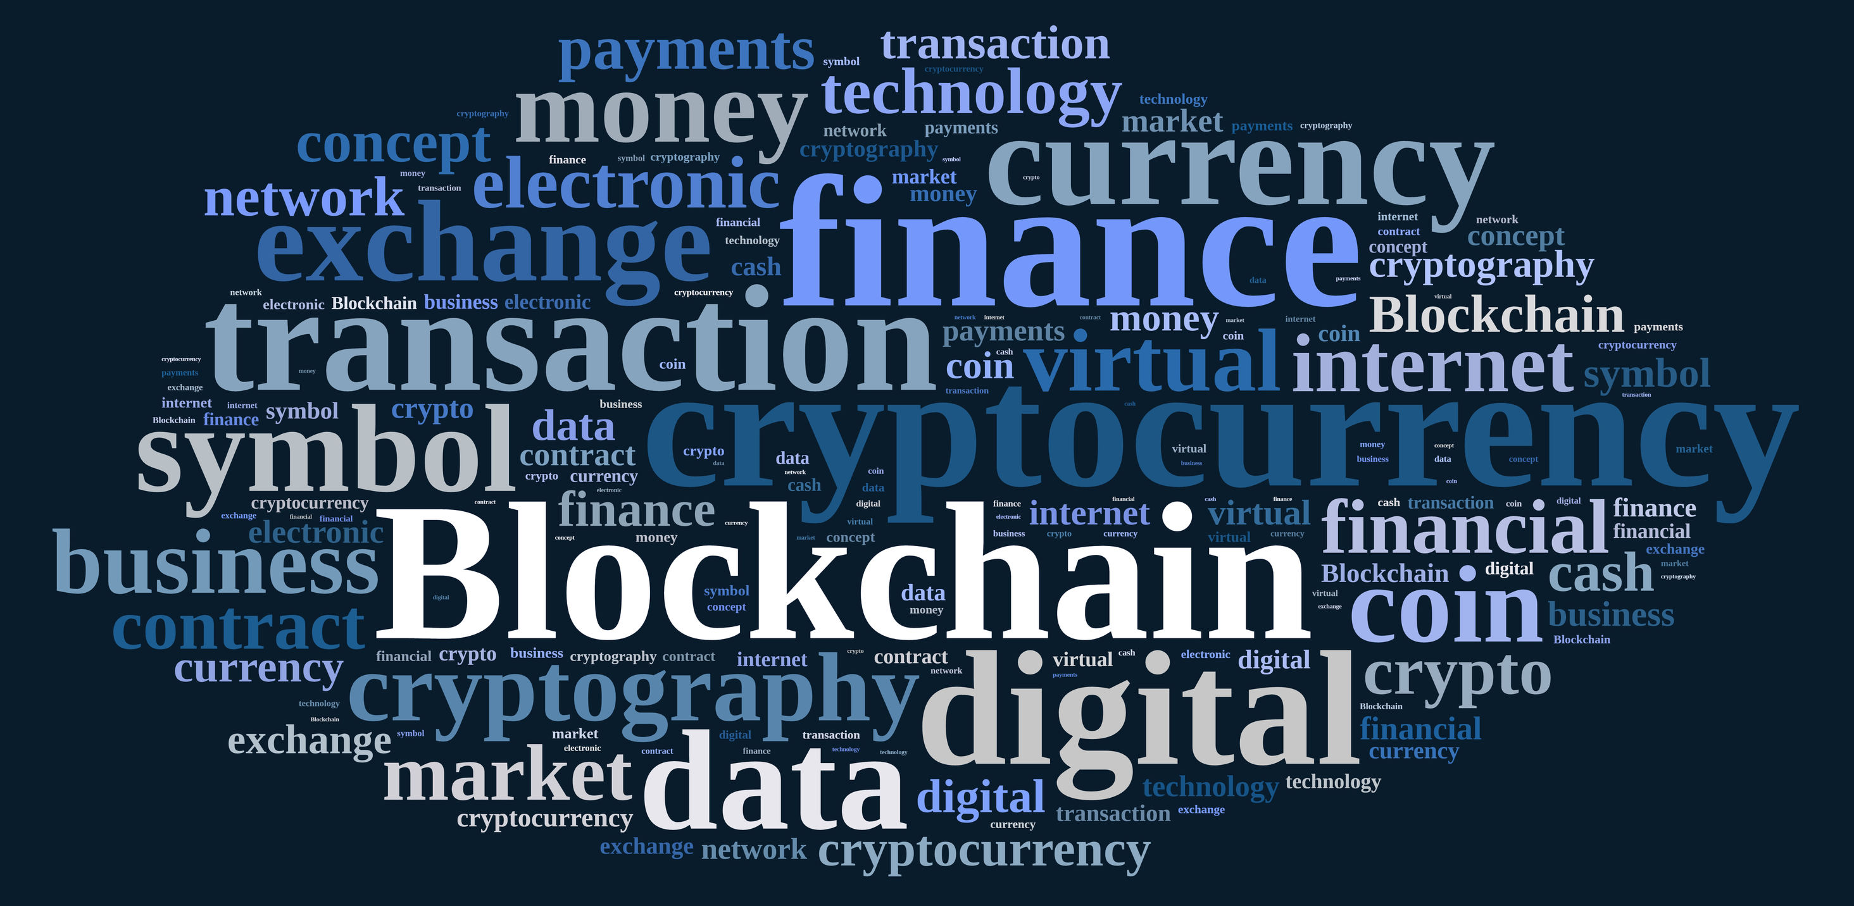
2. Blockchain technology
What is a Blockchain?
How does it work?
Benefits of Blockchain Technology
Blockchain applications

Slide 4
2.1 What is a blockchain?
Distributed Database
Public digital ledger
Source of Trust
Notes:
DISTRIBUTED DB
Blockchain technlogy is challenging the status quo in a radical way, by using math and cryptogrnaphy.
Blochchain provides an open decentralised database of every transaction involing value (Money, goods, property word or even votes)
Creating a record whose authenticity can be verified by the entire community -> Thirty part trust organisations may no longer be necessary
PUBLIC LEDGER
Every transaction will be recorded on a public and distributed ledger
SOURCE OF TRUST
Blockchain will become a global decentralised source of trust
Everything that is centralized makes it easy to attack because it offers a single point of failure.
(e.g. Firewall of a website).
Application built with Bloch chain technlogy do not require users to trust the developers with personal information or funds.
Currently, most people use a trusted middleman such as a bank to make a transaction. But blockchain allows consumers and suppliers to connect directly, removing the need for a third party.

Slide 5
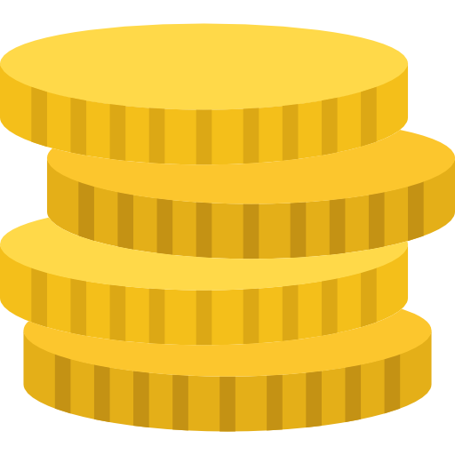


2.2 How does blockchain work?
Notes:
Alice wants to buy a product from bob’s store and she wants cryptovalues (e.g. bitcoins)

Slide 6

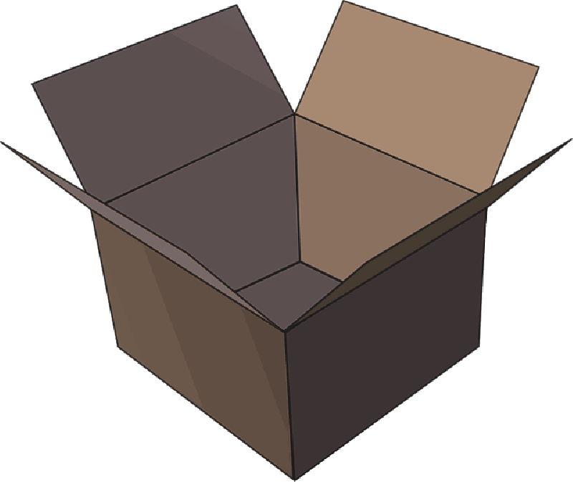
2.2 How does blockchain work?
Notes:
The transaction can be represented online as a ‘block’

Slide 7



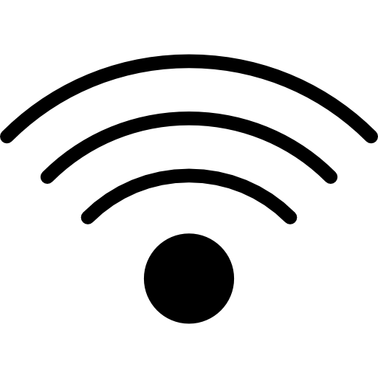
2.2 How does blockchain work?
Notes:
The block (resp. the transaction) is broadcast across the entire network

Slide 8

2.2 How does blockchain work?
Notes:
Which validates it
D6812B

Slide 9
2.2 How does blockchain work?
Notes:
The block is then added to the chain which records the entire NON-reversible (indelible) history of transactions in a public ledger
D6812B

Slide 10
2.2 How does blockchain work?
Notes:
The money moves from Alice to Bob

Slide 11
2.3 Benefits of blockchain

Slide 12
2.4 Blockchain applications
Notes:
The uses of blockchain technology are endless

Slide 13
Smart Contracts & Blockchain
Notes:
Think of it as wills and contract that execute themselves

