Slide 1
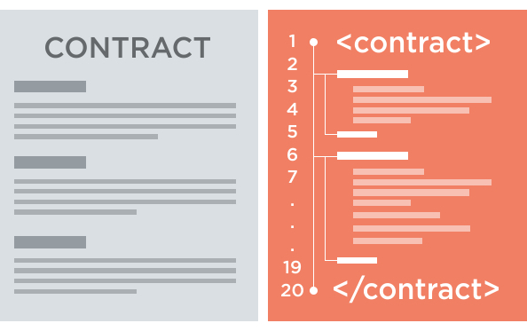
SECURITY CHALLENGES IN SMART CONTRACTS
Lucas pelloni
Ile cepilov

Slide 2
Content

Slide 3
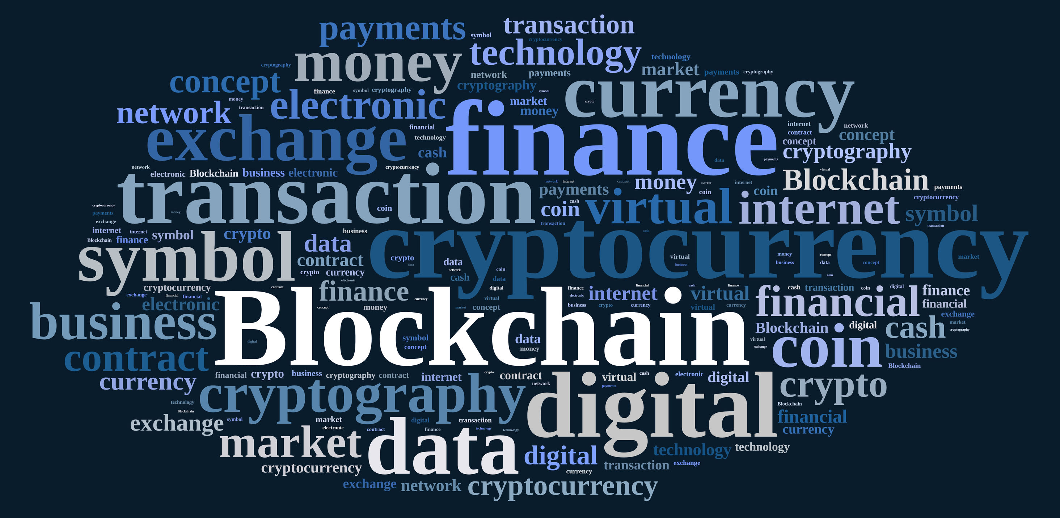
2. Blockchain technology
What is a Blockchain?
How does it work?
Benefits of Blockchain Technology
Blockchain applications

Slide 4
2.1 What is a blockchain?
Distributed Database
Public digital ledger
Source of Trust
Notes:
DISTRIBUTED DB
Blockchain technlogy is challenging the status quo in a radical way, by using math and cryptogrnaphy.
Blochchain provides an open decentralised database of every transaction involing value (Money, goods, property word or even votes)
Basically, a BC is an append-only data structure mainteined by the nodes of a peer-to.peer network
Creating a record whose authenticity can be verified by the entire community -> Thirty part trust organisations may no longer be necessary
PUBLIC LEDGER
Every transaction will be recorded on a public and distributed ledger
SOURCE OF TRUST
Blockchain will become a global decentralised source of trust
Everything that is centralized makes it easy to attack because it offers a single point of failure.
(e.g. Firewall of a website).
Application built with Bloch chain technlogy do not require users to trust the developers with personal information or funds.
Currently, most people use a trusted middleman such as a bank to make a transaction. But blockchain allows consumers and suppliers to connect directly, removing the need for a third party.

Slide 5
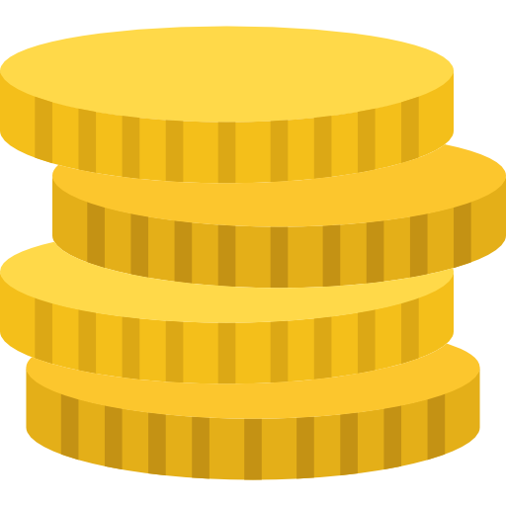


2.2 How does blockchain work?
Notes:
Alice wants to buy a product from bob’s store and she wants cryptovalues (e.g. bitcoins)

Slide 6

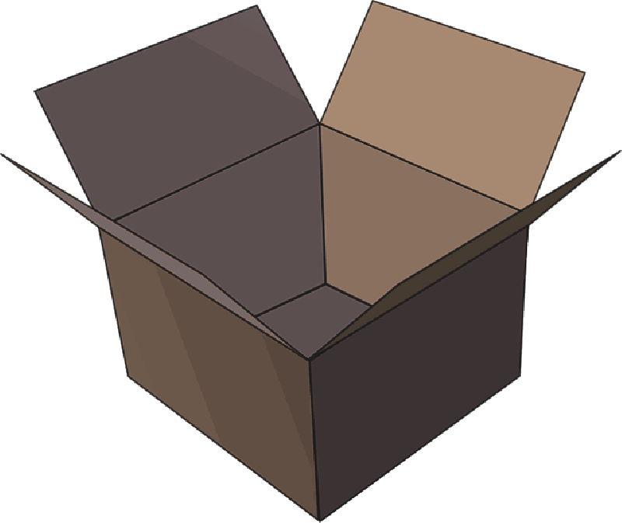
2.2 How does blockchain work?
Notes:
The transaction can be represented online as a ‘block’

Slide 7




2.2 How does blockchain work?
Notes:
The block (resp. the transaction) is broadcast across the entire network

Slide 8

2.2 How does blockchain work?
Notes:
Which validates it

Slide 9
2.2 How does blockchain work?
Notes:
The block is then added to the chain which records the entire NON-reversible (indelible) history of transactions in a public ledger

Slide 10
2.2 How does blockchain work?
Notes:
The money moves from Alice to Bob

Slide 11
2.3 Benefits of blockchain
Decentralization of technology
Transactions are immutable
Distributed shared Ledger
… but there are also some hurdles ...
Notes:
No middleman (transactions between users are instantaneous)
A centralized system it’s easier to attack.
For Example if you have to execute a transaction through a bank you have to pay a fee for it, whereas using blockchain technology you don’t have to pay
------------------------------------------
Transactions are not prone to third part interference
--------------------------------------------------------------------------
The transactions data, are available online to everyone on the distributed shared ledger

Slide 12
2.4 Blockchain applications
Decentralized exchanges (e.g. Bitcoin)
Encrypted cloud storage (e.g. Storj)
Digital identity
And also . . .
Notes:
One of the most famous blockchain application is the transfer of bitcoins used for online trades.
2. Cloud shared by the community (where each file is shredded and encrypted and spread across the network)
3. Blockchain application can be applied to identity applications, like Passports, Birth Certificates, IDs, Online accounts, and so on

Slide 13
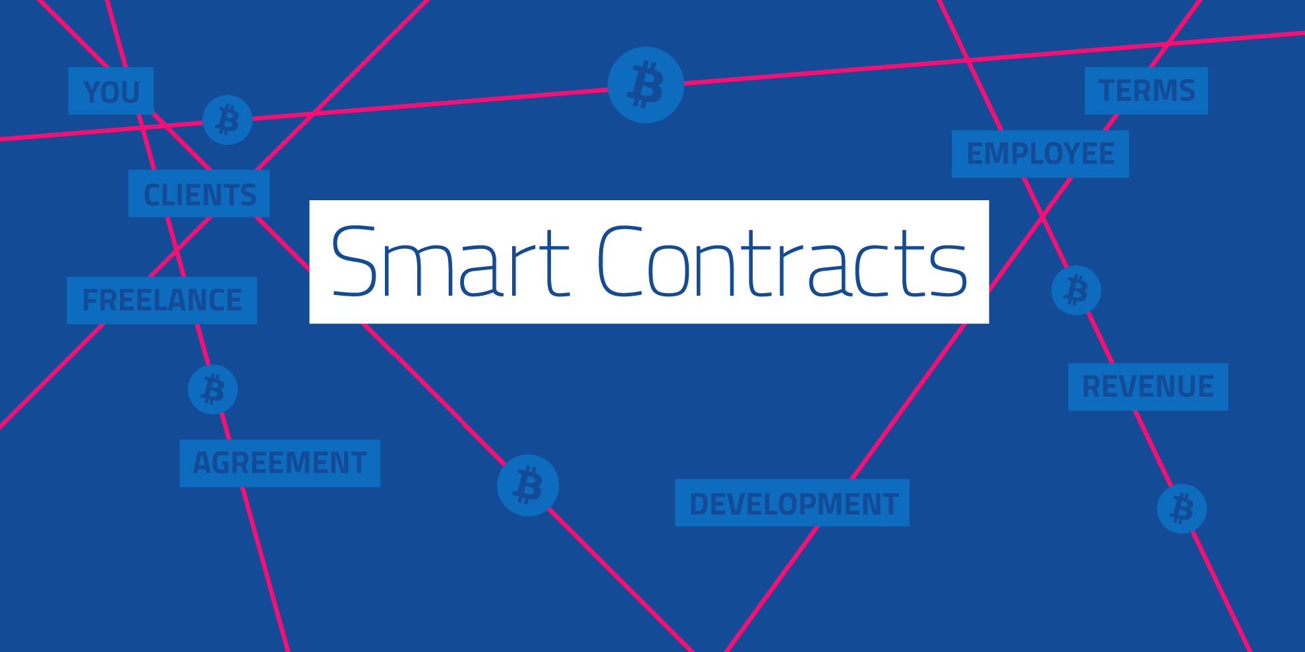
Notes:
Think of it as wills and contract that execute themselves

Slide 14
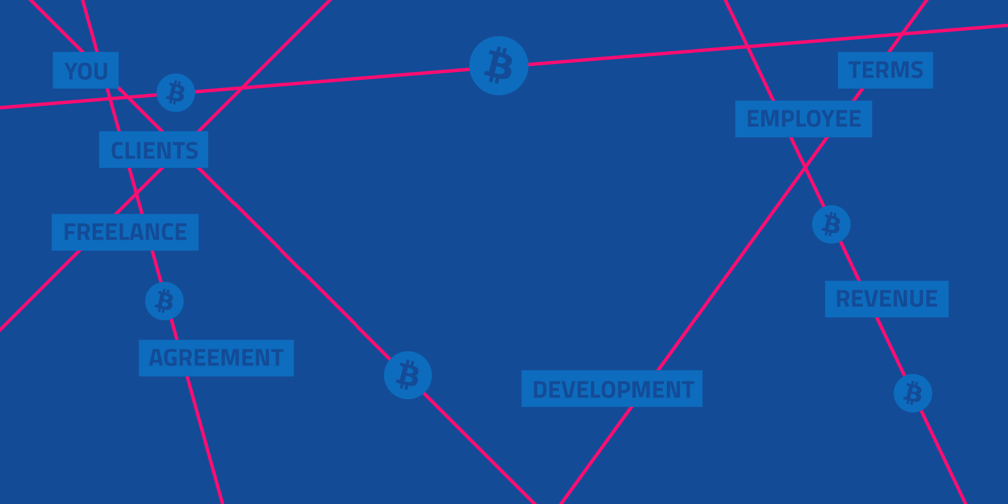
3. Smart Contracts
What is a Smart Contract?
Traditional Contract vs. Smart Contracts
What goes into a Smart Contract?
Possible applications
Ethereum, Blockchain-based Platform
Notes:
Think of it as wills and contract that execute themselves

Slide 15
3.1 What is a smart contracT?
A smart contract is a piece of software that defines the rules of an agreement
It automatically verifies itself and executes the terms contained inside it
Stored on the Blockchain
Notes:
A SC is a piece of software that stores rules for negotiating the terms of a contract, automatically verifies the contract and then executes the agreed terms.
Smart contracts are computer programs that can be correctly executed by a network of mutually distrusting nodes, without the need of an external trusted authority, which means that are the nodes the “autorithy”, who validates the valid execution of a smart contract
Encrypted and Stored on the blockchain
To append a new block of data (the code for the execution of a SC) to the blockchain, the miners have to validate the exectuion of the SC
SC are stored on the blockchain which all parties have a copy of and if any party fails the system continues to functions with no loss of data or integrity

Slide 16
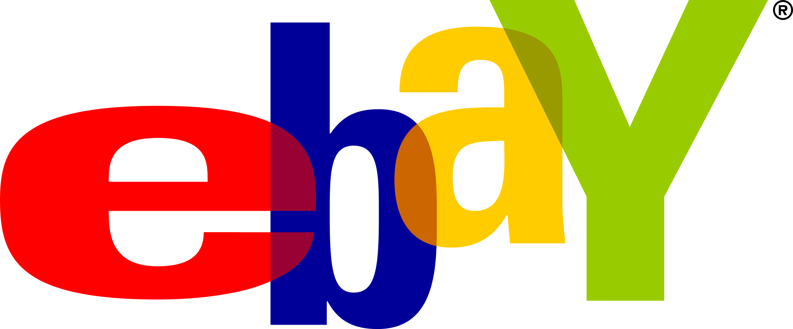
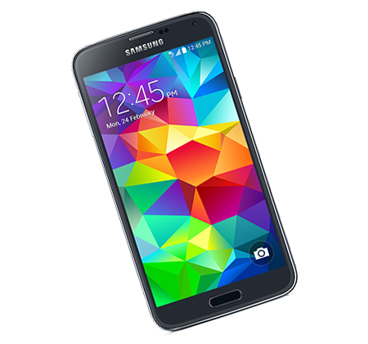
3.1 Scenario Example
Notes:
1. Alice wants to buy a SmartPhone on Ebay. She is willing to pay a certain amount of money for it.

Slide 17
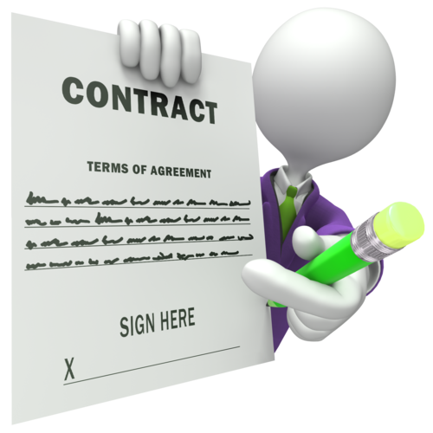
3.1 Scenario Example
Notes:
For buying the smart phone, alice wants to make sure that she would get the product she is paying for. Therefore, she stipulates a TRADITIONAL contract with Bob, an Ebay employee who works in the legal area.

Slide 18
3.1 Scenario Example
Notes:
On the tradictional contract there are the following agreements:
The Phone will be shipped to Alice only once the money transaction has been confirmed.
The middleman Bob, is in charge of checking whether the payment has really been made.
If not, he waits 1-2 days and then he checks the payment again.

Slide 19
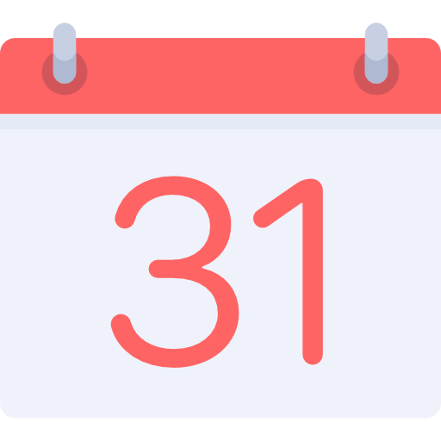


3.1 Scenario Example
Notes:
A better explanation of the contract terms
Alice pays for her Smartphone on a certain day
Bob, doesn’t know when Alice actually paid for her Smartphone. Therefore he checks the payment once in a while.
Might be possible that Alice’s money is already been transferred, but Bob will check it a couple of days later.
- When the payment is confirmed by Bob, the Smartphone will be shipped to Alice.

Slide 20


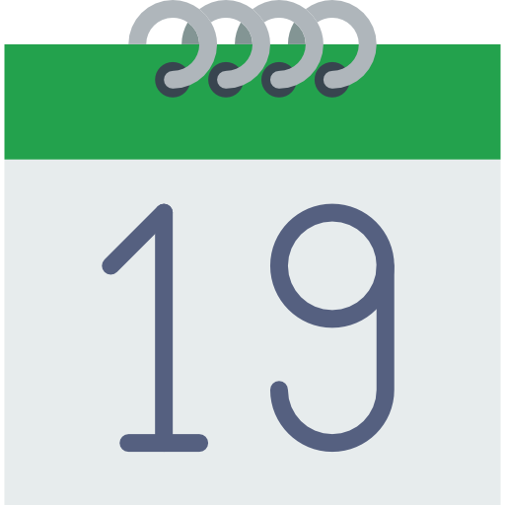
3.1 Scenario Example
Notes:
A better explanation of the contract terms
Alice pays for her Smartphone on a certain day
Bob, doesn’t know when Alice actually paid for her Smartphone. Therefore he checks the payment once in a while.
Might be possible that Alice’s money is already been transferred, but Bob will check it a couple of days later.
- When the payment is confirmed by Bob, the Smartphone will be shipped to Alice.

Slide 21
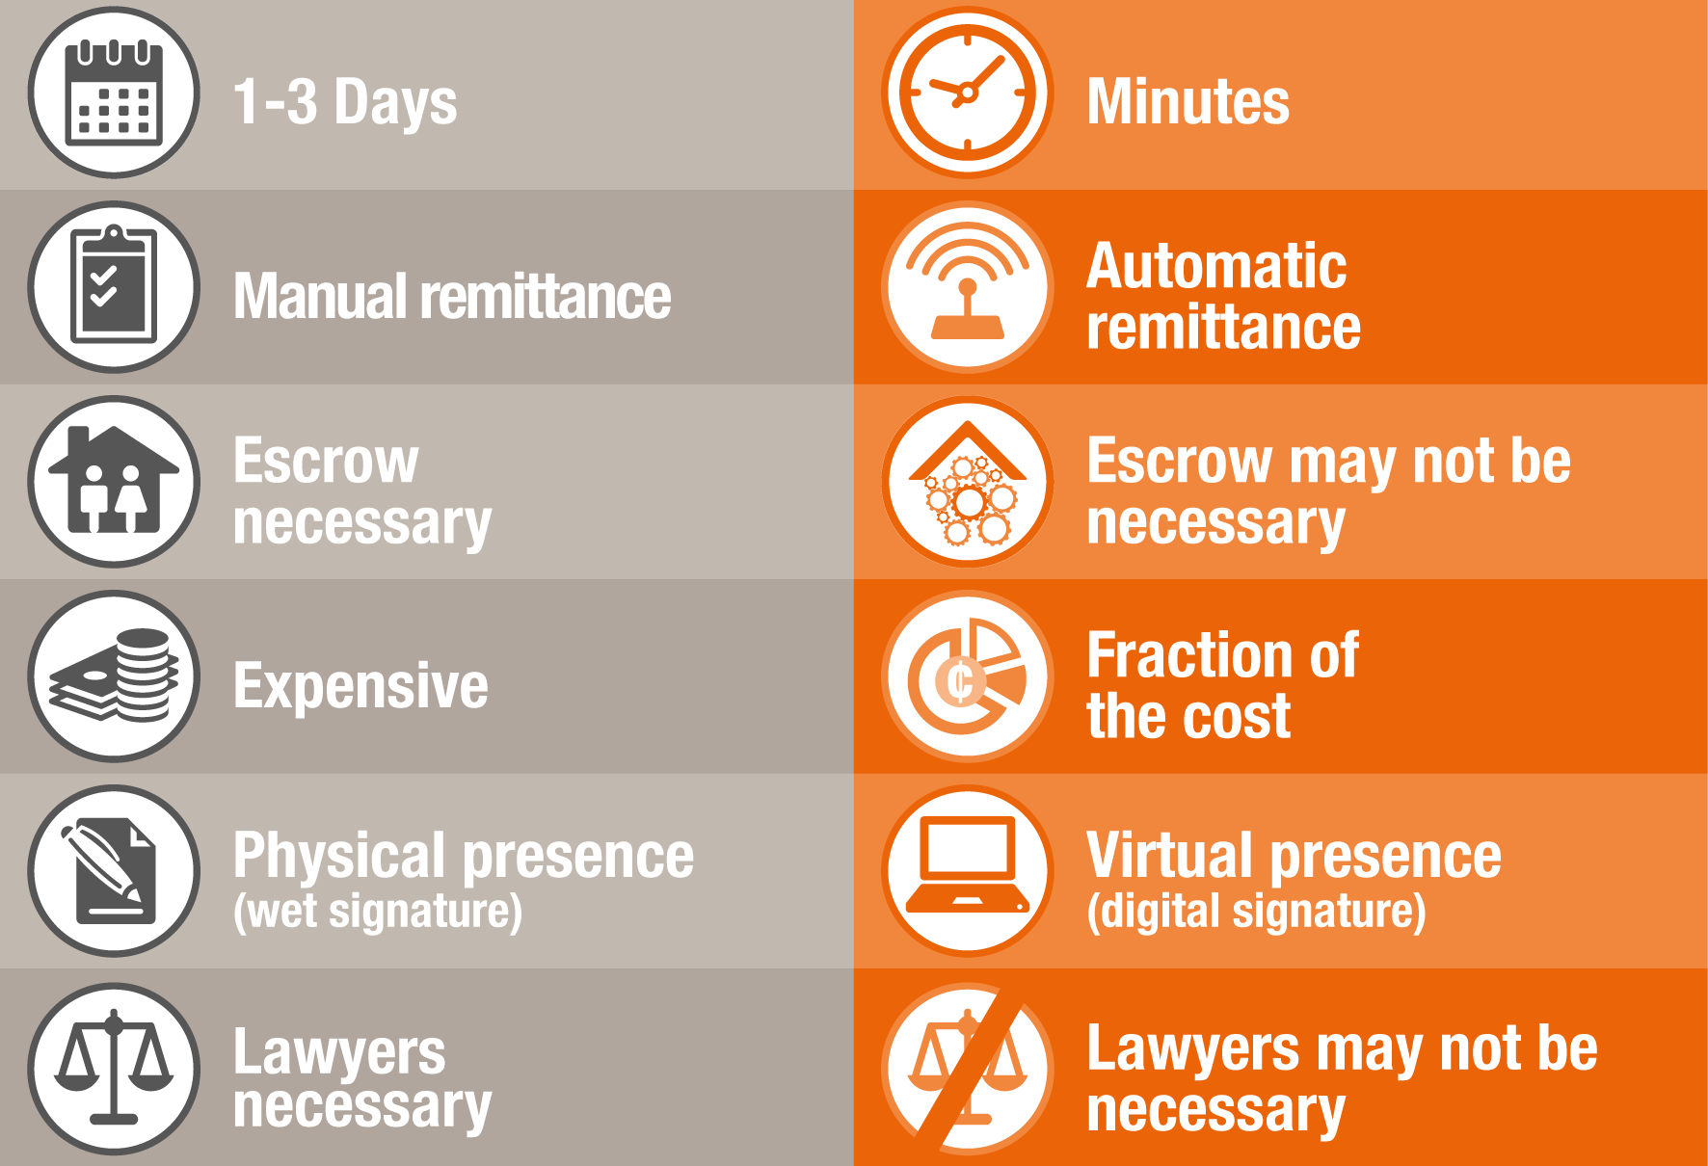
3.2 Traditional ContractS vs. Smart Contracts
TRADITIONAL
SMART
Notes:
http://www.pwc.com/us/en/technology-forecast/blockchain/digital-business.html
The execution of a smart contract doensn’t need a middleman, which mean that can be executed faster
Manual remittance: consider the following scenario: Alice wants to buy a product from Ebay. Let’s suppose that she has stipulated a smart contract with an Ebay agent. Inside the smart contract there is an agreement, that says “When the payment is confirmed, the product will automatically be shipped”. If it were a traditional contract, the Ebay agent should check that the payment has been really done. The process would not be automatic like in the smart contract.
A Smart Contract is for sure cheaper than a traditional one. You don’t have to pay for a middleman who checks the agreements, you have only to pay the ”code”.
A Smart Contract cannot get lost and its always available in chronological order on the blockchain for future access
Like said before, there is no need of a middleman (lawyer)
A Smart contract on a blockchain is like a single large secure Computer System BUT without the risks, costs and trust issues of a centralised model

Slide 22
3.1 What is a smart contracT?
Notes:
If any party tries to change a contract (the execution code) on the blockchain all other parties can detect and prevent it

