Slide 1
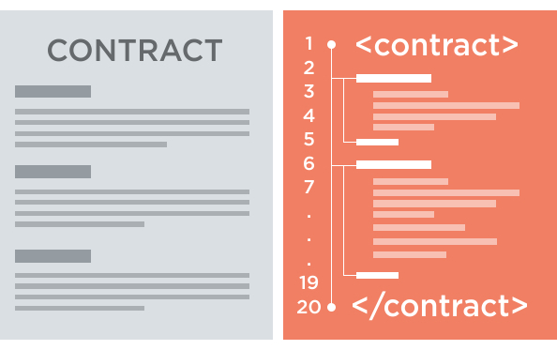
SECURITY CHALLENGES IN SMART CONTRACTS
Lucas pelloni
Ile cepilov

Slide 2
Content

Slide 3
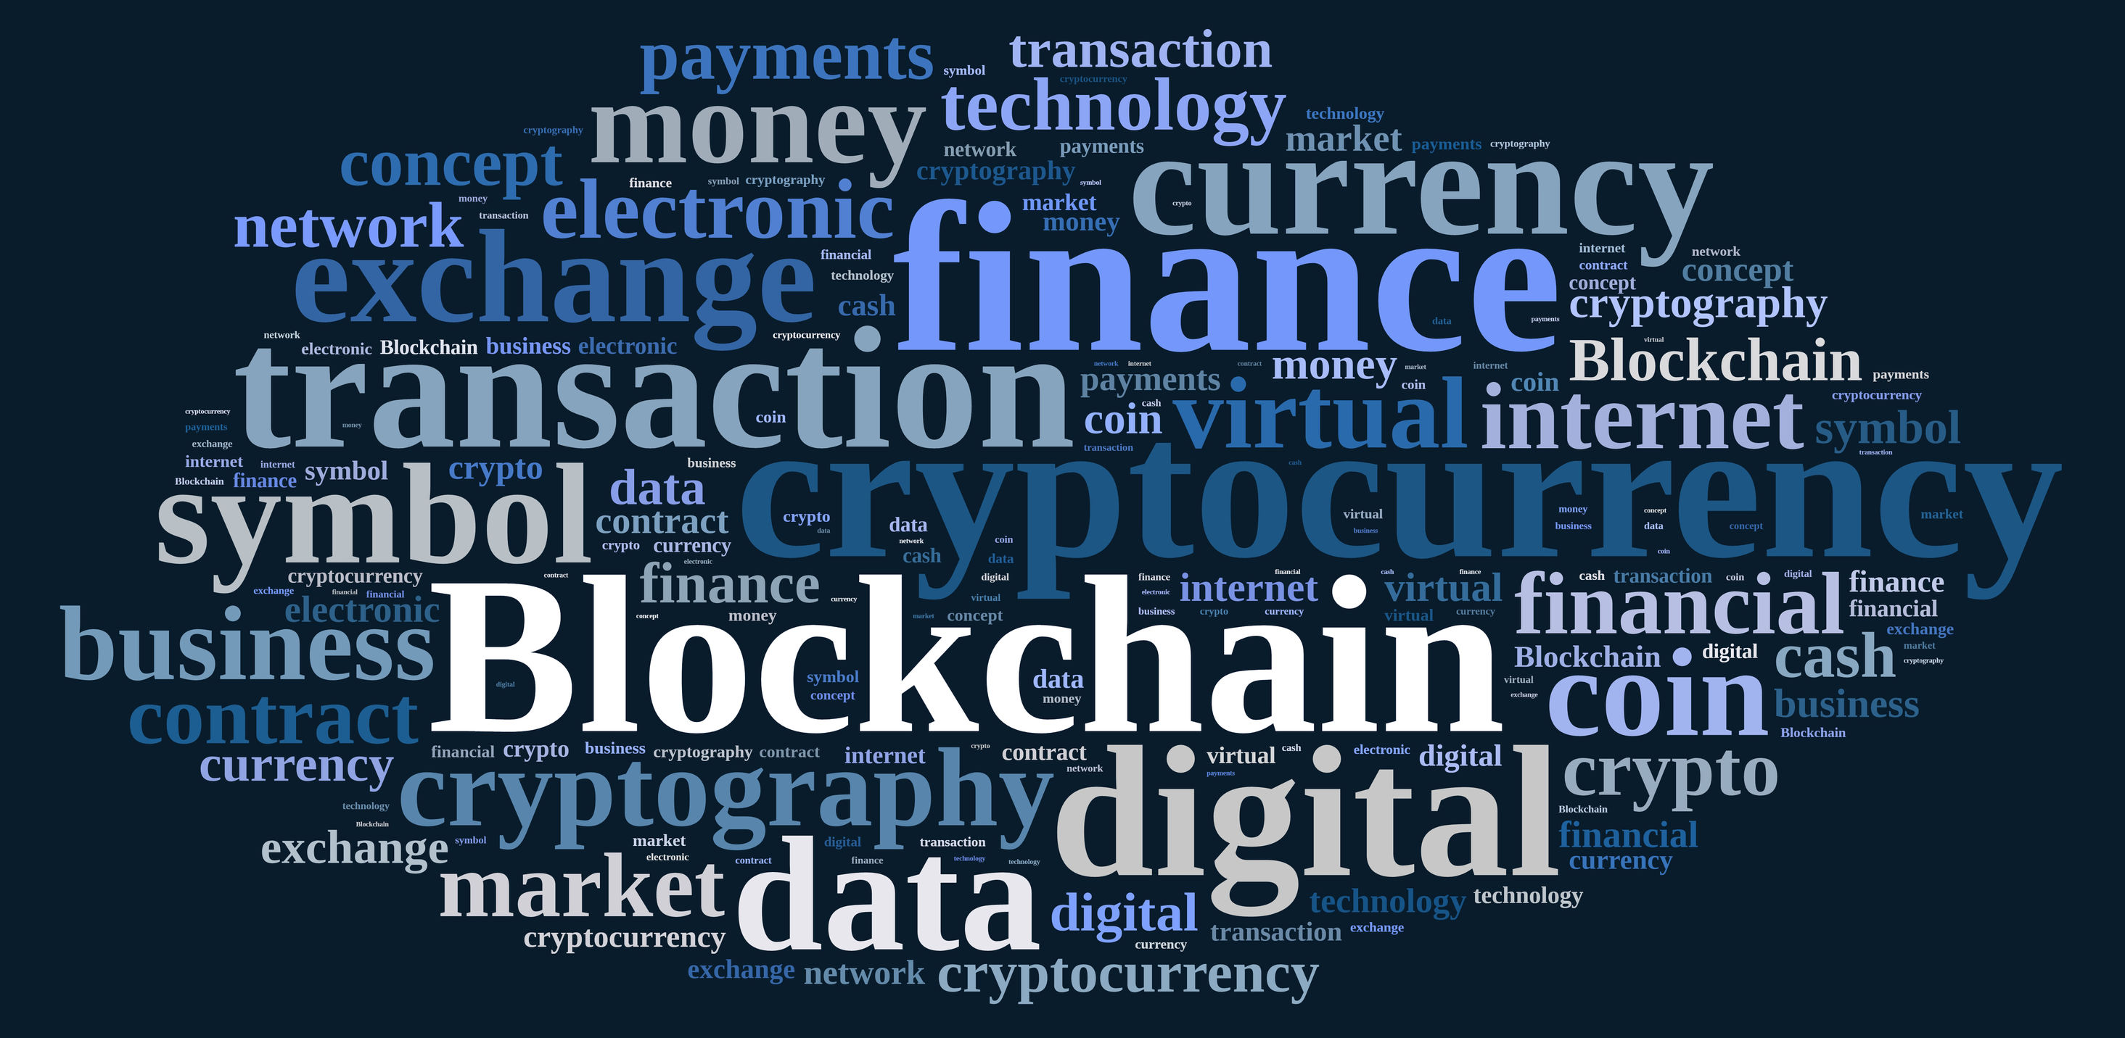
2. Blockchain technology
What is a Blockchain?
How does it work?
Benefits of Blockchain Technology
Blockchain applications

Slide 4
2.1 What is a blockchain?
Distributed Database
Public digital ledger
Source of Trust
Notes:
DISTRIBUTED DB
Blockchain technlogy is challenging the status quo in a radical way, by using math and cryptogrnaphy.
Blochchain provides an open decentralised database of every transaction involing value (Money, goods, property word or even votes)
Creating a record whose authenticity can be verified by the entire community -> Thirty part trust organisations may no longer be necessary
PUBLIC LEDGER
Every transaction will be recorded on a public and distributed ledger
SOURCE OF TRUST
Blockchain will become a global decentralised source of trust
Everything that is centralized makes it easy to attack because it offers a single point of failure.
(e.g. Firewall of a website).
Application built with Bloch chain technlogy do not require users to trust the developers with personal information or funds.
Currently, most people use a trusted middleman such as a bank to make a transaction. But blockchain allows consumers and suppliers to connect directly, removing the need for a third party.

Slide 5
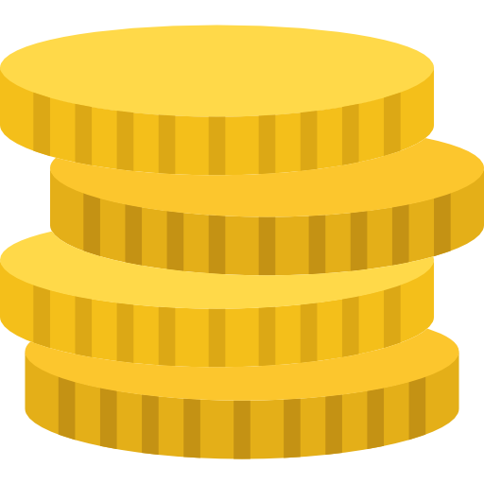


2.2 How does blockchain work?
Notes:
Alice wants to buy a product from bob’s store and she wants cryptovalues (e.g. bitcoins)

Slide 6

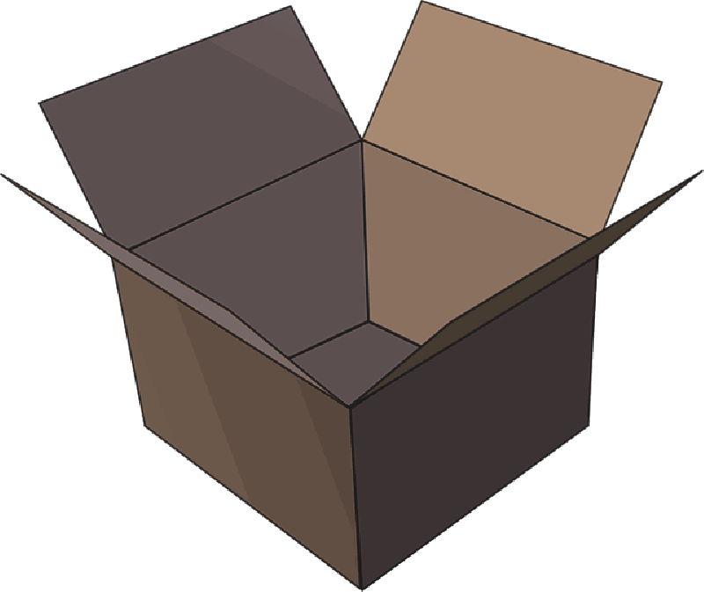
2.2 How does blockchain work?
Notes:
The transaction can be represented online as a ‘block’

Slide 7



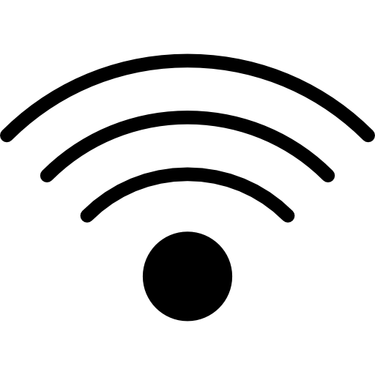
2.2 How does blockchain work?
Notes:
The block (resp. the transaction) is broadcast across the entire network

Slide 8

2.2 How does blockchain work?
Notes:
Which validates it

Slide 9
2.2 How does blockchain work?
Notes:
The block is then added to the chain which records the entire NON-reversible (indelible) history of transactions in a public ledger

Slide 10
2.2 How does blockchain work?
Notes:
The money moves from Alice to Bob

Slide 11
2.3 Benefits of blockchain
Decentralization of technology
Transactions are immutable
Distributed shared Ledger
… but there are also some hurdles ...
Notes:
No middleman (transactions between users are instantaneous)
A centralized system it’s easier to attack.
For Example if you have to execute a transaction through a bank you have to pay a fee for it, whereas using blockchain technology you don’t have to pay
------------------------------------------
Transactions are not prone to third part interference
--------------------------------------------------------------------------
The transactions data, are available online to everyone on the distributed shared ledger

Slide 12
2.4 Blockchain applications
Decentralized exchanges (e.g. Bitcoin)
Encrypted cloud storage (e.g. Storj)
Digital identity
And also . . .
Notes:
One of the most famous blockchain application is the transfer of bitcoins used for online trades.
2. Cloud shared by the community (where each file is shredded and encrypted and spread across the network)
3. Blockchain application can be applied to identity applications, like Passports, Birth Certificates, IDs, Online accounts, and so on

Slide 13
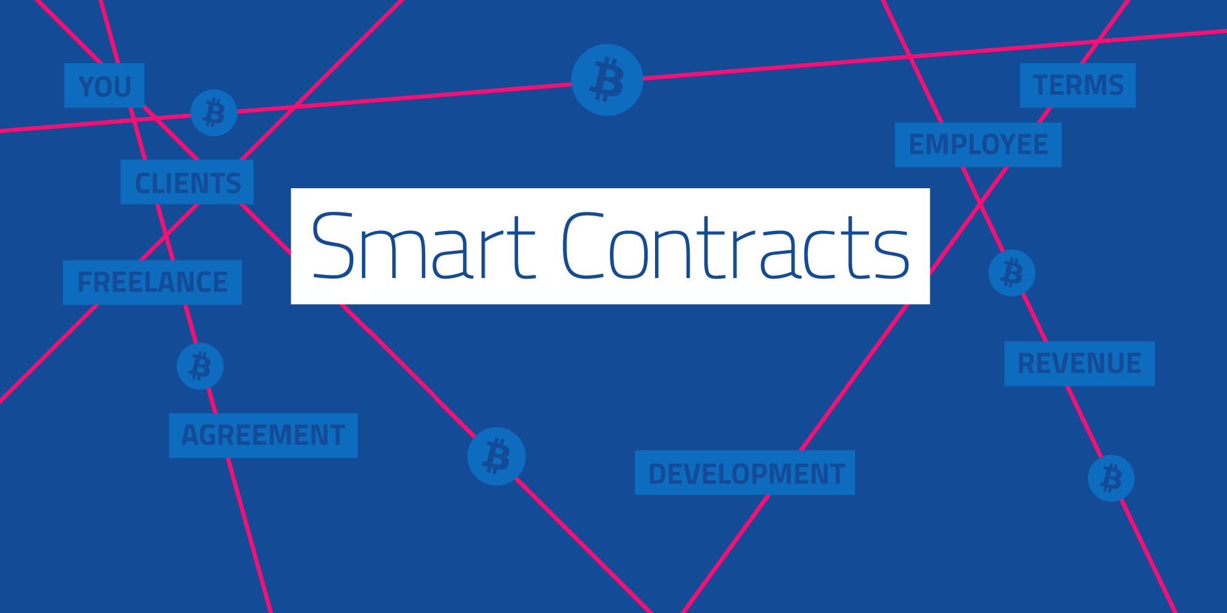
Notes:
Think of it as wills and contract that execute themselves

Slide 14
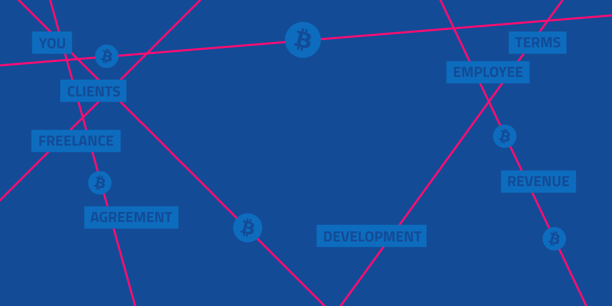
3. Smart Contracts
What is a Smart Contract?
Framework Ethereum
Distributed shared Ledger
Notes:
Think of it as wills and contract that execute themselves

Slide 15
3. Smart Contracts
What is a Smart Contract?
Framework Ethereum
Distributed shared Ledger
Notes:
Think of it as wills and contract that execute themselves

Slide 16
3. Smart Contracts
What is a Smart Contract?
Framework Ethereum
Distributed shared Ledger
Notes:
Think of it as wills and contract that execute themselves

Slide 17
3. Smart Contracts
What is a Smart Contract?
Framework Ethereum
Distributed shared Ledger
Notes:
Think of it as wills and contract that execute themselves

Slide 18
3. Smart Contracts
What is a Smart Contract?
Framework Ethereum
Distributed shared Ledger
Notes:
Think of it as wills and contract that execute themselves

Slide 19
3. Smart Contracts
What is a Smart Contract?
Framework Ethereum
Distributed shared Ledger
Notes:
Think of it as wills and contract that execute themselves

