Slide 1

Project 3: Time Locked Gifting(TLG)
Group 5:
Javier Palma, Jonathan Barajas,Lucas Riviere, Luke Agnew, Genki Hirayama

Slide 2

Purpose of TLG
Product Overview & Business Value
TLG Smart Contract Architecture
Features & Workflows
Product Demo with python
Code walk-through of contracts, architecture and relationship of functions

Slide 3

Business Problem
What business problem are you solving?:many people who have been involved in the crypto space for a while have understood that volatility is really high. However, newcomers may find this hard to overcome and may eventually capitulate part of their portfolio rather than riding it out. We want to offer avid crypto investors a smart contract that helps them gift crypto (i.e birthday from a family member, friend, co-worker) but make sure the recipient hold the asset for at least X years. Our solution will allow newcomers to receive these gifts without constantly questioning themselves on whether they should sell or not, giving them time to educate themselves and build conviction on why crypto is a good asset to hold
What are the key elements of the business problem / user experience that are critical?: amount of funds gifted ; time lock ; recipient address

Slide 4

Time Locked Gifting Solves...
Receiver’s gift liquidation inefficiency
“Paper Hands” syndrome
FOMO
Anxiety
Allows more people to get into Crypto
Notes:
many people who have been involved in the crypto space for a while have understood that volatility is really high. However, newcomers may find this hard to overcome and may eventually capitulate part of their portfolio rather than riding it out. We want to offer avid crypto investors a smart contract that helps them gift crypto (i.e birthday from a family member, friend, co-worker) but make sure the recipient hold the asset for at least X years. Our solution will allow newcomers to receive these gifts without constantly questioning themselves on whether they should sell or not, giving them time to educate themselves and build conviction on why crypto is a good asset to hold

Slide 5

Product Overview
Audiences:
Users who do not possess sufficient financial education
Newcomers to the crypto space

Slide 6
Smart Contract Architecture
Example Architecture from Class
Register gift and set timer
Set timer
Register gift
Timer starts
Contracts are compiled in a specific order in order for the timelock to work.
Set timer
Receive gift
Recipient receives gift
Decides what to do with the gift

Slide 7
Features and Workflows
Gifter
Owner Registers
Owners post receiver address
Owner posts timelock
Timelock Starts
Smart Contract
Timer finishes
Contract Receives assets
Contract timer starts
Receiver gets assets deposited
Receiver decides what to do with assets
Receiver

Slide 8

Script Breakdown
Mint
Token sale
Time locked wallet

Slide 9
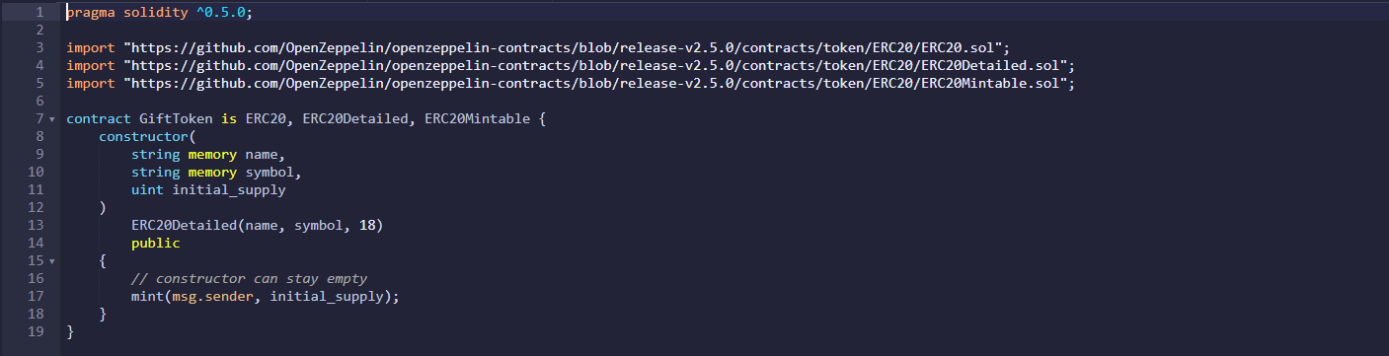
Mint Script

Slide 10
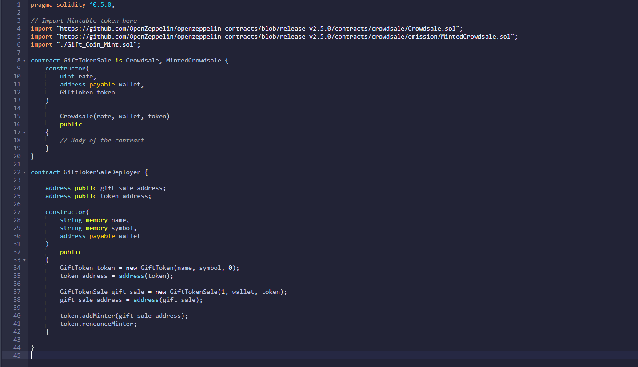
Token Sale Script

Slide 11
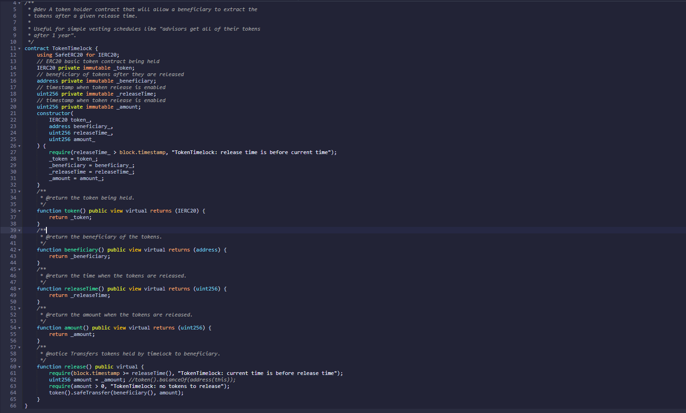
Time Locked Wallet Script

Slide 12
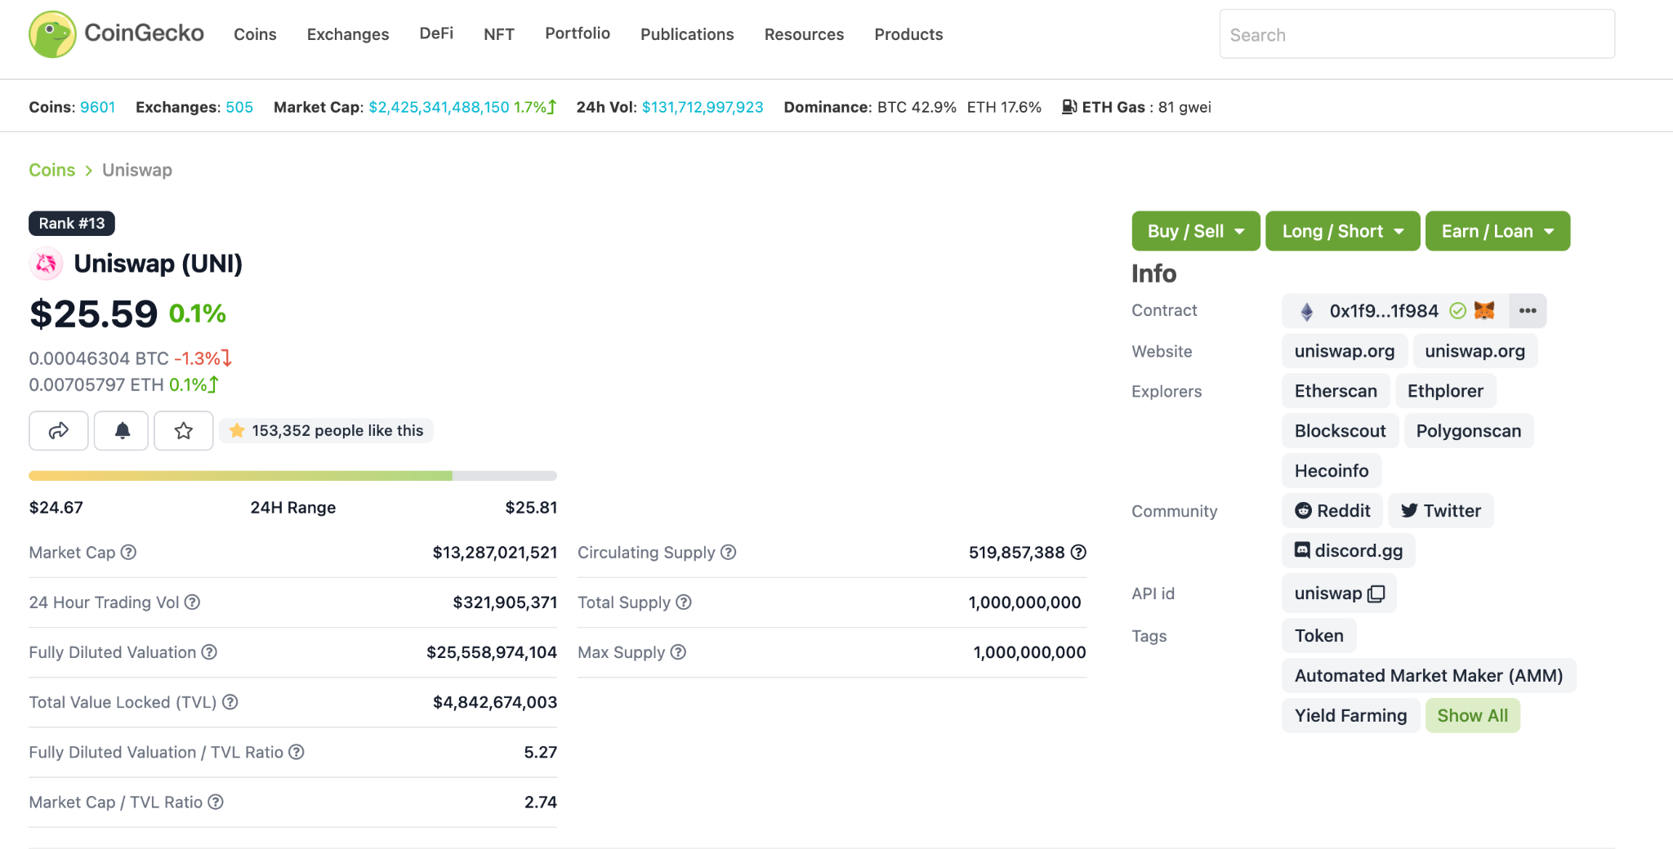

Slide 13
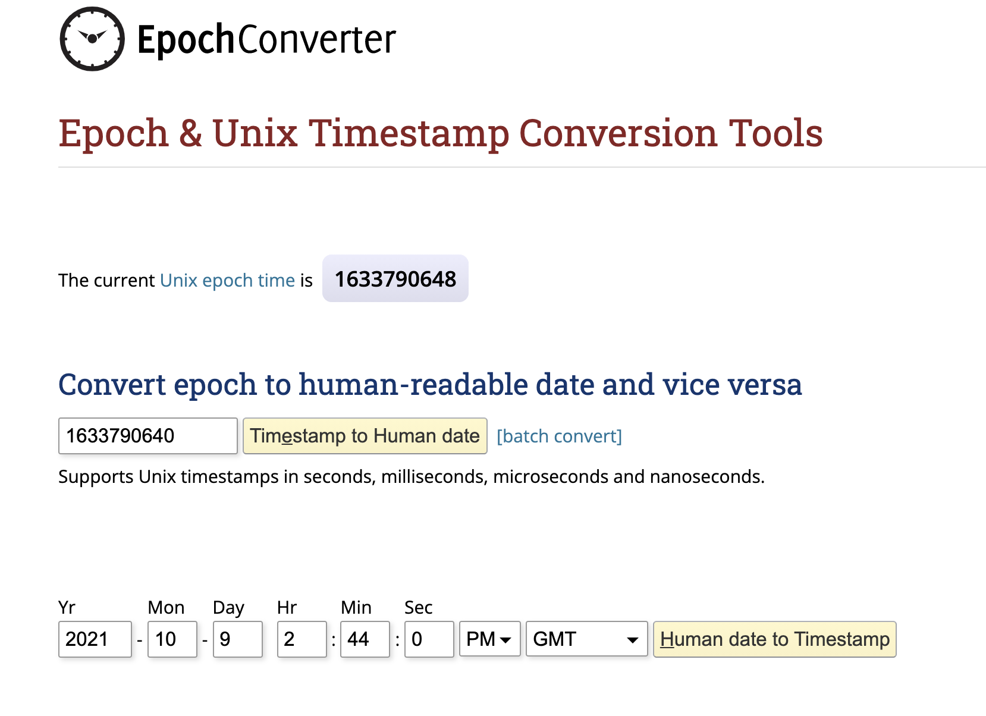
Notes:
https://www.epochconverter.com/

Slide 14
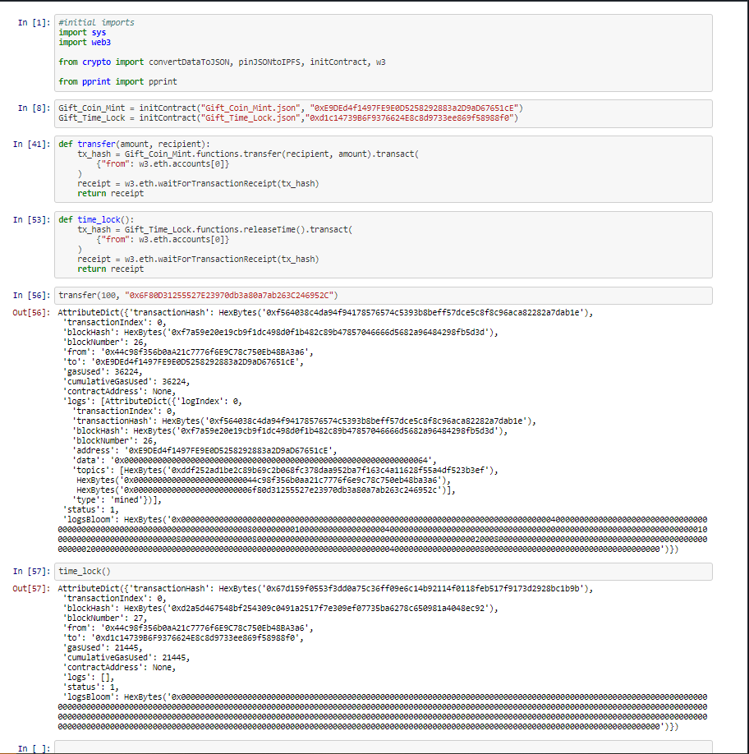
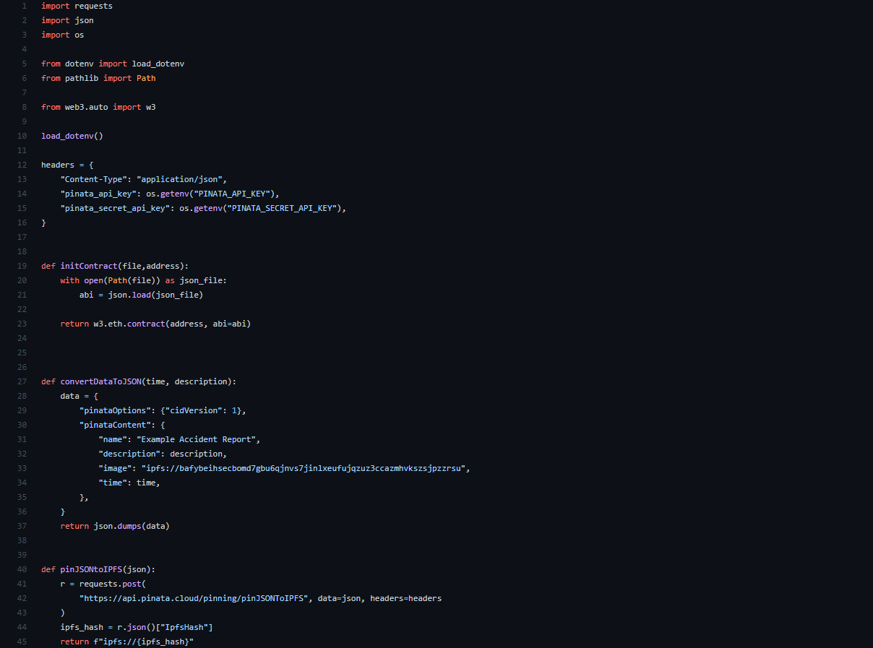
Python Execution

Slide 15
Q&A

Slide 16
Sourcesesources
https://github.com/radek1st/time-locked-wallets
https://www.toptal.com/ethereum-smart-contract/time-locked-wallet-truffle-tutorial
https://github.com/OpenZeppelin/openzeppelin-contracts/blob/master/contracts/token/ERC20/utils/TokenTimelock.sol
https://github.com/OpenZeppelin/openzeppelin-contracts/blob/release-v4.3/contracts/token/ERC20/utils/SafeERC20.sol
https://github.com/OpenZeppelin/openzeppelin-contracts/blob/release-v4.3/contracts/token/ERC20/utils/TokenTimelock.sol
https://www.epochconverter.com/
www.coingecko.com

