Slide 1
Installation of WRF-GC on Niagara

Slide 2
References
Github for WRFV3: https://github.com/NCAR/WRFV3/releases
Gitbub for WPSV4: https://github.com/wrf-model/WPS/releases
WRF-GC (https://fugroup.org/index.php/WRF-GC)
WRF-GF repository on GitHub (https://github.com/jimmielin/wrf-gc-release/tree/master)
WRF-GC guide (https://fugroup.org/wrf-gc/WRF-GC_Documentation_updated_for_v2_Feb2021.pdf)
WRF-GC Read the Docs (https://wrfgc.readthedocs.io/en/latest/getting-started.html )

Slide 3
System requirement (recommended/available in SciNet)
Compiler: Intel v15 or above / intel/2019u4
MPI Library: MVAPich2 (version 2.3+) / intelmpi/2019u4
Libraries: zlib, hdf5(1.8), netCDF-C(4.6.1), netCDF-Fortran(4.4.4), JasPer(1.900) / hdf5/1.8.21; netcdf/4.6.3
Tools: Git version management
Module load intel intelmpi hdf5 netcdf git

Slide 4
Recommended modules
module load git
module load intel/2019u4
module load intelmpi
module load hdf5
module load netcdf

Slide 5
Downloading WRF and WPS
Make the WRF-GC parent directory and cd
Download WRF version 3.1.1:
wget https://github.com/NCAR/WRFV3/archive/refs/tags/V3.9.1.1.zip
unzip V3.9.1.1.zip
mv WRFV3-3.9.1.1 WRFV3
Download WPS
wget https://github.com/wrf-model/WPS/archive/refs/tags/v4.0.zip
unzip v4.0.zip
mv WPS-4.0 WPS

Slide 6
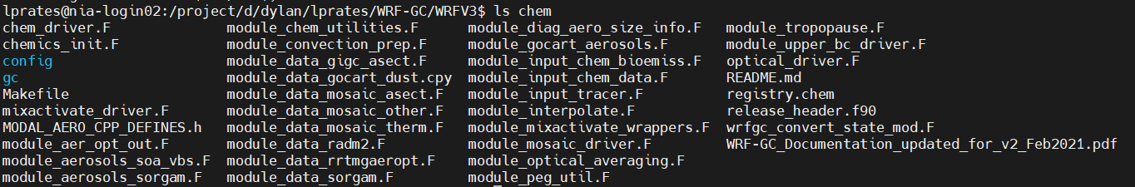
Downloading WRF-GC
Move into your WRFV3 folder and delete the folder chem
Download WRF-GC into chem:
git clone https://github.com/jimmielin/wrf-gc-release.git chem

Slide 7
Installation (libraries)
Zlib
- configure –prefix={location}
- make
- make check
- make install
Libpng
- configure –prefix={location}
- make
- make check
- make install
Jasper
- configure –prefix={location}
- make (ignore error messages)
- make check
- make install
These libraries are currently installed and available at /home/d/dylan/lprates/libraries

Slide 8
Configure environment: copy into shell
The appropriate environment variables are stored in the config.txt file I provide
Copy and paste these into the shell

Slide 9
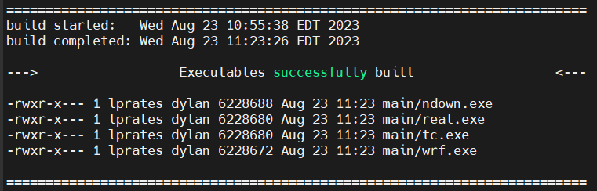
Building WRF (WRFv3.9.1.1)
Set environments (as same as 1 slide before)
./configure –hyb
(18. (serial) 19. (smpar) 20. (dmpar) 21. (dm+sm) INTEL (ifort/icc): Xeon (SNB with AVX mods))
Under configure for nesting, choose 1
In configure.wrf file, replace /lib/cpp by /scinet/niagara/software/2019b/core/bin/cpp and gcc to icc
In chem/gc/Makefile_header.mk, replace mpifort by mpif90 (L178)
Under WRFV3/chem directory
make install_registry
Go back to WRFV3 directory
./compile em_real

Slide 10
Common Error
If you copied WRF-GC from an existing instance in Niagara, you may see the following error in the compilation log
ld: cannot find -lGIGC -lHistory -lGeosCore -lHistory -lKpp -lGeosCore -lIsorropia -lHCOI -lHCOX -lHCO -lGeosUtil -lKpp -lHeaders –lNcUtils
The fix:
mv WRFV3/main/Makefile.bak WRFV3/main/Makefile
Make sure the new Makefile doesn’t have –lGIGC anywhere in the file. If it does, copy one over from a fresh copy of WRF
Now go to WRFV3/chem and run make compile_chem
Now you may attempt to recompile, no need to clean

Slide 11
Building WPS
./configure
Use option 19 for the compiler when prompted
In configure.wps file, replace /lib/cpp by /scinet/niagara/software/2019b/core/bin/cpp
In configure.wps, add paths to libpng and zlib libraries
You can do this by replacing line 68 with
COMPRESSION_LIBS = -L/home/d/dylan/lprates/libraries/jasper/lib -ljasper -L/home/d/dylan/lprates/libraries/libpng/lib -lpng -L/home/d/dylan/lprates/libraries/zlib/lib -lz
./compile
You should have geogrid.exe, metgrid.exe, and ungrib.exe

Slide 12
Mozbc
Later you will need mozbc to configure WRF-GC’s chemical boundary conditions, which can be found here
git clone https://github.com/fengx7/mozbc_for_WRFv3.9
After downloading mozbc, you may compile it using
export NETCDF_DIR=$SCINET_NETCDF_ROOT
./make_mozbc

Slide 13
Running WRF-GC On Niagara

Slide 14
Test run settings
If you just want a test run of WRF-GC, copy namelist.wps, namelist.input, and HEMCO_Config.rc from /project/d/dylan/lprates/wrf_test_config
You should still go through the configuration steps in the follow slides to make sure everything is set properly
You may also wish to copy the submission scripts from this directory to WRFV3/run

Slide 15
Configuring domain
Configure the following paths in WRFV3/run/input.geos:
Root data directory : /project/d/dylan/ctm/ExtData/
Fast-JX Directory : /project/d/dylan/ctm/ExtData/CHEM_INPUTS/FAST_JX/v2021-10/
In WRFV3/run/HEMCO_Config.rc, add
Root : /scratch/d/dylan/dylan/ctm_tmp/HEMCO
Configure the domain information in WPS/namelist.wps and WRFV3/run/namelist.input
In namelist.wps, set geog_data_path = /project/d/dylan/lprates/geog/
The geog data contains geographical data from both:
WRFV3 Geographical Data
WRFV4 Geographical Data

Slide 16
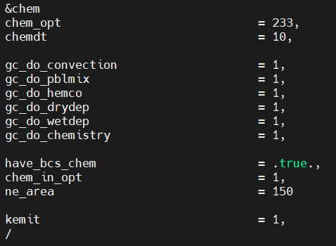
namelist.input GEOS-Chem settings
If you are adapting your configuration from a pre-existing WRF run, turn on WRF-GC chemistry by adding these to namelist.input
gc_do… turns on each geos-chem chemical process
Have_bcs_chem and chem_in_opt required for initial and boundary conditions

Slide 17
Running WPS
After configuring the domain, it is time to run geogrid.exe
You may need to add libpng to the path first. In /WPS/, run
export LD_LIBRARY_PATH=$LD_LIBRARY_PATH:/home/d/dylan/lprates/libraries/libpng/lib
./geogrid.exe
You can check your domain using
ncl util/plotgrids_new.ncl
If you haven’t already, you may need to link the Variable table corresponding to the meteorological fields you are using. For NARR fields:
ln -s ungrib/Variable_Tables/Vtable.NARR Vtable

Slide 18
Running WPS
The NARR fields can be found at /home/d/dylan/kimj/scratch/NARR/narr_tar
If it doesn’t already exist, copy /project/d/dylan/lprates/wrf_test_config/NARR.CONSTANT to /WPS/
Run ./link_grib.csh fields, where fields is the collection of meteorological fields required for your domain. The output for each field should be written to GRIBFILE.AAA, GRIBFILE.AAB, etc.
Make sure you link the individual fields, and not the folder or ungrib.exe will not run. For example, linking all the fields for January 2018 may look like
./link_grib.csh /home/d/dylan/kimj/scratch/NARR/narr_tar/merged_AWIP32.201801*
Then run ./ungrib.exe followed by ./metgrid.exe

Slide 19
Running WRF: real.exe
After running metgrid.exe, you should have a series of met_em files in /WPS/
These files need to be linked to /WRFV3/run/. In this directory, run
ln -sf ../../WPS/met_em* .
Then submit a batch job to run ./real.exe

Slide 20
Configuring chemical IC/BCs
If you simply want a test run using the test configuration, use the chemical data at /project/d/dylan/lprates/wrf_test_config/wrfgc_icbc_data.nc
Download the following MATLAB script to animus-c to convert the GEOS-Chem data to a format readable by mozbc
wget https://github.com/fengx7/WRF-GC-GCC_ICBC.git
You will need to do this on another machine like animus-c as Niagara does not support matlab
For a regional simulation, use the matlab script convert_gcoutput_mozart_structure_selected_domain.m

Slide 21
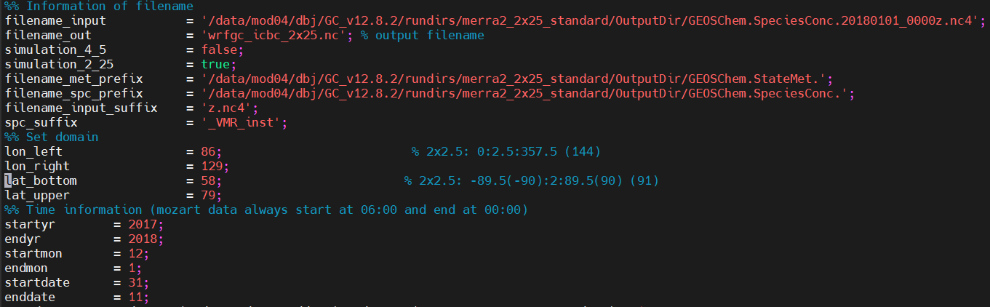
Configuring chemical IC/BCs
Set filename_input to any GEOS-Chem species concentration file
Set the simulation resolution (either simulation_4_5 or simulation_2_25 must be true)
Set the date range (at least one day preceding the WRF-GC run)
And the domain, which is index based for lat-lon. Make this slightly larger than the WRF-GC domain

Slide 22
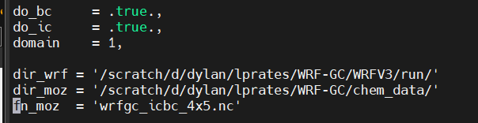
Running mozbc
After moving the chemical IC/BCs file to Niagara, you will need to run mozbc.
In the mozbc directory, open the file GEOSCHEM_3.0tp3.inp
Set the number of domains, as well as the paths to the wrf run directory and the the directory containing the chem data.
Also set the name of the chem data file
Turn on both BCs and IC
Run mozbc like-so
./mozbc < GEOSCHEM_3.0tp3.inp

Slide 23
Running WRF: wrf.exe
Submit a batch job to run wrf.exe

