Slide 1
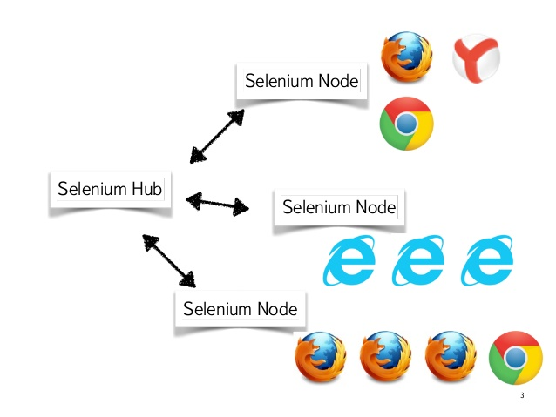
Terraform Setting up of selenium Grid
Installing Terraform
Download Terraform and move it to the default path
Selenium Grid For aws using terraform
Terraform will authenticate with aws either through aws cli, variables
Selenium grid for Azure using Terraform
Terraform will authenticate with azure either through azure cli , service principal
Running Terraform
Move to the directory containing terraform files
Terraform by default loads all the .tf files in the directory
terraform init (initializes the dependencies required for the provider)
terraform plan (it provides the details of the resources it will provision)
terraform apply (it creates the infrastructure in aws)
Terraform show (gives the existing configuration details)
terraform destroy (it destroys the created infrastructure in aws)
You can change the variables in terraform.tfvars file where terraform reads variables by default

