Slide 1
Dev10 Capstone
Lucas Shepherd

Slide 2

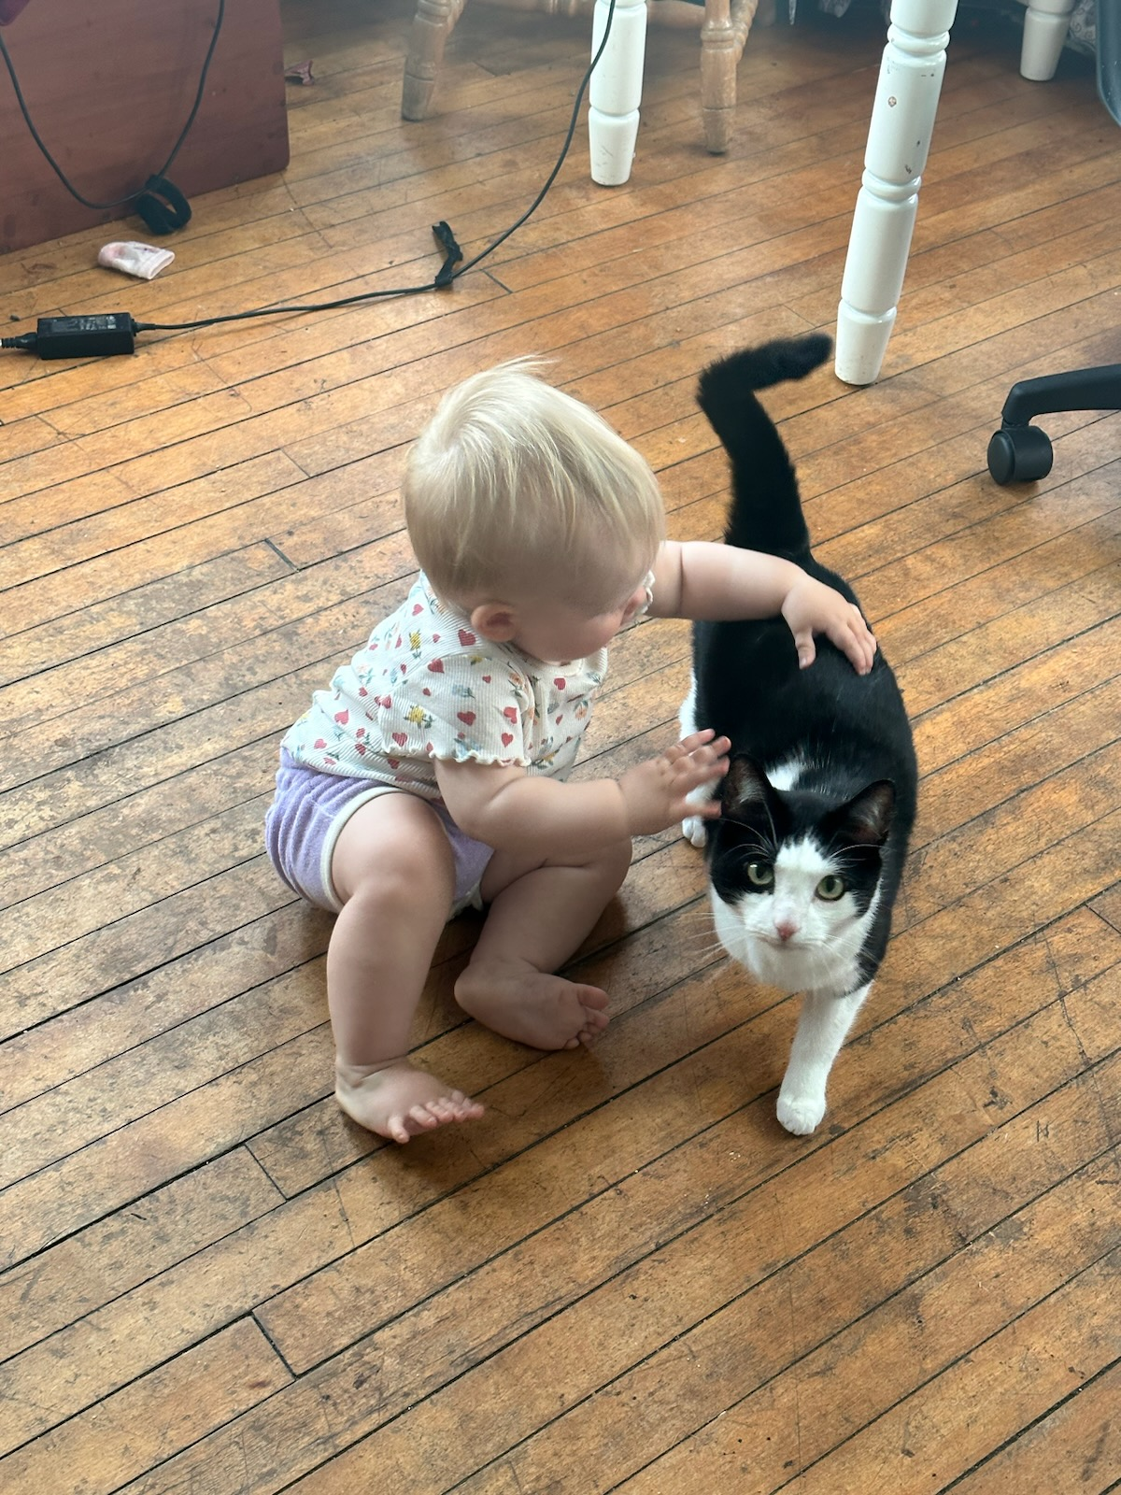


Introducing: Me
Recent college graduate, father, life-long student
How did I get into programming?
Tech enthusiasm and wonder
The challenge
What keeps me programming?
The satisfaction of creation
The power/applications
The excitement of new developments

Slide 3

Introducing: Bird Up
A social media application for bird-watchers
Spring Framework Java API backend with MySQL database
- JDBC Template
- JUnit, Mockito
- Validations API
- Token-based Security
React User Interface
- Router, Bootstrap, React-Select
- OpenAI API, Google Custom Search JSON API

Slide 4
Bird Up DEMO

Slide 5
Challenges
Dropdown Select with Search Filter
Delete Post Modal Without A Find Post By Id method
I wanted a dropdown selection with a search filter for species
I found and installed the ‘react-select’ module
I wanted to populate a modal with post data for a delete confirmation, but I did not create a findPostById method on my backend.
I used the `react-confirm-alert’ module with a custom identity function to populate the modal with post specific information

Slide 6
Thank you
Lucas Shepherd

