Slide 1
Multicycle Processor
Aaron Donawerth, Lucas Magasweran, Kevin Phan
5/9/11

Slide 2
Introduction
What is a multicycle processor?
Why use a multicycle processor?
Datapath and controller of the multicycle processor
Performance of the multicycle
Verilog simulation of the multicycle

Slide 3
What is the multicycle processor?
Processor that breaks an instruction into multiple steps and uses multiple cycles to execute.
Notes:
TODO:include cycle comparison graph

Slide 4
Why use a multicycle processor (trade-offs over single cycle)
Combined instruction memory and data memory
Pros: Realistic, reduced chip size
Cons: Single read port
Single ALU
Pros: Fewer complex parts, cheaper, reduced chip size
Cons: Needs non-architectural state registers and a finite state machine to share ALU
Faster clock
Pro: Clock is determined by slowest step not instruction

Slide 5
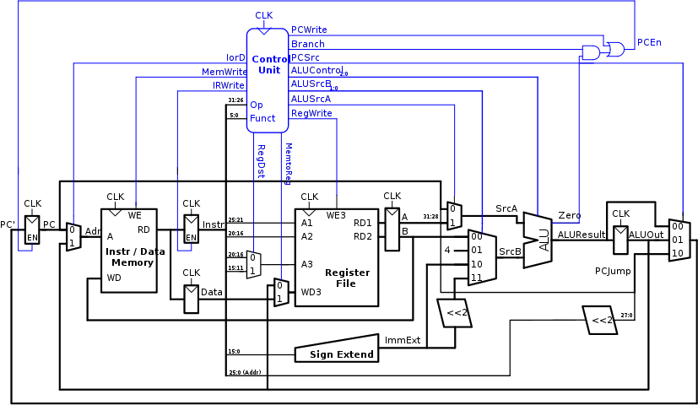
Datapath and Controller

Slide 6
Datapath and Controller
5 Step Process
Fetch and PC increment
Decode and register readout
ALU Operation
Memory Access/Register Write
Register Write (lw)
Notes:
At most 5 steps, at least 3 (e.g. j, beq)

Slide 7
Datapath and Controller
Control Signals define the datapath
Datapath changes depending on the 3 type of instructions
R-Type
I-Type
J-Type

Slide 8
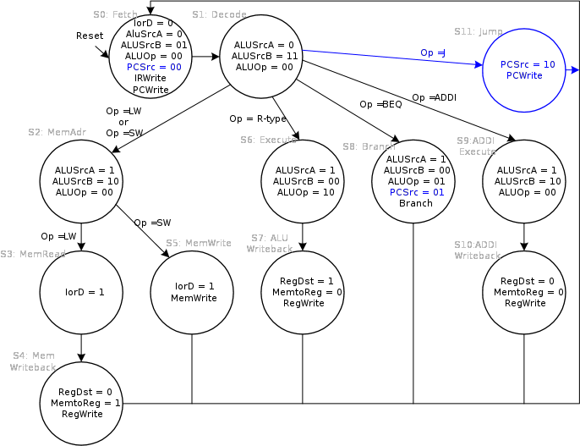
Controller Finite State Machine (FSM)
Notes:
Review 5 step process, first two states are common because decode, example instruction

Slide 9
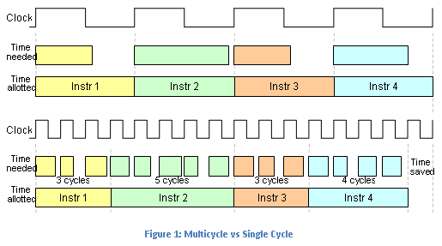
Multicycle Performance

Slide 10
Multicycle Performance
Performance is measured by Cycles Per Instruction (CPI)
CPI can be translated into Execution Time
Execution Time is
Notes:
Movitvation for Multicycle,

Slide 11
Multicycle Performance
Cycles per instruction
Load Word = 5 Cycles
Store Word = 4 Cycles
R –Type = 4 Cycles
Branch = 3 Cycles
Jump = 3 Cycles
Notes:
Main difference between Single Cycle!!!

Slide 12
Multicycle Performance
SpecINT2000 Benchmark states
25% loads
10% stores
11% branches
2% jumps
52% R-type instructions
Which comes to a CPI of 4.12 for Mutlicycle MIPS Processor

Slide 13

Simulation

