Slide 1
AI-FIRST BANKING
ATLAS
✳
A clearer path from card question
to a verified next step
Credit-card product information, simulated eligibility,
and human-review handoff in Spanish and Portuguese.
FACTORED HACKATHON 2026
Atlas · Lucas Wolff
Working prototype · Team-created offers and fictional public fixtures

Slide 2
✳ ATLAS
FACTORED HACKATHON 2026
01 / THE CUSTOMER PROBLEM
Help a prospective card customer decide with confidence
A customer can ask natural questions, compare cards, request a simulated precheck, or ask for a person.
Goal: answer prospective card questions with grounded facts,
then verify every action the agent claims it took.
SUPPLIED DATA / WHY WE USE IT
1
Campaigns + sends
3
Service agents + transcripts
MARKETING_CAMPAIGNS + CAMPAIGN_SENDS: 52 generic
credit campaigns; interest and entry context, not sales.
SERVICE_AGENTS: language-based mock routing.
CALL_TRANSCRIPTS: Spanish tone, not facts.
2
Customers + products
4
Team-created demo assets
CUSTOMERS + PRODUCTS: local scenario profiles, country,
score, income estimate, and existing holdings.
Four offer terms, synthetic policy, fictional public fixtures,
new chat events, and mock application/handoff records.
Evidence boundary: 1.75M sends and 97.8K clicks cover all supplied campaigns; neither proves card acquisition or chatbot demand.
ATLAS / CREDIT-PRODUCT INFO & ELIGIBILITY DEMO
02 / 06

Slide 3
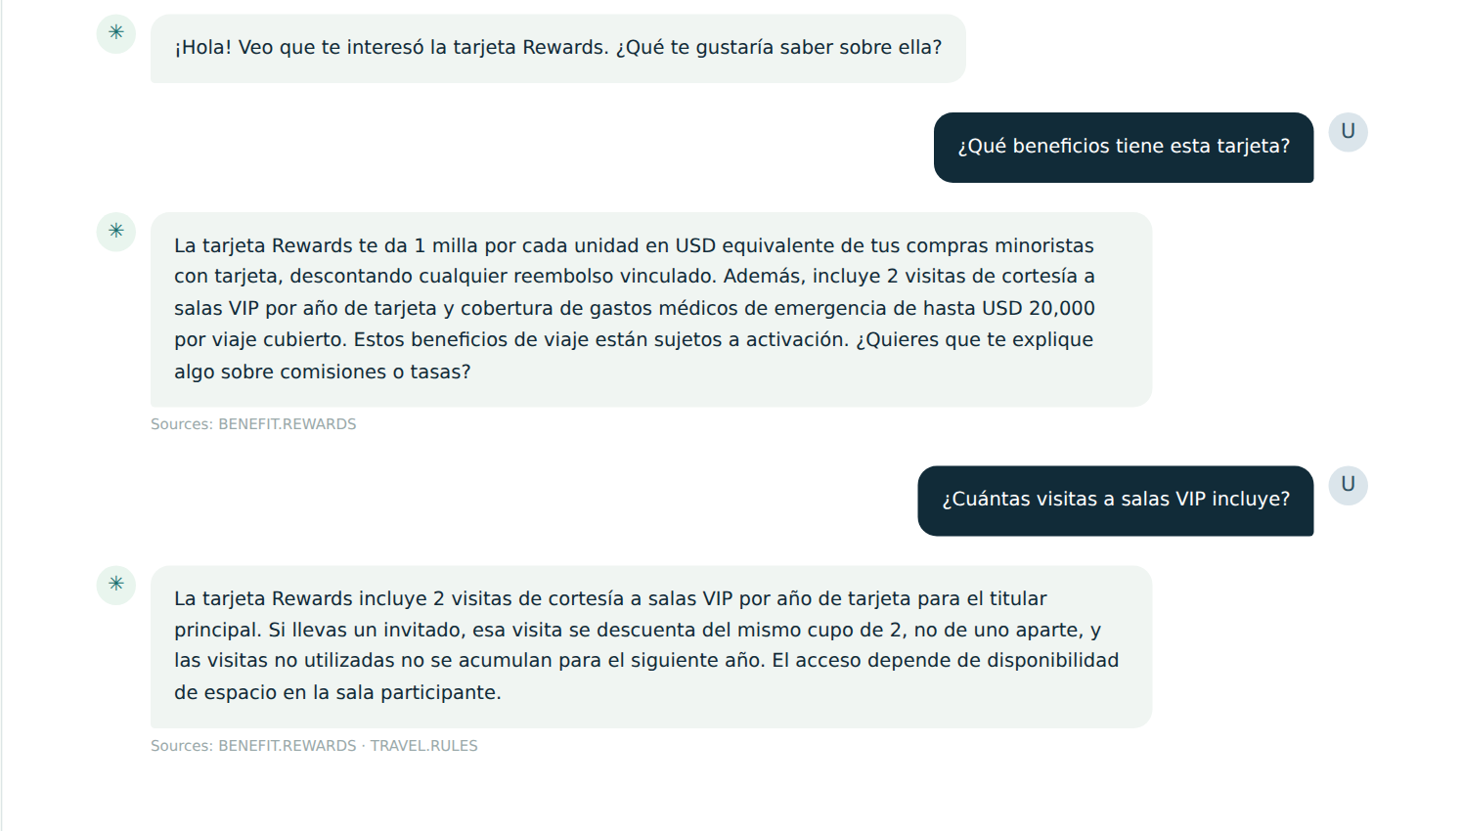
✳ ATLAS
FACTORED HACKATHON 2026
02 / WORKING EXPERIENCE
A real conversation in Spanish
Captured from the deployed judge app on 3 October 2026 · Rewards campaign · México · fictional fixture P02
What this
shows
Maintains the
selected card
Answers a
follow-up
Displays source
fact IDs
Live output; not a script
ATLAS / CREDIT-PRODUCT INFO & ELIGIBILITY DEMO
03 / 06

Slide 4
✳ ATLAS
FACTORED HACKATHON 2026
03 / HOW IT WORKS
Claude routes and answers; the service controls actions
A bounded intent choice comes before service-owned policy, consent, and durable outcomes.
Browser
Lambda service
Conversation router
DynamoDB state
→
→
→
Campaign / direct entry
Fictional fixture
HTTPS API + session
Protected review route
Haiku: bounded intent
Service validates session
Sessions + quota
Actions + roster
Product answers
Deterministic policy
Verified actions + reviewer
Sonnet + versioned public facts
Citations checked; unknown → offer review
Fixture-bound suggestions
Consented synthetic precheck
The model cannot approve credit
Confirmation → write once → read back
Application: PENDING_REVIEW
Full-thread handoff; bot pauses
Boundaries: no private profile in model requests · secrets in AWS SSM · sanitized CloudWatch logs · no bank write
ATLAS / CREDIT-PRODUCT INFO & ELIGIBILITY DEMO
04 / 06

Slide 5
✳ ATLAS
FACTORED HACKATHON 2026
04 / MEASURED BEHAVIOR
Live checks show progress and a remaining failure
4 October production smoke probes are separate from the earlier paired evaluation and judge rehearsal.
1
Product facts + context
2
Intent + consent
Benefits and monthly fee answered together with facts.
'This card' kept Horizon. A two-card cheaper question
failed to clarify its price reference.
Negation then application reached card-specific consent.
An unnamed other card triggered card choice. Declined
precheck never created an application by itself.
3
Profile + service boundaries
4
Evidence + capacity
Student suggestion named fixture and unverified status.
Existing-card cancellation was refused. A second
application was blocked before another precheck.
7/8 live smoke scenarios met expectation; 87 local tests
passed. Shared cap: 400 model attempts per UTC day.
No independent bilingual quality result yet.
Earlier 2 Oct rehearsal only: 12 entry/country/language paths; 3 application read-backs; 24 HTTP requests from six visitors.
ATLAS / CREDIT-PRODUCT INFO & ELIGIBILITY DEMO
05 / 06

Slide 6
✳ ATLAS
FACTORED HACKATHON 2026
05 / PATH TO A REAL SERVICE
What changes before a customer can rely on it
The prototype proves a workflow; a banking deployment needs approved data, live operations, and independent validation.
1
Approved products + policy
2
Identity + data permissions
Replace demo offers and thresholds with governed,
versioned bank terms and credit policy; legal review.
Real customer authentication, consent, current
account data, ownership checks, and retention controls.
3
Live human service
4
Quality + operations
Agent availability, queue ownership, employee inbox,
reply in the same chat, SLA, and escalation outcomes.
Independent bilingual held-out evaluation, security
testing, capacity/cost budgets, monitoring, and support.
Now: a working, public judge prototype with verified simulated actions.
Open the live demo ↗
Open the public repository ↗
ATLAS / CREDIT-PRODUCT INFO & ELIGIBILITY DEMO
06 / 06

