Slide 1
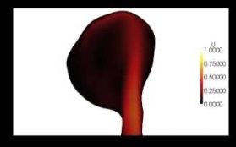
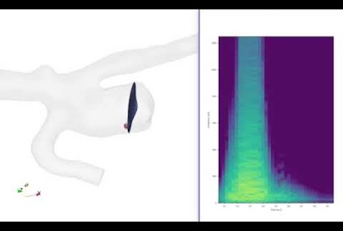
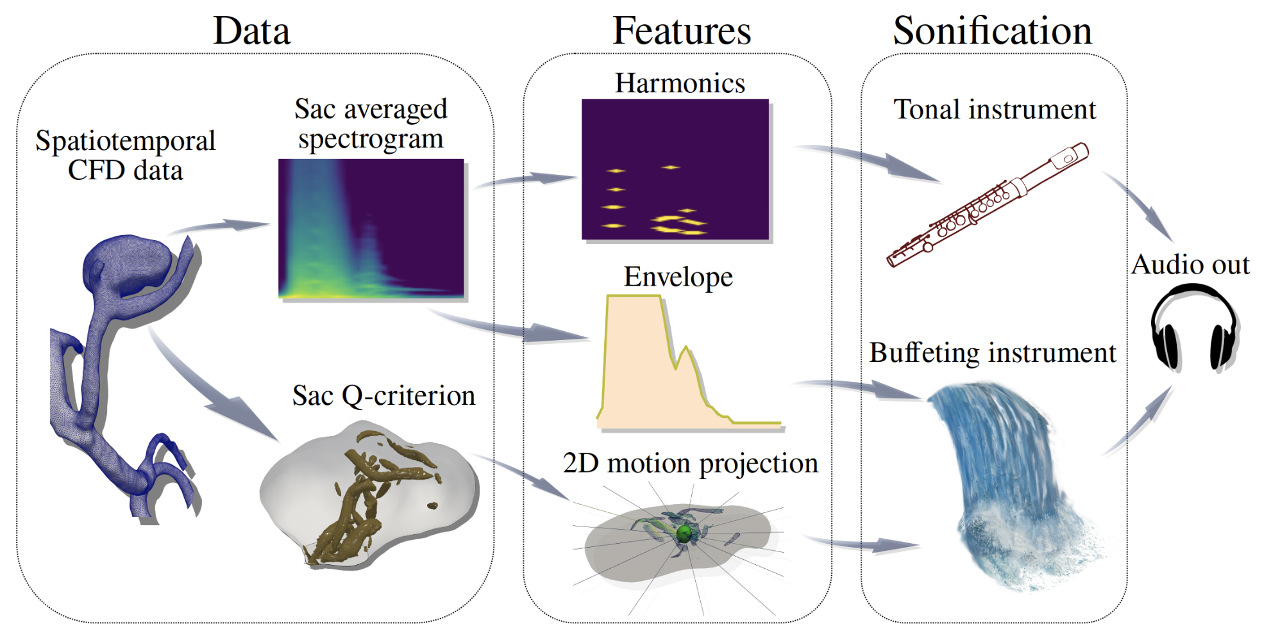
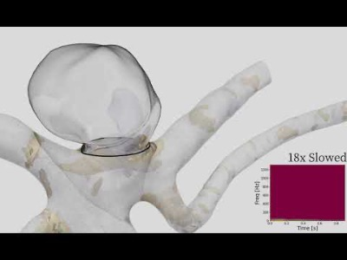
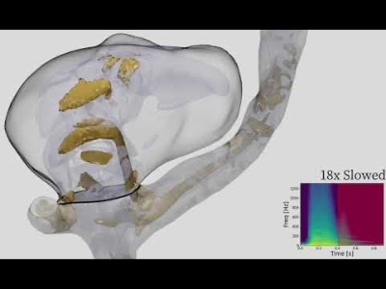
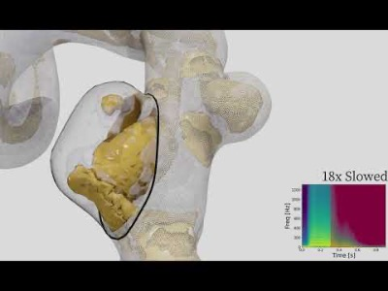
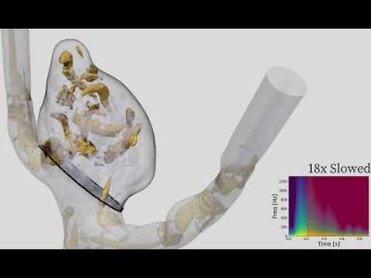
Perceptually-motivated sonification
of spatiotemporally-dynamic data
Introduction
3D spatiotemporal flows create large datasets
In our domain of aneurysms, we have this problem, and we want to better understand the nature of flow instabilities
We have tried this in the past
*pros and cons
Sonification of video, not data
Dependent on rendering decisions
Manual process, sound designer
Spectral analysis resynthesis
Data driven, crude
Poor communication of
multidimensional relationships
Most of these sounds were too similar between models, not allow for detection of features in the data, or introduced perceptual distortions
Methods
We propose a feature-based approach
To help us define these features we follow the analogy of caricature
Features can then be sonified along perceptually distinct streams, allowing for properties of the slow to be inferred from behavior of the stream (sound-source relationships)
HTML image map
Opens to VIDEO/audio (HTML modal image)? With more description
CFD Simulations → feature extraction
Spectral harmonics → tonal instrument
Q-criterion quasi-random fluctuation and spectral envelope → buffeting instrument
Auditory scene analysis and ecological perception motivated sound design
Results
Laminar
“Turbulent” with vortex shedding (note presence of harmonic structures and difference in the vortex core motion between models)
“Turbulent”
Discussion
Classification of flows easier than before
Avoiding reliance on low-level dimensions, timbrally unique streams can be segmented easily
Facilitate sound-source identification to interpret each auditory stream
Musical knowledge not required
Better identification of fluctuation than spectral analysis-resynthesis as more “randomness” is introduced back into the sounds
Bi-modal presentation helps, especially when redundancy is maintained between dimensions
Conclusion
Work to be done on user testing
Can reintroduce spatialization/probing in future
Clinical users are open to working with sound

