Slide 1


Rust
Programming Language
Why Rust?
  Advantages of static typing
  Easy speedup
How Rust?
  Brief introduction
  Accelerate Python
  Easy multi-threading

Slide 2
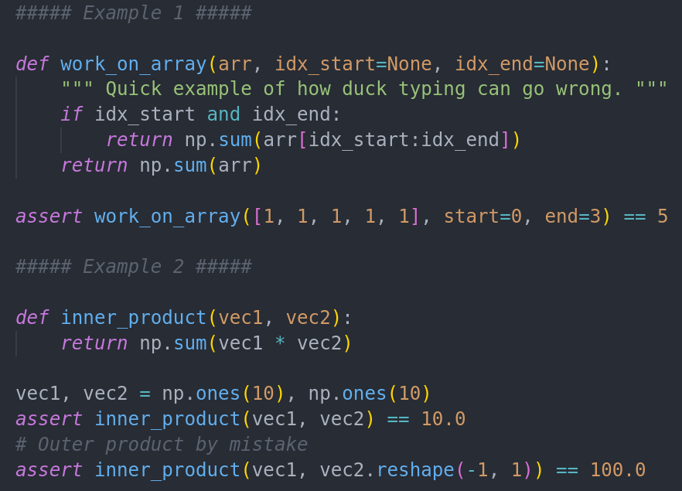
Dynamic Typing
Dynamic language:
  Types are cast automatically
  Python:
  “if it quacks it's a duck”
  Less Keyboard action
  More Errors

Slide 3

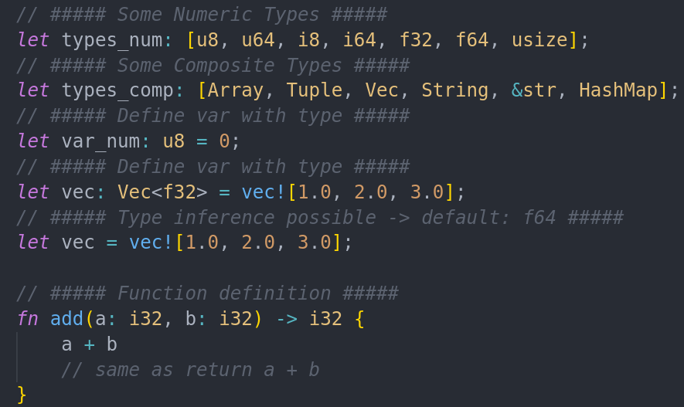
Static Typing
Types are defined for:
  Variables
  Function parameters
  Function return values
Helps with optimization
It’s just how the CPU works

Slide 4

Why Rust?
Modern language
Package manager
Type inference
Super Fast (with 1% of C)
Not C
No header files
Feels Great

Slide 5

Getting Started
Install in a single line:
  $ curl --proto '=https' --tlsv1.2 -sSf https://sh.rustup.rs | sh
Package Manager “cargo”
  Resolves dependencies
  Installs programms (ie “$ cargo install lsd”)
Start new project:
  $ cargo new myproject; cd myproject

Slide 6
Getting Started
Check for errors
  $ cargo check
Tip: Get overlay for editor like “rust-analyzer” for VSCode
Run with
  $ cargo run (-- release)
Add dependencies to Cargo.toml file

Slide 7

Pointers & Borrowing
Data can be passed:
  By copying
  By reference
By reference, memory address (pointer) gets passed
Requires lots of management:
  (De)Allocate memory
  Maintain valid data
  Maintain valid pointer, else → “Segmentaion Fault”

Slide 8
Pointers & Borrowing
In Rust:
  Variables are immutable by default
  Can be made mutable (mut keyword)
  Data is owned by a single variable
  When owner goes out of scope, data is deallocated
  Owner can borrow data to multiple readers (like pointer)
  Owner can borrow data mutably to single writer
  → Multiple Readers / Single Writer

Slide 9

Structs
Bundle data of different types
Performant Structuring of code
Not possible with python/numba:
  https://github.com/lucastepper/memtools/blob/master/memtools/gle_sim.py
Work like classes
Add Methods to a struct via implementation block

Slide 10

Traits
Define Common behavior for structs
Like inheritance in OOP
THE abstraction layer in Rust
Used all over the standard library:
  Copy → can be passed by value via copy
  Display/Debug → can be printed
  Add → works with “+” operator
  Send → can be shared between threads

Slide 11

Result & Option
Rust forces explicit handling for:
  Errors
  None-Values
Both are found in standard library
→ Implemented as Enums
Lazy Solution: call .unwrap()
→ Crash program if Error/None

Slide 12

Cool Features
Crate ndarray
  → Numpy-inspired multi-dim arrays
  → Stored as contiguous 1-dim arrays in memory
Crate py03
  → Build Python interfaces with little boilerplate
  → Create/interact with all native python types and np.ndarrays
Crate rayon
  → Build parallel iterators easily

Slide 13

More Material
Very good Documentation!
  Learning:
    https://doc.rust-lang.org/book/
  Reference standard lib:
    https://doc.rust-lang.org/std/
  Crates:
    https://docs.rs/
Thank you for your attention!

