Slide 1


Rust
Programming Language
Why Rust?
  Advantages of static typing
  Easy speedup
How Rust?
  Brief introduction
  Accelerate Python
  Easy multi-threading

Slide 2
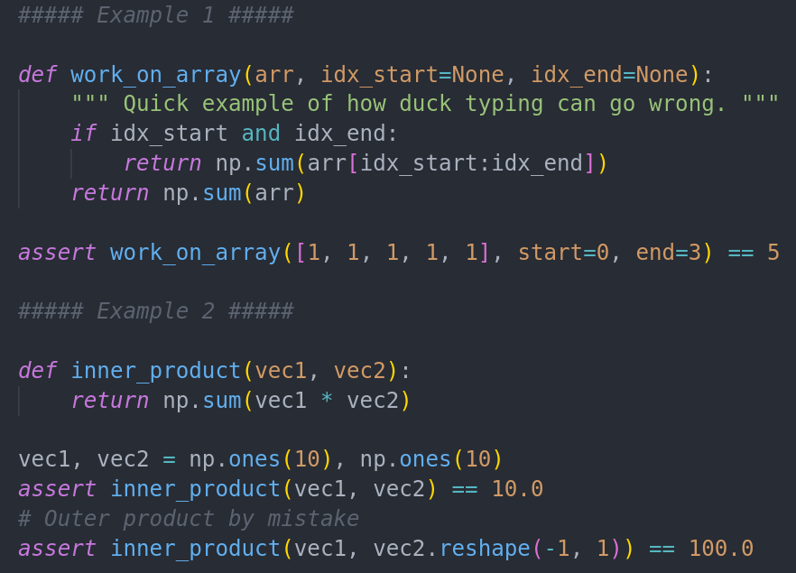
Dynamic Typing
Dynamic language:
Types are cast automatically
Python:
      “if it quacks it's a duck”
Less Keyboard action
More Errors

Slide 3
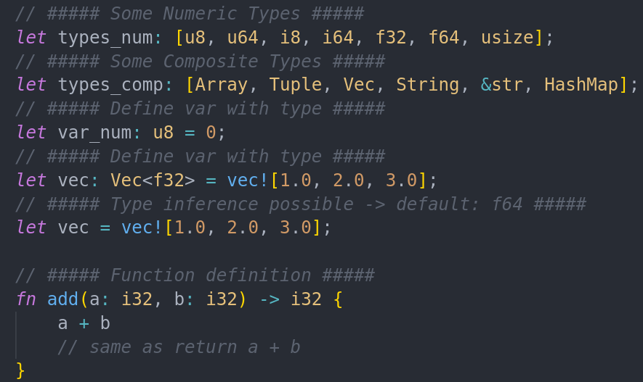
Static Typing
Types are defined for:
  Variables
  Function parameters
  Function return values
Helps with optimization
It’s just how the CPU works

Slide 4

Why Rust?
Modern language
Package manager
Type inference
Super Fast (with 1% of C)
Not C
Feels Great

Slide 5
Static Typing
Install in a single line:
  $ curl --proto '=https' --tlsv1.2 -sSf https://sh.rustup.rs | sh
Package Manager “cargo”
  Resolves dependencies
  Installs programms (ie “$ cargo install lsd”)
Start new project:
  $ cargo new MYPROJECT

