Slide 1

Lucas Liu Duke University

Slide 2
Overview
Open-source software library for ML
Developed by Google
Run on most 64-bit devices – Linux, macOS Windows, Android, iOS
Can make use of varied hardware – CPU, GPU, TPU

Slide 3
History
Developed from Google Brain internal project DistBelief
Initial release 2015
1.0.0 released in 2017
2.0.0 released in 2019
Notes:
TF 2: https://www.tensorflow.org/guide/effective_tf2

Slide 4
Tensor + Flow
Neural networks perform operations on multidimensional data arrays (tensors)
Expressed as stateful dataflow graphs
Parallelism, distributed execution, compilation, portability
Keras provides high level API
Notes:
https://www.tensorflow.org/guide/keras/customizing_what_happens_in_fit

Slide 5
Automatic Differentiation
AutoDiff: exploit the fact that computers find gradients through a sequence of basic arithmetic and elementary functions
TF1: Forces user to stitch abstract syntax tree (full static computational graph)
TF2: “Eager Execution” evaluates operations immediately and returns concrete values (dynamic graph)
Idea adopted from PyTorch - TensorFlow Competitor Developed by Facebook AI Research Lab (FAIR) in 2016
See this paper to understand more about Automatic Differentiation, and how it is different from Symbolic or Numeric Differentiation
Notes:
https://www.tensorflow.org/guide/keras/customizing_what_happens_in_fit
https://en.wikipedia.org/wiki/Automatic_differentiation
https://en.wikipedia.org/wiki/Abstract_syntax_tree
https://medium.com/analytics-vidhya/dynamic-vs-static-computation-graph-2579d1934ecf
https://stackoverflow.com/questions/46154189/what-is-the-difference-of-static-computational-graphs-in-tensorflow-and-dynamic
https://algorithmia.com/blog/exploring-the-deep-learning-framework-pytorch
https://thegradient.pub/state-of-ml-frameworks-2019-pytorch-dominates-research-tensorflow-dominates-industry/
Pytorch mobile 2020

Slide 6
PyTorch vs. TensorFlow
TensorFlow is older
Used to use different AutoDiff approaches – they have since copied each other’s features
TensorFlow used in industry more, PyTorch popular in research
TensorFlow is better for various platforms & devices, PyTorch Python targeted
Notes:
https://www.tensorflow.org/guide/keras/customizing_what_happens_in_fit
https://en.wikipedia.org/wiki/Automatic_differentiation
https://en.wikipedia.org/wiki/Abstract_syntax_tree
https://medium.com/analytics-vidhya/dynamic-vs-static-computation-graph-2579d1934ecf
https://stackoverflow.com/questions/46154189/what-is-the-difference-of-static-computational-graphs-in-tensorflow-and-dynamic
https://algorithmia.com/blog/exploring-the-deep-learning-framework-pytorch
https://thegradient.pub/state-of-ml-frameworks-2019-pytorch-dominates-research-tensorflow-dominates-industry/
Pytorch mobile 2020

Slide 7
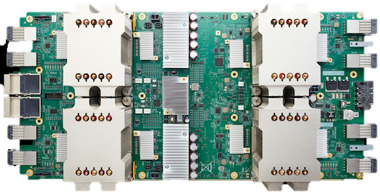
Tensor Processing Unit (TPU)
Google announces first TPU in 2016
AI / ML ASIC for TensorFlow (order of magnitude better performance per watt)
Focused on inference, not training
Gen 3 released in 2018, 420 teraflops
v3 Pods offer 100+ petaflops

Slide 8
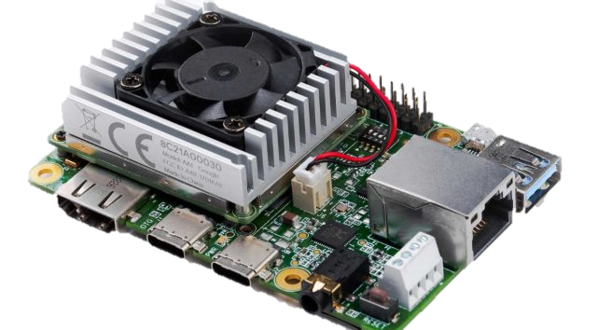
Edge TPU
Edge TPU released in 2018
ASIC designed for TensorFlow Lite
Edge Computing Targeted

Slide 9

TensorFlow Lite
Released in 2017
Targets mobile development
Uses FlatBuffers instead of Protocol Buffers
“TensorFlow Lite is an open source deep learning framework for on-device inference”
Notes:
https://google.github.io/flatbuffers/
Pytorch mobile 2020, not microcontroller
Pytorch better for python, worse for everything else

Slide 10
TensorFlow Lite
Interpreter – runs optimized models
Converter – converts regular tf models into efficient (size, performance) versions
Optimizer – toolkit to reduce total size, RAM usage, or latency
Achieved through quantization, pruning, and clustering
Special supported hardware accelerations (TPU)
Tradeoff accuracy
Select – Include operations not supported in base lite version, or even make your own custom operators (increases total binary size)
Notes:
https://www.tensorflow.org/lite/guide/ops_select
https://www.tensorflow.org/lite/guide/ops_custom
https://www.tensorflow.org/lite/guide/op_select_allowlist#tensorflow_core_operators
https://www.tensorflow.org/lite/guide/op_select_allowlist

Slide 11
TensorFlow Lite
Regular TF Operators
Current TFLite Limited Operations
Customizable Select Operators
In the future, TFLite wishes to support all regular TF operations
Notes:
https://www.tensorflow.org/lite/guide/roadmap
https://www.tensorflow.org/mlir/tfl_ops
https://www.tensorflow.org/lite/guide/ops_compatibility

Slide 12
TensorFlow Lite Micro
Merged with ARM’s uTensor in 2019
Designed for microcontrollers with only a few KB of memory (Targeted for ARM Cortex-M Series)
Core runtime (16 KB) requires no OS support, standard C libraries, or dynamic memory allocation
Written in C++ 11 for 32-bit platforms

Slide 13
TensorFlow Lite Micro
Train (smaller) models (supported operations only)
Convert to TFLite model
Convert to C byte array (read-only program memory)
Run inference using C++ library

Slide 14
TensorFlow Lite Micro
A Raspberry Pi is considered “too strong” in this context (just use regular TFLite)
No on device training (and no plans to support)
Very Limited Operations

Slide 15
TensorFlow Lite Micro
Upcoming Future Features:
Support all TFLite Operations
More platform support

Slide 16
References & Useful Links
Tensorflow.org
Pytorch.org
wikipedia.org/wiki/TensorFlow
wikipedia.org/wiki/PyTorch
github.com/tensorflow
https://algorithmia.com/blog/exploring-the-deep-learning-framework-pytorch
https://thegradient.pub/state-of-ml-frameworks-2019-pytorch-dominates-research-tensorflow-dominates-industry/

