Slide 1
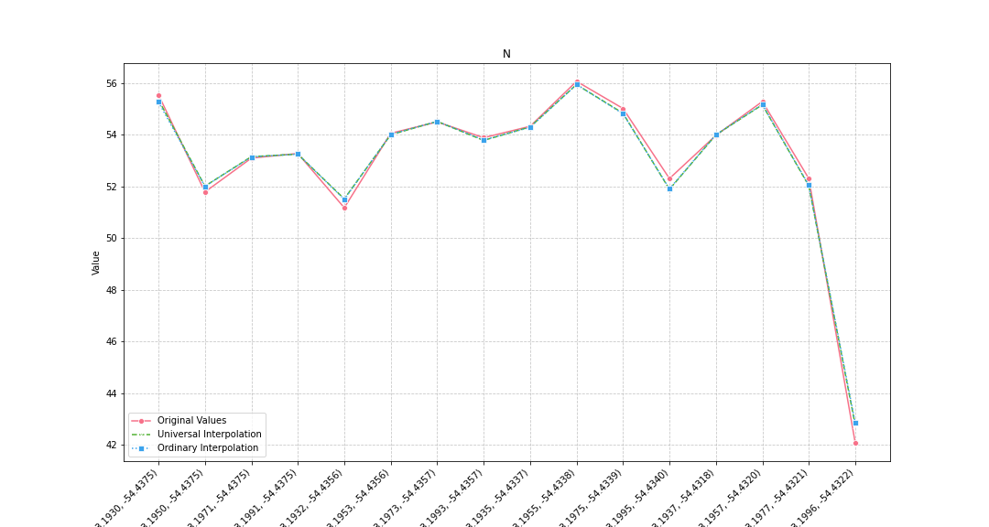
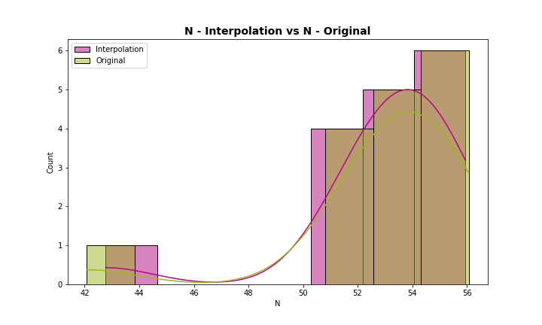
Analysis for column: N Model: UK
Interpolated Statistics:
mean 53.035074
std 3.043934
min 42.769211
25% 52.026017
50% 53.892582
75% 54.599163
80% 54.837002
85% 55.081979
90% 55.259963
95% 55.503754
99% 55.857672
Original Statistics:
mean 53.046250
std 3.237037
min 42.080000
25% 52.310000
50% 53.935000
75% 54.630000
80% 55.020000
85% 55.222500
90% 55.420000
95% 55.680000
99% 55.992000

Slide 2
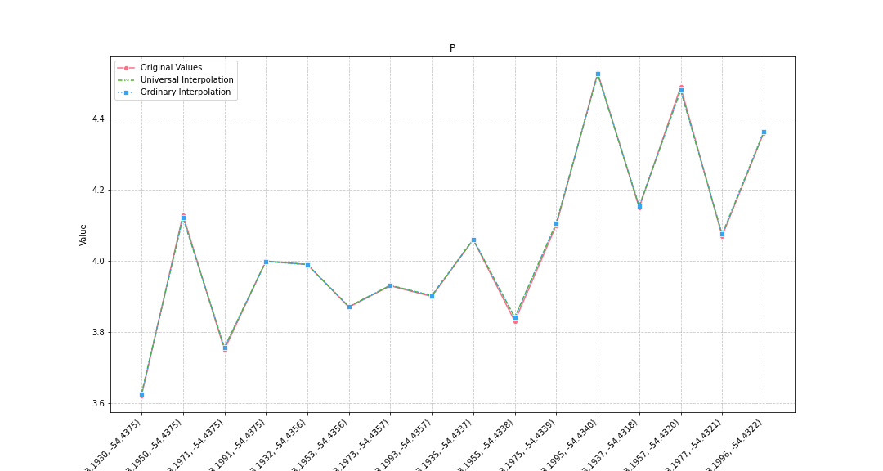
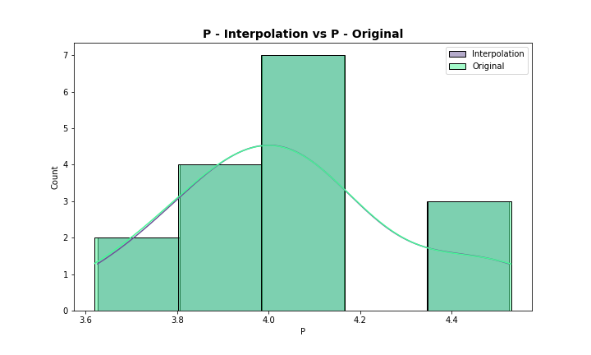
Analysis for column: P Model: UK
Interpolated Statistics:
mean 4.050164
std 0.246450
min 3.626188
25% 3.894568
50% 4.029950
75% 4.129768
80% 4.153451
85% 4.309497
90% 4.420925
95% 4.491544
99% 4.518437
Original Statistics:
mean 4.04875
std 0.25009
min 3.62000
25% 3.89250
50% 4.03000
75% 4.13500
80% 4.15000
85% 4.30750
90% 4.42500
95% 4.50000
99% 4.52400

Slide 3
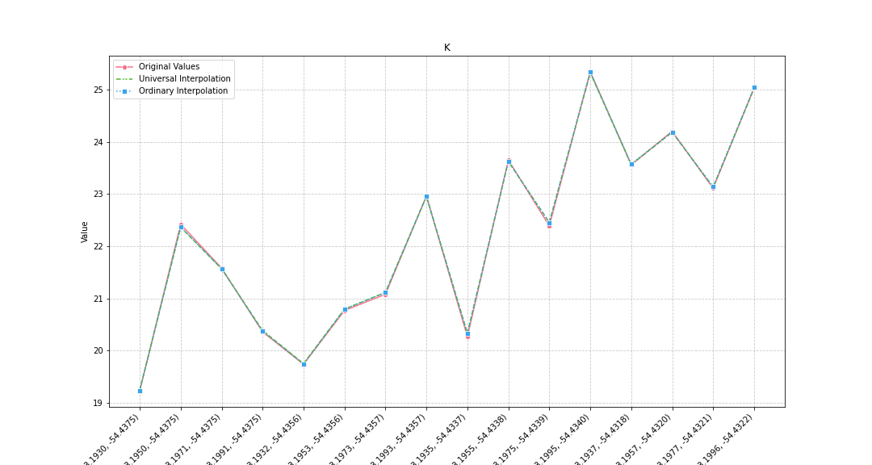
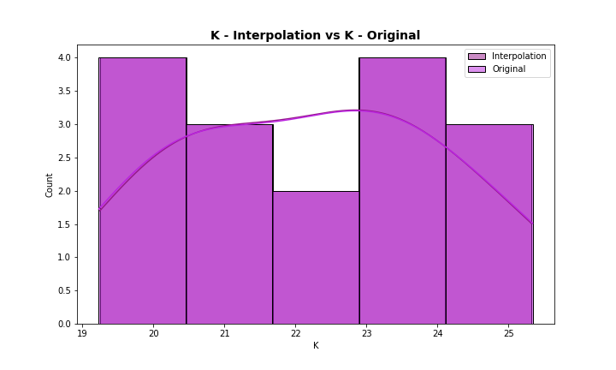
Analysis for column: K Model: UK
Interpolated Statistics:
mean 22.238326
std 1.862524
min 19.247816
25% 20.693174
50% 22.409276
75% 23.577038
80% 23.623404
85% 24.042559
90% 24.600851
95% 25.095016
99% 25.276437
Original Statistics:
mean 22.230625
std 1.879051
min 19.230000
25% 20.667500
50% 22.405000
75% 23.582500
80% 23.650000
85% 24.062500
90% 24.615000
95% 25.107500
99% 25.293500

Slide 4
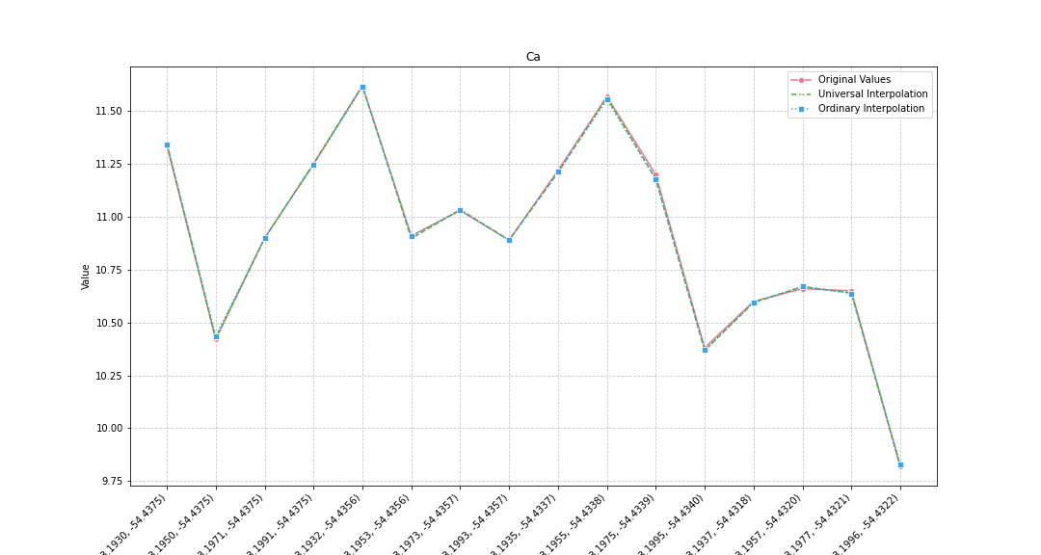
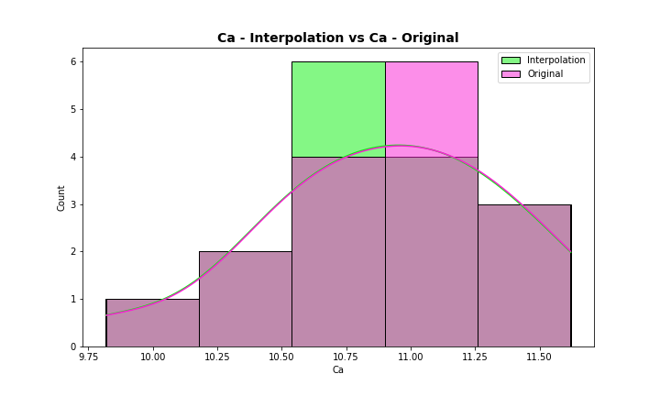
Analysis for column: Ca Model: UK
Interpolated Statistics:
mean 10.900452
std 0.474447
min 9.817926
25% 10.628390
50% 10.897526
75% 11.219831
80% 11.251550
85% 11.325106
90% 11.457049
95% 11.578692
99% 11.612817
Original Statistics:
mean 10.903750
std 0.473988
min 9.820000
25% 10.637500
50% 10.905000
75% 11.227500
80% 11.250000
85% 11.317500
90% 11.455000
95% 11.582500
99% 11.612500

Slide 5
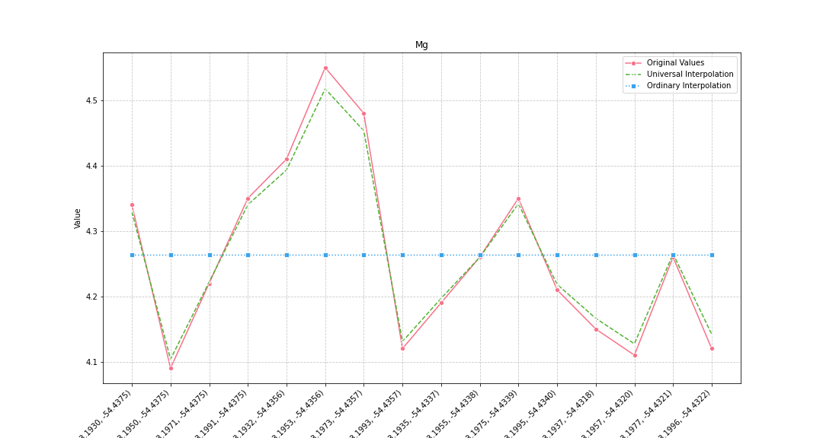
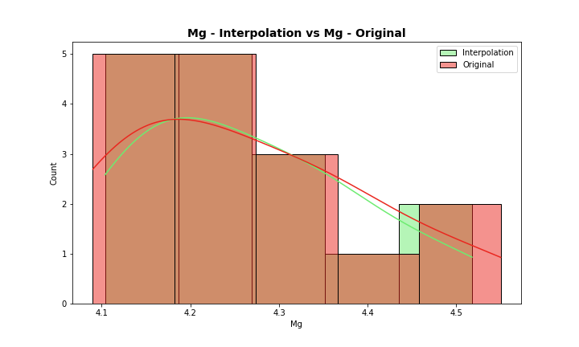
Analysis for column: Mg Model: UK
Interpolated Statistics:
mean 4.262990
std 0.123241
min 4.103770
25% 4.160232
50% 4.240871
75% 4.340546
80% 4.341817
85% 4.380392
90% 4.423272
95% 4.469381
99% 4.507988
Original Statistics:
mean 4.263125
std 0.138839
min 4.090000
25% 4.142500
50% 4.240000
75% 4.350000
80% 4.350000
85% 4.395000
90% 4.445000
95% 4.497500
99% 4.539500

Slide 6
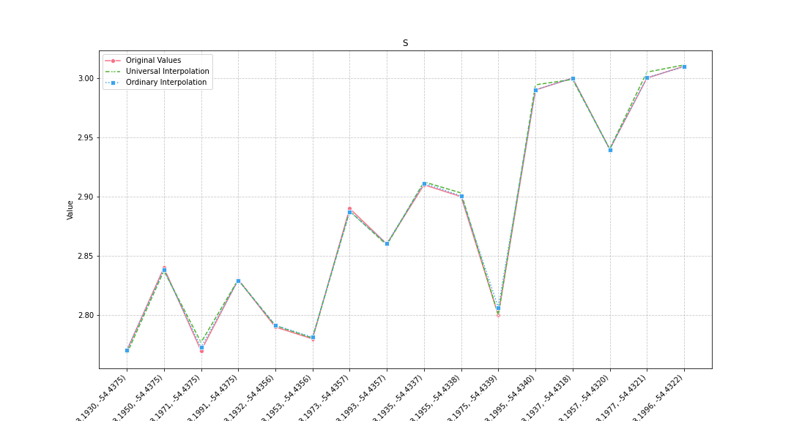
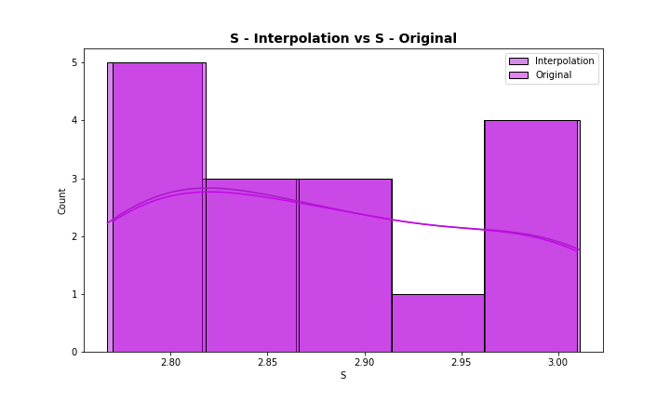
Analysis for column: S Model: UK
Interpolated Statistics:
mean 2.880997
std 0.088495
min 2.767275
25% 2.797956
50% 2.873545
75% 2.953682
80% 2.994330
85% 2.997776
90% 3.001990
95% 3.006564
99% 3.010188
Original Statistics:
mean 2.880000
std 0.087939
min 2.770000
25% 2.797500
50% 2.875000
75% 2.952500
80% 2.990000
85% 2.997500
90% 3.000000
95% 3.002500
99% 3.008500

Slide 7
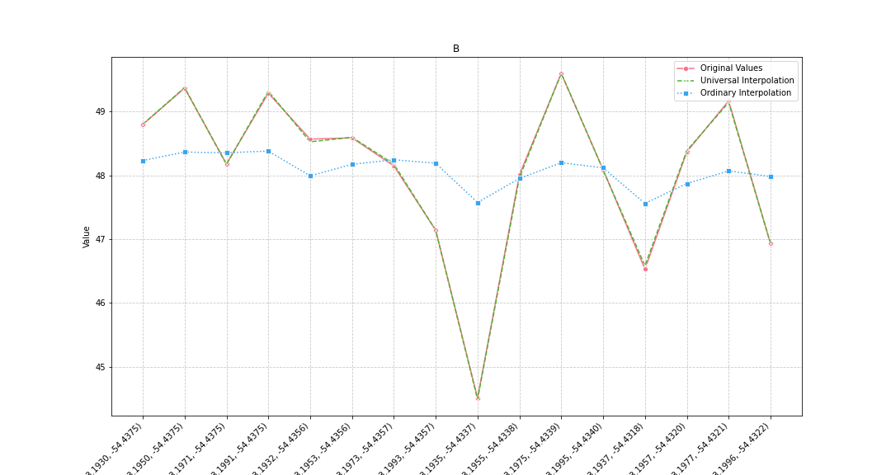
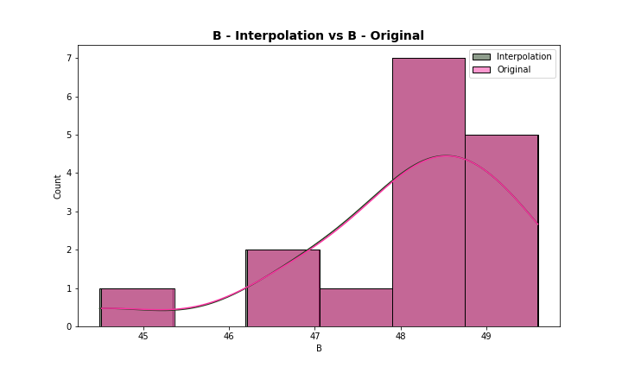
Analysis for column: B Model: UK
Interpolated Statistics:
mean 48.082068
std 1.294236
min 44.488981
25% 47.760839
50% 48.284030
75% 48.886791
80% 49.145150
85% 49.276371
90% 49.349571
95% 49.434792
99% 49.568620
Original Statistics:
mean 48.081250
std 1.293645
min 44.510000
25% 47.792500
50% 48.275000
75% 48.892500
80% 49.170000
85% 49.260000
90% 49.330000
95% 49.427500
99% 49.565500

Slide 8
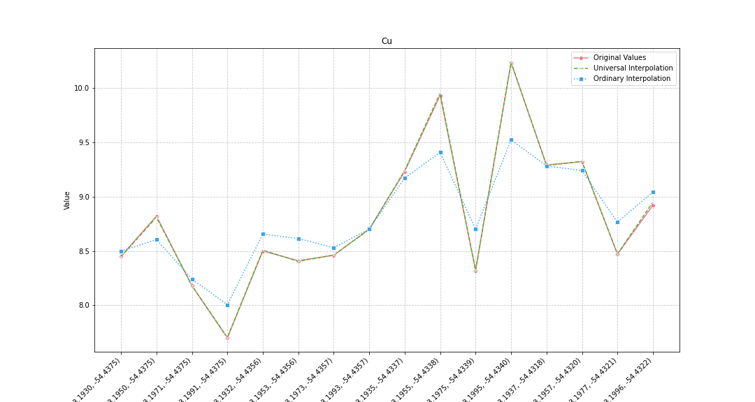
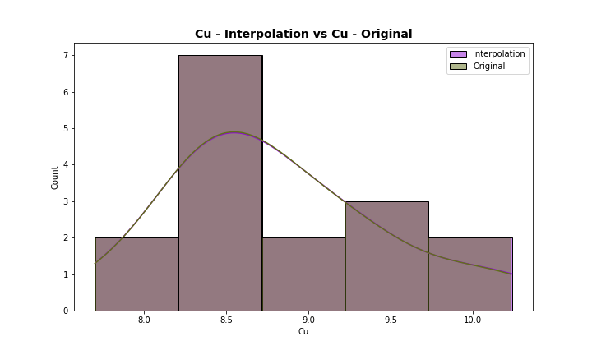
Analysis for column: Cu Model: UK
Interpolated Statistics:
mean 8.811688
std 0.659193
min 7.703487
25% 8.435778
50% 8.601701
75% 9.250205
80% 9.285276
85% 9.313412
90% 9.636410
95% 10.021517
99% 10.193088
Original Statistics:
mean 8.808125
std 0.655990
min 7.700000
25% 8.440000
50% 8.600000
75% 9.245000
80% 9.290000
85% 9.312500
90% 9.625000
95% 10.005000
99% 10.185000

Slide 9
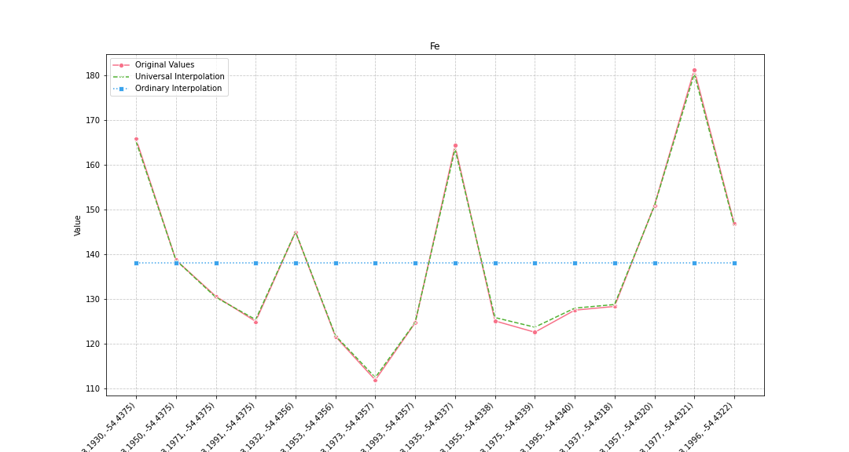
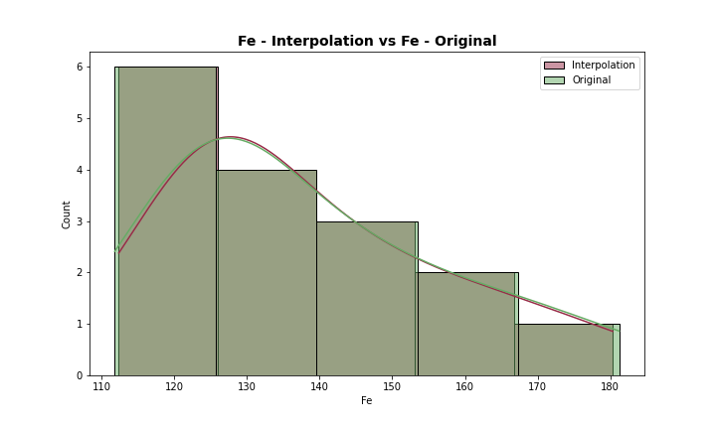
Analysis for column: Fe Model: UK
Interpolated Statistics:
mean 138.142886
std 18.846836
min 112.372882
25% 125.165661
50% 129.502270
75% 147.526613
80% 150.778197
85% 160.317897
90% 164.345411
95% 168.979435
99% 178.066820
Original Statistics:
mean 138.076250
std 19.322976
min 111.810000
25% 124.840000
50% 129.405000
75% 147.847500
80% 150.900000
85% 160.935000
90% 165.025000
95% 169.635000
99% 178.911000

Slide 10
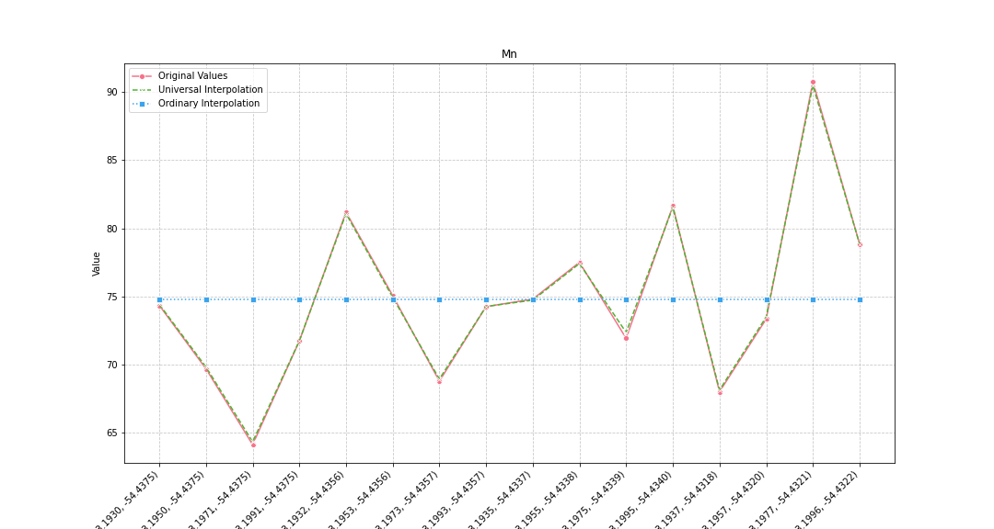
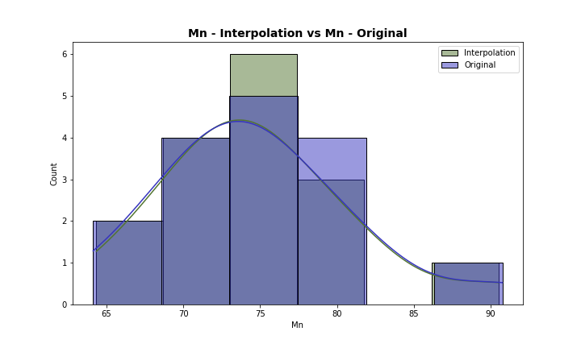
Analysis for column: Mn Model: UK
Interpolated Statistics:
mean 74.790375
std 6.243185
min 64.342723
25% 71.269861
50% 74.348499
75% 77.775059
80% 78.853811
85% 80.526861
90% 81.319064
95% 83.788300
99% 89.151621
Original Statistics:
mean 74.755625
std 6.369458
min 64.130000
25% 71.222500
50% 74.305000
75% 77.847500
80% 78.860000
85% 80.607500
90% 81.415000
95% 83.920000
99% 89.392000

Slide 11
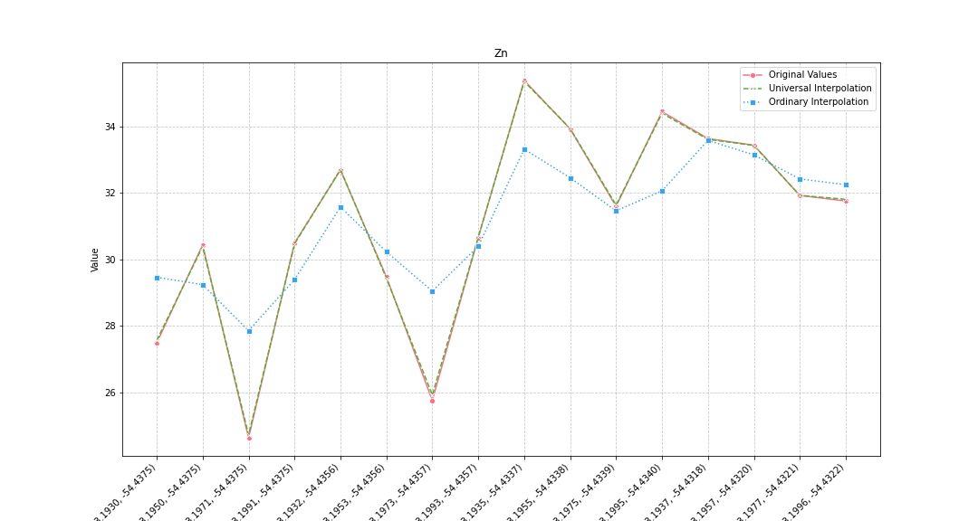
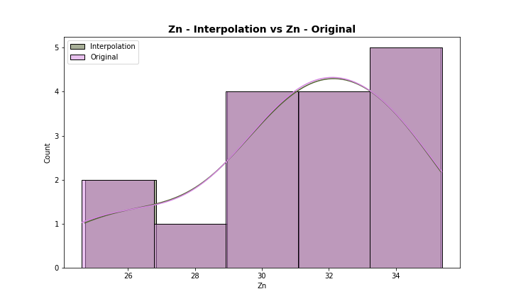
Analysis for column: Zn Model: UK
Interpolated Statistics:
mean 31.116611
std 3.020165
min 24.709221
25% 30.143600
50% 31.714470
75% 33.469045
80% 33.607557
85% 33.852783
90% 34.162477
95% 34.629952
99% 35.204807
Original Statistics:
mean 31.101875
std 3.060340
min 24.620000
25% 30.190000
50% 31.670000
75% 33.480000
80% 33.630000
85% 33.847500
90% 34.180000
95% 34.675000
99% 35.239000

Slide 12
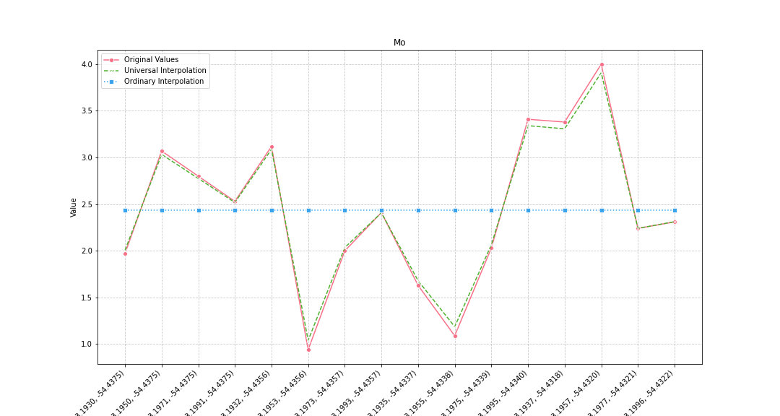
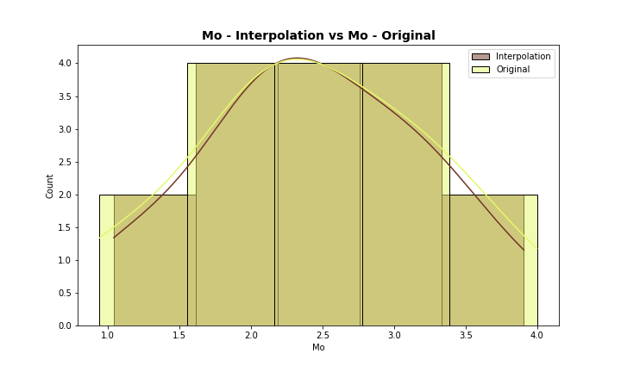
Analysis for column: Mo Model: UK
Interpolated Statistics:
mean 2.434079
std 0.786126
min 1.040066
25% 2.027371
50% 2.360127
75% 3.047149
80% 3.088106
85% 3.252869
90% 3.324478
95% 3.482952
99% 3.823238
Original Statistics:
mean 2.433125
std 0.841560
min 0.940000
25% 1.992500
50% 2.360000
75% 3.082500
80% 3.120000
85% 3.315000
90% 3.395000
95% 3.557500
99% 3.911500

Slide 13
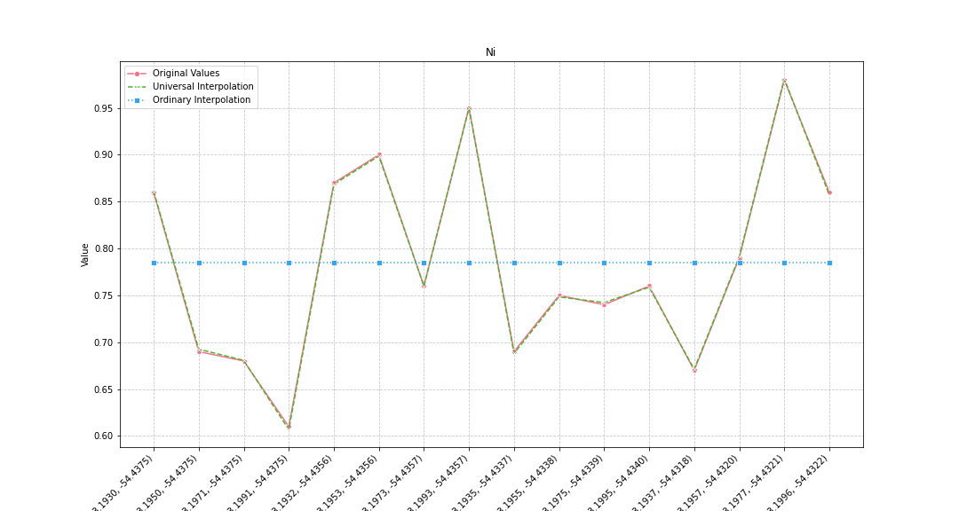
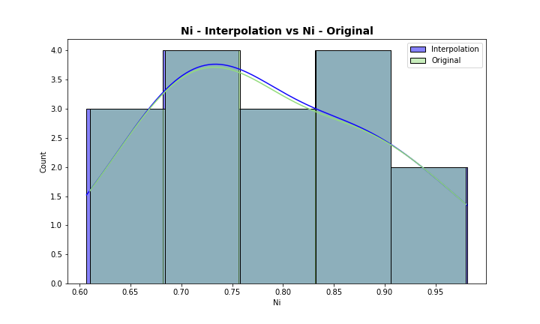
Analysis for column: Ni Model: UK
Interpolated Statistics:
mean 0.784746
std 0.107903
min 0.606769
25% 0.691403
50% 0.759279
75% 0.862983
80% 0.868484
85% 0.891119
90% 0.924355
95% 0.957792
99% 0.976380
Original Statistics:
mean 0.785000
std 0.107827
min 0.610000
25% 0.690000
50% 0.760000
75% 0.862500
80% 0.870000
85% 0.892500
90% 0.925000
95% 0.957500
99% 0.975500

Slide 14
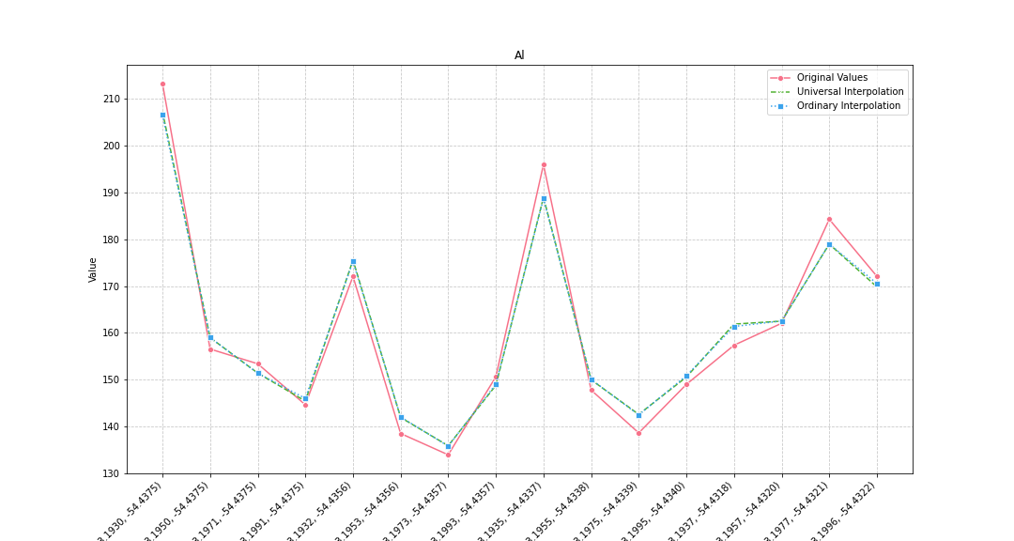
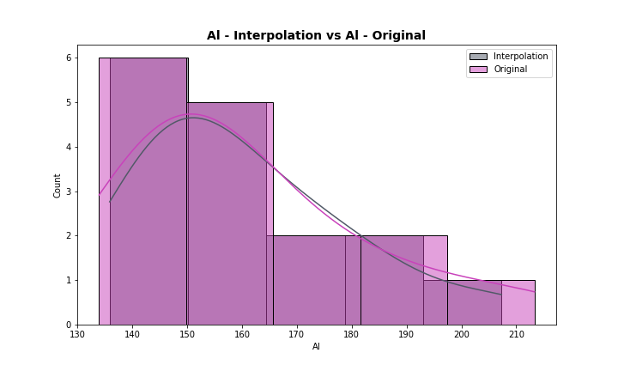
Analysis for column: Al Model: UK
Interpolated Statistics:
mean 160.663777
std 19.313860
min 135.879853
25% 147.942651
50% 155.201446
75% 171.275354
80% 175.583153
85% 178.128646
90% 183.980491
95% 193.565430
99% 204.561250
Original Statistics:
mean 160.640000
std 22.018858
min 133.940000
25% 146.995000
50% 154.975000
75% 172.085000
80% 172.100000
85% 181.242500
90% 190.140000
95% 200.320000
99% 210.712000

Slide 15
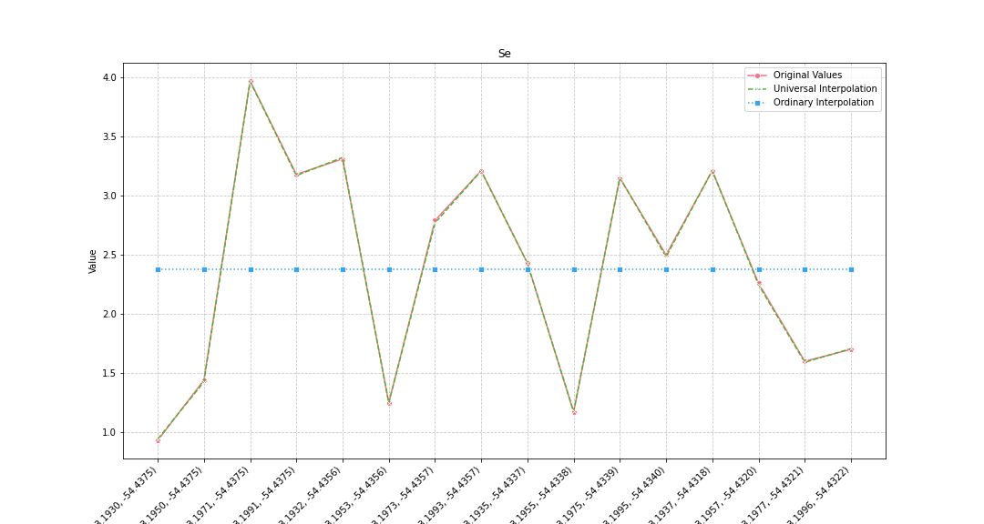
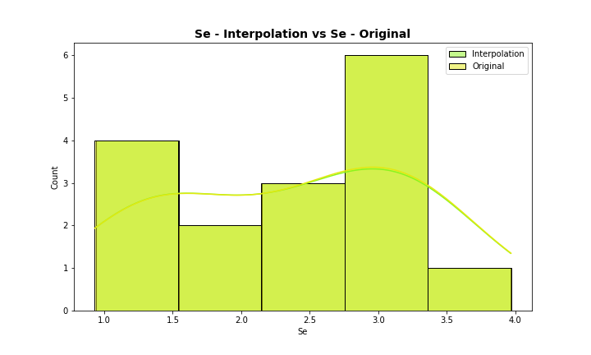
Analysis for column: Se Model: UK
Interpolated Statistics:
mean 2.377822
std 0.929961
min 0.941587
25% 1.549751
50% 2.455376
75% 3.179367
80% 3.209372
85% 3.211344
90% 3.267398
95% 3.483452
99% 3.869028
Original Statistics:
mean 2.381250
std 0.930984
min 0.930000
25% 1.560000
50% 2.465000
75% 3.187500
80% 3.210000
85% 3.210000
90% 3.260000
95% 3.475000
99% 3.871000

Slide 16
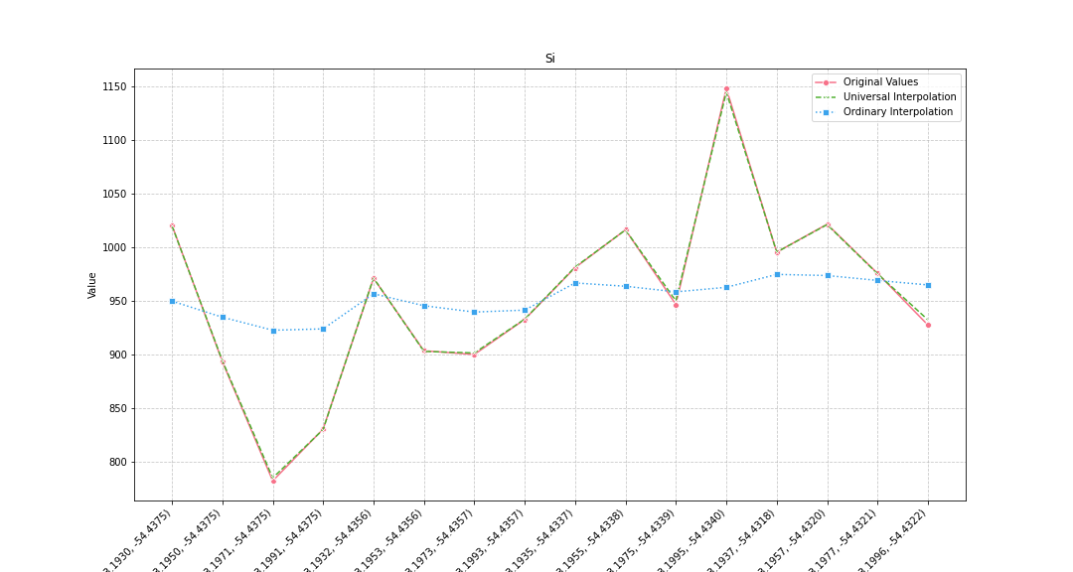
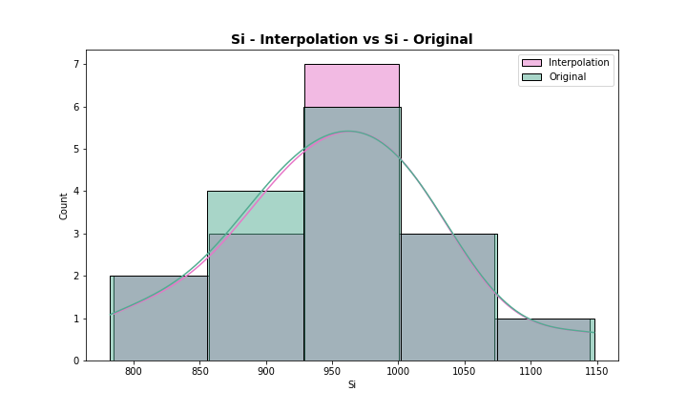
Analysis for column: Si Model: UK
Interpolated Statistics:
mean 953.271866
std 84.034208
min 784.939644
25% 902.448444
50% 960.543761
75% 1000.433483
80% 1015.933463
85% 1019.005903
90% 1020.453317
95% 1051.736402
99% 1125.799960
Original Statistics:
mean 952.745000
std 85.121909
min 782.200000
25% 902.530000
50% 958.715000
75% 1000.405000
80% 1016.050000
85% 1019.320000
90% 1020.850000
95% 1052.937500
99% 1128.891500

Slide 17
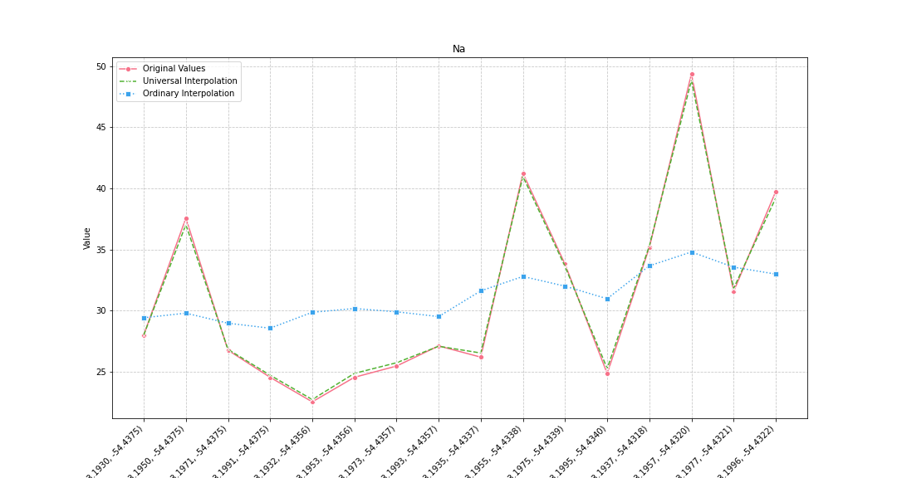
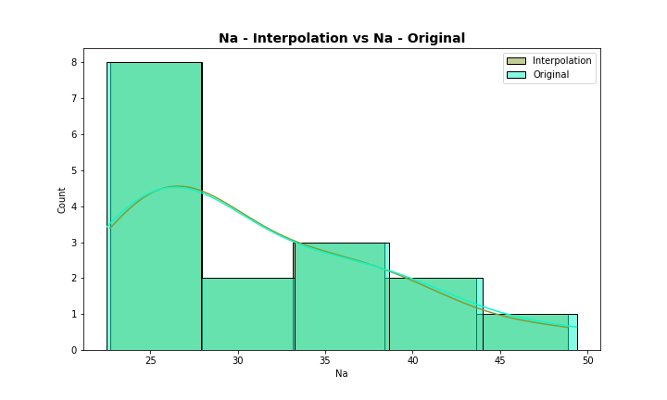
Analysis for column: Na Model: UK
Interpolated Statistics:
mean 31.148248
std 7.378203
min 22.711871
25% 25.603556
50% 27.529354
75% 35.715390
80% 37.032127
85% 38.660977
90% 40.089909
95% 42.945294
99% 47.671862
Original Statistics:
mean 31.143125
std 7.646432
min 22.520000
25% 25.297500
50% 27.545000
75% 35.752500
80% 37.560000
85% 39.195000
90% 40.490000
95% 43.275000
99% 48.159000

Slide 18
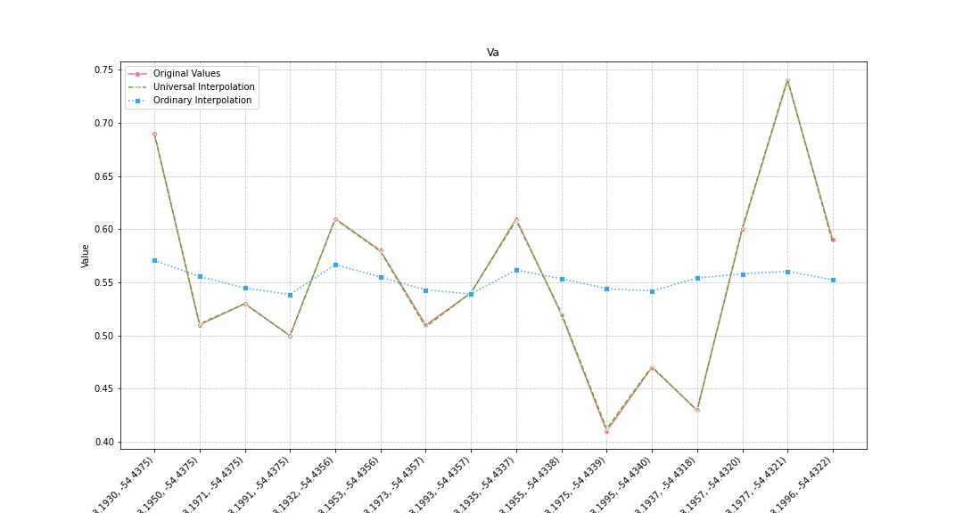
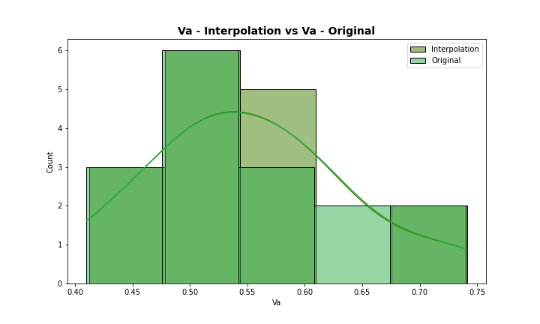
Analysis for column: Va Model: UK
Interpolated Statistics:
mean 0.552528
std 0.087522
min 0.412213
25% 0.506084
50% 0.535149
75% 0.603016
80% 0.608376
85% 0.609286
90% 0.649998
95% 0.703107
99% 0.733590
Original Statistics:
mean 0.552500
std 0.087674
min 0.410000
25% 0.507500
50% 0.535000
75% 0.602500
80% 0.610000
85% 0.610000
90% 0.650000
95% 0.702500
99% 0.732500

Slide 19
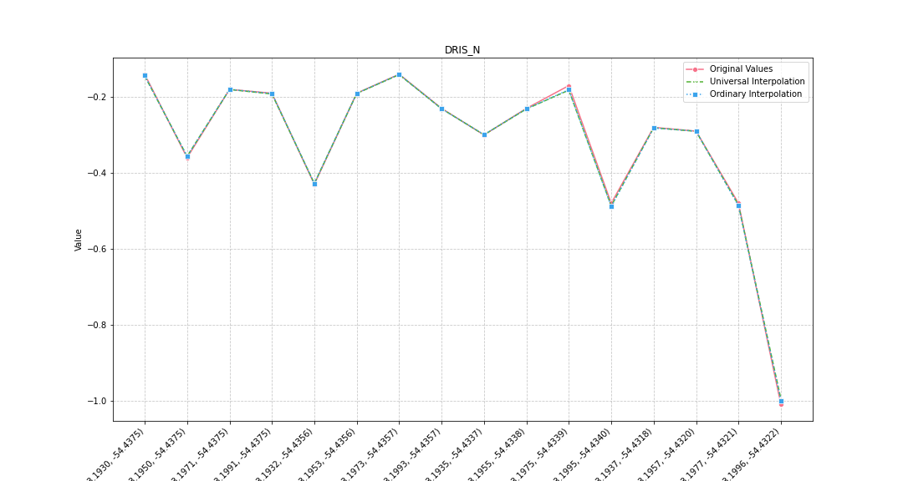
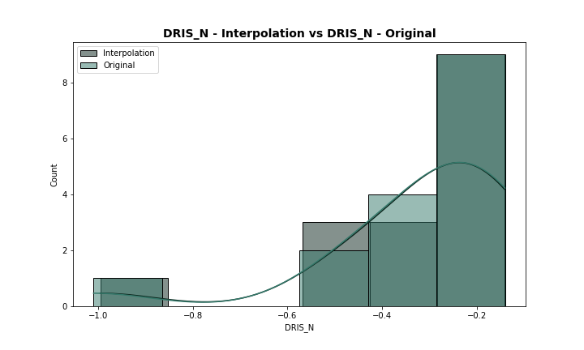
Analysis for column: DRIS_N Model: UK
Interpolated Statistics:
mean -0.319704
std 0.212517
min -0.995586
25% -0.374070
50% -0.256356
75% -0.188409
80% -0.182017
85% -0.180660
90% -0.162332
95% -0.143635
99% -0.141664
Original Statistics:
mean -0.318750
std 0.216144
min -1.010000
25% -0.377500
50% -0.255000
75% -0.187500
80% -0.180000
85% -0.172500
90% -0.155000
95% -0.140000
99% -0.140000

Slide 20
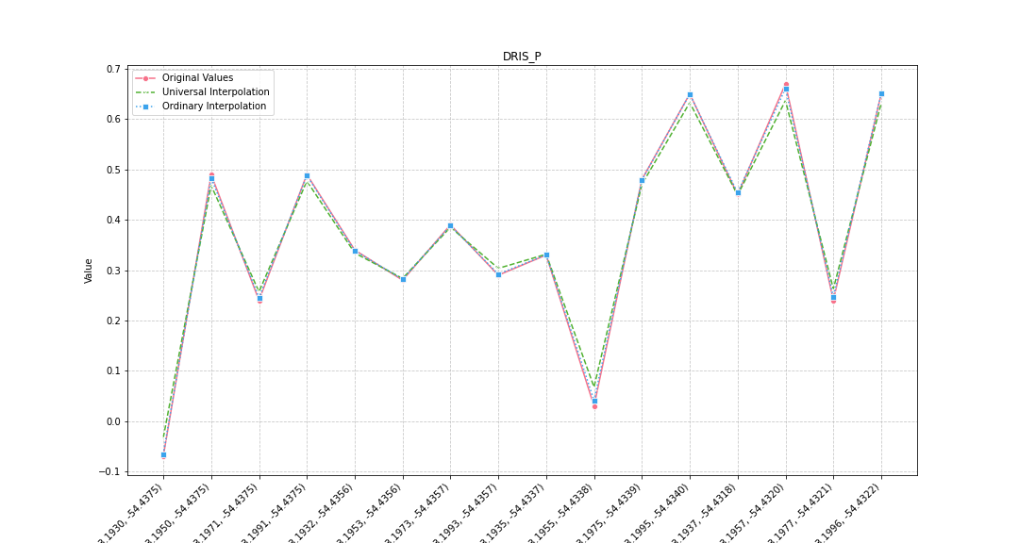
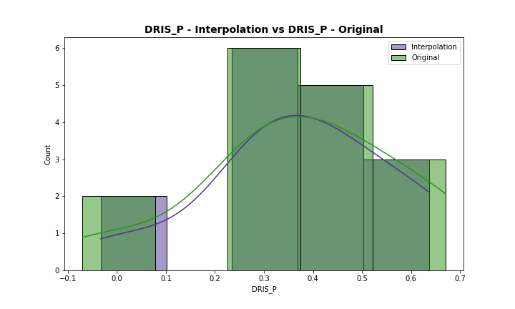
Analysis for column: DRIS_P Model: UK
Interpolated Statistics:
mean 0.372385
std 0.189496
min -0.032886
25% 0.278305
50% 0.359656
75% 0.472034
80% 0.476900
85% 0.592858
90% 0.632115
95% 0.633728
99% 0.636148
Original Statistics:
mean 0.371875
std 0.208877
min -0.070000
25% 0.270000
50% 0.365000
75% 0.490000
80% 0.490000
85% 0.610000
90% 0.650000
95% 0.655000
99% 0.667000

Slide 21
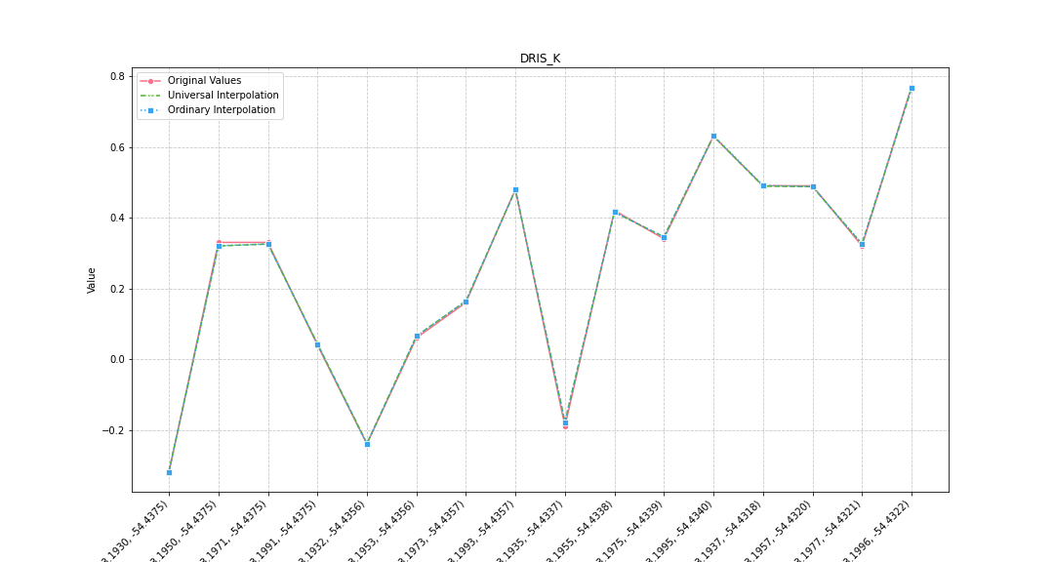
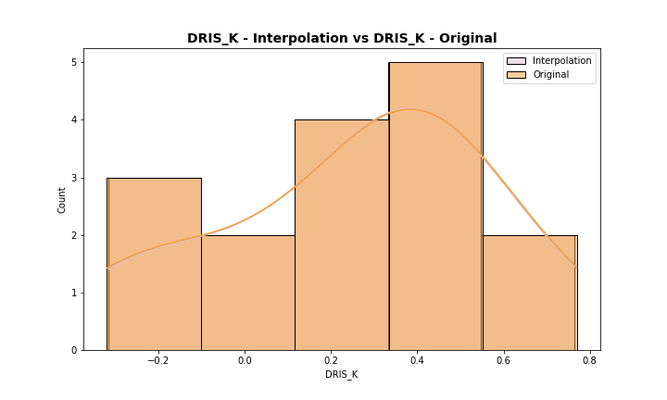
Analysis for column: DRIS_K Model: UK
Interpolated Statistics:
mean 0.257639
std 0.311217
min -0.316816
25% 0.059887
50% 0.325139
75% 0.480685
80% 0.487580
85% 0.488719
90% 0.559802
95% 0.663951
99% 0.744221
Original Statistics:
mean 0.256875
std 0.314510
min -0.320000
25% 0.055000
50% 0.330000
75% 0.482500
80% 0.490000
85% 0.490000
90% 0.560000
95% 0.665000
99% 0.749000

Slide 22
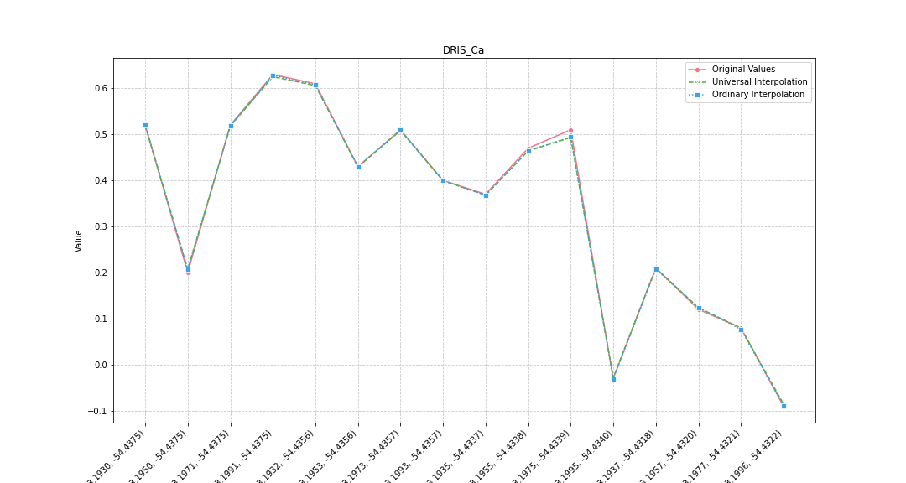
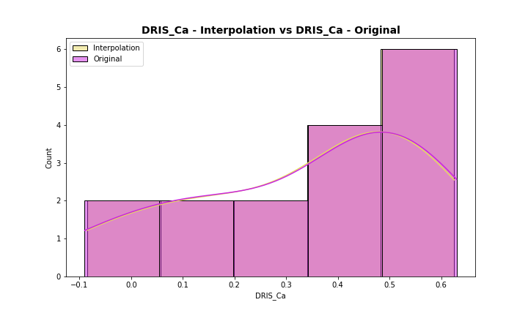
Analysis for column: DRIS_Ca Model: UK
Interpolated Statistics:
mean 0.339837
std 0.225367
min -0.085437
25% 0.186480
50% 0.414584
75% 0.510728
80% 0.517892
85% 0.519093
90% 0.562791
95% 0.610888
99% 0.622406
Original Statistics:
mean 0.341250
std 0.228528
min -0.090000
25% 0.180000
50% 0.415000
75% 0.512500
80% 0.520000
85% 0.520000
90% 0.565000
95% 0.615000
99% 0.627000

Slide 23
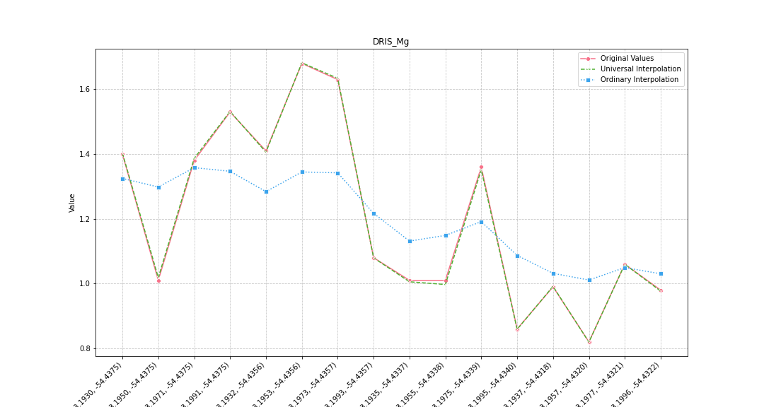
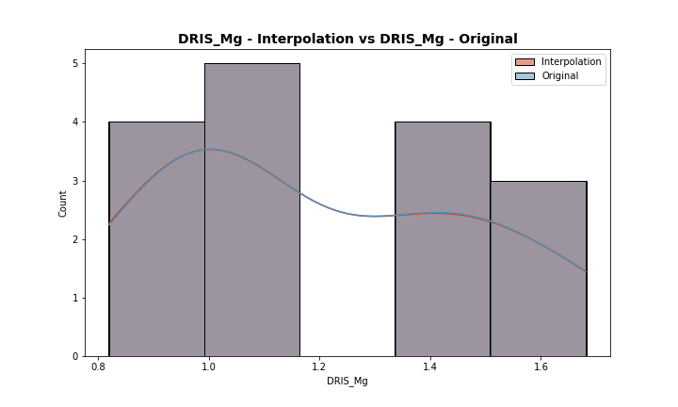
Analysis for column: DRIS_Mg Model: UK
Interpolated Statistics:
mean 1.200116
std 0.279664
min 0.819170
25% 0.995833
50% 1.069631
75% 1.403885
80% 1.405927
85% 1.500253
90% 1.582932
95% 1.646094
99% 1.674715
Original Statistics:
mean 1.200625
std 0.278220
min 0.820000
25% 1.005000
50% 1.070000
75% 1.402500
80% 1.410000
85% 1.500000
90% 1.580000
95% 1.642500
99% 1.672500

Slide 24
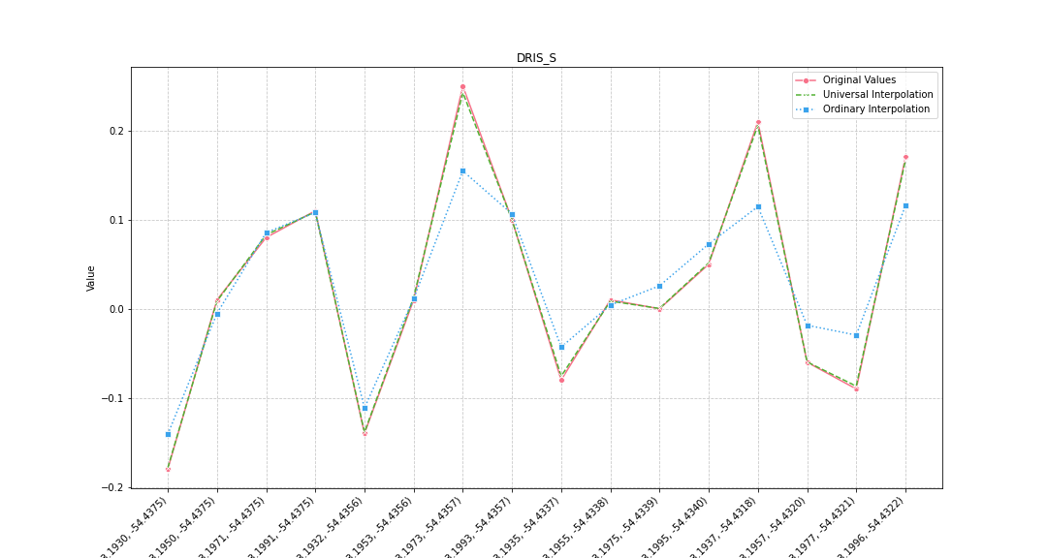
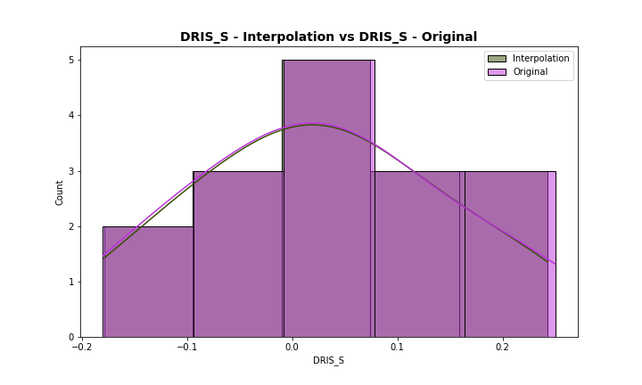
Analysis for column: DRIS_S Model: UK
Interpolated Statistics:
mean 0.028065
std 0.120073
min -0.178657
25% -0.063703
50% 0.010582
75% 0.102081
80% 0.108853
85% 0.152250
90% 0.186364
95% 0.215212
99% 0.237291
Original Statistics:
mean 0.028125
std 0.122268
min -0.180000
25% -0.065000
50% 0.010000
75% 0.102500
80% 0.110000
85% 0.155000
90% 0.190000
95% 0.220000
99% 0.244000

Slide 25
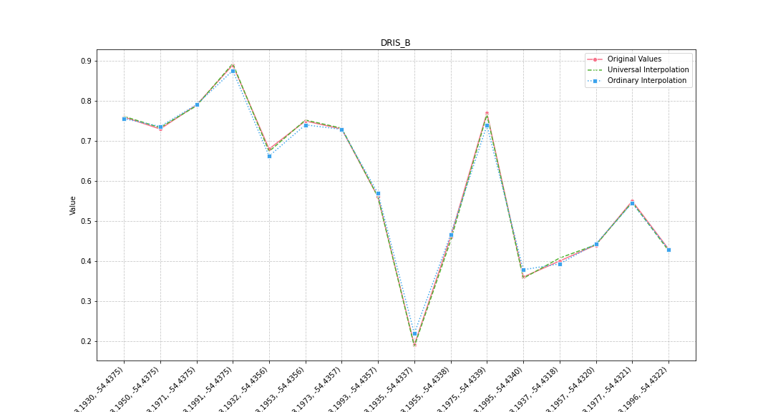
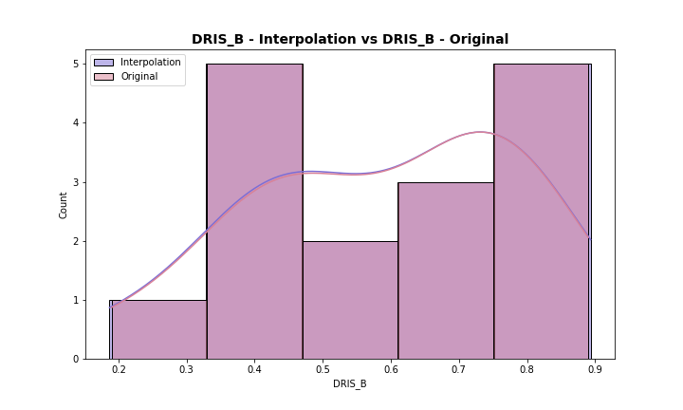
Analysis for column: DRIS_B Model: UK
Interpolated Statistics:
mean 0.592331
std 0.197897
min 0.186744
25% 0.437005
50% 0.616998
75% 0.754688
80% 0.761659
85% 0.765203
90% 0.777160
95% 0.814332
99% 0.877687
Original Statistics:
mean 0.593125
std 0.196731
min 0.190000
25% 0.437500
50% 0.620000
75% 0.752500
80% 0.760000
85% 0.767500
90% 0.780000
95% 0.815000
99% 0.875000

Slide 26


Analysis for column: DRIS_Cu Model: UK
Interpolated Statistics:
mean -3.859355
std 0.450466
min -4.691232
25% -4.116207
50% -3.851484
75% -3.631602
80% -3.572901
85% -3.467988
90% -3.266486
95% -3.082100
99% -3.039250
Original Statistics:
mean -3.860625
std 0.448753
min -4.690000
25% -4.115000
50% -3.850000
75% -3.632500
80% -3.580000
85% -3.467500
90% -3.270000
95% -3.090000
99% -3.042000

Slide 27


Analysis for column: DRIS_Fe Model: UK
Interpolated Statistics:
mean 1.597093
std 0.595524
min 0.869634
25% 1.145622
50% 1.451389
75% 1.842841
80% 1.845057
85% 2.212890
90% 2.487410
95% 2.693099
99% 2.822173
Original Statistics:
mean 1.596875
std 0.597123
min 0.880000
25% 1.142500
50% 1.455000
75% 1.845000
80% 1.860000
85% 2.220000
90% 2.490000
95% 2.692500
99% 2.818500

Slide 28


Analysis for column: DRIS_Mn Model: UK
Interpolated Statistics:
mean 0.443630
std 0.170008
min 0.199918
25% 0.326804
50% 0.441226
75% 0.517686
80% 0.551770
85% 0.578331
90% 0.618443
95% 0.705467
99% 0.839302
Original Statistics:
mean 0.443125
std 0.170205
min 0.200000
25% 0.325000
50% 0.440000
75% 0.520000
80% 0.550000
85% 0.580000
90% 0.620000
95% 0.705000
99% 0.837000

Slide 29


Analysis for column: DRIS_Zn Model: UK
Interpolated Statistics:
mean -0.407532
std 0.168965
min -0.761293
25% -0.458793
50% -0.365982
75% -0.296022
80% -0.253345
85% -0.244247
90% -0.237186
95% -0.227626
99% -0.214350
Original Statistics:
mean -0.408125
std 0.172944
min -0.770000
25% -0.457500
50% -0.365000
75% -0.295000
80% -0.250000
85% -0.242500
90% -0.235000
95% -0.225000
99% -0.213000

Slide 30


Analysis for column: IMS Model: UK
Interpolated Statistics:
mean -0.244362
std 0.079587
min -0.409511
25% -0.280200
50% -0.234953
75% -0.188020
80% -0.181916
85% -0.180413
90% -0.170613
95% -0.148481
99% -0.117681
Original Statistics:
mean -0.243750
std 0.079488
min -0.410000
25% -0.280000
50% -0.235000
75% -0.187500
80% -0.180000
85% -0.180000
90% -0.170000
95% -0.147500
99% -0.117500

Slide 31


Analysis for column: IBN Model: UK
Interpolated Statistics:
mean 9.849004
std 1.184828
min 7.776703
25% 9.214436
50% 9.743847
75% 10.842110
80% 10.854887
85% 10.968127
90% 11.278445
95% 11.651024
99% 11.891044
Original Statistics:
mean 9.849375
std 1.185796
min 7.790000
25% 9.232500
50% 9.750000
75% 10.847500
80% 10.900000
85% 10.990000
90% 11.280000
95% 11.640000
99% 11.880000

