Slide 1
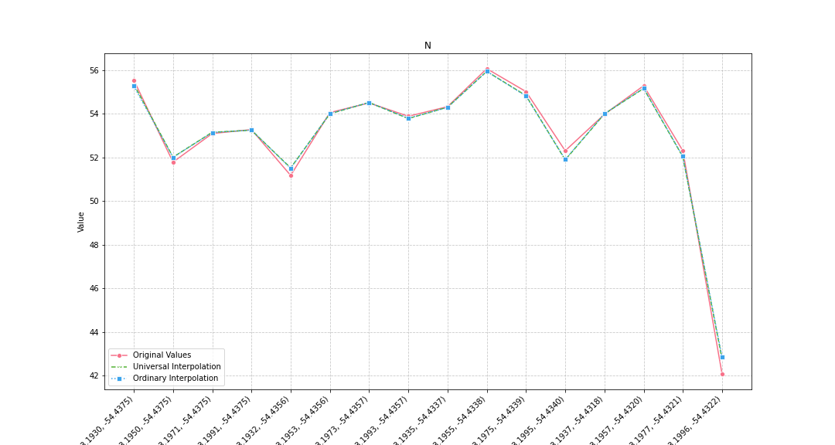
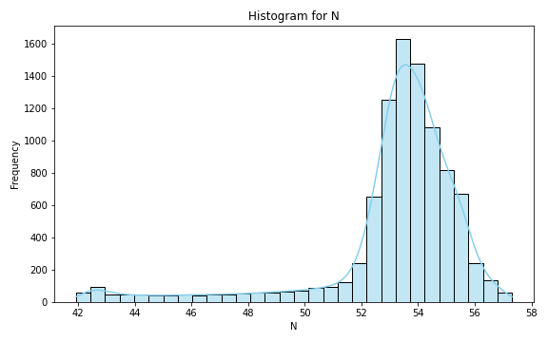
Analysis for column: N Model: UK
Interpolated Statistics:
mean 53.112613
std 2.658625
min 41.926501
25% 52.823061
50% 53.622727
75% 54.504446
80% 54.761206
85% 55.056080
90% 55.367352
95% 55.736435
99% 56.638052
Original Statistics:
mean 53.046250
std 3.237037
min 42.080000
25% 52.310000
50% 53.935000
75% 54.630000
80% 55.020000
85% 55.222500
90% 55.420000
95% 55.680000
99% 55.992000

Slide 2
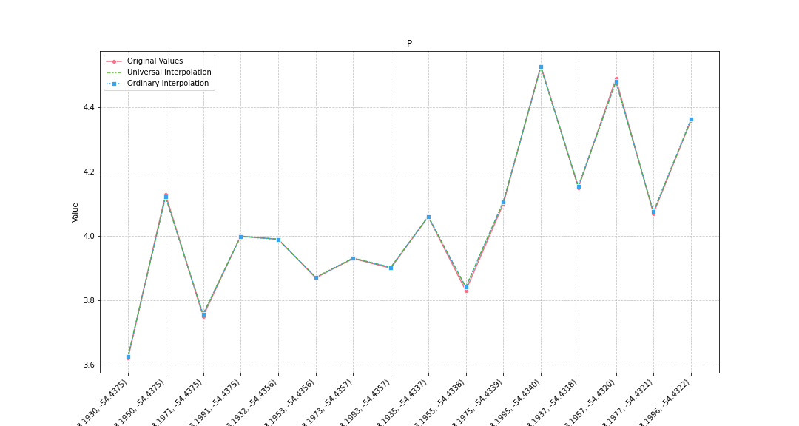
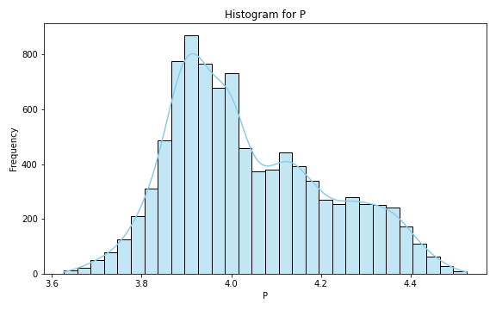
Analysis for column: P Model: UK
Interpolated Statistics:
mean 4.038377
std 0.174418
min 3.626188
25% 3.905839
50% 3.999504
75% 4.158503
80% 4.201330
85% 4.255393
90% 4.308014
95% 4.365017
99% 4.438529
Original Statistics:
mean 4.04875
std 0.25009
min 3.62000
25% 3.89250
50% 4.03000
75% 4.13500
80% 4.15000
85% 4.30750
90% 4.42500
95% 4.50000
99% 4.52400

Slide 3
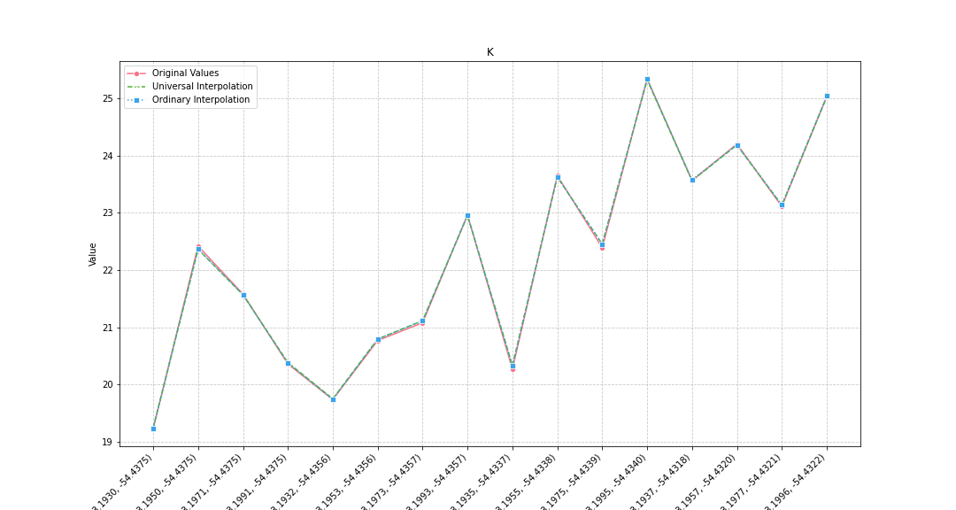
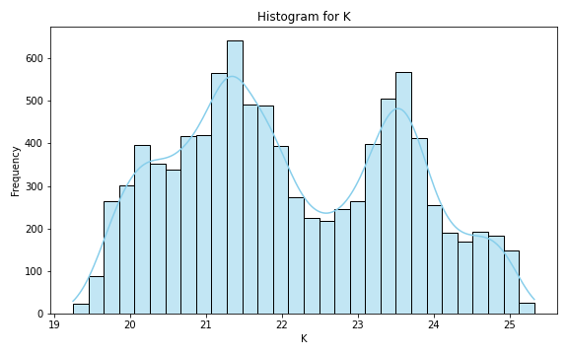
Analysis for column: K Model: UK
Interpolated Statistics:
mean 22.108031
std 1.460096
min 19.247816
25% 20.950313
50% 21.858564
75% 23.420530
80% 23.592162
85% 23.767472
90% 24.069661
95% 24.590288
99% 24.972353
Original Statistics:
mean 22.230625
std 1.879051
min 19.230000
25% 20.667500
50% 22.405000
75% 23.582500
80% 23.650000
85% 24.062500
90% 24.615000
95% 25.107500
99% 25.293500

Slide 4
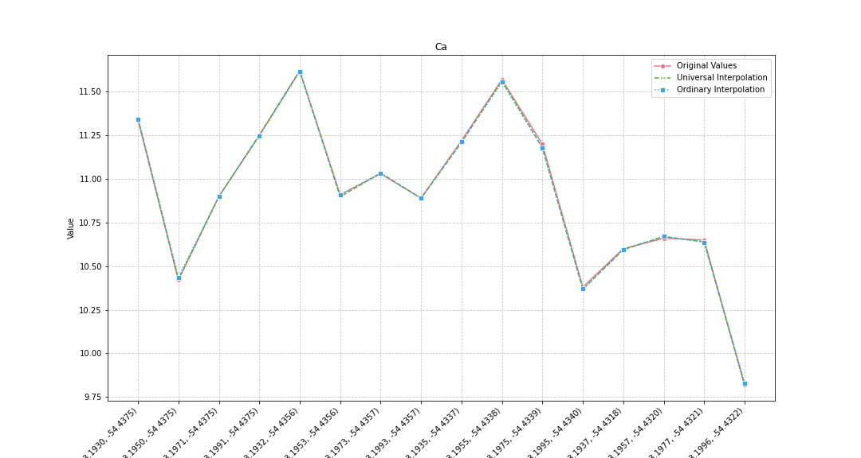
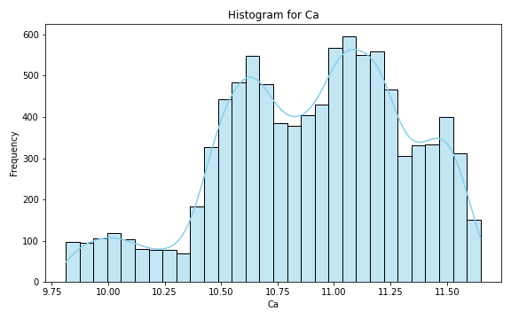
Analysis for column: Ca Model: UK
Interpolated Statistics:
mean 10.907436
std 0.413115
min 9.811922
25% 10.620729
50% 10.954173
75% 11.213526
80% 11.270450
85% 11.364188
90% 11.451302
95% 11.525105
99% 11.610363
Original Statistics:
mean 10.903750
std 0.473988
min 9.820000
25% 10.637500
50% 10.905000
75% 11.227500
80% 11.250000
85% 11.317500
90% 11.455000
95% 11.582500
99% 11.612500

Slide 5
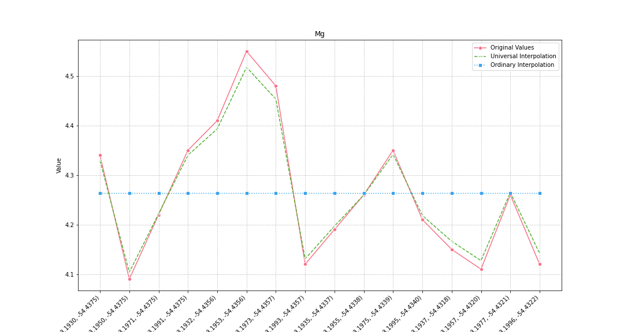
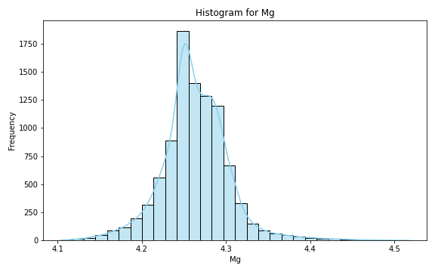
Analysis for column: Mg Model: UK
Interpolated Statistics:
mean 4.263378
std 0.040157
min 4.103770
25% 4.242729
50% 4.261003
75% 4.285920
80% 4.291364
85% 4.297470
90% 4.306905
95% 4.323586
99% 4.385941
Original Statistics:
mean 4.263125
std 0.138839
min 4.090000
25% 4.142500
50% 4.240000
75% 4.350000
80% 4.350000
85% 4.395000
90% 4.445000
95% 4.497500
99% 4.539500

Slide 6
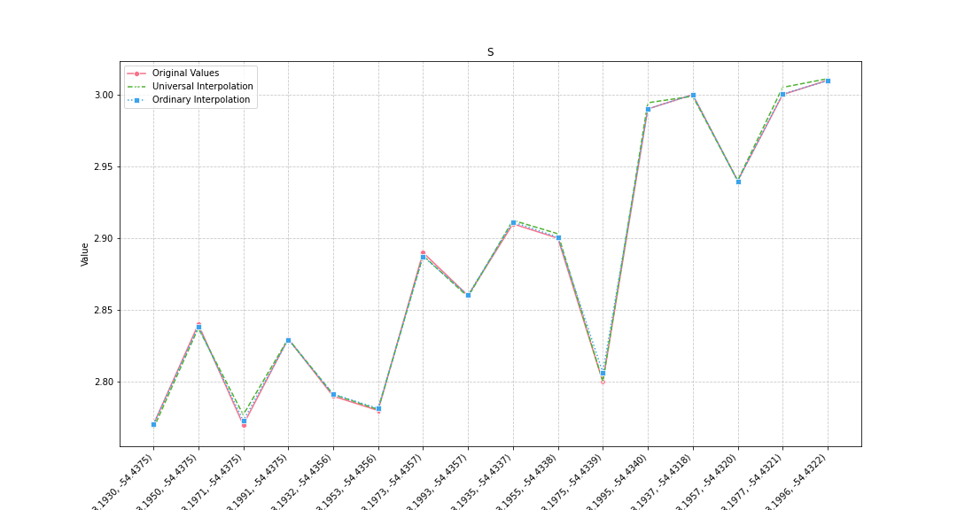
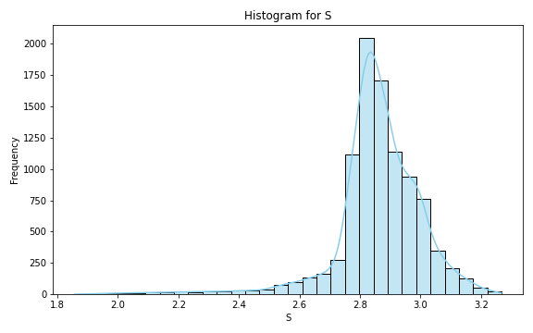
Analysis for column: S Model: UK
Interpolated Statistics:
mean 2.859859
std 0.148843
min 1.855810
25% 2.804217
50% 2.859450
75% 2.942278
80% 2.965837
85% 2.990799
90% 3.016712
95% 3.071110
99% 3.167299
Original Statistics:
mean 2.880000
std 0.087939
min 2.770000
25% 2.797500
50% 2.875000
75% 2.952500
80% 2.990000
85% 2.997500
90% 3.000000
95% 3.002500
99% 3.008500

Slide 7
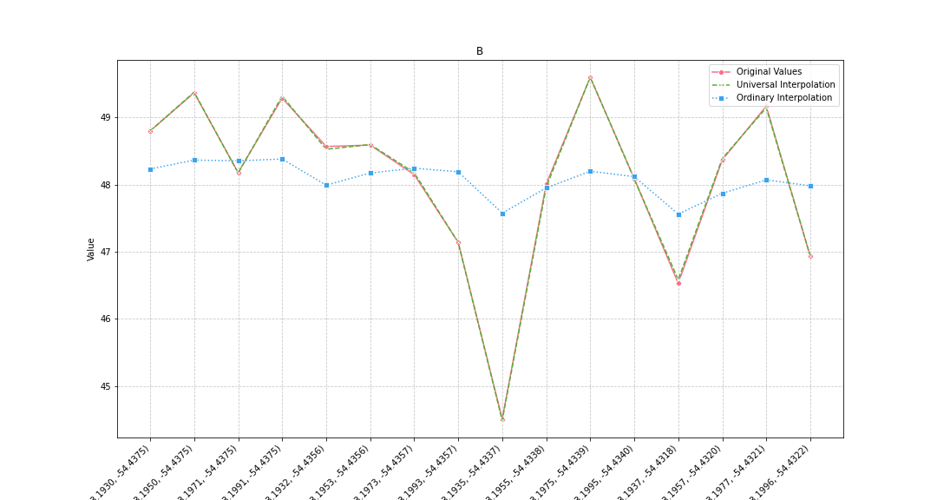
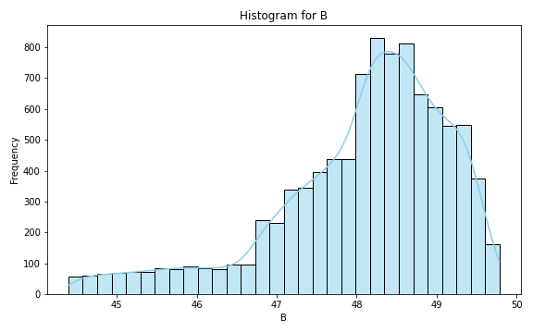
Analysis for column: B Model: UK
Interpolated Statistics:
mean 48.072404
std 1.103752
min 44.395626
25% 47.537217
50% 48.286715
75% 48.847128
80% 48.988269
85% 49.137172
90% 49.291474
95% 49.445819
99% 49.677986
Original Statistics:
mean 48.081250
std 1.293645
min 44.510000
25% 47.792500
50% 48.275000
75% 48.892500
80% 49.170000
85% 49.260000
90% 49.330000
95% 49.427500
99% 49.565500

Slide 8
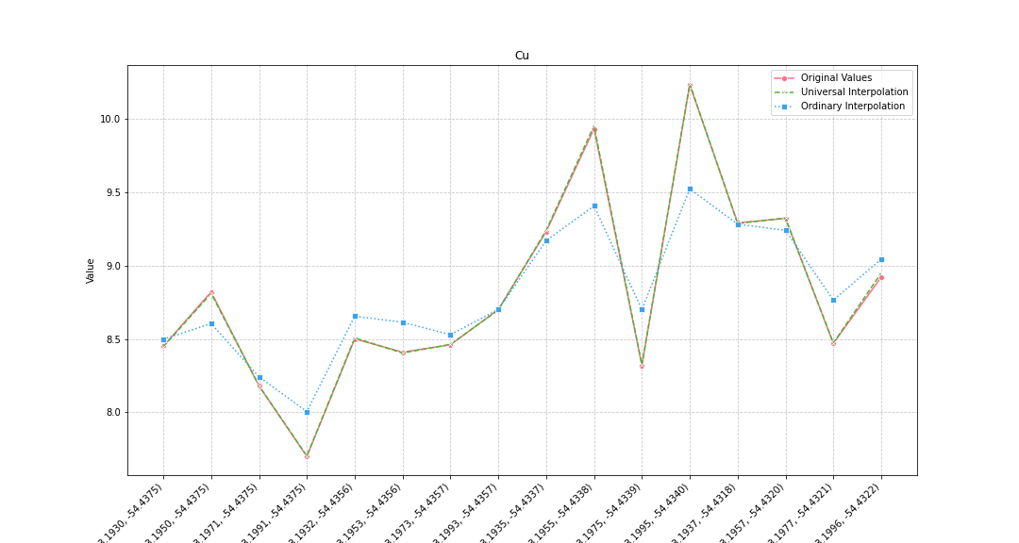
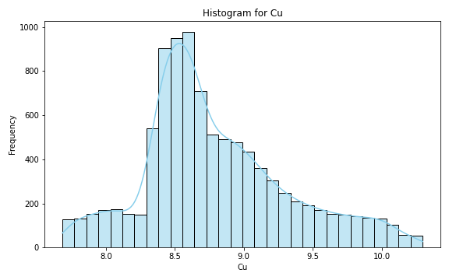
Analysis for column: Cu Model: UK
Interpolated Statistics:
mean 8.793965
std 0.527509
min 7.685040
25% 8.456506
50% 8.674320
75% 9.084725
80% 9.206574
85% 9.367988
90% 9.589188
95% 9.864381
99% 10.138610
Original Statistics:
mean 8.808125
std 0.655990
min 7.700000
25% 8.440000
50% 8.600000
75% 9.245000
80% 9.290000
85% 9.312500
90% 9.625000
95% 10.005000
99% 10.185000

Slide 9
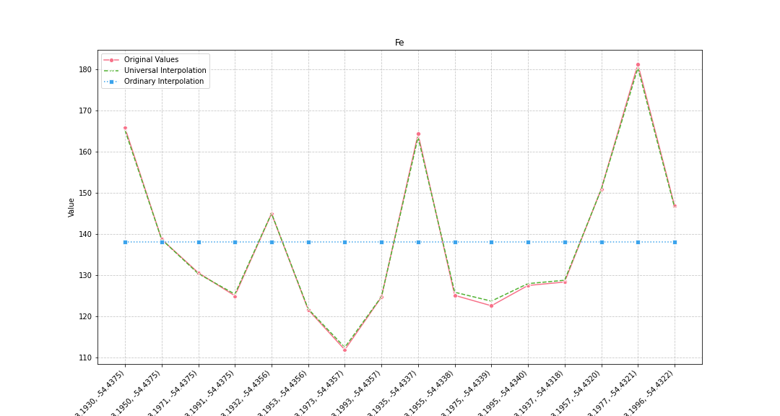
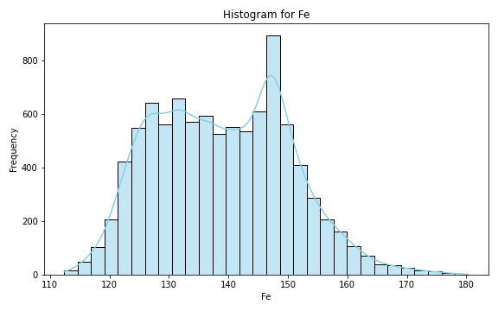
Analysis for column: Fe Model: UK
Interpolated Statistics:
mean 139.020845
std 11.386886
min 112.372882
25% 129.730358
50% 138.751749
75% 147.449374
80% 148.801546
85% 150.725738
90% 153.355219
95% 157.736654
99% 166.796233
Original Statistics:
mean 138.076250
std 19.322976
min 111.810000
25% 124.840000
50% 129.405000
75% 147.847500
80% 150.900000
85% 160.935000
90% 165.025000
95% 169.635000
99% 178.911000

Slide 10
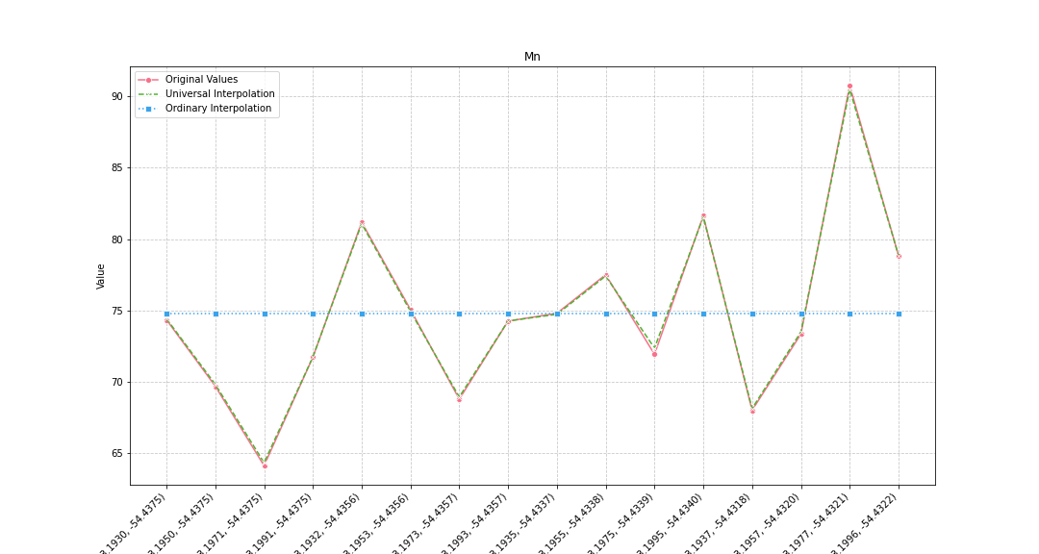
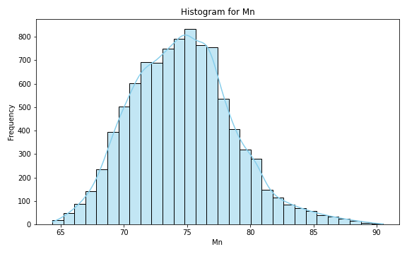
Analysis for column: Mn Model: UK
Interpolated Statistics:
mean 74.672564
std 4.062353
min 64.342723
25% 71.730007
50% 74.563621
75% 77.122647
80% 77.823393
85% 78.663194
90% 79.859509
95% 81.647180
99% 85.960336
Original Statistics:
mean 74.755625
std 6.369458
min 64.130000
25% 71.222500
50% 74.305000
75% 77.847500
80% 78.860000
85% 80.607500
90% 81.415000
95% 83.920000
99% 89.392000

Slide 11
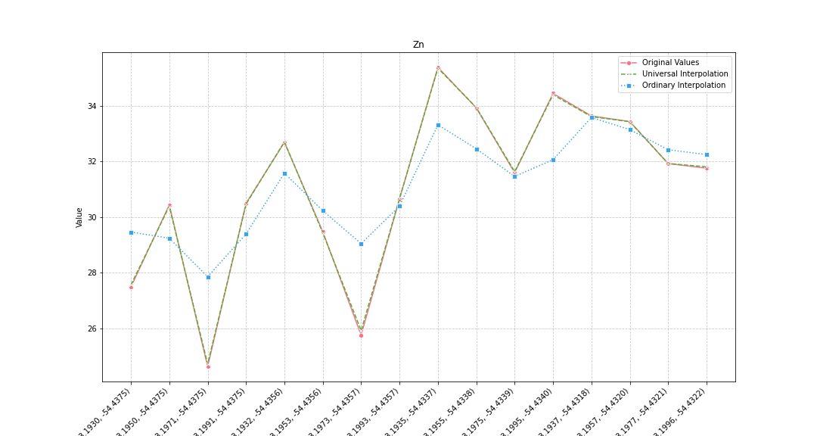
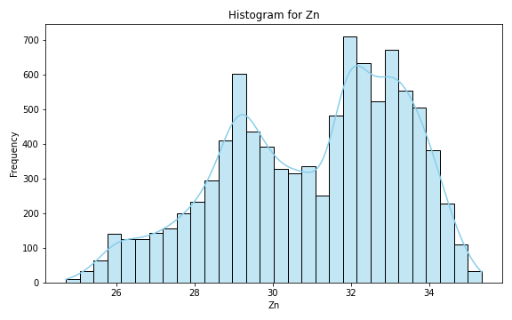
Analysis for column: Zn Model: UK
Interpolated Statistics:
mean 31.021047
std 2.308114
min 24.709221
25% 29.226878
50% 31.624097
75% 32.931385
80% 33.185470
85% 33.473602
90% 33.789826
95% 34.182237
99% 34.776093
Original Statistics:
mean 31.101875
std 3.060340
min 24.620000
25% 30.190000
50% 31.670000
75% 33.480000
80% 33.630000
85% 33.847500
90% 34.180000
95% 34.675000
99% 35.239000

Slide 12
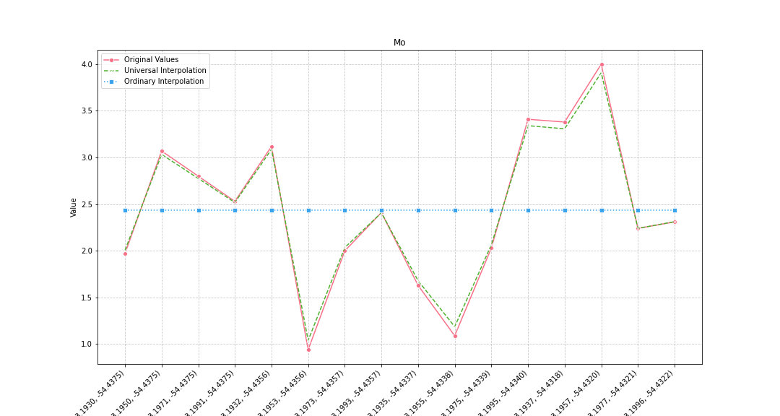
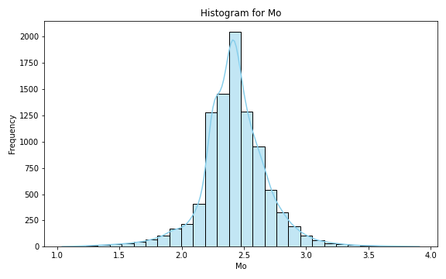
Analysis for column: Mo Model: UK
Interpolated Statistics:
mean 2.425670
std 0.264838
min 1.040066
25% 2.282569
50% 2.418218
75% 2.562683
80% 2.605191
85% 2.657902
90% 2.726426
95% 2.850643
99% 3.157886
Original Statistics:
mean 2.433125
std 0.841560
min 0.940000
25% 1.992500
50% 2.360000
75% 3.082500
80% 3.120000
85% 3.315000
90% 3.395000
95% 3.557500
99% 3.911500

Slide 13
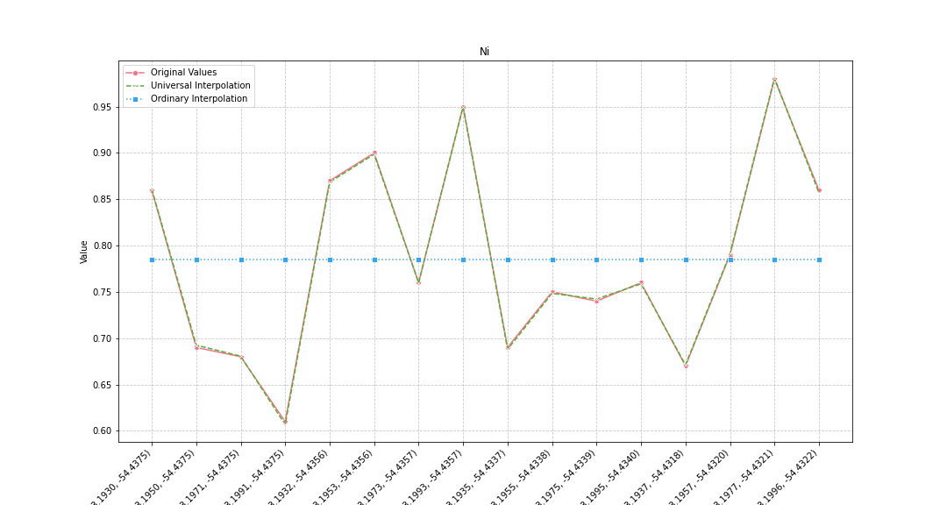
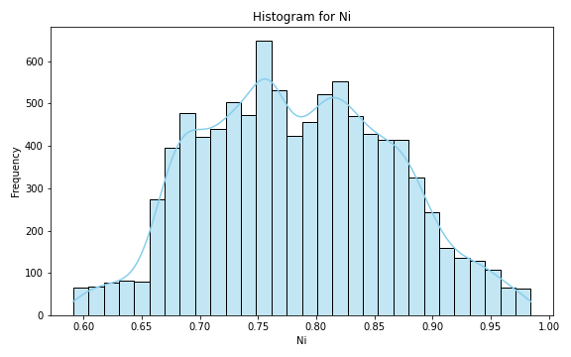
Analysis for column: Ni Model: UK
Interpolated Statistics:
mean 0.783864
std 0.081337
min 0.591120
25% 0.721637
50% 0.780477
75% 0.844005
80% 0.858610
85% 0.873889
90% 0.890874
95% 0.921913
99% 0.964738
Original Statistics:
mean 0.785000
std 0.107827
min 0.610000
25% 0.690000
50% 0.760000
75% 0.862500
80% 0.870000
85% 0.892500
90% 0.925000
95% 0.957500
99% 0.975500

Slide 14
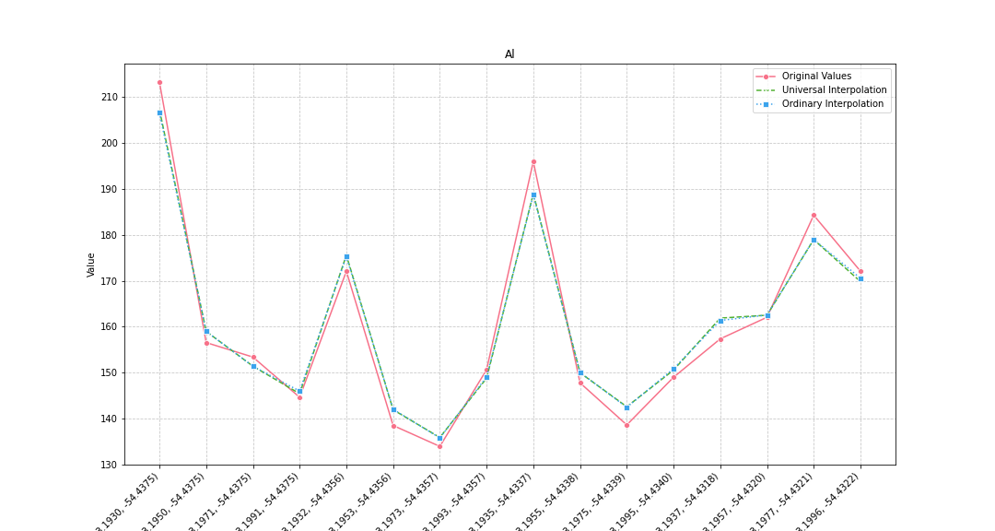
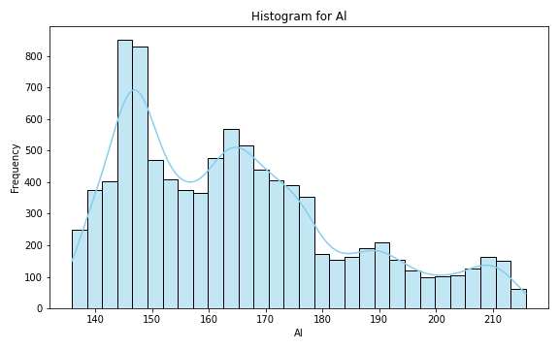
Analysis for column: Al Model: UK
Interpolated Statistics:
mean 164.679976
std 19.431766
min 135.879853
25% 148.085186
50% 162.274029
75% 175.588097
80% 179.623559
85% 187.458008
90% 194.174817
95% 205.882902
99% 212.487866
Original Statistics:
mean 160.640000
std 22.018858
min 133.940000
25% 146.995000
50% 154.975000
75% 172.085000
80% 172.100000
85% 181.242500
90% 190.140000
95% 200.320000
99% 210.712000

Slide 15
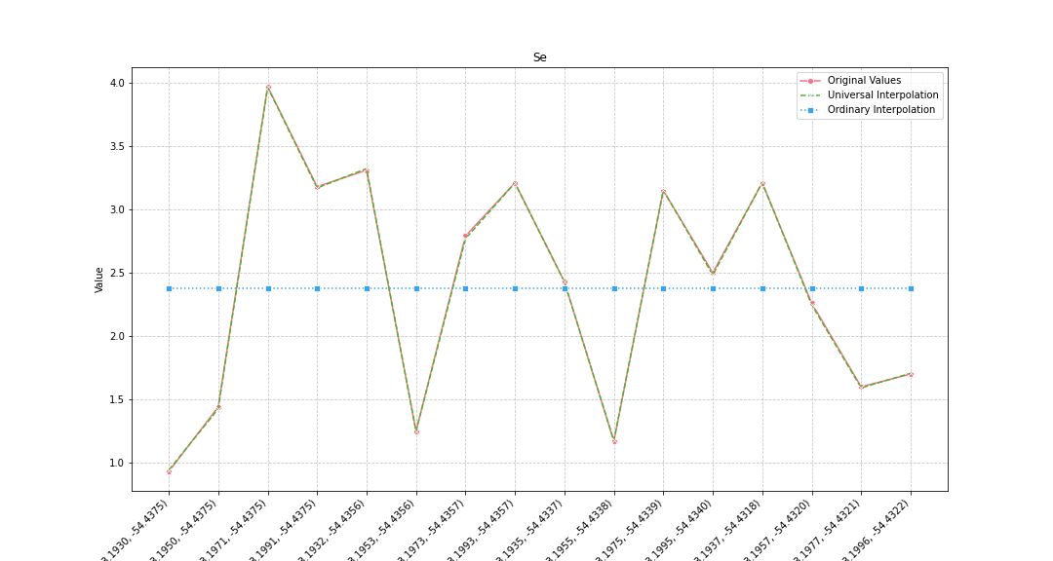
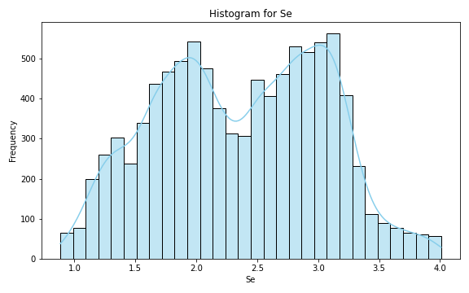
Analysis for column: Se Model: UK
Interpolated Statistics:
mean 2.365361
std 0.686188
min 0.883680
25% 1.817664
50% 2.390436
75% 2.934398
80% 3.030544
85% 3.114159
90% 3.207136
95% 3.377752
99% 3.834421
Original Statistics:
mean 2.381250
std 0.930984
min 0.930000
25% 1.560000
50% 2.465000
75% 3.187500
80% 3.210000
85% 3.210000
90% 3.260000
95% 3.475000
99% 3.871000

Slide 16
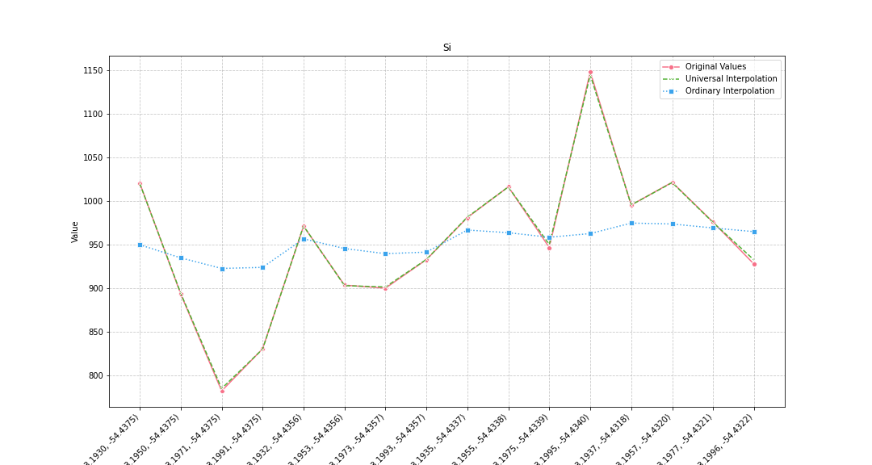
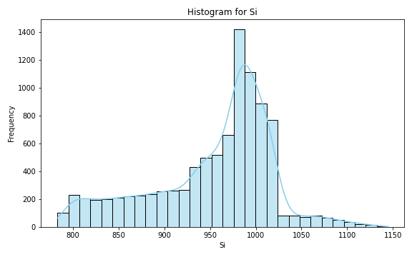
Analysis for column: Si Model: UK
Interpolated Statistics:
mean 953.594723
std 67.048769
min 783.079702
25% 915.995978
50% 975.702797
75% 997.760642
80% 1003.708314
85% 1010.230389
90% 1016.150337
95% 1031.380116
99% 1093.463727
Original Statistics:
mean 952.745000
std 85.121909
min 782.200000
25% 902.530000
50% 958.715000
75% 1000.405000
80% 1016.050000
85% 1019.320000
90% 1020.850000
95% 1052.937500
99% 1128.891500

Slide 17
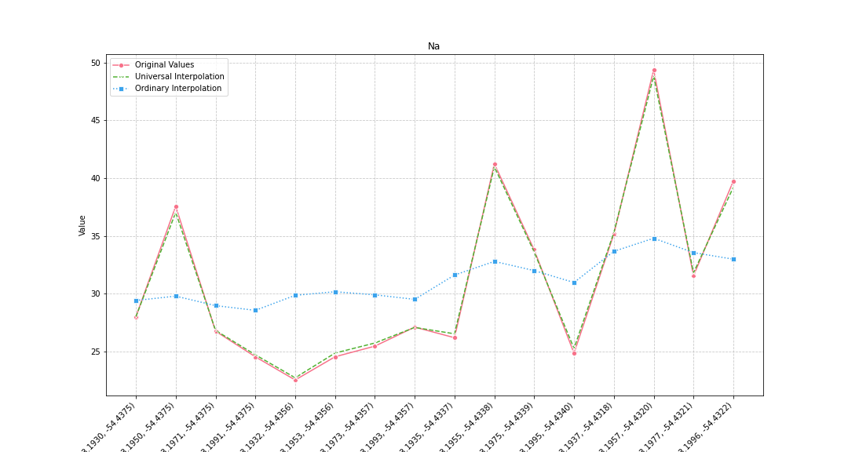
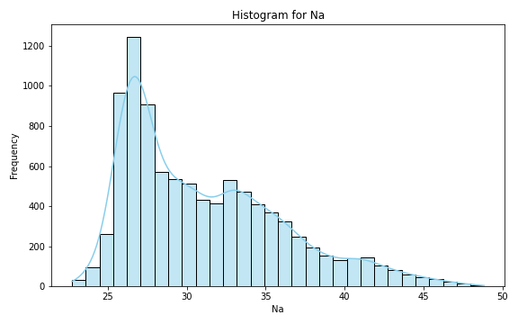
Analysis for column: Na Model: UK
Interpolated Statistics:
mean 31.105164
std 5.020102
min 22.711871
25% 26.914337
50% 29.877016
75% 34.288176
80% 35.319634
85% 36.522429
90% 38.351469
95% 41.182836
99% 45.020557
Original Statistics:
mean 31.143125
std 7.646432
min 22.520000
25% 25.297500
50% 27.545000
75% 35.752500
80% 37.560000
85% 39.195000
90% 40.490000
95% 43.275000
99% 48.159000

Slide 18
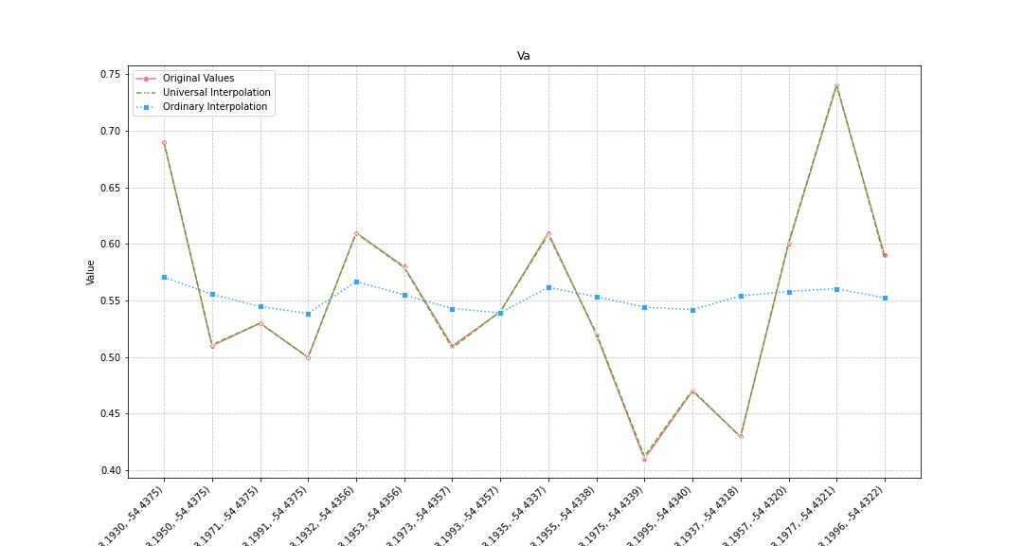
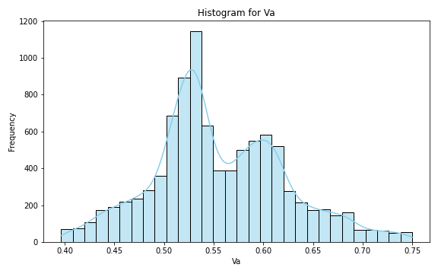
Analysis for column: Va Model: UK
Interpolated Statistics:
mean 0.555251
std 0.066928
min 0.396340
25% 0.513563
50% 0.542183
75% 0.600833
80% 0.609713
85% 0.621251
90% 0.645010
95% 0.677898
99% 0.729142
Original Statistics:
mean 0.552500
std 0.087674
min 0.410000
25% 0.507500
50% 0.535000
75% 0.602500
80% 0.610000
85% 0.610000
90% 0.650000
95% 0.702500
99% 0.732500

Slide 19
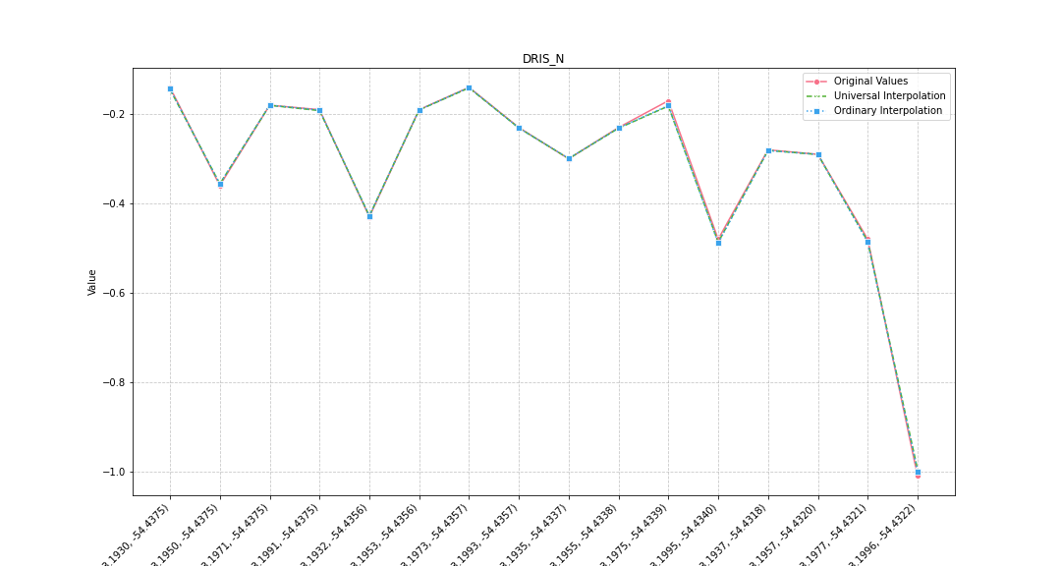
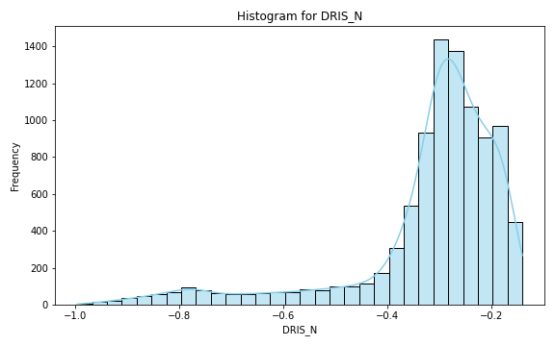
Analysis for column: DRIS_N Model: UK
Interpolated Statistics:
mean -0.319659
std 0.153791
min -0.995586
25% -0.337881
50% -0.282534
75% -0.227685
80% -0.213702
85% -0.198127
90% -0.184430
95% -0.170615
99% -0.154315
Original Statistics:
mean -0.318750
std 0.216144
min -1.010000
25% -0.377500
50% -0.255000
75% -0.187500
80% -0.180000
85% -0.172500
90% -0.155000
95% -0.140000
99% -0.140000

Slide 20
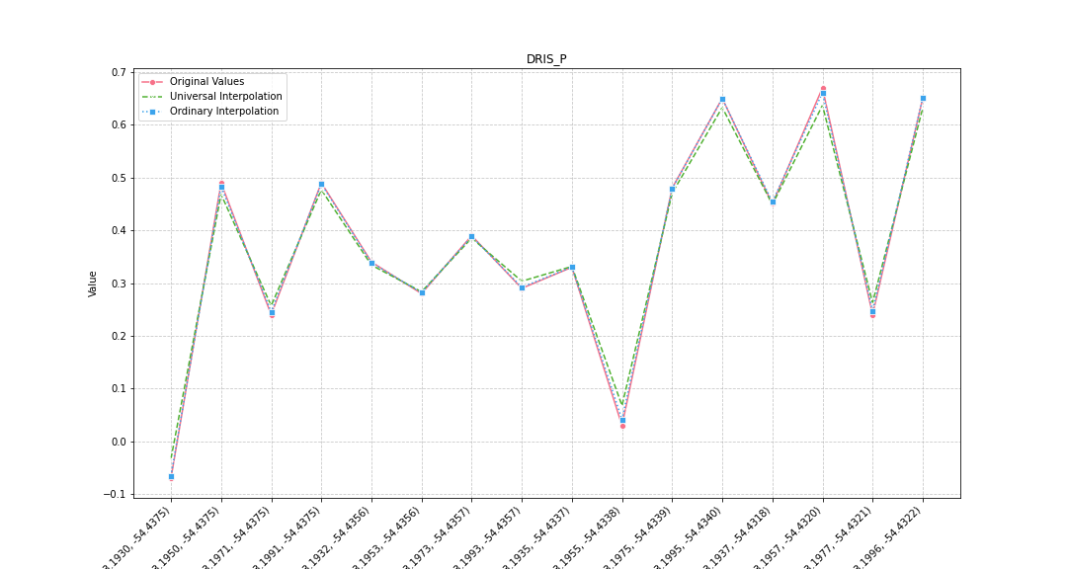
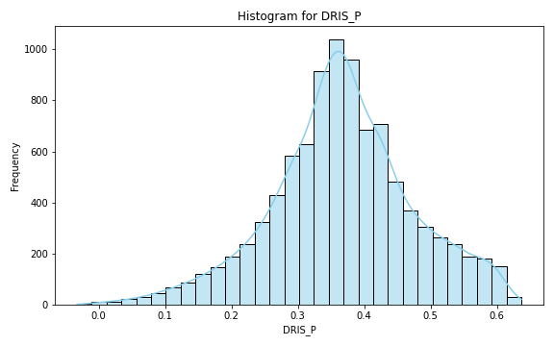
Analysis for column: DRIS_P Model: UK
Interpolated Statistics:
mean 0.366674
std 0.107830
min -0.032886
25% 0.303925
50% 0.365470
75% 0.430285
80% 0.449893
85% 0.476545
90% 0.511224
95% 0.555761
99% 0.601296
Original Statistics:
mean 0.371875
std 0.208877
min -0.070000
25% 0.270000
50% 0.365000
75% 0.490000
80% 0.490000
85% 0.610000
90% 0.650000
95% 0.655000
99% 0.667000

Slide 21
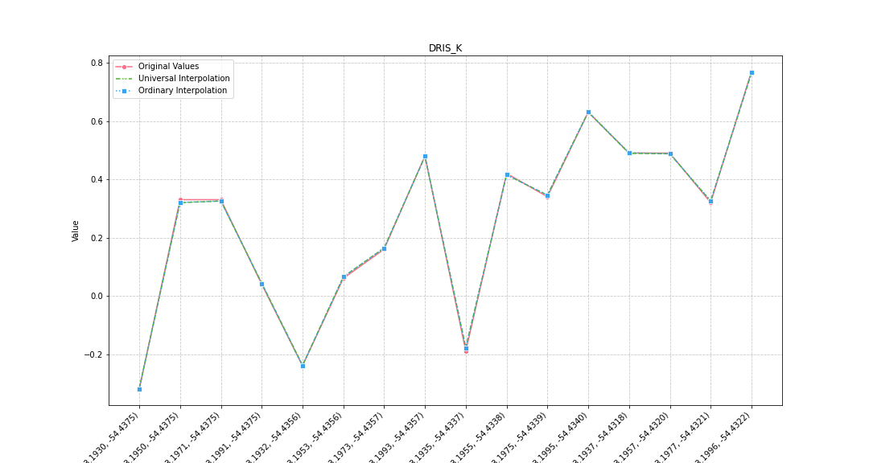
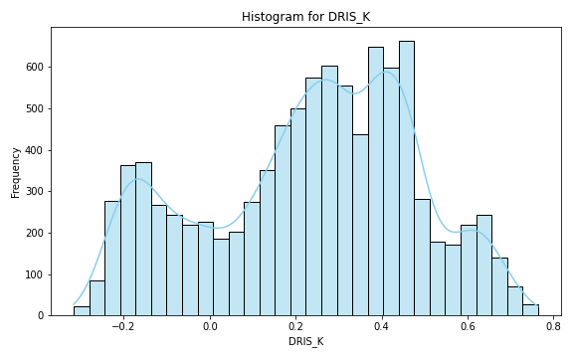
Analysis for column: DRIS_K Model: UK
Interpolated Statistics:
mean 0.233880
std 0.246077
min -0.316816
25% 0.063774
50% 0.266684
75% 0.416829
80% 0.446938
85% 0.472435
90% 0.532349
95% 0.620746
99% 0.692387
Original Statistics:
mean 0.256875
std 0.314510
min -0.320000
25% 0.055000
50% 0.330000
75% 0.482500
80% 0.490000
85% 0.490000
90% 0.560000
95% 0.665000
99% 0.749000

Slide 22
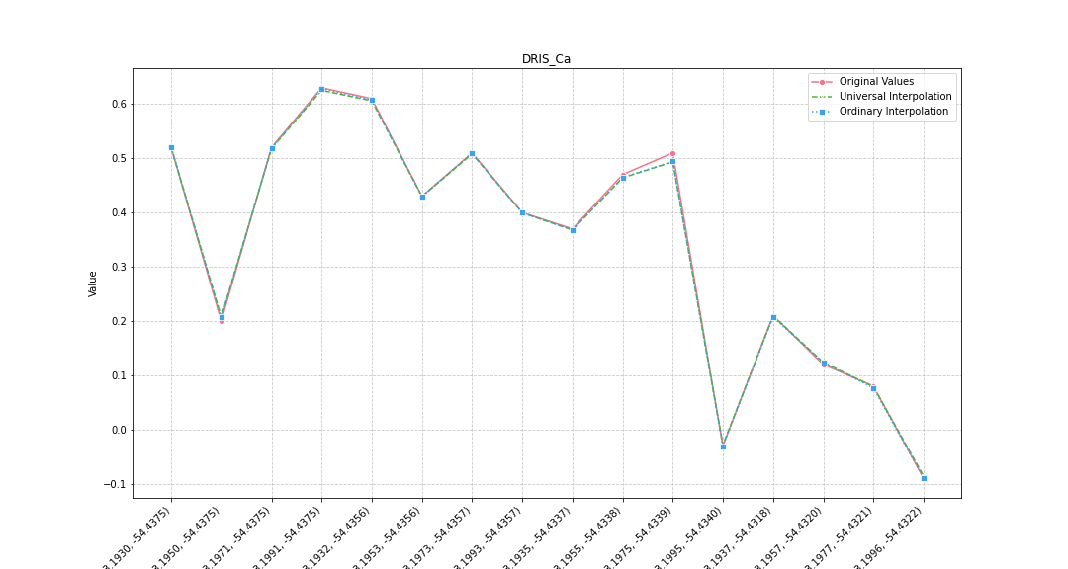
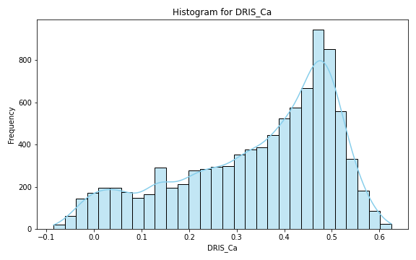
Analysis for column: DRIS_Ca Model: UK
Interpolated Statistics:
mean 0.343088
std 0.163648
min -0.085437
25% 0.231228
50% 0.389411
75% 0.474581
80% 0.487311
85% 0.499245
90% 0.516496
95% 0.539844
99% 0.580915
Original Statistics:
mean 0.341250
std 0.228528
min -0.090000
25% 0.180000
50% 0.415000
75% 0.512500
80% 0.520000
85% 0.520000
90% 0.565000
95% 0.615000
99% 0.627000

Slide 23
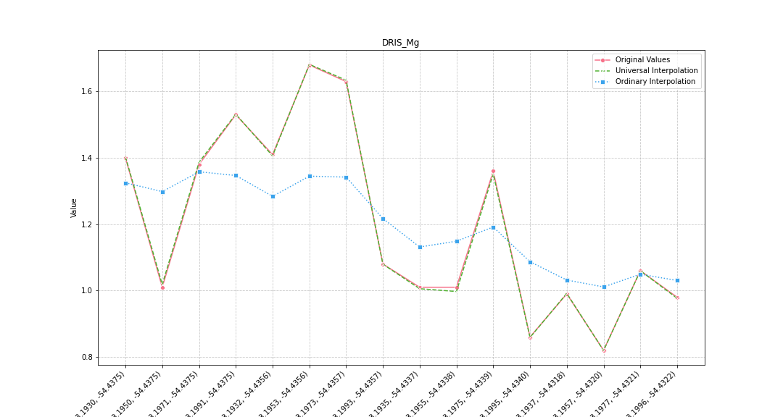
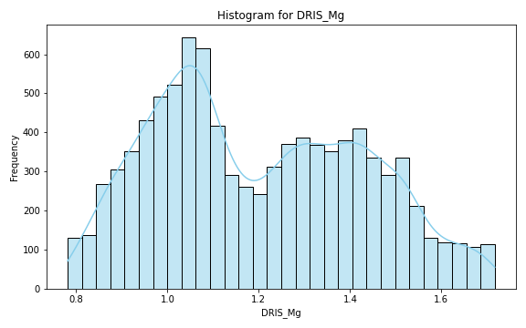
Analysis for column: DRIS_Mg Model: UK
Interpolated Statistics:
mean 1.200736
std 0.228705
min 0.781351
25% 1.014908
50% 1.169830
75% 1.389458
80% 1.427227
85% 1.468537
90% 1.516929
95% 1.588030
99% 1.689750
Original Statistics:
mean 1.200625
std 0.278220
min 0.820000
25% 1.005000
50% 1.070000
75% 1.402500
80% 1.410000
85% 1.500000
90% 1.580000
95% 1.642500
99% 1.672500

Slide 24
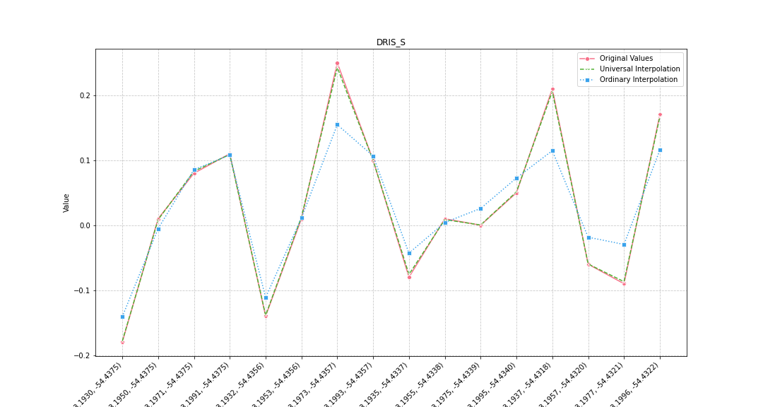
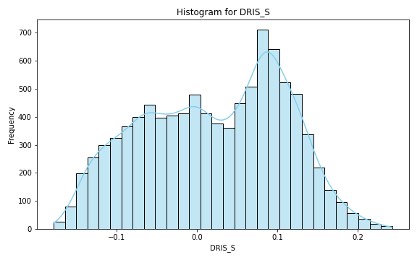
Analysis for column: DRIS_S Model: UK
Interpolated Statistics:
mean 0.020478
std 0.088581
min -0.178657
25% -0.053151
50% 0.026769
75% 0.091953
80% 0.102960
85% 0.115318
90% 0.129385
95% 0.150159
99% 0.193841
Original Statistics:
mean 0.028125
std 0.122268
min -0.180000
25% -0.065000
50% 0.010000
75% 0.102500
80% 0.110000
85% 0.155000
90% 0.190000
95% 0.220000
99% 0.244000

Slide 25
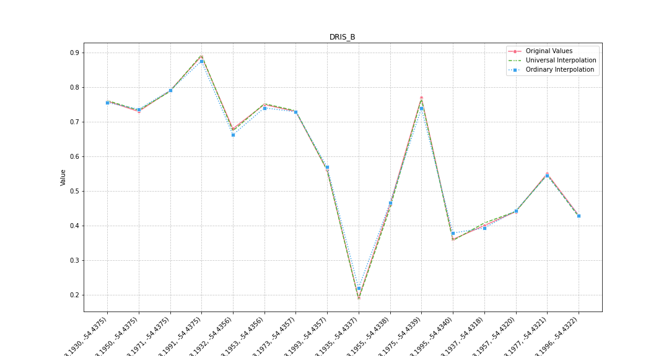
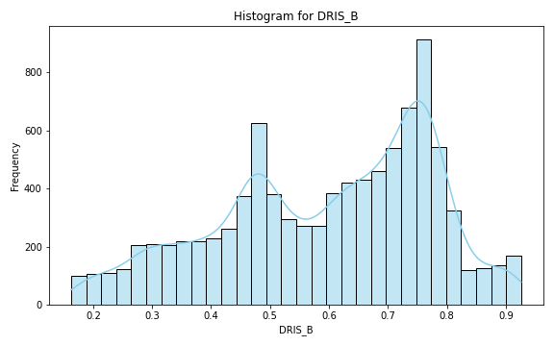
Analysis for column: DRIS_B Model: UK
Interpolated Statistics:
mean 0.595300
std 0.180176
min 0.162756
25% 0.468051
50% 0.628559
75% 0.746934
80% 0.759279
85% 0.773392
90% 0.794771
95% 0.842100
99% 0.913076
Original Statistics:
mean 0.593125
std 0.196731
min 0.190000
25% 0.437500
50% 0.620000
75% 0.752500
80% 0.760000
85% 0.767500
90% 0.780000
95% 0.815000
99% 0.875000

Slide 26


Analysis for column: DRIS_Cu Model: UK
Interpolated Statistics:
mean -3.867034
std 0.345338
min -4.691558
25% -4.081733
50% -3.918622
75% -3.654874
80% -3.572017
85% -3.476822
90% -3.365717
95% -3.220203
99% -3.066273
Original Statistics:
mean -3.860625
std 0.448753
min -4.690000
25% -4.115000
50% -3.850000
75% -3.632500
80% -3.580000
85% -3.467500
90% -3.270000
95% -3.090000
99% -3.042000

Slide 27


Analysis for column: DRIS_Fe Model: UK
Interpolated Statistics:
mean 1.628586
std 0.474884
min 0.759452
25% 1.275405
50% 1.595786
75% 1.958235
80% 2.054232
85% 2.167363
90% 2.301282
95% 2.489839
99% 2.746044
Original Statistics:
mean 1.596875
std 0.597123
min 0.880000
25% 1.142500
50% 1.455000
75% 1.845000
80% 1.860000
85% 2.220000
90% 2.490000
95% 2.692500
99% 2.818500

Slide 28


Analysis for column: DRIS_Mn Model: UK
Interpolated Statistics:
mean 0.439547
std 0.136982
min 0.193972
25% 0.337306
50% 0.433994
75% 0.520726
80% 0.543478
85% 0.571675
90% 0.612317
95% 0.698098
99% 0.838953
Original Statistics:
mean 0.443125
std 0.170205
min 0.200000
25% 0.325000
50% 0.440000
75% 0.520000
80% 0.550000
85% 0.580000
90% 0.620000
95% 0.705000
99% 0.837000

Slide 29


Analysis for column: DRIS_Zn Model: UK
Interpolated Statistics:
mean -0.416922
std 0.124274
min -0.761293
25% -0.517732
50% -0.393138
75% -0.317649
80% -0.300278
85% -0.282157
90% -0.262735
95% -0.241503
99% -0.223926
Original Statistics:
mean -0.408125
std 0.172944
min -0.770000
25% -0.457500
50% -0.365000
75% -0.295000
80% -0.250000
85% -0.242500
90% -0.235000
95% -0.225000
99% -0.213000

Slide 30


Analysis for column: IMS Model: UK
Interpolated Statistics:
mean -0.242034
std 0.069424
min -0.427964
25% -0.280321
50% -0.237124
75% -0.192296
80% -0.177649
85% -0.163228
90% -0.149028
95% -0.134466
99% -0.115983
Original Statistics:
mean -0.243750
std 0.079488
min -0.410000
25% -0.280000
50% -0.235000
75% -0.187500
80% -0.180000
85% -0.180000
90% -0.170000
95% -0.147500
99% -0.117500

Slide 31


Analysis for column: IBN Model: UK
Interpolated Statistics:
mean 9.895732
std 0.967084
min 7.722418
25% 9.201502
50% 9.897403
75% 10.633541
80% 10.759974
85% 10.915063
90% 11.173451
95% 11.451823
99% 11.832392
Original Statistics:
mean 9.849375
std 1.185796
min 7.790000
25% 9.232500
50% 9.750000
75% 10.847500
80% 10.900000
85% 10.990000
90% 11.280000
95% 11.640000
99% 11.880000

